Slide 1
Pointer in C Lecture-21
Dr. Asif Uddin Khan

Slide 2

C Pointers
Pointers (pointer variables) are special variables that are used to store addresses of other variables.
How to find address of a variable?
& operator is used with the variable to find the address of a variable. Example: &var
Example to print address of a variable
======================================
#include <stdio.h>
int main()
{
int var = 5;
printf("var: %d\n", var);
// Notice the use of & before var
printf("address of var: %p", &var);
return 0;
}

Slide 3
C Pointers
The pointer is a variable which stores the address of another variable.
This variable can be of type int, char, array, function, or any other pointer.
Pointer Syntax
int* p;
or
int *p;
Example:

Slide 4
Declaring a pointer
The pointer in c language can be declared using * (asterisk symbol). It is also known as indirection pointer used to dereference a pointer.
Example
int* a;//pointer to int
char *c;//pointer to char

Slide 5
Example of declaring pointers.
int *p1, p2;
Here, we have declared a pointer p1 and a normal variable p2.

Slide 6
Assigning addresses to Pointers
Example
int *pc, c;
c = 5;
pc = &c;
Here, 5 is assigned to the c variable. And, the address of c is assigned to the pc pointer.

Slide 7
Get Value of the variable Pointed by Pointers
To get the value of the thing pointed by the pointers, we use the * operator.
Example:
int *pc, c;
c = 5;
pc = &c;
printf("%d", *pc); // Output: 5
Note: In the above example, pc is a pointer, not *pc. You cannot and should not do something like *pc = &c;
Notes:
By the way, * is called the dereference operator (when working with pointers). It operates on a pointer and gives the value stored in that pointer.

Slide 8
Changing Value Pointed by Pointers
int* pc, c; c = 5;
pc = &c;
c = 1;
printf("%d", c); // Output: 1
printf("%d", *pc); // Ouptut: 1
We have assigned the address of c to the pc pointer. Then, we changed the value of c to 1. Since pc and the address of c is the same, *pc gives us 1.

Slide 9
Example-2
int* pc, c;
c = 5;
pc = &c;
*pc = 1;
printf("%d", *pc); // Ouptut: 1
printf("%d", c); // Output: 1
We have assigned the address of c to the pc pointer. Then, we changed *pc to 1 using *pc = 1;. Since pc and the address of c is the same, c will be equal to 1.

Slide 10
Example-3
int* pc, c, d;
c = 5; d = -15;
pc = &c;
printf("%d", *pc); // Output: 5
pc = &d; printf("%d", *pc); // Ouptut: -15
Initially, the address of c is assigned to the pc pointer using pc = &c;. Since c is 5, *pc gives us 5. Then, the address of d is assigned to the pc pointer using pc = &d;. Since d is -15, *pc gives us -15.

Slide 11
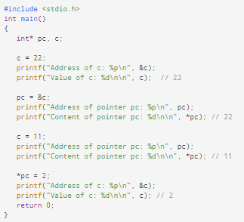
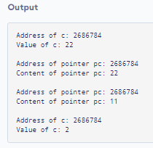
Working of Pointers
Notes:
%p is used to printing the address of a pointer the addresses are depending by our system bit. %p is for printing a pointer address.

Slide 12
Common mistakes when working with pointers
int c, *pc; // pc is address but c is not
pc = c; // Error // &c is address but *pc is not
*pc = &c; // Error // both &c and pc are addresses
pc = &c; // both c and are *pc values
*pc = c;

Slide 13
Here's an example of pointer syntax beginners often find confusing.
#include <stdio.h>
int main() {
int c = 5;
int *p = &c;
printf("%d", *p); //5
return 0;
}
Why didn't we get an error when using int *p = &c;?
It is equivalent to
int* p;
p = &c;
In both cases, we are creating a pointer p (not *p) and assigning &c to it. To avoid this confusion, we can use the statement like following:
int* p = &c;

Slide 14
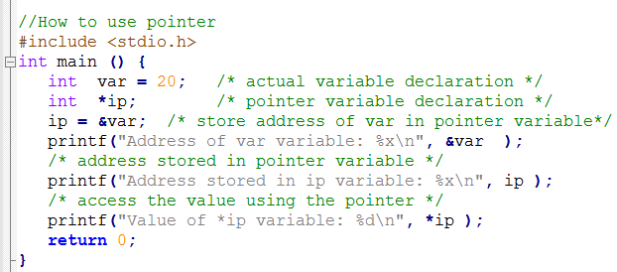
How to Use Pointers?
Steps
Declare a pointer variable
Assign the address of a variable to a pointer
Finally access the value at the address available in the pointer variable.

Slide 15
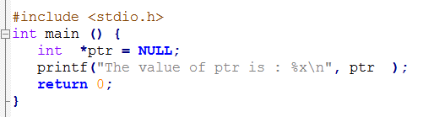
NULL Pointers
A pointer that is assigned NULL is called a null pointer.
The NULL pointer is a constant with a value of zero defined in several standard libraries. Consider the following program
Output:
The value of ptr is 0

Slide 16


Pointer to Pointer
The pointer to pointer is a variable which stores the address of another pointer.
The first pointer contains the address of the second pointer, which points to the location that contains the actual value as shown below.

Slide 17
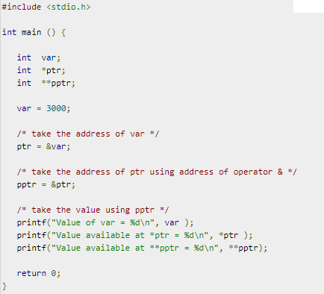

Declaration of a pointer to a pointer of integer type
int **var;
Output

Slide 18
Pointers and Functions
Pass Addresses
In C programming, it is also possible to pass addresses as arguments to functions.
To accept these addresses in the function definition, we can use pointers. It's because pointers are used to store addresses.

Slide 19
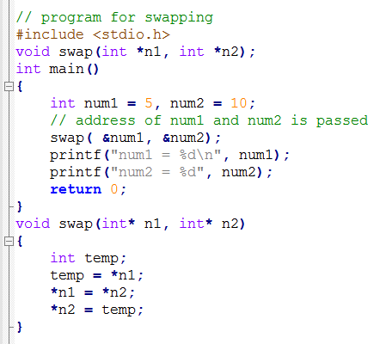
Example: Pass Addresses to Functions (Swapping using call by reference)
Output:
num1 = 10
num2 = 5

Slide 20
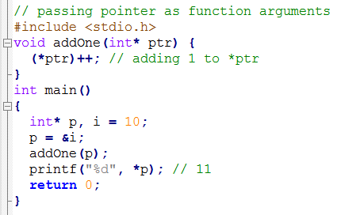
Example 2: Passing Pointers to Functions

Slide 21
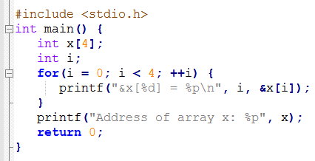
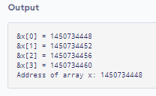

Relationship Between Arrays and Pointers
An array is a block of sequential data. Let's write a program to print addresses of array elements.
There is a difference of 4 bytes between two consecutive addresses. It is because the size of int is 4 bytes (on my compiler).
Notice that, &x[0] and x is the same. It's because the array name x points to the first element of the array.

Slide 22
Relationship Between Arrays and Pointers
From the above, it is clear that &x[0] is equivalent to x. And, x[0] is equivalent to *x.
&x[0] is equivalent to x+0 and x[0] is equivalent to *(x+0)
Similarly,
&x[1] is equivalent to x+1 and x[1] is equivalent to *(x+1).
&x[2] is equivalent to x+2 and x[2] is equivalent to *(x+2).
...
Basically, &x[i] is equivalent to x+i and x[i] is equivalent to *(x+i).

Slide 23
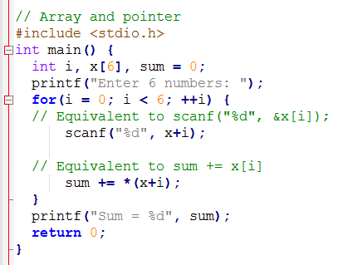
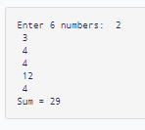
Example 1: Pointers and Arrays
Output

Slide 24
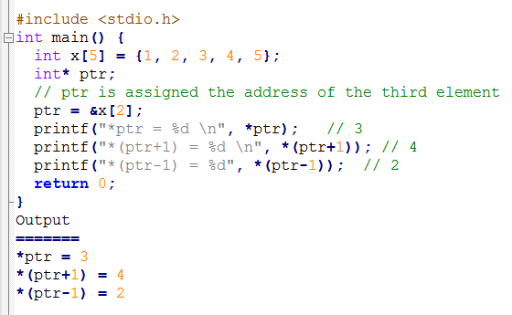
Example 2: Arrays and Pointers

Slide 25
Sort an array using pointer
for(i=0;i<n;i++)
{
for(j=i+1;j<n;j++)
{
if( *(a+i) > *(a+j))
{
tmp = *(a+i);
*(a+i) = *(a+j);
*(a+j) = tmp;
}
}
}

Slide 26
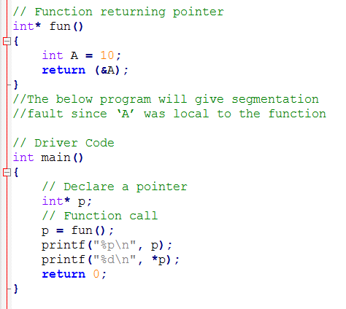
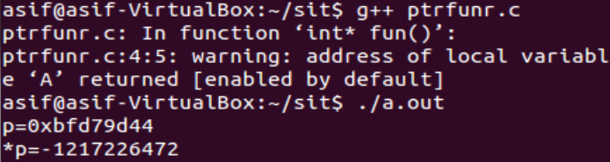
How to return a Pointer from a Function in C
Explanation: The main reason behind this scenario is that compiler always make a stack for a function call. As soon as the function exits the function stack also gets removed which causes the local variables of functions goes out of scope.
Output

Slide 27
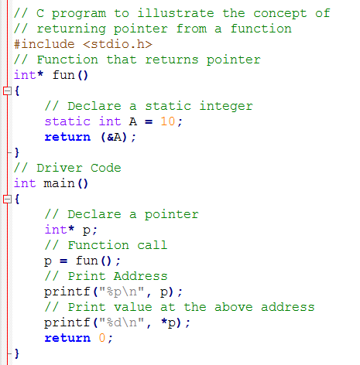
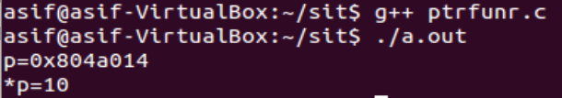
How to return a Pointer from a Function in C
Output

Slide 28
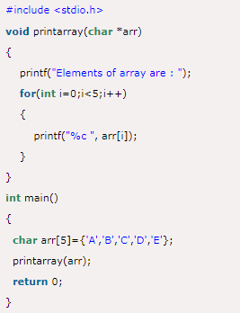
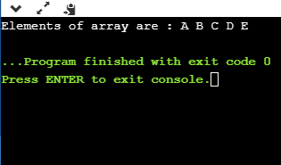
Passing array to a function as a pointer

Slide 29
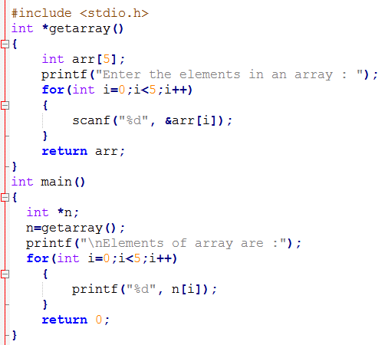
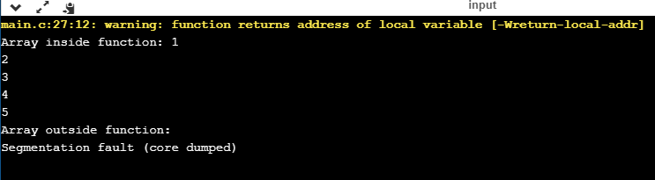
How to return an array from a function
A function can return an array by returning pointer pointing to the array as follows

Slide 30
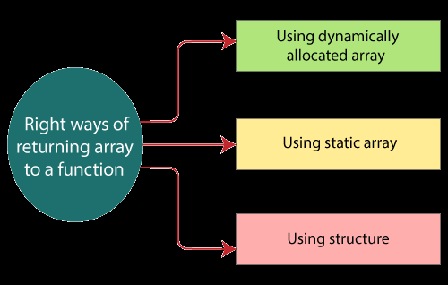
How to return an array from a function
There are three right ways of returning an array to a function:
Using dynamically allocated array
Using static array
Using structure

Slide 31
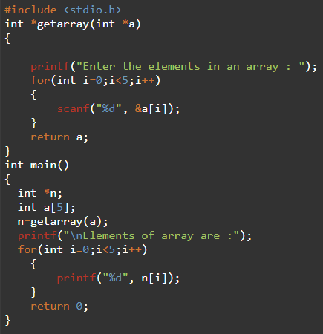
Returning a pointer to array by passing an array

Slide 32
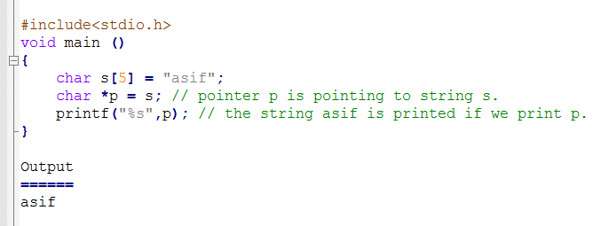
Strings and Pointers
string is an array of characters, the pointers can be used in the same way they were used with array.
There are various advantages of using pointers to point strings.
Let us consider the following example to access the string via the pointer.

Slide 33
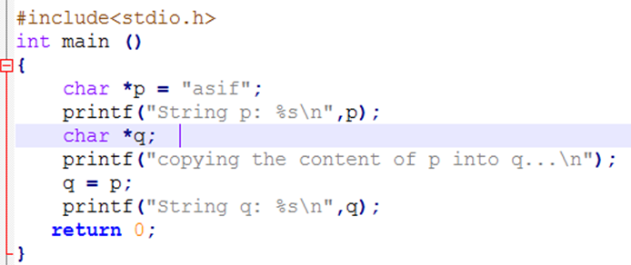
Use of pointers to copy the content of a string into another

Slide 34
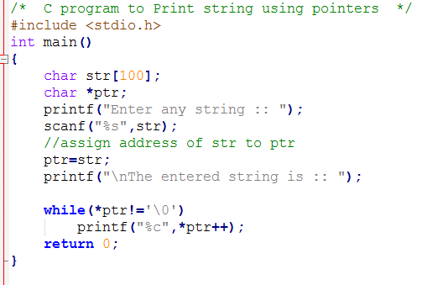
Program to print string using pointer

Slide 35
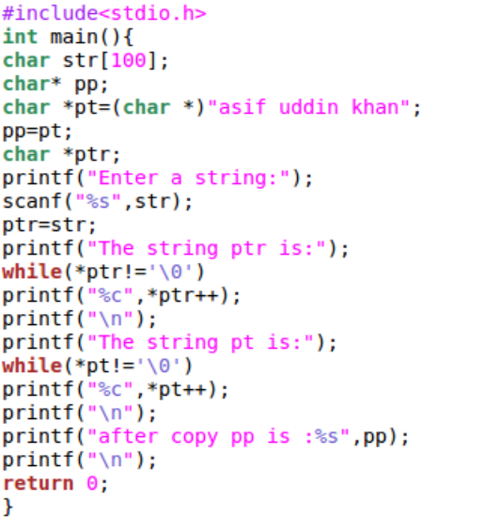
Example

Slide 36
Advantage of pointer
1) Pointer reduces the code and improves the performance, it is used to retrieving strings, trees, etc. and used with arrays, structures, and functions.
2) We can return multiple values from a function using the pointer.
3) It makes you able to access any memory location in the computer's memory.

Slide 37
References
C programming by E Balaguruswami
Programming C by Y. kanitkar
Programming C by Denis Ritchie
NPTEL Lecture note of Dr. Partha Pratim Das, Department of Computer Science and Engineering, Indian Institute of Technology, Kharagpur.
https://docs.oracle.com/cd/E18752_01/html/817-6223/chp-typeopexpr-2.html
https://data-flair.training/blogs/escape-sequence-in-c/
Internet source

Slide 38
References
NPTEL Lecture note of Dr. Partha Pratim Das, Department of Computer Science and Engineering, Indian Institute of Technology, Kharagpur.
https://docs.oracle.com/cd/E18752_01/html/817-6223/chp-typeopexpr-2.html
https://data-flair.training/blogs/escape-sequence-in-c/
Internet source

