Slide 1
C Programming Structures
Dr. Asif Uddin Khan

Slide 2
Structure in C
Structure is a user-defined data type that enables us to store the collection of different data types.
Each element of a structure is called a member.
struct keyword is used to define the structure.

Slide 3
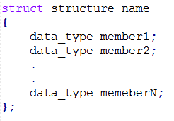
How to define structures?
Before you can create structure variables, you need to define its data type. To define a structure, the struct keyword is used.
Syntax
Example
struct employee
{ int id;
char name[20];
float salary;
};

Slide 4
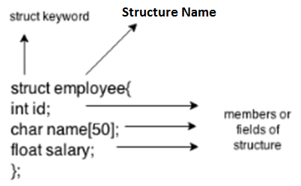
Structure Elements

Slide 5
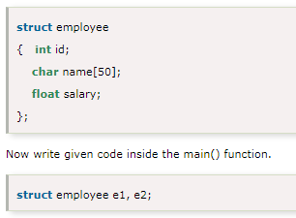
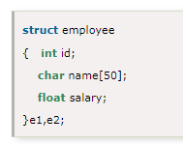
Declaring structure variable
By struct keyword within main() function
By declaring a variable at the time of defining the structure.
Which approach is good?
If number of variables are not fixed, use the 1st approach. It provides you the flexibility to declare the structure variable many times.
If no. of variables are fixed, use 2nd approach. It saves your code to declare a variable in main() function.

Slide 6
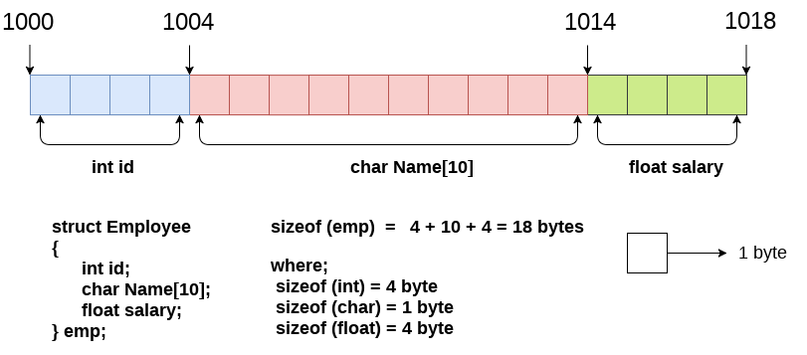
Structure in memory

Slide 7
Accessing members of the structure
Two ways to access structure members:
By . (member or dot operator)
By -> (structure pointer operator)
Example: Using of dot operator :
emp.id
Where
emp is the structure variable.
id is the structure member
Example: Using pointer operator :
emp->id

Slide 8
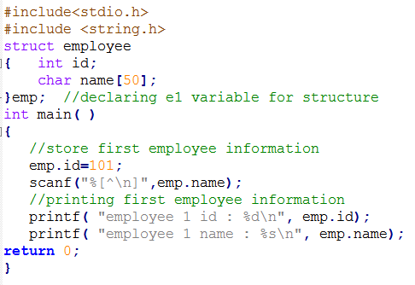
C Structure example

Slide 9
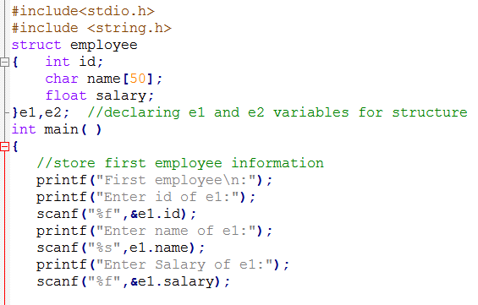
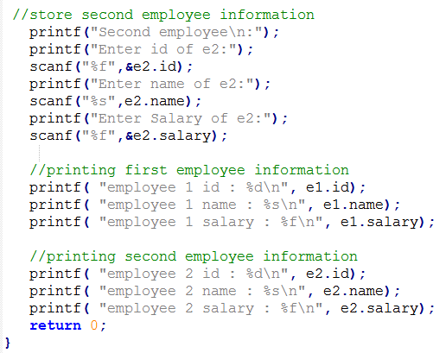
Example-2

Slide 10
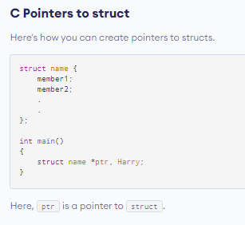
Structures and Pointers

Slide 11
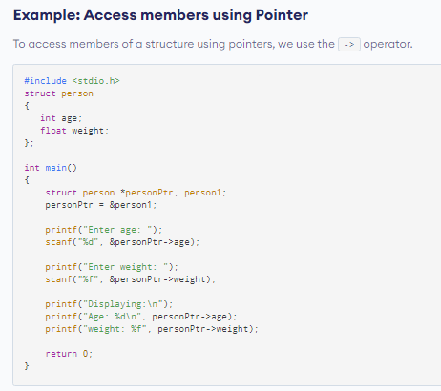
Example

Slide 12
Array of Structures in C
Collection of multiple structure variables where each variable contains information about different entities.
Used to store information about multiple entities

Slide 13
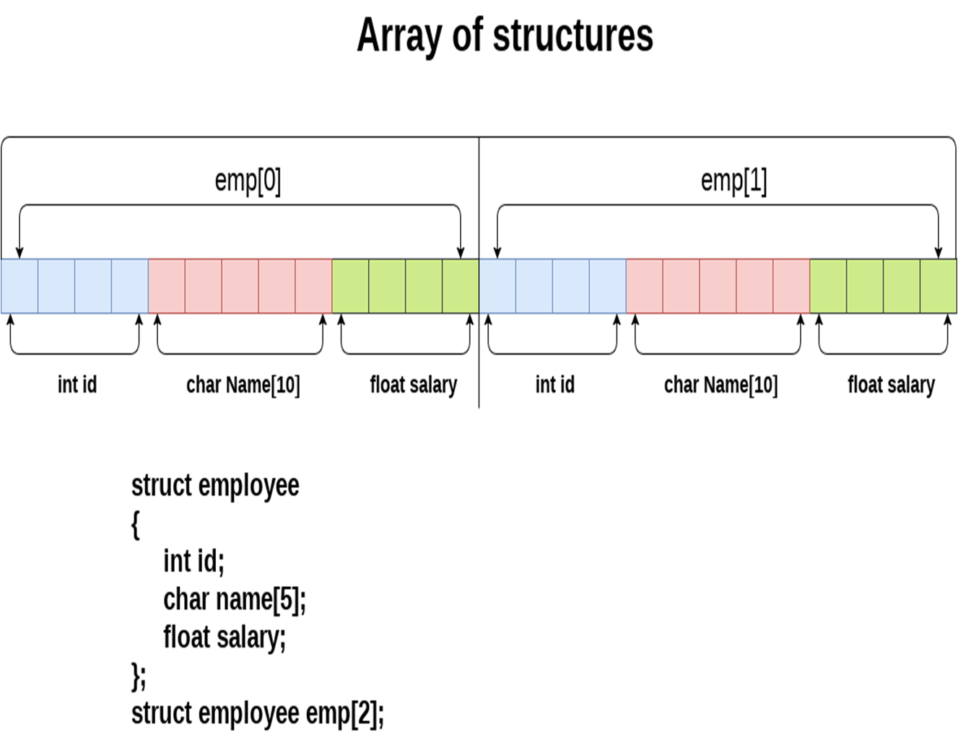

Slide 14
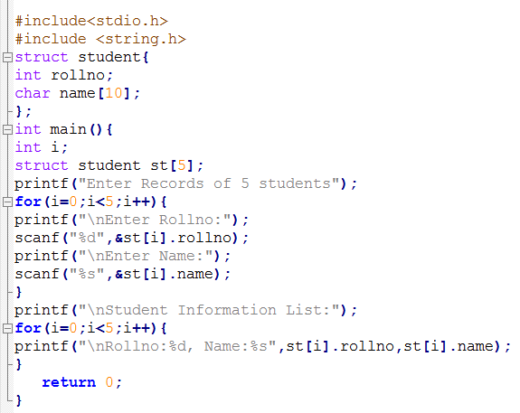
Example

Slide 15

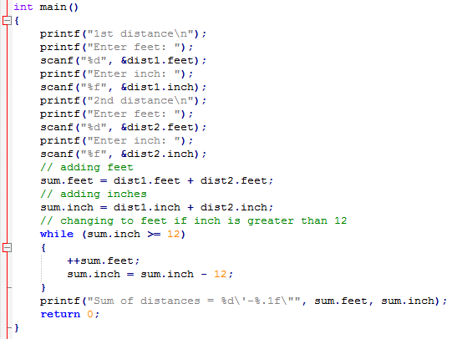


Slide 16
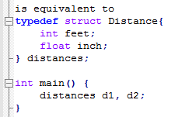
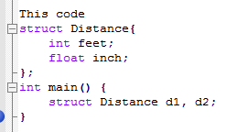
Keyword typedef
We use the typedef keyword to create an alias name for data types.
It is commonly used with structures to simplify the syntax of declaring variables.

Slide 17
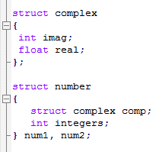
Nested Structures
You can create structures within a structure in C programming. For example,
Suppose, you want to set imag of num2 variable to 11. Here's how you can do it:

Slide 18
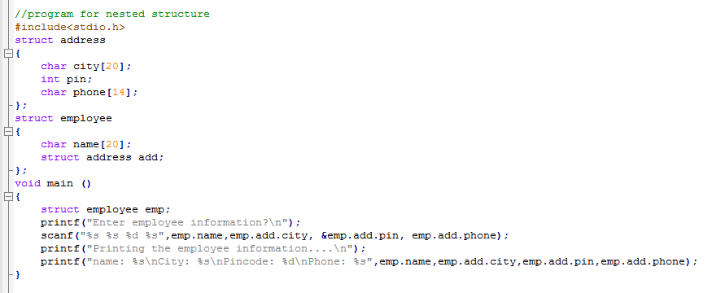
Program for nested structure

Slide 19
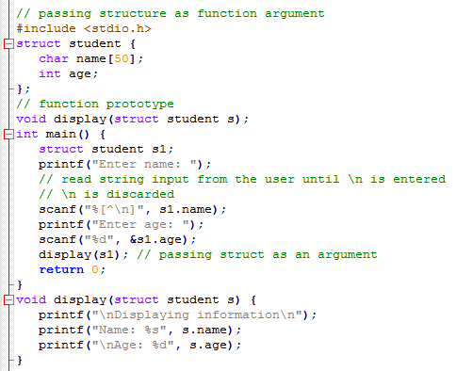
Passing structure as function argument

Slide 20
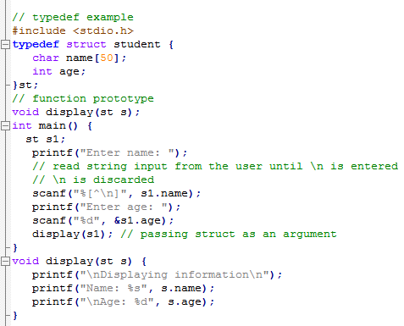
typedef example

Slide 21
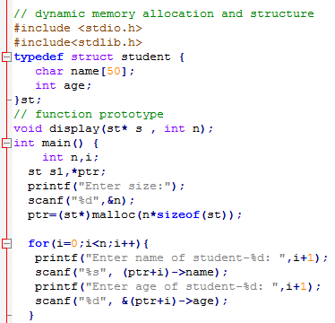
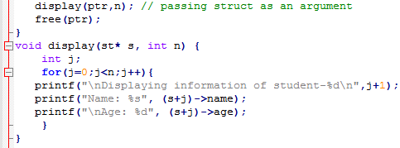
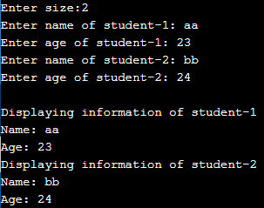
Dynamic memory allocation and structure
Output

Slide 22
References
C programming by E Balaguruswami
Programming C by Y. kanitkar
Programming C by Denis Ritchie
NPTEL Lecture note of Dr. Partha Pratim Das, Department of Computer Science and Engineering, Indian Institute of Technology, Kharagpur.
https://docs.oracle.com/cd/E18752_01/html/817-6223/chp-typeopexpr-2.html
https://data-flair.training/blogs/escape-sequence-in-c/
Internet source

Slide 23
References
NPTEL Lecture note of Dr. Partha Pratim Das, Department of Computer Science and Engineering, Indian Institute of Technology, Kharagpur.
https://docs.oracle.com/cd/E18752_01/html/817-6223/chp-typeopexpr-2.html
https://data-flair.training/blogs/escape-sequence-in-c/
Internet source

