Slide 1

ECE 8890 Neural Network Final Project
Ensemble Generative Adversarial Networks for Anomaly Detection
Wenlong Wu
Advisor: Derek Anderson, James Keller
University of Missouri
May 2019

Slide 2
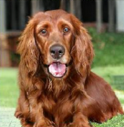
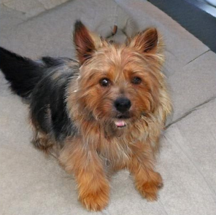
Overview and Motivation
Generative Adversarial Network (GAN) is a powerful framework to learn generative model and has been achieved a great success on image generation, image super-resolution and etc.
However, the GAN algorithm is mostly used on image datasets to learn the distribution of images nowadays [1]. Few research has been done on structure / tabular data to model the high-dimensional data distribution.
In this project, the GAN is used to model data distribution on structure/tabular data and to detect potential outliers that is out of data distribution.
Which image do you think is REAL?

Slide 3
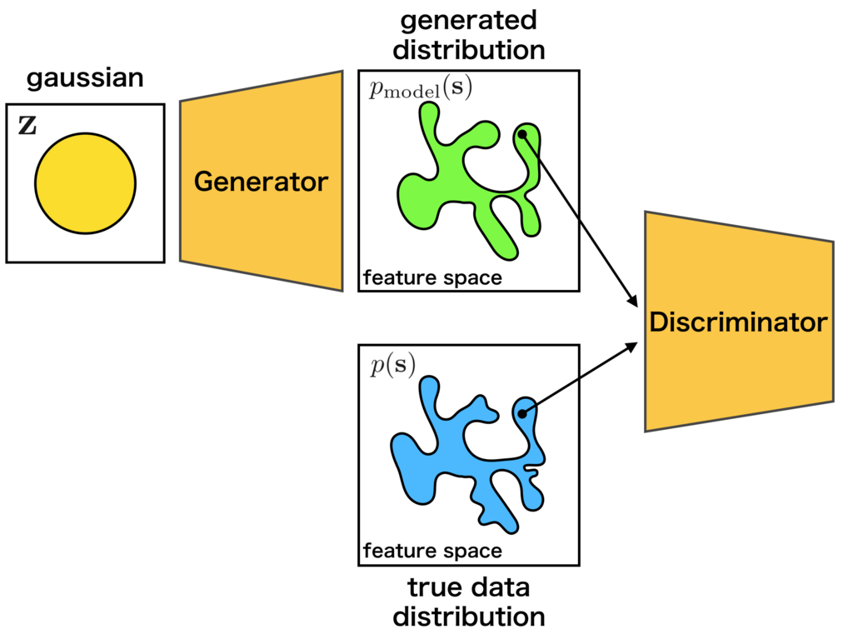
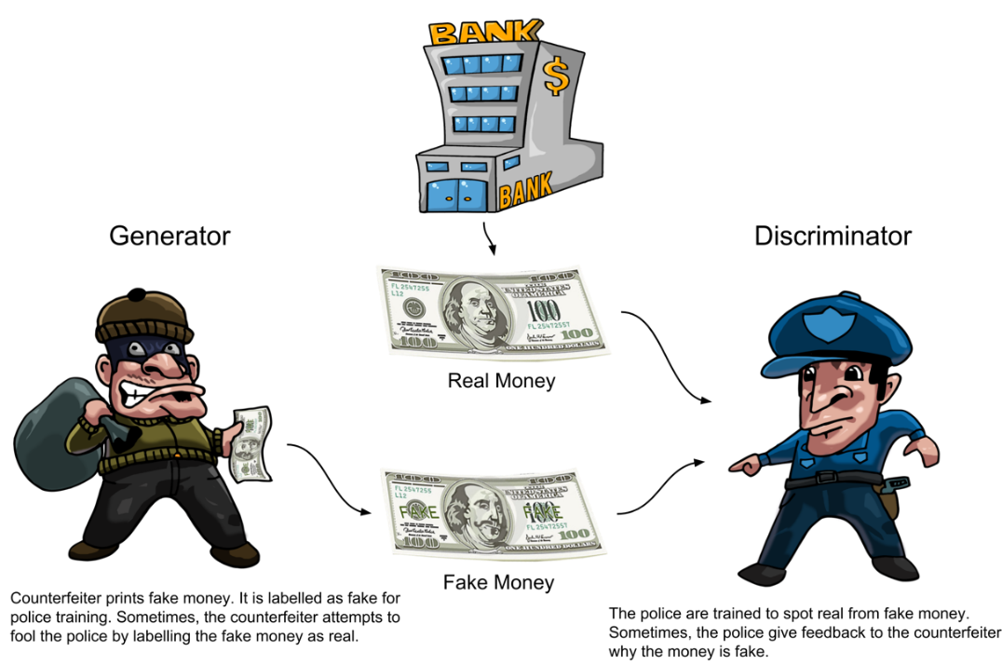
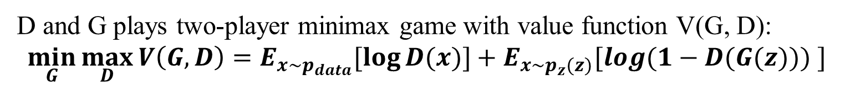
Methodology: GAN
Noise (0,1)
Real/Fake
Two networks competing with each other.
Discriminator D tries to distinguish between real samples and samples generated by Generator G.
G tries to “fool” D.
G will learn to generate samples similar to real data.
D and G plays two-player minimax game with value function V(G, D):
$$\min_{G}{\max_{D}{V\left(G,D\right)=E_{x\sim p_{data}}[\log{D(x)}]}+E_{x\sim p_{z}(z)}[\log{(1−D(G(z))) }]}$$

Slide 4
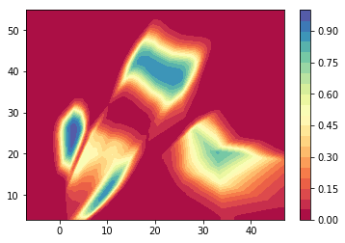
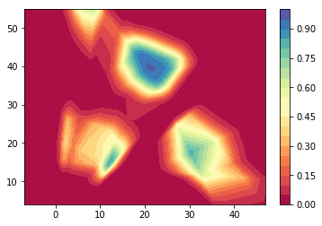
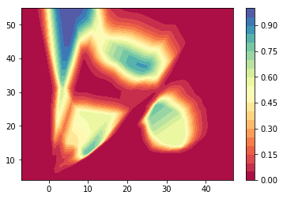
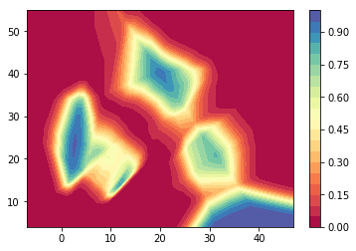
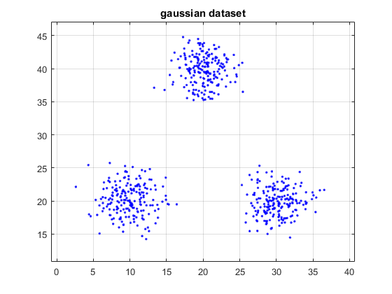
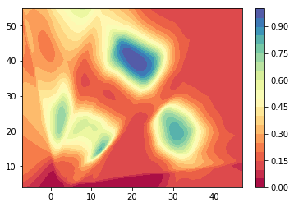
Methodology: Ensemble GAN
Red area is not in data distribution for sure;
Blue area is likely to be in data distribution, but not for sure.
Single GAN
…
10
Ensemble (mean)
Ensemble GAN
Fuzzy integral ensemble?

Slide 5
Experiments: model data distributions

Slide 6
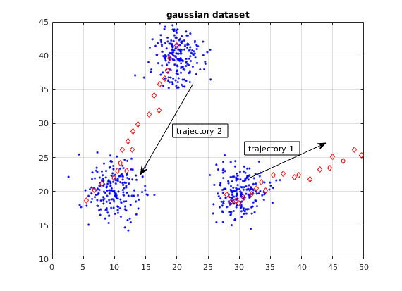
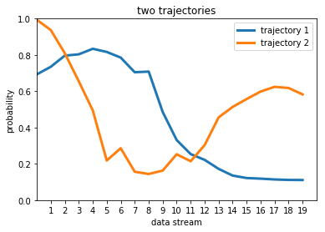
Experiments: trajectory analysis
Trajectory 1:
-- Goes from cluster center to outside;
Trajectory 2:
-- Goes from one cluster to another cluster.

Slide 7
Summary and Future Work
GAN has the ability to model data distribution:
Generator G learns to generate samples similar to real data
Discriminator D learns to distinguish between real and fake data
Ensemble GAN performs better at modeling data distribution than the single GAN and the GMM;
Ensemble GAN can serve as a base model for anomaly detection.
Fuzzy integral ensemble can be used in the future;
Ensemble GAN can be developed in data stream processing mode.
References
[1] Brock, Andrew, Jeff Donahue, and Karen Simonyan. "Large scale gan training for high fidelity natural image synthesis." arXiv preprint arXiv:1809.11096 (2018).
[2] https://dzone.com/articles/working-principles-of-generative-adversarial-netwo
[3] http://cs.joensuu.fi/sipu/datasets/

