Slide 1
Interpreting a trained CNN -- What did my convolutional network learn?
Columbus Machine Learners Meetup
Waylon Chen
June 5, 2019

Slide 2
Outline Interpreting a trained CNN
Motivation and introduction to CNN
Neural network
Convolution
Convolutional network
The approaches
Visualize intermediate activations
My CNN encoder and interpreters – some hybrid models
Did my CNN learn translational invariance?
Conclusion
Notes:
Approaches:
hard to

Slide 3
Motivation and Introduction to CNN
Motivation
Neural network
Convolution
Convolutional network

Slide 4
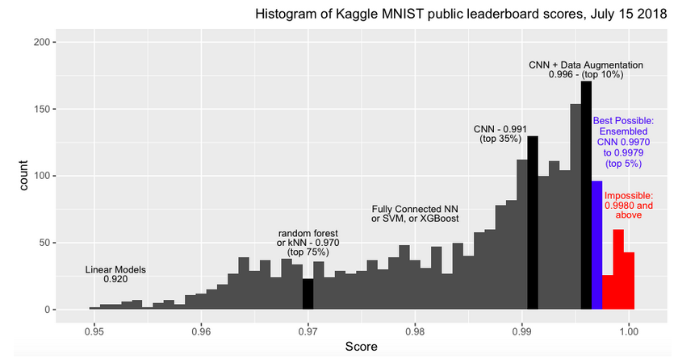
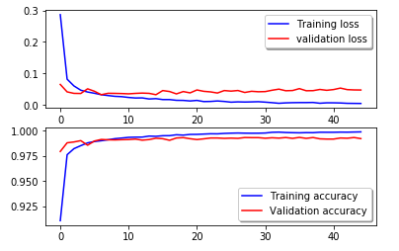
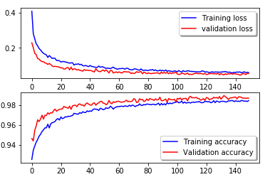
Motivation
My CNN classifier achieved 99.3% accuracy on MNIST hand-written digit dataset, but I cannot interpret it!
Knowing the information it did/did not learn can be the key to improvements.
Validation accuracy exceeds training accuracy after data augmentation!
https://www.kaggle.com/cdeotte/25-million-images-0-99757-mnist

Slide 5


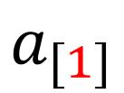


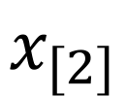

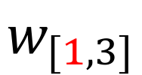
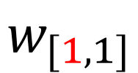
Neural network
$$σ:nonlinear activation function$$
$$w_{[1,1]}$$
TL;DR
Weigh
Bias
Activate
$$x_{[1]}$$
$$a_{[1]}$$
$$x_{[2]}$$
$$a_{[2]}$$
$$w_{[1,3]}$$
$$x_{[3]}$$
Hidden layer 1
output
input

Slide 6
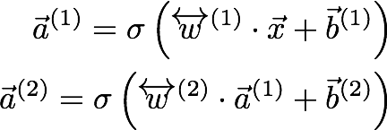


Slide 7
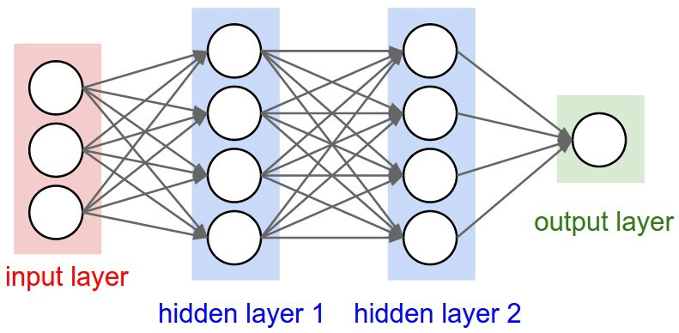
Neural Network – fully connected

Slide 8
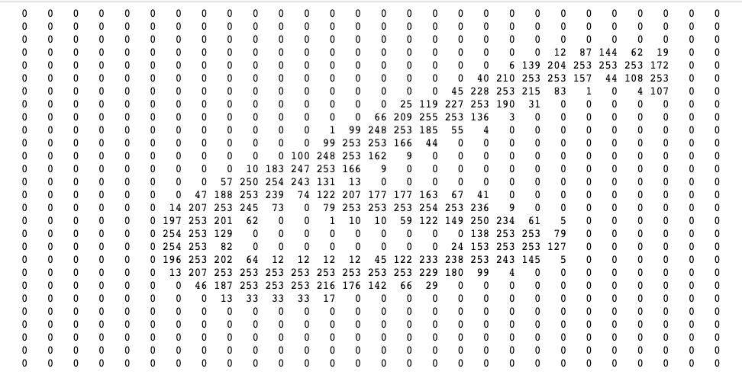
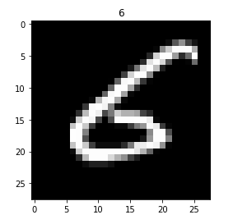
Pixels

Slide 9
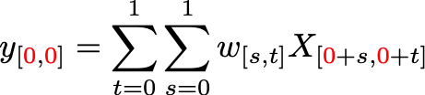
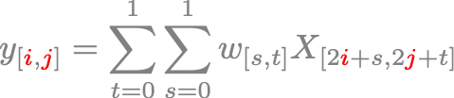


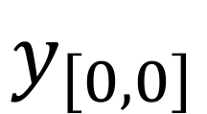

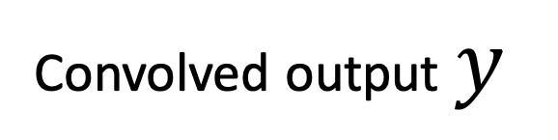
Convolution
$$w$$
filter
3
0
$$y_{\left[0,0\right]}$$
1
-1
1
1
3
1
-1
1
-1
1
5
-4
1
-1
0
0
Convolved output $y$
input
$$X$$
$$y=w∗X$$

Slide 10
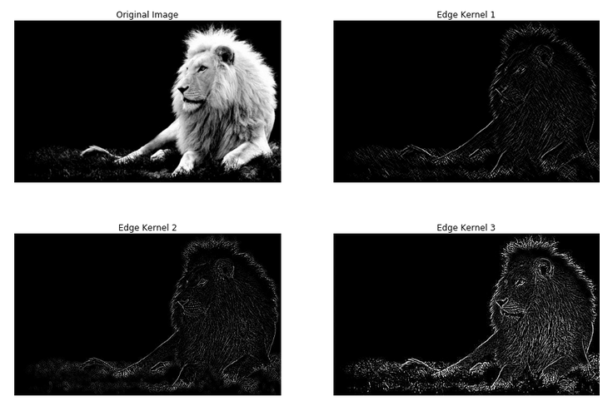
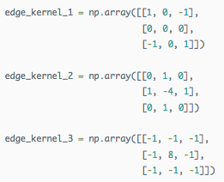
Convolution
Convolution can do edge detection, blurring, sharpening and etc.
https://beckernick.github.io/convolutions/

Slide 11








Convolutional Network-I
$$a_{1\left[0,0\right]}$$
5
0
input
$$X$$
1
-1
$$b_{1}=2$$
1
-1
3
0
$$w$$
filter
1
1
$$y=w∗X$$
1
5
0
0
TL;DR
Convolve
Bias
Activate
Activation : eg.$ReLu:$ $$σ\left(z\right)=z, when z≥0$$
$$=0, when z<0$$
Convolutional
hidden layer 1

Slide 12
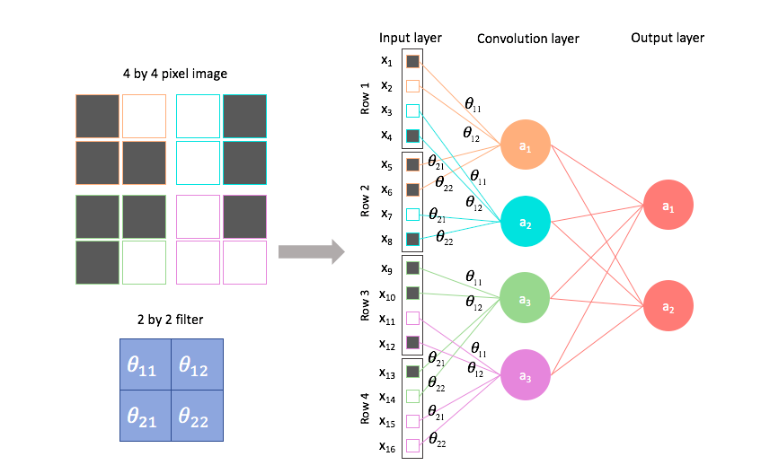
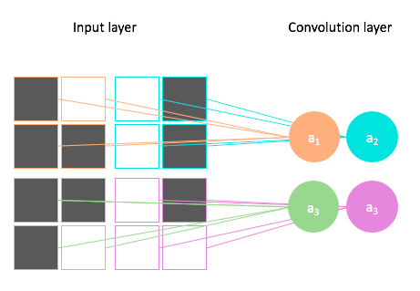
Conv Net-II
Sparsely connected network
Locality is preserved with convolution
https://www.jeremyjordan.me/convolutional-neural-networks/

Slide 13
The approaches
Visualize the intermediate activations
CNN encoder and interpreters
Did my CNN learn translational invariance?

Slide 14
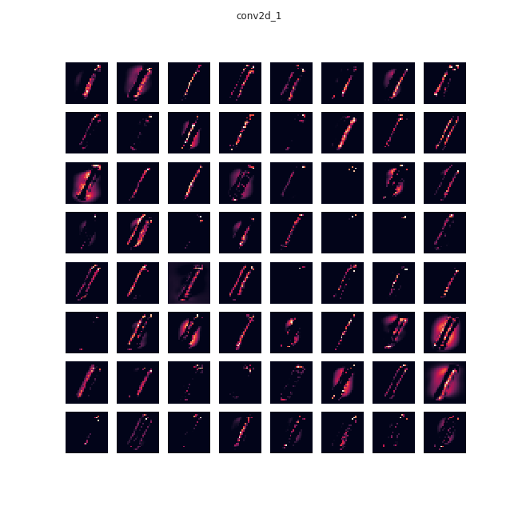
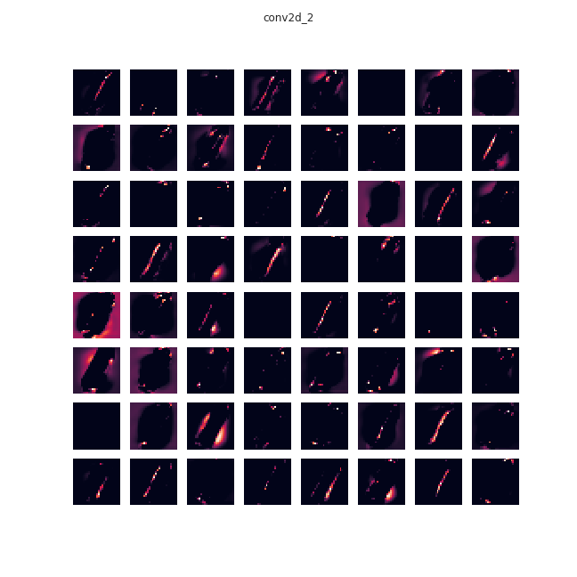
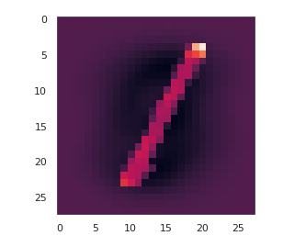
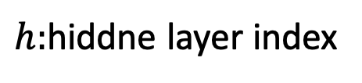


Visualize the intermediate activations-I
$$h=1$$
$$h=2$$
$h:$hiddne layer index
28*28=784
(28*28)*64=50,176
(28*28)*64=50,176

Slide 15
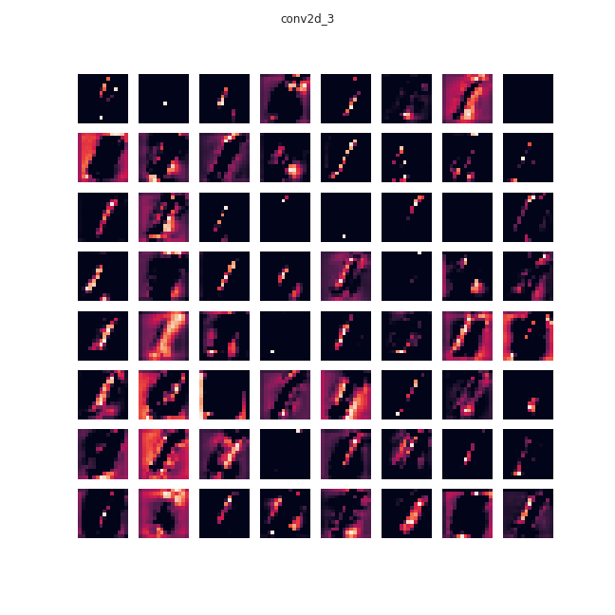
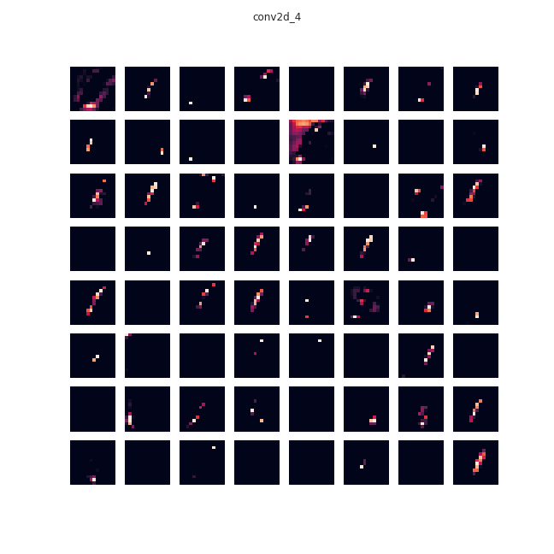


Visualize the intermediate activations-II
$$h=5$$
$$h=6$$
$h:$hiddne layer index
28*28=784
(14*14)*64=12,544
(14*14)*64=12,544

Slide 16
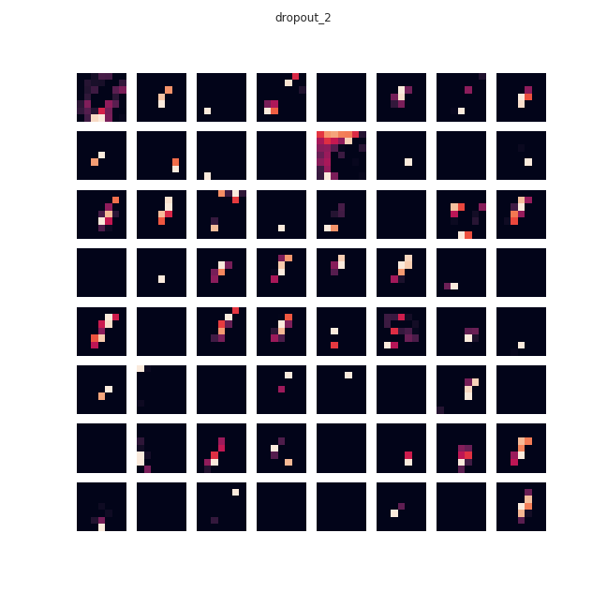
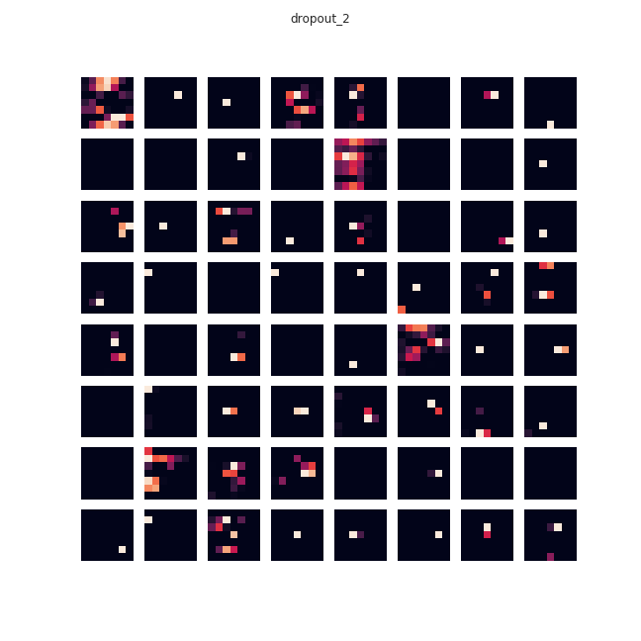
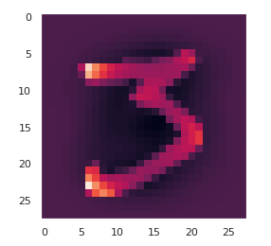


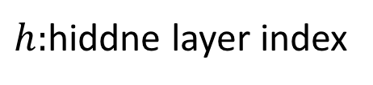
Visualize the intermediate activations-III
$$h=8$$
$$h=8$$
$h:$hiddne layer index
28*28=784
(7*7)*64=3,136
(7*7)*64=3,136

Slide 17
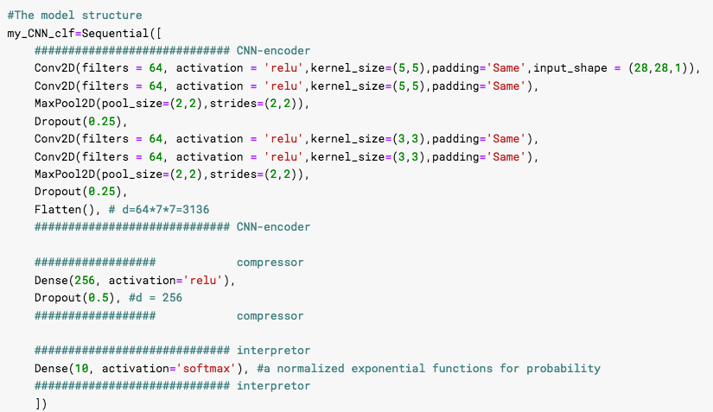







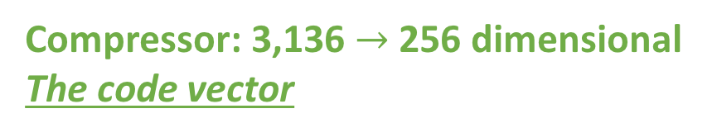
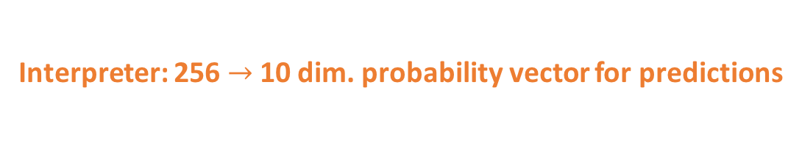
CNN encoder and interpreters
the architecture
$$h=1$$
$$h=2$$
$$h=5$$
$$h=6$$
$$h=8$$
Encoder: input$→$ 3,136-dimensional vector
$$h=10$$
Compressor: 3,136 $→$ 256 dimensional
The code vector
Interpreter: 256$→$ 10 dim. probability vector for predictions

Slide 18
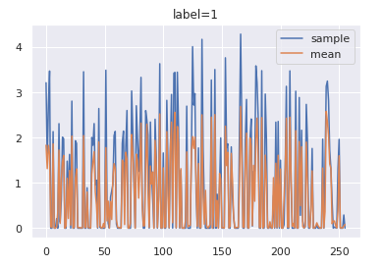
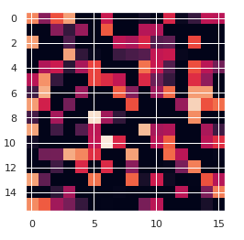
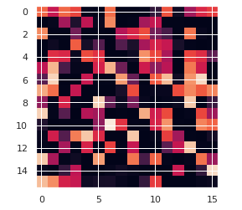
CNN encoder and interpreters
the code vectors
Code vector
Consistent and self-similarity within a class
Different interpreters show similar accuracy => Conv. encoder is the key
Code vector, label =1
sample
mean
Interpreters | accuracy
1 Dense layer NN | 99.44%
SVM | 99.35%
Random Forests (100 trees) | 99.32%
Gradient Boost (100 trees) | 99.24%
Decision Tree | 98.46%

Slide 19
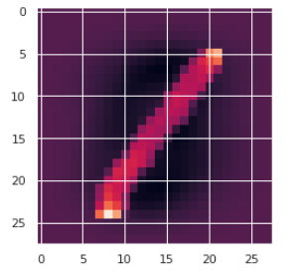
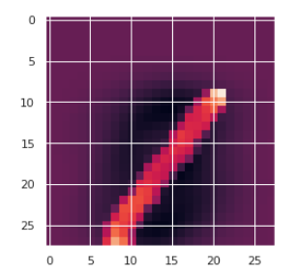
Translational Invariance

Slide 20
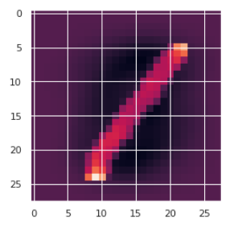
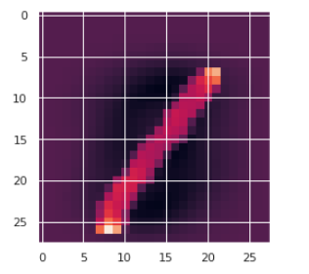
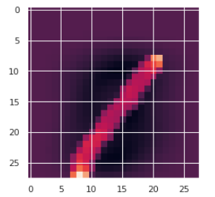
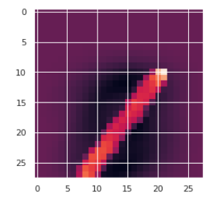

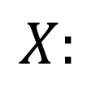
Did my CNN learn translational invariance?
$$Prob(y=1|X)$$
$$X:$$
y shift (pixels) | 0 | -1 | -2 | -3 | -4 | -5
CNN (CNN+NN) (acc = 99.3%) | 100% | 100% | 99.99% | 99.4% | 0.71% (7: 99.29%) | 1.4E-4% (7: 99.99%)
CNN+RF, T=1000 (acc = 99.3%) | 100% | 96.6% | 67.7% (7: 18.4) | 52.8% (7: 28.3%) | 44.4% (7: 35.5%) | 34.8% (7: 47.6 %)
CNN+SVM (acc = 99.3%) | 99.9% | 99.8% | 97.8% | 79.9% (9: 18.8%) | 21% (9: 77.76%) | 1% (9: 98.9%)
Random Forest (RF) (acc = 96.6%) | 99.5% | 84.9% (7: 9.8%) | 34.1% (7: 39.6%) | 9.1% (7: 56.3%) | 5.4% (7: 70.1%) | 4.8% (7: 70.2 %)
SVM (acc = 96.1%) | 99.6% | 42.8% (7: 50.8%) | 0.85% (7: 94.5%) | 0.42% (7: 81.3 %) | 0.43% (7: 79.5%) | 0.42% (80.8%)

Slide 21
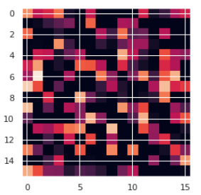
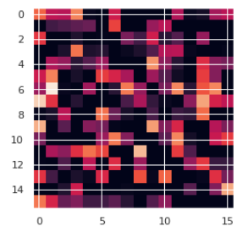
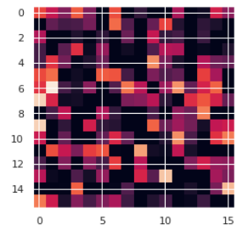
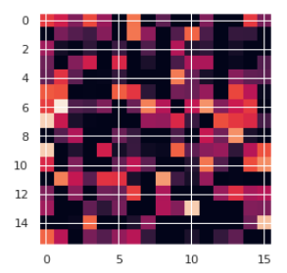
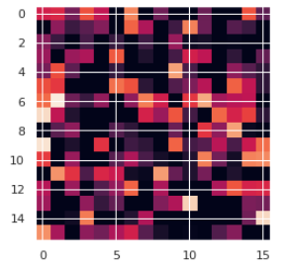
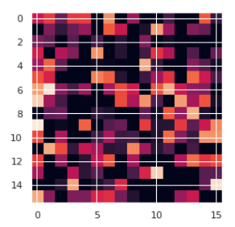




Did my CNN learn translational symmetry?
y shift
0 | -1 | -2 | -3 | -4 | -5
$$X:$$
(0,-1)
(-3,-4)
(0,-4)

Slide 22
Conclusion
Convolution reduces the neural network complexity and comprehend locality (relative positions) of the image (image pixels).
The deep convolutional encoder is the key for the performance
CNN encoding models learn translational invariance better than others, though not perfect.

Slide 23
Conclusion
Code vectors in hidden layers of CNN reduce the dimensionality of images.
Information learned in CNN is position sensitive. And convolution is the key for high accuracy performance.
The predicted probabilities of CNN are not continuous with respect to translations.
Translations deform CNN code vectors more softly.

Slide 24


Slide 25


