Slide 1
{{Customer Logo}}
{{Date}}
{{Customer Name}}
{{Preview}} | {{Partnership Updates}} | {{YYYY Planning}}
{{AE Name}}
{{SE Name}}
{{CSM Name}}
{{CSE Name}}

Slide 2

Agenda
{{Customer Logo}}
{{Date}}
{M1 -} Team Introductions [stakeholders]
{M2 -} Partnership Updates [shared strategy]
{M3 -} Success Plan Updates [priorities & KPI list]
{M4 -} Value Adoption Highlights [measure & expand]
{M5 -} Training & Enablement [increase ROI]
{M6 -} Communication Cadence [stakeholder group]
Appendix
{M7 -} Why Change? [solution overview]
{M8 -} Why Change Now? [accelerate time to value]
{M9 -} Why Change with Us? [dog food / thought leadership]
{Module #} API

Slide 3
Team Introductions
{{Customer Logo}}
{{Date}}

Slide 4
Your Account Team
{{Customer Logo}}
{{Date}}
Relationship Manager
Solutions Engineer
Customer Success Manager
Customer Success Engineer
{{AE Name}}
{{PreSales Name}}
{{BRM Name}}
{{SME Name}}
Strategic Alignment
accountexec@vendor.com
Use Case Creation & Validation
presales_name@vendor.com
Business Relationship Manager
brm_name@vendor.com
Adoption & Best Practices
sme_name@vendor.com
{{Title}}
{{Title}}
{{Title}}
{{Title}}
{{Name}}
{{Name}}
{{Name}}
{{Name}}
client_name1@client.com
client_name2@client.com
client_name3@client.com
client_name4@client.com
(CRM-SYSTEM API)

Slide 5
Partners & Stakeholders
{{Customer Logo}}
{{Date}}
Business Sponsors
{{Name}}
{{Title}}
{{Name}}
{{Title}}
{{Name}}
{{Title}}
Champions & Admins
{{Name}}
{{Title}}
{{Name}}
{{Title}}
{{Name}}
{{Title}}
Power Users
{{Name}}
{{Title}}
{{Name}}
{{Title}}
{{Name}}
{{Title}}
Stakeholder Groups
Finance & Operations
Engineering
(Dev/SecOps)
Line of Business
Go To Market
AP/AR
SOX
SRE
DevOps
InfoSec
Product
BI
Customer Service
Sales
Marketing
(CRM-SYSTEM API)

Slide 6
Steering Committee
{{Customer Logo}}
{{Date}}
Role
Name
Expertise
Influence
Executive Sponsor
{{Name}}
{{Title}}
Business Need
Business Owner
Change Agent
{{Name}}
{{Title}}
Concept & Design
Budget Owner
Delivery Agent
{{Name}}
{{Title}}
Implement & Deliver
POV Champion
Adoption Agent
{{Name}}
{{Title}}
Grow & Measure
Champion / Power User
Critical Stakeholder
{{Name}}
{{Title}}
Influencers & Detractors
Indirect Owners
Target Audience
{{Name}}
{{Title}}
Users & Consumers
End User
(CRM-SYSTEM API)

Slide 7
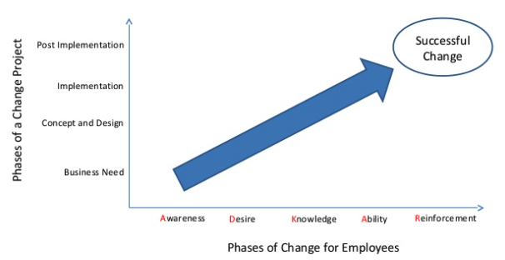
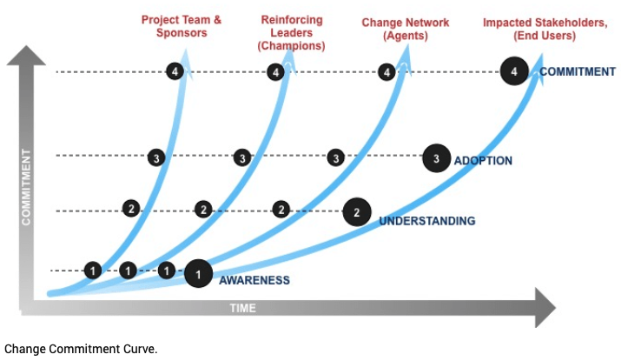
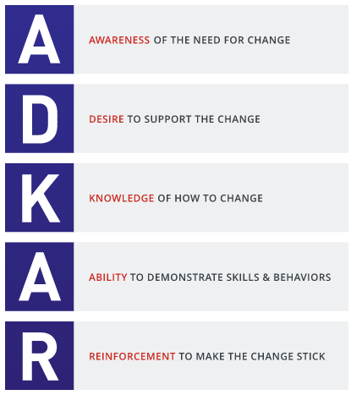
People, Process, & Technology [Change Mgmt.]
{{Customer Logo}}
{{Date}}
Audience: | Organizer: | Recommended Cadence: | Commitment:
Executive Sponsors | {{Account Executive}} | Every 6mo | 90 min
Business Owners | {{Customer Success}} | Every 3mo | 60 min
Project Team | {{Customer Success}} | Slack and Monthly | 30 min
End User Office Hours | {{Account Support}} | Slack and Monthly | 30 min

Slide 8
News and Notifications
{{Customer Logo}}
{{Date}}

Slide 9
Key Updates
{{Customer Logo}}
{{Date}}

Slide 10




{{Industry}} Competitive Landscape
{{Customer Logo}}
{{Date}}
Strengths
{{Improved Customer Experience}}
{{Revenue Protection}}
Weaknesses
{{Tool Unification}}
{{Zero Mgmt. Overhead}}
Opportunities
{{Deeper Business Insights}}
{{Faster Release Cycles}}
Threats
{{Improved Audit & Compliance}}
{{Improved Security Posture}}
(Gartner/Forrester/Ecosystems API)

Slide 11
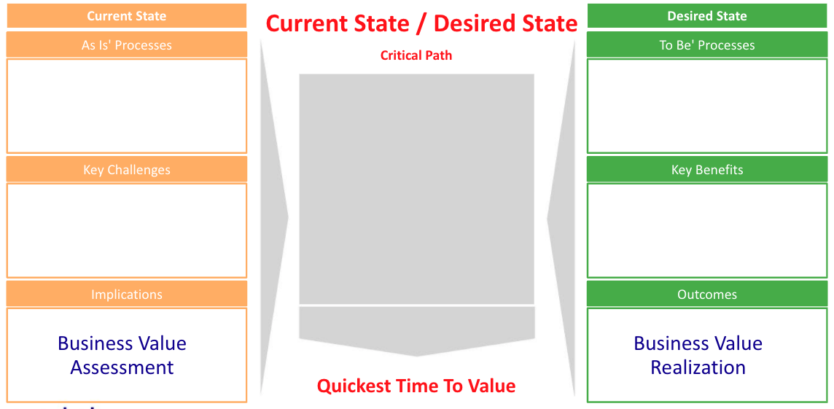
{{Customer Logo}}
{{Date}}
{{SIP}}
{{SIP}}
Stakeholder Success Factors:
{{Business Owner KPIs}}
{{Budget Owner KPIs}}
{{SIP}}
{{POV Champion KPIs}}
{{SIP}}
{{Administrator KPIs}}
{{Influencer KPIs}}
{{End User KPIs}}
{{Value KPIs}}

Slide 12
Partnership Plan
{{Customer Logo}}
{{Date}}

Slide 13
Economic Landscape As-Is-Situation
{{Customer Logo}}
{{Date}}

Slide 14
{{Account Name}}
Mutual Success Plan
{{Customer Logo}}
{{Date}}
Business Value Drivers
Revenue Protection | Improved Customer Experience | Faster Release Cycles | Deeper Business Insights | Improved Security Posture | Improved Audit & Compliance | Zero Mgmt. Overhead | Tool Unification
{{vx1}} | {{vx1}} | {{vx1}} | {{vx1}} | {{vx1}} | {{vx1}} | {{vx1}} | {{vx1}}
Security Analytics | Operational Analytics | Business Analytics
{{SIP Security Use Case}} | {{SIP Operational Use Case}} | {{SIP Business Analytics Use Case}}
{{SIP Security Use Case}} | {{SIP Operational Use Case}} | {{SIP Business Analytics Use Case}}
Use Cases
Business Outcomes / Measures of Success
{{BVA Issue KPI}} {{BVA Issue KPI}} {{BVA Issue KPI}} |  | {{BVR Solution/KPI}} {{BVR Solution/KPI}} {{BVR Solution/KPI}}
Roadmap Priorities
Short-Term Priorities (<3-6 months) | Longer-Term Objectives (6 months +)
{{Asana Workstream 1}} {{Asana Workstream 2}} {{Asana Workstream 3}} | {{BVR Workstream 1}} {{BVR Workstream 2}} {{BVR Workstream 3}}
(SIP / Asana Integration)
(CRM-SYSTEM API)

Slide 15
{{Account Name}}
Mutual Success Plan (By Workstream)
{{Customer Logo}}
(TICKETING API)
{{Date}}
Q2
Q3
User Group
Outcomes
Mar
Apr
May
June
July
Engineering:
Personas:
{{DevOps Engineer}}
{{SRE}}
{{Management}}
Automate rollback of releases that cause errors in production
Reduce MTTI/MTTR
SLOs / SLAs
{{Asana Project 1}}
Champion(s):
{{InternalName}}
Security:
Identify system anomalies and send automated alerts
Automate identification of new error messages
Automate Incident Responses
Identify incidents more quickly
Reduce Loss / Risk profile
Personas:
{{SecOps Engineer}}
{{InfoSec Engineer}}
{{Management}}
{{Asana Project 2}}
Champion(s):
{{Lucid}}
Business:
Increase CLTV
Decrease Time to Market
Increase Time to Value
Automation & Efficiency
Business Line Enablement
Personas:
{{Product Manager}}
{{Data Scientist}}
{{Management}}
{{Asana Project 3}}
Champion(s):
{{InternalName}}
Vendor:
Personas:
{{CSM}}
{{CSE}}
{{Management}}
Increase Time to Value
Automation & Efficiency
Business Line Enablement
Value Realization
Best Practices
Technical Onboarding
Office hours
Classes
Adoption Checkpoint
Best Practices
Account Optimization
BVA / BVR Review
Mutual Success Plan
User Groups
Value Checkpoint
Working Groups
Persona Optimization
Quarterly Business Review
Champion(s):
{{CRM-SYSTEM}}

Slide 16
Economic Benefits To-Be-State
{{Customer Logo}}
{{Date}}

Slide 17
Adoption Updates
{{Customer Logo}}
{{Date}}

Slide 18
Adoption Tracker Report
{{Customer Logo}}
{{Date}}

Slide 19
Stakeholder Adoption
{{Account Name}}
{{Customer Logo}}
{{Date}}
{{Account Details Highlights}}
{{Client Health Score}}
{{Dashboard Views}}
{{Power User Highlights}}
{{Client Feedback}}
{{Client Value Metrics Score}}
{{Client Notes}}
(CRM-SYSTEM API)

Slide 20
Training & Enablement
{{Customer Logo}}
{{Date}}

Slide 21
Training & Enablement Plan and Milestones
{{Customer Logo}}
{{Date}}

Slide 22
Product Announcements
{{Customer Logo}}
{{Date}}

Slide 23
Training Announcements
{{Customer Logo}}
{{Date}}

Slide 24
Training Reference
{{Customer Logo}}
{{Date}}

Slide 25
Communication Schedule
{{Customer Logo}}
{{Date}}

Slide 26
Prior Meeting: Notes, Actions
{{Customer Logo}}
{{Date}}

Slide 27
Current Meeting: Agenda and Status
{{Customer Logo}}
{{Date}}

Slide 28
Meeting Schedule: Goals and Milestones
{{Customer Logo}}
{{Date}}

Slide 29
Appendix

Slide 30
Why Change?
{{Vendor Logo}}
{{Customer Logo}}
{{Date}}

Slide 31
Why Change Now?
{{Vendor Logo}}
{{Customer Logo}}
{{Date}}

Slide 32
Why Partner with Us?
{{Vendor Logo}}
{{Customer Logo}}
{{Date}}

