Slide 1
29. Sentence Classification for News
Chien-Wei Lin(chienwli), I-An Huang(huangian), Hung-Wei Wu(hungwei)

Slide 2
Project Description
News titles, though consisting of short sentences, provide rich information of the semantic content in a concise way
Given news titles from various sources of data, classify them into predefined news categories such as sports, politics, or technology
Dataset: News Aggregator Data Set
Notes:
Motivation
Definition
Dataset

Slide 3
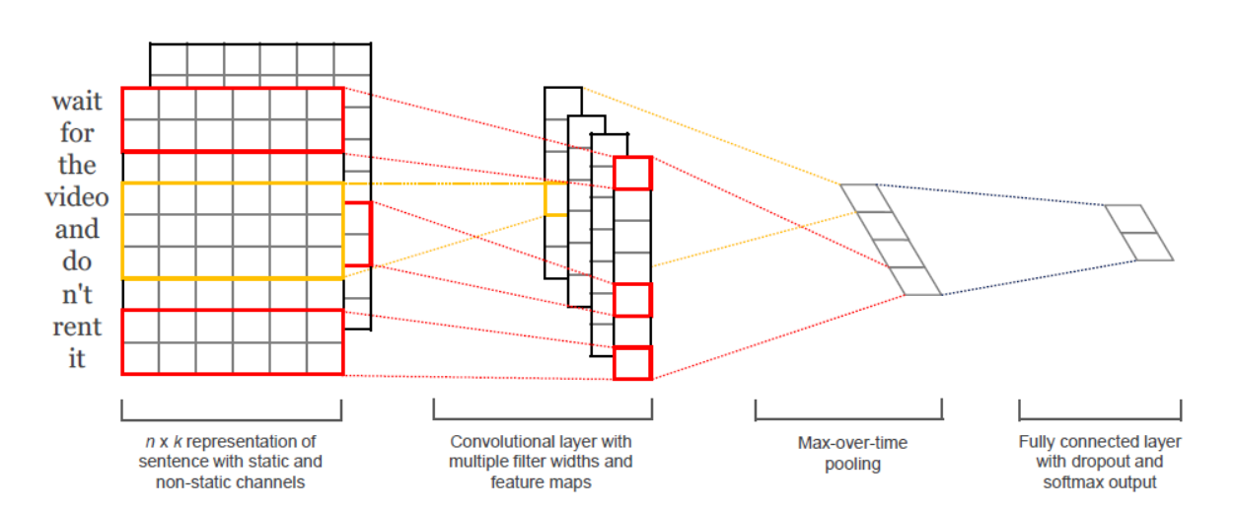
Methodology
Representation: count of words v.s. w2v
Model (CNN)
Apply convolution on multiple windows with different length
Max pooling over time as the down sample strategy to handle different length of the affine output
Regularization: Dropout
Notes:
Sentence Representation
CNN structure

Slide 4
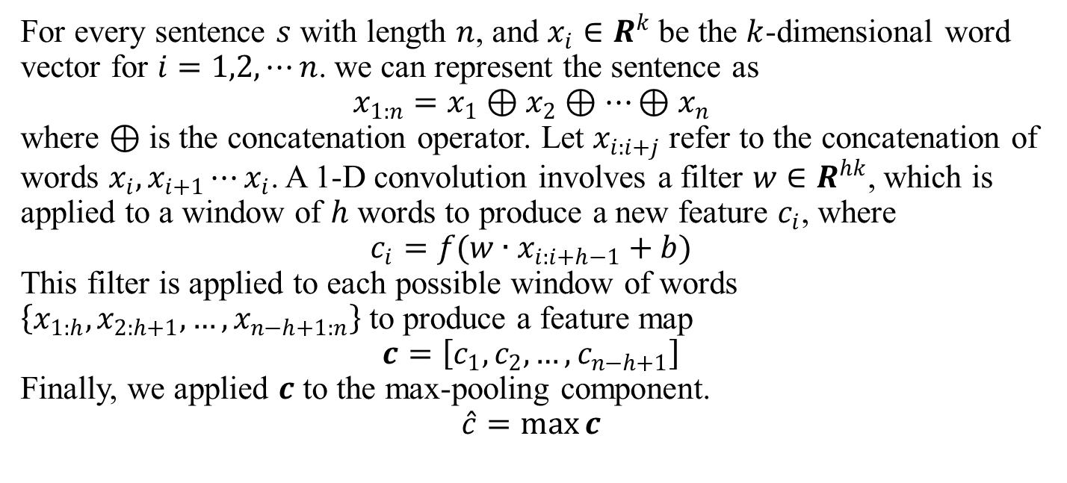
For every sentence $s$ with length $n$, and $x_{i}∈R^{k}$ be the $k$-dimensional word vector for $i=1,2, ⋯n$. we can represent the sentence as
$$x_{1:n}=x_{1}⊕x_{2}⊕⋯⊕x_{n}$$
where $⊕$ is the concatenation operator. Let $x_{i:i+j}$ refer to the concatenation of words $x_{i}, x_{i+1}⋯x_{i}$. A 1-D convolution involves a filter $w∈R^{hk}$, which is applied to a window of $h$ words to produce a new feature $c_{i}$, where
$$c_{i}=f(w∙x_{i:i+h−1}+b)$$
This filter is applied to each possible window of words $\left\{x_{1:h},x_{2:h+1},…,x_{n−h+1:n}\right\}$ to produce a feature map
$$c=\left[c_{1}, c_{2}, …, c_{n−h+1}\right]$$
Finally, we applied $c$ to the max-pooling component.
$$\hat{c}=\max_{}{c}$$

Slide 7
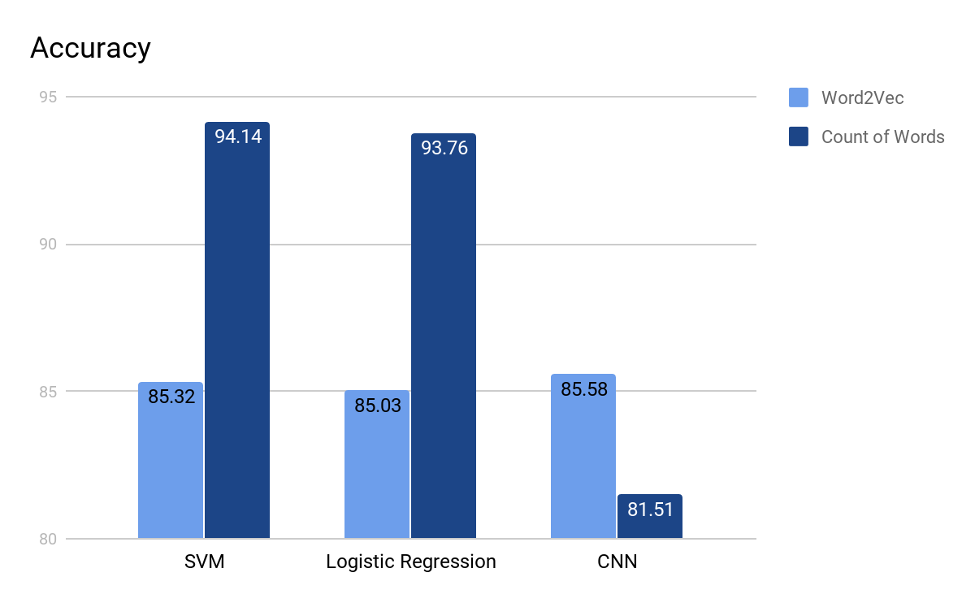
Result
Tokens in dataset: 888M
Count of words is better than w2v in simple model
w2v has better performace on CNN
Conclusion
Dataset might be too simple for the task
Future Work
Working on new datasets
Notes:
Training Size
Performance
The distribution of the data set is too easy

