Slide 1
Introduction to Computer Networking
Final Project
電機三 吳倉永 黃平瑋 張問寬

Slide 2
Outline
Introduction
Interface
Features
Achievement
Implementation of Frontend & Backend
Problems Encountered and Solution
Future Work

Slide 3
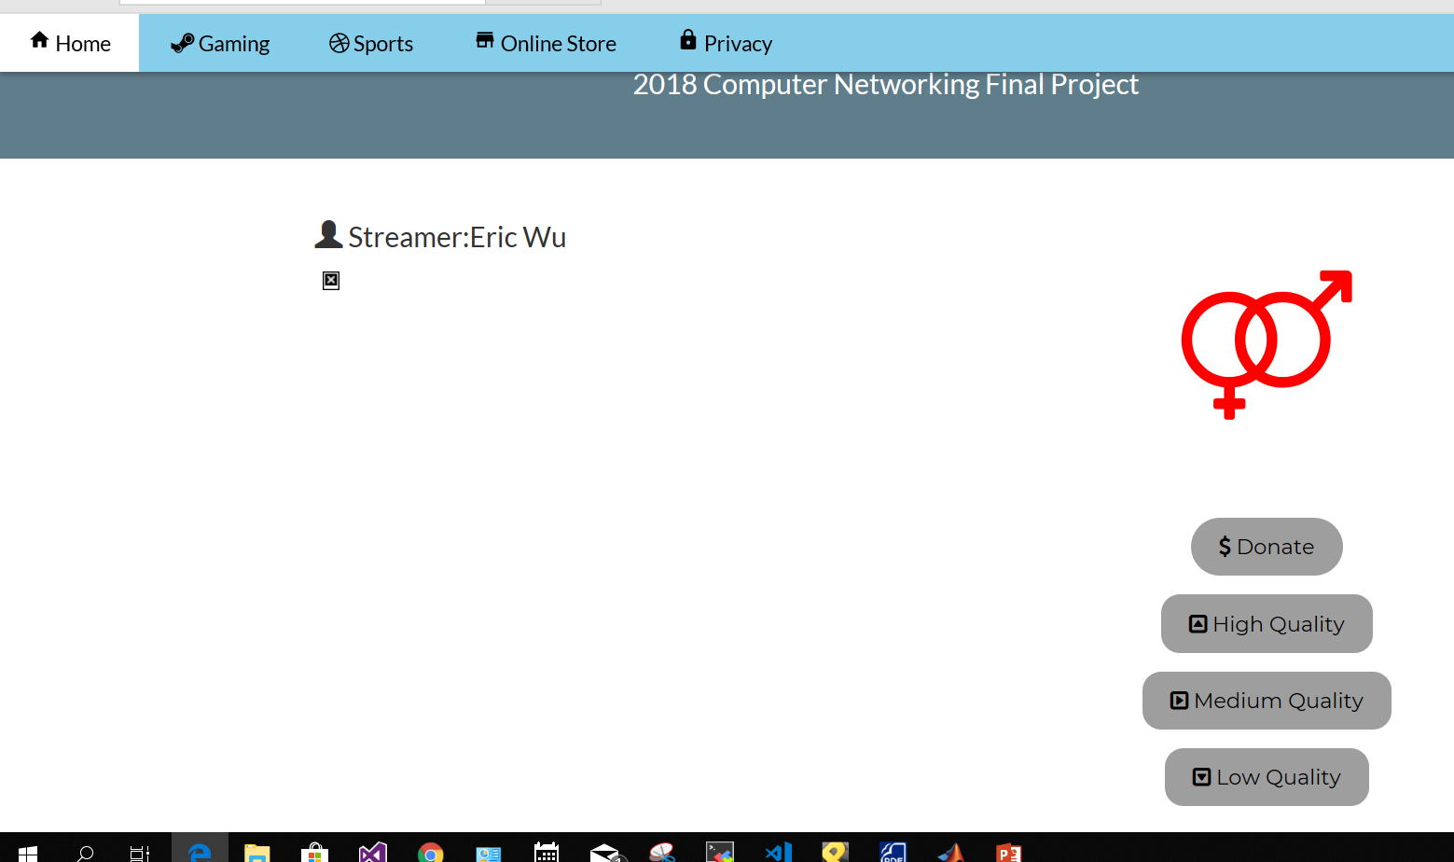
Introduction
Interface
Screen
Donate & Quality Setting
Mode Setting

Slide 4



Introduction
Features
Automatic Bandwidth
Adjustment
L

Slide 5



Introduction
Features
Automatic Bandwidth
Adjustment
Motion Detection
L

Slide 6
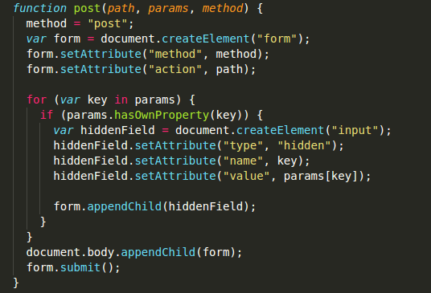
Achievement
Frontend Implementation
HTML
CSS
Javascript

Slide 7
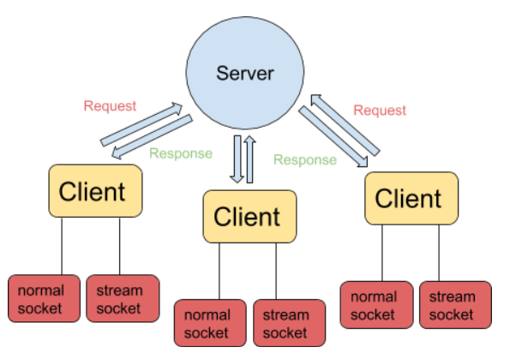
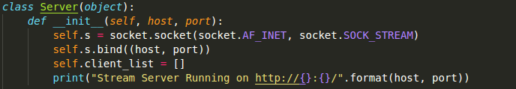
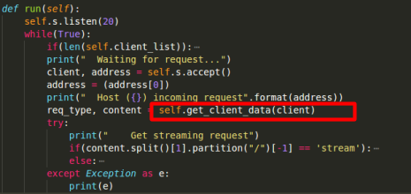
Achievement
Backend Implementation
Server

Slide 8
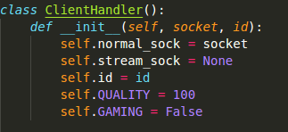
Achievement
Backend Implementation
Server
ClientHandler

Slide 9
Achievement
Backend Implementation
Server
ClientHandler
Multi-threading

Slide 10

Achievement
Problem Encountered
Streaming via HTML
Multi-threading

Slide 11
Future Work
Add More Features
Filter on Stream
Chatting Room

