Slide 1
Machine Numbers and Errors
Basic concepts of numerical errors
數值表示法與誤差

Slide 2
Outline
Floating point representation
Round-off errors
Truncation errors
Absolute errors and relative errors
Over- and underflow
Loss of significant digits
Error propagation

Slide 3
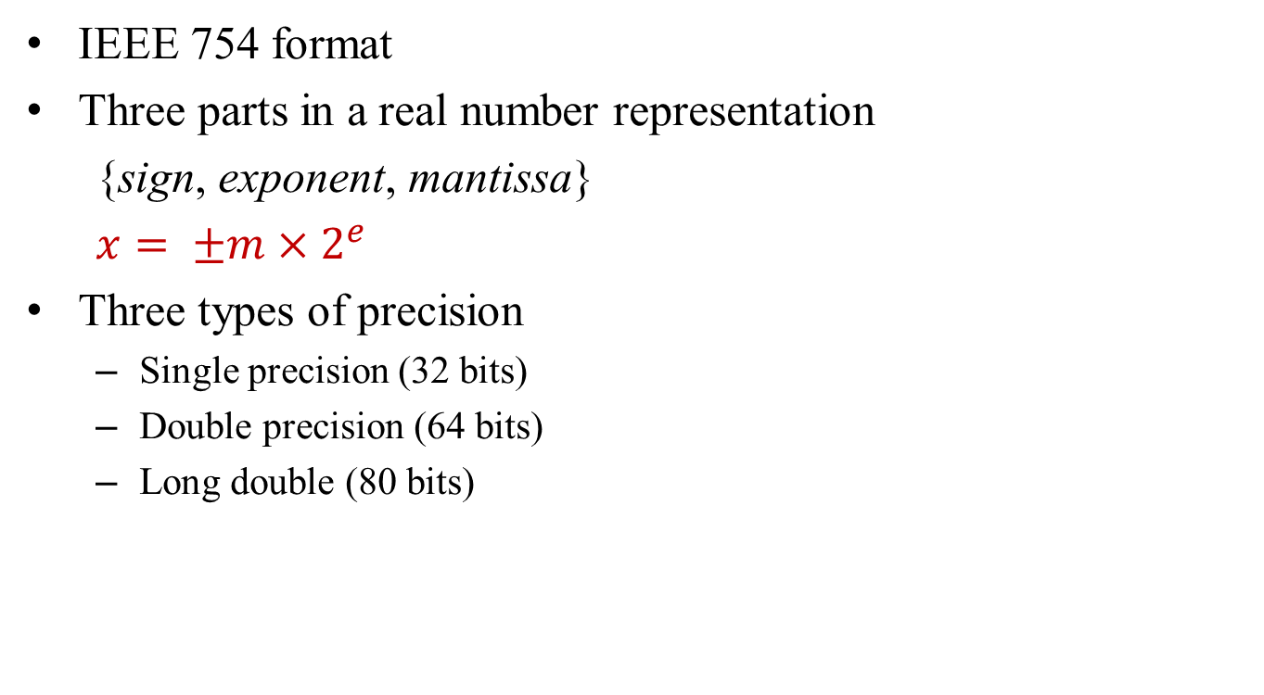
Floating Point Numbers
IEEE 754 format
Three parts in a real number representation
{sign, exponent, mantissa}
$x= ±m×2^{e}$
Three types of precision
Single precision (32 bits)
Double precision (64 bits)
Long double (80 bits)
precision | sign | exponent | mantissa
single | 1 | 8 | 23
double | 1 | 11 | 52
Long double | 1 | 15 | 64
exponent
Mantissa (fraction)
sign

Slide 4
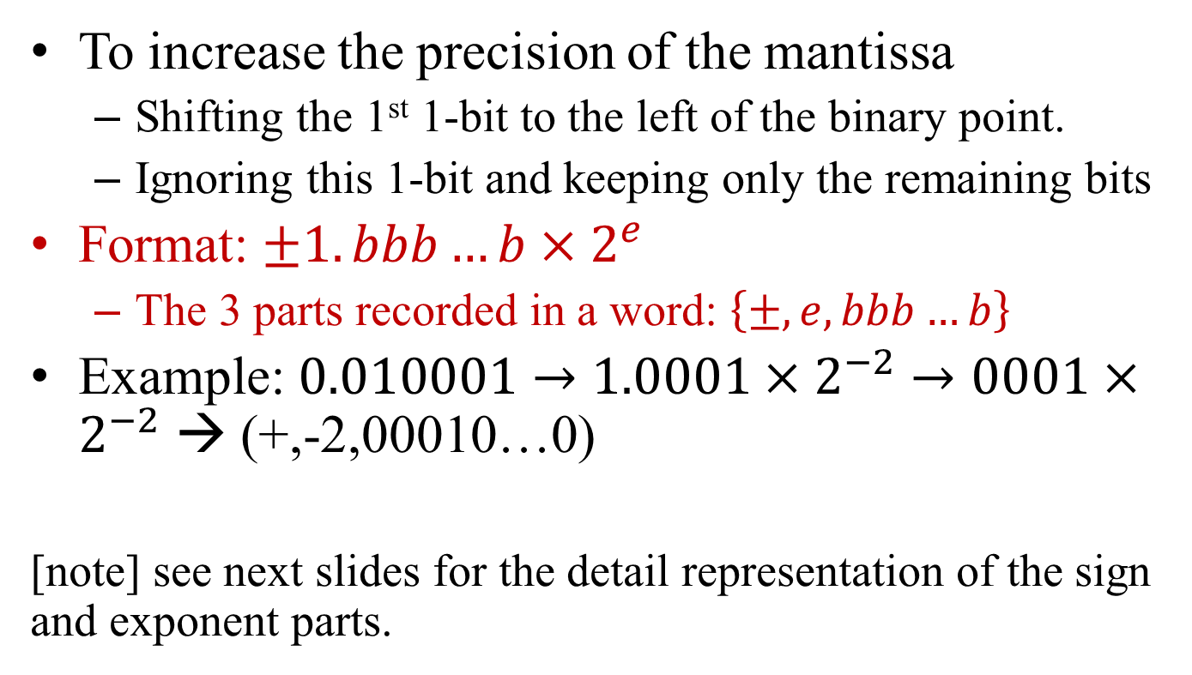
Normalized Floating Point Numbers
To increase the precision of the mantissa
Shifting the 1st 1-bit to the left of the binary point.
Ignoring this 1-bit and keeping only the remaining bits
Format: $±1.bbb…b×2^{e}$
The 3 parts recorded in a word: $\left\{±, e,bbb…b\right\}$
Example: $0.010001→1.0001×2^{−2}→0001×2^{−2}$ → (+,-2,00010…0)
[note] see next slides for the detail representation of the sign and exponent parts.

Slide 5
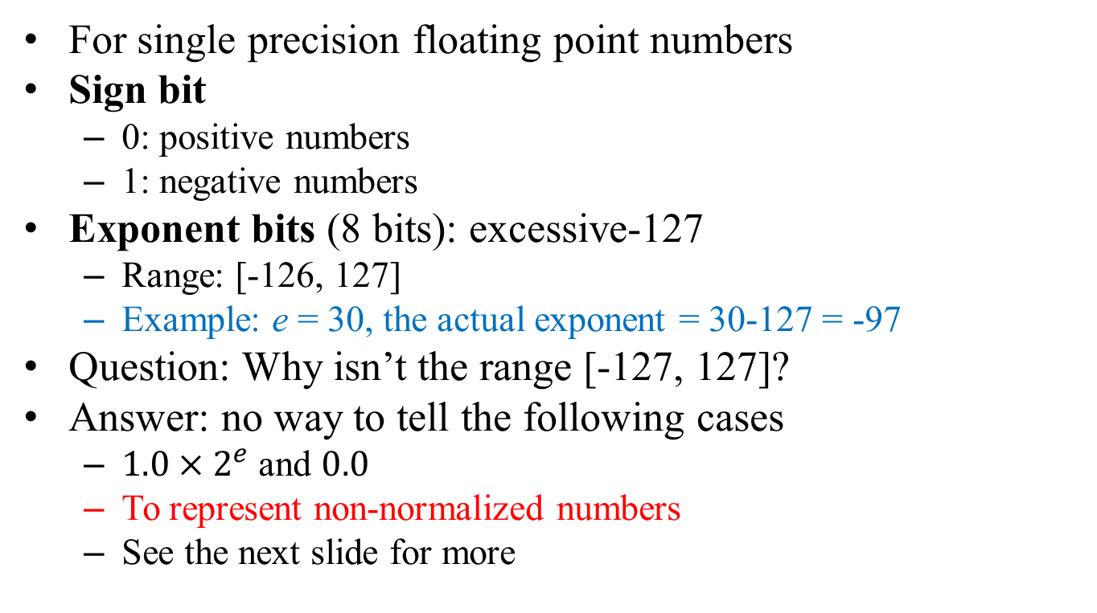
Representation Method
For single precision floating point numbers
Sign bit
0: positive numbers
1: negative numbers
Exponent bits (8 bits): excessive-127
Range: [-126, 127]
Example: e = 30, the actual exponent = 30-127 = -97
Question: Why isn’t the range [-127, 127]?
Answer: no way to tell the following cases
$1.0×2^{e}$ and $0.0$
To represent non-normalized numbers
See the next slide for more

Slide 6
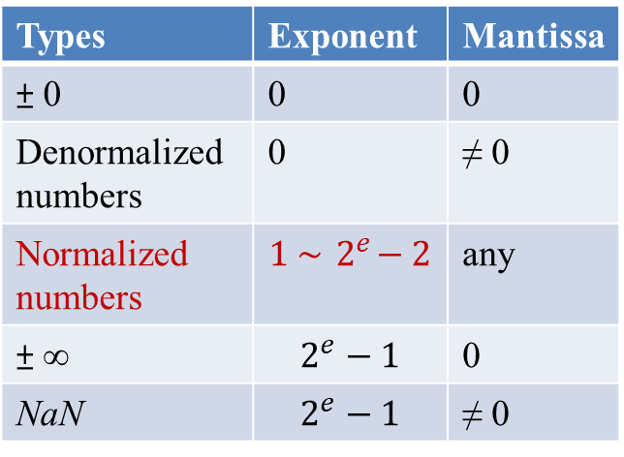
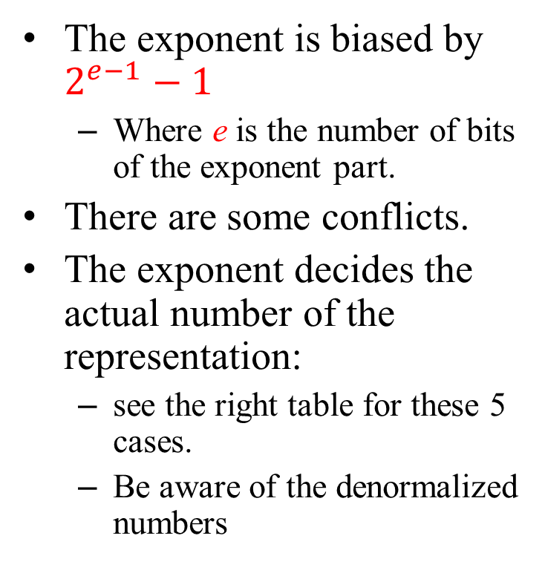
Special Cases
The exponent is biased by $2^{e−1}−1$
Where e is the number of bits of the exponent part.
There are some conflicts.
The exponent decides the actual number of the representation:
see the right table for these 5 cases.
Be aware of the denormalized numbers
Representation formats of floating numbers
Types | Exponent | Mantissa
± 0 | 0 | 0
Denormalized numbers | 0 | ≠ 0
Normalized numbers | $$1 \sim { 2}^{e}−2$$ | any
± ∞ | $$2^{e}−1$$ | 0
NaN | $$2^{e}−1$$ | ≠ 0
e: number of bits of the exponent parts

Slide 7
Extensions
Encoding methods for double and long-double real numbers are similar.
1 bit for the sign
Longer (larger) exponent parts
Excessive 2^{e-1} -1
Longer (more precise) mantissa parts
Normalized representation
1.bbb…b → bbb…b
Precisions and word-lengths of floating point numbers of different precisions.
precision | sign | exponent | mantissa
Single | 1 | 8 | 23
Double | 1 | 11 | 52
Long double | 1 | 15 | 64

Slide 8

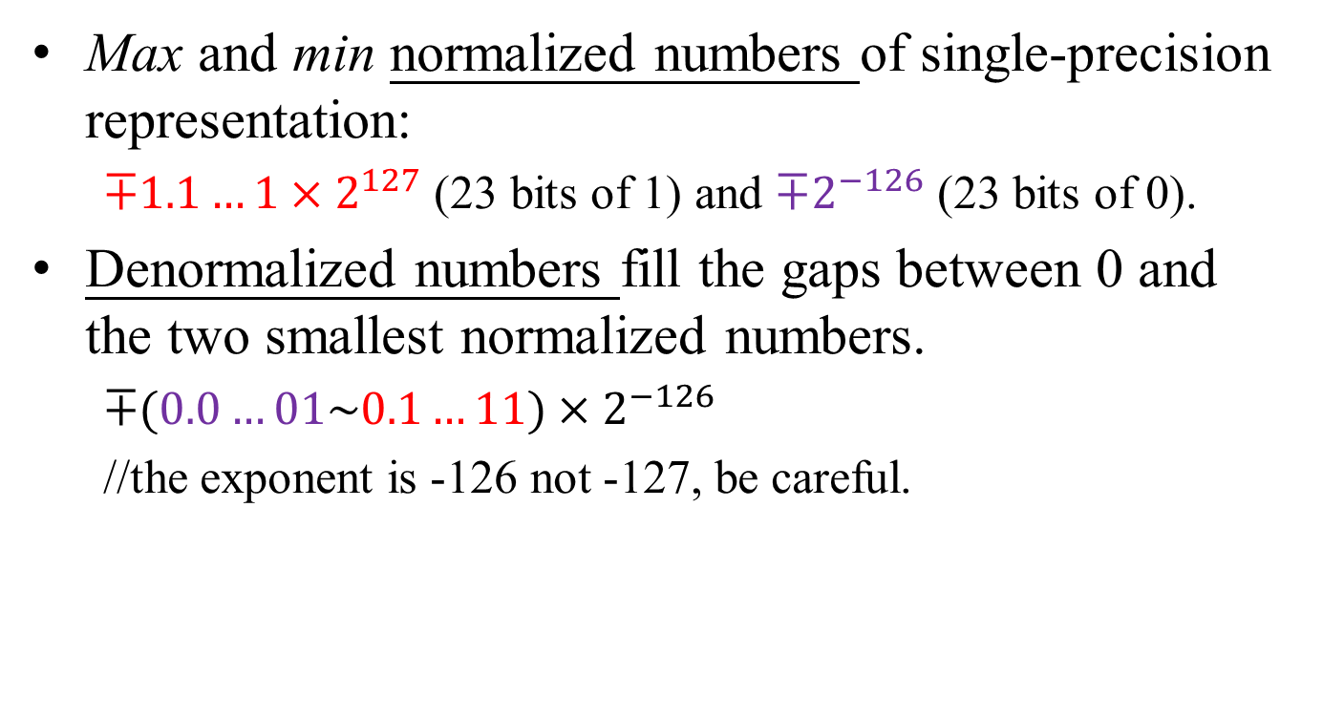



Range of Floating Point Numbers
Max and min normalized numbers of single-precision representation:
$∓1.1…1×2^{127}$ (23 bits of 1) and $∓2^{−126}$ (23 bits of 0).
Denormalized numbers fill the gaps between 0 and the two smallest normalized numbers.
$∓(0.0…01\sim 0.1…11)×2^{−126}$
//the exponent is -126 not -127, be careful.
$$−1.111…1×2^{127}$$
$$−2^{−126}$$
0
$$+2^{−126}$$
$$+1.111…1×2^{127}$$
Denormalized numbers

Slide 9
Round-off Methods
For single-precision numbers:
Only 23 bits constitute the mantissa
The bits after the 23rd are truncated.
If so, the error < 2⁻²³ * 2e
But, to half the error, we adopt the “round-to-the nearest point” method.
The round-off method
Assume x=0.b₁b₂b₃…b₂₃b₂₄b₂₅…
If b₂₄ = 1 and b₂₅ …≠ 0, add 1 to b₂₃
If b₂₄ = 1 and b₂₅ …= 0, add 1 to b₂₃ if and only if b₂₃ = 1.
The error < 2⁻²⁴ * 2e .

Slide 10
Round-off Errors
Single-precision
The error < 2⁻²⁴ * 2e
≈ c*10⁻⁷ * 2e
Sometimes, we ignore the 2e part and say the precision is about 2⁻²⁵ ≈ c*10^{-7.6}.
We use 23 bits to store the mantissa, but we have 25-bit binary accuracy.
Don’t forget the shifted bit and the round-off bit.
We have 7 digits of (decimal) accuracy.
Double-precision
The error < 2⁻⁵³ * 2e
≈ 10⁻¹⁶ * 2e
We have 15 digits of decimal accuracy
1 + 52 + 1 = 54 bits long.
54 digit binary accuracy.
15 digits of decimal accuracy.
Homework: How many significant digits can we possess by using long-double words to represent real numbers?

Slide 11
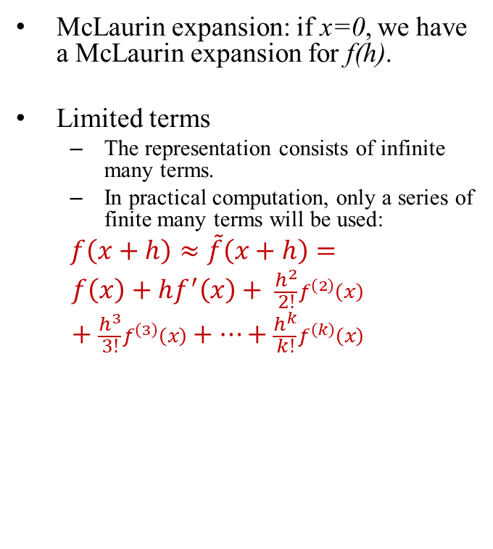
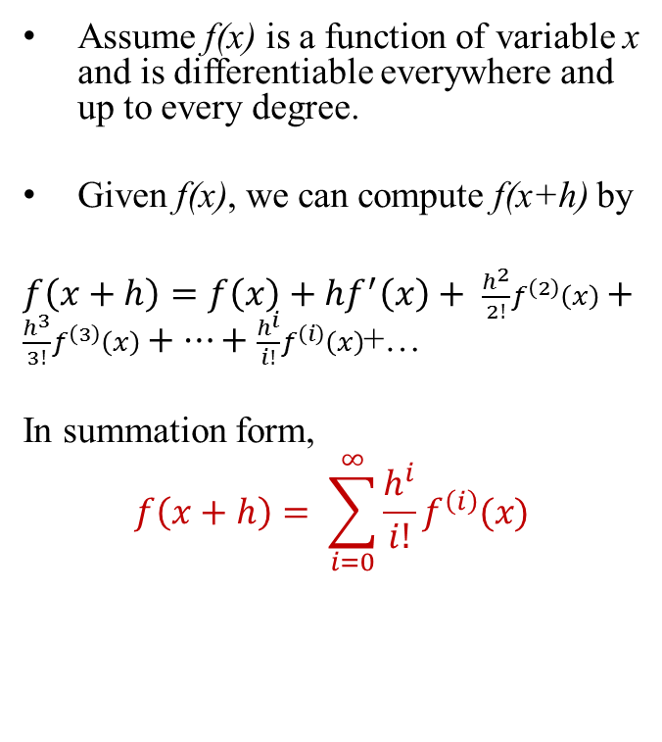
Taylor Series
Assume f(x) is a function of variable x and is differentiable everywhere and up to every degree.
Given f(x), we can compute f(x+h) by
$f\left(x+h\right)=f\left(x\right)+hf^{′}\left(x\right)+ \frac{h^{2}}{2!}f^{\left(2\right)}\left(x\right)+\frac{h^{3}}{3!}f^{\left(3\right)}\left(x\right)+…+\frac{h^{i}}{i!}f^{\left(i\right)}\left(x\right)$+…
In summation form,
$$f\left(x+h\right)= \sum_{i=0}^{∞}{\frac{h^{i}}{i!}f^{\left(i\right)}(x)}$$
McLaurin expansion: if x=0, we have a McLaurin expansion for f(h).
Limited terms
The representation consists of infinite many terms.
In practical computation, only a series of finite many terms will be used:
$f\left(x+h\right)≈\tilde{f}\left(x+h\right)=$
$$f\left(x\right)+hf^{′}\left(x\right)+ \frac{h^{2}}{2!}f^{\left(2\right)}\left(x\right)+\frac{h^{3}}{3!}f^{\left(3\right)}\left(x\right)+…+\frac{h^{k}}{k!}f^{\left(k\right)}\left(x\right)$$
x
x+h

Slide 12
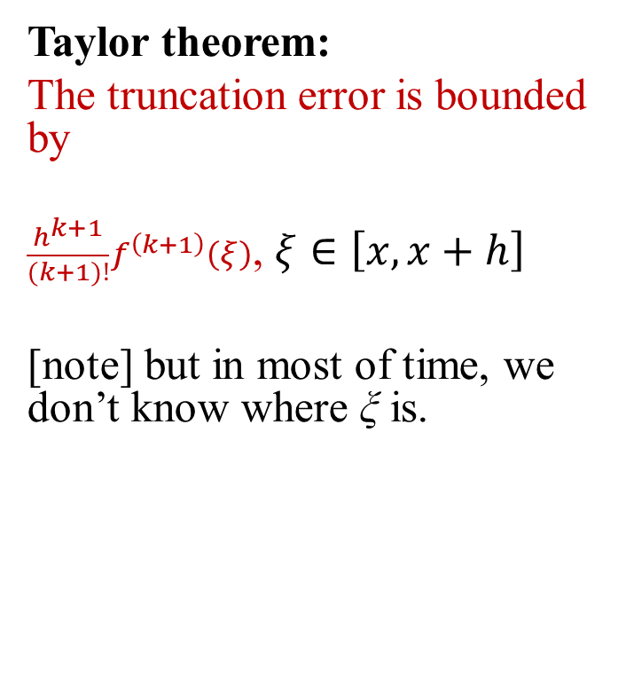
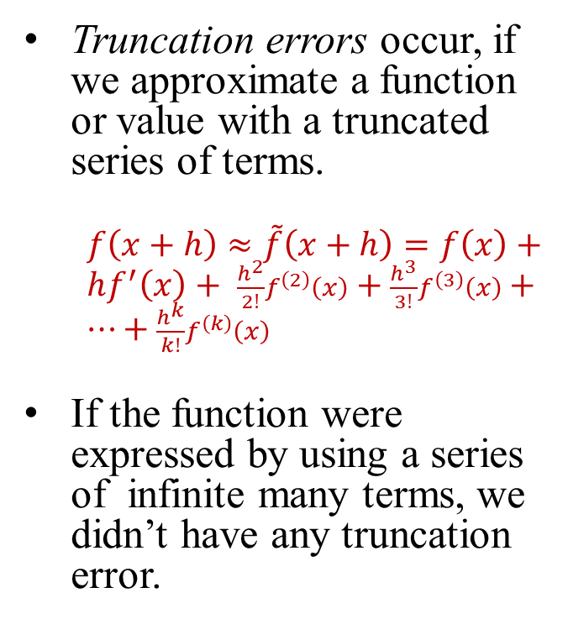
Truncation Errors
Truncation errors occur, if we approximate a function or value with a truncated series of terms.
$f\left(x+h\right)≈\tilde{f}\left(x+h\right)=f\left(x\right)+hf^{′}\left(x\right)+ \frac{h^{2}}{2!}f^{\left(2\right)}\left(x\right)+\frac{h^{3}}{3!}f^{\left(3\right)}\left(x\right)+…+\frac{h^{k}}{k!}f^{\left(k\right)}\left(x\right)$
If the function were expressed by using a series of infinite many terms, we didn’t have any truncation error.
Taylor theorem:
The truncation error is bounded by
$\frac{h^{k+1}}{(k+1)!}f^{\left(k+1\right)}\left(ξ\right)$, $ξ∈\left[x, x+h\right]$
[note] but in most of time, we don’t know where ξ is.
ξ
x
x+h

Slide 13
Truncation and Round-off errors
Round-off error:
Representing a float number using computer words.
Limited word length.
Round the number to the nearest machine number.
Always existing, if we compute values using numerical algorithms.
Truncation error:
Approximating a function (or value) using a finite series of terms.
Polynomial, trigonometric functions
The truncated terms constitute the truncation error.
Might not happen, unless we perform the afore-mentioned approximation.

Slide 14
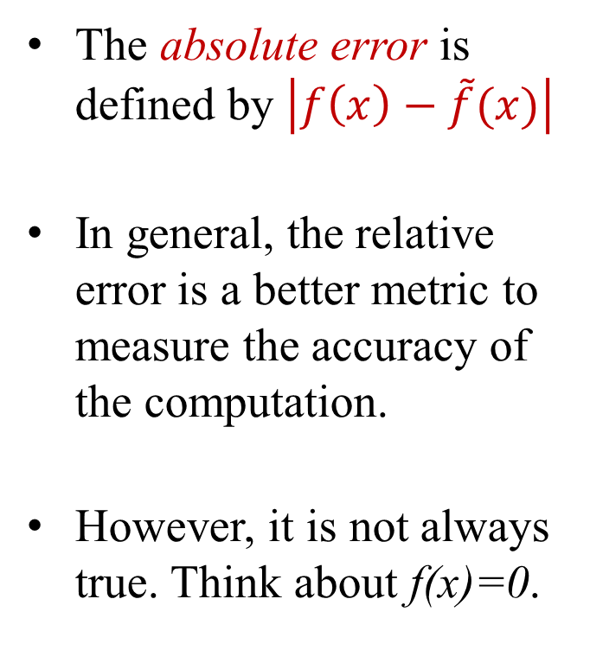
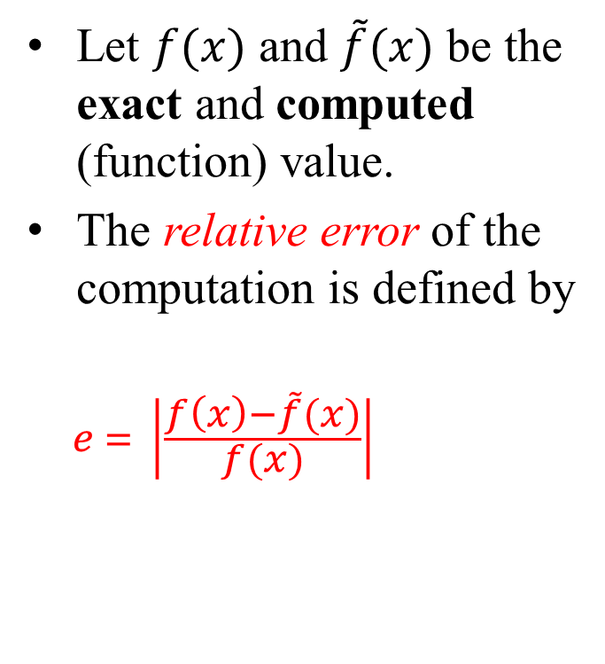
Absolute and Relative Errors
Let $f(x)$ and $\tilde{f}(x)$ be the exact and computed (function) value.
The relative error of the computation is defined by
$$e = \left|\frac{f\left(x\right)−\tilde{f}(x)}{f(x)}\right|$$
The absolute error is defined by $\left|f\left(x\right)−\tilde{f}(x)\right|$
In general, the relative error is a better metric to measure the accuracy of the computation.
However, it is not always true. Think about f(x)=0.

Slide 15
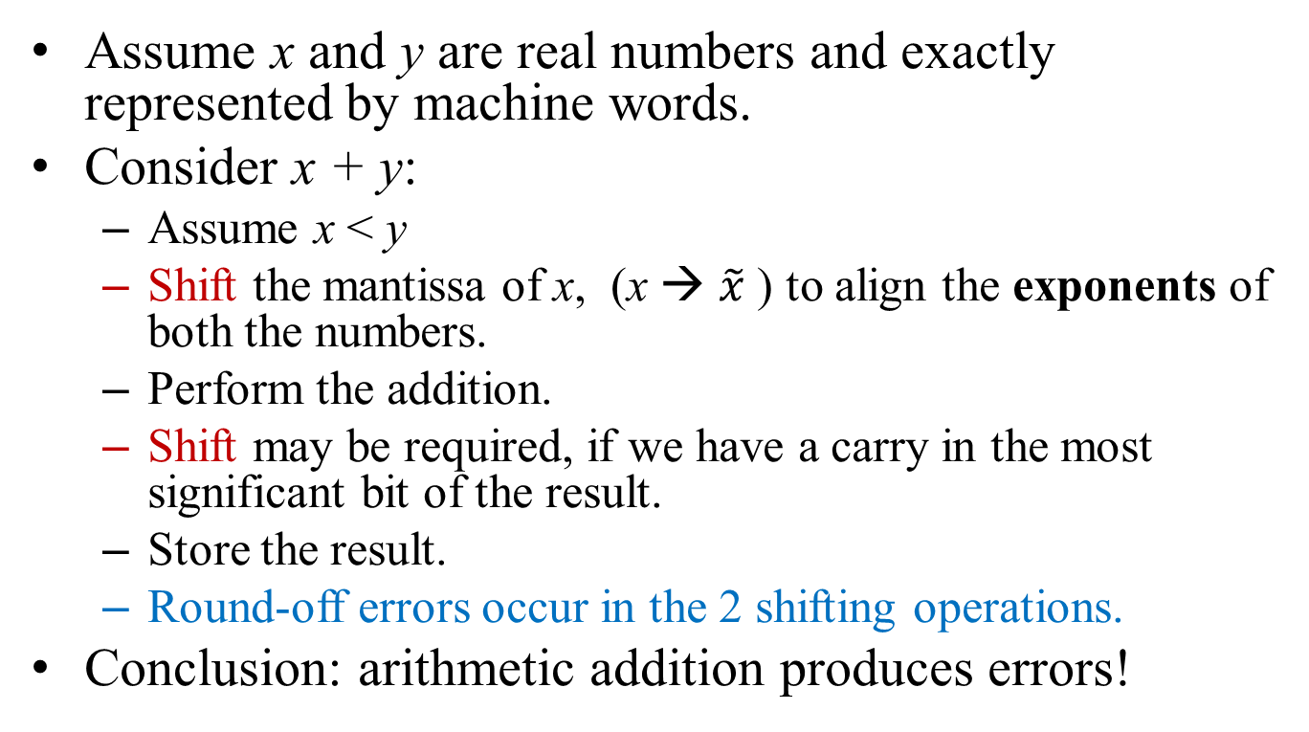
Arithmetic Errors, Addition
Assume x and y are real numbers and exactly represented by machine words.
Consider x + y:
Assume x < y
Shift the mantissa of x, (x → $\tilde{x}$ ) to align the exponents of both the numbers.
Perform the addition.
Shift may be required, if we have a carry in the most significant bit of the result.
Store the result.
Round-off errors occur in the 2 shifting operations.
Conclusion: arithmetic addition produces errors!

Slide 16
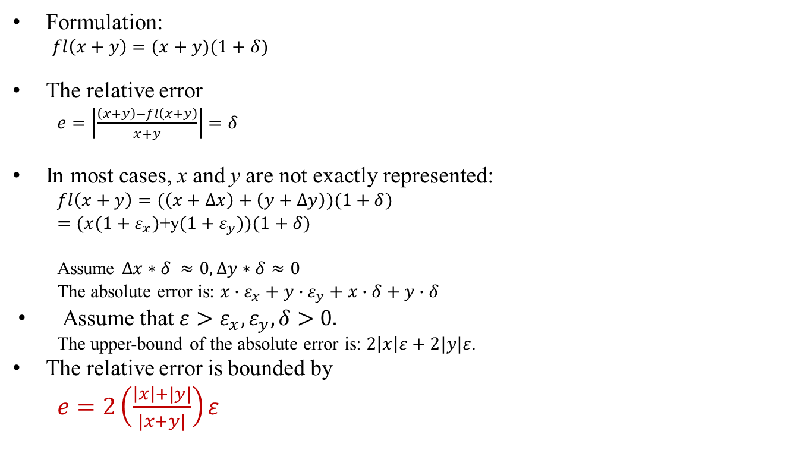
Arithmetic Errors, Addition
Formulation:
$fl\left(x+y\right)=(x+y)(1+δ)$
The relative error
$e=\left|\frac{\left(x+y\right)−fl\left(x+y\right)}{x+y}\right|=δ$
In most cases, x and y are not exactly represented:
$fl\left(x+y\right)=(\left(x+Δx\right)+\left(y+Δy\right))(1+δ)$
$=(x(1+ε_{x})$+y$(1+ε_{y}))(1+δ)$
Assume $Δx∗δ ≈0, ∆y∗δ≈0$
The absolute error is: $x∙ε_{x}+y∙ε_{y}+x∙δ+y∙δ$
Assume that ${ε>ε}_{x},ε_{y},δ>0.$
The upper-bound of the absolute error is: $2\left|x\right|ε+2|y|ε$.
The relative error is bounded by
$e=2\left(\frac{\left|x\right|+|y|}{|x+y|}\right)ε$
Question: When will we encounter large relative errors?

Slide 17
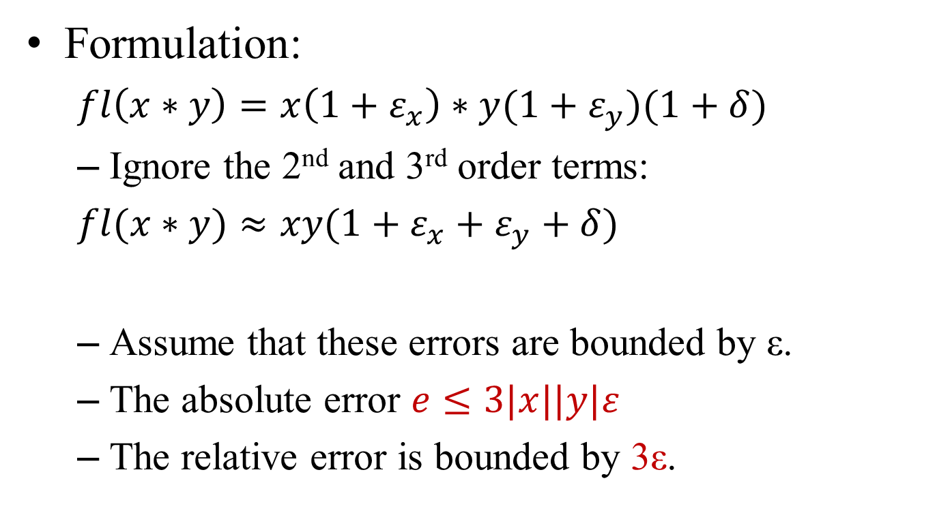
Arithmetic Errors, Multiplication
Formulation:
$fl\left(x∗y\right)=x\left(1+ε_{x}\right)∗y(1+ε_{y})(1+δ)$
Ignore the 2nd and 3rd order terms:
$fl(x∗y)≈xy(1+ε_{x}+ε_{y}+δ)$
Assume that these errors are bounded by ε.
The absolute error $e≤3|x||y|ε$
The relative error is bounded by 3ε.
When will we encounter large absolute errors?

Slide 18
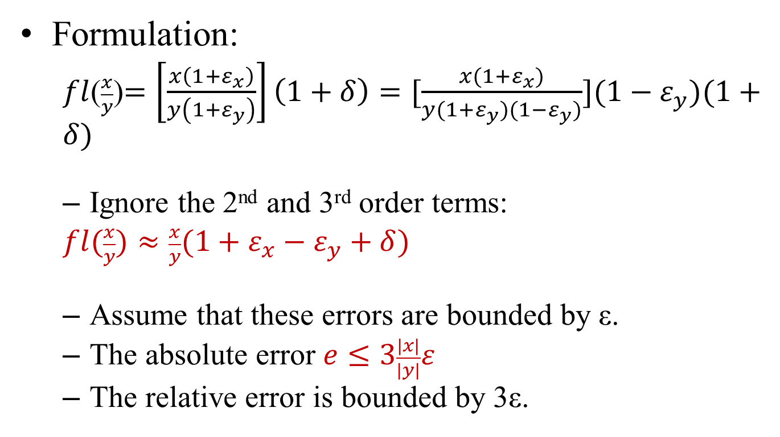
Arithmetic Errors, Division
Formulation:
$fl$($\frac{x}{y}$)$=\left[\frac{x\left(1+ε_{x}\right)}{y\left(1+ε_{y}\right)}\right]\left(1+δ\right)=[\frac{x(1+ε_{x})}{y(1+ε_{y})(1−ε_{y})}](1−ε_{y})(1+δ)$
Ignore the 2nd and 3rd order terms:
$fl(\frac{x}{y})≈\frac{x}{y}(1+ε_{x}−ε_{y}+δ)$
Assume that these errors are bounded by ε.
The absolute error $e≤3\frac{|x|}{|y|}ε$
The relative error is bounded by 3ε.
Question: Where will we encounter large absolute errors?

Slide 19
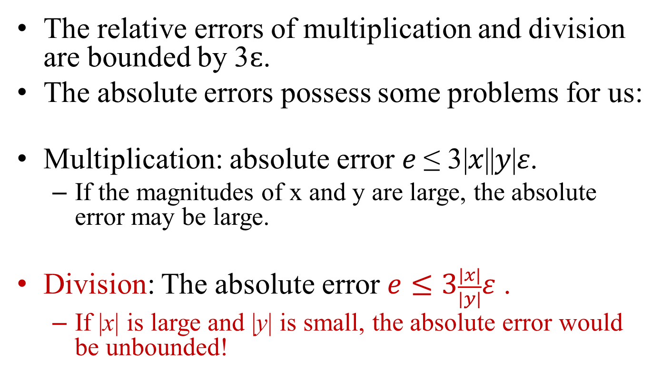
Absolute Errors in Multiplication and Division
The relative errors of multiplication and division are bounded by 3$ԑ$.
The absolute errors possess some problems for us:
Multiplication: absolute error 𝑒 ≤ 3|𝑥||𝑦|𝜀.
If the magnitudes of x and y are large, the absolute error may be large.
Division: The absolute error $e≤3\frac{|x|}{|y|}ε$ .
If |x| is large and |y| is small, the absolute error would be unbounded!

Slide 20
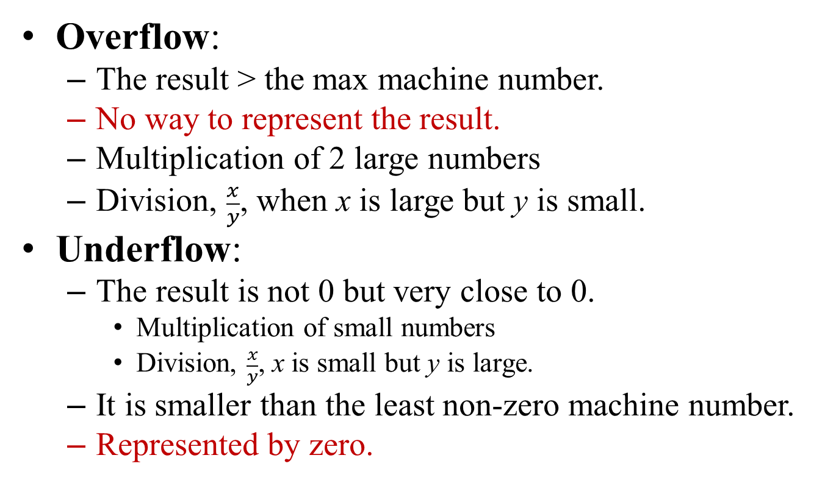
Overflow and Underflow
Overflow:
The result > the max machine number.
No way to represent the result.
Multiplication of 2 large numbers
Division, $\frac{x}{y}$, when x is large but y is small.
Underflow:
The result is not 0 but very close to 0.
Multiplication of small numbers
Division, $\frac{x}{y}$, x is small but y is large.
It is smaller than the least non-zero machine number.
Represented by zero.

Slide 21
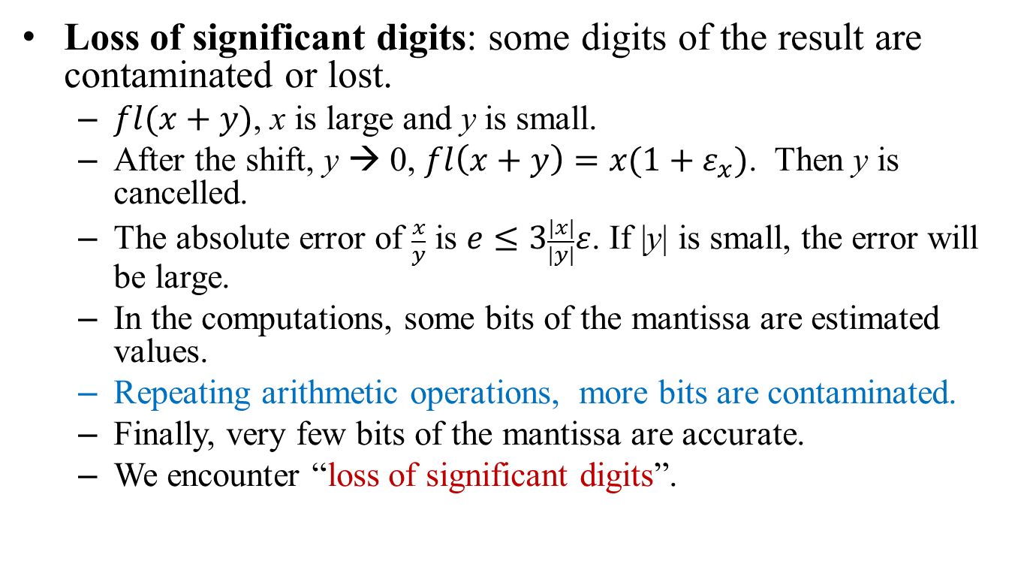
Loss-of-Significant-Digits
Loss of significant digits: some digits of the result are contaminated or lost.
$fl(x+y)$, x is large and y is small.
After the shift, y → 0, $fl\left(x+y\right)=x(1+ε_{x})$. Then y is cancelled.
The absolute error of $\frac{x}{y}$ is $e≤3\frac{|x|}{|y|}ε$. If |y| is small, the error will be large.
In the computations, some bits of the mantissa are estimated values.
Repeating arithmetic operations, more bits are contaminated.
Finally, very few bits of the mantissa are accurate.
We encounter “loss of significant digits”.

Slide 22
Errors from Subroutines
Sometimes, we use subroutines from numerical libraries to construct our computation procedures.
For examples, sin(x), cos(x), tan(x), arctan(x), …
These subroutines do not produce exact function values.
Calling them produces extra numerical errors.

Slide 23
Error Propagation
Floating point representation contains round-off errors.
Approximating functions by using polynomial results in truncation errors.
Arithmetic operations and sub-routines produce numerical errors.
Errors occur everywhere.
In iterative methods, errors are enlarged in each iteration of the computing.
Exponentially increasing errors are unacceptable.
Errors, bounded by O(nε), O(n²ε), or O(n³ε), are acceptable.
Where n is the size of the data, an n by n matrix for example.
Numerical stable

Slide 24

Arithmetic Trees & Error Propagation Analysis
We an build an arithmetic tree to represent an arithmetic expression.
For code generation in compiling.
For error analysis in scientific computing.
Arithmetic tree:
A binary tree.
The internal nodes = operators or subroutines.
The leaf nodes = operands (numbers or variables)
The tree structure should match the priorities of the operators.
f(x, y) =
$2∗\sin\left(x\right)−5∗x{∗y}^{2}+3$
-
*
+
2
sin
*
3
x
5
*
x
^
y
2

Slide 25
Conclusion
Real numbers are recorded in computers by using normalized floating point representations.
Denormalized numbers, 0, and ∞ are special cases.
Round-off errors are caused by rounding-off tailing bits of float point numbers.
Truncation errors occur when a function is approximated by a polynomial of limited terms.
Relative and absolute errors are utilized to convey precision of computation.
Errors are enlarged as computation carrying on.

