Slide 1
Bisection Method
Introduction to root-finding
半區間求根法

Slide 2
Outline
Root-finding problems
The bisection method
Error analysis and converge rate
Examples

Slide 3
Root-Finding Problem
Given a function f(x), find an x making f(x) = 0.
The value of x = the root.
Denoted by x* in this lecture.
Applications
Inverse problems
Eigenvalues
Max and min values of F(x), where F’(x) = f(x).
Intersection computation
…
Graph of f(x) and its root x*.
f(x)
x
x*

Slide 4
Root-Finding Methods
Bisection Method
The slowest
The most accurate, in terms of max error.
Newton’s method
The fastest
May diverge
Need to know the derivative f’(x)
Secant method
Similar to the Newton’s method
But, derivative f’(x) is not required.
Faster than the bisection, but slower than the Newton’s method.

Slide 5
The Bisection Method
Find x=x* such that f(x*) = 0.
The algorithm::
0. Find an interval [a, b], where a < b and sign( f(a) ) ≠ sign( f(b) );
Compute c = (a+b)/2;
Compute f(c);
If sign( f(a) ) = sign( f(c) ), a = c;
Else b = c;
If |b-a| ≤ ε, output c;
Else go to 1;
Graph of the bi-section method. One iteration computation.
c
a
b

Slide 6
The Pseudo-Codes
double bisect(double a, double b, double (*f)(double))
{
double c, fa, fb, fc;
fa = f(a); fb = f(b);
while(fabs(b-a)>ε){
c = (a+b)/2.0;
fc = f(c);
if(fc==0.0) return (c); //be careful here! Why?
if(fa<0.0&&fc<0.0||fa>0.0&&fc>0.0) a = c;
else b = c;
}
return (c);
}

Slide 7

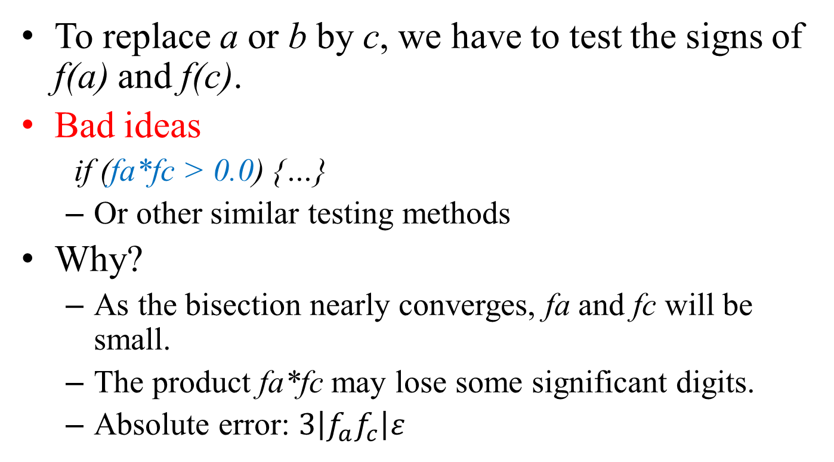
Reminder
To replace a or b by c, we have to test the signs of f(a) and f(c).
Bad ideas
if (fa*fc > 0.0) {…}
Or other similar testing methods
Why?
As the bisection nearly converges, fa and fc will be small.
The product fa*fc may lose some significant digits.
Absolute error: $3\left|f_{a}f_{c}\right|ε$
$$f_{a}f_{c}≈0.0$$

Slide 8
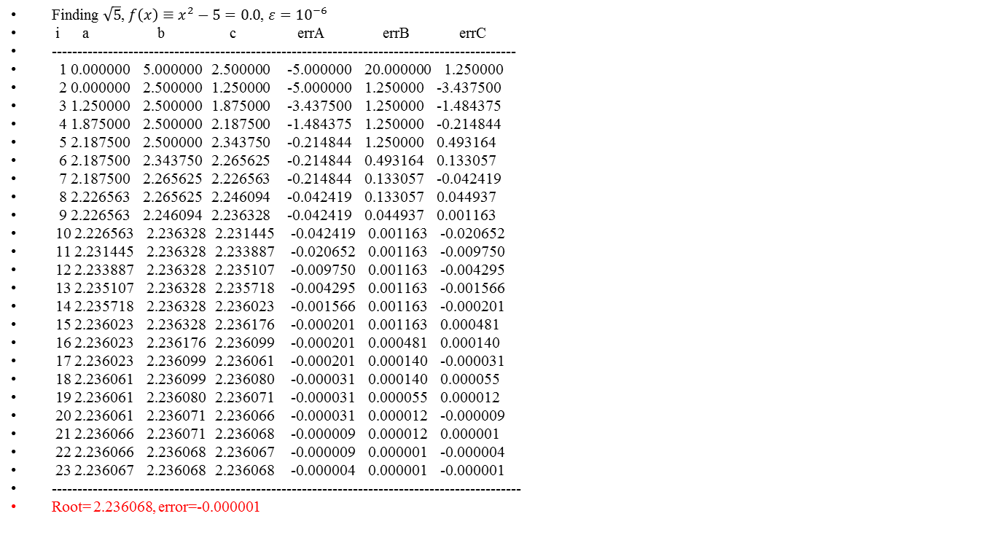
Example
Finding $\sqrt{5}$, $f\left(x\right)≡x^{2}−5=0.0$, $ε={10}^{−6}$
i a b c errA errB errC
-------------------------------------------------------------------------------------------
1 0.000000 5.000000 2.500000 -5.000000 20.000000 1.250000
2 0.000000 2.500000 1.250000 -5.000000 1.250000 -3.437500
3 1.250000 2.500000 1.875000 -3.437500 1.250000 -1.484375
4 1.875000 2.500000 2.187500 -1.484375 1.250000 -0.214844
5 2.187500 2.500000 2.343750 -0.214844 1.250000 0.493164
6 2.187500 2.343750 2.265625 -0.214844 0.493164 0.133057
7 2.187500 2.265625 2.226563 -0.214844 0.133057 -0.042419
8 2.226563 2.265625 2.246094 -0.042419 0.133057 0.044937
9 2.226563 2.246094 2.236328 -0.042419 0.044937 0.001163
10 2.226563 2.236328 2.231445 -0.042419 0.001163 -0.020652
11 2.231445 2.236328 2.233887 -0.020652 0.001163 -0.009750
12 2.233887 2.236328 2.235107 -0.009750 0.001163 -0.004295
13 2.235107 2.236328 2.235718 -0.004295 0.001163 -0.001566
14 2.235718 2.236328 2.236023 -0.001566 0.001163 -0.000201
15 2.236023 2.236328 2.236176 -0.000201 0.001163 0.000481
16 2.236023 2.236176 2.236099 -0.000201 0.000481 0.000140
17 2.236023 2.236099 2.236061 -0.000201 0.000140 -0.000031
18 2.236061 2.236099 2.236080 -0.000031 0.000140 0.000055
19 2.236061 2.236080 2.236071 -0.000031 0.000055 0.000012
20 2.236061 2.236071 2.236066 -0.000031 0.000012 -0.000009
21 2.236066 2.236071 2.236068 -0.000009 0.000012 0.000001
22 2.236066 2.236068 2.236067 -0.000009 0.000001 -0.000004
23 2.236067 2.236068 2.236068 -0.000004 0.000001 -0.000001
--------------------------------------------------------------------------------------------
Root= 2.236068, error=-0.000001

Slide 9
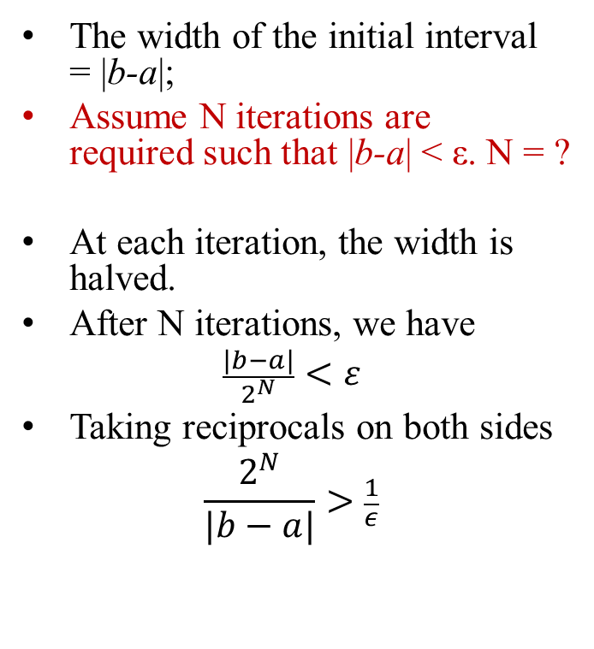
Converge Rate (1)
The width of the initial interval = |b-a|;
Assume N iterations are required such that |b-a| < ε. N = ?
At each iteration, the width is halved.
After N iterations, we have
$$\frac{|b−a|}{2^{N}}<ε$$
Taking reciprocals on both sides
$$\frac{2^{N}}{|b−a|}>\frac{1}{ε}$$
double bisect(double a, double b, double (*f)(double))
{
double c, fa, fb, fc;
fa = f(a); fb = f(b);
while(fabs(b-a)>ε){
c = (a+b)/2.0;
fc = f(c);
if(fc==0.0) return (c);
if(fa<0.0&&fc<0.0||fa>0.0&&fc>0.0) a = c;
else b = c;
}
return (c);
}

Slide 10
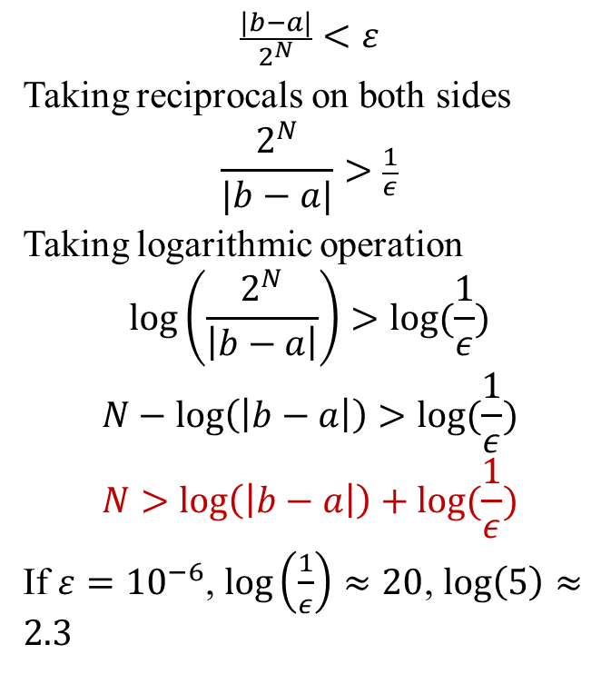
Converge Rate (2)
$$\frac{|b−a|}{2^{N}}<ε$$
Taking reciprocals on both sides
$$\frac{2^{N}}{|b−a|}>\frac{1}{ε}$$
Taking logarithmic operation
$$\log\left(\frac{2^{N}}{\left|b−a\right|}\right)>log⁡(\frac{1}{ε})$$
$$N−\log\left(\left|b−a\right|\right)>log⁡(\frac{1}{ε})$$
$$N>\log\left(\left|b−a\right|\right)+log⁡(\frac{1}{ε})$$
If $ε={10}^{−6}$, $\log\left(\frac{1}{ε}\right)≈20$, $\log\left(5\right)≈2.3$
The pseudo codes
double bisect(double a, double b, double (*f)(double))
{
double c, fa, fb, fc;
fa = f(a); fb = f(b);
while(fabs(b-a)>ε){
c = (a+b)/2.0;
fc = f(c);
if(fc==0.0) return (c);
if(fa<0.0&&fc<0.0||fa>0.0&&fc>0.0) a = c;
else b = c;
}
return (c);
}

Slide 11

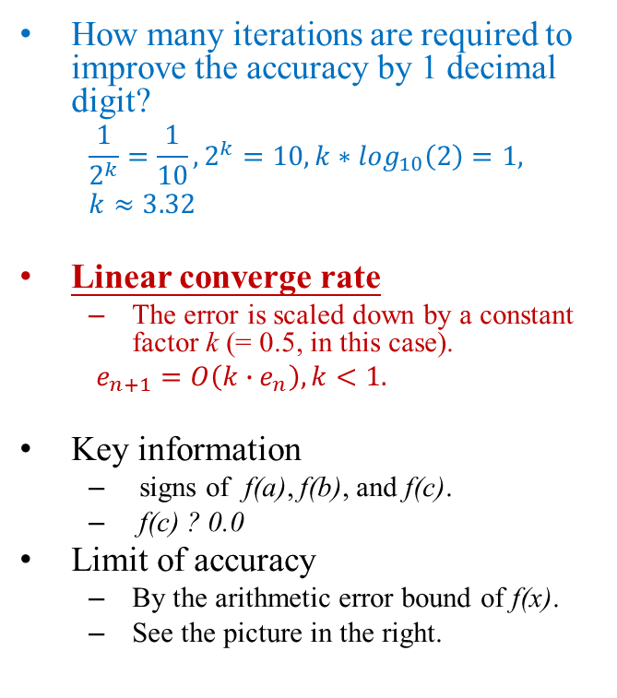
More
How many iterations are required to improve the accuracy by 1 decimal digit?
$$\frac{1}{2^{k}}=\frac{1}{10}, 2^{k}=10, {k∗log}_{10}\left(2\right)=1,$$
$k≈3.32$
Linear converge rate
The error is scaled down by a constant factor k (= 0.5, in this case).
$e_{n+1}=O\left(k∙e_{n}\right), k<1.$
Key information
signs of f(a), f(b), and f(c).
f(c) ? 0.0
Limit of accuracy
By the arithmetic error bound of f(x).
See the picture in the right.
The bound of the arithmetic error of f(x) and the key information determining the termination of the bisection method.
$$δ_{f}$$
a
c
b
Inside this box, we can no longer tell the true value of f(x) because of numerical errors.
The decision is thus invalid.

Slide 12
Discussion
Pros
If the initial [a, b] can be found, the bisection method always converges.
It is the most accurate root-finding method. It produces the least maximum error.
Cons
[a, b] may not exist. Think about double-roots (重根) cases.
Slow converge rate

Slide 13
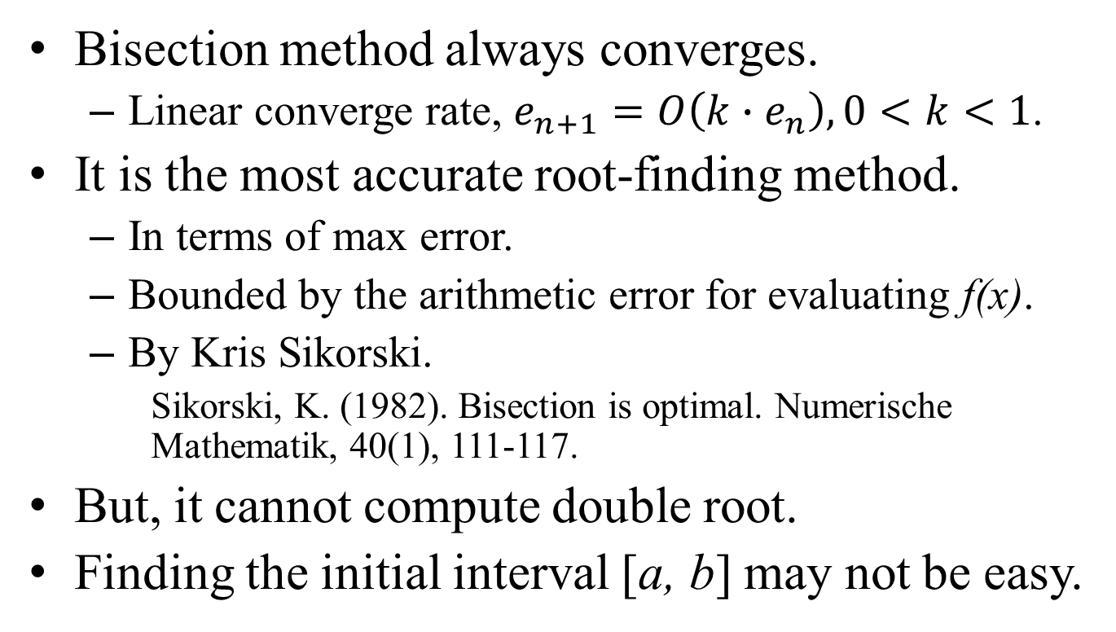
Conclusion
Bisection method always converges.
Linear converge rate, $e_{n+1}=O\left(k∙e_{n}\right),0<k<1$.
It is the most accurate root-finding method.
In terms of max error.
Bounded by the arithmetic error for evaluating f(x).
By Kris Sikorski.
Sikorski, K. (1982). Bisection is optimal. Numerische Mathematik, 40(1), 111-117.
But, it cannot compute double root.
Finding the initial interval [a, b] may not be easy.

