Slide 1
Newton’s Method for Root-Finding
Single variable root finding

Slide 2
Outline
Deduction of the method
The algorithm
Converge rate and error analysis
Problems with Newton’s method
Modification for multiple roots
Examples

Slide 3
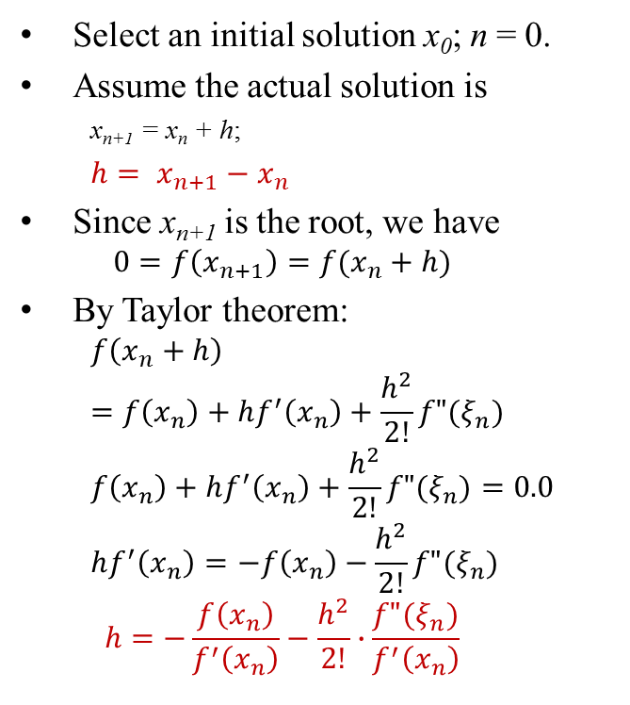
Deduction by Taylor Expansion
Select an initial solution x₀; n = 0.
Assume the actual solution is
x_{n+1} = x_{n} + h;
$h= x_{n+1}−x_{n}$
Since x_{n+1} is the root, we have
$$0=f\left(x_{n+1}\right)=f(x_{n}+h)$$
By Taylor theorem:
$$f\left(x_{n}+h\right)=f\left(x_{n}\right)+hf^{′}\left(x_{n}\right)+\frac{h^{2}}{2!}f"(ξ_{n})$$
$$f\left(x_{n}\right)+hf^{′}\left(x_{n}\right)+\frac{h^{2}}{2!}f"(ξ_{n})=0.0$$
$$hf^{′}\left(x_{n}\right)=−f\left(x_{n}\right)−\frac{h^{2}}{2!}f"(ξ_{n})$$
$$h=−\frac{f\left(x_{n}\right)}{f^{′}\left(x_{n}\right)}−\frac{h^{2}}{2!}∙\frac{f"(ξ_{n})}{f^{′}\left(x_{n}\right)}$$
Current position and the expected root
x’_{n+1}
x_{n+1}
h
x_{n}

Slide 4

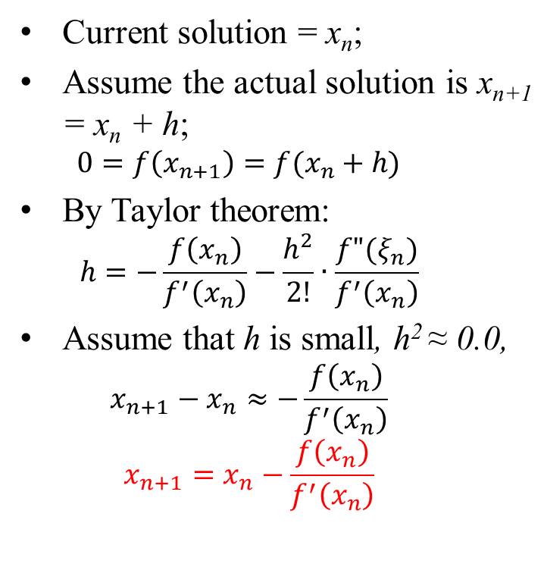
Deduction by Taylor Expansion
Current solution = x_{n};
Assume the actual solution is x_{n+1} = x_{n} + h;
$$0=f\left(x_{n+1}\right)=f(x_{n}+h)$$
By Taylor theorem:
$$h=−\frac{f\left(x_{n}\right)}{f^{′}\left(x_{n}\right)}−\frac{h^{2}}{2!}∙\frac{f"(ξ_{n})}{f^{′}\left(x_{n}\right)}$$
Assume that h is small, h² ≈ 0.0,
$$x_{n+1}−x_{n}≈−\frac{f\left(x_{n}\right)}{f^{′}\left(x_{n}\right)}$$
$$x_{n+1}=x_{n}−\frac{f\left(x_{n}\right)}{f^{′}\left(x_{n}\right)}$$
Recurrence equation:
$$x_{n+1}=x_{n}−\frac{f\left(x_{n}\right)}{f^{′}\left(x_{n}\right)}$$
x’_{n+1}
x_{n+1}
h
x_{n}

Slide 5
The Pseudo-Codes
Select x₀; n = 0;
Repeat {
compute f(x_{n});
compute f’(x_{n});
x_{n+1} = x_{n} – f(x_{n})/f’(x_{n});
e_{n} = fabs(x_{n+1} – x_{n});
n++;
} until (e_{n} ≤ ε);
Ouput x_{n+1};

Slide 6
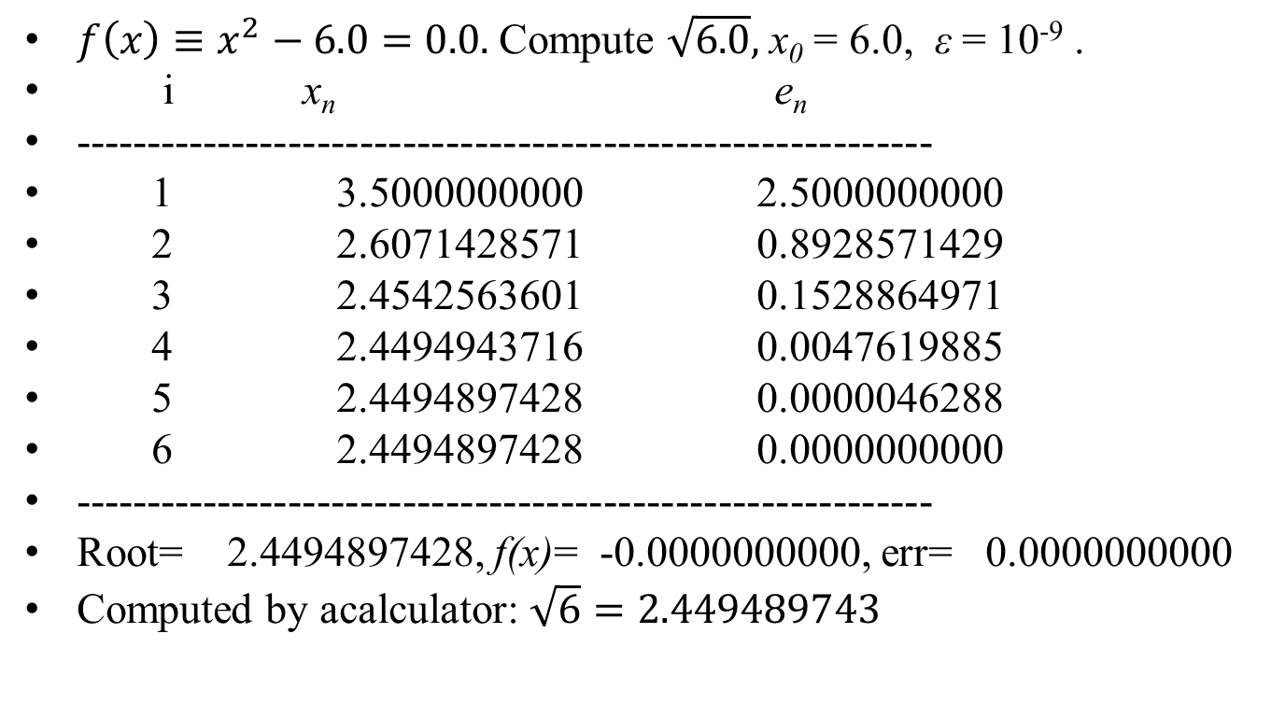
Example: square root finding
$f\left(x\right)≡x^{2}−6.0=0.0.$ Compute $\sqrt{6.0},$ x₀ = 6.0, ε = 10⁻⁹ .
i x_{n} e_{n}
------------------------------------------------------------
1 3.5000000000 2.5000000000
2 2.6071428571 0.8928571429
3 2.4542563601 0.1528864971
4 2.4494943716 0.0047619885
5 2.4494897428 0.0000046288
6 2.4494897428 0.0000000000
------------------------------------------------------------
Root= 2.4494897428, f(x)= -0.0000000000, err= 0.0000000000
Computed by acalculator: $\sqrt{6}=2.449489743$

Slide 7
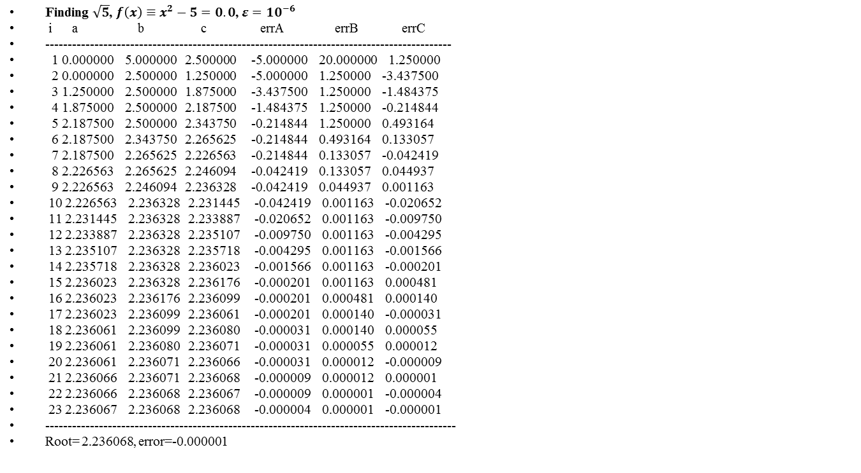
Comparison: bisection method
Finding $\sqrt{5}$, $f\left(x\right)≡x^{2}−5=0.0$, $ε={10}^{−6}$
i a b c errA errB errC
-------------------------------------------------------------------------------------------
1 0.000000 5.000000 2.500000 -5.000000 20.000000 1.250000
2 0.000000 2.500000 1.250000 -5.000000 1.250000 -3.437500
3 1.250000 2.500000 1.875000 -3.437500 1.250000 -1.484375
4 1.875000 2.500000 2.187500 -1.484375 1.250000 -0.214844
5 2.187500 2.500000 2.343750 -0.214844 1.250000 0.493164
6 2.187500 2.343750 2.265625 -0.214844 0.493164 0.133057
7 2.187500 2.265625 2.226563 -0.214844 0.133057 -0.042419
8 2.226563 2.265625 2.246094 -0.042419 0.133057 0.044937
9 2.226563 2.246094 2.236328 -0.042419 0.044937 0.001163
10 2.226563 2.236328 2.231445 -0.042419 0.001163 -0.020652
11 2.231445 2.236328 2.233887 -0.020652 0.001163 -0.009750
12 2.233887 2.236328 2.235107 -0.009750 0.001163 -0.004295
13 2.235107 2.236328 2.235718 -0.004295 0.001163 -0.001566
14 2.235718 2.236328 2.236023 -0.001566 0.001163 -0.000201
15 2.236023 2.236328 2.236176 -0.000201 0.001163 0.000481
16 2.236023 2.236176 2.236099 -0.000201 0.000481 0.000140
17 2.236023 2.236099 2.236061 -0.000201 0.000140 -0.000031
18 2.236061 2.236099 2.236080 -0.000031 0.000140 0.000055
19 2.236061 2.236080 2.236071 -0.000031 0.000055 0.000012
20 2.236061 2.236071 2.236066 -0.000031 0.000012 -0.000009
21 2.236066 2.236071 2.236068 -0.000009 0.000012 0.000001
22 2.236066 2.236068 2.236067 -0.000009 0.000001 -0.000004
23 2.236067 2.236068 2.236068 -0.000004 0.000001 -0.000001
--------------------------------------------------------------------------------------------
Root= 2.236068, error=-0.000001

Slide 8
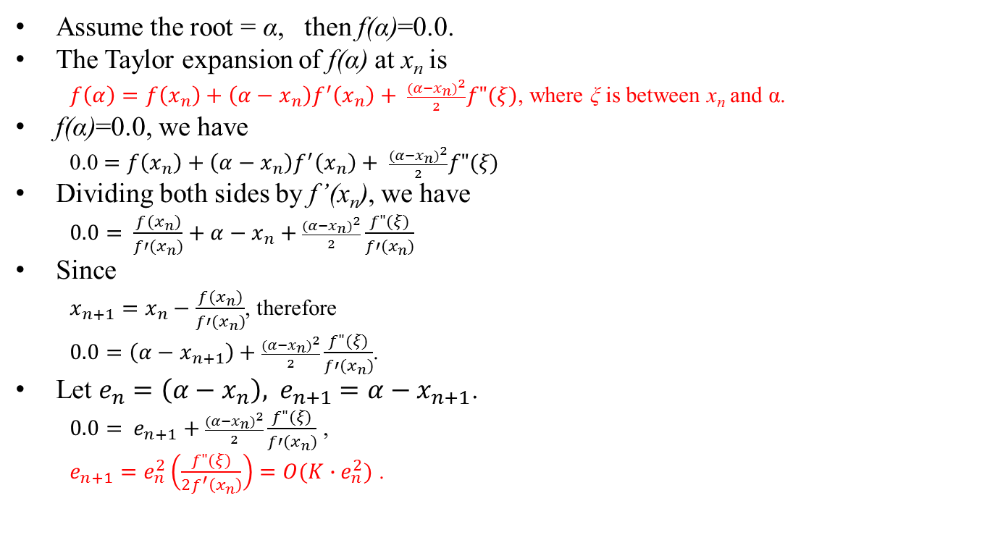
Converge Rate
Assume the root = α, then f(α)=0.0.
The Taylor expansion of f(α) at x_{n} is
$f\left(α\right)=f\left(x_{n}\right)+\left(α−x_{n}\right)f^{′}\left(x_{n}\right)+ \frac{{(α−x_{n})}^{2}}{2}f"(ξ)$, where ξ is between x_{n} and α.
f(α)=0.0, we have
0.0 $=f\left(x_{n}\right)+\left(α−x_{n}\right)f^{′}\left(x_{n}\right)+ \frac{{(α−x_{n})}^{2}}{2}f"(ξ)$
Dividing both sides by f’(x_{n}), we have
$0.0= \frac{f(x_{n})}{f′(x_{n})}+α−x_{n}+\frac{{(α−x_{n})}^{2}}{2}\frac{f"(ξ)}{f′(x_{n})}$
Since
$x_{n+1}=x_{n}−\frac{f(x_{n})}{f′(x_{n})}$, therefore
$0.0=\left(α−x_{n+1}\right)+\frac{{(α−x_{n})}^{2}}{2}\frac{f"(ξ)}{f′(x_{n})}$.
Let $e_{n}=\left(α−x_{n}\right), { e}_{n+1}=α−x_{n+1}$.
$0.0= e_{n+1}+\frac{{(α−x_{n})}^{2}}{2}\frac{f"(ξ)}{f′(x_{n})}$ ,
$e_{n+1}=e_{n}^{2}\left(\frac{f"(ξ)}{2f^{′}\left(x_{n}\right)}\right)=O(K∙e_{n}^{2})$ .

Slide 9
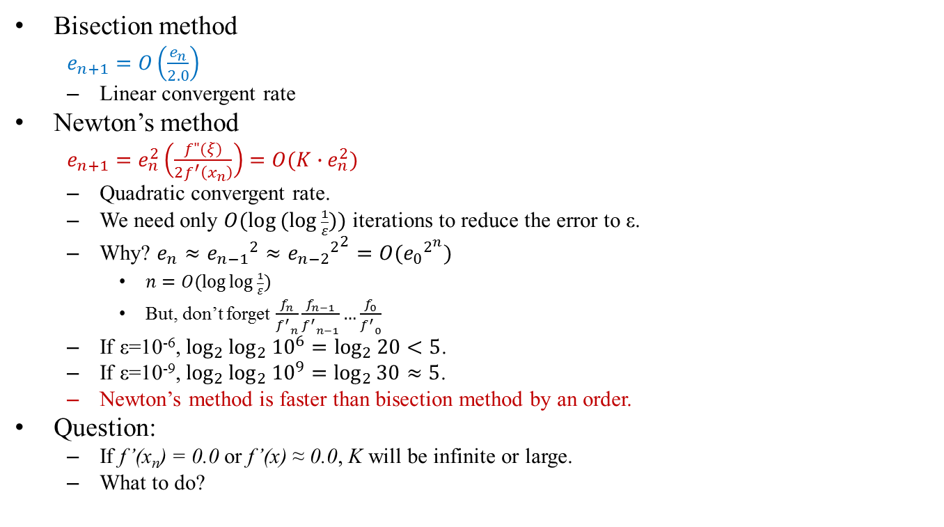
Converge Rates
Bisection method
$e_{n+1}=O\left(\frac{e_{n}}{2.0}\right)$
Linear convergent rate
Newton’s method
$e_{n+1}=e_{n}^{2}\left(\frac{f"(ξ)}{2f^{′}\left(x_{n}\right)}\right)=O(K∙e_{n}^{2})$
Quadratic convergent rate.
We need only $O(\log{(log{\frac{1}{ε}))}}$ iterations to reduce the error to ε.
Why? $e_{n}≈{e_{n−1}}^{2}≈{{e_{n−2}}^{2}}^{2}=O({e_{0}}^{2^{n}})$
$n=O(\log{\log{\frac{1}{ε}})}$
But, don’t forget $\frac{f_{n}}{{f^{′}}_{n}}\frac{f_{n−1}}{{f^{′}}_{n−1}}…\frac{f_{0}}{{f^{′}}_{0}}$
If ε=10⁻⁶, $\log_{2}{\log_{2}{{10}^{6}}=\log_{2}{20}}<5$.
If ε=10⁻⁹, $\log_{2}{\log_{2}{{10}^{9}}=\log_{2}{30}}≈5$.
Newton’s method is faster than bisection method by an order.
Question:
If f’(x_{n}) = 0.0 or f’(x) ≈ 0.0, K will be infinite or large.
What to do?

Slide 10

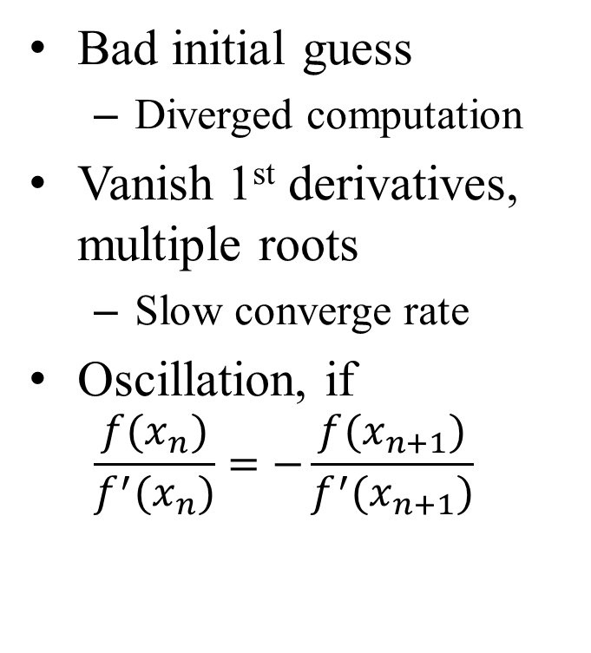
Problems with Newton’s Method
Bad initial guess
Diverged computation
Vanish 1st derivatives, multiple roots
Slow converge rate
Oscillation, if
$$\frac{f(x_{n})}{f^{′}(x_{n})}=−\frac{f(x_{n+1})}{f^{′}(x_{n+1})}$$
Multiple roots
$$f\left(x\right)=f^{′}\left(x\right)=0$$

Slide 11
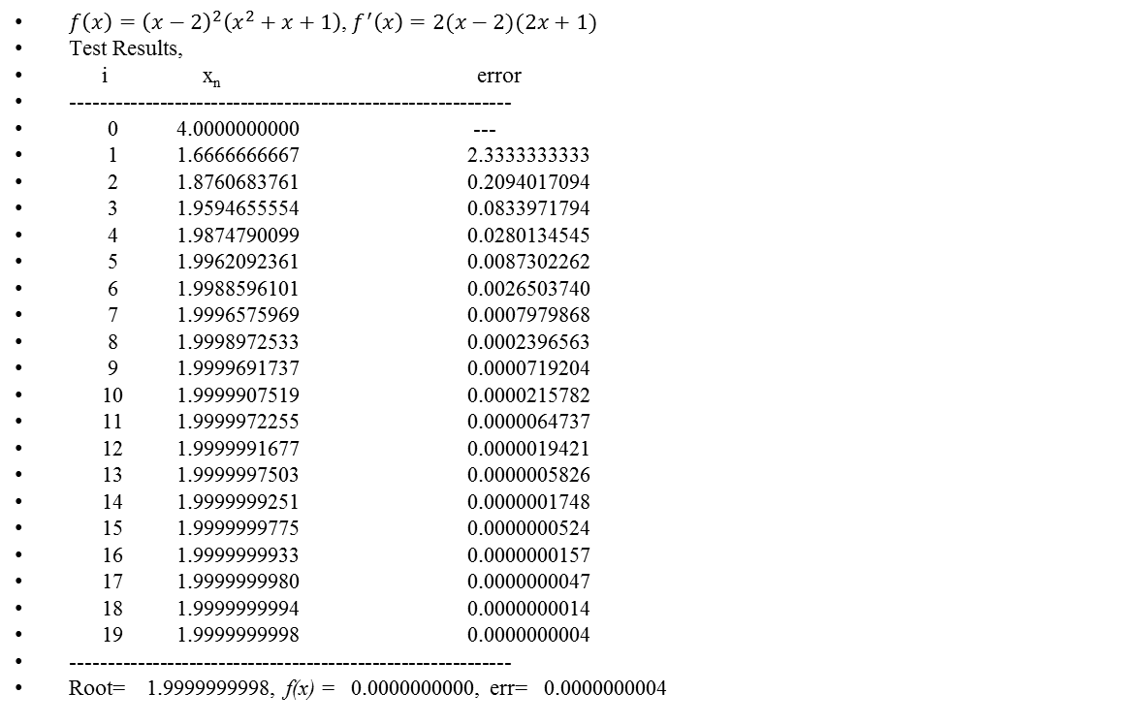
Multiple Roots
$f\left(x\right)={\left(x−2\right)}^{2}\left(x^{2}+x+1\right)$, $f^{′}\left(x\right)=2(x−2)(2x+1)$
Test Results,
i x_{n} error
------------------------------------------------------------
0 4.0000000000 ---
1 1.6666666667 2.3333333333
2 1.8760683761 0.2094017094
3 1.9594655554 0.0833971794
4 1.9874790099 0.0280134545
5 1.9962092361 0.0087302262
6 1.9988596101 0.0026503740
7 1.9996575969 0.0007979868
8 1.9998972533 0.0002396563
9 1.9999691737 0.0000719204
10 1.9999907519 0.0000215782
11 1.9999972255 0.0000064737
12 1.9999991677 0.0000019421
13 1.9999997503 0.0000005826
14 1.9999999251 0.0000001748
15 1.9999999775 0.0000000524
16 1.9999999933 0.0000000157
17 1.9999999980 0.0000000047
18 1.9999999994 0.0000000014
19 1.9999999998 0.0000000004
------------------------------------------------------------
Root= 1.9999999998, f(x) = 0.0000000000, err= 0.0000000004

Slide 12
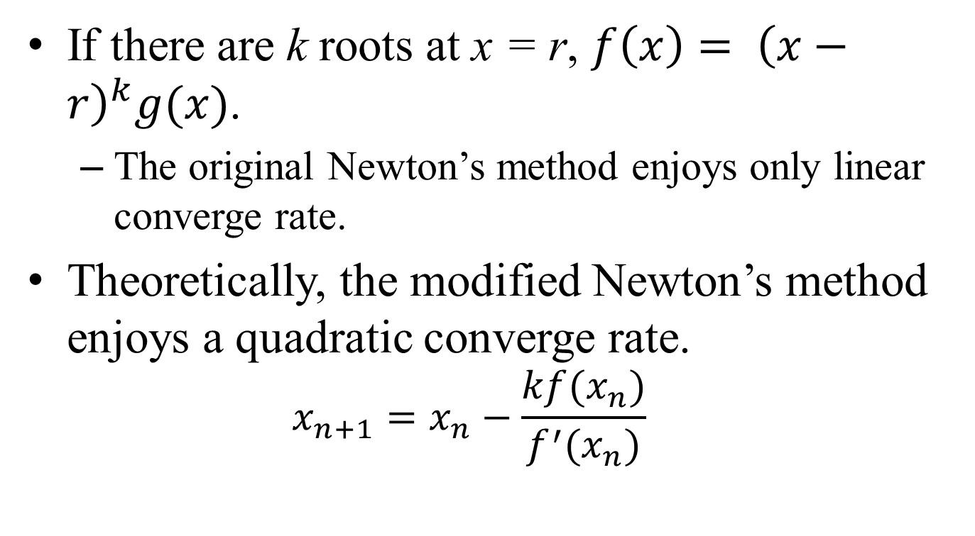
Modified Newton’s Method
If there are k roots at x = r, $f\left(x\right)= {\left(x−r\right)}^{k}g(x)$.
The original Newton’s method enjoys only linear converge rate.
Theoretically, the modified Newton’s method enjoys a quadratic converge rate.
$$x_{n+1}=x_{n}−\frac{kf(x_{n})}{f^{′}(x_{n})}$$

Slide 13
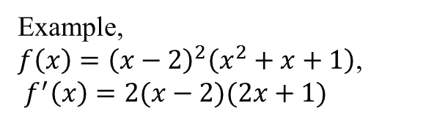
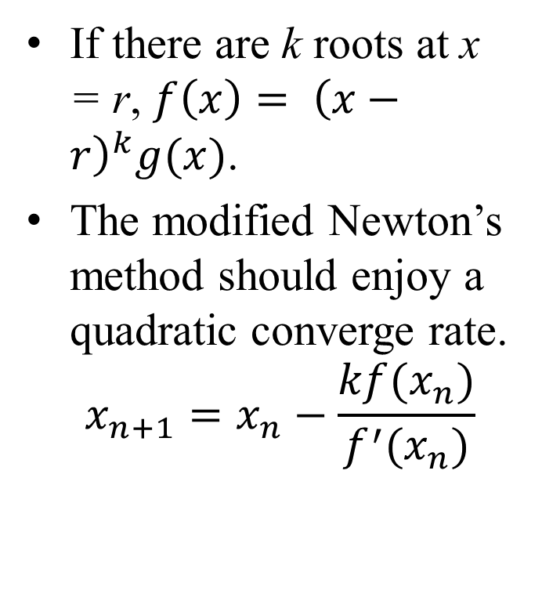
Modified Newton’s Method
If there are k roots at x = r, $f\left(x\right)= {\left(x−r\right)}^{k}g(x)$.
The modified Newton’s method should enjoy a quadratic converge rate.
$$x_{n+1}=x_{n}−\frac{kf(x_{n})}{f^{′}(x_{n})}$$
But, test results don’t support this theorem.
i xn error
------------------------------------------------------------
0 3.5000000000 ---
1 0.3593750000 3.1406250000
2 1.7802401456 1.4208651456
3 2.0669336731 0.2866935275
4 1.9712482702 0.0956854028
5 2.0111375377 0.0398892675
6 1.9954903722 0.0156471655
7 2.0017949052 0.0063045329
8 1.9992806203 0.0025142849
9 2.0002875242 0.0010069039
10 1.9998849539 0.0004025703
11 2.0000460126 0.0001610587
12 1.9999815940 0.0000644186
13 2.0000073622 0.0000257682
14 1.9999970551 0.0000103072
15 2.0000011780 0.0000041229
16 1.9999995288 0.0000016492
17 2.0000001885 0.0000006597
18 1.9999999246 0.0000002639
19 2.0000000302 0.0000001055
20 1.9999999879 0.0000000422
21 2.0000000048 0.0000000169
22 1.9999999981 0.0000000068
23 2.0000000008 0.0000000027
24 1.9999999997 0.0000000011
25 2.0000000001 0.0000000004
------------------------------------------------------------
Root= 2.0000000001, f(x)= 0.0000000000, err= 0.0000000004
Example, $f\left(x\right)={\left(x−2\right)}^{2}\left(x^{2}+x+1\right)$,
$f^{′}\left(x\right)=2(x−2)(2x+1)$

Slide 14
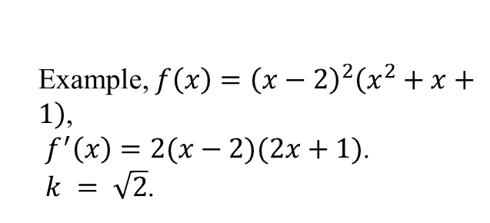

My Modified Newton Method
$x_{n+1}=x_{n}−\frac{\sqrt{k}∙f(x_{n})}{f^{′}(x_{n})}$.
Test results
i xn error
------------------------------------------------------------
0 4.0000000000 ---
1 0.7006666667 3.2993333333
2 1.5390621390 0.8383954723
3 1.9312425804 0.3921804414
4 1.9978336894 0.0665911090
5 1.9999764439 0.0021427545
6 1.9999997596 0.0000233156
7 1.9999999975 0.0000002380
8 2.0000000000 0.0000000024
9 2.0000000000 0.0000000000
------------------------------------------------------------
Root= 2.0000000000, f(x)= 0.0000000000, err= 0.0000000000
Example, $f\left(x\right)={\left(x−2\right)}^{2}\left(x^{2}+x+1\right)$,
$f^{′}\left(x\right)=2(x−2)(2x+1)$.
$k = \sqrt{2}$.

Slide 15
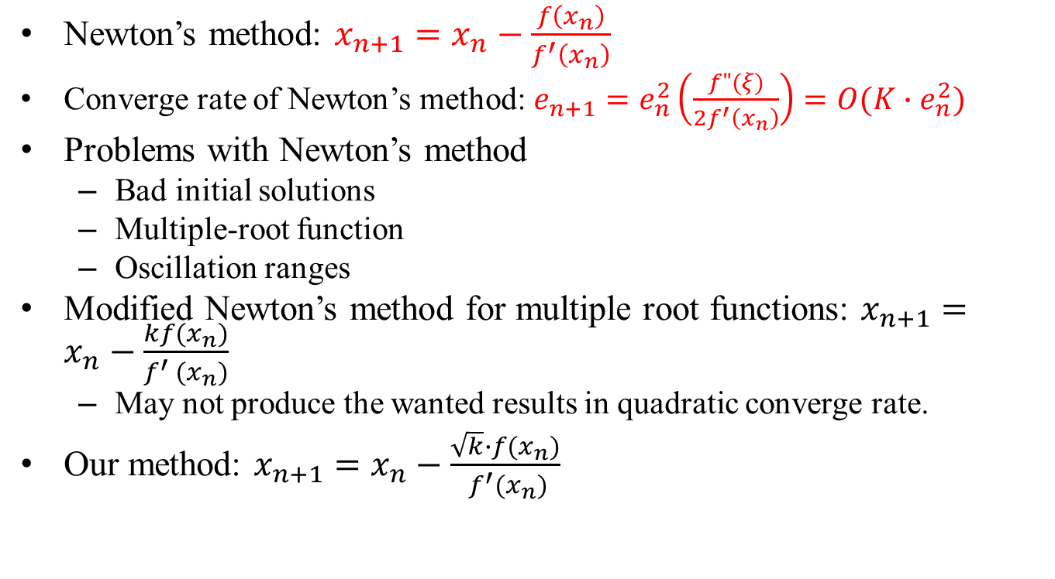
Conclusion
Newton’s method: $x_{n+1}=x_{n}−\frac{f\left(x_{n}\right)}{f^{′}\left(x_{n}\right)}$
Converge rate of Newton’s method: $e_{n+1}=e_{n}^{2}\left(\frac{f"(ξ)}{2f^{′}\left(x_{n}\right)}\right)=O(K∙e_{n}^{2})$
Problems with Newton’s method
Bad initial solutions
Multiple-root function
Oscillation ranges
Modified Newton’s method for multiple root functions: $x_{n+1}=x_{n}−\frac{kf(x_{n})}{f^{′} (x_{n})}$
May not produce the wanted results in quadratic converge rate.
Our method: $x_{n+1}=x_{n}−\frac{\sqrt{k}∙f(x_{n})}{ f^{′}(x_{n})}$

Slide 16

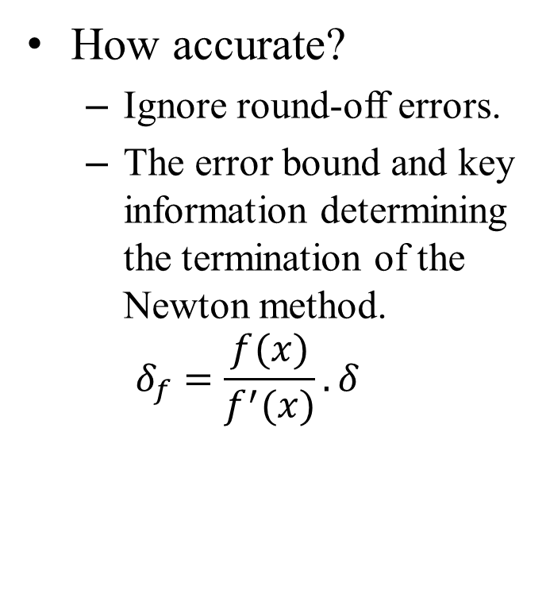
Extra Material
Information based error complexity analysis
How accurate?
Ignore round-off errors.
The error bound and key information determining the termination of the Newton method.
$$δ_{f}=\frac{f(x)}{f^{′}(x)}.δ$$
∞
$$δ_{f}$$
a
b

