Slide 1
Secant Method
Root-finding without using 1st derivatives

Slide 2
Outline
Backward differentiation
Secant method
Converge rate
Example

Slide 3
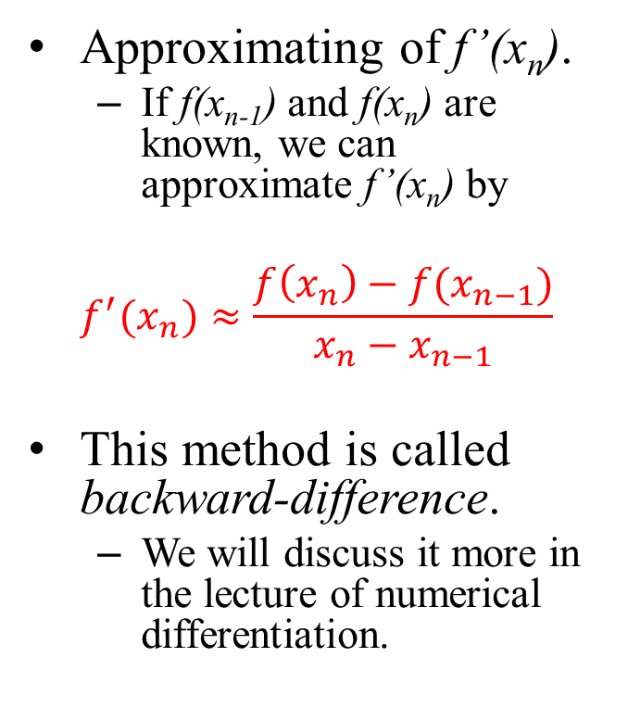
Approximation of 1st Derivative
Approximating of f’(x_{n}).
If f(x_{n-1}) and f(x_{n}) are known, we can approximate f’(x_{n}) by
$$f^{′}(x_{n})≈\frac{f\left(x_{n}\right)−f(x_{n−1})}{x_{n}−x_{n−1}}$$
This method is called backward-difference.
We will discuss it more in the lecture of numerical differentiation.
Approximating f’(x_{n}) using the secant line.
F_{n-1}
F_{n}
x_{n+1}
x_{n}
x_{n-1}

Slide 4

Review: Newton’s Method
Recurrence equation for Newton’s method
$x_{n+1}=x_{n}−\frac{f\left(x_{n}\right)}{f^{′}\left(x_{n}\right)}$
x’_{n+1}
x_{n+1}
h
x_{n}

Slide 5
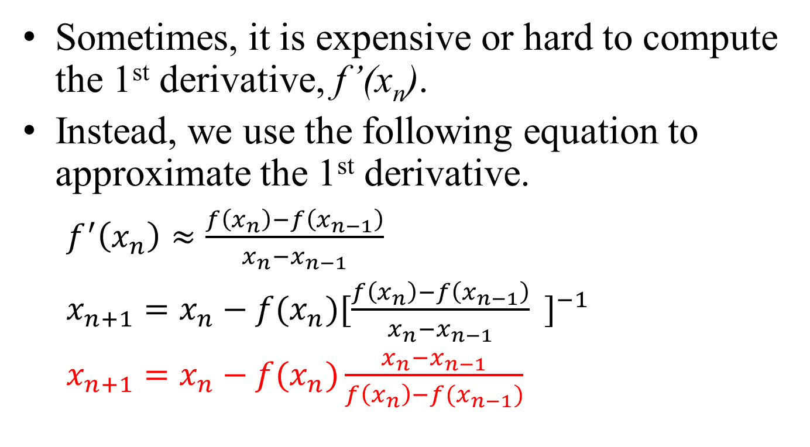
Secant Method
Sometimes, it is expensive or hard to compute the 1st derivative, f’(x_{n}).
Instead, we use the following equation to approximate the 1st derivative.
$f^{′}\left(x_{n}\right)≈\frac{f\left(x_{n}\right)−f\left(x_{n−1}\right)}{x_{n}−x_{n−1}}$
$x_{n+1}=x_{n}−f(x_{n}){[\frac{f\left(x_{n}\right)−f\left(x_{n−1}\right)}{x_{n}−x_{n−1}} ]}^{−1}$
$x_{n+1}=x_{n}−f(x_{n})\frac{x_{n}−x_{n−1}}{f\left(x_{n}\right)−f(x_{n−1})}$

Slide 6
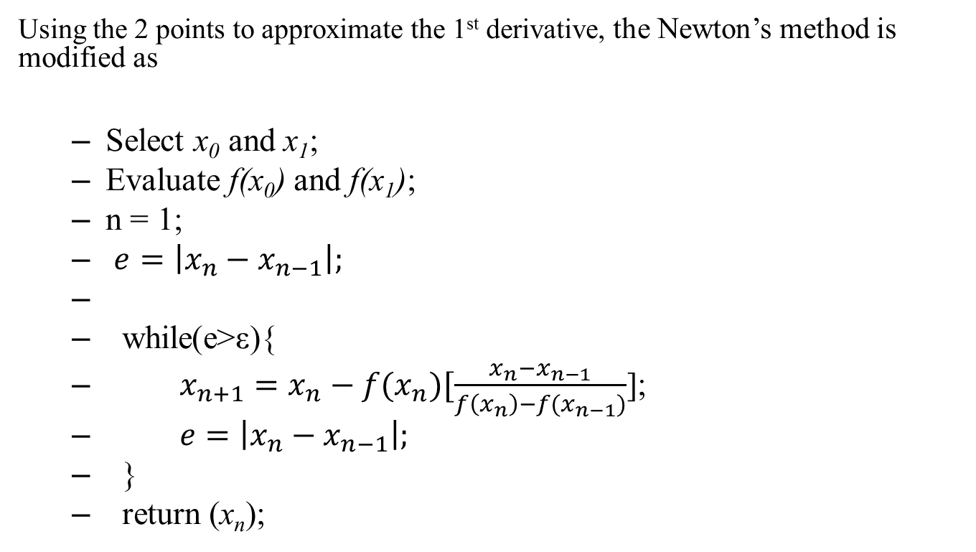
Secant Method
Using the 2 points to approximate the 1st derivative, the Newton’s method is modified as
Select x₀ and x₁;
Evaluate f(x₀) and f(x₁);
n = 1;
$e=\left|x_{n}−x_{n−1}\right|;$
while(e>ε){
$x_{n+1}=x_{n}−f(x_{n})[\frac{x_{n}−x_{n−1}}{f\left(x_{n}\right)−f(x_{n−1})}$];
$e=\left|x_{n}−x_{n−1}\right|;$
}
return (x_{n});
F_{n-1}
F_{n}
x_{n+1}
x_{n}
x_{n-1}

Slide 7
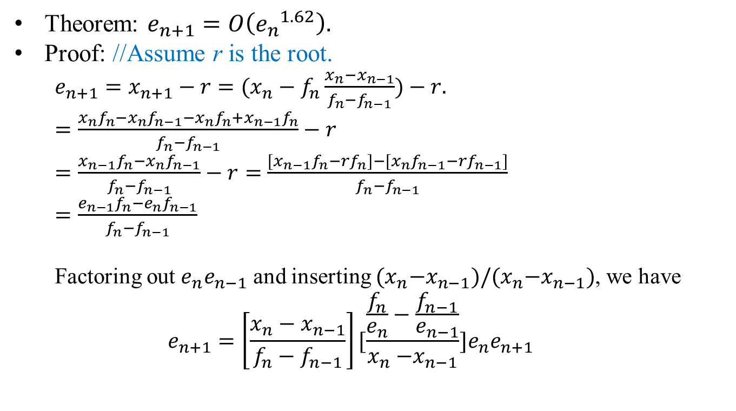
Converge Rate
Theorem: $e_{n+1}=O\left({e_{n}}^{1.62}\right).$
Proof: //Assume r is the root.
$e_{n+1}=x_{n+1}−r=(x_{n}−f_{n}\frac{x_{n}−x_{n−1}}{f_{n}−f_{n−1}})−r.$
$=\frac{x_{n}f_{n}−x_{n}f_{n−1}−x_{n}f_{n}{+x}_{n−1}f_{n}}{f_{n}−f_{n−1}}−r$
$=\frac{x_{n−1}f_{n}−x_{n}f_{n−1}}{f_{n}−f_{n−1}}−r=$ $\frac{{[x}_{n−1}f_{n}−{rf_{n}]−[x}_{n}f_{n−1}−rf_{n−1}]}{f_{n}−f_{n−1}}$
$=\frac{e_{n−1}f_{n}−e_{n}f_{n−1}}{f_{n}−f_{n−1}}$
Factoring out $e_{n}e_{n−1}$ and inserting ${(x}_{n}−x_{n−1})/{(x}_{n}−x_{n−1})$, we have
$$e_{n+1}=\left[\frac{x_{n}−x_{n−1}}{f_{n}−f_{n−1}}\right][\frac{\frac{f_{n}}{e_{n}}−\frac{f_{n−1}}{e_{n−1}}}{x_{n}{−x}_{n−1}}]e_{n}e_{n+1}$$

Slide 8
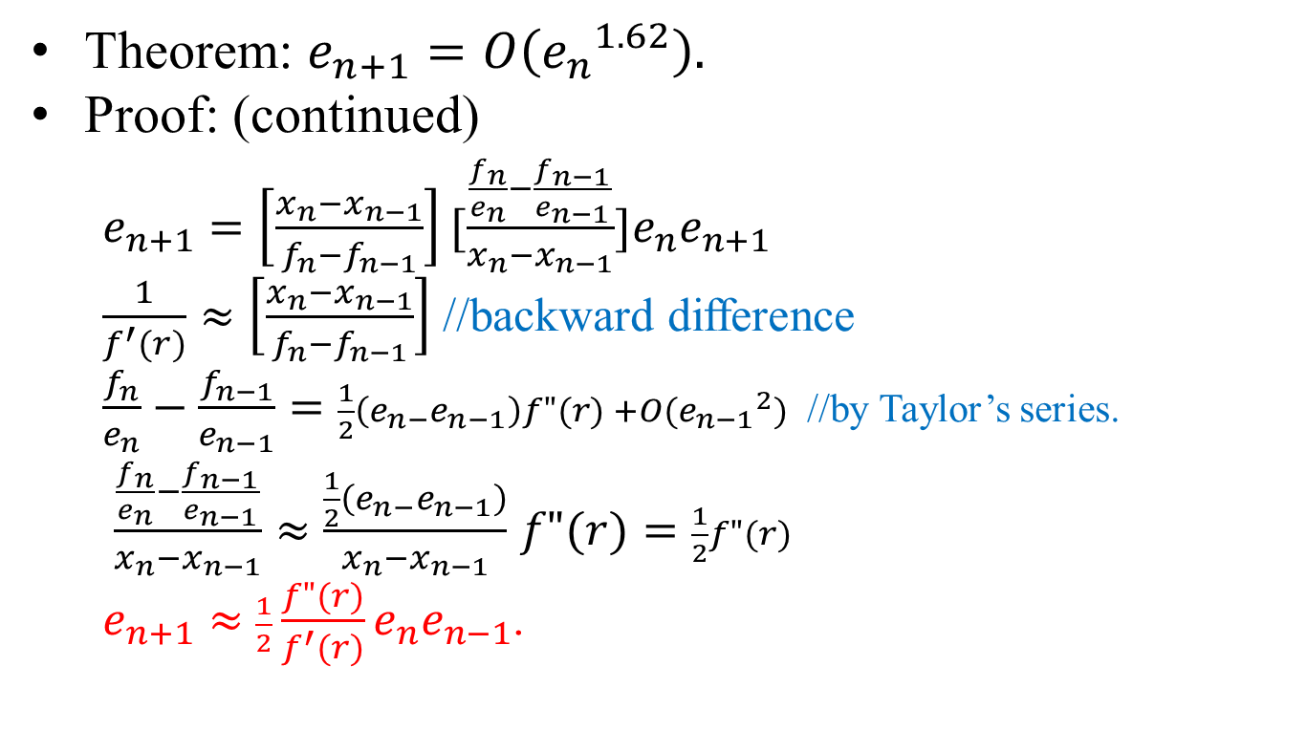
Converge Rate
Theorem: $e_{n+1}=O\left({e_{n}}^{1.62}\right).$
Proof: (continued)
$e_{n+1}=\left[\frac{x_{n}−x_{n−1}}{f_{n}−f_{n−1}}\right][\frac{\frac{f_{n}}{e_{n}}−\frac{f_{n−1}}{e_{n−1}}}{x_{n}{−x}_{n−1}}]e_{n}e_{n+1}$
$\frac{1}{f^{′}(r)}≈\left[\frac{x_{n}−x_{n−1}}{f_{n}−f_{n−1}}\right]$ //backward difference
$\frac{f_{n}}{e_{n}}−\frac{f_{n−1}}{e_{n−1}}=\frac{1}{2}\left(e_{n−}e_{n−1}\right)f"(r) +O({e_{n−1}}^{2})$ //by Taylor’s series.
$\frac{\frac{f_{n}}{e_{n}}−\frac{f_{n−1}}{e_{n−1}}}{x_{n}{−x}_{n−1}}≈\frac{\frac{1}{2}\left(e_{n−}e_{n−1}\right)}{x_{n}{−x}_{n−1}}$ $f"(r)=\frac{1}{2}f"(r)$
$e_{n+1}≈$ $\frac{1}{2}\frac{f"(r)}{f^{′}(r)}e_{n}e_{n−1}$.

Slide 9
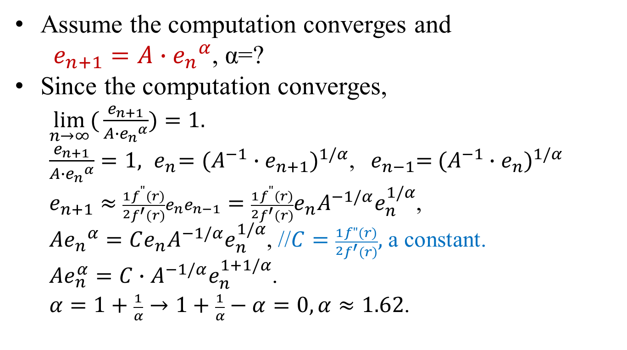
Converge Rate
Assume the computation converges and
$e_{n+1}=A∙{e_{n}}^{α}$, α=?
Since the computation converges,
$\lim_{n→∞}({\frac{e_{n+1}}{A∙{e_{n}}^{α}}})=1.$
$\frac{e_{n+1}}{A∙{e_{n}}^{α}}=1, { e}_{n}={(A^{−1}∙e_{n+1})}^{1/α}$, ${ e}_{n−1}={ (A^{−1}∙e_{n})}^{1/α}$
$e_{n+1}≈$ $\frac{1}{2}\frac{f^{"}(r)}{f^{′}(r)}e_{n}e_{n−1}=\frac{1}{2}\frac{f^{"}(r)}{f^{′}(r)}e_{n}A^{−1/α}e_{n}^{1/α}$,
$A{e_{n}}^{α}=Ce_{n}A^{−1/α}e_{n}^{1/α}$, //$C=\frac{1}{2}\frac{f"(r)}{f^{′}(r)},$ a constant.
$Ae_{n}^{α}=C∙A^{−1/α}e_{n}^{1+1/α}$.
$α=1+\frac{1}{α}→1+\frac{1}{α}−α=0, α≈1.62$.

Slide 10
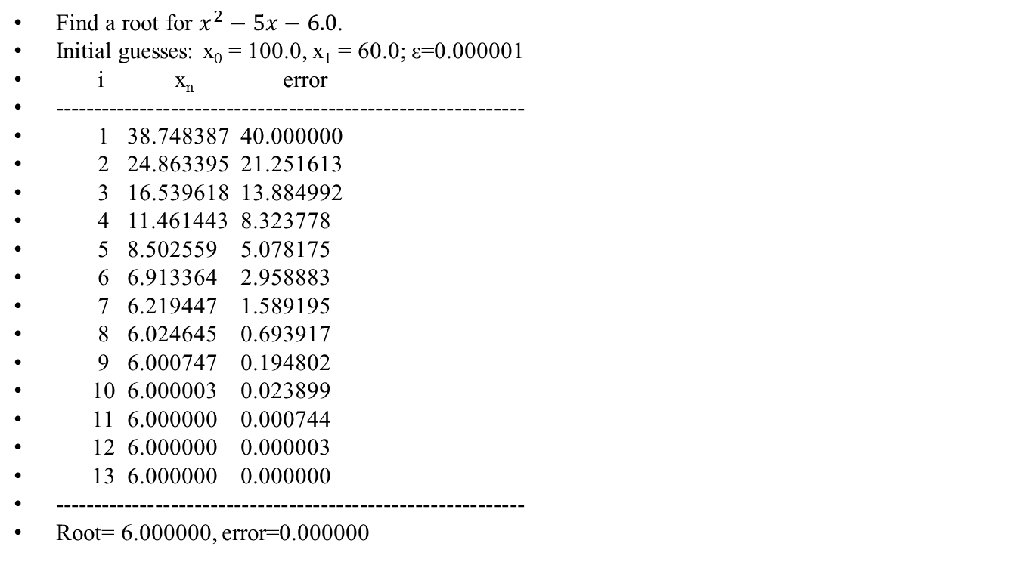
Example
Find a root for $x^{2}−5x−6.0$.
Initial guesses: x₀ = 100.0, x₁ = 60.0; ε=0.000001
i x_{n} error
------------------------------------------------------------
1 38.748387 40.000000
2 24.863395 21.251613
3 16.539618 13.884992
4 11.461443 8.323778
5 8.502559 5.078175
6 6.913364 2.958883
7 6.219447 1.589195
8 6.024645 0.693917
9 6.000747 0.194802
10 6.000003 0.023899
11 6.000000 0.000744
12 6.000000 0.000003
13 6.000000 0.000000
------------------------------------------------------------
Root= 6.000000, error=0.000000

Slide 11
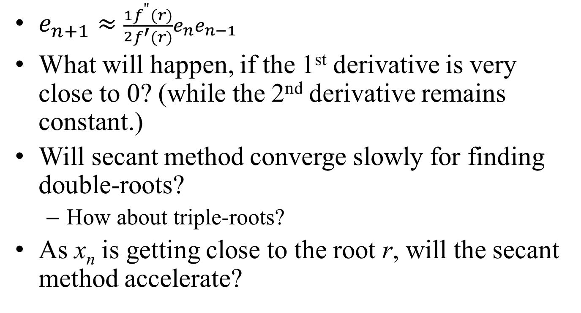
Analysis and Discussion
$e_{n+1}≈$ $\frac{1}{2}\frac{f^{"}(r)}{f^{′}(r)}e_{n}e_{n−1}$
What will happen, if the 1st derivative is very close to 0? (while the 2nd derivative remains constant.)
Will secant method converge slowly for finding double-roots?
How about triple-roots?
As x_{n} is getting close to the root r, will the secant method accelerate?

