Slide 1
2D Newton’s Method
Solving 2D non-linear systems

Slide 2
Outline
Two variable Taylor expansion
2D non-linear systems
2D Newton’s method
Extension to n-D space
Example & applications

Slide 3
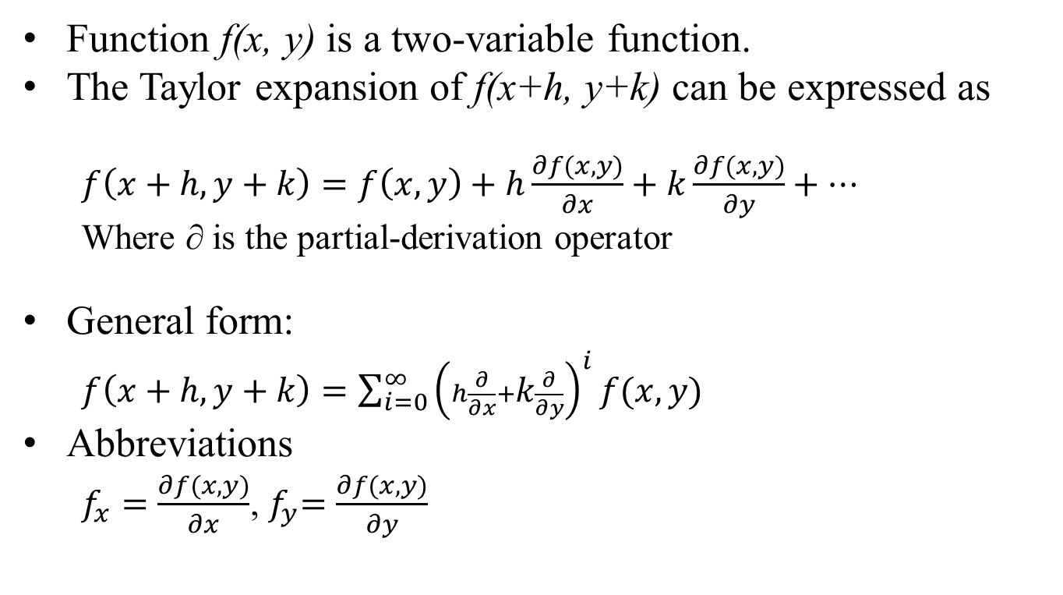
Two-Variable Taylor Expansion
Function f(x, y) is a two-variable function.
The Taylor expansion of f(x+h, y+k) can be expressed as
$f\left(x+h,y+k\right)=f\left(x,y\right)+h\frac{∂f(x,y)}{∂x}+k\frac{∂f(x,y)}{∂y}+…$
Where ∂ is the partial-derivation operator
General form:
$f\left(x+h,y+k\right)=\sum_{i=0}^{∞}{{\left(h\frac{∂}{∂x}+k\frac{∂}{∂y}\right)}^{i}}f(x,y)$
Abbreviations
$f_{x}=\frac{∂f(x,y)}{∂x}$,${ f}_{y}=\frac{∂f(x,y)}{∂y}$
(x+h, y+g)
(x, y)

Slide 4

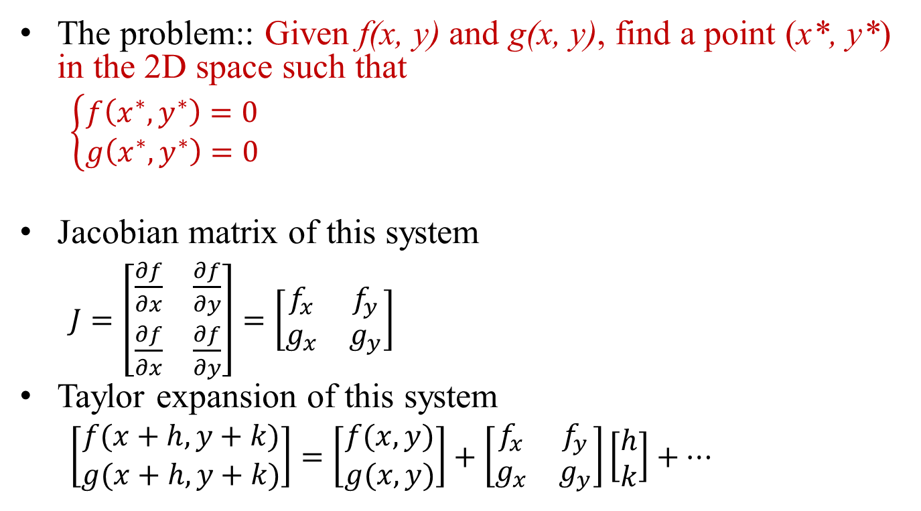
2D Non-linear Systems
The problem:: Given f(x, y) and g(x, y), find a point (x*, y*) in the 2D space such that
$\left\{\begin{matrix}f\left(x^{∗},y^{∗}\right)=0 \\ g\left(x^{∗},y^{∗}\right)=0\end{matrix}\right.$
Jacobian matrix of this system
$J=\left[\begin{matrix}\frac{∂f}{∂x} & \frac{∂f}{∂y} \\ \frac{∂f}{∂x} & \frac{∂f}{∂y}\end{matrix}\right]=\left[\begin{matrix}f_{x} & f_{y} \\ g_{x} & g_{y}\end{matrix}\right]$
Taylor expansion of this system
$\left[\begin{matrix}f(x+h,y+k) \\ g(x+h,y+k)\end{matrix}\right]=\left[\begin{matrix}f(x,y) \\ g(x,y)\end{matrix}\right]+\left[\begin{matrix}f_{x} & f_{y} \\ g_{x} & g_{y}\end{matrix}\right]\left[\begin{matrix}h \\ k\end{matrix}\right]+…$
G(x,y)
F(x,y)
$$\left(x^{∗},y^{∗}\right)$$

Slide 5
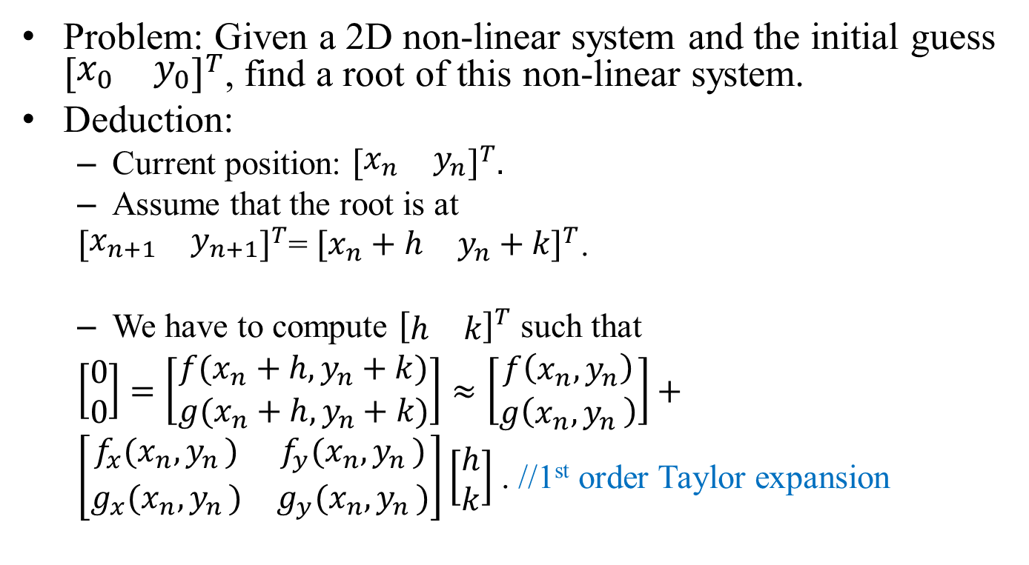
2D Newton’s Method
Problem: Given a 2D non-linear system and the initial guess ${\left[\begin{matrix}x_{0} & y_{0}\end{matrix}\right]}^{T}$, find a root of this non-linear system.
Deduction:
Current position: ${\left[\begin{matrix}x_{n} & y_{n}\end{matrix}\right]}^{T}.$
Assume that the root is at
${\left[\begin{matrix}x_{n+1} & y_{n+1}\end{matrix}\right]}^{T}$= ${\left[\begin{matrix}x_{n}+h & y_{n}+k\end{matrix}\right]}^{T}$.
We have to compute ${\left[\begin{matrix}h & k\end{matrix}\right]}^{T}$ such that
$\left[\begin{matrix}0 \\ 0\end{matrix}\right]=\left[\begin{matrix}f(x_{n}+h,y_{n}+k) \\ g(x_{n}+h,y_{n}+k)\end{matrix}\right]≈\left[\begin{matrix}f\left(x_{n},y_{n}\right) \\ g\left(x_{n}{,y}_{n}\right)\end{matrix}\right]+$
$\left[\begin{matrix}f_{x}(x_{n}{,y}_{n}) & f_{y}(x_{n}{,y}_{n}) \\ g_{x}(x_{n}{,y}_{n}) & g_{y}(x_{n}{,y}_{n})\end{matrix}\right]\left[\begin{matrix}h \\ k\end{matrix}\right]$ . //1st order Taylor expansion

Slide 6
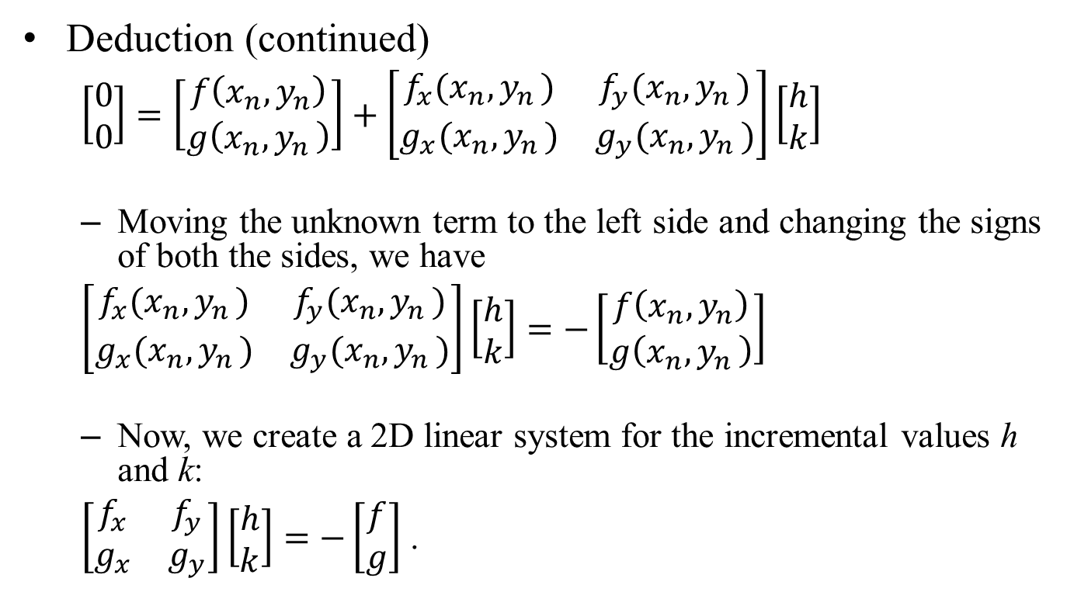
2D Newton’s Method
Deduction (continued)
$\left[\begin{matrix}0 \\ 0\end{matrix}\right]=\left[\begin{matrix}f\left(x_{n},y_{n}\right) \\ g\left(x_{n}{,y}_{n}\right)\end{matrix}\right]+\left[\begin{matrix}f_{x}(x_{n}{,y}_{n}) & f_{y}(x_{n}{,y}_{n}) \\ g_{x}(x_{n}{,y}_{n}) & g_{y}(x_{n}{,y}_{n})\end{matrix}\right]\left[\begin{matrix}h \\ k\end{matrix}\right]$
Moving the unknown term to the left side and changing the signs of both the sides, we have
$\left[\begin{matrix}f_{x}(x_{n}{,y}_{n}) & f_{y}(x_{n}{,y}_{n}) \\ g_{x}(x_{n}{,y}_{n}) & g_{y}(x_{n}{,y}_{n})\end{matrix}\right]\left[\begin{matrix}h \\ k\end{matrix}\right]=−\left[\begin{matrix}f\left(x_{n},y_{n}\right) \\ g\left(x_{n}{,y}_{n}\right)\end{matrix}\right]$
Now, we create a 2D linear system for the incremental values h and k:
$\left[\begin{matrix}f_{x} & f_{y} \\ g_{x} & g_{y}\end{matrix}\right]\left[\begin{matrix}h \\ k\end{matrix}\right]=−\left[\begin{matrix}f \\ g\end{matrix}\right]$ .

Slide 7
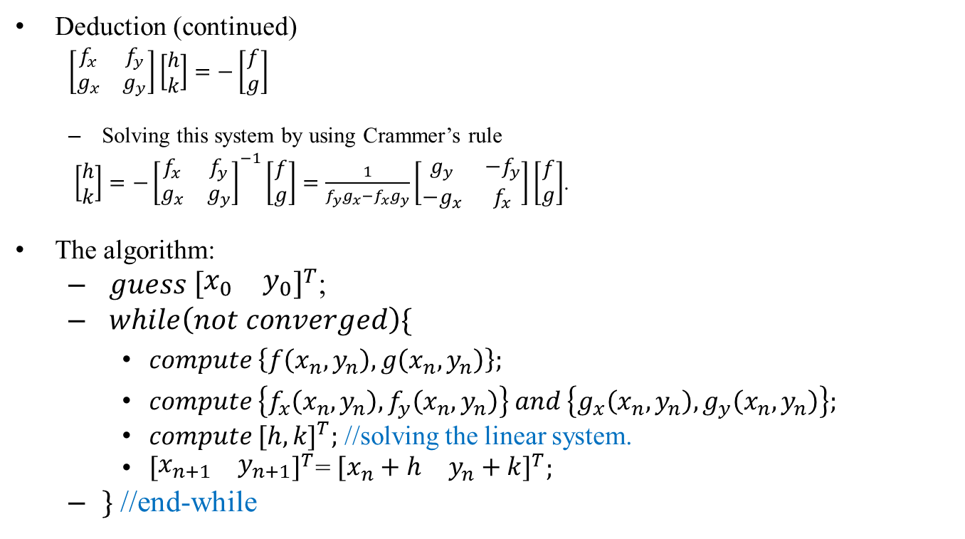
2D Newton’s Method
Deduction (continued)
$\left[\begin{matrix}f_{x} & f_{y} \\ g_{x} & g_{y}\end{matrix}\right]\left[\begin{matrix}h \\ k\end{matrix}\right]=−\left[\begin{matrix}f \\ g\end{matrix}\right]$
Solving this system by using Crammer’s rule
$\left[\begin{matrix}h \\ k\end{matrix}\right]={−\left[\begin{matrix}f_{x} & f_{y} \\ g_{x} & g_{y}\end{matrix}\right]}^{−1}\left[\begin{matrix}f \\ g\end{matrix}\right]=\frac{1}{f_{y}g_{x}−f_{x}g_{y}}\left[\begin{matrix}g_{y} & {−f}_{y} \\ {−g}_{x} & f_{x}\end{matrix}\right]\left[\begin{matrix}f \\ g\end{matrix}\right]$.
The algorithm:
${guess \left[\begin{matrix}x_{0} & y_{0}\end{matrix}\right]}^{T}$;
$while\left(not converged\right)\{$
$compute \left\{f\left(x_{n},y_{n}\right),g\left(x_{n},y_{n}\right)\right\};$
$compute \left\{f_{x}\left(x_{n},y_{n}\right),f_{y}\left(x_{n},y_{n}\right)\right\} and \left\{g_{x}\left(x_{n},y_{n}\right),g_{y}\left(x_{n},y_{n}\right)\right\};$
$compute {[h,k]}^{T};$ //solving the linear system.
${\left[\begin{matrix}x_{n+1} & y_{n+1}\end{matrix}\right]}^{T}$= ${\left[\begin{matrix}x_{n}+h & y_{n}+k\end{matrix}\right]}^{T};$
$\}$ //end-while

Slide 8
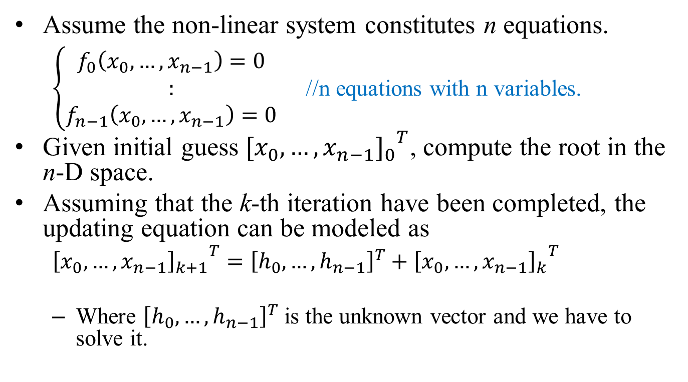
Extension
Assume the non-linear system constitutes n equations.
$\left\{\begin{matrix}f_{0}\left(x_{0},…,x_{n−1}\right)=0 \\ : \\ f_{n−1}\left(x_{0},…,x_{n−1}\right)=0\end{matrix}\right.$ //n equations with n variables.
Given initial guess ${{[x_{0},…,x_{n−1}]}_{0}}^{T}$, compute the root in the n-D space.
Assuming that the k-th iteration have been completed, the updating equation can be modeled as
${{\left[x_{0},…,x_{n−1}\right]}_{k+1}}^{T}={\left[h_{0},…,h_{n−1}\right]}^{T}+{{\left[x_{0},…,x_{n−1}\right]}_{k}}^{T}$
Where ${\left[h_{0},…,h_{n−1}\right]}^{T}$ is the unknown vector and we have to solve it.

Slide 9
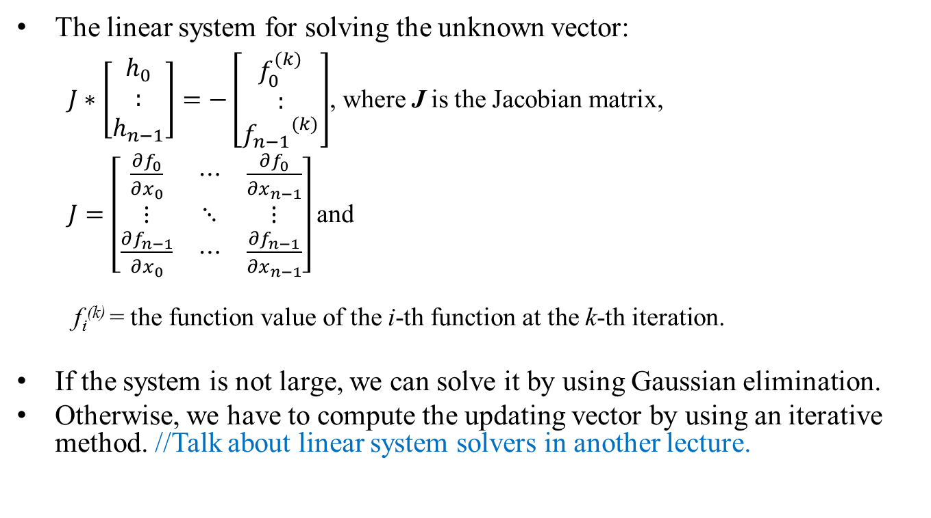
Extension
The linear system for solving the unknown vector:
$J∗\left[\begin{matrix}h_{0} \\ : \\ h_{n−1}\end{matrix}\right]=−\left[\begin{matrix}f_{0}^{(k)} \\ : \\ {f_{n−1}}^{(k)}\end{matrix}\right]$, where J is the Jacobian matrix,
$J=\left[\begin{matrix}\frac{∂f_{0}}{∂x_{0}} & ⋯ & \frac{∂f_{0}}{∂x_{n−1}} \\ ⋮ & ⋱ & ⋮ \\ \frac{∂f_{n−1}}{∂x_{0}} & ⋯ & \frac{∂f_{n−1}}{∂x_{n−1}}\end{matrix}\right]$and
f_{i}^{(k)} = the function value of the i-th function at the k-th iteration.
If the system is not large, we can solve it by using Gaussian elimination.
Otherwise, we have to compute the updating vector by using an iterative method. //Talk about linear system solvers in another lecture.

Slide 10

Vector Norms
In the n-D Newton’s method, assume
${\vec{x}}_{k}={\left[x_{0},…,x_{n−1}\right]}^{T}$ be the solution vector obtain at the k-th iteration.
We have to verify whether the error
${\vec{e}}_{k+1}={\vec{x}}_{k+1}−{\vec{x}}_{k}$ is small enough or not such that we can terminate the iterations.
How to measure the magnitude of a vector?
$\vec{e}={\left[e_{0},e_{1},…,e_{n−1}\right]}^{T}$
1-norm:${\left\|\vec{e}\right\|}_{1}=\sum_{i=0}^{n−1}{|e_{i}|}$.
2-norm :${\left\|\vec{e}\right\|}_{2}={\left(\sum_{i=0}^{n−1}{{e_{i}}^{2}}\right)}^{1/2}$.
∞-norm:${\left\|\vec{e}\right\|}_{∞}=\max_{0≤i≤n−1}\left|e_{i}\right|$.
Which norm is the loosest?
The infinite norm.
Which norm is the strictest?
The 1-norm.
∞-norm
2-norm
1-norm

Slide 11
Example
f(x, y) = x^2 -5y -6
g(x,y)= 3x - y^2 - 8
f_{x} = 2x, f_{y} = -5
g_{x} = 3, g_{y} = -2y
Initial guess:
[x₀, y₀] = [20.0, 20.0]
Using 1-norm to measure the errors.
The results
n x_{n} y_{n} e_{n}
---------------------------------------------------
0 20.000000 20.000000 ---
1 11.482650 10.661199 17.856151
2 7.305257 5.983236 8.855355
3 5.314227 3.655363 4.318903
4 4.419895 2.547129 2.002565
5 4.079746 2.105724 0.781555
6 4.004269 2.005695 0.175505
7 4.000014 2.000018 0.009933
8 4.000000 2.000000 0.000032
--------------------------------------------------
9 4.000000 2.000000 0.000000

Slide 12
Applications
In Computer Aided Geometry Design (CAGD), we use Newton’s method to compute the intersections of implicit functions.
The implicit functions: Ellipse, circle, parabola, hyperbola, lines
In nonlinear optimization, Newton’s method is used to find solutions for the objective functions under some given constraints (nonlinear functions)

Slide 13
Convergence
Will Newton’s method fail to find a root?
Yes, like in the 1D cases, Newton’s method may fail.
Because of bad initial guests.
Sensitivities of the functions f(x,y) and g(x,y).
If the Jocobian matrix is ill-conditioned, the Newton’s method may fail.
Solving the linear system produces large round-off errors in each iteration.
Which case is easier to solve?

