Slide 1
Lagrange Interpolation
A polynomial-based interpolation method
內插方法

Slide 2
Outline
Introduction to interpolation (內插)
Lagrange method
Uniqueness of polynomial
Example

Slide 3
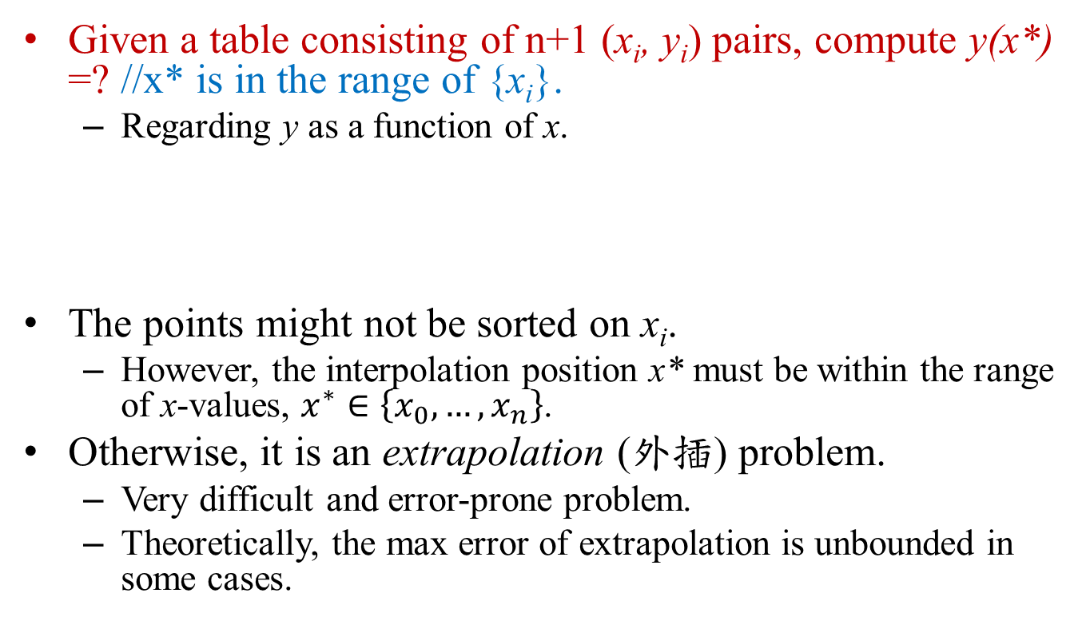
Interpolation Problem
Given a table consisting of n+1 (x_{i}, y_{i}) pairs, compute y(x*) =? //x* is in the range of {x_{i}}.
Regarding y as a function of x.
The points might not be sorted on x_{i}.
However, the interpolation position x* must be within the range of x-values, $x^{∗}∈\left\{x_{0},…,x_{n}\right\}$.
Otherwise, it is an extrapolation (外插) problem.
Very difficult and error-prone problem.
Theoretically, the max error of extrapolation is unbounded in some cases.
x | x₀ | x₁ | x₂ | x₃ | … | x_{n-1} | x_{n}
y | y₀ | y₁ | y₂ | y₃ | … | y_{n-1} | y_{n}

Slide 4
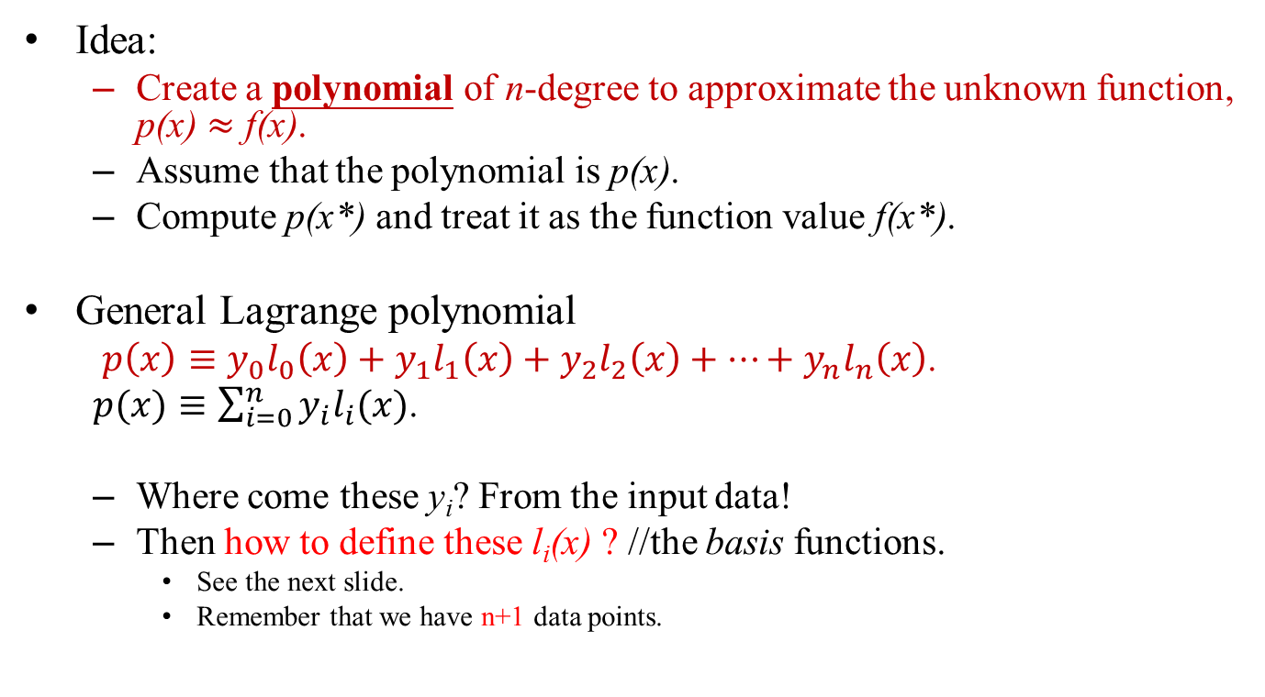
Lagrange Method (1/3)
Idea:
Create a polynomial of n-degree to approximate the unknown function, p(x) $≈$ f(x).
Assume that the polynomial is p(x).
Compute p(x*) and treat it as the function value f(x*).
General Lagrange polynomial
$p\left(x\right)≡y_{0}l_{0}\left(x\right)+y_{1}l_{1}\left(x\right)+y_{2}l_{2}\left(x\right)+…+y_{n}l_{n}\left(x\right)$.
$p(x)≡\sum_{i=0}^{n}{y_{i}l_{i}(x)}$.
Where come these y_{i}? From the input data!
Then how to define these l_{i}(x) ? //the basis functions.
See the next slide.
Remember that we have n+1 data points.

Slide 5
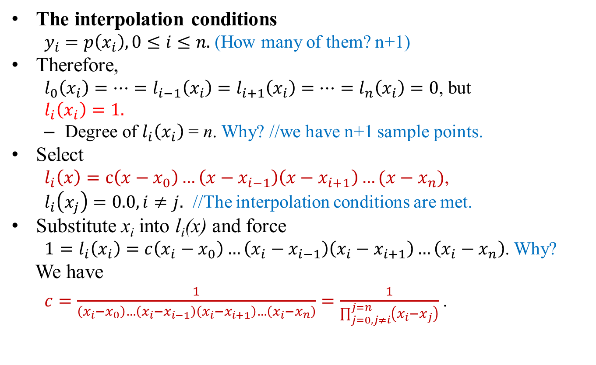
Lagrange Method (2/3)
The interpolation conditions
$y_{i}=p\left(x_{i}\right),0≤i≤n.$ (How many of them? n+1)
Therefore,
$l_{0}\left(x_{i}\right)=…=l_{i−1}\left(x_{i}\right)=l_{i+1}\left(x_{i}\right)=…=l_{n}\left(x_{i}\right)=0$, but
$l_{i}\left(x_{i}\right)=1.$
Degree of $l_{i}\left(x_{i}\right)$ = n. Why? //we have n+1 sample points.
Select
$l_{i}\left(x\right)=c\left(x−x_{0}\right)…\left(x−x_{i−1}\right)\left(x−x_{i+1}\right)…(x−x_{n})$,
$l_{i}\left(x_{j}\right)=0.0, i≠j.$ //The interpolation conditions are met.
Substitute x_{i} into l_{i}(x) and force
$1=l_{i}\left(x_{i}\right)=c\left(x_{i}−x_{0}\right)…\left(x_{i}−x_{i−1}\right)\left(x_{i}−x_{i+1}\right)…\left(x_{i}−x_{n}\right)$. Why?
We have
$c=\frac{1}{\left(x_{i}−x_{0}\right)…\left(x_{i}−x_{i−1}\right)\left(x_{i}−x_{i+1}\right)…\left(x_{i}−x_{n}\right)}=\frac{1}{\prod_{j=0,j≠i}^{j=n}{\left(x_{i}−x_{j}\right)}}$ .

Slide 6
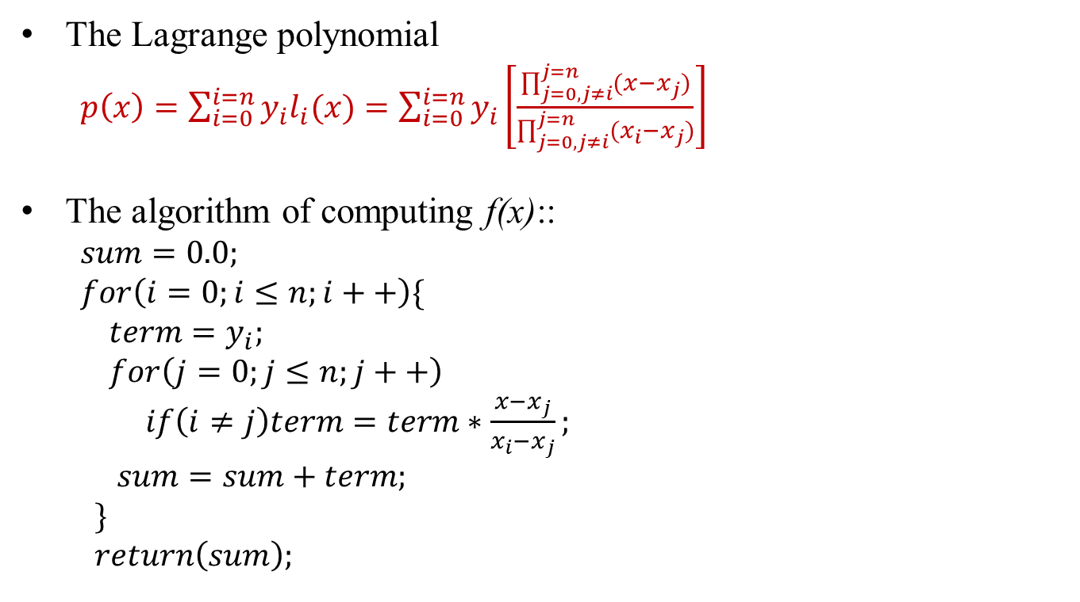
Lagrange Method (3/3)
The Lagrange polynomial
$p\left(x\right)=\sum_{i=0}^{i=n}{y_{i}l_{i}(x)}=\sum_{i=0}^{i=n}{y_{i}\left[\frac{\prod_{j=0,j≠i}^{j=n}{(x−x_{j})}}{\prod_{j=0,j≠i}^{j=n}{(x_{i}−x_{j})}}\right]}$
The algorithm of computing f(x)::
$sum=0.0;$
$for\left(i=0;i≤n;i++\right)\{$
$term=y_{i};$
$for\left(j=0;j≤n;j++\right)$
$if\left(i≠j\right)term=term∗\frac{x−x_{j}}{x_{i}−x_{j}};$
$sum=sum+term;$
$\}$
$return\left(sum\right);$

Slide 7

Time Complexity Analysis
Time complexity = O(n²). //we (n+1) samples.
Two layers of iteration
$sum=0.0;$
$for\left(i=0;i≤n;i++\right)\{$
$term=y_{i};$
$for\left(j=0;j≤n;j++\right)$
$$if\left(i≠j\right)term=term∗\frac{x−x_{j}}{x_{i}−x_{j}};$$
$$sum=sum+term;\}$$

Slide 8

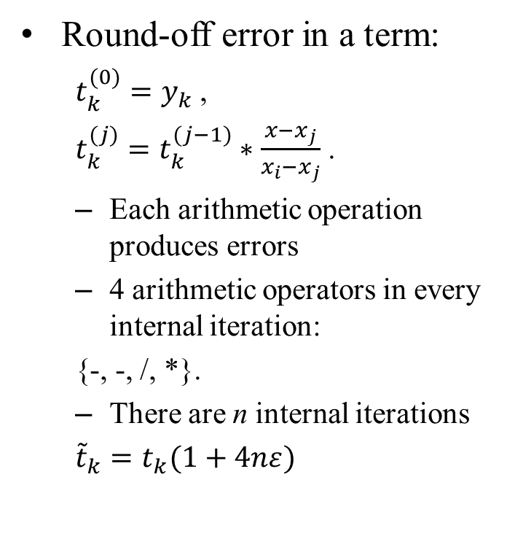
Error Analysis (1/2)
Round-off error in a term:
$t_{k}^{(0)}=y_{k}$ ,
$t_{k}^{(j)}=t_{k}^{(j−1)}∗\frac{x−x_{j}}{x_{i}{−x}_{j}}$ .
Each arithmetic operation produces errors
4 arithmetic operators in every internal iteration:
{-, -, /, *}.
There are n internal iterations
${\tilde{t}}_{k}=t_{k}(1+4nε)$
The Lagrange interpolation method::
$sum=0.0;$
$for\left(i=0;i≤n;i++\right)\{$
$term=y_{i};$
$for\left(j=0;j≤n;j++\right)$
$$if\left(i≠j\right) term=term∗\frac{x−x_{j}}{x_{i}−x_{j}};$$
$sum=sum+term;\}$

Slide 9
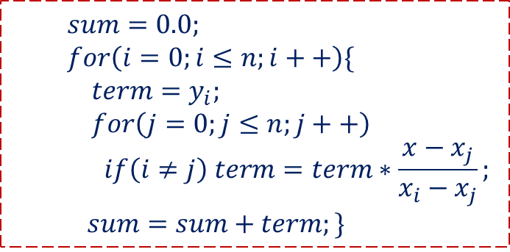
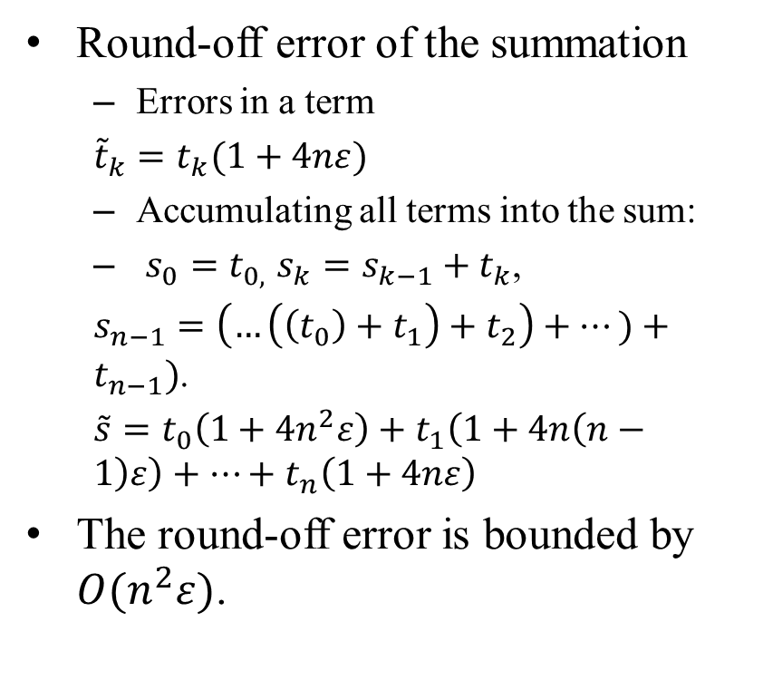
Error Analysis (2/2)
Round-off error of the summation
Errors in a term
${\tilde{t}}_{k}=t_{k}(1+4nε)$
Accumulating all terms into the sum:
$s_{0}=t_{0,}$ $s_{k}=s_{k−1}+t_{k}$,
$s_{n−1}=\left(…\left(\left(t_{0}\right)+t_{1}\right)+t_{2}\right)+…)+t_{n−1})$.
$\tilde{s}=t_{0}\left(1+{4n}^{2}ε\right)+t_{1}\left(1+4n\left(n−1\right)ε\right)+…+t_{n}\left(1+4nε\right)$
The round-off error is bounded by $O(n^{2}ε)$.
$sum=0.0;$
$for\left(i=0;i≤n;i++\right)\{$
$term=y_{i};$
$for\left(j=0;j≤n;j++\right)$
$$if\left(i≠j\right) term=term∗\frac{x−x_{j}}{x_{i}−x_{j}};$$
$sum=sum+term;\}$

Slide 10
More Analysis
The real trouble about Lagrange polynomial is the truncation error.
Talking about it in another lecture.
Some convenient but not accurate round-off error bound estimation:
If the time complexity of a numerical algorithm is O(n^{k}), then the round-off error caused by the arithmetic operation is usually bounded by O(n^{k}ε).
But be aware of division!!! Very large absolute error, if the denominator is small.
Explanations:
Here, ε = max round-off error in arithmetic operations.
Time complexity is measured by arithmetic operations, like ‘+’, ‘*’, …,etc.

Slide 11
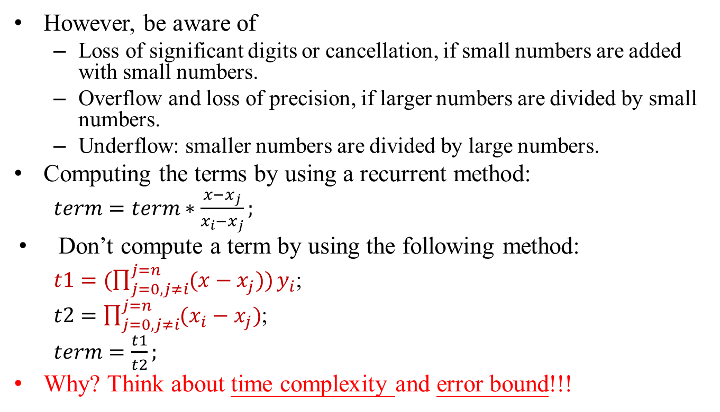
More Analysis
However, be aware of
Loss of significant digits or cancellation, if small numbers are added with small numbers.
Overflow and loss of precision, if larger numbers are divided by small numbers.
Underflow: smaller numbers are divided by large numbers.
Computing the terms by using a recurrent method:
$term=term∗\frac{x−x_{j}}{x_{i}−x_{j}};$
Don’t compute a term by using the following method:
${t1=(\prod_{j=0,j≠i}^{j=n}{(x−x_{j}))}y}_{i}$;
$t2=\prod_{j=0,j≠i}^{j=n}{(x_{i}−x_{j})}$;
$term=\frac{t1}{t2};$
Why? Think about time complexity and error bound!!!
Incorrect method

Slide 12
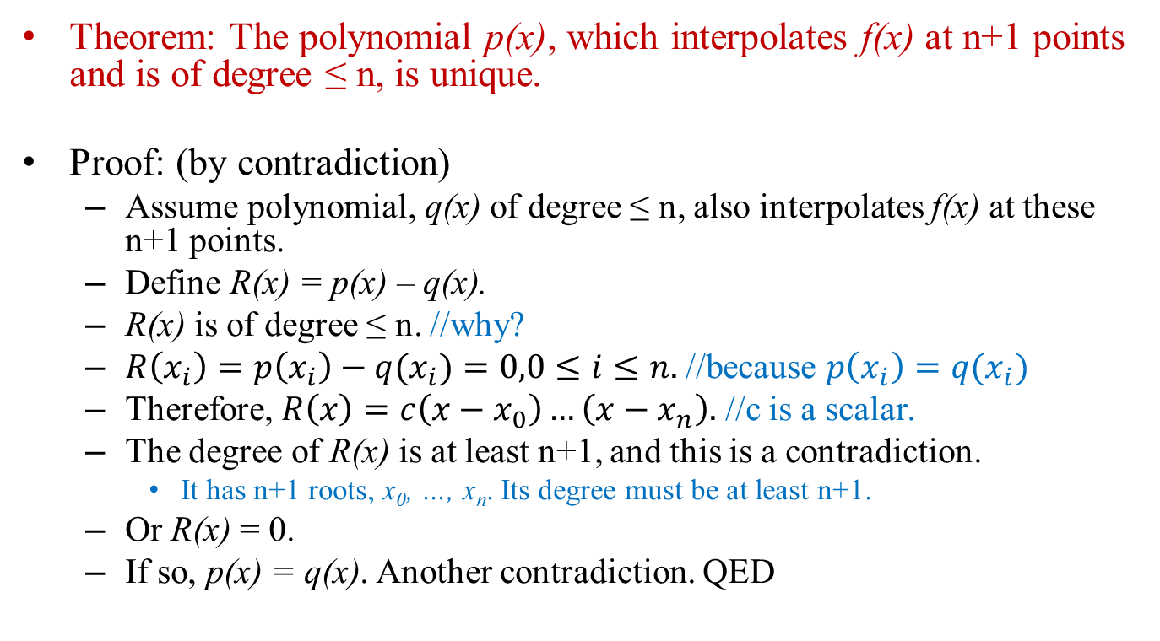
Uniqueness Property
Theorem: The polynomial p(x), which interpolates f(x) at n+1 points and is of degree ≤ n, is unique.
Proof: (by contradiction)
Assume polynomial, q(x) of degree ≤ n, also interpolates f(x) at these n+1 points.
Define R(x) = p(x) – q(x).
R(x) is of degree ≤ n. //why?
$R\left(x_{i}\right)=p\left(x_{i}\right)−q(x_{i})=0,0≤i≤n.$ //because $p\left(x_{i}\right)=q(x_{i})$
Therefore, $R\left(x\right)=c\left(x−x_{0}\right)…\left(x−x_{n}\right).$ //c is a scalar.
The degree of R(x) is at least n+1, and this is a contradiction.
It has n+1 roots, x₀, …, x_{n}. Its degree must be at least n+1.
Or R(x) = 0.
If so, p(x) = q(x). Another contradiction. QED

Slide 13
Usage of the Uniqueness Property
Since p(x) is unique, all other polynomials which is of degree ≤ n and interpolate f(x) at these n+1 points can be converted into p(x).
The polynomial p(x) can be expressed in many forms, but it is unique.
Corollary: Given n+1 samples of f(x), the degree of any polynomial, which interpolates f(x) at these points, must be at least n.
Here, f(x) is an arbitrary function.
We are talking about the worst case scenario.

Slide 14
Usage of the Uniqueness Property
Since p(x) is unique, all other polynomials which is of degree ≤ n and interpolate f(x) at these n+1 points can be converted into p(x).
On the other hand, the Lagrange polynomial can be converted into another form which produces less round-off errors.
Newton’s polynomial //given in the following lecture
Evaluated by using Horner’s algorithm.
See them in another lecture.

Slide 15
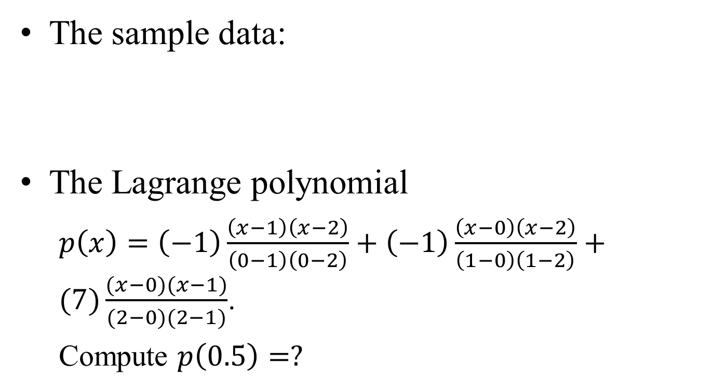
Example
The sample data:
The Lagrange polynomial
$p\left(x\right)=\left(−1\right)\frac{\left(x−1\right)\left(x−2\right)}{\left(0−1\right)\left(0−2\right)}+\left(−1\right)\frac{\left(x−0\right)\left(x−2\right)}{\left(1−0\right)\left(1−2\right)}+(7)\frac{(x−0)(x−1)}{(2−0)(2−1)}$.
Compute $p\left(0.5\right)=?$
x | 0 | 1 | 2
y | -1 | -1 | 7

Slide 16
Some Questions
If we made more samples, will the interpolation error be reduced?
For round-off error, the answer is no.
For truncation error, the answer is partially correct. (See the next lecture.)
When computing f(t), do we have to use all the sample data?
In the Lagrange method, we do.
Global influences
Good or bad?
See next lecture for more explanation.
Truncation error or round-of error, which one dominates the final error?

