Slide 1
Interpolation, Newton’s Polynomial
Divided difference method

Slide 2
Outline
Divided difference
Newton’s polynomial
The algorithm
Complexity and error analysis
Example

Slide 3
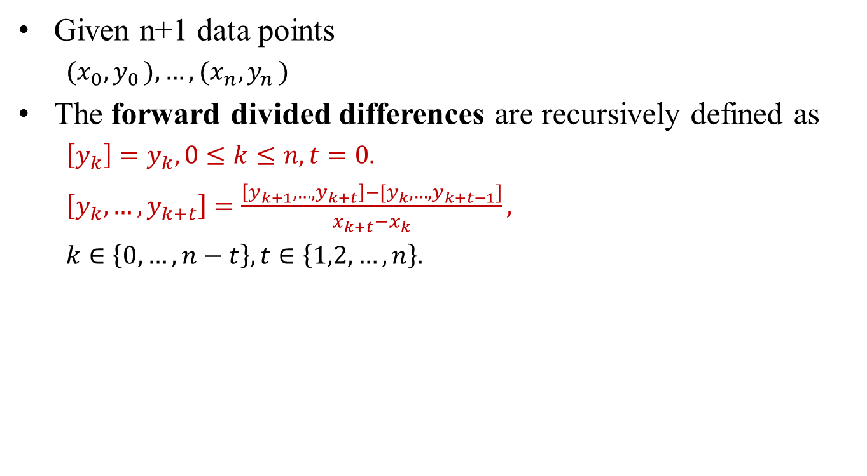
Divided Difference
Given n+1 data points
${(x}_{0}{,y}_{0}),…,{(x}_{n}{,y}_{n})$
The forward divided differences are recursively defined as
$\left[y_{k}\right]=y_{k},0≤k≤n, t=0.$
$\left[y_{k},…,y_{k+t}\right]=\frac{\left[y_{k+1},…,y_{k+t}\right]−[y_{k},…,y_{k+t−1}]}{x_{k+t}−x_{k}},$
$k∈\left\{0,…,n−t\right\}, t∈\left\{1,2,…,n\right\}.$
order
0
t
n
t: order
k: position
k
position
n

Slide 4
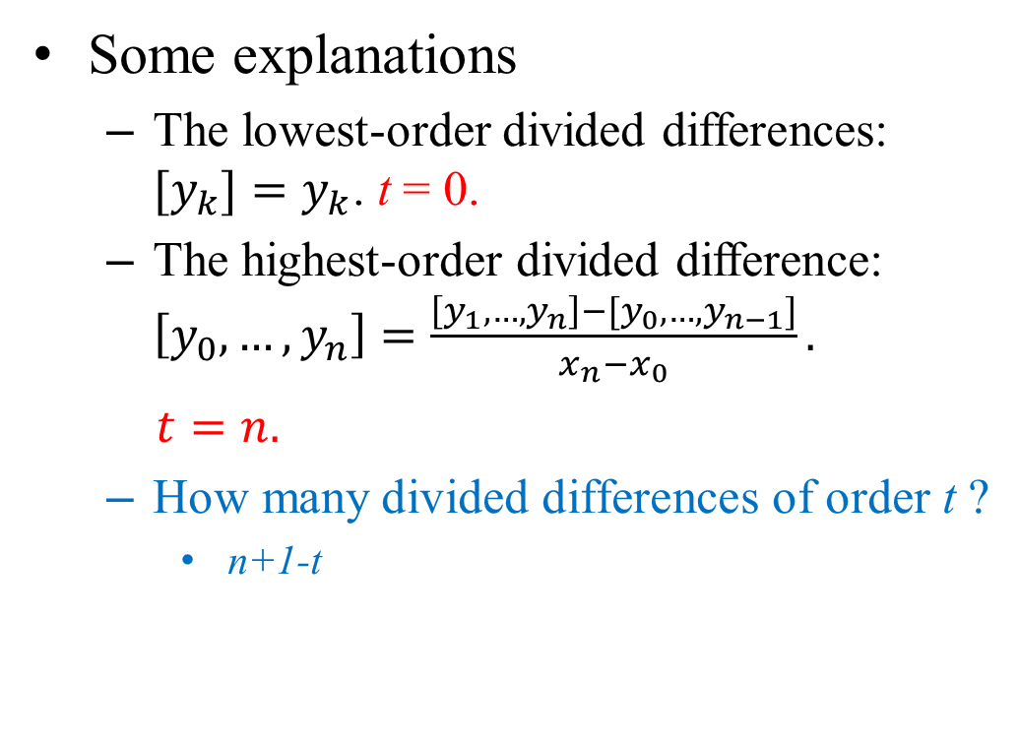
Explanation
Some explanations
The lowest-order divided differences: $[y_{k}{]=y}_{k}$. t = 0.
The highest-order divided difference: $\left[y_{0},…,y_{n}\right]=\frac{\left[y_{1},…,y_{n}\right]−[y_{0},…,y_{n−1}]}{x_{n}−x_{0}}.$
$t=n.$
How many divided differences of order t ?
n+1-t
order
0
t
n
k
position
n

Slide 5

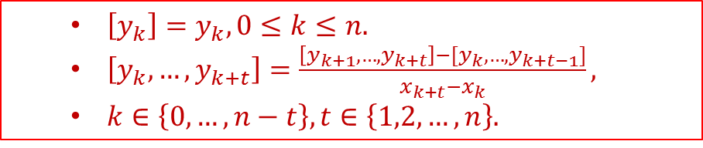
Computing Divided Differences
t
Table form
x/y | [y_{k}] | [y_{k},y_{k+1}] | [y_{k},…,y_{k+2}] | [y_{k},…,y_{k+3}]
x₀ | [y₀] | [y₀,y₁] | [y₀,…,y₂] | [y₀,…,y₃]
x₁ | [y₁] | [y₁,y₂] | [y₁,…,y₃] | ---------
x₂ | [y₂] | [y₂,y₃] | --------- | ---------
x₃ | [y₃] | -------- | --------- | ---------
k
negative
positive
Denominator = $x_{k+t}−x_{t}$
$\left[y_{k}\right]=y_{k},0≤k≤n.$
$\left[y_{k},…,y_{k+t}\right]=\frac{\left[y_{k+1},…,y_{k+t}\right]−[y_{k},…,y_{k+t−1}]}{x_{k+t}−x_{k}},$
$k∈\left\{0,…,n−t\right\}, t∈\left\{1,2,…,n\right\}.$

Slide 6
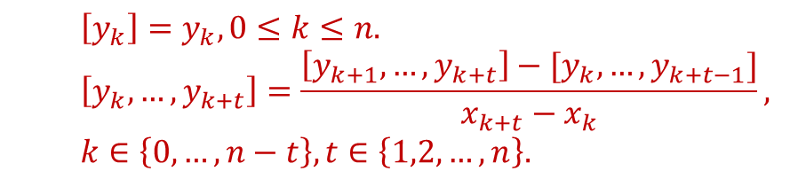
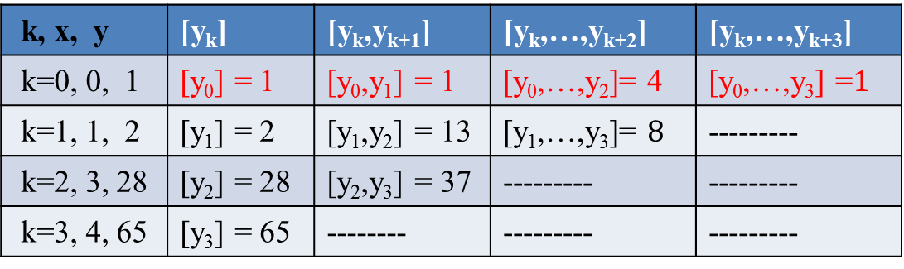
Example
Example, n = 3, 4 sample points.
$\left[y_{k}\right]=y_{k},0≤k≤n.$
$$\left[y_{k},…,y_{k+t}\right]=\frac{\left[y_{k+1},…,y_{k+t}\right]−[y_{k},…,y_{k+t−1}]}{x_{k+t}−x_{k}},$$
$k∈\left\{0,…,n−t\right\}, t∈\left\{1,2,…,n\right\}.$
k, x, y | [y_{k}] | [y_{k},y_{k+1}] | [y_{k},…,y_{k+2}] | [y_{k},…,y_{k+3}]
k=0, 0, 1 | [y₀] = 1 | [y₀,y₁] = 1 | [y₀,…,y₂]= 4 | [y₀,…,y₃] =$1$
k=1, 1, 2 | [y₁] = 2 | [y₁,y₂] = 13 | [y₁,…,y₃]= $8$ | ---------
k=2, 3, 28 | [y₂] = 28 | [y₂,y₃] = 37 | --------- | ---------
k=3, 4, 65 | [y₃] = 65 | -------- | --------- | ---------

Slide 7
Usage
Divided differences are used to form Newton’s polynomial for interpolation.
Divided differences in discrete computations resemble derivatives in continuous algorithms.
We use derivatives to construct Taylor’s expansion for functions.
Similarly, we use divided differences to produce Newton’s polynomials to approximate functions.
Formulations using divided differences are found in
Bezier curves
B-splines
…

Slide 8
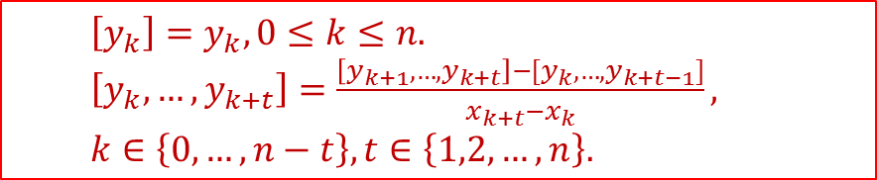
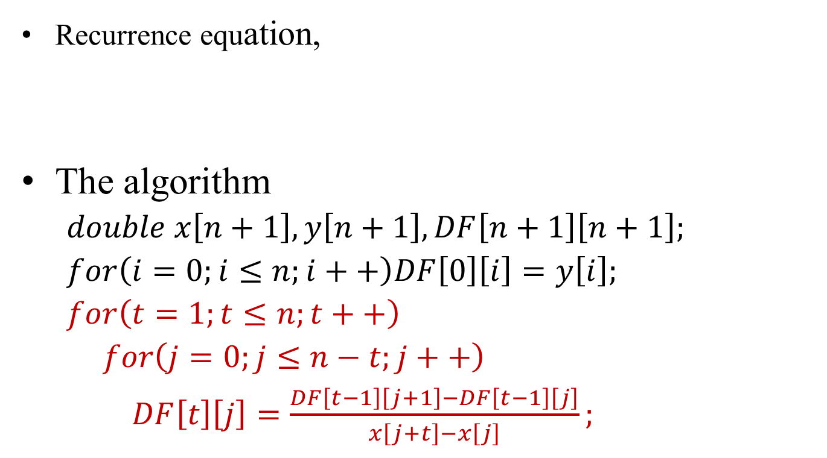
2D Computing Algorithm
Recurrence equation,
The algorithm
$double x\left[n+1\right],y\left[n+1\right], DF\left[n+1\right]\left[n+1\right];$
$for\left(i=0;i≤n;i++\right)DF\left[0\right]\left[i\right]=y\left[i\right];$
$for\left(t=1;t≤n;t++\right)$
$for\left(j=0;j≤n−t;j++\right)$
$DF\left[t\right]\left[j\right]=\frac{DF\left[t−1\right]\left[j+1\right]−DF\left[t−1\right]\left[j\right]}{x\left[j+t\right]−x\left[j\right]};$
$\left[y_{k}\right]=y_{k},0≤k≤n.$
$\left[y_{k},…,y_{k+t}\right]=\frac{\left[y_{k+1},…,y_{k+t}\right]−[y_{k},…,y_{k+t−1}]}{x_{k+t}−x_{k}},$
$k∈\left\{0,…,n−t\right\}, t∈\left\{1,2,…,n\right\}.$

Slide 9
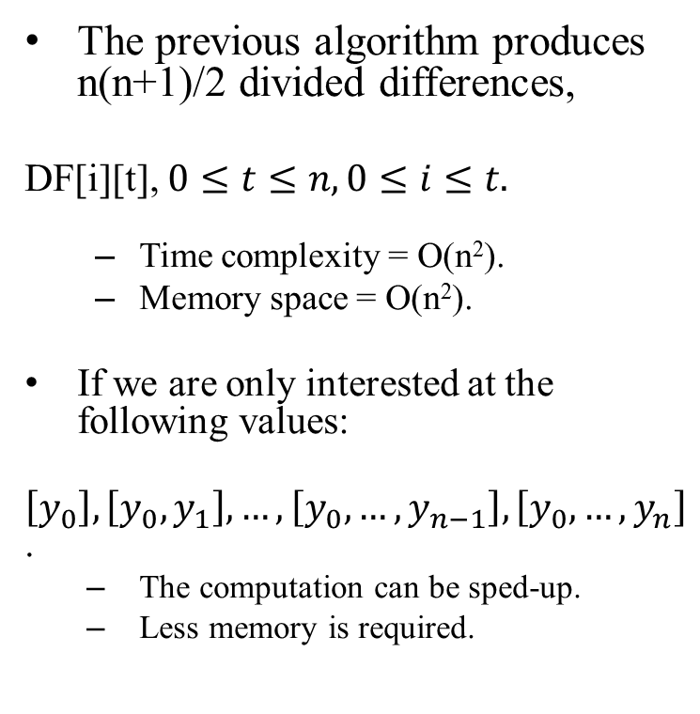
1-D Divided Difference
The previous algorithm produces n(n+1)/2 divided differences,
DF[i][t], $0≤t≤n, 0≤i≤t.$
Time complexity = O(n²).
Memory space = O(n²).
If we are only interested at the following values:
$\left[y_{0}\right],\left[y_{0},y_{1}\right],…,\left[y_{0},…,y_{n−1}\right],\left[y_{0},…,y_{n}\right]$.
The computation can be sped-up.
Less memory is required.
2D & 1D results
2D array of divided differences
1D array of divided differences

Slide 10

1-D In-place Algorithm
x/y | [y_{k}] | [y_{k},y_{k+1}] | [y_{k},…,y_{k+2}] | [y_{k},…,y_{k+3}]
x₀ | [y₀] | [y₀,y₁] | [y₀,…,y₂] | [y₀,…,y₃]
x₁ | [y₁] | [y₁,y₂] | [y₁,…,y₃] | ---------
x₂ | [y₂] | [y₂,y₃] | --------- | ---------
x₃ | [y₃] | -------- | --------- | ---------
In-place algorithm
$double x\left[n+1\right],y\left[n+1\right],DF\left[n+1\right];$
$for\left(i=0;i≤n;i++\right)DF\left[i\right]=y\left[i\right];$
$for\left(t=1;t≤n;t++\right)$ //in backward order
$for\left(j=n;j≥t;j−−\right)$
$DF\left[j\right]= \frac{DF\left[j\right]−DF[j−1]}{x\left[j\right]−x[j−t]};$

Slide 11
C-Program
/*-------------------------------------------------------------
* Samples: x[], y[],
* Number of samples = n+1,
* Newton polynomial coefficients = c[].
*/
void newton(double x[], double y[], double c[], int n)
{
int k, i;
//Order 0 divided differences
for(i=0;i<=n;i++) c[i] = y[i];
//Order k divided differences
for(k=1;k<=n;k++)
for(i=n;i>=k;i--)
c[i] = (c[i]-c[i-1])/(x[i]-x[i-k]);
}

Slide 12
Interpolation Problem
Given a table consisting of n+1 (x_{i}, y_{i}) pairs, compute y(x*) =?
The items might not be sorted on x_{i}.
The data points could be in any order.
However, the interpolation position x* must be within the range of x-values.
x | x₀ | x₁ | x₂ | x₃ | … | x_{n-1} | x_{n}
y | y₀ | y₁ | y₂ | y₃ | … | y_{n-1} | y_{n}

Slide 13
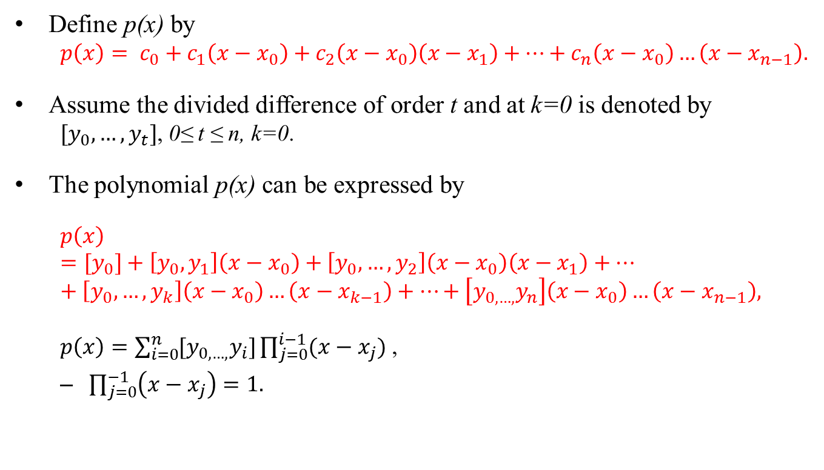
Newton’s Polynomial
Define p(x) by
$p\left(x\right)= c_{0}+c_{1}\left(x−x_{0}\right)+c_{2}\left(x−x_{0}\right)\left(x−x_{1}\right)+…+c_{n}\left(x−x_{0}\right)…\left(x−x_{n−1}\right).$
Assume the divided difference of order t and at k=0 is denoted by
$[y_{0},…,y_{t}]$, 0≤ t ≤ n, k=0.
The polynomial p(x) can be expressed by
$$p\left(x\right)={[y}_{0}]+\left[y_{0},y_{1}\right]\left(x−x_{0}\right)+\left[y_{0},…,y_{2}\right]\left(x−x_{0}\right)\left(x−x_{1}\right)+…+\left[y_{0},…,y_{k}\right]\left(x−x_{0}\right)…\left(x−x_{k−1}\right)+…+\left[y_{0,…,}y_{n}\right]\left(x−x_{0}\right)…\left(x−x_{n−1}\right),$$
$p\left(x\right)=\sum_{i=0}^{n}{[y_{0,…,}y_{i}]\prod_{j=0}^{i−1}{(x−x_{j})}}$ ,
$\prod_{j=0}^{−1}{\left(x−x_{j}\right)=1.}$

Slide 14
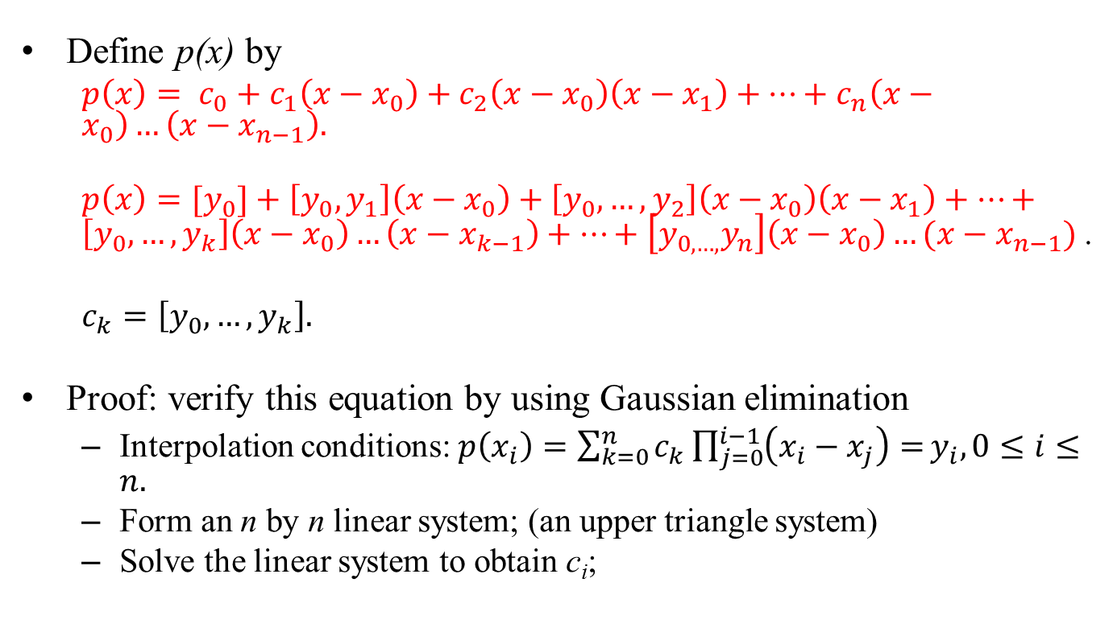
Newton’s Polynomial
Define p(x) by
$p\left(x\right)= c_{0}+c_{1}\left(x−x_{0}\right)+c_{2}\left(x−x_{0}\right)\left(x−x_{1}\right)+…+c_{n}\left(x−x_{0}\right)…\left(x−x_{n−1}\right).$
$p\left(x\right)={[y}_{0}]+\left[y_{0},y_{1}\right]\left(x−x_{0}\right)+\left[y_{0},…,y_{2}\right]\left(x−x_{0}\right)\left(x−x_{1}\right)+…+\left[y_{0},…,y_{k}\right]\left(x−x_{0}\right)…\left(x−x_{k−1}\right)+…+\left[y_{0,…,}y_{n}\right]\left(x−x_{0}\right)…(x−x_{n−1})$.
$c_{k}=\left[y_{0},…,y_{k}\right].$
Proof: verify this equation by using Gaussian elimination
Interpolation conditions: $p\left(x_{i}\right)={\sum_{k=0}^{n}{c_{k}\prod_{j=0}^{i−1}{\left(x_{i}−x_{j}\right)=}}y}_{i}, 0≤i≤n.$
Form an n by n linear system; (an upper triangle system)
Solve the linear system to obtain c_{i};

Slide 15
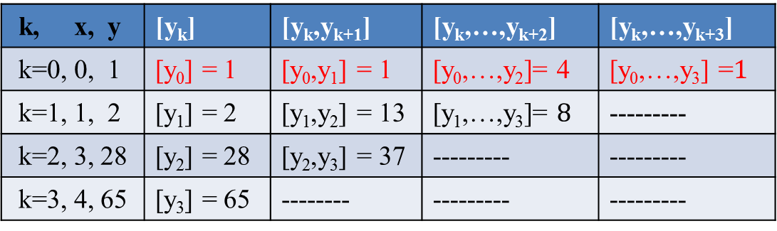
Example
Example, n = 3, 4 sample points.
k, x, y | [y_{k}] | [y_{k},y_{k+1}] | [y_{k},…,y_{k+2}] | [y_{k},…,y_{k+3}]
k=0, 0, 1 | [y₀] = 1 | [y₀,y₁] = 1 | [y₀,…,y₂]= 4 | [y₀,…,y₃] =$1$
k=1, 1, 2 | [y₁] = 2 | [y₁,y₂] = 13 | [y₁,…,y₃]= $8$ | ---------
k=2, 3, 28 | [y₂] = 28 | [y₂,y₃] = 37 | --------- | ---------
k=3, 4, 65 | [y₃] = 65 | -------- | --------- | ---------
$$p\left(x\right)≡1+\left(1\right)\left(x−0\right)+\left(4\right)\left(x−0\right)\left(x−1\right)+(1)(x−0)(x−1)(x−3)$$

Slide 16
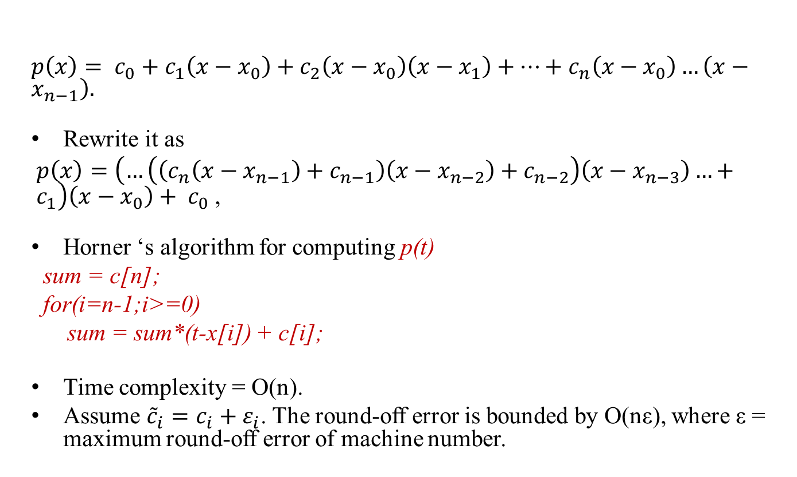
Computing by Horner’s Algorithm
$p\left(x\right)= c_{0}+c_{1}\left(x−x_{0}\right)+c_{2}\left(x−x_{0}\right)\left(x−x_{1}\right)+…+c_{n}\left(x−x_{0}\right)…\left(x−x_{n−1}\right).$
Rewrite it as
$p\left(x\right)=\left(…\left(\left(c_{n}\left(x−x_{n−1}\right)+c_{n−1}\right)\left(x−x_{n−2}\right)+c_{n−2}\right)\left(x−x_{n−3}\right)…+c_{1}\right)\left(x−x_{0}\right)+ c_{0}$ ,
Horner ‘s algorithm for computing p(t)
sum = c[n];
for(i=n-1;i>=0)
sum = sum*(t-x[i]) + c[i];
Time complexity = O(n).
Assume ${\tilde{c}}_{i}=c_{i}+ε_{i}$. The round-off error is bounded by O(nε), where ε = maximum round-off error of machine number.

Slide 17
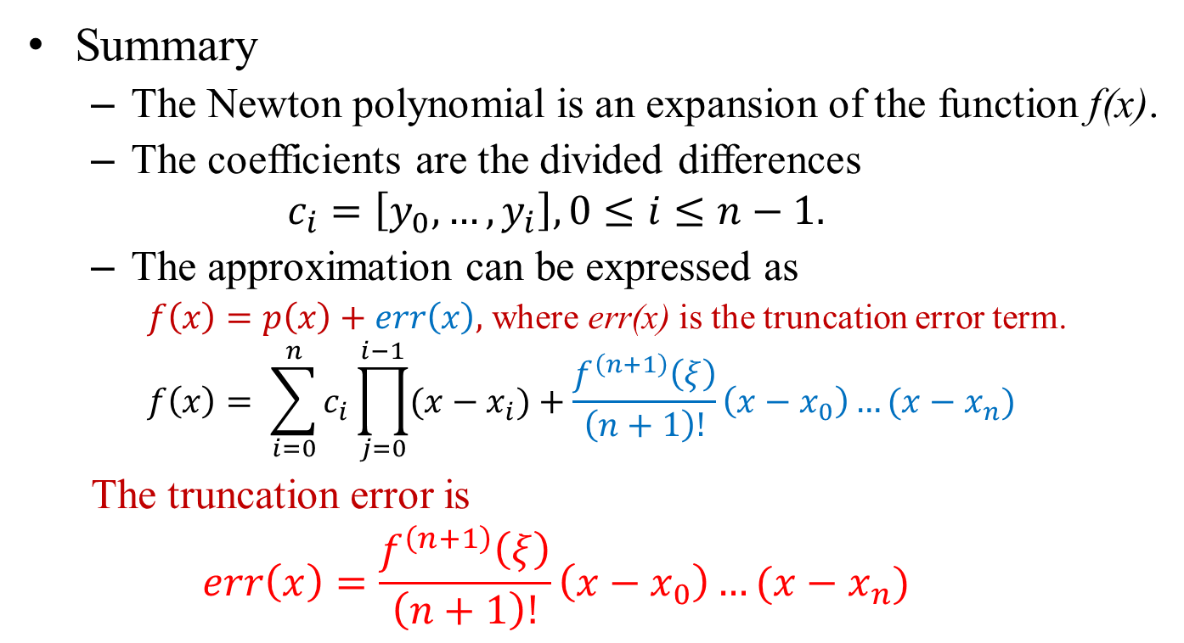
Truncation Error
Summary
The Newton polynomial is an expansion of the function f(x).
The coefficients are the divided differences
$$c_{i}=\left[y_{0},…,y_{i}\right],0≤i≤n−1.$$
The approximation can be expressed as
$f\left(x\right)=p\left(x\right)+err\left(x\right),$ where err(x) is the truncation error term.
$$f\left(x\right)= \sum_{i=0}^{n}{c_{i}\prod_{j=0}^{i−1}{(x−x_{i})}+\frac{f^{\left(n+1\right)}\left(ξ\right)}{\left(n+1\right)!}\left(x−x_{0}\right)…(x−x_{n})}$$
The truncation error is
$$err\left(x\right)=\frac{f^{\left(n+1\right)}\left(ξ\right)}{\left(n+1\right)!}\left(x−x_{0}\right)…(x−x_{n})$$

Slide 18
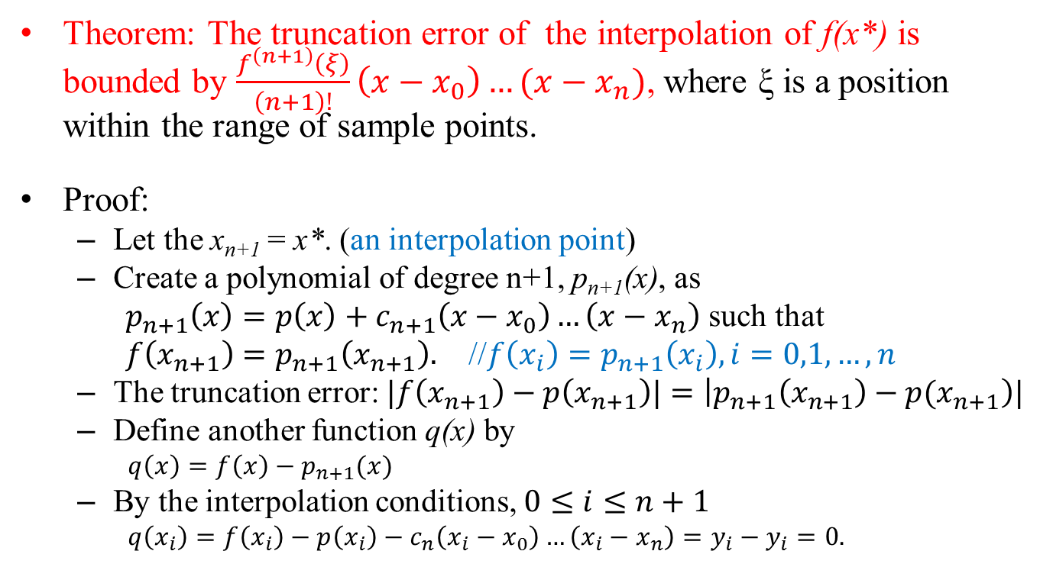
The Proof
Theorem: The truncation error of the interpolation of f(x*) is bounded by $\frac{f^{\left(n+1\right)}\left(ξ\right)}{\left(n+1\right)!}\left(x−x_{0}\right)…(x−x_{n})$, where ξ is a position within the range of sample points.
Proof:
Let the x_{n+1} = x*. (an interpolation point)
Create a polynomial of degree n+1, p_{n+1}(x), as
$p_{n+1}\left(x\right)=p\left(x\right)+c_{n+1}\left(x−x_{0}\right)…\left(x−x_{n}\right)$ such that
$f\left(x_{n+1}\right)=p_{n+1}\left(x_{n+1}\right).$ //$f\left(x_{i}\right)=p_{n+1}\left(x_{i}\right), i=0,1,…,n$
The truncation error: $|f\left(x_{n+1}\right)−p\left(x_{n+1}\right)|=\left|p_{n+1}\left(x_{n+1}\right)−{p(x}_{n+1}\right)|$
Define another function q(x) by
$q\left(x\right)=f\left(x\right)−p_{n+1}(x)$
By the interpolation conditions, $0≤i≤n+1$
$q\left(x_{i}\right)=f\left(x_{i}\right)−p\left(x_{i}\right)−c_{n}\left(x_{i}−x_{0}\right)…\left(x_{i}−x_{n}\right)=y_{i}−y_{i}=0.$
x | x₀ | x₁ | … | x_{n} | x_{n+1}
y | y₀ | y₁ | … | y_{n} | y_{n+1}

Slide 19
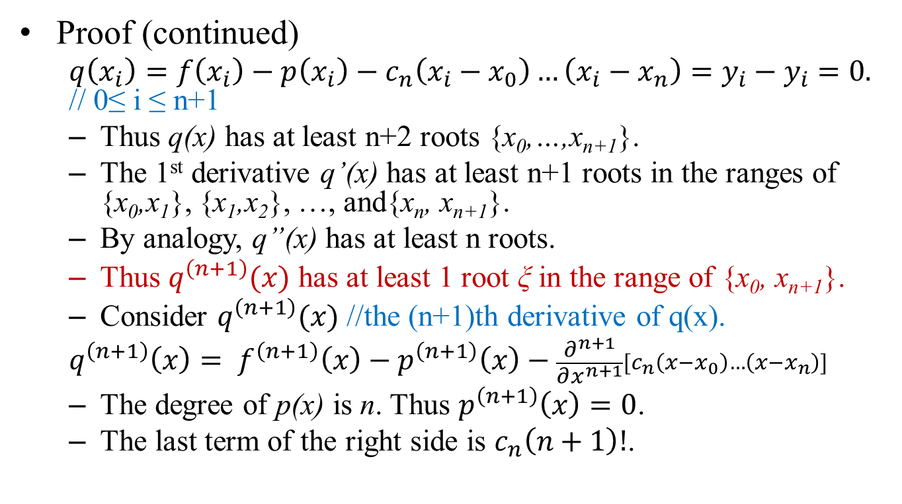
The Proof
Proof (continued)
$q\left(x_{i}\right)=f\left(x_{i}\right)−p\left(x_{i}\right)−c_{n}\left(x_{i}−x_{0}\right)…\left(x_{i}−x_{n}\right)=y_{i}−y_{i}=0.$ // 0≤ i ≤ n+1
Thus q(x) has at least n+2 roots {x₀,…,x_{n+1}}.
The 1st derivative q’(x) has at least n+1 roots in the ranges of {x₀,x₁}, {x₁,x₂}, …, and{x_{n}, x_{n+1}}.
By analogy, q”(x) has at least n roots.
Thus $q^{\left(n+1\right)}(x)$ has at least 1 root ξ in the range of {x₀, x_{n+1}}.
Consider $q^{\left(n+1\right)}(x)$ //the (n+1)th derivative of q(x).
$$q^{\left(n+1\right)}\left(x\right)= f^{\left(n+1\right)}\left(x\right)−p^{\left(n+1\right)}\left(x\right)−\frac{∂^{n+1}}{∂x^{n+1}}[c_{n}\left(x−x_{0}\right)…\left(x−x_{n}\right)]$$
The degree of p(x) is n. Thus $p^{\left(n+1\right)}\left(x\right)=0$.
The last term of the right side is $c_{n}\left(n+1\right)!$.

Slide 20
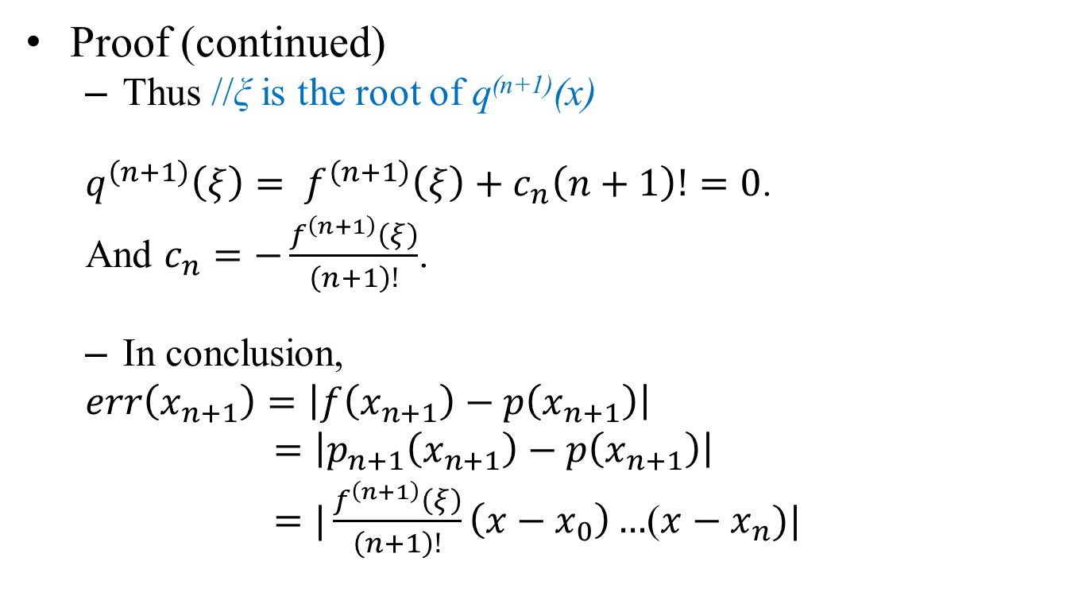
The Proof
Proof (continued)
Thus //ξ is the root of q^{(n+1)}(x)
$q^{\left(n+1\right)}\left(ξ\right)= f^{\left(n+1\right)}\left(ξ\right)+c_{n}\left(n+1\right)!=0$.
And $c_{n}=−\frac{f^{\left(n+1\right)}\left(ξ\right)}{\left(n+1\right)!}$.
In conclusion,
$err\left(x_{n+1}\right)=\left|f\left(x_{n+1}\right)−p\left(x_{n+1}\right)\right|$
$=\left|p_{n+1}\left(x_{n+1}\right)−p\left(x_{n+1}\right)\right|$
$=|\frac{f^{\left(n+1\right)}\left(ξ\right)}{\left(n+1\right)!}\left(x−x_{0}\right)…$($x−x_{n})|$

Slide 21
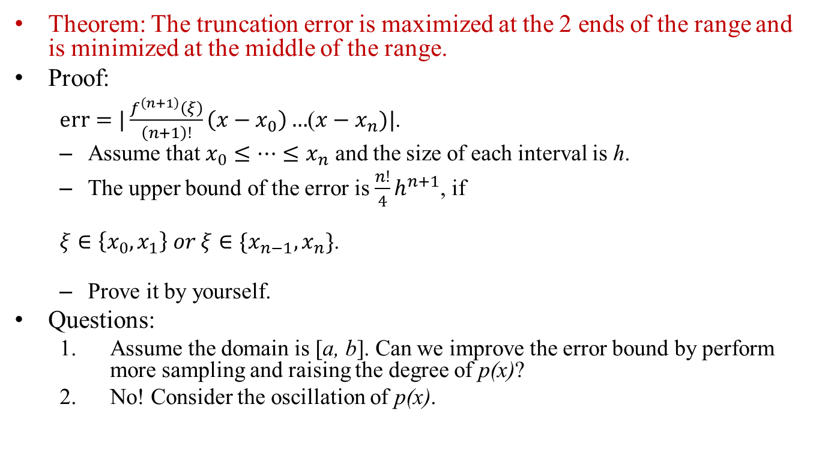
Upper Bound of the Error
Theorem: The truncation error is maximized at the 2 ends of the range and is minimized at the middle of the range.
Proof:
$err=|\frac{f^{\left(n+1\right)}\left(ξ\right)}{\left(n+1\right)!}\left(x−x_{0}\right)…$($x−x_{n})|$.
Assume that $x_{0}{≤…≤x}_{n}$ and the size of each interval is h.
The upper bound of the error is $\frac{n!}{4}h^{n+1}$, if
$ξ∈\left\{x_{0},x_{1}\right\} or ξ∈\{x_{n−1},x_{n}\}$.
Prove it by yourself.
Questions:
Assume the domain is [a, b]. Can we improve the error bound by perform more sampling and raising the degree of p(x)?
No! Consider the oscillation of p(x).

Slide 22
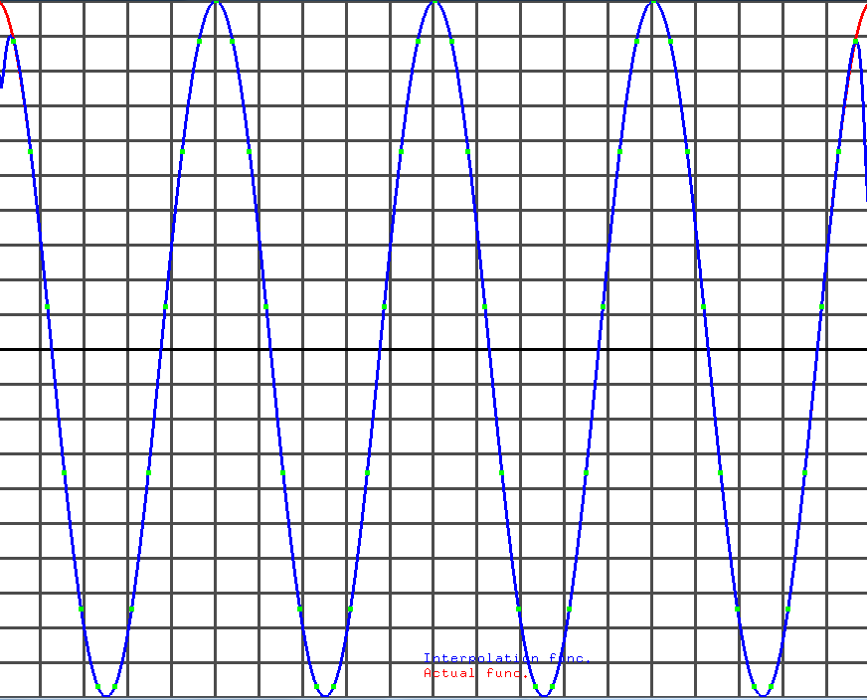


Example
Taking 53 samples from a cosine function.
To demonstrate the problem (truncation error) of polynomial interpolation.
Find the interpolation errors on both sides of the range.
$$cos⁡(x)$$
$$p⁡(x)$$

Slide 23
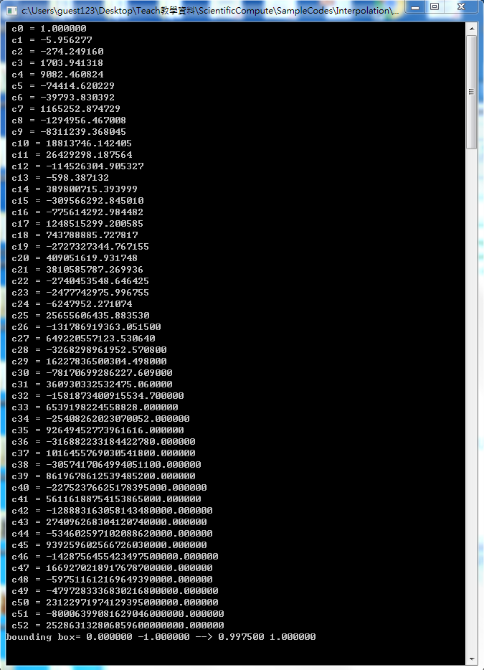
Accuracy of c_{k}::
As n increases, we will encounter loss of significant digits by using Newton’s polynomial.
The magnitudes of the coefficients become larger.
The round-off errors are getting larger in computing the coefficients.
Combined, loss-of-significant digit will occur.

Slide 24
Some Discussion
If the domain is small, say [0,1], and the range of function value is large, for example -10⁷ < f(x)<10⁷.
The coefficients will be large.
Large numerators and small denominators
Loss of significant digits is inevitable.
Solution:
Scale the domain such that it is compatible with the range of function value.
Perform interpolation in the scaled domain.

Slide 25
Conclusion
Newton’s interpolation method uses forward divided differences to form the interpolation polynomial.
The 1-D in-place algorithm speeds up the computation and reduces the memory space.
The round-off error is bounded by O(nε), if Horner’s algorithm is used to evaluate p(x) and assume that the coefficients contain no round-off errors.
The max truncation error occur at the both ends.
Increasing the number of sample points will not reduce truncation error and round-off error.
Oscillation of the interpolation polynomial
Loss of significant digit in the coefficients

Slide 26
Some Problems
If f(x) is a polynomial with degree ≤ n, p(x) is exact. (no truncation error) Prove it.
If the Taylor expansion of f(x) contains infinite many terms, p(x) is not exact. Prove it.
Given n+1 sample points, construct an algorithm to estimate the k-th derivative of the unknown function f(x), where 0≤ k ≤ n.

Slide 27
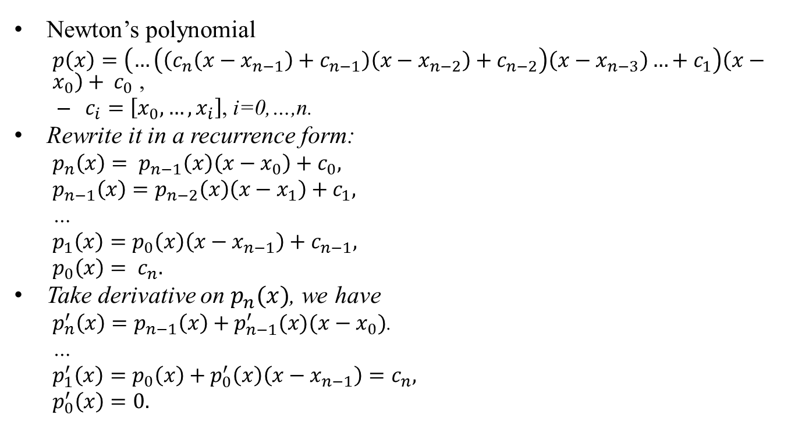
1st derivative of Newton’s Polynomial
Newton’s polynomial
$p\left(x\right)=\left(…\left(\left(c_{n}\left(x−x_{n−1}\right)+c_{n−1}\right)\left(x−x_{n−2}\right)+c_{n−2}\right)\left(x−x_{n−3}\right)…+c_{1}\right)\left(x−x_{0}\right)+ c_{0}$ ,
$c_{i}=\left[x_{0},…,x_{i}\right]$, i=0,…,n.
Rewrite it in a recurrence form:
$p_{n}\left(x\right)= p_{n−1}\left(x\right)\left(x−x_{0}\right)+c_{0},$
$p_{n−1}\left(x\right)=p_{n−2}\left(x\right)\left(x−x_{1}\right)+c_{1},$
…
$p_{1}\left(x\right)=p_{0}\left(x\right)\left(x−x_{n−1}\right)+c_{n−1},$
$p_{0}\left(x\right)= c_{n}.$
Take derivative on $p_{n}(x)$, we have
$p_{n}^{′}\left(x\right)=p_{n−1}\left(x\right)+p_{n−1}^{′}(x)(x−x_{0})$.
…
$p_{1}^{′}\left(x\right)=p_{0}\left(x\right)+p_{0}^{′}\left(x\right)\left(x−x_{n−1}\right)=c_{n},$
$p_{0}^{′}\left(x\right)=0.$

