Slide 1
Other Interpolation and Fitting Methods
Commonly Used in Computation

Slide 2
Outline
Linear, bi-linear, and tri-linear interpolation
Barycentric coordinate interpolation
Fitting and interpolation
Natural cubic splines (optional)

Slide 3
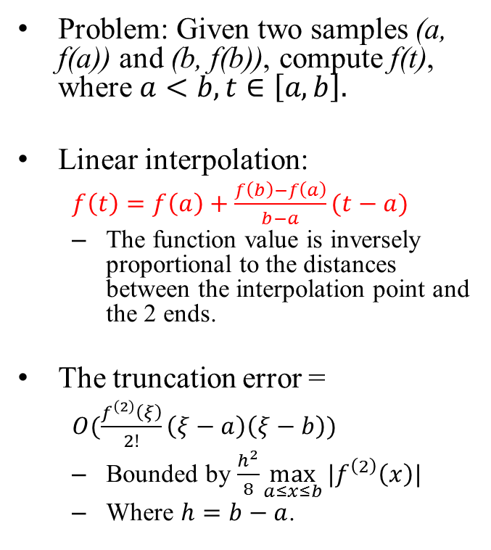
Linear Interpolation
Problem: Given two samples (a, f(a)) and (b, f(b)), compute f(t), where $a<b, t∈\left[a,b\right].$
Linear interpolation:
$f\left(t\right)=f\left(a\right)+\frac{f\left(b\right)−f\left(a\right)}{b−a}(t−a)$
The function value is inversely proportional to the distances between the interpolation point and the 2 ends.
The truncation error =
$O(\frac{f^{\left(2\right)}\left(ξ\right)}{2!}\left(ξ−a\right)\left(ξ−b\right))$
Bounded by $\frac{h^{2}}{8}\max_{a≤x≤b}{|f^{\left(2\right)}\left(x\right)|}$
Where $h=b−a$.
Graph
a
t
b

Slide 4
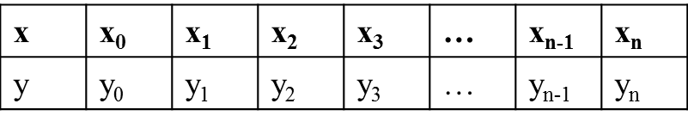
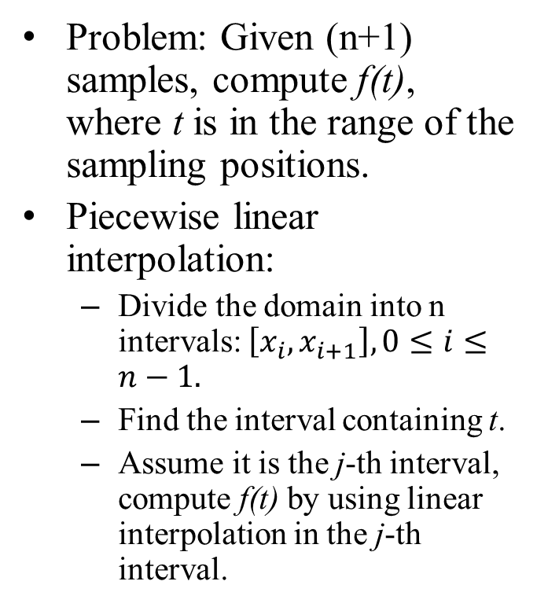
Piecewise Linear Interpolation
Problem: Given (n+1) samples, compute f(t), where t is in the range of the sampling positions.
Piecewise linear interpolation:
Divide the domain into n intervals: $\left[x_{i},x_{i+1}\right],0≤i≤n−1.$
Find the interval containing t.
Assume it is the j-th interval, compute f(t) by using linear interpolation in the j-th interval.
The input data:
The piecewise linear interpolation function s(x) consists of n linear polynomials.
x₀
x_{n}
x_{i}
x_{i+1}

Slide 5
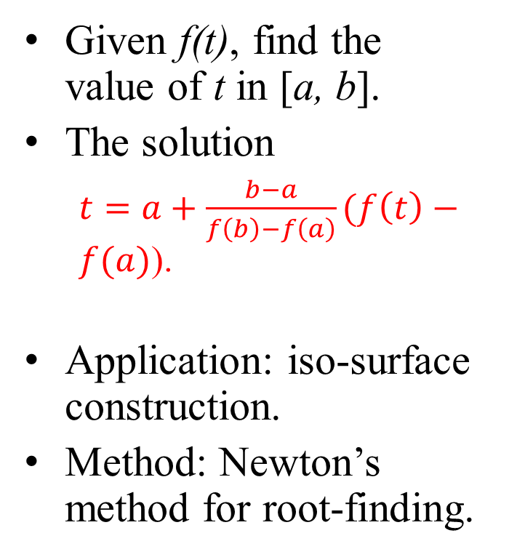
The Inverse Problem
Given f(t), find the value of t in [a, b].
The solution
$t=a+\frac{b−a}{f\left(b\right)−f\left(a\right)}(f\left(t\right)−f(a)$).
Application: iso-surface construction.
Method: Newton’s method for root-finding.
Given function value, find the parametric value.
f(t)
a
t=?
b

Slide 6
Bi-linear Interpolation
Problem: Given the coordinates and function values of the 4 corners of a rectangle, compute the function value f(s, t).
Assume P₀ = (x₀, y₀).
Bi-linear interpolation
Interpolate function values linearly in 1 direction;
For example, the y-direction.
Then interpolate the function value at the target position by using the 2 interpolated values in the other direction.
The x-direction
The 2D domain
P₃, f₃
P₂, f₂
Y
(s,t)
k
P₀, f₀
h
P₁, f₁
X

Slide 7
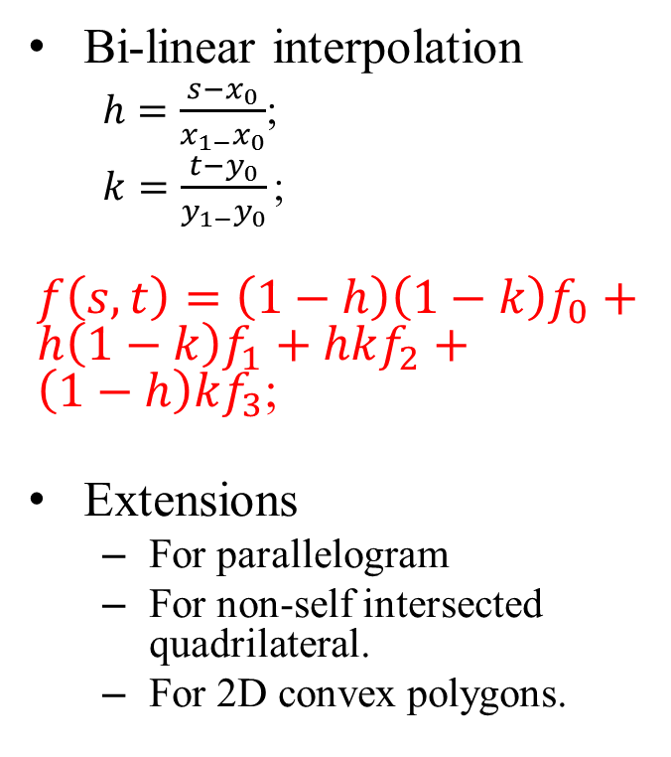
Bi-linear Interpolation
Bi-linear interpolation
$h=\frac{s−x_{0}}{x_{1−}x_{0}}$;
$k=\frac{t−y_{0}}{y_{1−}y_{0}}\text{;}$
$f\left(s,t\right)=\left(1−h\right)\left(1−k\right)f_{0}+h\left(1−k\right)f_{1}+hkf_{2}+\left(1−h\right)kf_{3}$;
Extensions
For parallelogram
For non-self intersected quadrilateral.
For 2D convex polygons.
The domain
P₃, f₃
P₂, f₂
T₀
T₁
k
h
P₀, f₀
P₁, f₁

Slide 8
Bi-linear Interpolation for Quads
The algorithm
Interpolate Q₁ and Q₂ in 2 edges in the y-axis by using the 4 corners;
Interpolate the function value using Q₁ and Q₂ and linear interpolation;
Convex quad
P₃, f₃
P₂, f₂
Q₁, t₁
y
Q₂, t₂
P₀, f₀
P₁, f₁
Q₁, t₁
x
Q₂, t₂

Slide 9

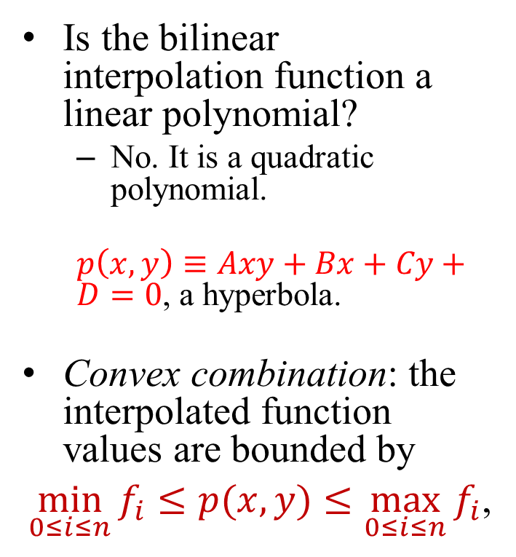
Discussion
Is the bilinear interpolation function a linear polynomial?
No. It is a quadratic polynomial.
$p\left(x,y\right)≡Axy+Bx+Cy+D=0$, a hyperbola.
Convex combination: the interpolated function values are bounded by
$\min_{0≤i≤n}{f_{i}}≤p(x,y)≤\max_{0≤i≤n}{f_{i}}$,
Any iso-curve of p(x,y) is a hyperbola.
p$\left(x,y\right)=f^{∗}$ forms an iso-curve.

Slide 10

Discussion
Given a function value f*, find a point (s, t) such that p(s, t) = f*.
This is the iso-curve problem. We may have infinite many points where function values are f*.
Applications of bilinear interpolation in Computer Graphics
Interpolation of colors, texture coordinates, normal vectors, …
Rasterization
The interpolation function = a hyperbola function.
$f\left(x,y\right)=f^{∗}$ forms an iso-curve.

Slide 11
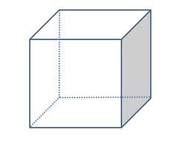
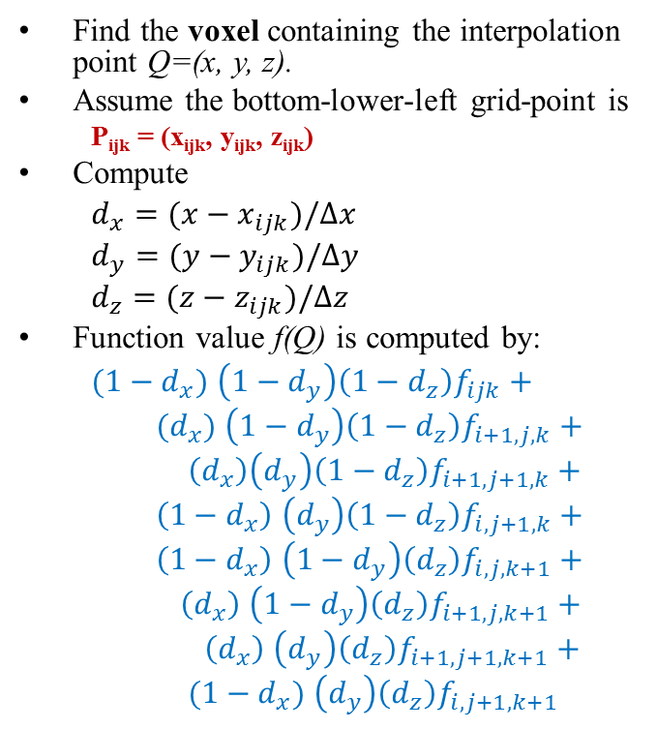
Tri-Linear Interpolation
Find the voxel containing the interpolation point Q=(x, y, z).
Assume the bottom-lower-left grid-point is
P_{ijk} = (x_{ijk}, y_{ijk}, z_{ijk})
Compute
$d_{x}=(x−x_{ijk})/∆x$
$d_{y}=(y−y_{ijk})/∆y$
$d_{z}=(z−z_{ijk})/∆z$
Function value f(Q) is computed by:
$(1−d_{x})$ $\left(1−d_{y}\right)\left(1−d_{z}\right)f_{ijk}+$
$(d_{x})$ $\left(1−d_{y}\right)\left(1−d_{z}\right)f_{i+1,j,k}+$
$\left(d_{x}\right)\left(d_{y}\right)\left(1−d_{z}\right)f_{i+1,j+1,k}+$
$\left(1−d_{x}\right) \left(d_{y}\right)\left(1−d_{z}\right)f_{i,j+1,k}+$
$\left(1−d_{x}\right) \left(1−d_{y}\right)\left(d_{z}\right)f_{i,j,k+1}+$
$\left(d_{x}\right) \left(1−d_{y}\right)\left(d_{z}\right)f_{i+1,j,k+1}+$
$\left(d_{x}\right) \left(d_{y}\right)\left(d_{z}\right)f_{i+1,j+1,k+1}+$
$(1−d_{x}) \left(d_{y}\right)\left(d_{z}\right)f_{i,j+1,k+1}$
Tri-linear interpolation: offsets = {d_{x}, d_{y}, d_{z} } in the master voxel.
P_{i,j+1,k+1}
P_{i+1,j+1,k+1}
P_{i,j,k+1}
P_{i+1,j,k+1}
Q
z
P_{i,j+1,k}
d_{z}
P_{i+1,j+1,k}
d_{x}
y
P_{i,j,k}
d_{y}
x
P_{i+1,j,k}

Slide 12
Application of Tri-linear Interpolation
Medial image visualization
Volume rendering
Iso-surface constrution
Scientific visualization
Iso-surface construction
Volume rendering
Flow visualization
Super-sampling
…

Slide 13
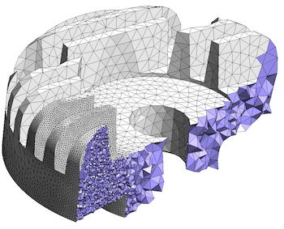
Interpolation in Finite Element Analysis (FEA)
FEA
Decompose the problem domain into cells (or elements);
Convert partial differentiation equation into linear algebraic equation in each cell;
Assemble linear equations of cells to form a global linear equation;
Solve the global linear system to obtain function values at the sample points;
Popular cell types of FEA
http://tetrahedron.montefiore.ulg.ac.be/

Slide 14
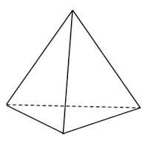
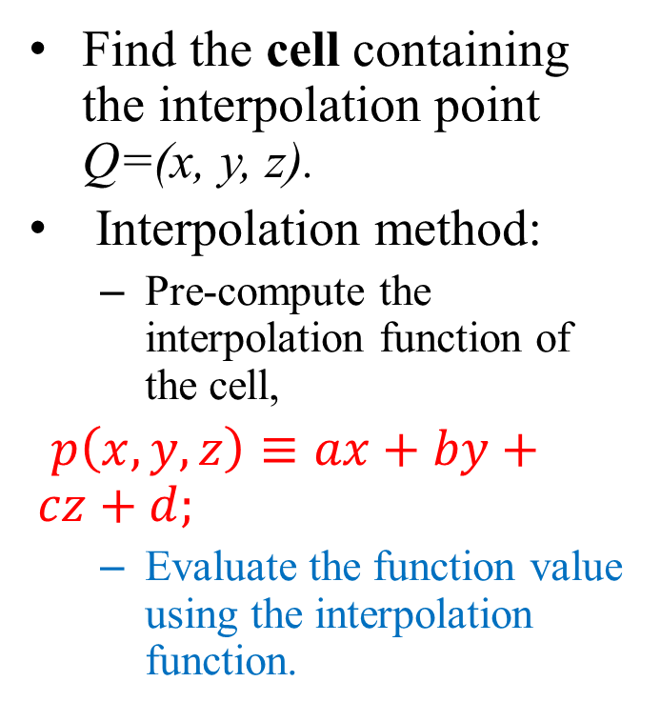

Interpolation for Tetrahedral Meshes
Find the cell containing the interpolation point Q=(x, y, z).
Interpolation method:
Pre-compute the interpolation function of the cell,
$p\left(x,y,z\right)≡ax+by+cz+d;$
Evaluate the function value using the interpolation function.
In a tetrahedral cell, the interpolation function is a linear polynomial:
$$f\left(x,y,z\right)≈ax+by+cz+d$$

Slide 15
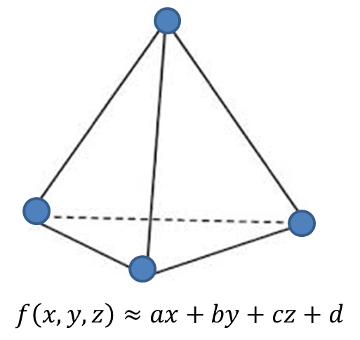
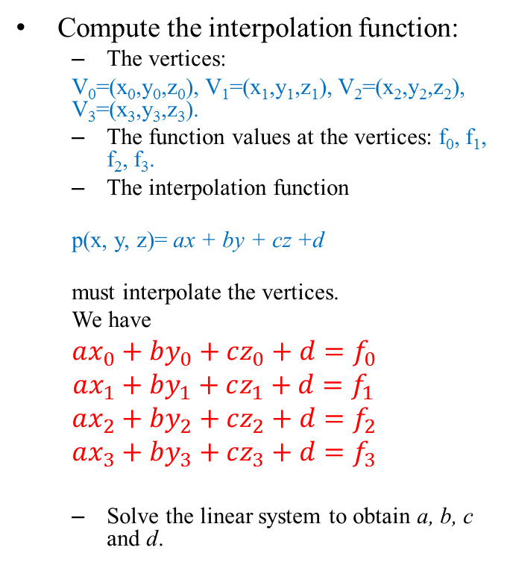
Interpolation Function of Tetrahedral Cell
Compute the interpolation function:
The vertices:
V₀=(x₀,y₀,z₀), V₁=(x₁,y₁,z₁), V₂=(x₂,y₂,z₂), V₃=(x₃,y₃,z₃).
The function values at the vertices: f₀, f₁, f₂, f₃.
The interpolation function
p(x, y, z)= ax + by + cz +d
must interpolate the vertices.
We have
$$ax_{0}+by_{0}+cz_{0}+d=f_{0}$$
$$ax_{1}+by_{1}+cz_{1}+d=f_{1}$$
$$ax_{2}+by_{2}+cz_{2}+d=f_{2}$$
$$ax_{3}+by_{3}+cz_{3}+d=f_{3}$$
Solve the linear system to obtain a, b, c and d.
Using the function values and coordinates of the vertices to compute the interpolation function.
V₀, f₀
V₁, f₁
V₂, f₂
V₃, f₃

Slide 16
Tetrahedral Cell Containment Test
How do we know that a cell contain the interpolation point Q?
Compute the barycentric coordinates of Q =
(u, v, w)
If Q is inside the cell:
0≤ u, v, w ≤1
0≤ u+v+w ≤1
[note] The barycentric coordinates of the 4 vertices:
(0, 0, 0), (1, 0, 0), (0, 1, 0), (0, 0, 1)
The canonical cell and barycentryic coordinates:
z
y
w
x
(0,0,1)
(0,0,0)
v
(0,1,0)
(1,0,0)
u

Slide 17
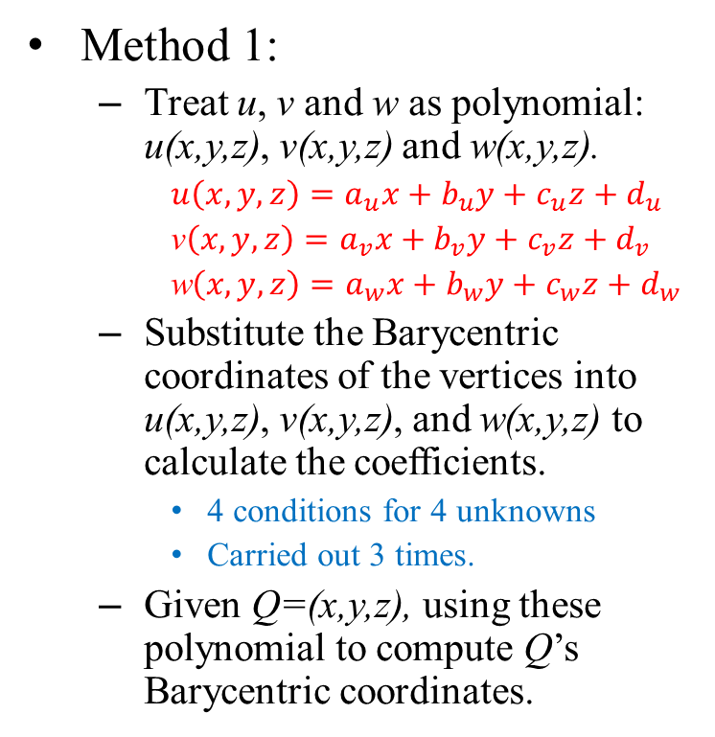
The Barycentric Coordinates (1)
Method 1:
Treat u, v and w as polynomial: u(x,y,z), v(x,y,z) and w(x,y,z).
$u\left(x,y,z\right)=a_{u}x+b_{u}y+c_{u}z+d_{u}$
v$\left(x,y,z\right)=a_{v}x+b_{v}y+c_{v}z+d_{v}$
w$\left(x,y,z\right)=a_{w}x+b_{w}y+c_{w}z+d_{w}$
Substitute the Barycentric coordinates of the vertices into u(x,y,z), v(x,y,z), and w(x,y,z) to calculate the coefficients.
4 conditions for 4 unknowns
Carried out 3 times.
Given Q=(x,y,z), using these polynomial to compute Q’s Barycentric coordinates.
Using interpolation conditions to compute the transformation functions.
w
(0,0,1)
(0,0,0)
v
(0,1,0)
(1,0,0)
u

Slide 18
The Barycentric Coordinates (2)
Method 2:
Using Crammer’s rule to compute u, v, and w.
v
(x₂, y₂)
(x,y,z)
(x₀, y₀)
(x₁, y₁)
u

Slide 19
Interpolation using Barycentric Coordinates
The Barycentric coordinates can be used to compute the function value f(Q):
Compute (u,v,w) at run time;
Substitute (u,v,w) into the following equation:
f(u, v, w) = (1-u-v-w)*f₀ + u*f₁ + v*f₂ + w*f₃
Interpolation using barycentric coordinates and function values of the vertices.
w
f₃
(0,0,1)
(u,v,w)
f₂
(0,0,0)
v
f₀
(0,1,0)
f₁
(1,0,0)
u

Slide 20
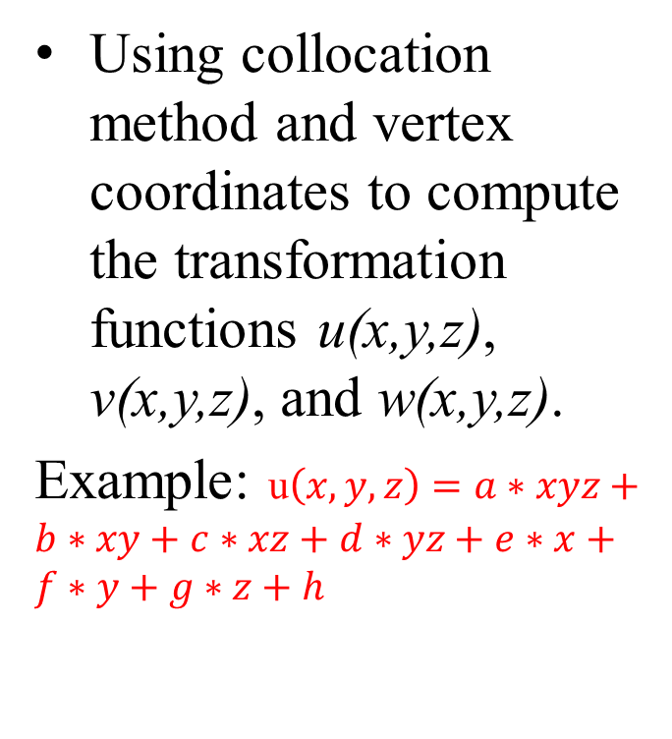
Barycentric Coordinates of Hexahedral Cell
Using collocation method and vertex coordinates to compute the transformation functions u(x,y,z), v(x,y,z), and w(x,y,z).
Example: u$\left(x,y,z\right)=a∗xyz+b∗xy+c∗xz+d∗yz+e∗x+f∗y+g∗z+h$
The canonical hexahedral cell
(0,0,1)
(0,1,0)
(0,0,0)
(1,0,0)

Slide 21
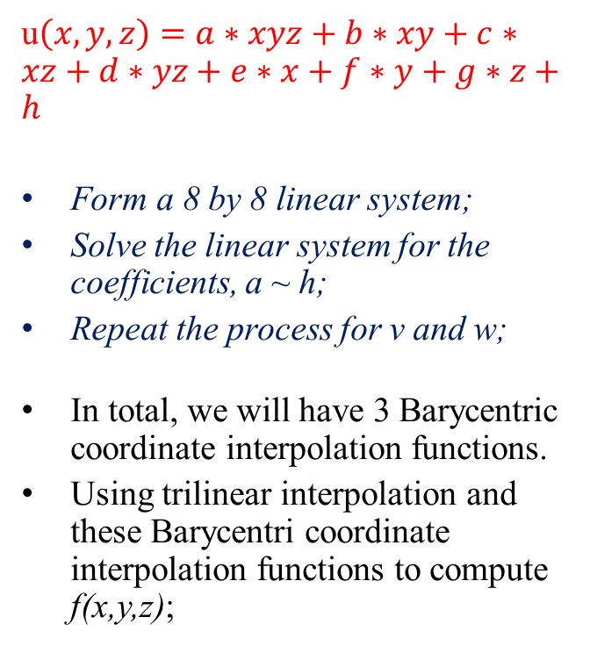
Barycentric Coordinates of Hexahedral Cell
u$\left(x,y,z\right)=a∗xyz+b∗xy+c∗xz+d∗yz+e∗x+f∗y+g∗z+h$
Form a 8 by 8 linear system;
Solve the linear system for the coefficients, a ~ h;
Repeat the process for v and w;
In total, we will have 3 Barycentric coordinate interpolation functions.
Using trilinear interpolation and these Barycentri coordinate interpolation functions to compute f(x,y,z);
The canonical hexahedral cell
(0,0,1)
(u,v,w)
(0,1,0)
(0,0,0)
(1,0,0)

Slide 22
Fitting vs. Interpolation
Fitting: Given
{x_{i}, f_{i}=f(x_{i})}, i = 0,1,2,…,n,
find (construct) a function p(.) so that f(x) can be approximated by p(x).
However,
Interpolation computation requires p(x_{i})=f_{i},
Fitting does not adopt this requirement. (it approximates f(x_{i}).)
Fitting & interpolation
interpolation
fitting

Slide 23
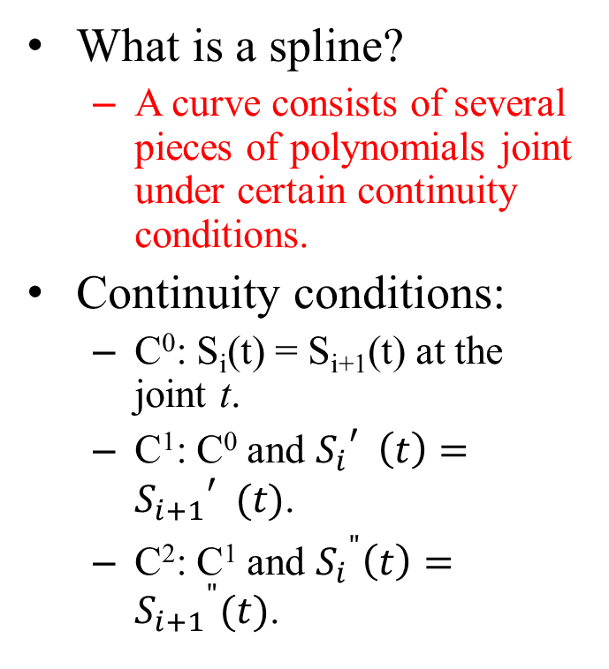
Splines
What is a spline?
A curve consists of several pieces of polynomials joint under certain continuity conditions.
Continuity conditions:
C⁰: S_{i}(t) = S_{i+1}(t) at the joint t.
C¹: C⁰ and ${S_{i}}_{}^{′}\left(t\right)={S_{i+1}}_{}^{′}(t)$.
C²: C¹ and ${S_{i}}^{"}\left(t\right)={S_{i+1}}^{"}(t)$.
A spline of 3 pieces.
S₁(t)
S₀(t)
S₂(t)

Slide 24
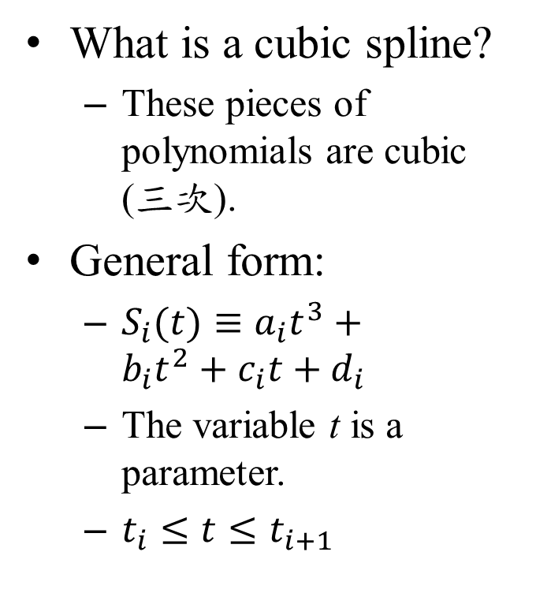
Cubic Splines
What is a cubic spline?
These pieces of polynomials are cubic (三次).
General form:
$S_{i}(t)≡a_{i}t^{3}+b_{i}{t_{}^{2}+c}_{i}t+d_{i}$
The variable t is a parameter.
$t_{i}≤t≤t_{i+1}$
A spline of 3 pieces.
S₁(t)
S₀(t)
S₂(t)
t₀
t₁
t₂
t₃

Slide 25
Natural Cubic Splines
Required conditions:
Assume there are n+1 samples {(t_{i}, f_{i})}, 0 ≤ i ≤ n.
There are n pieces of polynomials, S_{i}(t).
C² continuity at the joints t_{i}, 1≤ i ≤ n.
S₀”(t₀) = S_{n}”(t_{n}) = 0.
The input data:
t | t₀ | t₁ | … | t_{n}
f | f₀ | f₁ | … | f_{n}
t₀
t_{n}

Slide 26
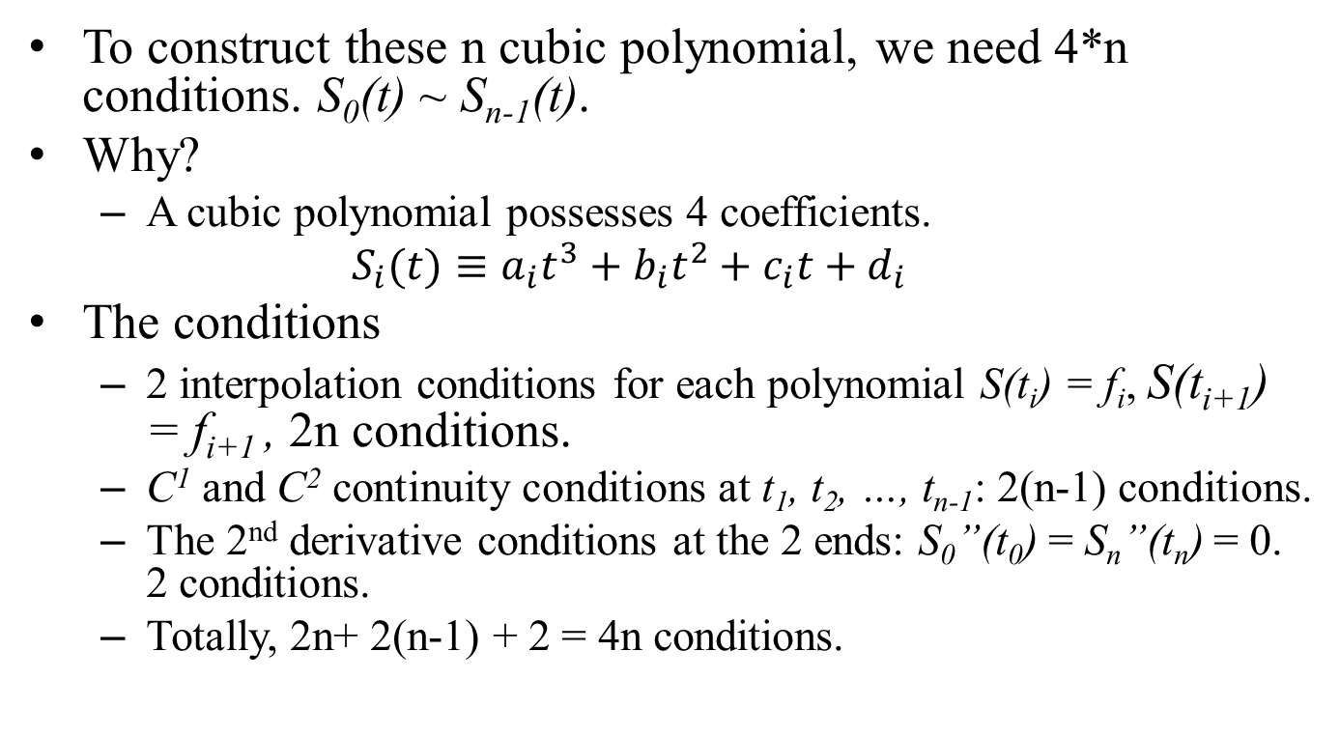
Interpolation Conditions
To construct these n cubic polynomial, we need 4*n conditions. S₀(t) ~ S_{n-1}(t).
Why?
A cubic polynomial possesses 4 coefficients.
$$S_{i}(t)≡a_{i}t^{3}+b_{i}{t_{}^{2}+c}_{i}t+d_{i}$$
The conditions
2 interpolation conditions for each polynomial S(t_{i}) = f_{i}, S(t_{i+1}) = f_{i+1} , 2n conditions.
C¹ and C² continuity conditions at t₁, t₂, …, t_{n-1}: 2(n-1) conditions.
The 2nd derivative conditions at the 2 ends: S₀”(t₀) = S_{n}”(t_{n}) = 0. 2 conditions.
Totally, 2n+ 2(n-1) + 2 = 4n conditions.

Slide 27
Construction Algorithm
We an apply these conditions to form a 4n by 4n linear system and solve the linear system for the coefficients.
The time complexity is O(64n³/3).
But, there are more efficient algorithms for creating these S_{i}(t).
The time complexity is only O(n).

Slide 28
Other Popular Fitting Curves
Bezier curves
B-splines
Piecewise Hermite curves (interpolation)
Non-Uniform Rational B-Splines (NURBS)

