Slide 1
Trapezoid Rule
An integration method based on linear interpolation

Slide 2
Outline
Integration problem
Riemann sum
The trapezoid rule
Truncation error analysis
Example

Slide 3
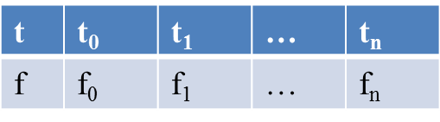

Integration Problem
Input data: a list of n+1 samples.
Goal: compute the integration
$$I_{f}=\int_{t_{0}}^{t_{n}}{f\left(t\right)dt}$$
t₀
t_{n}

Slide 4
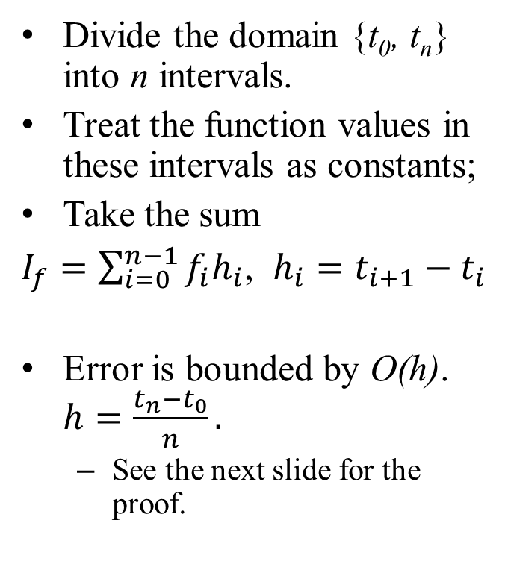
Riemann Sum
Divide the domain {t₀, t_{n}} into n intervals.
Treat the function values in these intervals as constants;
Take the sum
$I_{f}=\sum_{i=0}^{n−1}{f_{i}h_{i}}$, $h_{i}=t_{i+1}−t_{i}$
Error is bounded by O(h). $h=\frac{t_{n}−t_{0}}{n}.$
See the next slide for the proof.
Riemann sum
t | t₀ | t₁ | … | t_{n}
f | f₀ | f₁ | … | f_{n}

Slide 5
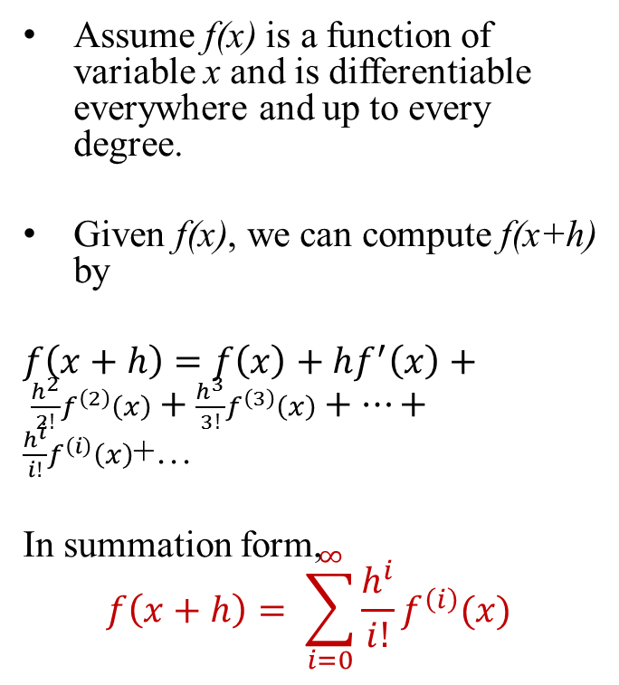
Review: Taylor Series
Assume f(x) is a function of variable x and is differentiable everywhere and up to every degree.
Given f(x), we can compute f(x+h) by
$f\left(x+h\right)=f\left(x\right)+hf^{′}\left(x\right)+ \frac{h^{2}}{2!}f^{\left(2\right)}\left(x\right)+\frac{h^{3}}{3!}f^{\left(3\right)}\left(x\right)+…+\frac{h^{i}}{i!}f^{\left(i\right)}\left(x\right)$+…
In summation form,
$$f\left(x+h\right)= \sum_{i=0}^{∞}{\frac{h^{i}}{i!}f^{\left(i\right)}(x)}$$

Slide 6

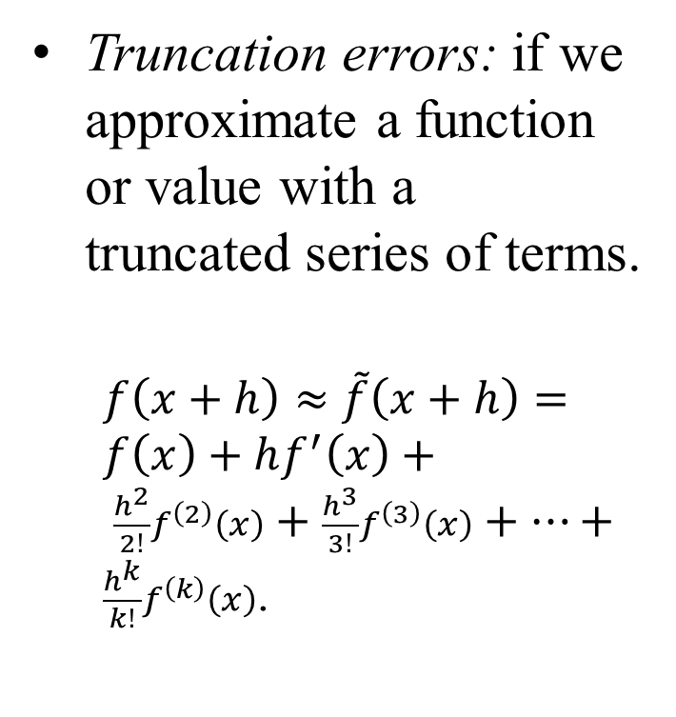
Review: Truncation Errors
Truncation errors: if we approximate a function or value with a truncated series of terms.
$f\left(x+h\right)≈\tilde{f}\left(x+h\right)=f\left(x\right)+hf^{′}\left(x\right)+ \frac{h^{2}}{2!}f^{\left(2\right)}\left(x\right)+\frac{h^{3}}{3!}f^{\left(3\right)}\left(x\right)+…+\frac{h^{k}}{k!}f^{\left(k\right)}\left(x\right)$.
Taylor theorem: The truncation error is bounded by
$\frac{h^{k+1}}{(k+1)!}f^{\left(k+1\right)}\left(ξ\right)$, where ξ is inside interval [x, x+h].
ξ
x
x+h

Slide 7
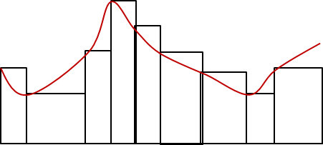
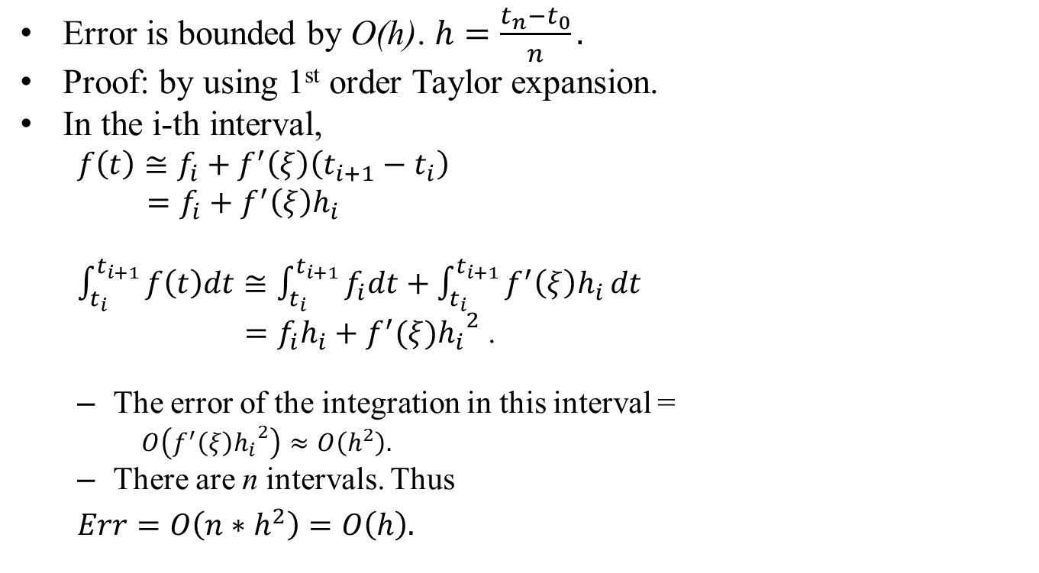
Error Analysis of Riemann Sum
Error is bounded by O(h). $h=\frac{t_{n}−t_{0}}{n}.$
Proof: by using 1st order Taylor expansion.
In the i-th interval,
$f\left(t\right)≅f_{i}+f^{′}\left(ξ\right)\left(t_{i+1}−t_{i}\right)$
$=f_{i}+f^{′}\left(ξ\right)h_{i}$
$\int_{t_{i}}^{t_{i+1}}{f\left(t\right)dt≅\int_{t_{i}}^{t_{i+1}}{f_{i}dt}}+\int_{t_{i}}^{t_{i+1}}{f^{′}\left(ξ\right)h_{i}}dt$
$=f_{i}h_{i}+f^{′}(ξ){h_{i}}^{2}$ .
The error of the integration in this interval =
$O\left(f^{′}\left(ξ\right){h_{i}}^{2}\right)≈O\left(h^{2}\right).$
There are n intervals. Thus
$Err=O\left(n∗h^{2}\right)=O\left(h\right).$

Slide 8
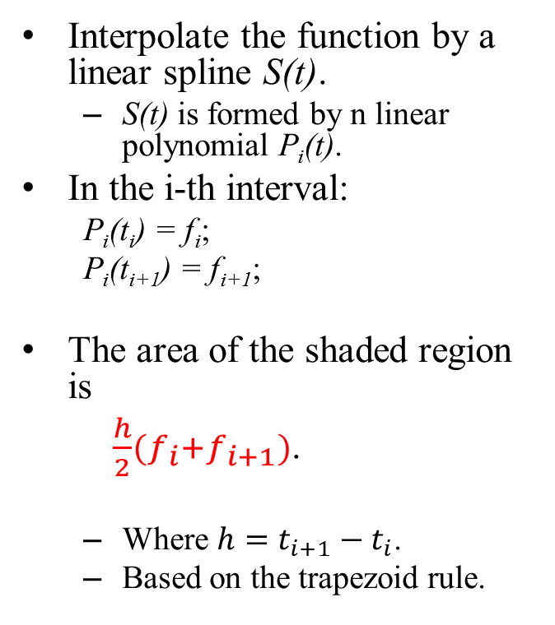
Trapezoid Rule
Interpolate the function by a linear spline S(t).
S(t) is formed by n linear polynomial P_{i}(t).
In the i-th interval:
P_{i}(t_{i}) = f_{i};
P_{i}(t_{i+1}) = f_{i+1};
The area of the shaded region is
$\frac{h}{2}(f_{i}+f_{i+1})$.
Where $h=t_{i+1}−t_{i}$.
Based on the trapezoid rule.
Piecewise linear interpolation results in trapezoid rule.
t_{i}
t_{i+1}

Slide 9
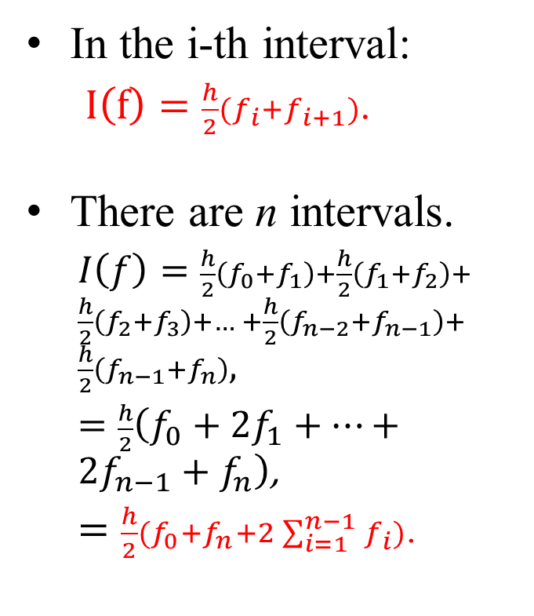
Trapezoid Rule
In the i-th interval:
$I\left(f\right)=\frac{h}{2}(f_{i}+f_{i+1})$.
There are n intervals.
$I\left(f\right)=\frac{h}{2}\left(f_{0}{+f}_{1}\right)+\frac{h}{2}\left(f_{1}{+f}_{2}\right)+\frac{h}{2}\left(f_{2}{+f}_{3}\right)+… +\frac{h}{2}\left(f_{n−2}{+f}_{n−1}\right)+\frac{h}{2}\left(f_{n−1}{+f}_{n}\right),$
$=\frac{h}{2}\left(f_{0}+2f_{1}+…+2f_{n−1}+f_{n}\right)$,
$=\frac{h}{2}(f_{0}+f_{n}+2\sum_{i=1}^{n−1}{f_{i}})$.
Piecewise linear interpolation results in trapezoid rule.
t_{i}
t_{i+1}

Slide 10
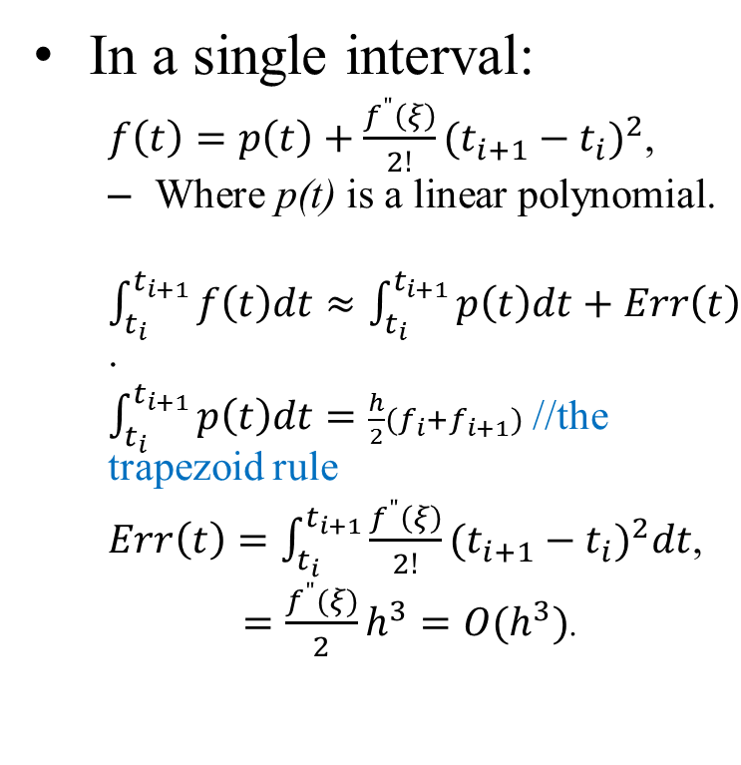
Truncation Error Analysis
In a single interval:
$f\left(t\right)=p\left(t\right)+\frac{f^{"}\left(ξ\right)}{2!}{(t_{i+1}−t_{i})}^{2}$,
Where p(t) is a linear polynomial.
$\int_{t_{i}}^{t_{i+1}}{f\left(t\right)dt≈\int_{t_{i}}^{t_{i+1}}{p\left(t\right)dt+Err\left(t\right)}}$.
$\int_{t_{i}}^{t_{i+1}}{p\left(t\right)dt=\frac{h}{2}(f_{i}+f_{i+1})}$ //the trapezoid rule
$Err\left(t\right)=\int_{t_{i}}^{t_{i+1}}{\frac{f^{"}\left(ξ\right)}{2!}{(t_{i+1}−t_{i})}^{2}dt}$,
$=\frac{f^{"}(ξ)}{2}h^{3}=O(h^{3})$.
Linear interpolation in each interval
t_{i}
t_{i+1}

Slide 11
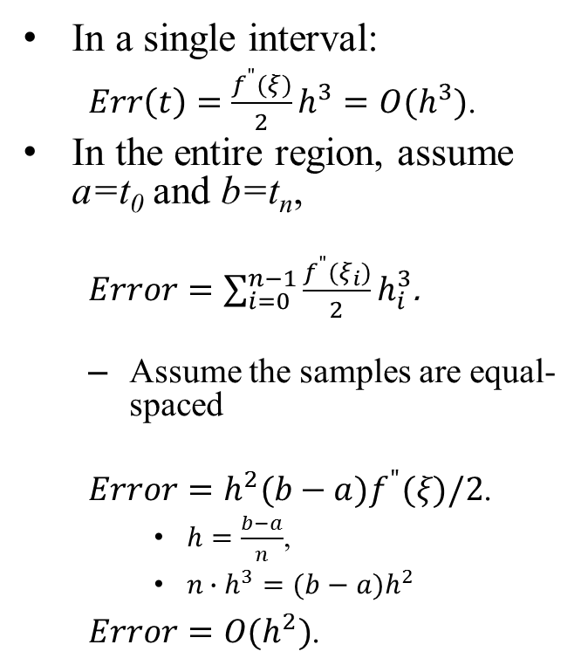
Truncation Error Analysis
In a single interval:
$Err\left(t\right)=\frac{f^{"}(ξ)}{2}h^{3}=O(h^{3})$.
In the entire region, assume a=t₀ and b=t_{n},
$Error=\sum_{i=0}^{n−1}{\frac{f^{"}(ξ_{i})}{2}}h_{i}^{3}$.
Assume the samples are equal-spaced
$Error=h^{2}(b−a)f^{"}(ξ)/2$.
$h=\frac{b−a}{n}$,
$n∙h^{3}=(b−a)h^{2}$
$Error=O(h^{2})$.
Linear interpolation in each interval
t_{i}
t_{i+1}

Slide 12
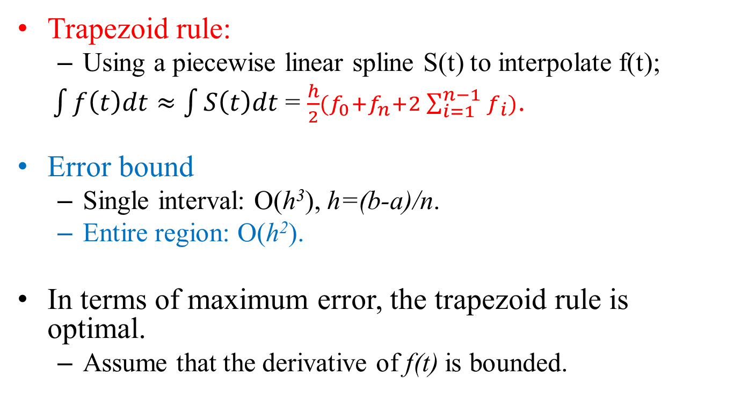
Conclusion
Trapezoid rule:
Using a piecewise linear spline S(t) to interpolate f(t);
$\int{f\left(t\right)dt≈\int{S\left(t\right)dt}}$ = $\frac{h}{2}(f_{0}+f_{n}+2\sum_{i=1}^{n−1}{f_{i}})$.
Error bound
Single interval: O(h³), h=(b-a)/n.
Entire region: O(h²).
In terms of maximum error, the trapezoid rule is optimal.
Assume that the derivative of f(t) is bounded.

