Slide 1
Simpson’s Rule
Quadratic interpolation and integration

Slide 2
Outline
Quadratic interpolation method
Simpson’s rule
Error analysis
Comparisons

Slide 3
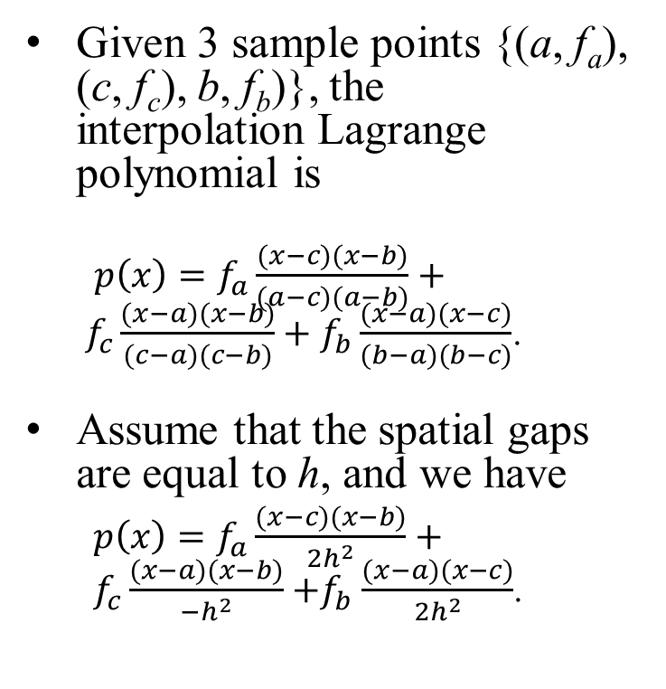
Interpolation Using Lagrange Polynomial
Given 3 sample points {(a, f_{a}), (c, f_{c}), b, f_{b})}, the interpolation Lagrange polynomial is
$p\left(x\right)=f_{a}\frac{(x−c)(x−b)}{(a−c)(a−b)}+f_{c}\frac{(x−a)(x−b)}{(c−a)(c−b)}+f_{b}\frac{(x−a)(x−c)}{(b−a)(b−c)}$.
Assume that the spatial gaps are equal to h, and we have
$p\left(x\right)=f_{a}\frac{(x−c)(x−b)}{{2h}^{2}}+f_{c}\frac{(x−a)(x−b)}{{−h}^{2}}{+f}_{b}\frac{(x−a)(x−c)}{{2h}^{2}}$.
Quadratic Lagrange polynomial p(x).
f(x)
p(x)
a
c=a+h
b=a+2h

Slide 4

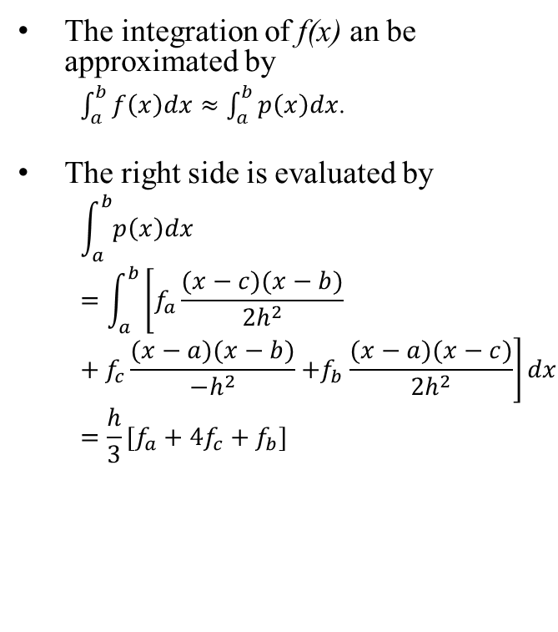
Simpson’s Rule in an Interval
The integration of f(x) an be approximated by
$\int_{a}^{b}{f\left(x\right)dx≈\int_{a}^{b}{p\left(x\right)dx}}$.
The right side is evaluated by
$$\int_{a}^{b}{p\left(x\right)dx}=\int_{a}^{b}{\left[f_{a}\frac{(x−c)(x−b)}{{2h}^{2}}+f_{c}\frac{(x−a)(x−b)}{{−h}^{2}}{+f}_{b}\frac{(x−a)(x−c)}{{2h}^{2}}\right]dx}=\frac{h}{3}[f_{a}+4f_{c}+f_{b}]$$
Quadratic Lagrange polynomial p(x).
$$I\left(p\right)=\frac{h}{3}[f_{a}{+4f}_{c}{+f}_{b}]$$
f(x)
p(x)
a
c=a+h
b=a+2h

Slide 5
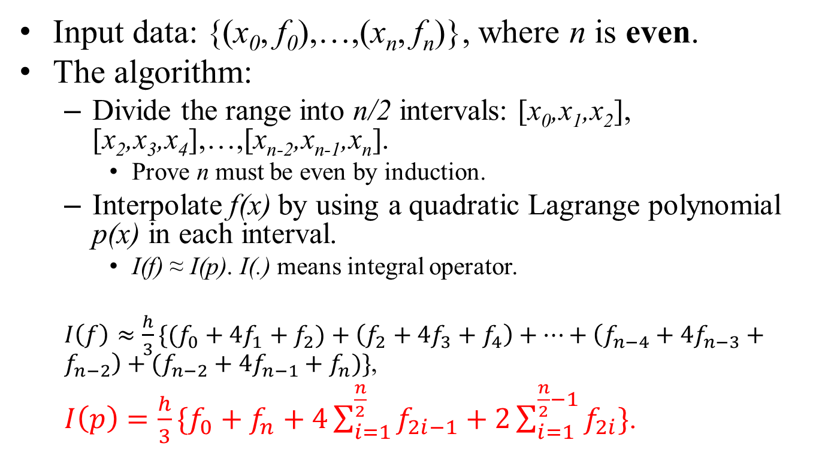
Simpson’s Rule for Integration
Input data: {(x₀, f₀),…,(x_{n}, f_{n})}, where n is even.
The algorithm:
Divide the range into n/2 intervals: [x₀,x₁,x₂], [x₂,x₃,x₄],…,[x_{n-2},x_{n-1},x_{n}].
Prove n must be even by induction.
Interpolate f(x) by using a quadratic Lagrange polynomial p(x) in each interval.
I(f) ≈ I(p). I(.) means integral operator.
$I\left(f\right)≈{\frac{h}{3}\{(f}_{0}+{4f}_{1}+f_{2})+\left(f_{2}+4f_{3}+f_{4}\right)+…+\left(f_{n−4}+{4f}_{n−3}+f_{n−2}\right)+(f_{n−2}+{4f}_{n−1}+f_{n})\}$,
$I\left(p\right)=\frac{h}{3}\{f_{0}+f_{n}+4\sum_{i=1}^{\frac{n}{2}}{f_{2i−1}}+2\sum_{i=1}^{\frac{n}{2}−1}{f_{2i}}\}$.

Slide 6
Accuracy of Simpson’s Rule
Theorem: Simpson’s rule produces no truncation error if f(x) is a polynomial of degree ≤ 3.
Discussion:
Truncation error of interpolation using Lagrange polynomial of degree 2 = O( f⁽³⁾(ξ)*h³).
But, the accuracy of Simpson’s rule is much higher.
Why? 截長補短。
Integration generates less truncation error by at least one order than the interpolation. (If the underlined interpolation method uses splines.)
Proof will be given in class.

Slide 7
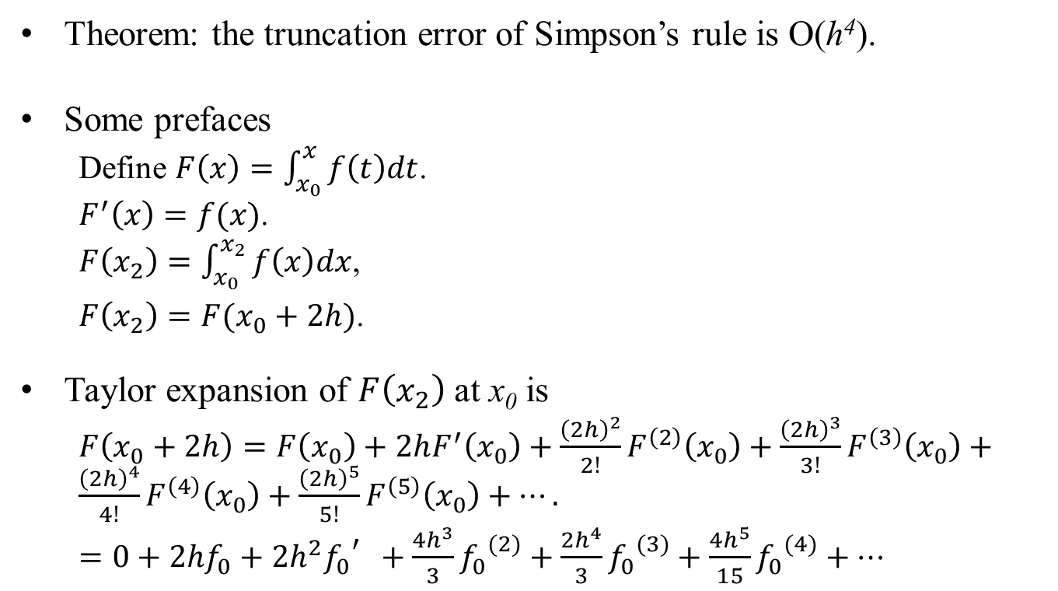
Truncation Error
Theorem: the truncation error of Simpson’s rule is O(h⁴).
Some prefaces
Define $F\left(x\right)=\int_{x_{0}}^{x}{f\left(t\right)dt}$.
$F^{′}\left(x\right)=f(x)$.
$F\left(x_{2}\right)=\int_{x_{0}}^{x_{2}}{f\left(x\right)dx}$,
$F\left(x_{2}\right)={F(x}_{0}+2h)$.
Taylor expansion of $F\left(x_{2}\right)$ at x₀ is
$F\left(x_{0}+2h\right)=F\left(x_{0}\right)+2hF^{′}\left(x_{0}\right)+\frac{{\left(2h\right)}^{2}}{2!}F^{\left(2\right)}\left(x_{0}\right)+\frac{{\left(2h\right)}^{3}}{3!}F^{\left(3\right)}\left(x_{0}\right)+\frac{{\left(2h\right)}^{4}}{4!}F^{\left(4\right)}\left(x_{0}\right)+\frac{{\left(2h\right)}^{5}}{5!}F^{\left(5\right)}\left(x_{0}\right)+….$
$=0+{2hf}_{0}+2h^{2}{f_{0}}_{}^{′}+\frac{4h^{3}}{3}{f_{0}}^{(2)}+\frac{2h^{4}}{3}{f_{0}}^{(3)}+\frac{4h^{5}}{15}{f_{0}}^{(4)}+…$

Slide 8
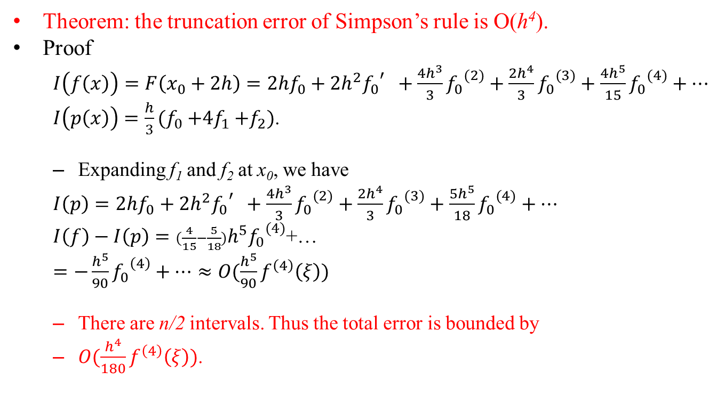
Truncation Error
Theorem: the truncation error of Simpson’s rule is O(h⁴).
Proof
$I\left(f\left(x\right)\right)=F\left(x_{0}+2h\right)={2hf}_{0}+2h^{2}{f_{0}}_{}^{′}+\frac{4h^{3}}{3}{f_{0}}^{(2)}+\frac{2h^{4}}{3}{f_{0}}^{(3)}+\frac{4h^{5}}{15}{f_{0}}^{(4)}+…$
$I\left(p\left(x\right)\right)={\frac{h}{3}(f}_{0}{+4f}_{1}+f_{2})$.
Expanding f₁ and f₂ at x₀, we have
$I\left(p\right)=2hf_{0}+2h^{2}{f_{0}}_{}^{′}+\frac{4h^{3}}{3}{f_{0}}^{(2)}+\frac{2h^{4}}{3}{f_{0}}^{(3)}+\frac{5h^{5}}{18}{f_{0}}^{(4)}+…$
$I\left(f\right)−I\left(p\right)=(\frac{4}{15}−\frac{5}{18})h^{5}{f_{0}}^{(4)}$+…
$=−\frac{h^{5}}{90}{f_{0}}^{\left(4\right)}+…≈O({\frac{h^{5}}{90}f}^{\left(4\right)}\left(ξ\right))$
There are n/2 intervals. Thus the total error is bounded by
$O(\frac{h^{4}}{180}f^{\left(4\right)}\left(ξ\right))$.

Slide 9

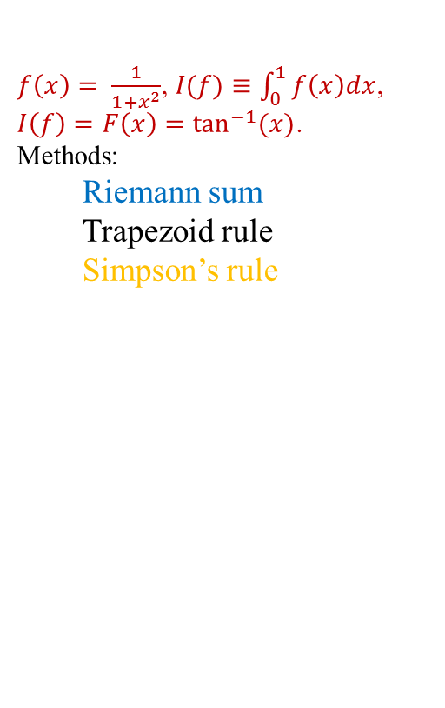
Comparison
$f\left(x\right)= \frac{1}{1+x^{2}}$, $I(f)≡\int_{0}^{1}{f\left(x\right)dx}$,
$I\left(f\right)=F\left(x\right)=\tan^{−1}{(x)}$.
Methods:
Riemann sum
Trapezoid rule
Simpson’s rule
Exact integration = 0.785398
---------------------------------------------------------------------
N= 10, Riemann= 0.809981, Trapezoid=0.784981, Simpson=0.785398
N= 20, Riemann= 0.797794, Trapezoid=0.785294, Simpson=0.785398
N= 30, Riemann= 0.793685, Trapezoid=0.785352, Simpson=0.785398
N= 40, Riemann= 0.791622, Trapezoid=0.785372, Simpson=0.785398
N= 50, Riemann= 0.790381, Trapezoid=0.785381, Simpson=0.785398
N= 60, Riemann= 0.789553, Trapezoid=0.785387, Simpson=0.785398
N= 70, Riemann= 0.788961, Trapezoid=0.785390, Simpson=0.785398
N= 80, Riemann= 0.788517, Trapezoid=0.785392, Simpson=0.785398
$h=0.1={10}^{−1}$,
Rieman, $O(f^{′}\left(ξ\right)h)≈O(\frac{1}{N}),$
Trapezoid, $O(\frac{f"(ξ)}{2}h^{2})≈O(\frac{1}{2}∙\frac{1}{N^{2}})$,
Sinpson, $O(\frac{1}{180}f^{\left(4\right)}(ξ)h^{4} )≈)(\frac{1}{180}∙\frac{1}{N^{4}}).$

Slide 10
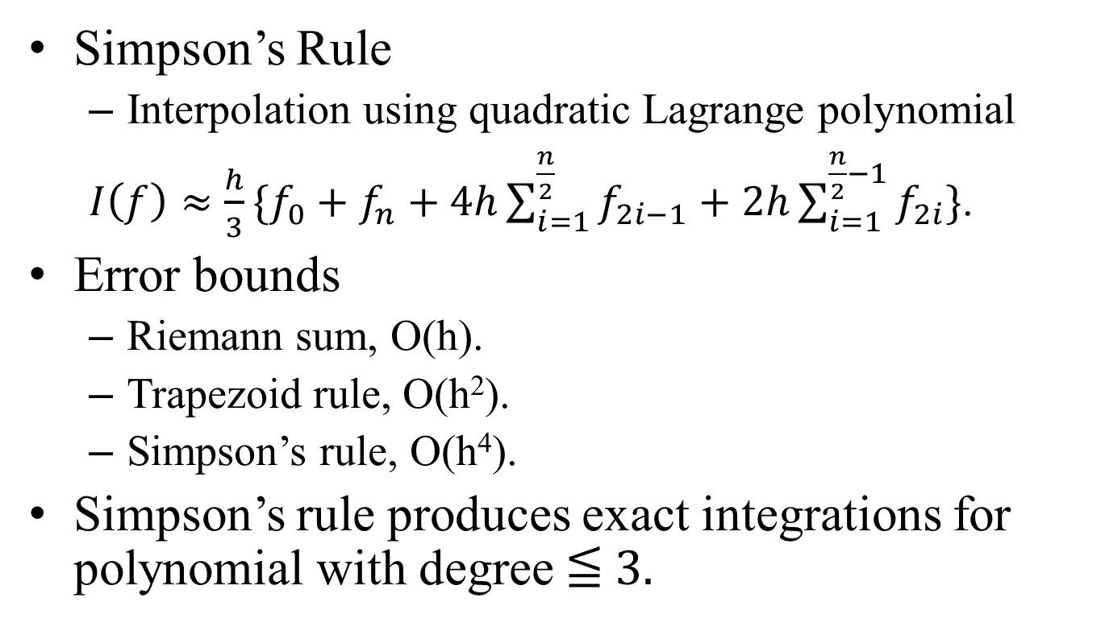
Conclusion
Simpson’s Rule
Interpolation using quadratic Lagrange polynomial
$I\left(f\right)≈\frac{h}{3}\{f_{0}+f_{n}+4h\sum_{i=1}^{\frac{n}{2}}{f_{2i−1}}+2h\sum_{i=1}^{\frac{n}{2}−1}{f_{2i}}\}$.
Error bounds
Riemann sum, O(h).
Trapezoid rule, O(h²).
Simpson’s rule, O(h⁴).
Simpson’s rule produces exact integrations for polynomial with degree ≦ 3.

