Slide 1
Gaussian Quadrature Integration
Orthogonal polynomial

Slide 2
Outline
Introduction
Functional space
Orthogonal polynomials
Legendre polynomials
The algorithm
Review of Lagrange polynomial for interpolation
The formulation of Gaussian quadrature
Conformation mapping of problem domain
The table of weights and sample positions
Error analysis

Slide 3
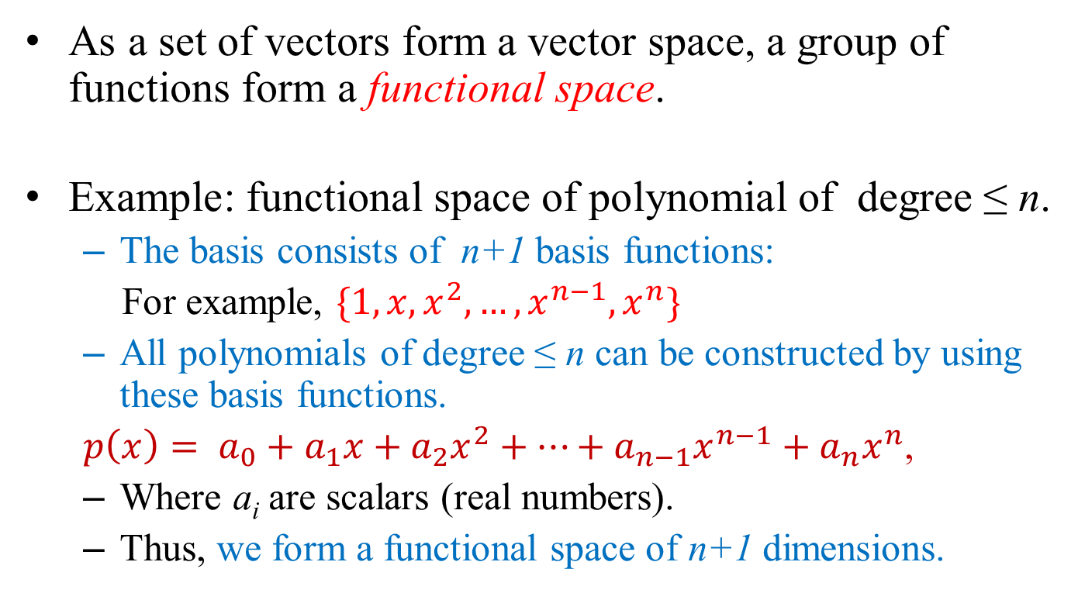
Functional Space
As a set of vectors form a vector space, a group of functions form a functional space.
Example: functional space of polynomial of degree ≤ n.
The basis consists of n+1 basis functions:
For example, $\{1,x,x^{2},…,x^{n−1},x^{n}\}$
All polynomials of degree ≤ n can be constructed by using these basis functions.
$p\left(x\right)= a_{0}+a_{1}x+a_{2}x^{2}+…+a_{n−1}x^{n−1}+a_{n}x^{n}$,
Where a_{i} are scalars (real numbers).
Thus, we form a functional space of n+1 dimensions.

Slide 4
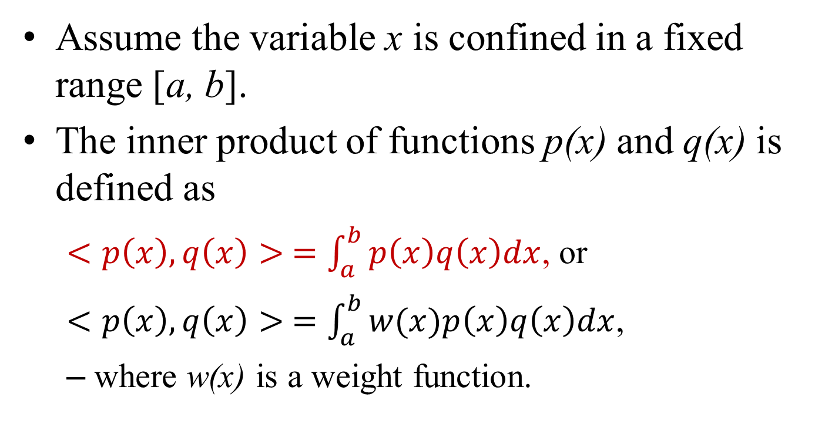
Inner Product of Functions
Assume the variable x is confined in a fixed range [a, b].
The inner product of functions p(x) and q(x) is defined as
$<p\left(x\right),q\left(x\right)> =\int_{a}^{b}{p\left(x\right)q\left(x\right)dx}$, or
$<p\left(x\right),q\left(x\right)> =\int_{a}^{b}{w(x)p\left(x\right)q\left(x\right)dx}$,
where w(x) is a weight function.

Slide 5
Orthogonality
Definition: Functions p(x) and q(x) are orthogonal in the functional space, if
<p(x), q(x)> = 0.
Similar to the orthogonality of vector spaces.
Orthogonal polynomial of degree n:
h_{n}(x) is a polynomial of degree n, and
<h_{n}(x), x^{k}> = 0, for 0 ≤ k ≤ n.
Properties
h_{n}(x) is orthogonal to all polynomial with degrees ≤ n in the functional space except itself.
<h_{n}(x), h_{n}(x)> = 1. //maybe another constant.

Slide 6
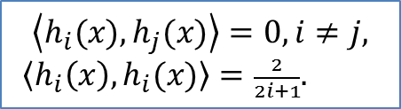
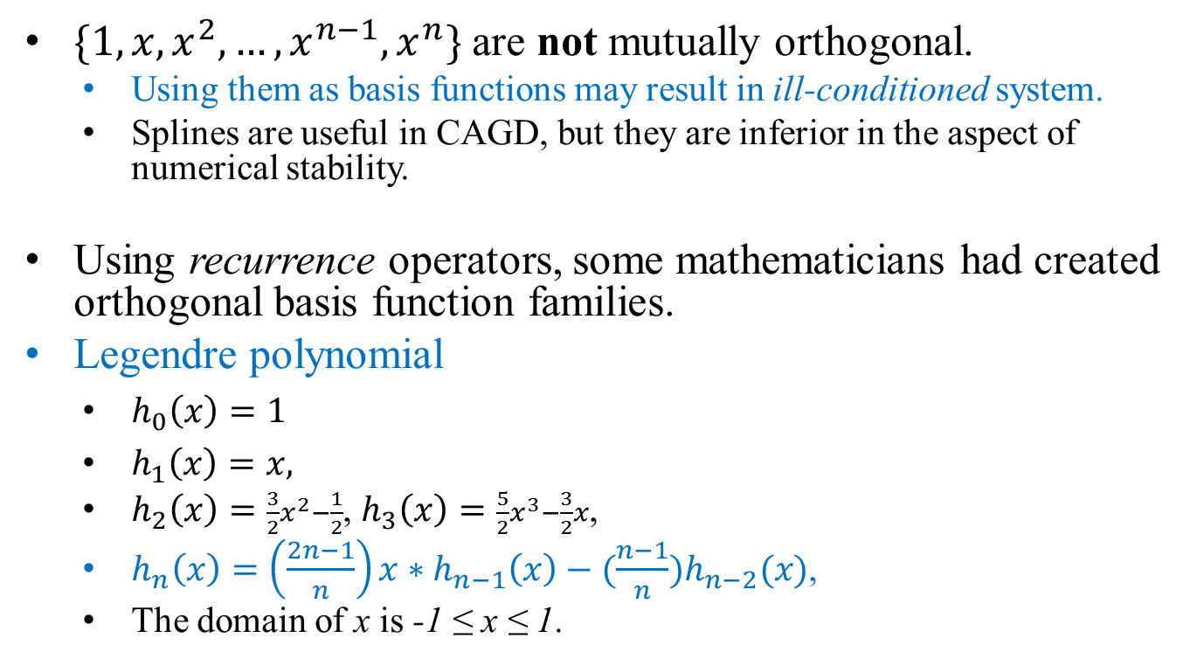
Legendre Polynomials
$\{1,x,x^{2},…,x^{n−1},x^{n}\}$ are not mutually orthogonal.
Using them as basis functions may result in ill-conditioned system.
Splines are useful in CAGD, but they are inferior in the aspect of numerical stability.
Using recurrence operators, some mathematicians had created orthogonal basis function families.
Legendre polynomial
$h_{0}\left(x\right)=1$
$h_{1}\left(x\right)=x,$
$h_{2}\left(x\right)=\frac{3}{2}x^{2}−\frac{1}{2}$, $h_{3}\left(x\right)=\frac{5}{2}x^{3}−\frac{3}{2}x$,
$h_{n}\left(x\right)=\left(\frac{2n−1}{n}\right)x∗h_{n−1}\left(x\right)−(\frac{n−1}{n})h_{n−2}(x)$,
The domain of x is -1 ≤ x ≤ 1.
$$\left\langle h_{i}(x),h_{j}(x)\right\rangle =0,i≠j,$$
$\left\langle h_{i}\left(x\right),h_{i}(x)\right\rangle =\frac{2}{2i+1}.$

Slide 7
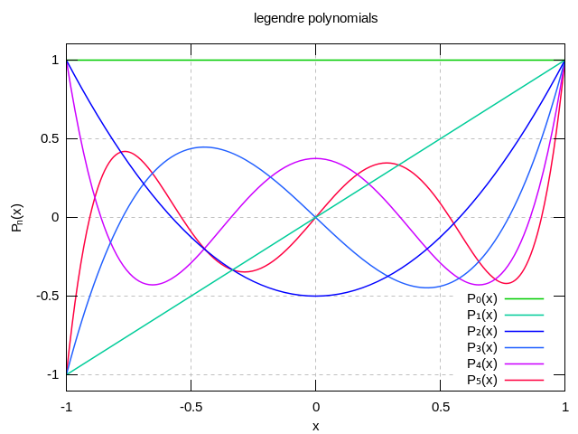
Graphs of Legendre Polynomial
From Wiki
How many roots can P_{n}(x) possess?
Answer: n roots.

Slide 8
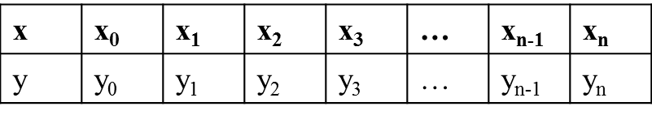
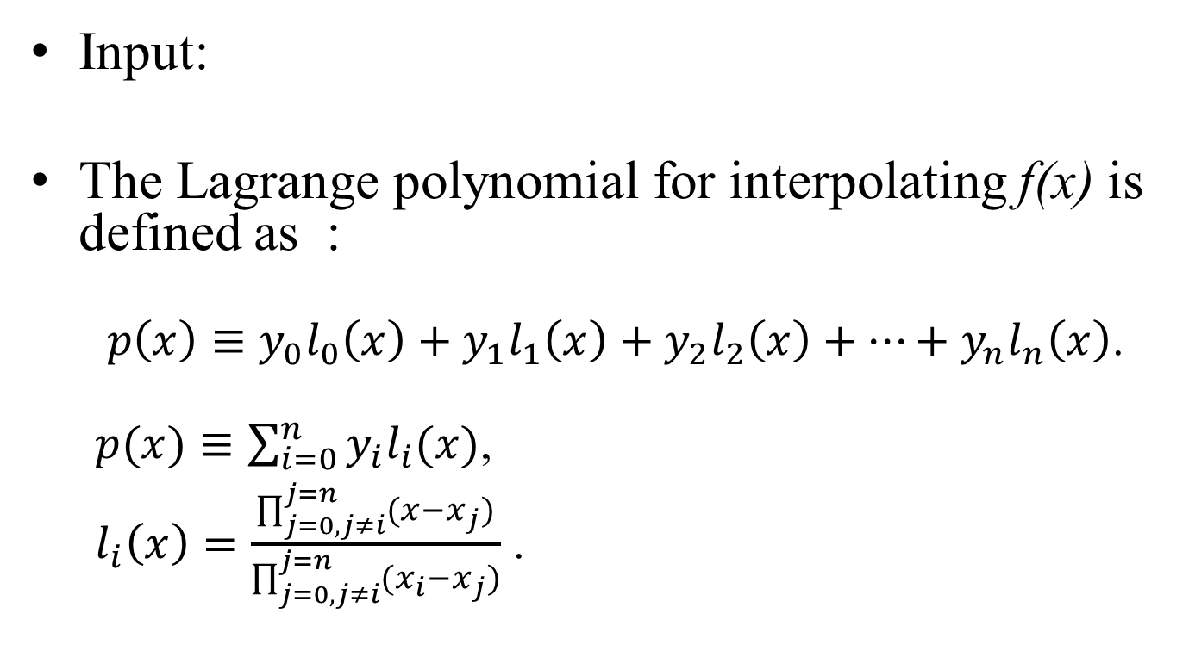
Lagrange Polynomial
Input:
The Lagrange polynomial for interpolating f(x) is defined as :
$p\left(x\right)≡y_{0}l_{0}\left(x\right)+y_{1}l_{1}\left(x\right)+y_{2}l_{2}\left(x\right)+…+y_{n}l_{n}\left(x\right)$.
$p(x)≡\sum_{i=0}^{n}{y_{i}l_{i}(x)}$,
$l_{i}\left(x\right)=\frac{\prod_{j=0,j≠i}^{j=n}{(x−x_{j})}}{\prod_{j=0,j≠i}^{j=n}{(x_{i}−x_{j})}}$ .

Slide 9
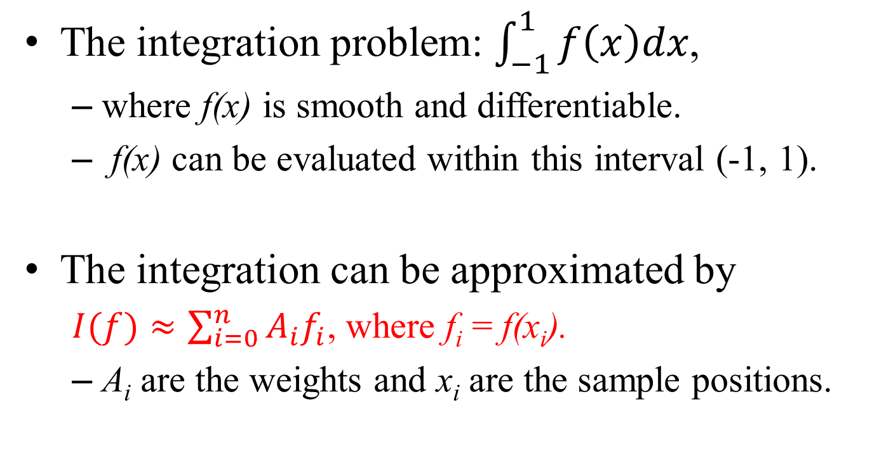
Gaussian Quadrature
The integration problem: $\int_{−1}^{1}{f\left(x\right)dx}$,
where f(x) is smooth and differentiable.
f(x) can be evaluated within this interval (-1, 1).
The integration can be approximated by
$I(f)≈\sum_{i=0}^{n}{A_{i}f_{i}}$, where f_{i} = f(x_{i}).
A_{i} are the weights and x_{i} are the sample positions.

Slide 10
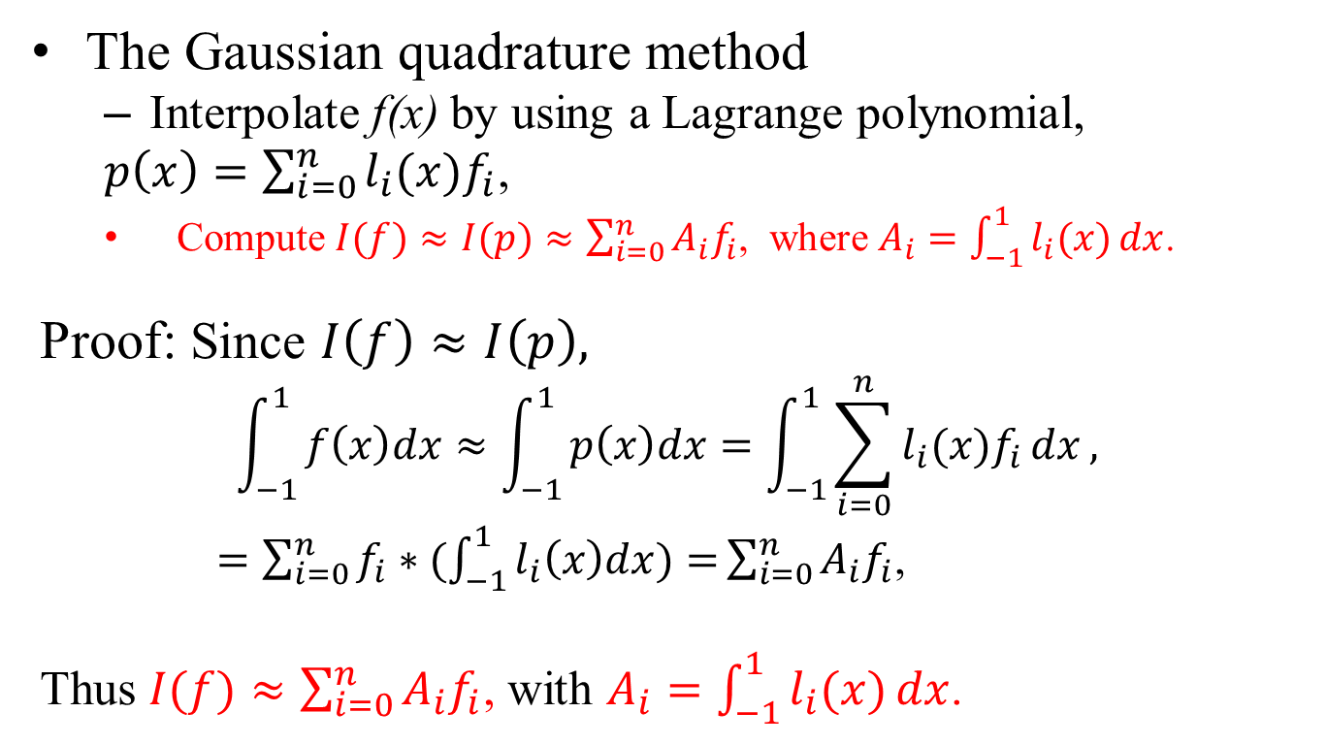
Gaussian Quadrature
The Gaussian quadrature method
Interpolate f(x) by using a Lagrange polynomial,
$p\left(x\right)=\sum_{i=0}^{n}{l_{i}(x)f_{i}}$,
Compute $I(f)≈I(p)≈\sum_{i=0}^{n}{A_{i}f_{i}}$, where $A_{i}=\int_{−1}^{1}{l_{i}(x)}dx$.
Proof: Since $I\left(f\right)≈I\left(p\right),$
$$\int_{−1}^{1}{f\left(x\right)dx≈\int_{−1}^{1}{p\left(x\right)dx=\int_{−1}^{1}{\sum_{i=0}^{n}{l_{i}(x)f_{i}}}dx}},$$
$=\sum_{i=0}^{n}{f_{i}∗(\int_{−1}^{1}{l_{i}\left(x\right)dx)=}}\sum_{i=0}^{n}{A_{i}f_{i}}$,
Thus $I(f)≈\sum_{i=0}^{n}{A_{i}f_{i}}$, with $A_{i}=\int_{−1}^{1}{l_{i}(x)}dx$.

Slide 11
Roots of Legendre Polynomial
To improve accuracy
The sample positions are the roots of an orthogonal polynomial of degree (n+1).
We have (n+1) samples in the input data
In this lecture, we use the Legendre polynomial h_{n+1}(x).
Why do we select these roots as the sample positions?
To achieve greater accuracy!
See the following slides.

Slide 12
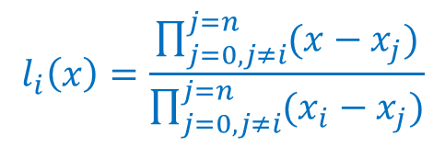
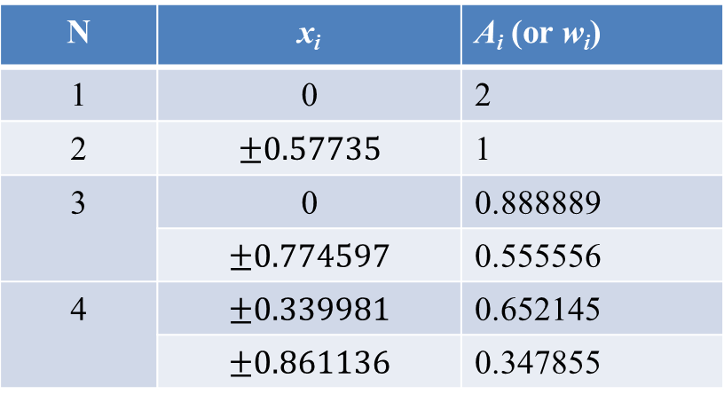
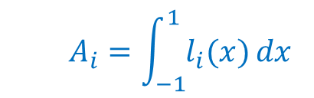
Table of Sample Points & Weights
The roots and the weights had been computed and tabulated. Parts of the table are shown below.
N | x_{i} | A_{i} (or w_{i})
1 | 0 | 2
2 | $$±0.57735$$ | 1
3 | 0 | 0.888889
 | $$±0.774597$$ | 0.555556
4 | $$±0.339981$$ | 0.652145
 | $$±0.861136$$ | 0.347855
$$A_{i}=\int_{−1}^{1}{l_{i}(x)}dx$$
$$l_{i}\left(x\right)=\frac{\prod_{j=0,j≠i}^{j=n}{(x−x_{j})}}{\prod_{j=0,j≠i}^{j=n}{(x_{i}−x_{j})}}$$
x_{i} : roots of the Legendre polynomial
[note] N= n+1

Slide 13
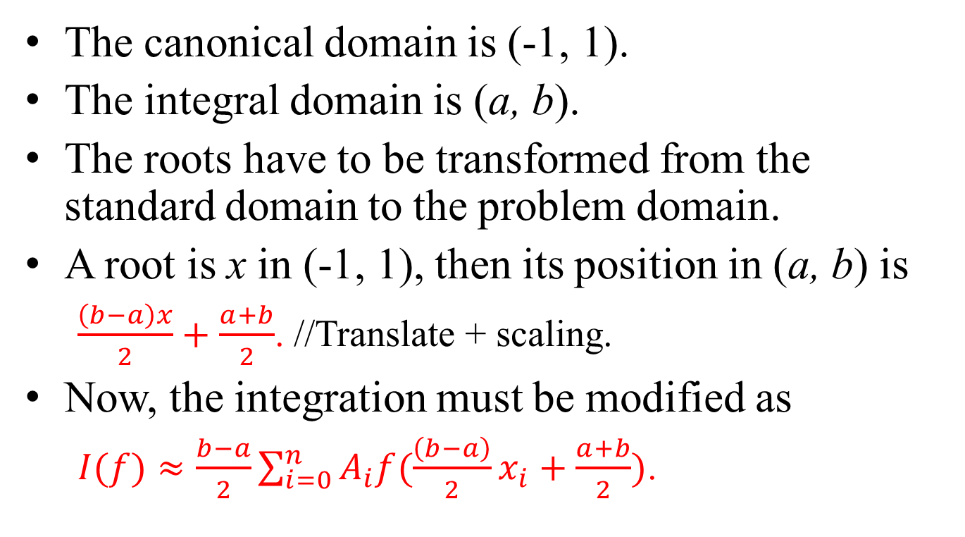
Conformation Mapping
The canonical domain is (-1, 1).
The integral domain is (a, b).
The roots have to be transformed from the standard domain to the problem domain.
A root is x in (-1, 1), then its position in (a, b) is
$\frac{\left(b−a\right)x}{2}+\frac{a+b}{2}$. //Translate + scaling.
Now, the integration must be modified as
$I(f)≈\frac{b−a}{2}\sum_{i=0}^{n}{A_{i}f(\frac{\left(b−a\right)}{2}x_{i}+\frac{a+b}{2})}$.

Slide 14
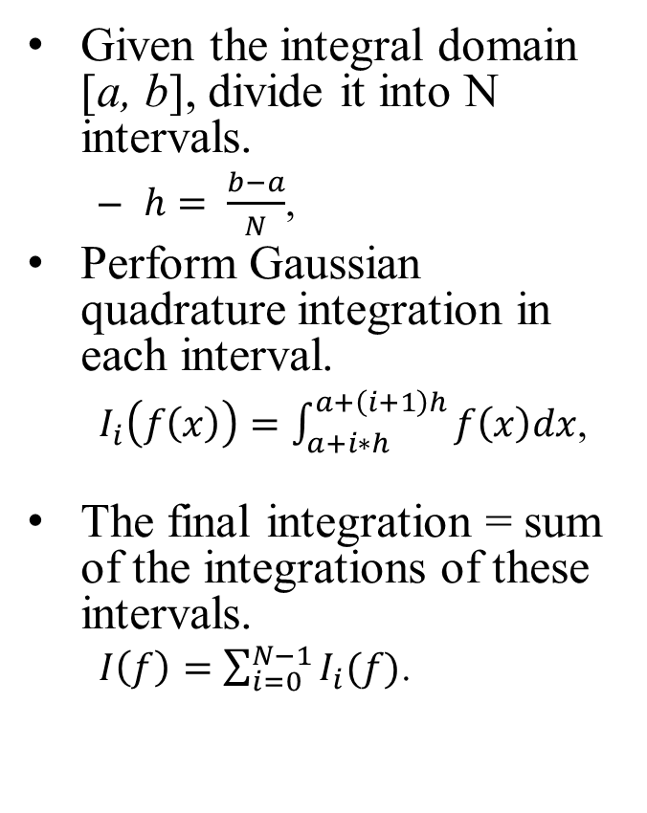
Composite Gaussian Quadrature
Given the integral domain [a, b], divide it into N intervals.
$h= \frac{b−a}{N}$,
Perform Gaussian quadrature integration in each interval.
$I_{i}\left(f\left(x\right)\right)=\int_{a+i∗h}^{a+\left(i+1\right)h}{f\left(x\right)dx}$,
The final integration = sum of the integrations of these intervals.
$I\left(f\right)=\sum_{i=0}^{N−1}{I_{i}(f)}$.
Composite rule
a
a+h
a+2h
a+3h
b

Slide 15
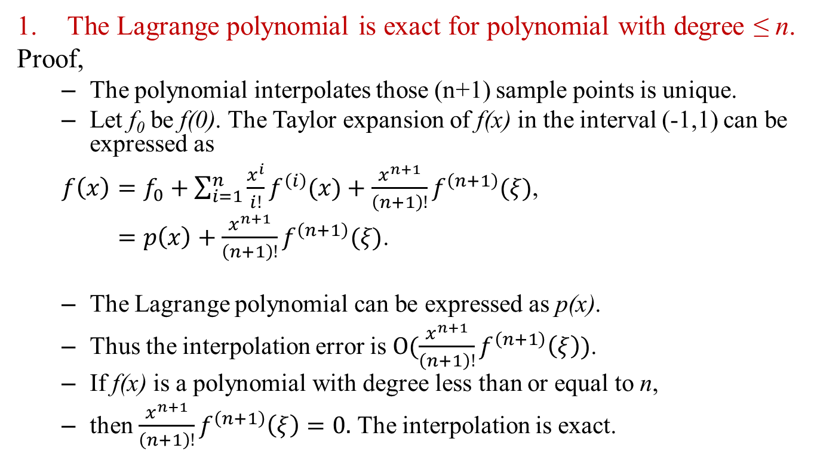
Lemma 1
The Lagrange polynomial is exact for polynomial with degree ≤ n.
Proof,
The polynomial interpolates those (n+1) sample points is unique.
Let f₀ be f(0). The Taylor expansion of f(x) in the interval (-1,1) can be expressed as
$f\left(x\right)=f_{0}+\sum_{i=1}^{n}{\frac{x^{i}}{i!}f^{\left(i\right)}(x)}+\frac{x^{n+1}}{\left(n+1\right)!}f^{\left(n+1\right)}(ξ)$,
$=p\left(x\right)+\frac{x^{n+1}}{\left(n+1\right)!}f^{\left(n+1\right)}(ξ)$.
The Lagrange polynomial can be expressed as p(x).
Thus the interpolation error is $O(\frac{x^{n+1}}{\left(n+1\right)!}f^{\left(n+1\right)}\left(ξ\right))$.
If f(x) is a polynomial with degree less than or equal to n,
then $\frac{x^{n+1}}{\left(n+1\right)!}f^{\left(n+1\right)}\left(ξ\right)=0.$ The interpolation is exact.

Slide 16
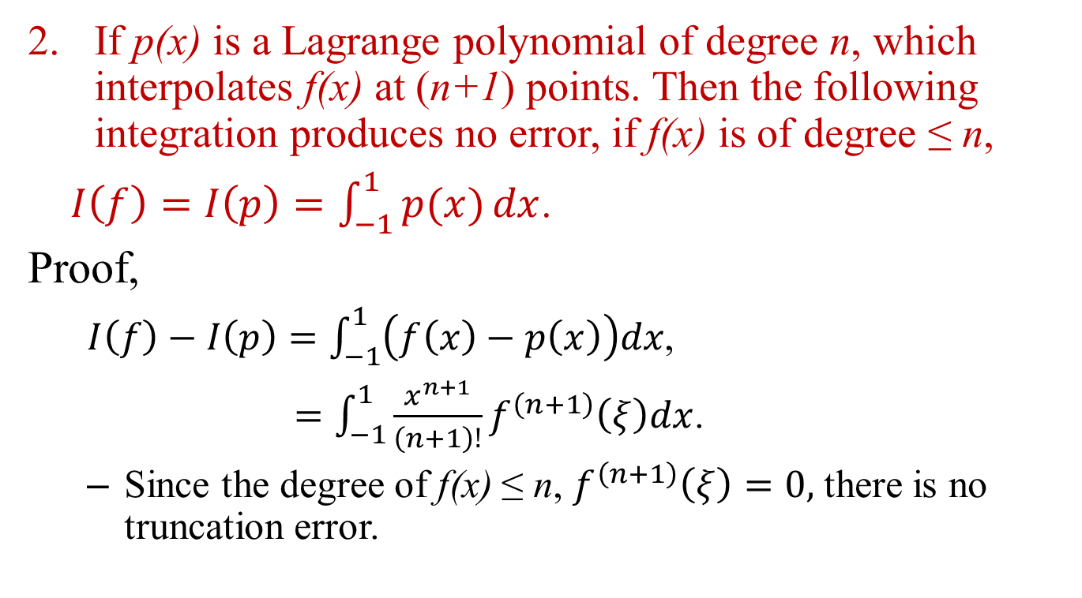
Lemma 2
If p(x) is a Lagrange polynomial of degree n, which interpolates f(x) at (n+1) points. Then the following integration produces no error, if f(x) is of degree ≤ n,
$I\left(f\right)=I\left(p\right)=\int_{−1}^{1}{p(x)}dx$.
Proof,
$I\left(f\right)−I\left(p\right)=\int_{−1}^{1}{\left(f\left(x\right)−p\left(x\right)\right)dx}$,
$=\int_{−1}^{1}{\frac{x^{n+1}}{\left(n+1\right)!}f^{\left(n+1\right)}\left(ξ\right)dx}$.
Since the degree of f(x) ≤ n, $f^{\left(n+1\right)}\left(ξ\right)=0,$ there is no truncation error.

Slide 17
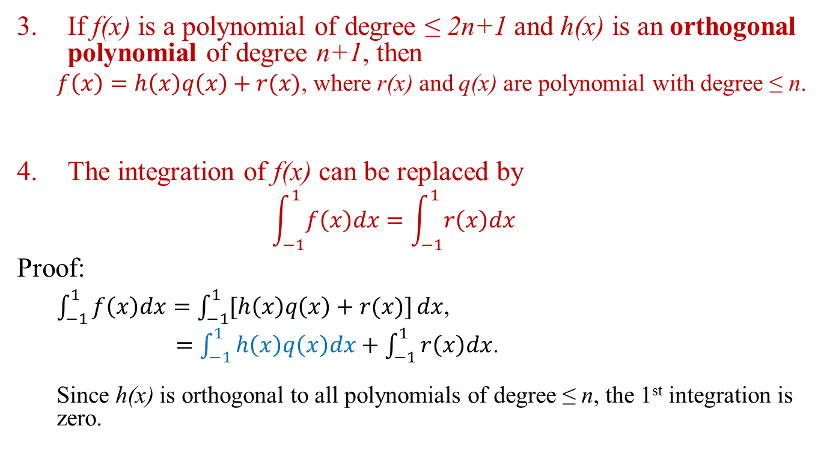
Lemmas 3 and 4
If f(x) is a polynomial of degree ≤ 2n+1 and h(x) is an orthogonal polynomial of degree n+1, then
$f\left(x\right)=h\left(x\right)q\left(x\right)+r(x)$, where r(x) and q(x) are polynomial with degree ≤ n.
The integration of f(x) can be replaced by
$$\int_{−1}^{1}{f\left(x\right)dx}=\int_{−1}^{1}{r\left(x\right)dx}$$
Proof:
$\int_{−1}^{1}{f\left(x\right)dx}=\int_{−1}^{1}{[h\left(x\right)q\left(x\right)+r(x)]}dx$,
$=\int_{−1}^{1}{h\left(x\right)q\left(x\right)dx}+\int_{−1}^{1}{r\left(x\right)dx}$.
Since h(x) is orthogonal to all polynomials of degree ≤ n, the 1st integration is zero.

Slide 18
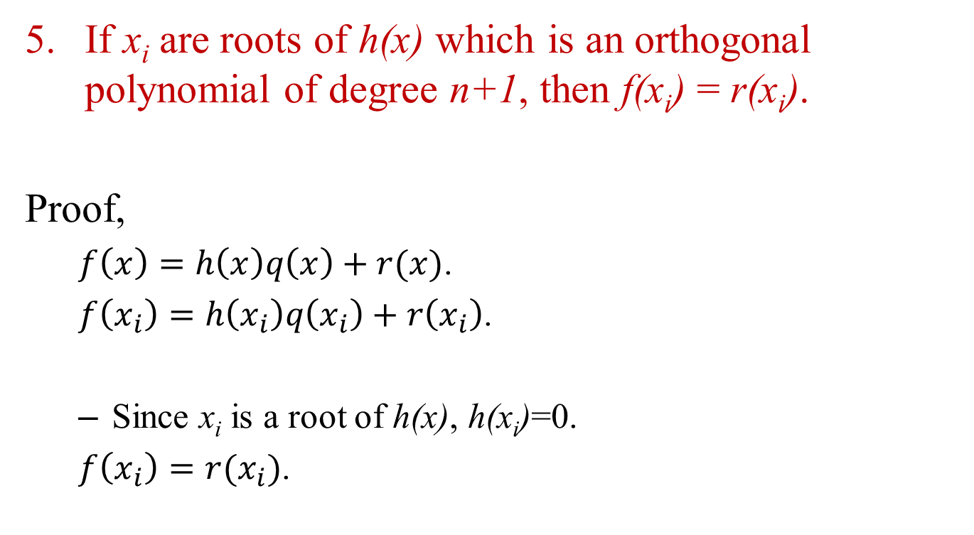
Lemma 5
If x_{i} are roots of h(x) which is an orthogonal polynomial of degree n+1, then f(x_{i}) = r(x_{i}).
Proof,
$f\left(x\right)=h\left(x\right)q\left(x\right)+r(x)$.
$f\left(x_{i}\right)=h\left(x_{i}\right)q\left(x_{i}\right)+r\left(x_{i}\right)$.
Since x_{i} is a root of h(x), h(x_{i})=0.
$f\left(x_{i}\right)=r(x_{i})$.

Slide 19
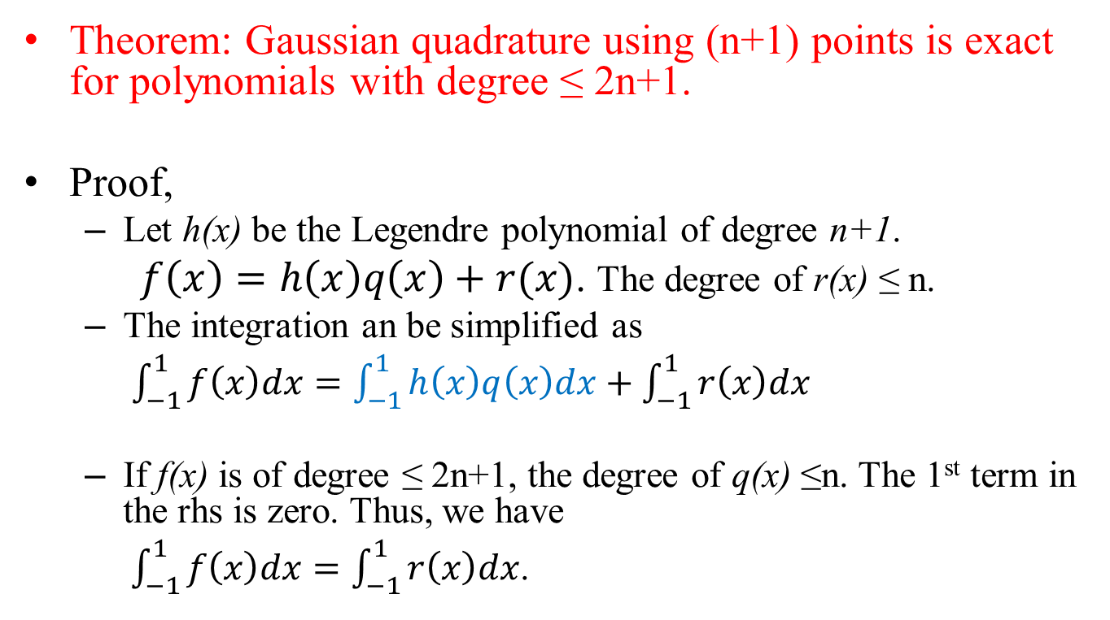
Accuracy of Gaussian Quadrature
Theorem: Gaussian quadrature using (n+1) points is exact for polynomials with degree ≤ 2n+1.
Proof,
Let h(x) be the Legendre polynomial of degree n+1.
$f\left(x\right)=h\left(x\right)q\left(x\right)+r(x)$. The degree of r(x) ≤ n.
The integration an be simplified as
$\int_{−1}^{1}{f\left(x\right)dx}=\int_{−1}^{1}{h\left(x\right)q\left(x\right)dx}+\int_{−1}^{1}{r\left(x\right)dx}$
If f(x) is of degree ≤ 2n+1, the degree of q(x) ≤n. The 1st term in the rhs is zero. Thus, we have
$\int_{−1}^{1}{f\left(x\right)dx}=\int_{−1}^{1}{r\left(x\right)dx}$.

Slide 20
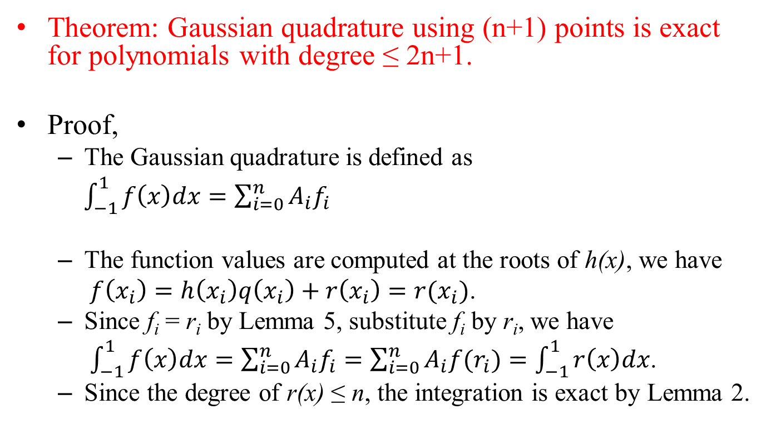
Accuracy of Gaussian Quadrature
Theorem: Gaussian quadrature using (n+1) points is exact for polynomials with degree ≤ 2n+1.
Proof,
The Gaussian quadrature is defined as
$\int_{−1}^{1}{f\left(x\right)dx}=\sum_{i=0}^{n}{A_{i}f_{i}}$
The function values are computed at the roots of h(x), we have
$f\left(x_{i}\right)=h\left(x_{i}\right)q\left(x_{i}\right)+r\left(x_{i}\right)=r(x_{i})$.
Since f_{i} = r_{i} by Lemma 5, substitute f_{i} by r_{i}, we have
$\int_{−1}^{1}{f\left(x\right)dx}=\sum_{i=0}^{n}{A_{i}f_{i}}=\sum_{i=0}^{n}{A_{i}{f(r}_{i})}=\int_{−1}^{1}{r\left(x\right)dx}$.
Since the degree of r(x) ≤ n, the integration is exact by Lemma 2.

Slide 21
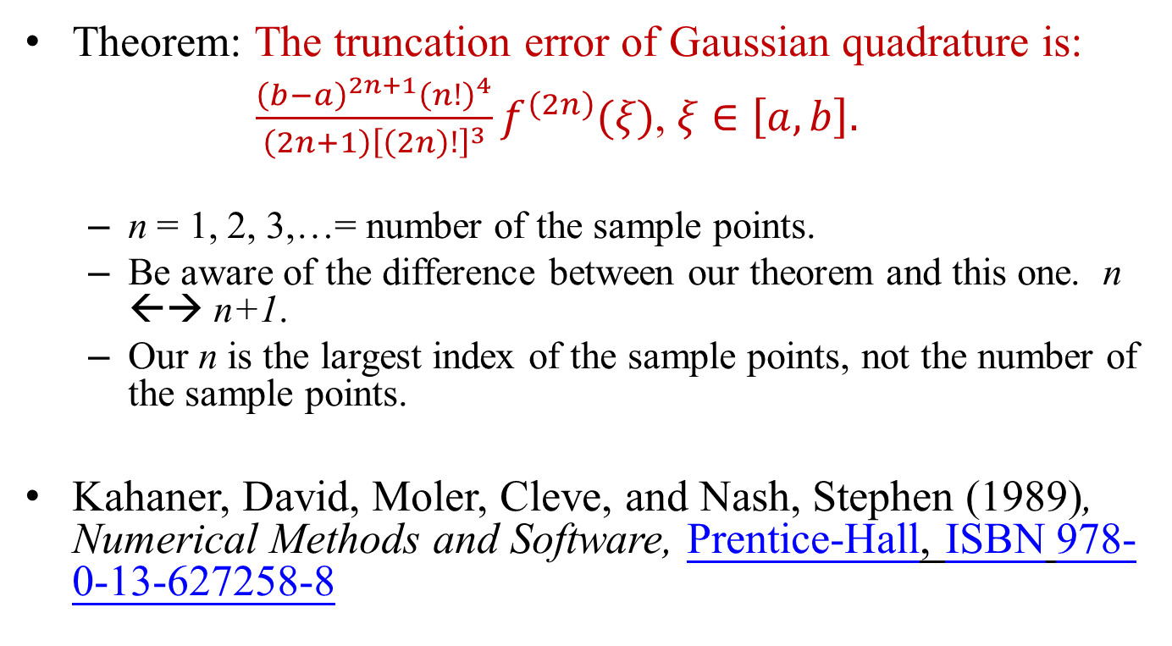
Truncation Error
Theorem: The truncation error of Gaussian quadrature is:
$\frac{{\left(b−a\right)}^{2n+1}{\left(n!\right)}^{4}}{\left(2n+1\right){\left[\left(2n\right)!\right]}^{3}}f^{\left(2n\right)}(ξ)$, $ξ∈\left[a,b\right].$
n = 1, 2, 3,…= number of the sample points.
Be aware of the difference between our theorem and this one. n ←→ n+1.
Our n is the largest index of the sample points, not the number of the sample points.
Kahaner, David, Moler, Cleve, and Nash, Stephen (1989), Numerical Methods and Software, Prentice-Hall, ISBN 978-0-13-627258-8

Slide 22
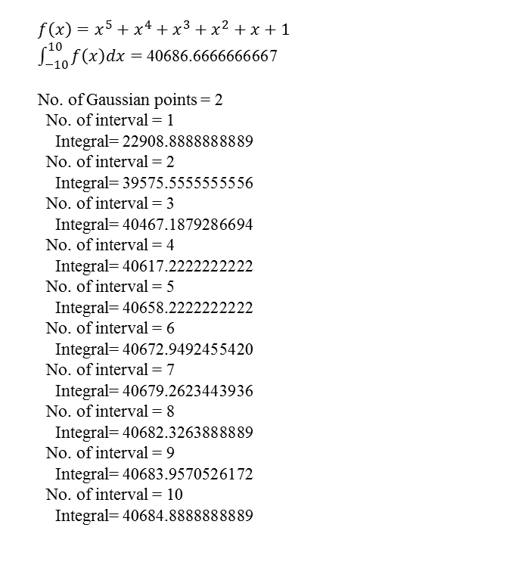
Example
$$f\left(x\right)=x^{5}+x^{4}+x^{3}+x^{2}+x+1$$
$\int_{−10}^{10}{f\left(x\right)dx}=$40686.6666666667
No. of Gaussian points = 2
No. of interval = 1
Integral= 22908.8888888889
No. of interval = 2
Integral= 39575.5555555556
No. of interval = 3
Integral= 40467.1879286694
No. of interval = 4
Integral= 40617.2222222222
No. of interval = 5
Integral= 40658.2222222222
No. of interval = 6
Integral= 40672.9492455420
No. of interval = 7
Integral= 40679.2623443936
No. of interval = 8
Integral= 40682.3263888889
No. of interval = 9
Integral= 40683.9570526172
No. of interval = 10
Integral= 40684.8888888889
No. of Gaussian points = 3, n=2
No. of interval = 1
Integral= 40686.6666666667
No. of interval = 2
Integral= 40686.6666666667
No. of interval = 3
Integral= 40686.6666666667
No. of interval = 4
Integral= 40686.6666666667
No. of interval = 5
Integral= 40686.6666666667
No. of interval = 6
Integral= 40686.6666666668
No. of interval = 7
Integral= 40686.6666666667
No. of interval = 8
Integral= 40686.6666666666
No. of interval = 9
Integral= 40686.6666666667
No. of interval = 10
Integral= 40686.6666666667

Slide 23
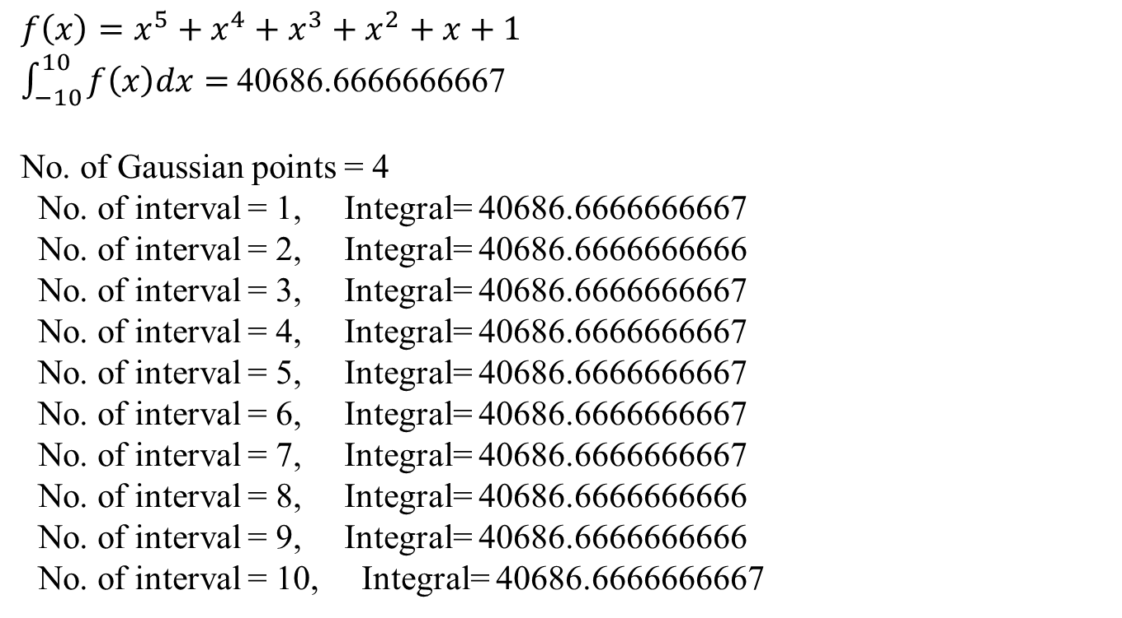
Example
$$f\left(x\right)=x^{5}+x^{4}+x^{3}+x^{2}+x+1$$
$\int_{−10}^{10}{f\left(x\right)dx}=$40686.6666666667
No. of Gaussian points = 4
No. of interval = 1, Integral= 40686.6666666667
No. of interval = 2, Integral= 40686.6666666666
No. of interval = 3, Integral= 40686.6666666667
No. of interval = 4, Integral= 40686.6666666667
No. of interval = 5, Integral= 40686.6666666667
No. of interval = 6, Integral= 40686.6666666667
No. of interval = 7, Integral= 40686.6666666667
No. of interval = 8, Integral= 40686.6666666666
No. of interval = 9, Integral= 40686.6666666666
No. of interval = 10, Integral= 40686.6666666667

Slide 24
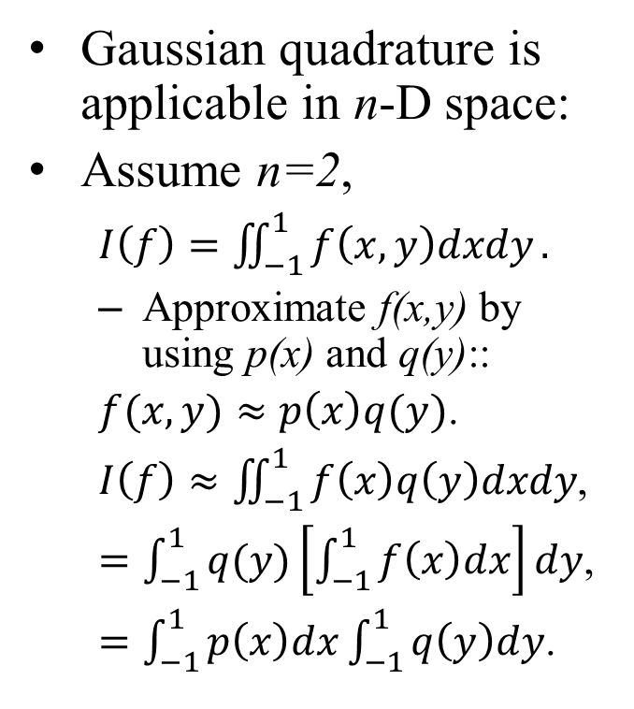
2D Gaussian Quadrature
Gaussian quadrature is applicable in n-D space:
Assume n=2,
$I\left(f\right)=\iint_{−1}^{1}{f\left(x,y\right)dxdy}.$
Approximate f(x,y) by using p(x) and q(y)::
$f(x,y)≈p\left(x\right)q(y)$.
$I\left(f\right)≈\iint_{−1}^{1}{f\left(x\right)q\left(y\right)dxdy}$,
$=\int_{−1}^{1}{q(y)\left[\int_{−1}^{1}{f\left(x\right)dx}\right]}dy$,
$=\int_{−1}^{1}{p\left(x\right)dx}\int_{−1}^{1}{q\left(y\right)dy}$.
The 2D canonical space for Gaussian quadrature.
(1,1)
(-1,-1)

Slide 25
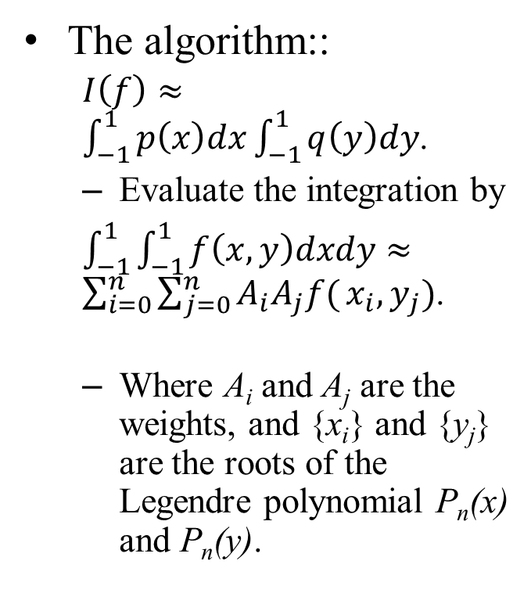
2D Gaussian Quadrature
The algorithm::
$I\left(f\right)≈\int_{−1}^{1}{p\left(x\right)dx}\int_{−1}^{1}{q\left(y\right)dy}$.
Evaluate the integration by
$\int_{−1}^{1}{\int_{−1}^{1}{f\left(x,y\right)dxdy}}≈\sum_{i=0}^{n}{\sum_{j=0}^{n}{A_{i}A_{j}f(}}x_{i},y_{j})$.
Where A_{i} and A_{j} are the weights, and {x_{i}} and {y_{j}} are the roots of the Legendre polynomial P_{n}(x) and P_{n}(y).
The 2D canonical space for Gaussian quadrature.
(1,1)
(-1,-1)

Slide 26
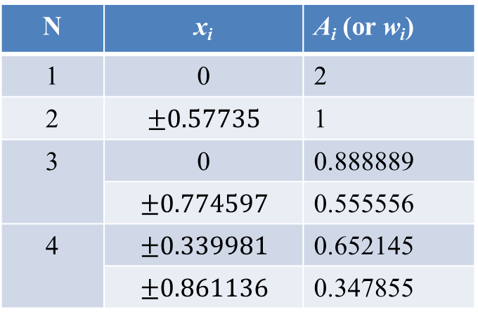
2D Gaussian Quadrature
Table of roots and weights
Example, N = 3.
We have 9 sample points inside the canonical integration domain.
N | x_{i} | A_{i} (or w_{i})
1 | 0 | 2
2 | $$±0.57735$$ | 1
3 | 0 | 0.888889
 | $$±0.774597$$ | 0.555556
4 | $$±0.339981$$ | 0.652145
 | $$±0.861136$$ | 0.347855
N= n+1

Slide 27
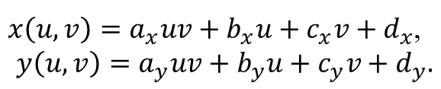
2D Conformation Mapping
Assume that the roots are defined in (u,v) space, (-1,-1) – (1,1).
Assume x- and y-coordinates are functions of u and v:
Transform the root (u_{i}, v_{j}) to (x_{i}, y_{j}) using the transformation functions.
Evaluate f(x_{i},y_{j}) and the integral equation.
Barycentric coordinates
y
x
$x\left(u,v\right)=a_{x}uv+b_{x}u+c_{x}v+d_{x}$,
$$y\left(u,v\right)=a_{y}uv+b_{y}u+c_{y}v+d_{y}.$$
v
u

Slide 28
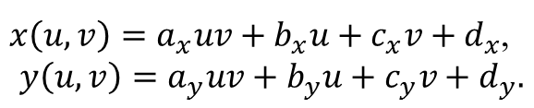
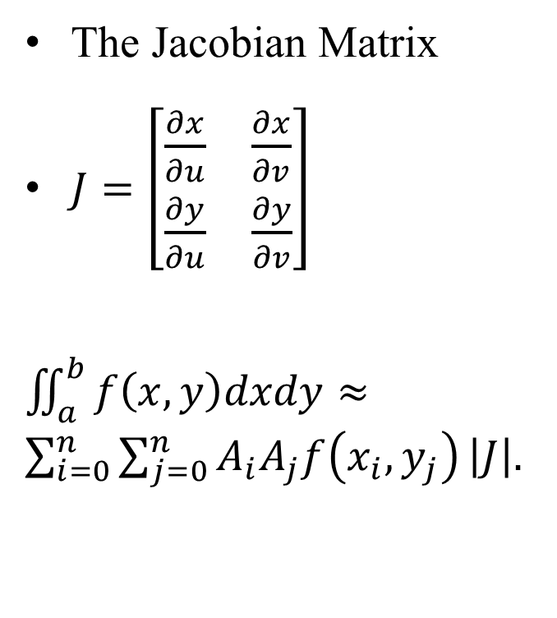
The Determinant of the Jacobian Matrix
The Jacobian Matrix
$J=\left[\begin{matrix}\frac{∂x}{∂u} & \frac{∂x}{∂v} \\ \frac{∂y}{∂u} & \frac{∂y}{∂v}\end{matrix}\right]$
$\iint_{a}^{b}{f\left(x,y\right)dxdy}≈\sum_{i=0}^{n}{\sum_{j=0}^{n}{A_{i}A_{j}f\left(x_{i},y_{j}\right)}}\left|J\right|.$
Space transformation
$x\left(u,v\right)=a_{x}uv+b_{x}u+c_{x}v+d_{x}$,
$$y\left(u,v\right)=a_{y}uv+b_{y}u+c_{y}v+d_{y}.$$
y
x
v
u

Slide 29
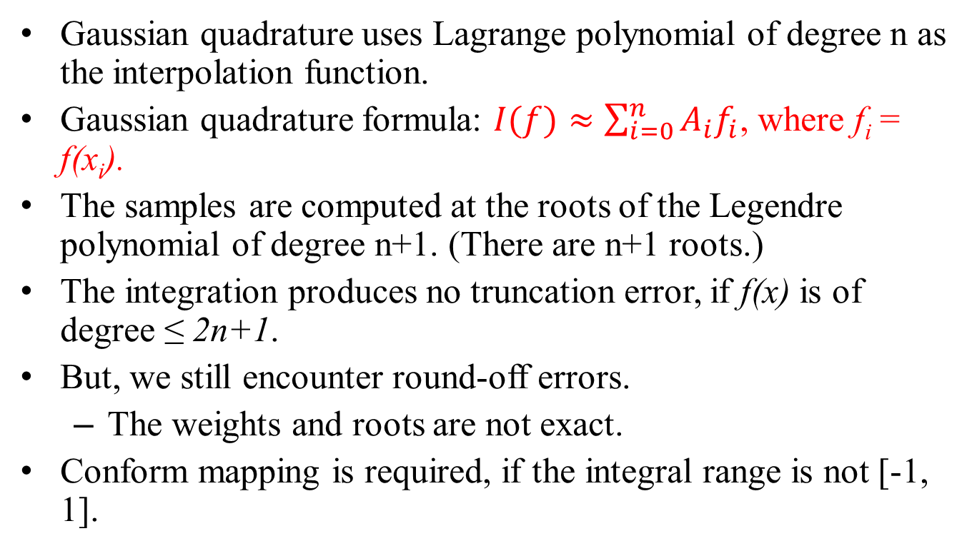
Conclusion
Gaussian quadrature uses Lagrange polynomial of degree n as the interpolation function.
Gaussian quadrature formula: $I(f)≈\sum_{i=0}^{n}{A_{i}f_{i}}$, where f_{i} = f(x_{i}).
The samples are computed at the roots of the Legendre polynomial of degree n+1. (There are n+1 roots.)
The integration produces no truncation error, if f(x) is of degree ≤ 2n+1.
But, we still encounter round-off errors.
The weights and roots are not exact.
Conform mapping is required, if the integral range is not [-1, 1].

Slide 30
Advanced Topics
Study Gaussian quadrature in 3D spaces.
Study Gaussian quadrature integration in tetrahedral and hexahedral.
Similar formulation, but different sample positions.
There are tables of roots and weights in the internet.
Used for finite element method.
Tetrahedral and hexahedra elements
1
1
0
1
1
1
0
1

