Slide 1
Numerical Differentiation
Basis for Finite Difference Method (FDM)

Slide 2
Outline
1st order differentiation
Forward method
Backward method
Central difference method
2nd order differentiation
Undetermined coefficient method
Central difference method
Differentiation at boundaries
Truncation error vs. round-off error
Noses and numerical differentiation

Slide 3
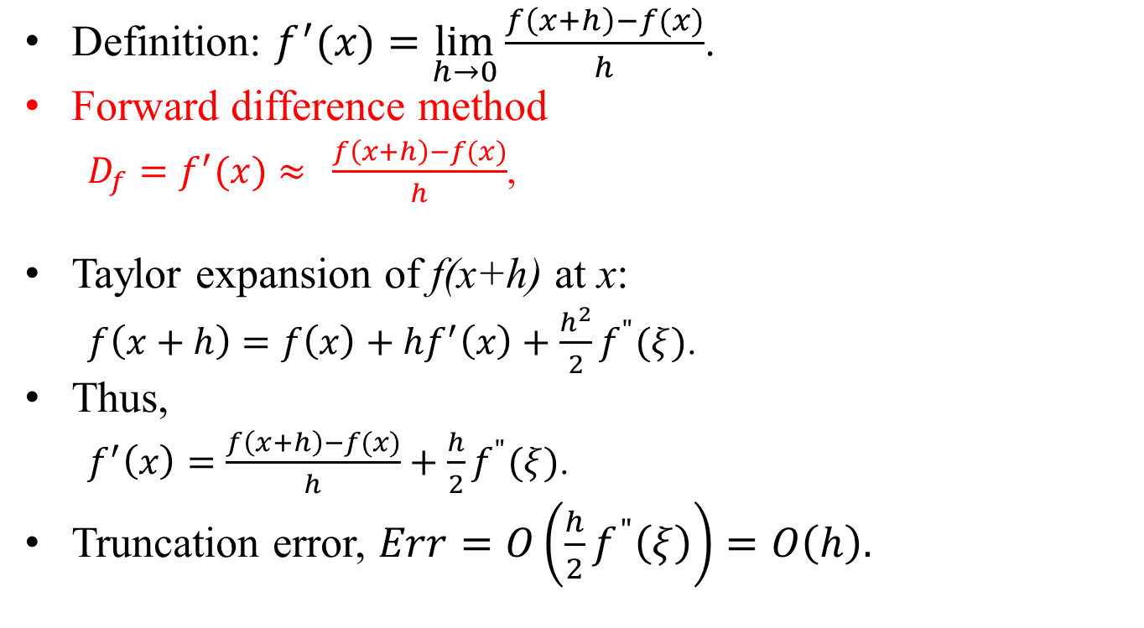
Forward Difference
Definition: $f^{′}(x)=\lim_{h→0}{\frac{f\left(x+h\right)−f(x)}{h}}$.
Forward difference method
$D_{f}=f^{′}(x)≈{\frac{f\left(x+h\right)−f(x)}{h}}$,
Taylor expansion of f(x+h) at x:
$f\left(x+h\right)=f\left(x\right)+hf^{′}\left(x\right)+\frac{h^{2}}{2}f^{"}(ξ)$.
Thus,
$f^{′}\left(x\right)=\frac{f\left(x+h\right)−f(x)}{h}+\frac{h}{2}f^{"}(ξ)$.
Truncation error, $Err=O\left(\frac{h}{2}f^{"}\left(ξ\right)\right)=O\left(h\right).$
x-h
x
x+h

Slide 4
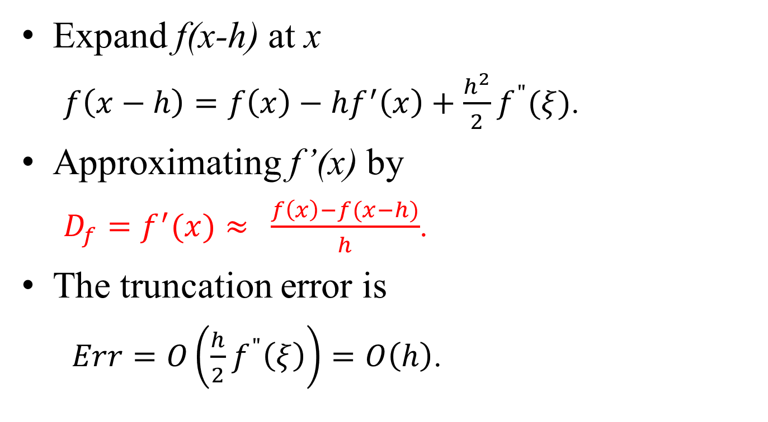
Backward Differentiation
Expand f(x-h) at x
$f\left(x−h\right)=f\left(x\right)−hf^{′}\left(x\right)+\frac{h^{2}}{2}f^{"}(ξ)$.
Approximating f’(x) by
$D_{f}=f^{′}(x)≈{\frac{f\left(x\right)−f(x−h)}{h}}$.
The truncation error is
$Err=O\left(\frac{h}{2}f^{"}\left(ξ\right)\right)=O\left(h\right)$.
x-h
x
x+h

Slide 5
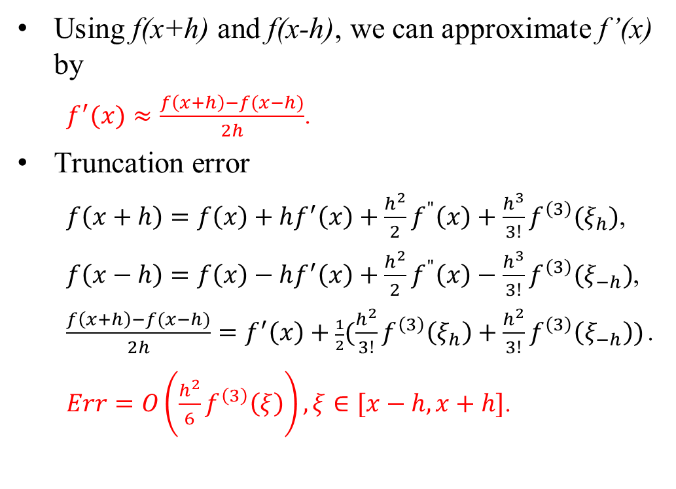
Central Difference Method
Using f(x+h) and f(x-h), we can approximate f’(x) by
$f^{′}(x)≈\frac{f\left(x+h\right)−f(x−h)}{2h}$.
Truncation error
$f\left(x+h\right)=f\left(x\right)+hf^{′}\left(x\right)+\frac{h^{2}}{2}f^{"}\left(x\right)+\frac{h^{3}}{3!}f^{\left(3\right)}(ξ_{h})$,
$f\left(x−h\right)=f\left(x\right)−hf^{′}\left(x\right)+\frac{h^{2}}{2}f^{"}\left(x\right)−\frac{h^{3}}{3!}f^{\left(3\right)}(ξ_{−h})$,
$\frac{f\left(x+h\right)−f(x−h)}{2h}=f^{′}\left(x\right)+\frac{1}{2}(\frac{h^{2}}{3!}f^{\left(3\right)}\left(ξ_{h}\right)+\frac{h^{2}}{3!}f^{\left(3\right)}\left(ξ_{−h}\right))$.
$Err=O\left(\frac{h^{2}}{6}f^{\left(3\right)}\left(ξ\right)\right),ξ∈[x−h,x+h]$.
x-h
x
x+h

Slide 6
Discussion
Central difference method is more accurate then backward- and forward-differentiation by 1 order.
O(h²) vs. O(h).
Central difference is exact for polynomial with degree ≤ 2.
Difference methods are the kernel of Finite Difference Method (FDM) and other numerical methods for solving differential equations.
For time-dependent differential equations
Forward method: quickest
Central difference: most accurate
Backward method and central difference produce numerical stable algebraic equations.
Forward method is numerical unstable.

Slide 7
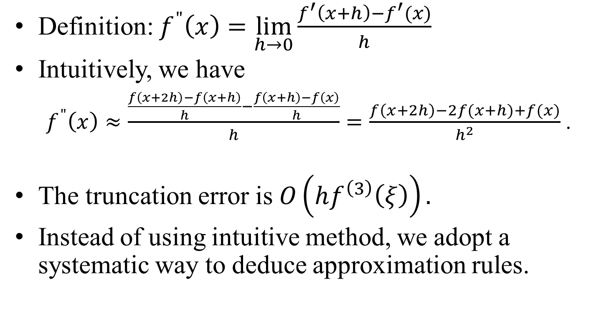
2nd Order Differentiation
Definition: $f^{"}\left(x\right)=\lim_{h→0}{\frac{f^{′}\left(x+h\right)−f^{′}(x)}{h}}$
Intuitively, we have
$f^{"}\left(x\right)≈\frac{\frac{f\left(x+2h\right)−f\left(x+h\right)}{h}−\frac{f\left(x+h\right)−f\left(x\right)}{h}}{h}=\frac{f\left(x+2h\right)−2f(x+h)+f(x)}{h^{2}}$.
The truncation error is $O\left(hf^{\left(3\right)}\left(ξ\right)\right).$
Instead of using intuitive method, we adopt a systematic way to deduce approximation rules.

Slide 8
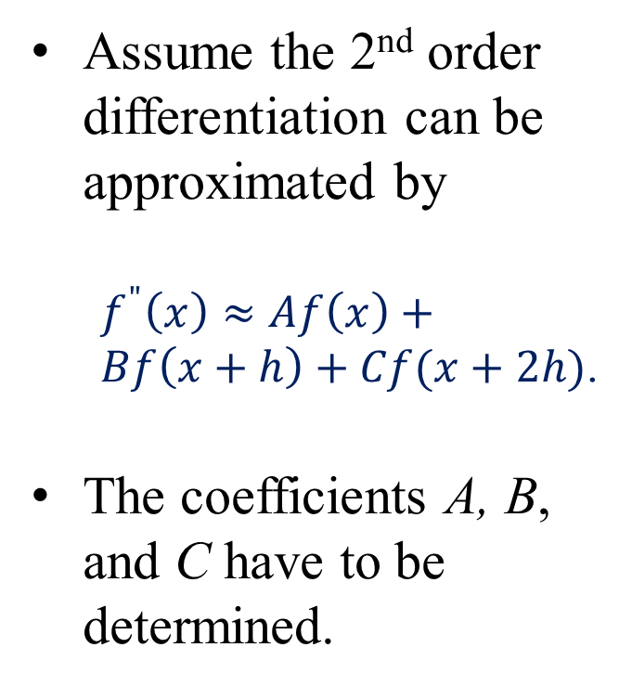
Undetermined Coefficient Method
Assume the 2nd order differentiation can be approximated by
$f^{"}\left(x\right)≈Af\left(x\right)+Bf\left(x+h\right)+Cf(x+2h)$.
The coefficients A, B, and C have to be determined.
2nd order differentiation at the left boundary
3 points are x, x+h, and x+2h
x
x+h
x+2h

Slide 9
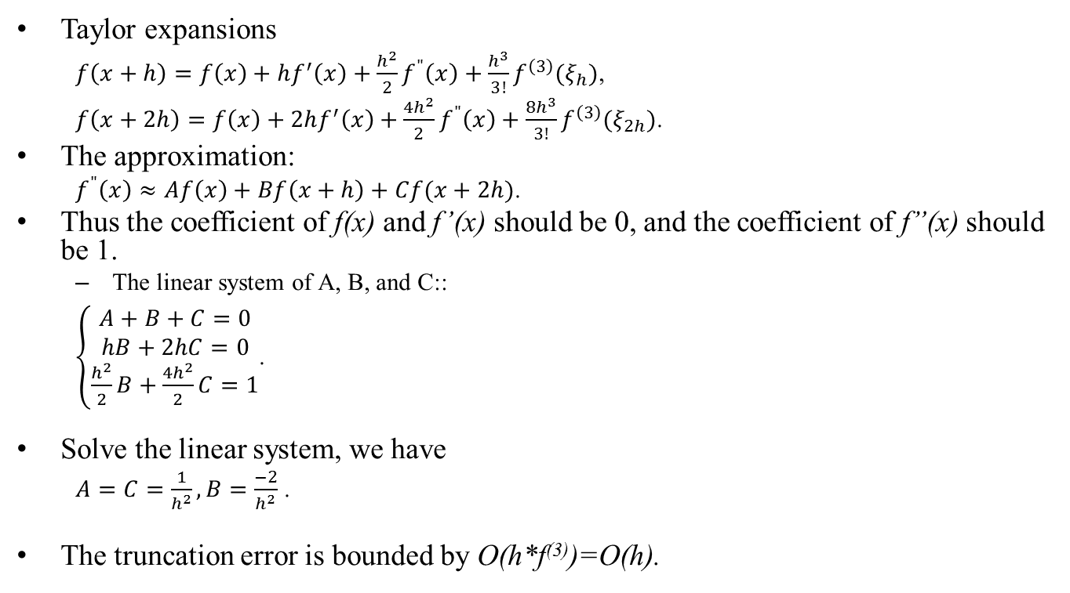
Undetermined Coefficient Method
Taylor expansions
$f\left(x+h\right)=f\left(x\right)+hf^{′}\left(x\right)+\frac{h^{2}}{2}f^{"}\left(x\right)+\frac{h^{3}}{3!}f^{\left(3\right)}(ξ_{h})$,
$f\left(x+2h\right)=f\left(x\right)+2hf^{′}\left(x\right)+\frac{{4h}^{2}}{2}f^{"}\left(x\right)+\frac{{8h}^{3}}{3!}f^{\left(3\right)}(ξ_{2h})$.
The approximation:
$f^{"}\left(x\right)≈Af\left(x\right)+Bf\left(x+h\right)+Cf(x+2h)$.
Thus the coefficient of f(x) and f’(x) should be 0, and the coefficient of f”(x) should be 1.
The linear system of A, B, and C::
$\left\{\begin{matrix}A+B+C=0 \\ hB+2hC=0 \\ \frac{h^{2}}{2}B+\frac{4h^{2}}{2}C=1\end{matrix}\right.$.
Solve the linear system, we have
$A=C=\frac{1}{h^{2}}, B=\frac{−2}{h^{2}}$ .
The truncation error is bounded by O(h*f⁽³⁾)=O(h).

Slide 10
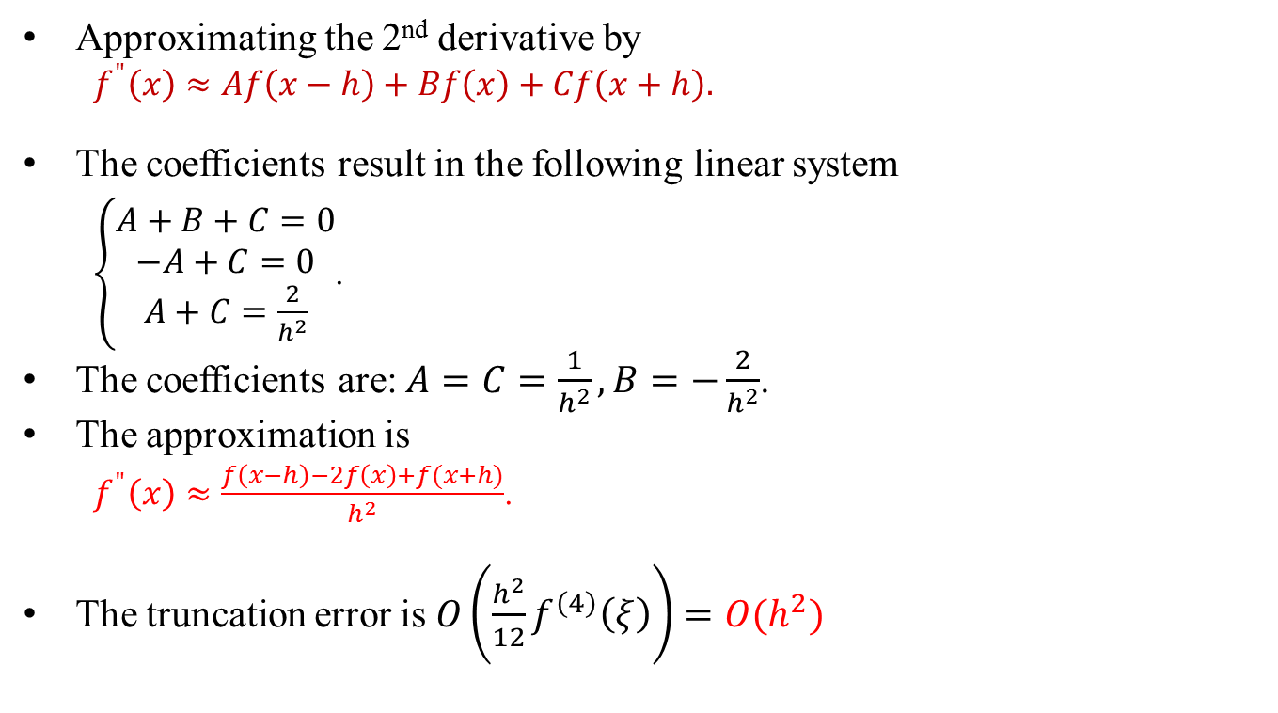
Central Difference Method
Approximating the 2nd derivative by
$f^{"}\left(x\right)≈Af\left(x−h\right)+Bf\left(x\right)+Cf\left(x+h\right).$
The coefficients result in the following linear system
$\left\{\begin{matrix}A+B+C=0 \\ −A+C=0 \\ A+C=\frac{2}{h^{2}}\end{matrix}\right.$.
The coefficients are: $A=C=\frac{1}{h^{2}},B=−\frac{2}{h^{2}}$.
The approximation is
$f^{"}\left(x\right)≈\frac{f\left(x−h\right)−2f\left(x\right)+f(x+h)}{h^{2}}$.
The truncation error is $O\left(\frac{h^{2}}{12}f^{\left(4\right)}\left(ξ\right)\right)=O(h^{2})$

Slide 11
Round-off Error
Based on the difference methods, we can see
As h becomes smaller, the truncation errors are getting smaller too.
We expect the numerical errors will decline.
However, numerical errors include
Round-off errors (by sampling), arithmetic errors, and truncation errors.
As h is reduced, these round-off errors increase.
Finally, they will cancel the effectiveness of shrinking h and create large numerical errors.
See the next slide for explanation.

Slide 12
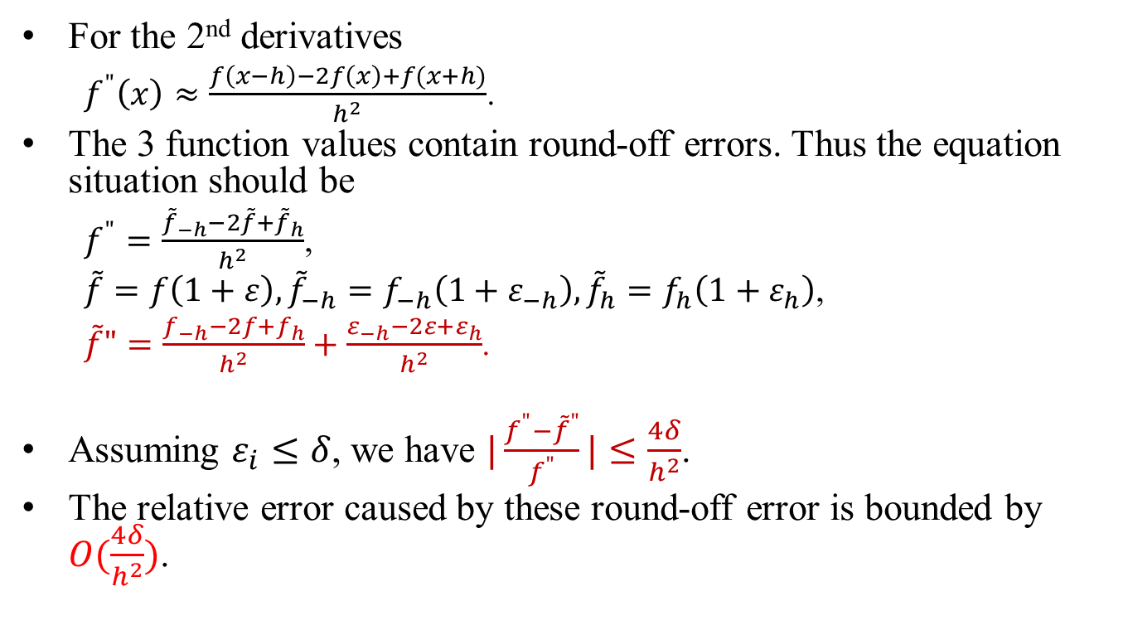
Round-off Errors
For the 2nd derivatives
$f^{"}\left(x\right)≈\frac{f\left(x−h\right)−2f\left(x\right)+f(x+h)}{h^{2}}$.
The 3 function values contain round-off errors. Thus the equation situation should be
$f^{"}=\frac{{\tilde{f}}_{−h}−{2\tilde{f}+\tilde{f}}_{h}}{h^{2}}$,
$\tilde{f}=f\left(1+ε\right),{\tilde{f}}_{−h}=f_{−h}\left(1+ε_{−h}\right),{\tilde{f}}_{h}=f_{h}\left(1+ε_{h}\right)$,
$\tilde{f}"=\frac{f_{−h}−2f+f_{h}}{h^{2}}+\frac{ε_{−h}−2ε+ε_{h}}{h^{2}}$.
Assuming $ε_{i}≤δ$, we have $|\frac{f^{"}−{\tilde{f}}^{"}}{f^{"}}|≤\frac{4δ}{h^{2}}$.
The relative error caused by these round-off error is bounded by $O(\frac{4δ}{h^{2}})$.

Slide 13
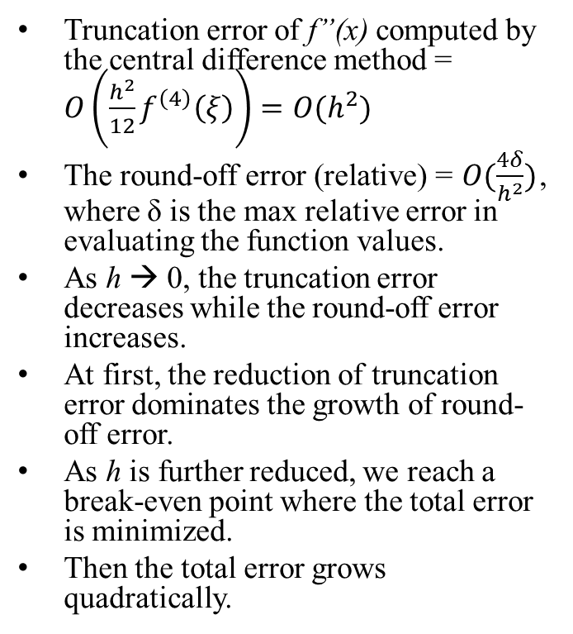
Discussion
Truncation error of f”(x) computed by the central difference method = $O\left(\frac{h^{2}}{12}f^{\left(4\right)}\left(ξ\right)\right)=O(h^{2})$
The round-off error (relative) = $O(\frac{4δ}{h^{2}})$, where δ is the max relative error in evaluating the function values.
As h → 0, the truncation error decreases while the round-off error increases.
At first, the reduction of truncation error dominates the growth of round-off error.
As h is further reduced, we reach a break-even point where the total error is minimized.
Then the total error grows quadratically.
Let N=1/h, the following figure shows the relation between N and the total error.
Error
N
N_{min}
N_{opt}

Slide 14
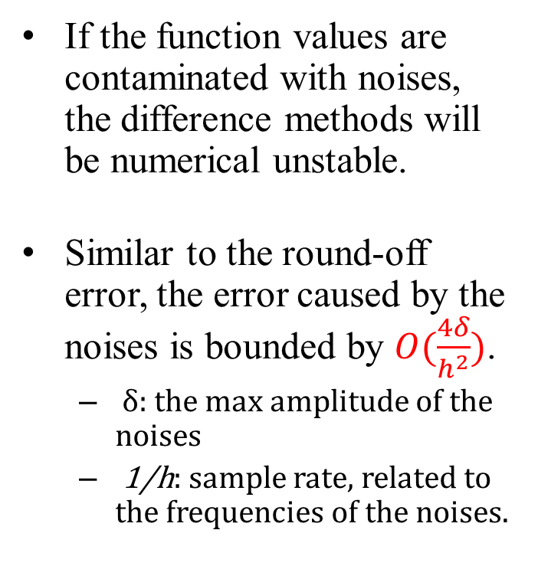
Sampling Noises
If the function values are contaminated with noises, the difference methods will be numerical unstable.
Similar to the round-off error, the error caused by the noises is bounded by $O(\frac{4δ}{h^{2}})$.
δ: the max amplitude of the noises
1/h: sample rate, related to the frequencies of the noises.
Sampling and noises
Noises
Function or process
Sampling,
Train of delta functions
Contaminated data

Slide 15
Filtering
Using low-pass filters to reduce the noise level in the differentiations.
Two methods:
Filtering the sample data before computing the derivatives.
Filtering the computed derivatives.
Both methods work well.
Good filters
Gaussian filters
Box filters
Tent filters
…
Filters

Slide 16
Applications
Numerical differentiations are widely used in the following areas:
Computer graphics
Data visualization and analysis
Computer vision
Image processing
Partial differential equation solvers
Ordinary differential equation solvers
Computer-Aided Geometry Design (CAGD)
…

Slide 17
Study for the midterm exam.
Complete project #3.
報考本系研究所，10月底截止。

