Slide 1
Linear System & Gaussian Elimination
Introduction高斯消去法

Slide 2
Outline
Linear systems
Basic raw operations
Fundamentals of Gaussian elimination
Partial and full pivoting
Revised Gaussian elimination
Round-off error analysis
Matrix norms
Condition numbers of linear systems

Slide 3
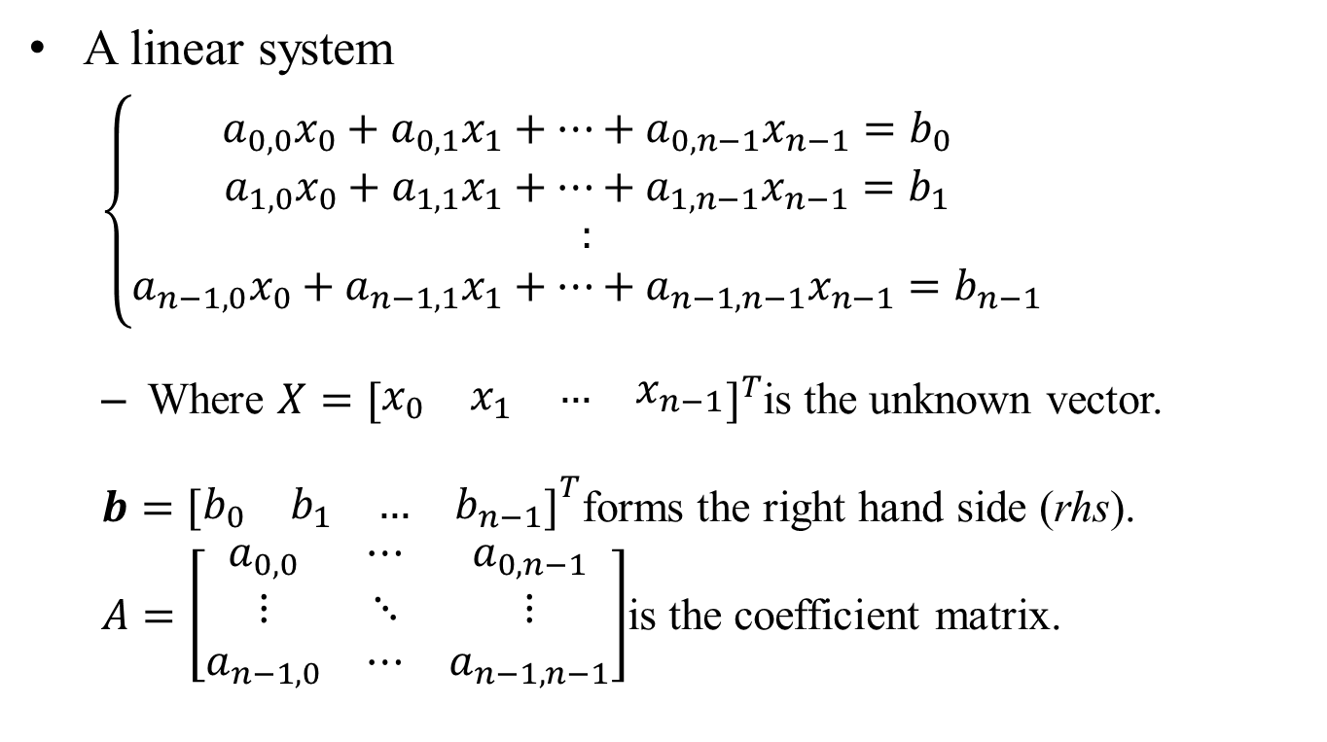
Linear System
A linear system
$\left\{\begin{matrix}\begin{matrix}a_{0,0}x_{0}+a_{0,1}x_{1}+…+a_{0,n−1}x_{n−1}=b_{0} \\ a_{1,0}x_{0}+a_{1,1}x_{1}+…+a_{1,n−1}x_{n−1}=b_{1}\end{matrix} \\ \begin{matrix}: \\ a_{n−1,0}x_{0}+a_{n−1,1}x_{1}+…+a_{n−1,n−1}x_{n−1}=b_{n−1}\end{matrix}\end{matrix}\right.$
Where $X={[\begin{matrix}x_{0} & x_{1} & \begin{matrix}… & x_{n−1}\end{matrix}\end{matrix}]}^{T}$is the unknown vector.
$b={\begin{matrix}[\begin{matrix}b_{0} & b_{1}\end{matrix} & \begin{matrix}… & b_{n−1}\end{matrix}]\end{matrix}}^{T}$forms the right hand side (rhs).
$A=\left[\begin{matrix}a_{0,0} & ⋯ & a_{0,n−1} \\ ⋮ & ⋱ & ⋮ \\ a_{n−1,0} & ⋯ & a_{n−1,n−1}\end{matrix}\right]$is the coefficient matrix.

Slide 4
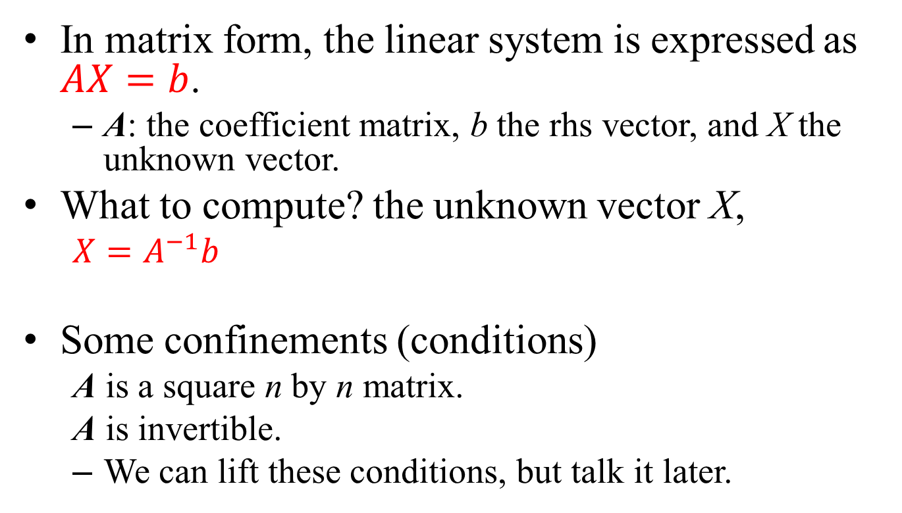
Matrix Form
In matrix form, the linear system is expressed as $AX=b$.
A: the coefficient matrix, b the rhs vector, and X the unknown vector.
What to compute? the unknown vector X,
$X=A^{−1}b$
Some confinements (conditions)
A is a square n by n matrix.
A is invertible.
We can lift these conditions, but talk it later.

Slide 5
Applications
Linear systems are used in many scientific and engineering applications:
Finite element analysis
Finite difference method
Linear programming
Dynamic programming
Operation research problems
Computer graphics (Radiosity for example)
…
We usually convert differential, integral, and non-linear algebraic equations into linear systems.
Then we use linear system solvers to compute the target function values.

Slide 6
Linear System Solvers, 2 major groups
Direct methods
Using basic row and column operations to convert matrix A into a simpler form and solving the unknowns by using substitution.
Gaussian elimination
LU-decomposition methods,
QR method, …
Iterative methods
Select an initial guess for the unknown vector.
Revise the unknown vector in each iteration based on the residual, previous unknown vectors, and some heuristic rules.
Jacobi method, Gauss-Seidel method, SOR method
Gradient methods
Conjugate gradient methods
Multi-grid method
Alternating Direction Iteration (ADI) method
…

Slide 7
Direct Method
Gaussian Elimination
with partial pivoting
Chapter 2, Section 1

Slide 8
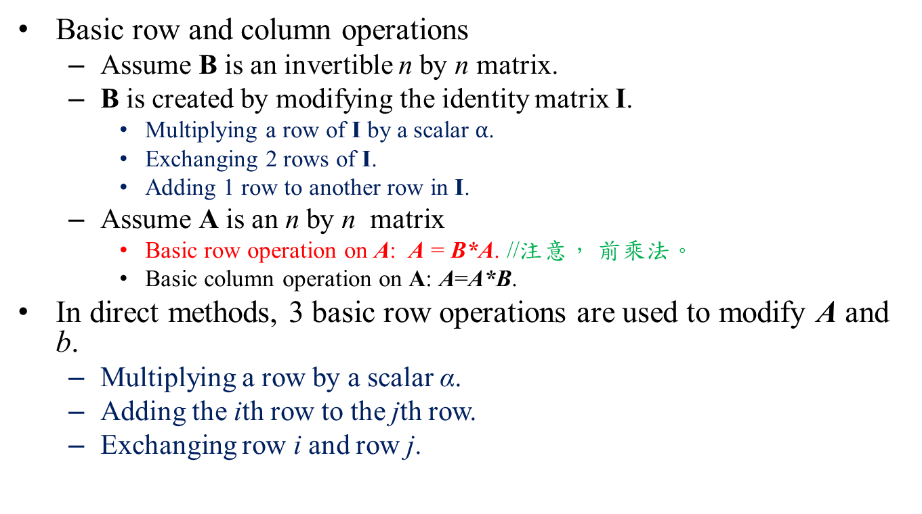
Basic Row Operations
Basic row and column operations
Assume B is an invertible n by n matrix.
B is created by modifying the identity matrix I.
Multiplying a row of I by a scalar $α$.
Exchanging 2 rows of I.
Adding 1 row to another row in I.
Assume A is an n by n matrix
Basic row operation on A: A = B*A. //注意， 前乘法。
Basic column operation on A: A=A*B.
In direct methods, 3 basic row operations are used to modify A and b.
Multiplying a row by a scalar α.
Adding the ith row to the jth row.
Exchanging row i and row j.

Slide 9
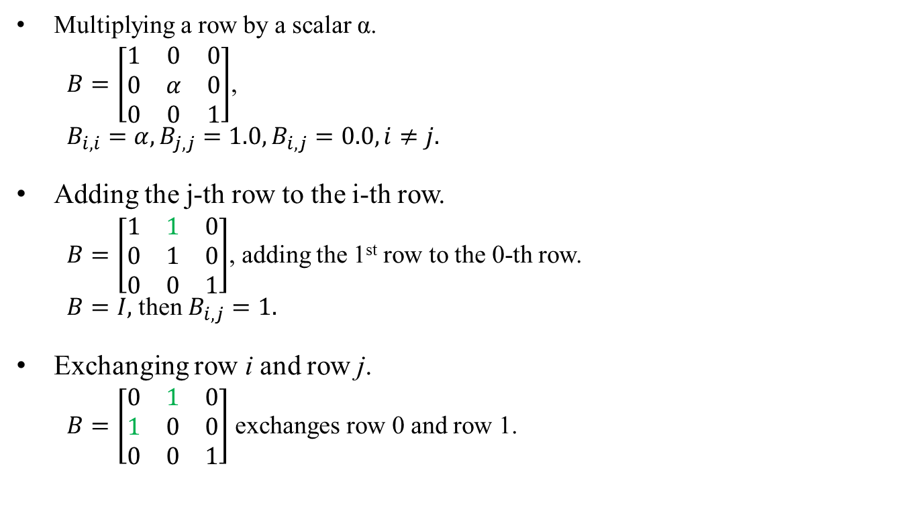
Basic Row-operation Matrices
Multiplying a row by a scalar α.
$B=\left[\begin{matrix}1 & 0 & 0 \\ 0 & α & 0 \\ 0 & 0 & 1\end{matrix}\right]$,
$B_{i,i}=α, B_{j,j}=1.0, B_{i,j}=0.0, i≠j.$
Adding the j-th row to the i-th row.
$B=\left[\begin{matrix}1 & 1 & 0 \\ 0 & 1 & 0 \\ 0 & 0 & 1\end{matrix}\right]$, adding the 1st row to the 0-th row.
$B=I,$ then $B_{i,j}=1.$
Exchanging row i and row j.
$B=\left[\begin{matrix}0 & 1 & 0 \\ 1 & 0 & 0 \\ 0 & 0 & 1\end{matrix}\right]$ exchanges row 0 and row 1.

Slide 10
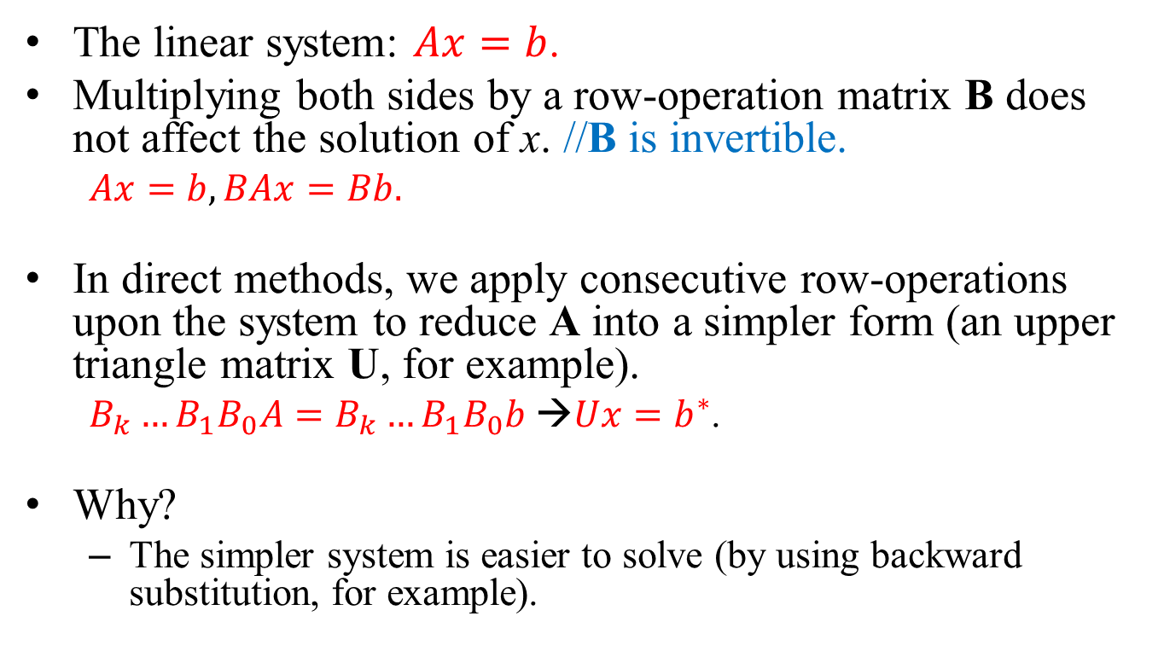
Applications of Row Operations
The linear system: $Ax=b$.
Multiplying both sides by a row-operation matrix B does not affect the solution of x. //B is invertible.
$Ax=b, BAx=Bb.$
In direct methods, we apply consecutive row-operations upon the system to reduce A into a simpler form (an upper triangle matrix U, for example).
$B_{k}…B_{1}B_{0}A=B_{k}…B_{1}B_{0}b$ →$Ux=b^{∗}$.
Why?
The simpler system is easier to solve (by using backward substitution, for example).

Slide 11
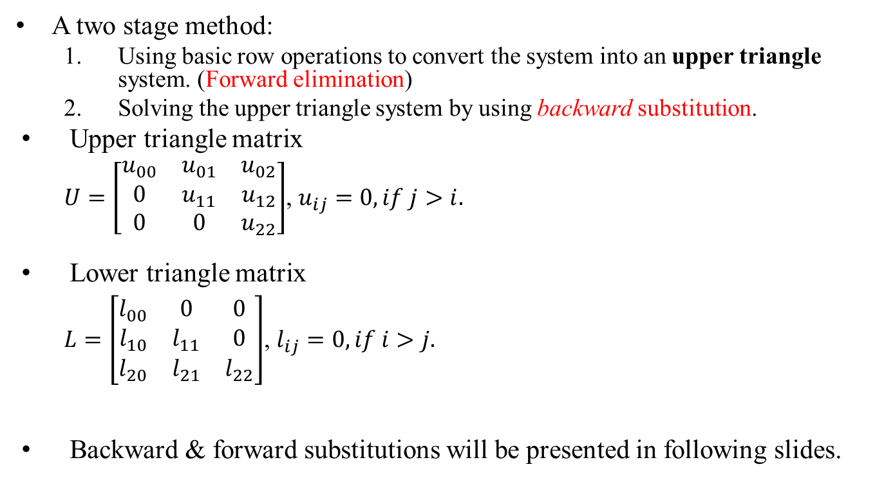
Gaussian Elimination Method
A two stage method:
Using basic row operations to convert the system into an upper triangle system. (Forward elimination)
Solving the upper triangle system by using backward substitution.
Upper triangle matrix
$U=\left[\begin{matrix}u_{00} & u_{01} & u_{02} \\ 0 & u_{11} & u_{12} \\ 0 & 0 & u_{22}\end{matrix}\right]$, $u_{ij}=0, if j>i.$
Lower triangle matrix
$L=\left[\begin{matrix}l_{00} & 0 & 0 \\ l_{10} & l_{11} & 0 \\ l_{20} & l_{21} & l_{22}\end{matrix}\right]$, $l_{ij}=0, if i>j.$
Backward & forward substitutions will be presented in following slides.

Slide 12
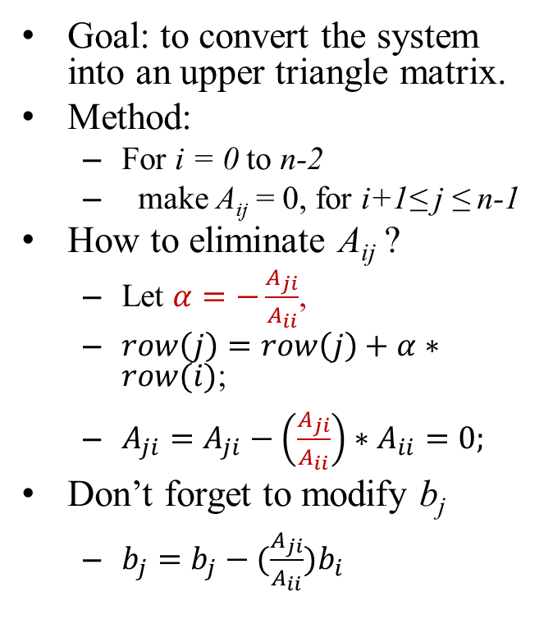
Forward Elimination
Goal: to convert the system into an upper triangle matrix.
Method:
For i = 0 to n-2
make A_{ij} = 0, for i+1≤ j ≤ n-1
How to eliminate A_{ij} ?
Let $α=−\frac{A_{ji}}{A_{ii}}$,
$row\left(j\right)=row\left(j\right)+α∗row(i)$;
$A_{ji}=A_{ji}−\left(\frac{A_{ji}}{A_{ii}}\right)∗A_{ii}=0;$
Don’t forget to modify b_{j}
$b_{j}=b_{j}−(\frac{A_{ji}}{A_{ii}})b_{i}$
Forward elimination

Slide 13
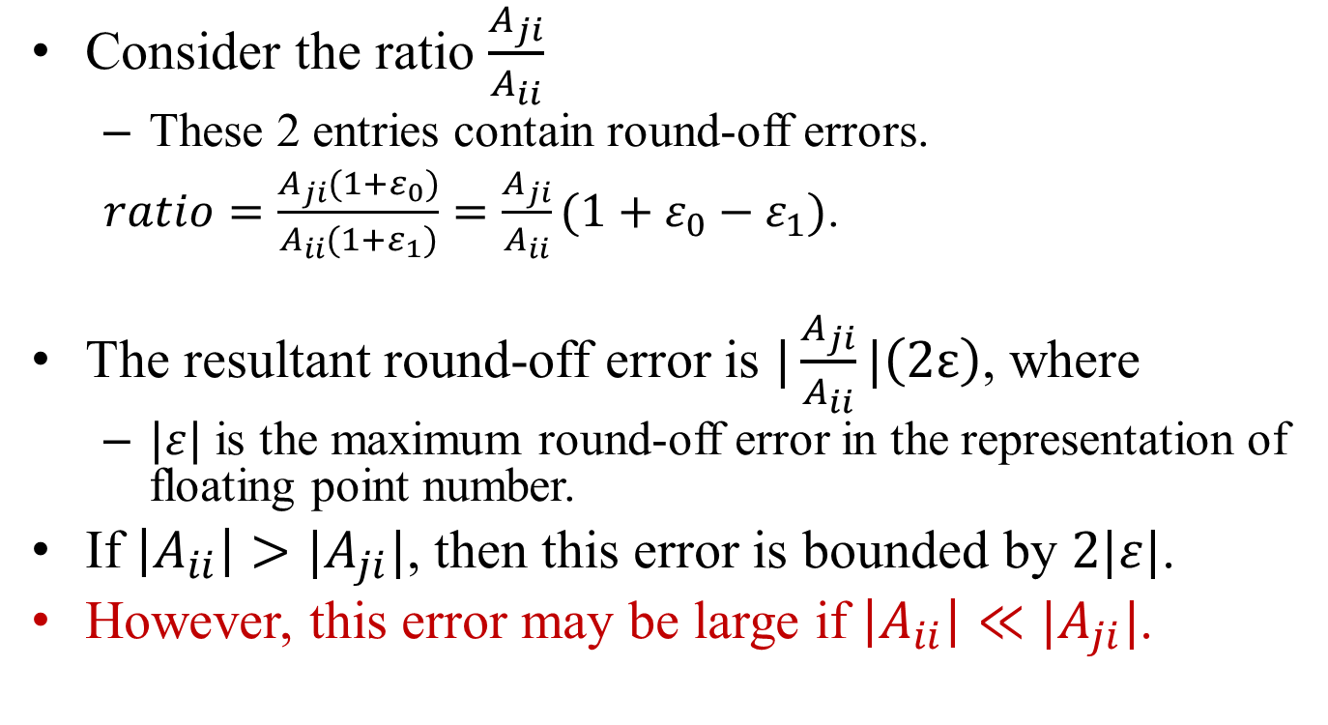
Partial Pivoting
Consider the ratio $\frac{A_{ji}}{A_{ii}}$
These 2 entries contain round-off errors.
$ratio=\frac{A_{ji}(1+ε_{0})}{A_{ii}(1+ε_{1})}=\frac{A_{ji}}{A_{ii}}(1+ε_{0}−ε_{1})$.
The resultant round-off error is $|\frac{A_{ji}}{A_{ii}}|\left(2ε\right)$, where
$|ε|$ is the maximum round-off error in the representation of floating point number.
If $\left|A_{ii}\right|>|A_{ji}|$, then this error is bounded by $2|ε|$.
However, this error may be large if $\left|A_{ii}\right|≪|A_{ji}|$.

Slide 14
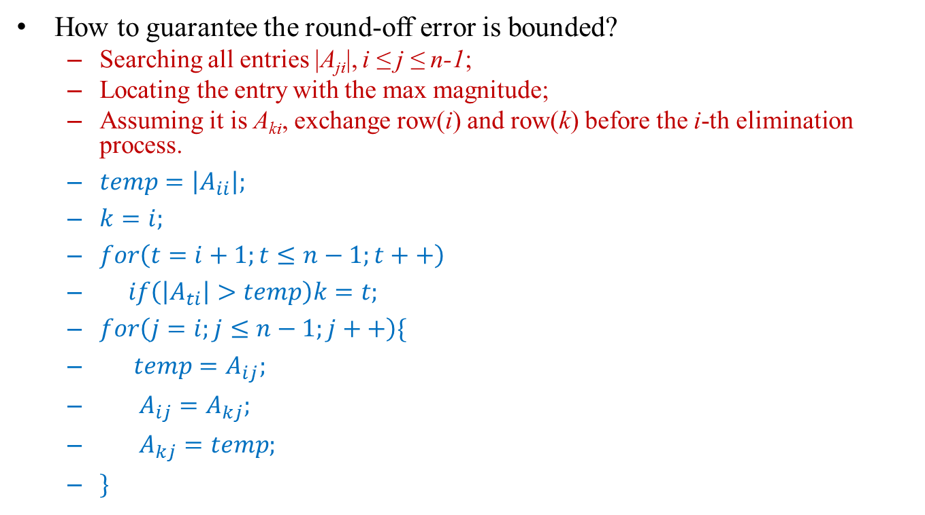
Partial Pivoting
How to guarantee the round-off error is bounded?
Searching all entries |A_{ji}|, i ≤ j ≤ n-1;
Locating the entry with the max magnitude;
Assuming it is A_{ki}, exchange row(i) and row(k) before the i-th elimination process.
$temp=\left|A_{ii}\right|;$
$k=i;$
$for\left(t=i+1;t≤n−1;t++\right)$
$if\left(\left|A_{ti}\right|>temp\right)k=t;$
$for\left(j=i;j≤n−1;j++\right)\{$
$temp=A_{ij};$
$A_{ij}=A_{kj};$
$A_{kj}=temp;$
$\}$
Pivot = the max entry in the current column.

Slide 15
Forward Elimination with Partial Pivoting
for(i=0;i<n-1;i++){
//Partial pivoting
k=i; temp=fabs(A[i][i]);
for(j=i+1;j<=n-1;j++)
if(fabs(A[j][i]>temp){
k=j; temp=fabs(A[j][i]);
}
//swapping is necessary
if(i!=k)
for(j=i;j<=n-1;j++){
temp = A[i][j];
A[i][j] = A[k][j];
A[k][j] = temp;
}
//Elimination of rows below
for(j=i+1;j<=n-1;j++){
if(A[j][i]==0.0) continue;
ratio = A[j][i]/A[i][i];
for(k=i;k<=n-1;k++)
A[j][k] = A[j][k] - ratio*A[i][k];
}//end_for(j)
}//end_for(i)

Slide 16
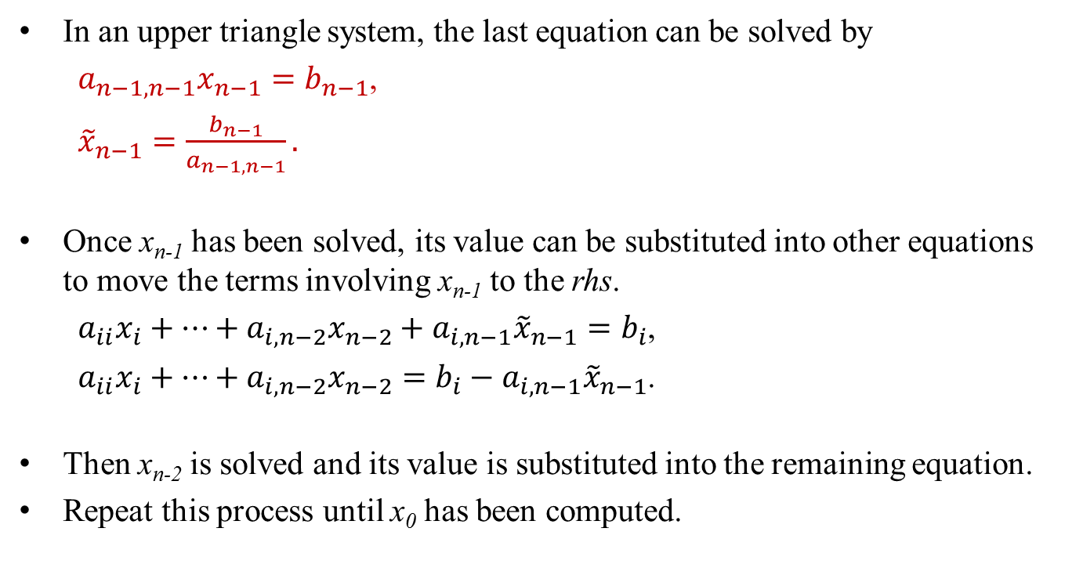
Backward Substitution
In an upper triangle system, the last equation can be solved by
$a_{n−1,n−1}x_{n−1}=b_{n−1}$,
${\tilde{x}}_{n−1}=\frac{b_{n−1}}{a_{n−1,n−1}}.$
Once x_{n-1} has been solved, its value can be substituted into other equations to move the terms involving x_{n-1} to the rhs.
$a_{ii}x_{i}+…+a_{i,n−2}x_{n−2}+a_{i,n−1}{\tilde{x}}_{n−1}=b_{i}$,
$a_{ii}x_{i}+…+a_{i,n−2}x_{n−2}=b_{i}−a_{i,n−1}{\tilde{x}}_{n−1}$.
Then x_{n-2} is solved and its value is substituted into the remaining equation.
Repeat this process until x₀ has been computed.

Slide 17

Example
An upper triangle system
$a_{00}x_{0}+a_{01}x_{1}+a_{02}x_{2}+a_{03}x_{3}=b_{0}$
${{ a}_{11}x}_{1}+a_{12}x_{2}+a_{13}x_{3}=b_{1 }$
$a_{22}x_{2}+a_{23}x_{3}=b_{2}$
${ a}_{33}x_{3}=b_{3}$
$a_{00}x_{0}+a_{01}x_{1}+a_{02}x_{2}=b_{0}$
${{ a}_{11}x}_{1}+a_{12}x_{2}=b_{1 }$
$a_{22}x_{2}=b_{2}$
$a_{00}x_{0}+a_{01}x_{1}=b_{0}$
${{ a}_{11}x}_{1}=b_{1 }$
$a_{00}x_{0}=b_{0}$

Slide 18
Backward Substitution
for(i=n-1;i>=0;i--){
//Solve x_{i}.
x[i] = b[i]/A[i][i];
//backward substitution
for(j=i-1;j>=0;j--)
b[j] = b[j] – A[j][i]*x[i];
} //end for(i)

Slide 19

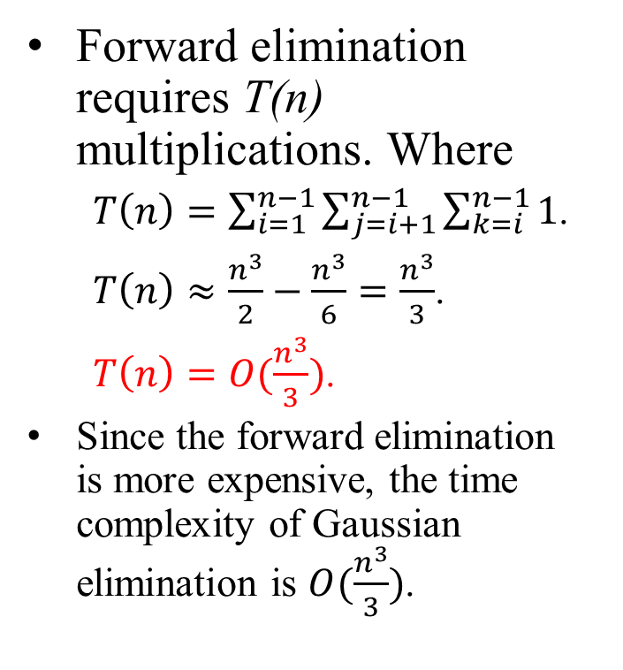
Time Complexity
Forward elimination requires T(n) multiplications. Where
$T\left(n\right)=\sum_{i=1}^{n−1}{\sum_{j=i+1}^{n−1}{\sum_{k=i}^{n−1}{1}}}$.
$T\left(n\right)≈\frac{n^{3}}{2}−\frac{n^{3}}{6}=\frac{n^{3}}{3}$.
$T\left(n\right)=O(\frac{n^{3}}{3})$.
Since the forward elimination is more expensive, the time complexity of Gaussian elimination is $O(\frac{n^{3}}{3})$.
Backward substitution requires T(n) steps.
$T\left(n\right)=\sum_{i=0}^{n−1}{\sum_{j=0}^{i}{1}}≈\frac{n^{2}}{2}$,
$T\left(n\right)=O(\frac{n^{2}}{2})$.

Slide 20
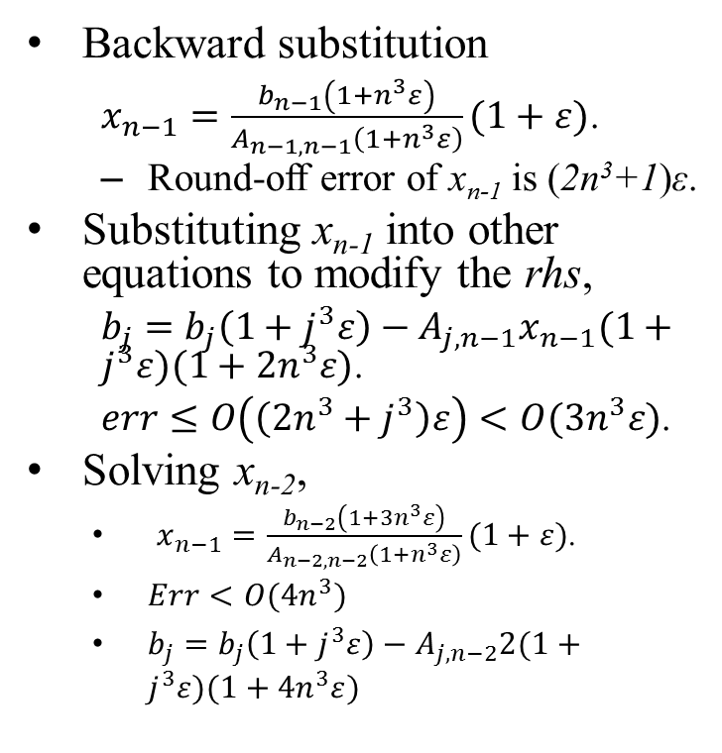
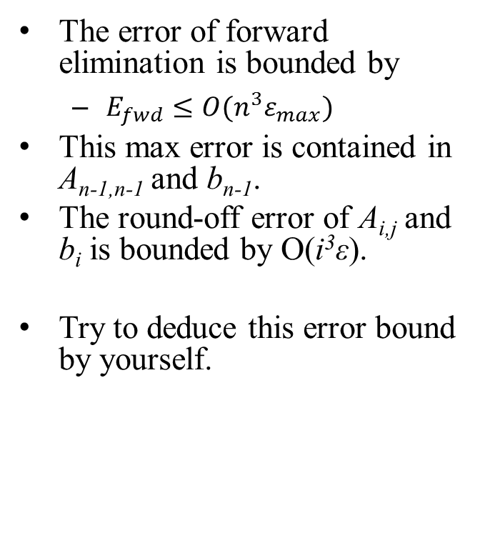
Round-off Error Analysis
The error of forward elimination is bounded by
$E_{fwd}≤O(n^{3}ε_{max})$
This max error is contained in A_{n-1,n-1} and b_{n-1}.
The round-off error of A_{i,j} and b_{i} is bounded by O(i³ε).
Try to deduce this error bound by yourself.
Backward substitution
$x_{n−1}=\frac{b_{n−1}\left(1+n^{3}ε\right)}{A_{n−1,n−1}\left(1+n^{3}ε\right)}(1+ε)$.
Round-off error of x_{n-1} is (2n³+1)ε.
Substituting x_{n-1} into other equations to modify the rhs,
$b_{j}=b_{j}\left(1+j^{3}ε\right)−A_{j,n−1}x_{n−1}(1+j^{3}ε)(1+{2n}^{3}ε)$.
$err≤O\left(\left({2n}^{3}+j^{3}\right)ε\right)<O({3n}^{3}ε)$.
Solving x_{n-2},
$x_{n−1}=\frac{b_{n−2}\left(1+{3n}^{3}ε\right)}{A_{n−2,n−2}\left(1+n^{3}ε\right)}(1+ε)$.
$Err<O(4n^{3})$
$b_{j}=b_{j}\left(1+j^{3}ε\right)−A_{j,n−2}2(1+j^{3}ε)(1+{4n}^{3}ε)$

Slide 21
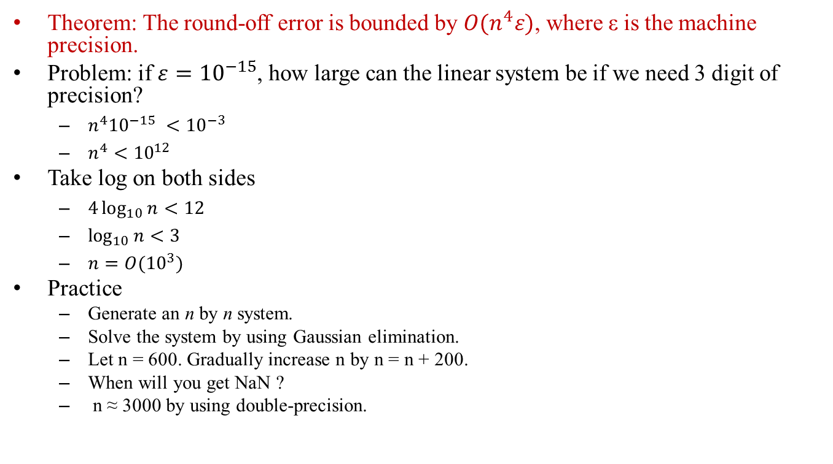
Round-off Error Analysis
Theorem: The round-off error is bounded by $O(n^{4}ε)$, where ε is the machine precision.
Problem: if $ε={10}^{−15}$, how large can the linear system be if we need 3 digit of precision?
${n^{4}{10}^{−15} <10}^{−3}$
$n^{4}<{10}^{12}$
Take log on both sides
$4\log_{10}{n}<12$
$\log_{10}{n}<3$
$n=O({10}^{3})$
Practice
Generate an n by n system.
Solve the system by using Gaussian elimination.
Let n = 600. Gradually increase n by n = n + 200.
When will you get NaN ?
n ≈ 3000 by using double-precision.

Slide 22
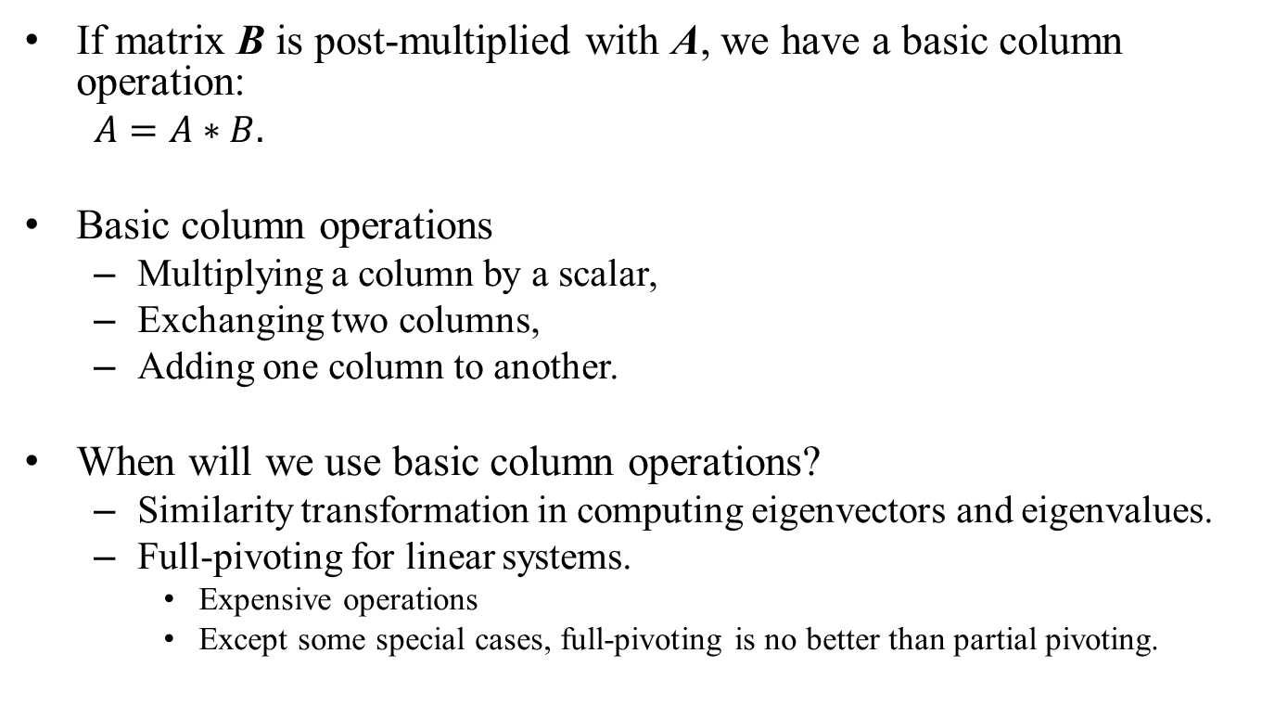
Digression, Basic Column Operation
If matrix B is post-multiplied with A, we have a basic column operation:
$A=A∗B.$
Basic column operations
Multiplying a column by a scalar,
Exchanging two columns,
Adding one column to another.
When will we use basic column operations?
Similarity transformation in computing eigenvectors and eigenvalues.
Full-pivoting for linear systems.
Expensive operations
Except some special cases, full-pivoting is no better than partial pivoting.

Slide 23
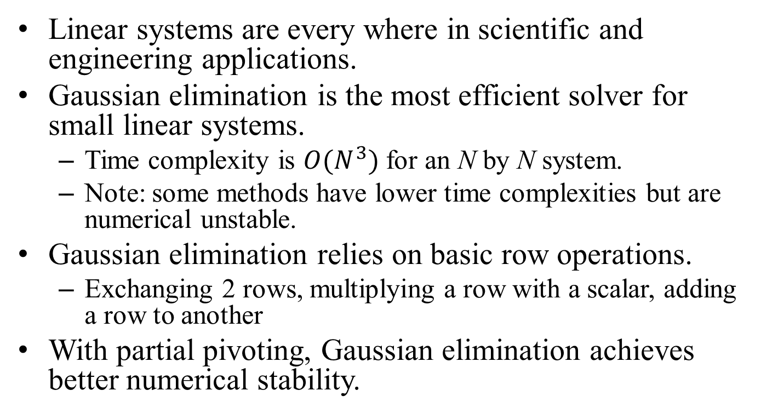
Conclusion
Linear systems are every where in scientific and engineering applications.
Gaussian elimination is the most efficient solver for small linear systems.
Time complexity is $O(N^{3})$ for an N by N system.
Note: some methods have lower time complexities but are numerical unstable.
Gaussian elimination relies on basic row operations.
Exchanging 2 rows, multiplying a row with a scalar, adding a row to another
With partial pivoting, Gaussian elimination achieves better numerical stability.

