Slide 1
LU-Decomposition
Doolittle’s Method
Ch. 2.2

Slide 2
Outline
Introduction, triangular systems
Doolittle’s method
Time complexity
Error analysis

Slide 3
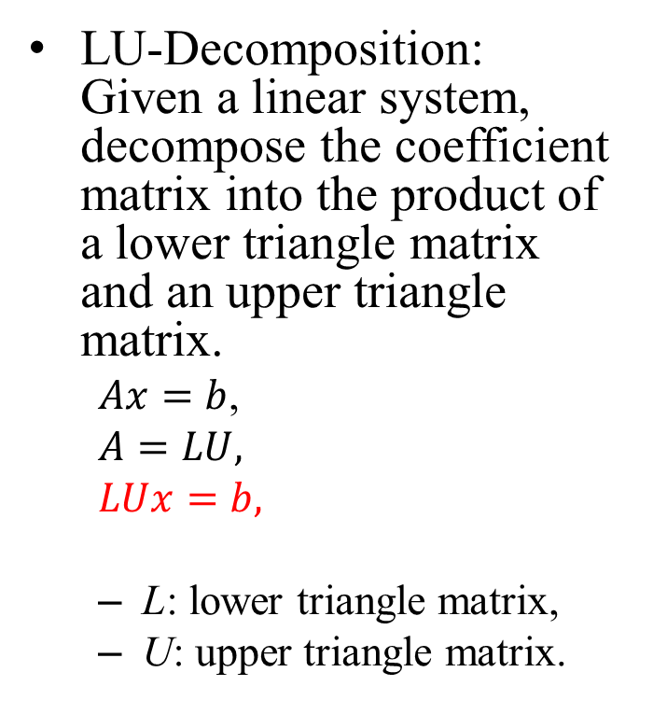
Introduction
LU-Decomposition: Given a linear system, decompose the coefficient matrix into the product of a lower triangle matrix and an upper triangle matrix.
$Ax=b$,
$A=LU,$
$LUx=b,$
L: lower triangle matrix,
U: upper triangle matrix.
LU-decomposition, A = L*U
A
L
U

Slide 4
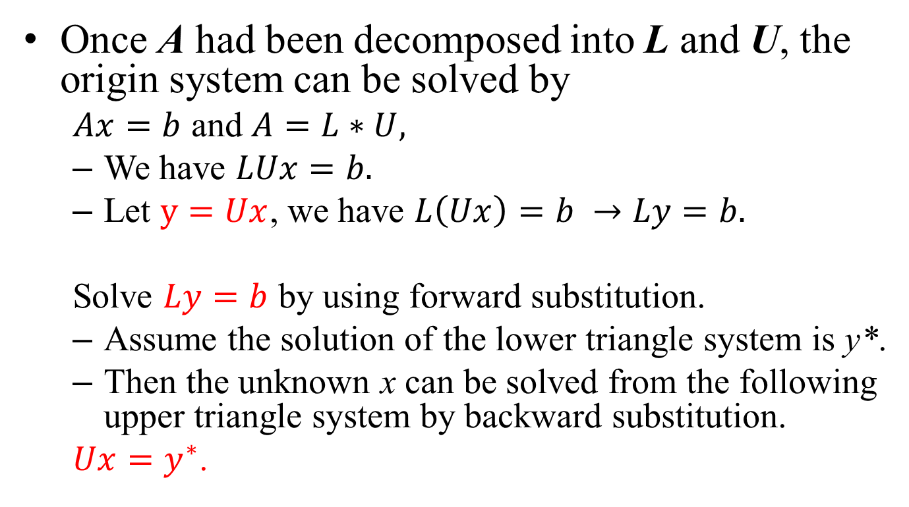
After the LU-Decomposition
Once A had been decomposed into L and U, the origin system can be solved by
$Ax=b$ and $A=L∗U,$
We have $LUx=b.$
Let $y=Ux$, we have $L\left(Ux\right)=b →Ly=b.$
Solve $Ly=b$ by using forward substitution.
Assume the solution of the lower triangle system is y*.
Then the unknown x can be solved from the following upper triangle system by backward substitution.
$Ux=y^{∗}$.

Slide 5
Why LU-Decomposition?
In some systems, the coefficient matrix A is invariant while the rhs b varies with time.
We decompose A into A = L*U by using a high precision method.
Then solve the system by using backward and forward substitution for each b.
Benefits
Less time complexity: LU-decomposition needs O(n³/3) time steps, but the substitution computations require only O(n²/2) each. If the system has to be solved repeatedly, we save a lot of costs.
Less errors: if the LU-decomposition is performed in a higher precision environment, the errors in L and U are relatively less. Backward- and forward-substitution are numerical stable. The whole process generates smaller errors than Gaussian elimination.

Slide 6
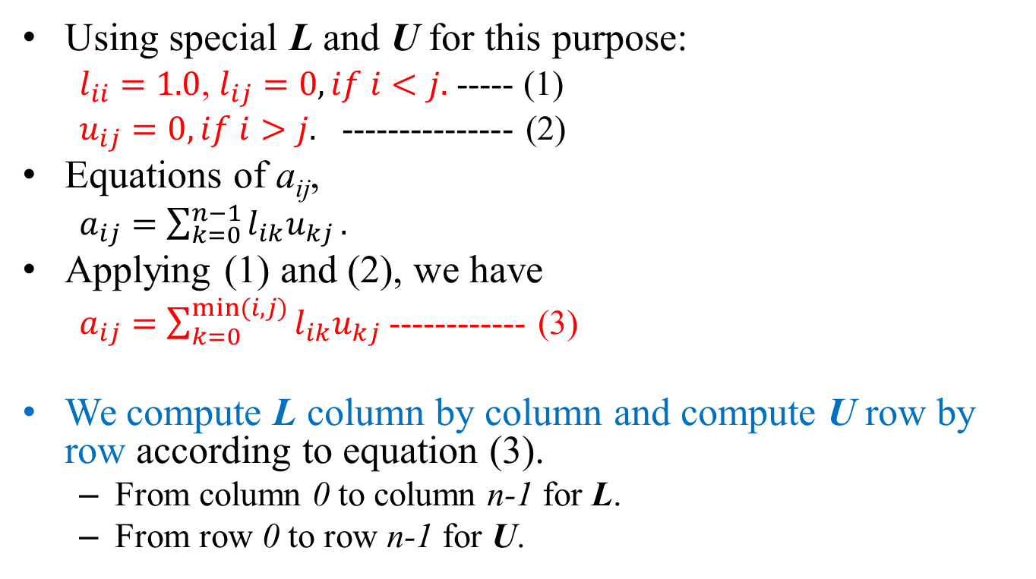
Overview of Doolittle’s Method
Using special L and U for this purpose:
$l_{ii}=1.0$, $l_{ij}=0, if i<j.$ ----- (1)
$u_{ij}=0, if i>j.$ --------------- (2)
Equations of a_{ij},
$a_{ij}=\sum_{k=0}^{n−1}{l_{ik}u_{kj}}.$
Applying (1) and (2), we have
$a_{ij}=\sum_{k=0}^{min⁡(i,j)}{l_{ik}u_{kj}}$ ------------ (3)
We compute L column by column and compute U row by row according to equation (3).
From column 0 to column n-1 for L.
From row 0 to row n-1 for U.
j
i<j
i
i>j
i=j
[a_{ij}]

Slide 7

Illustration
Relation between a_{ij}, l_{ik}, and u_{kj}.
$a_{ij}=\sum_{k=0}^{min⁡(i,j)}{l_{ik}u_{kj}}$.
Compute L column by column and compute U row by row // shaded entries had been computed, 0~k-1.
Col. j
k
[u_{ik}]
0
[a_{ij}]
[l_{ik}]
0
Row i
k

Slide 8
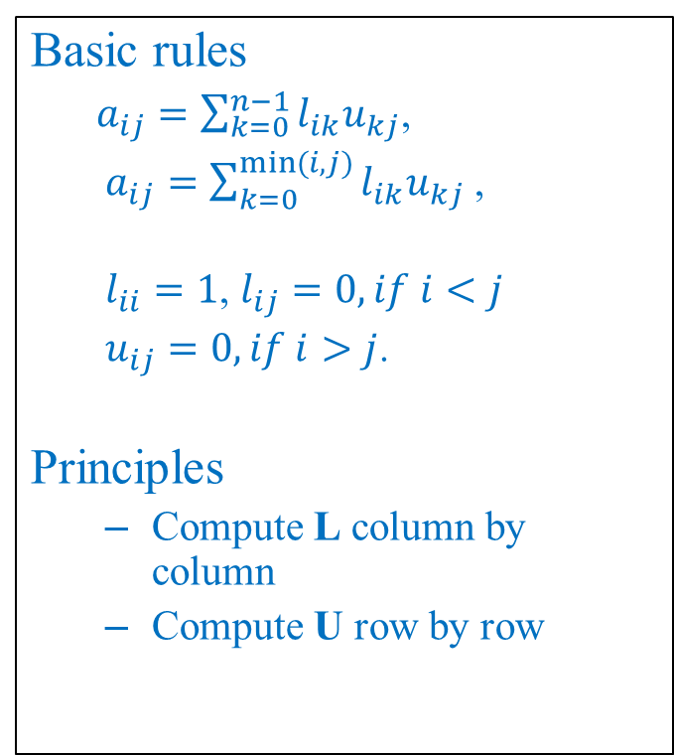
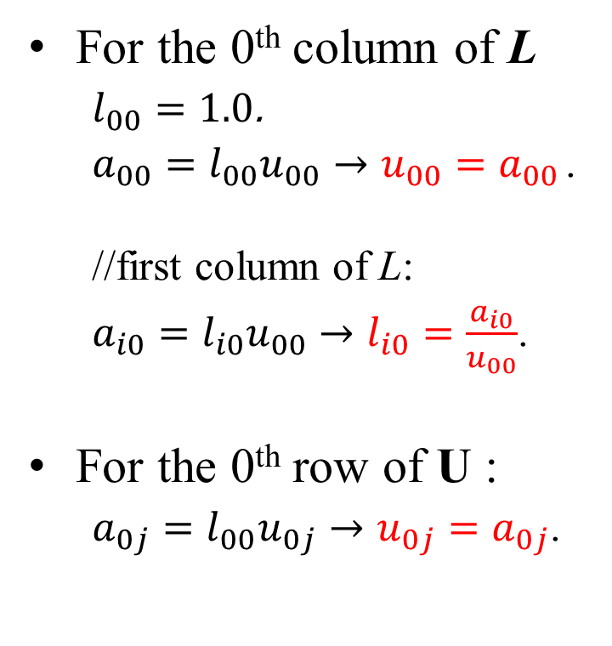
Doolittle’s Method
Basic rules
$a_{ij}=\sum_{k=0}^{n−1}{l_{ik}u_{kj}}$,
$a_{ij}=\sum_{k=0}^{min⁡(i,j)}{l_{ik}u_{kj}}$ ,
$l_{ii}=1$, $l_{ij}=0, if i<j$
$u_{ij}=0, if i>j$.
Principles
Compute L column by column
Compute U row by row
For the 0th column of L
$l_{00}=1.0$.
$a_{00}=l_{00}u_{00}→u_{00}=a_{00}$.
//first column of L:
$a_{i0}=l_{i0}u_{00}→l_{i0}=\frac{a_{i0}}{u_{00}}$.
For the 0th row of U :
$a_{0j}=l_{00}u_{0j}→u_{0j}=a_{0j}$.

Slide 9

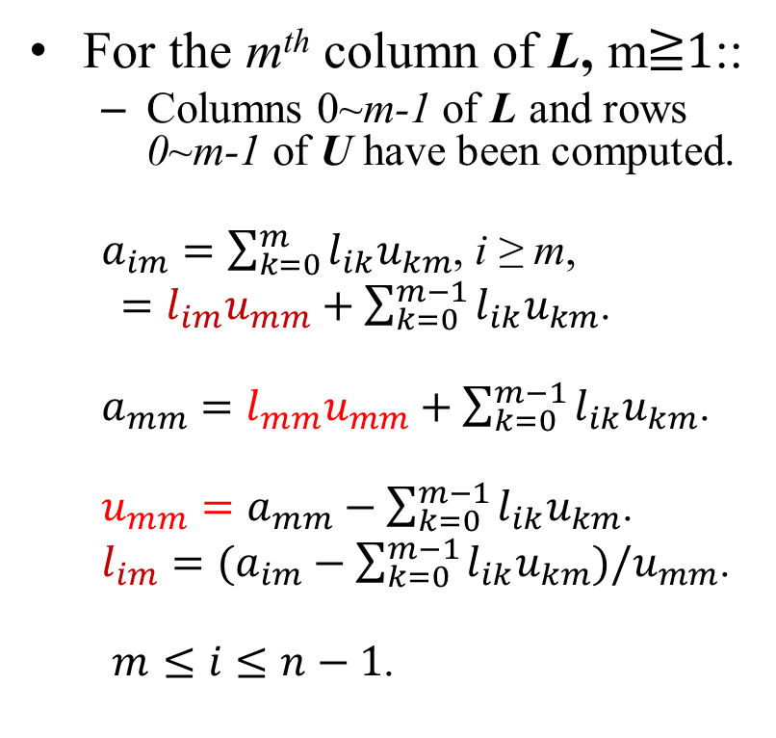
Doolittle’s Method
For the m^{th} column of L, m≧1::
Columns 0~m-1 of L and rows 0~m-1 of U have been computed.
$a_{im}=\sum_{k=0}^{m}{l_{ik}u_{km}}$, i ≥ m,
$=l_{im}u_{mm}+\sum_{k=0}^{m−1}{l_{ik}u_{km}}$.
$a_{mm}=l_{mm}u_{mm}+\sum_{k=0}^{m−1}{l_{ik}u_{km}}$.
$u_{mm}=a_{mm}−\sum_{k=0}^{m−1}{l_{ik}u_{km}}$.
$l_{im}=(a_{im}−\sum_{k=0}^{m−1}{l_{ik}u_{km}})/u_{mm}$.
$m≤i≤n−1$.
Configuration in the m-th round computation:
[a_{im}]
$$i≥m.$$
i
k
[l_{ik}]
k
[u_{km}]
m
i
i ≥ m
[u_{km}]

Slide 10

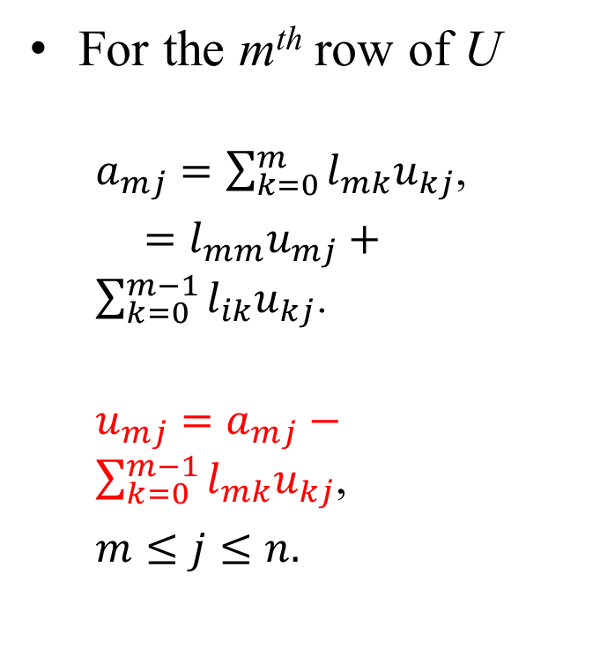


Doolittle’s Method
For the m^{th} row of U
$a_{mj}=\sum_{k=0}^{m}{l_{mk}u_{kj}}$,
$=l_{mm}u_{mj}+\sum_{k=0}^{m−1}{l_{ik}u_{kj}}$.
$u_{mj}=a_{mj}−\sum_{k=0}^{m−1}{l_{mk}u_{kj}}$,
$m≤j≤n.$
Configuration in the m-th round
$$a_{mj}$$
$$m≤j.$$
$$u_{mj}$$

Slide 11


The Pseudo-Codes
//Initialize L and U.
L={0}; U={0};
for(i=0;i<n;i++){
L[i][i] = 1.0;
for(j=i;j<n;j++){ //Compute i-th row of U
sum = 0.0;
for(k=0;k<i;k++) sum += L[i][k]*U[k][j];
U[i][j] = A[i][j] – sum;
} //end for(j)
for(j=i+1;j<n;j++){//Compute i-th column of L
sum = 0.0;
for(k=0;k<i;k++) sum += L[j][k]*U[k][i];
L[j][i] = (A[j][i]-sum)/U[i][i];
} //end for(j)
} // end for(i)
$$u_{mj}$$
$$l_{jm}$$

Slide 12
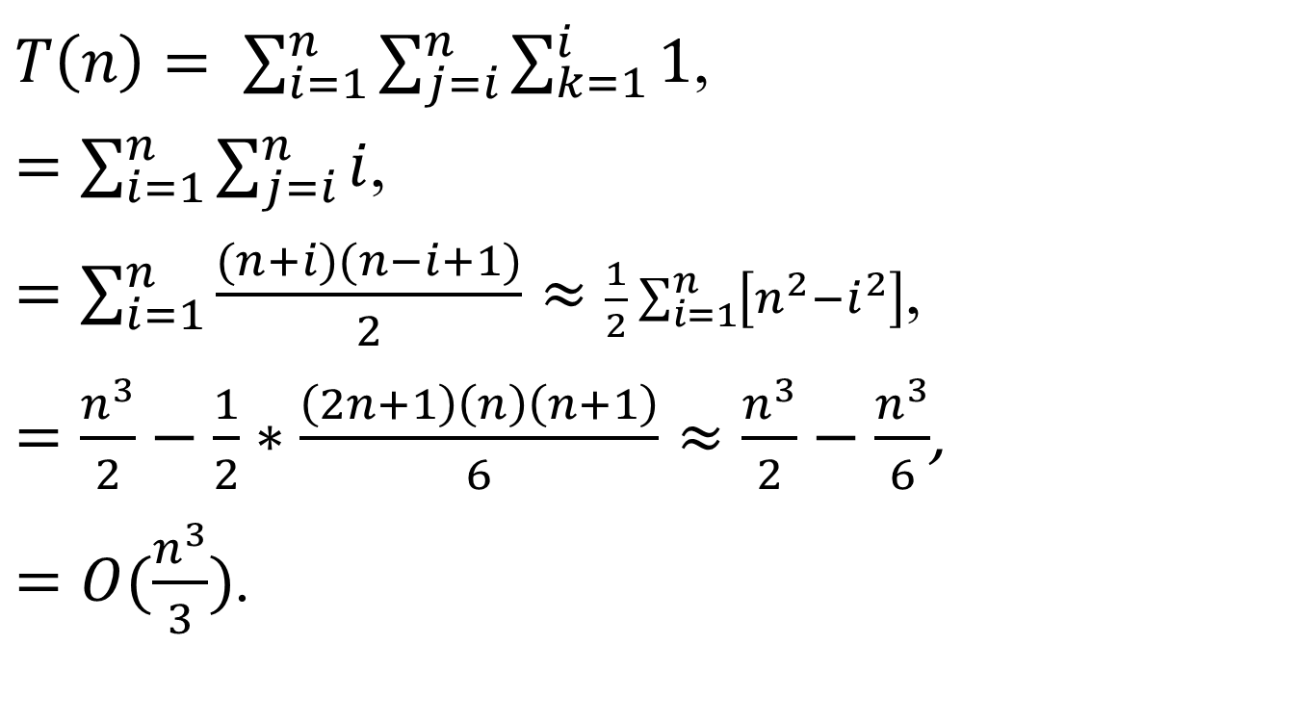
Time Complexity
$T\left(n\right)= \sum_{i=1}^{n}{\sum_{j=i}^{n}{\sum_{k=1}^{i}{1}}}$,
$=\sum_{i=1}^{n}{\sum_{j=i}^{n}{i}}$,
$=\sum_{i=1}^{n}{\frac{(n+i)(n−i+1)}{2}}≈\frac{1}{2}\sum_{i=1}^{n}{\left[n^{2}−i^{2}\right]}$,
$=\frac{n^{3}}{2}−\frac{1}{2}∗\frac{\left(2n+1\right)\left(n\right)\left(n+1\right)}{6}≈\frac{n^{3}}{2}−\frac{n^{3}}{6}$,
$=O(\frac{n^{3}}{3})$.

Slide 13
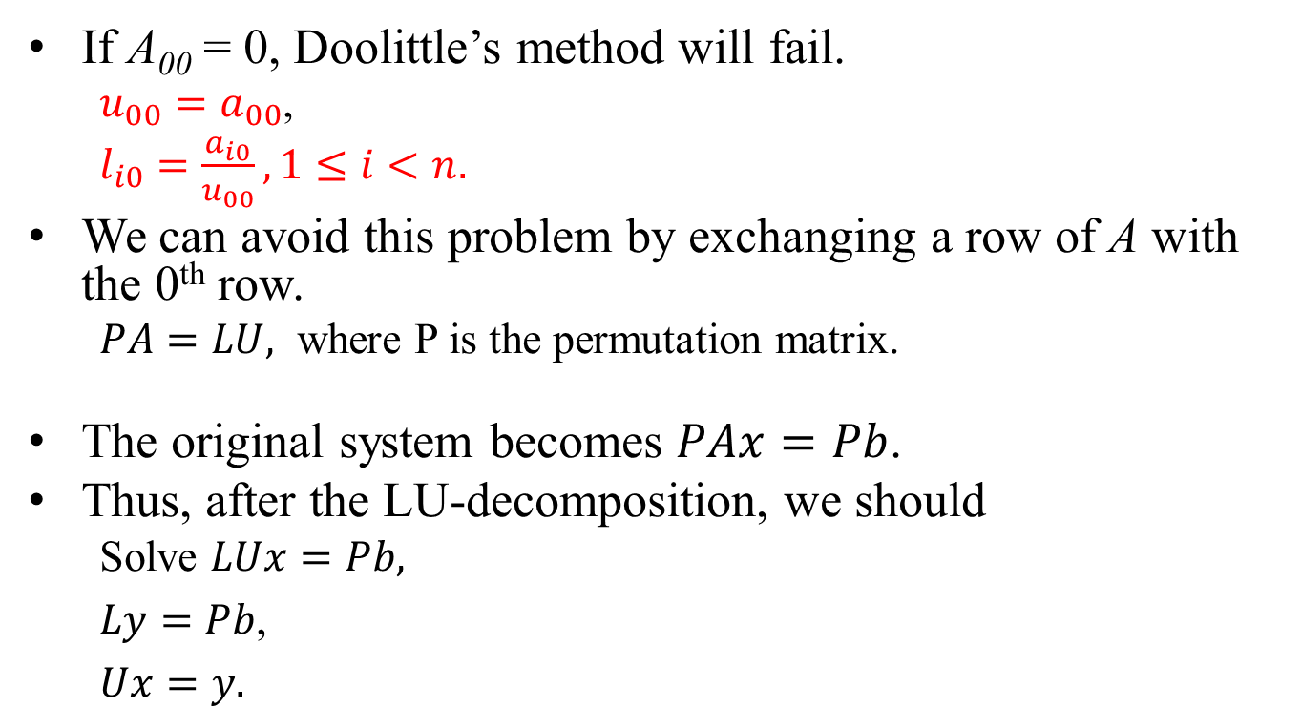
Pivoting
If A₀₀ = 0, Doolittle’s method will fail.
$u_{00}=a_{00}$,
$l_{i0}=\frac{a_{i0}}{u_{00}},1≤i<n.$
We can avoid this problem by exchanging a row of A with the 0th row.
$PA=LU,$ where P is the permutation matrix.
The original system becomes $PAx=Pb$.
Thus, after the LU-decomposition, we should
Solve $LUx=Pb,$
$Ly=Pb$,
$Ux=y.$

Slide 14
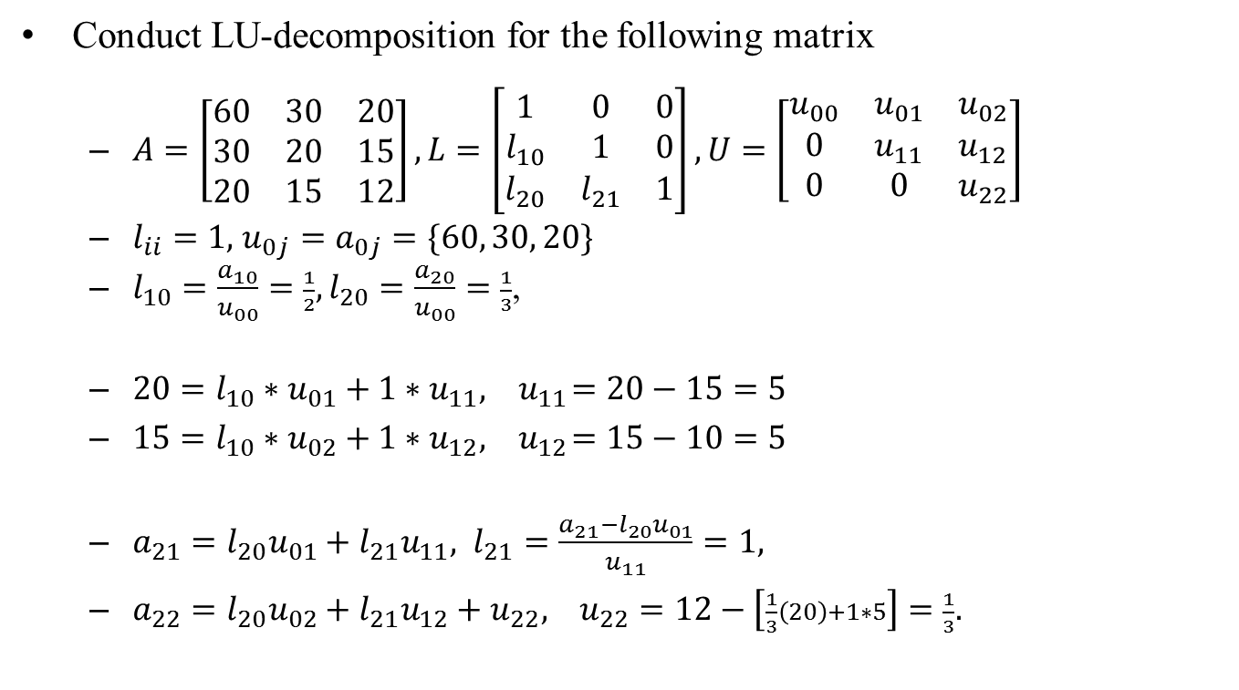
Example
Conduct LU-decomposition for the following matrix
$A=\left[\begin{matrix}60 & 30 & 20 \\ 30 & 20 & 15 \\ 20 & 15 & 12\end{matrix}\right],L=\left[\begin{matrix}1 & 0 & 0 \\ l_{10} & 1 & 0 \\ l_{20} & l_{21} & 1\end{matrix}\right],U=\left[\begin{matrix}u_{00} & u_{01} & u_{02} \\ 0 & u_{11} & u_{12} \\ 0 & 0 & u_{22}\end{matrix}\right]$
$l_{ii}=1,$ $u_{0j}=a_{0j}=\{60, 30, 20\}$
$l_{10}=\frac{a_{10}}{u_{00}}=\frac{1}{2},l_{20}=\frac{a_{20}}{u_{00}}=\frac{1}{3}$,
$20=l_{10}∗u_{01}+{1∗u}_{11}, { u}_{11}=20−15=5$
$15=l_{10}∗u_{02}+{1∗u}_{12},{ u}_{12}=15−10=5$
$a_{21}=l_{20}u_{01}+l_{21}u_{11}, l_{21}=\frac{a_{21}−l_{20}u_{01}}{u_{11}}=1,$
$a_{22}=l_{20}u_{02}+l_{21}u_{12}+u_{22}, u_{22}=12−\left[\frac{1}{3}\left(20\right)+1∗5\right]=\frac{1}{3}.$

Slide 15
Iterative Refinement
LU-decomposition has been used in improving the solution of a linear system.
The steps
Decompose A = LU.
Solve Ax = b.
Assume the solution is x’, where x’ = x + Δx.
Compute residual r = b – Ax’ = b – A(x+Δx) = -AΔx.
Since A⁻¹r = -Δx, we have A(Δx) = -r.
Solve the above linear system to obtain Δx.
Improve the solution by
x = x’ – Δx.
The refinement procedure can be iterated, if the improved solution is not accurate enough.
Thus L and U are applicable in forming lower- and upper-triangular systems.
Each iteration needs O(n²) steps instead of O(n³) steps.

