Slide 1
QR-Decomposition
Using Householder’s Transformation

Slide 2
Outline
Introduction
Householder’s transformation
The pseudo-codes
Time complexity
Error bound
Applications

Slide 3
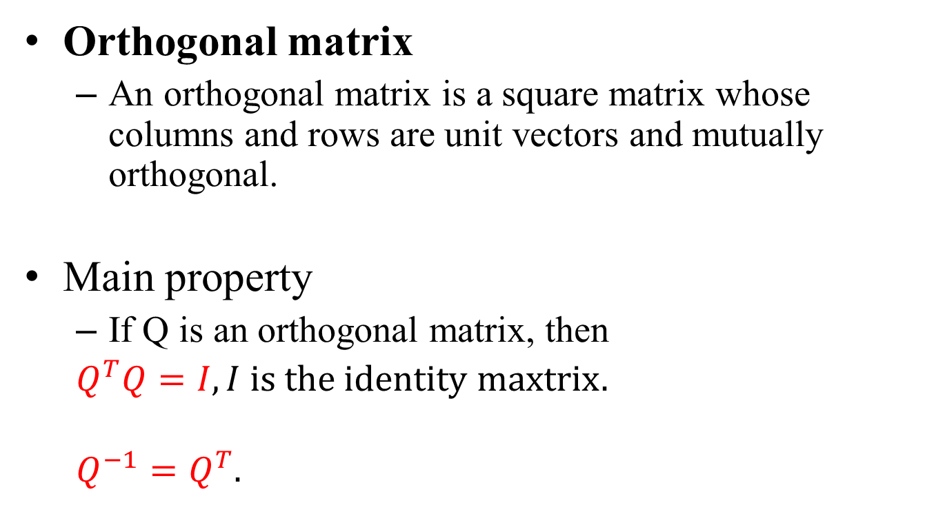
Introduction
Orthogonal matrix
An orthogonal matrix is a square matrix whose columns and rows are unit vectors and mutually orthogonal.
Main property
If Q is an orthogonal matrix, then
$Q^{T}Q=I, I is the identity maxtrix.$
$Q^{−1}=Q^{T}.$

Slide 4
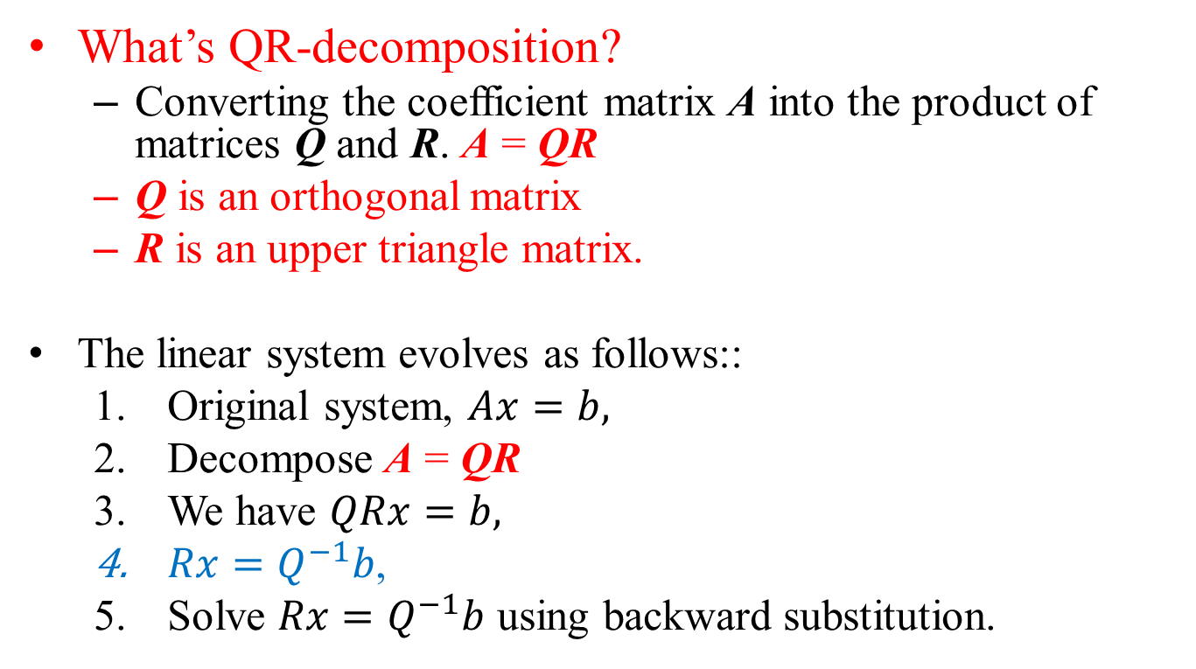
Introduction
What’s QR-decomposition?
Converting the coefficient matrix A into the product of matrices Q and R. A = QR
Q is an orthogonal matrix
R is an upper triangle matrix.
The linear system evolves as follows::
Original system, $Ax=b,$
Decompose A = QR
We have $QRx=b,$
$Rx=Q^{−1}b$,
Solve $Rx=Q^{−1}b$ using backward substitution.

Slide 5
QR-decomposition Algorithms
There are several ways to achieve QR-decomposition.
Gram–Schmidt method (projection)
Householder method (reflection)
Givens method (rotation)
We use Householder transformations
Easier to implement
Numerical stable

Slide 6
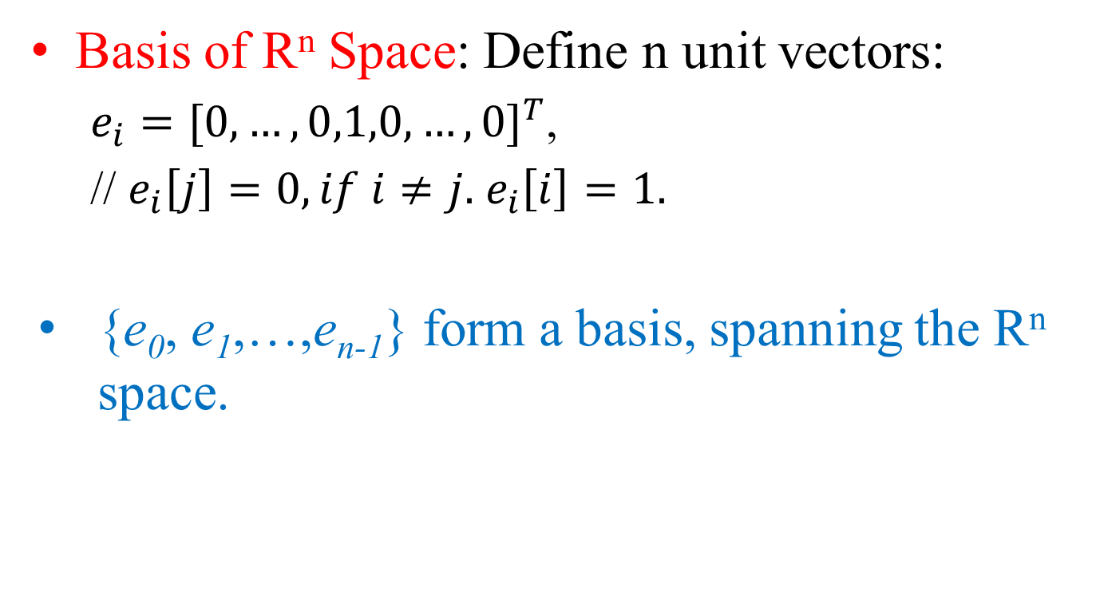
Basis Vectors
Basis of R^{n} Space: Define n unit vectors:
$e_{i}={[0,…,0,1,0,…,0]}^{T}$,
// $e_{i}\left[j\right]=0, if i≠j.$ $e_{i}\left[i\right]=1.$
{e₀, e₁,…,e_{n-1}} form a basis, spanning the R^{n} space.

Slide 7
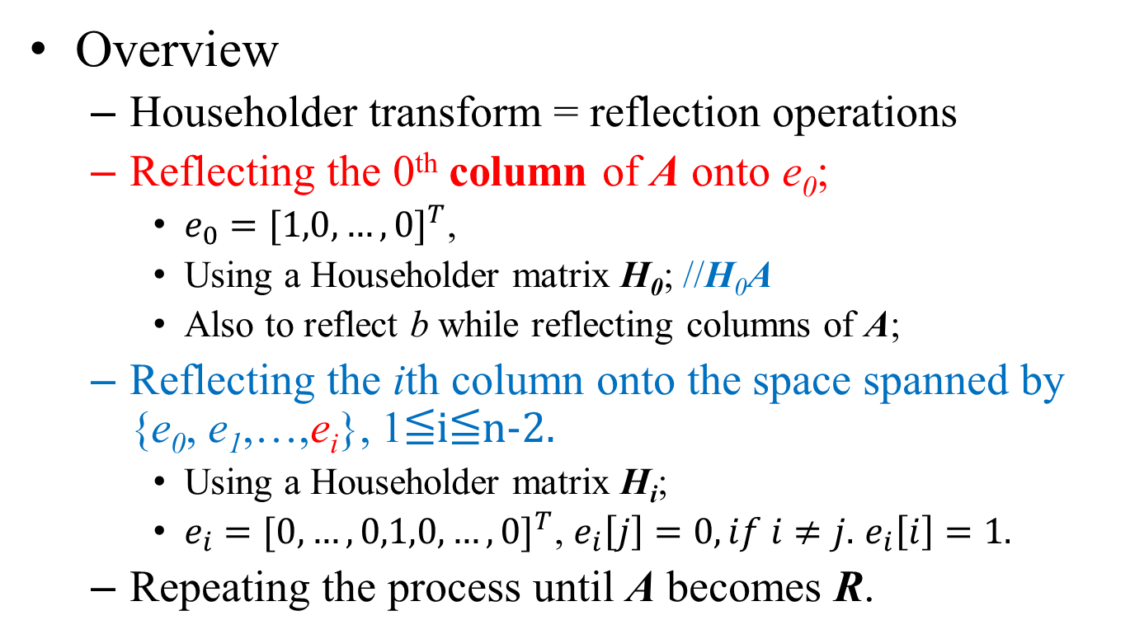
Algorithm Overview
Overview
Householder transform = reflection operations
Reflecting the 0th column of A onto e₀;
$e_{0}={[1,0,…,0]}^{T}$,
Using a Householder matrix H₀; //H₀A
Also to reflect b while reflecting columns of A;
Reflecting the ith column onto the space spanned by {e₀, e₁,…,e_{i}}, 1≦i≦n-2.
Using a Householder matrix H_{i};
$e_{i}={[0,…,0,1,0,…,0]}^{T}$, $e_{i}\left[j\right]=0, if i≠j.$ $e_{i}\left[i\right]=1.$
Repeating the process until A becomes R.

Slide 8
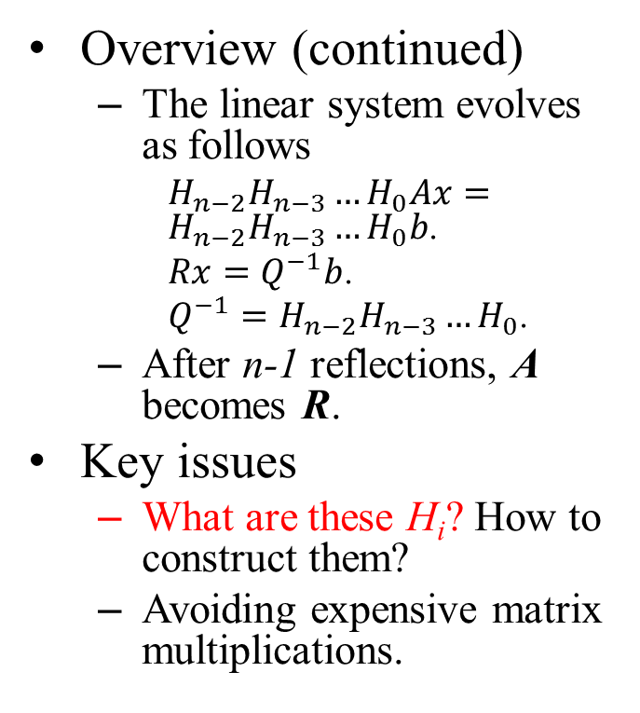
Algorithm Overview
Overview (continued)
The linear system evolves as follows
$H_{n−2}H_{n−3}…H_{0}Ax=H_{n−2}H_{n−3}…H_{0}b$.
$Rx=Q^{−1}b$.
$Q^{−1}=H_{n−2}H_{n−3}…H_{0}$.
After n-1 reflections, A becomes R.
Key issues
What are these H_{i}? How to construct them?
Avoiding expensive matrix multiplications.
Shapes of A, Q, and R:
Column i
A =
Projection of col. i
0
Q
R

Slide 9

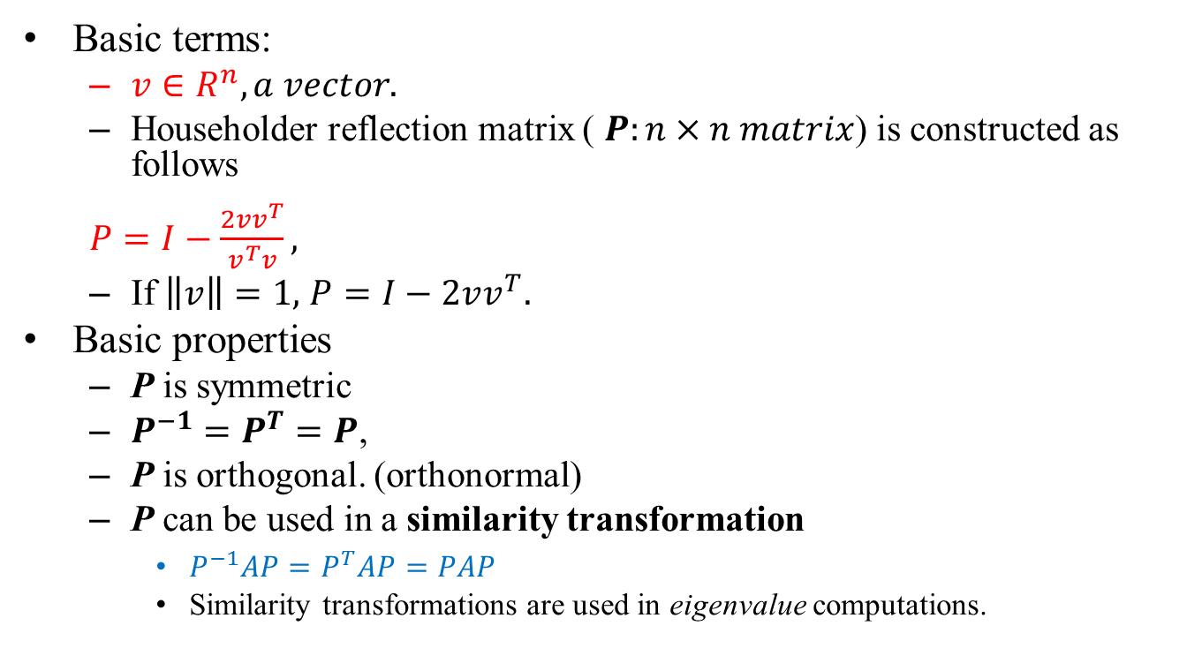
Householder Transformation Matrix
Basic terms:
$v∈R^{n}, a vector.$
Householder reflection matrix ( $P:n×n matrix$) is constructed as follows
$P=I−\frac{2vv^{T}}{v^{T}v},$
If $\left\|v\right\|=1,$ $P=I−2vv^{T}.$
Basic properties
P is symmetric
$P^{−1}=P^{T}=P$,
P is orthogonal. (orthonormal)
P can be used in a similarity transformation
$P^{−1}AP=P^{T}AP=PAP$
Similarity transformations are used in eigenvalue computations.
I: identity matrix
$v^{T}v→scalar.$
$vv^{T}→matrix.$

Slide 10
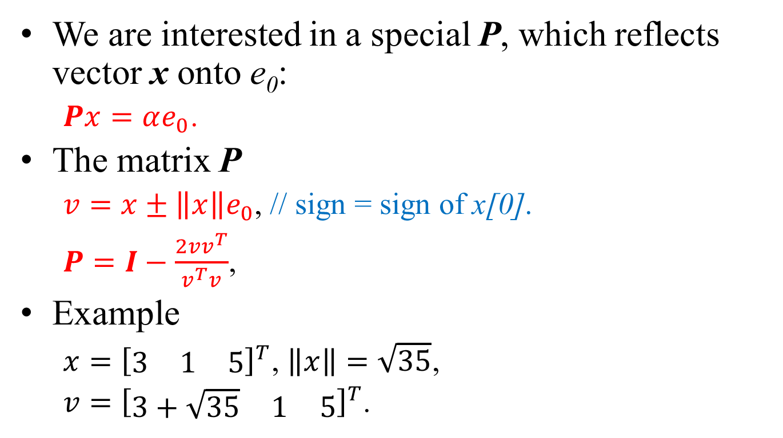
Special Householder Matrix
We are interested in a special P, which reflects vector x onto e₀:
$Px=αe_{0}$.
The matrix P
$v=x±\left\|x\right\|e_{0}$, // sign = sign of x[0].
$P=I−\frac{2vv^{T}}{v^{T}v}$,
Example
$x={\left[\begin{matrix}3 & 1 & 5\end{matrix}\right]}^{T}$, $\left\|x\right\|=\sqrt{35}$,
$v={\left[\begin{matrix}3+\sqrt{35} & 1 & 5\end{matrix}\right]}^{T}$.
x
αe₀

Slide 11
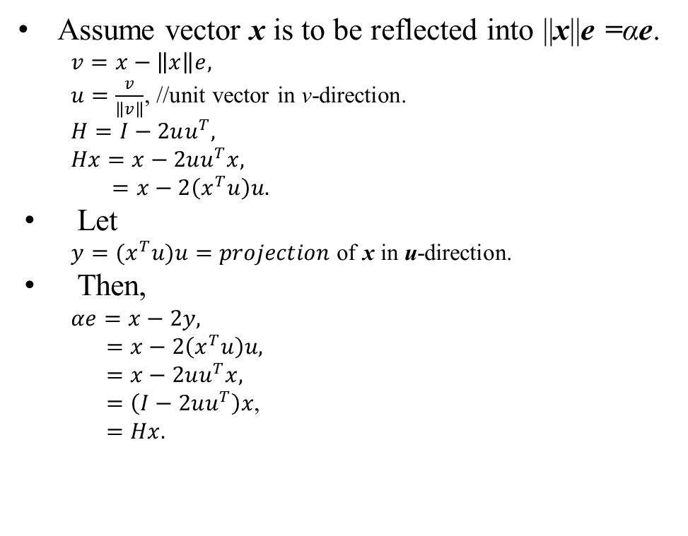
Illustration
Assume vector x is to be reflected into ||x||e =αe.
$v=x−\left\|x\right\|e,$
$u=\frac{v}{\left\|v\right\|}$, //unit vector in v-direction.
$H=I−2uu^{T},$
$Hx=x−2uu^{T}x,$
$=x−2\left(x^{T}u\right)u.$
Let
${y=(x}^{T}u)u=projection$ of x in u-direction.
Then,
$αe=x−2y,$
$=x−2\left(x^{T}u\right)u,$
$=x−2uu^{T}x,$
$=\left(I−2uu^{T}\right)x$,
$=Hx.$
x
x
y
v
u
αe

Slide 12
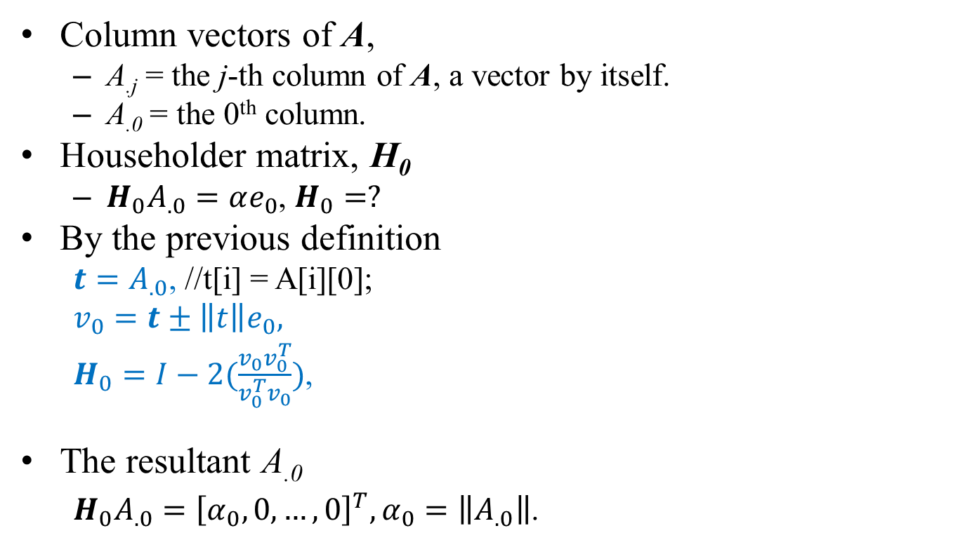
Householder Matrix, H₀
Column vectors of A,
A_{.j} = the j-th column of A, a vector by itself.
A_{.0} = the 0th column.
Householder matrix, H₀
$H_{0}A_{.0}=αe_{0}$, $H_{0}=?$
By the previous definition
$t=A_{.0}$, //t[i] = A[i][0];
$v_{0}=t±\left\|t\right\|e_{0},$
$H_{0}=I−2(\frac{v_{0}v_{0}^{T}}{v_{0}^{T}v_{0}})$,
The resultant A_{.0}
${H_{0}A}_{.0}={\left[α_{0},0,…,0\right]}^{T},α_{0}=\left\|A_{.0}\right\|$.

Slide 13
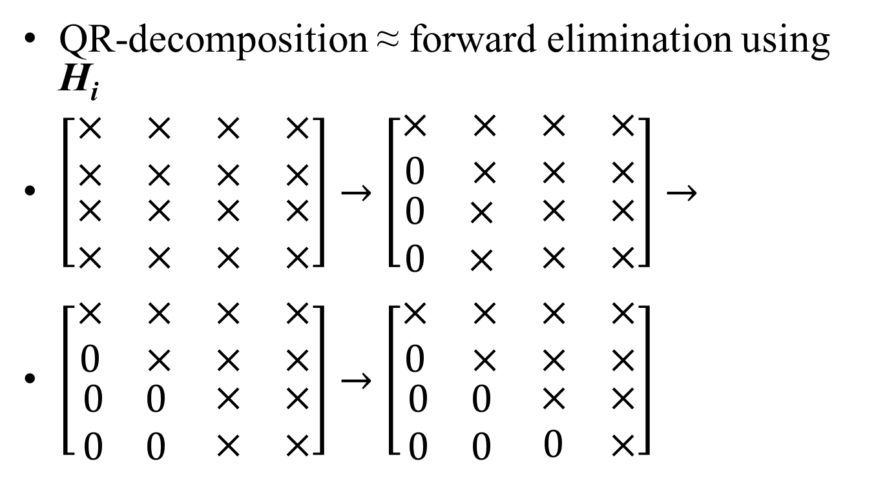
Flowchart of QR-decomposition
QR-decomposition ≈ forward elimination using H_{i}
$\left[\begin{matrix}\begin{matrix}× & × \\ × & ×\end{matrix} & \begin{matrix}× & × \\ × & ×\end{matrix} \\ \begin{matrix}× & × \\ × & ×\end{matrix} & \begin{matrix}× & × \\ × & ×\end{matrix}\end{matrix}\right]→\left[\begin{matrix}\begin{matrix}× & × \\ 0 & ×\end{matrix} & \begin{matrix}× & × \\ × & ×\end{matrix} \\ \begin{matrix}0 & × \\ 0 & ×\end{matrix} & \begin{matrix}× & × \\ × & ×\end{matrix}\end{matrix}\right]→$
$\left[\begin{matrix}\begin{matrix}× & × \\ 0 & ×\end{matrix} & \begin{matrix}× & × \\ × & ×\end{matrix} \\ \begin{matrix}0 & 0 \\ 0 & 0\end{matrix} & \begin{matrix}× & × \\ × & ×\end{matrix}\end{matrix}\right]→\left[\begin{matrix}\begin{matrix}× & × \\ 0 & ×\end{matrix} & \begin{matrix}× & × \\ × & ×\end{matrix} \\ \begin{matrix}0 & 0 \\ 0 & 0\end{matrix} & \begin{matrix}× & × \\ 0 & ×\end{matrix}\end{matrix}\right]$
H₀
H₁
H₂

Slide 14
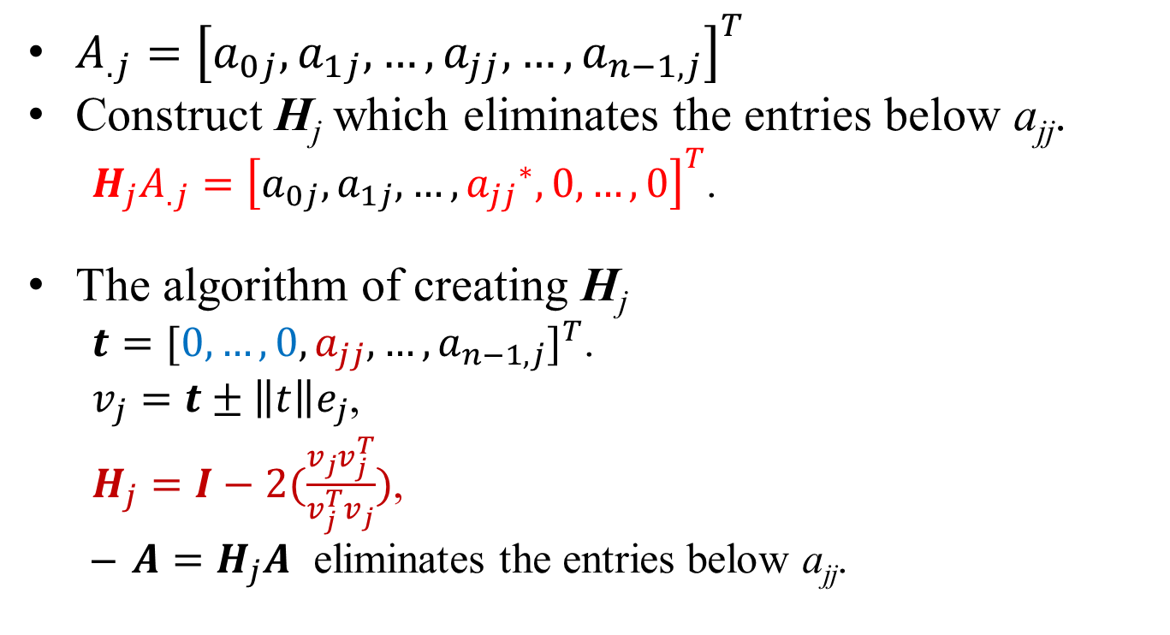
Eliminating the j-th Column
$A_{.j}={\left[a_{0j},a_{1j},…,a_{jj},…,a_{n−1,j}\right]}^{T}$
Construct H_{j} which eliminates the entries below a_{jj}.
$H_{j}A_{.j}={\left[a_{0j},a_{1j},…,{a_{jj}}^{∗},0,…,0\right]}^{T}$.
The algorithm of creating H_{j}
$t={[0,…,0,a_{jj},…,a_{n−1,j}]}^{T}$.
$v_{j}=t±\left\|t\right\|e_{j}$,
$H_{j}=I−2(\frac{v_{j}v_{j}^{T}}{v_{j}^{T}v_{j}})$,
$A=H_{j}A$ eliminates the entries below a_{jj}.
j
I
0
0
B
H_{j}

Slide 15
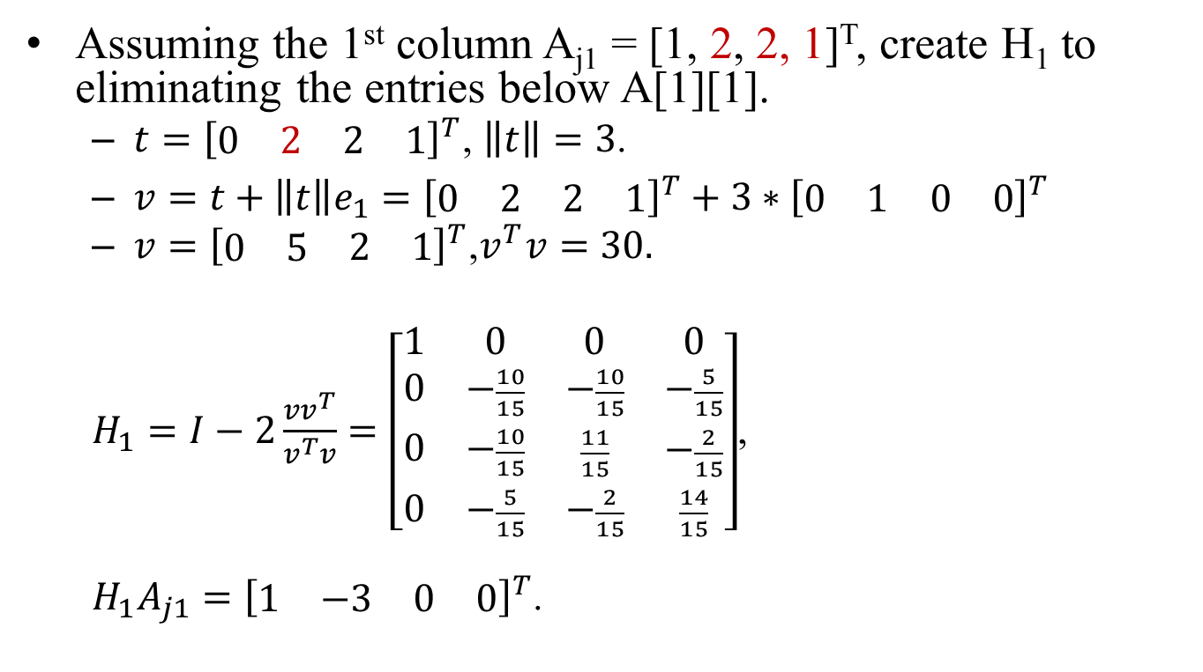
Practice
Assuming the 1st column A_{j1} = [1, 2, 2, 1]^{T}, create H₁ to eliminating the entries below A[1][1].
$t={\left[\begin{matrix}\begin{matrix}0 & 2\end{matrix} & \begin{matrix}2 & 1\end{matrix}\end{matrix}\right]}^{T}$, $\left\|t\right\|=3$.
$v=t+\left\|t\right\|e_{1}={\left[\begin{matrix}\begin{matrix}0 & 2\end{matrix} & \begin{matrix}2 & 1\end{matrix}\end{matrix}\right]}^{T}+{3∗\left[\begin{matrix}\begin{matrix}0 & 1\end{matrix} & \begin{matrix}0 & 0\end{matrix}\end{matrix}\right]}^{T}$
$v={\left[\begin{matrix}\begin{matrix}0 & 5\end{matrix} & \begin{matrix}2 & 1\end{matrix}\end{matrix}\right]}^{T}$,$v^{T}v=30.$
$H_{1}=I−2\frac{{vv}^{T}}{v^{T}v}=\left[\begin{matrix}\begin{matrix}1 & 0 \\ 0 & −\frac{10}{15}\end{matrix} & \begin{matrix}0 & 0 \\ −\frac{10}{15} & −\frac{5}{15}\end{matrix} \\ \begin{matrix}0 & −\frac{10}{15} \\ 0 & −\frac{5}{15}\end{matrix} & \begin{matrix}\frac{11}{15} & −\frac{2}{15} \\ −\frac{2}{15} & \frac{14}{15}\end{matrix}\end{matrix}\right]$,
$H_{1}A_{j1}={\left[\begin{matrix}\begin{matrix}1 & −3\end{matrix} & \begin{matrix}0 & 0\end{matrix}\end{matrix}\right]}^{T}$.

Slide 16
Cost Analysis
We have (n-1) eliminations have to perform.
(n-1) columns
(n-1) matrix multiplications, H_{j}*A.
Matrix multiplication is of O(n³).
In total, O(n⁴) steps.
Too expensive.

Slide 17
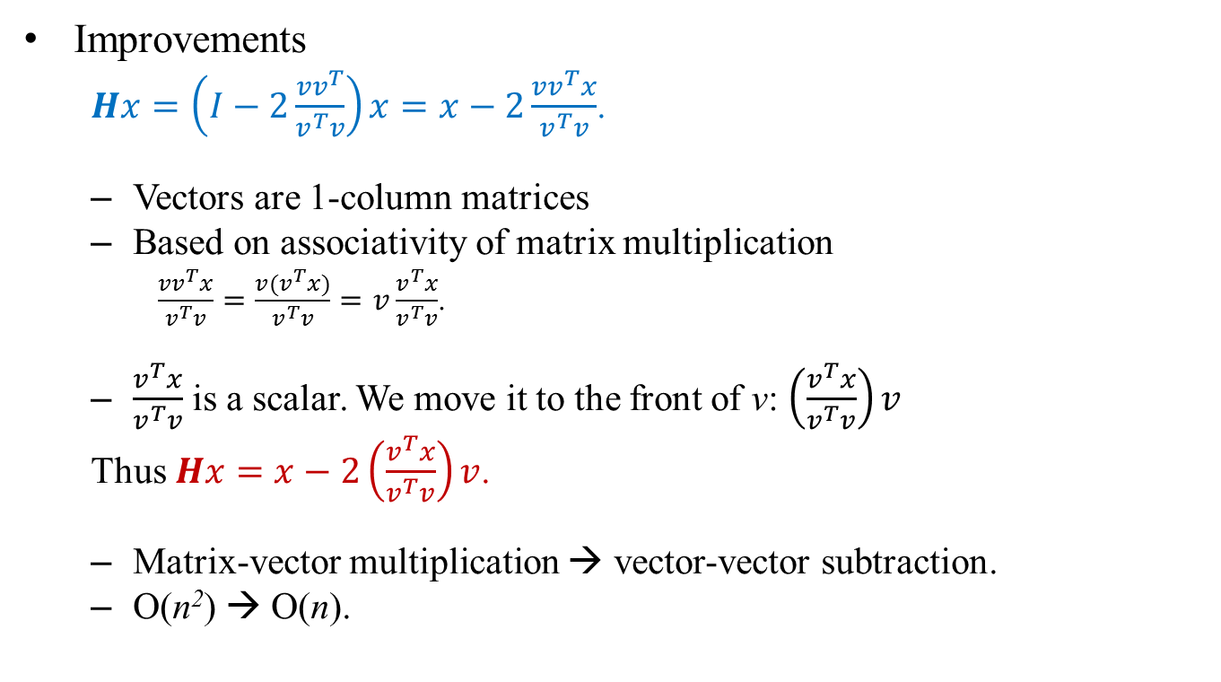
Improvements (1/2)
Improvements
$Hx=\left(I−2\frac{{vv}^{T}}{v^{T}v}\right)x=x−2\frac{{vv}^{T}x}{v^{T}v}$.
Vectors are 1-column matrices
Based on associativity of matrix multiplication
$\frac{{vv}^{T}x}{v^{T}v}=\frac{{v(v}^{T}x)}{v^{T}v}=v\frac{v^{T}x}{v^{T}v}$.
$\frac{v^{T}x}{v^{T}v}$ is a scalar. We move it to the front of v: $\left(\frac{v^{T}x}{v^{T}v}\right)v$
Thus $Hx=x−2\left(\frac{v^{T}x}{v^{T}v}\right)v$.
Matrix-vector multiplication → vector-vector subtraction.
O(n²) → O(n).

Slide 18
Improvements (2/2)
The matrix H_{j} is in a special form consisting of matrices I and B :: //0≦j≦n-2.
B is a (n-j) by (n-j) matrix.
H_{j}*A affects columns A_{.k}, j≤ k ≤ n-1. //n-j columns
H_{j}*A_{.k} afftects entries A_{ik}, j≤ i≤ n-1. //n-j entries
Thus H_{j}*A needs only O((n-j)²) time steps.
j x j
I
0
0
B
n-j

Slide 19
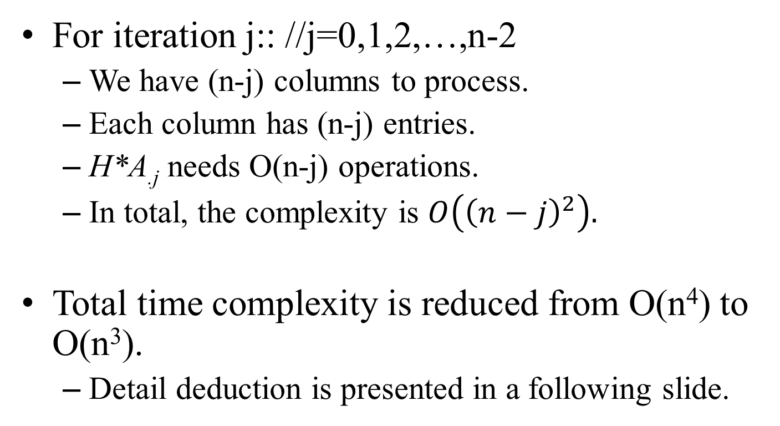
Cost Analysis
For iteration j:: //j=0,1,2,…,n-2
We have (n-j) columns to process.
Each column has (n-j) entries.
H*A_{.j} needs O(n-j) operations.
In total, the complexity is $O\left({\left(n−j\right)}^{2}\right).$
Total time complexity is reduced from O(n⁴) to O(n³).
Detail deduction is presented in a following slide.

Slide 20

QR-Decomposition Algorithm
//Forward elimination
for(j=0;j≤n-2;j++){ //eliminate n-1 columns
//Create vector v.
create_vector_v(A, v, n, j);
vTv = inner_product(v, v);
t = {0}; //Initialize vector t.
//Elimination process
for(k=j;k≤n-1;k++){
//Retrieve the column vector
for(i=j;i≤n-1;i++) t[i] = A[i][k];
vTt = inner_product(v, t);
//Modify the k-th column
for(i=j;i≤n-1;i++) A[i][k] = A[i][k]-2.0*(vTt/vTv)*v[i];
} //end for(k)
//Modify rhs b[]
for(i=j;i≤n-1;i++) t[i] = b[i];
vTb = inner_product(v, t);
for(k=j;k≤n-1;k++)
b[k] = b[k] - 2.0*(vTb/vTv)*v[k];
} // end for(j)
//Creation of vector v[] for eliminating column j.
void create_vector_v(A, v, n, j)
{
t[] = {0};
//retrieve the j-th column
for(i=j;i≤n-1;i++) t[i] = A[i][j];
//Compute the norm of the vector.
tTt = inner_product(t, t);
a = sqrt(tTt);
//t = t + sign(t[j])*e_{j};
if(t[j]>=0) t[j] = t[j] + a;
else t[j] = t[j] – a;
}
$$H=I−2\frac{v∙v^{T}}{v^{T}v},$$
$$Hx=x−2\left(\frac{v^{T}x}{v^{T}v}\right)v.$$

Slide 21
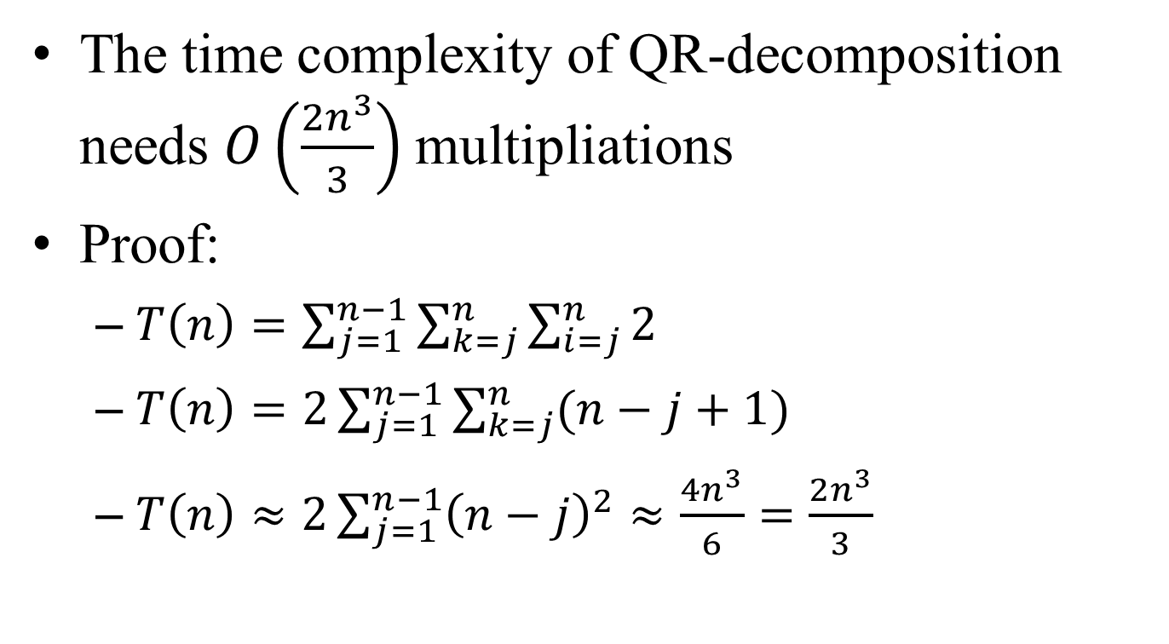
Time Complexity
The time complexity of QR-decomposition needs $O\left(\frac{2n^{3}}{3}\right)$ multipliations
Proof:
$T\left(n\right)=\sum_{j=1}^{n−1}{\sum_{k=j}^{n}{\sum_{i=j}^{n}{2}}}$
$T\left(n\right)=2\sum_{j=1}^{n−1}{\sum_{k=j}^{n}{(n−j+1)}}$
$T\left(n\right)≈2\sum_{j=1}^{n−1}{{\left(n−j\right)}^{2}}≈\frac{4n^{3}}{6}=\frac{2n^{3}}{3}$

Slide 22
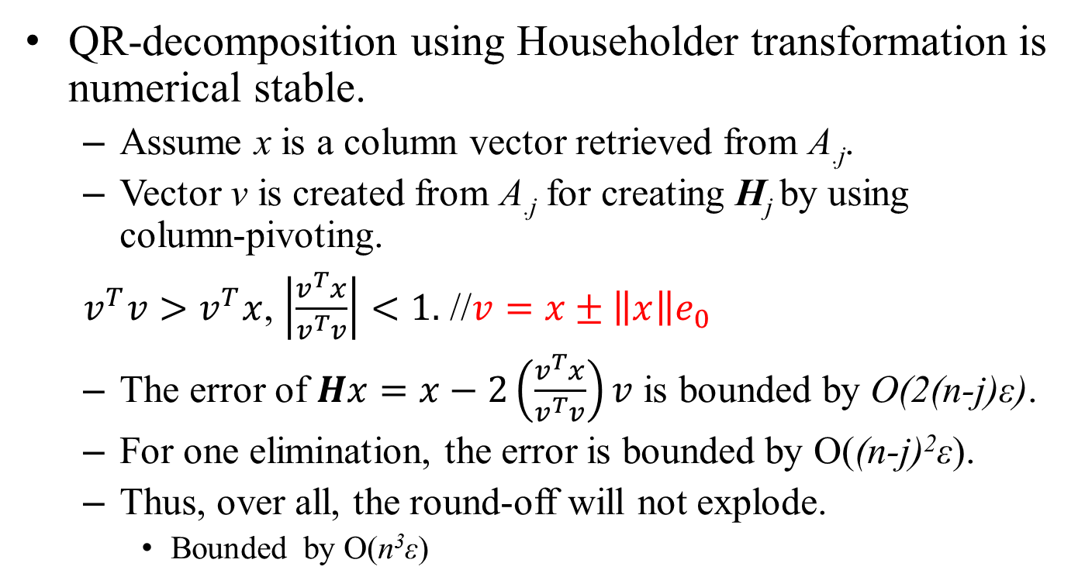
Error Analysis
QR-decomposition using Householder transformation is numerical stable.
Assume x is a column vector retrieved from A_{.j}.
Vector v is created from A_{.j} for creating H_{j} by using column-pivoting.
$v^{T}v>v^{T}x$, $\left|\frac{v^{T}x}{v^{T}v}\right|<1.$ //$v=x±\left\|x\right\|e_{0}$
The error of $Hx=x−2\left(\frac{v^{T}x}{v^{T}v}\right)v$ is bounded by O(2(n-j)ε).
For one elimination, the error is bounded by O((n-j)²ε).
Thus, over all, the round-off will not explode.
Bounded by O(n³ε)

Slide 23
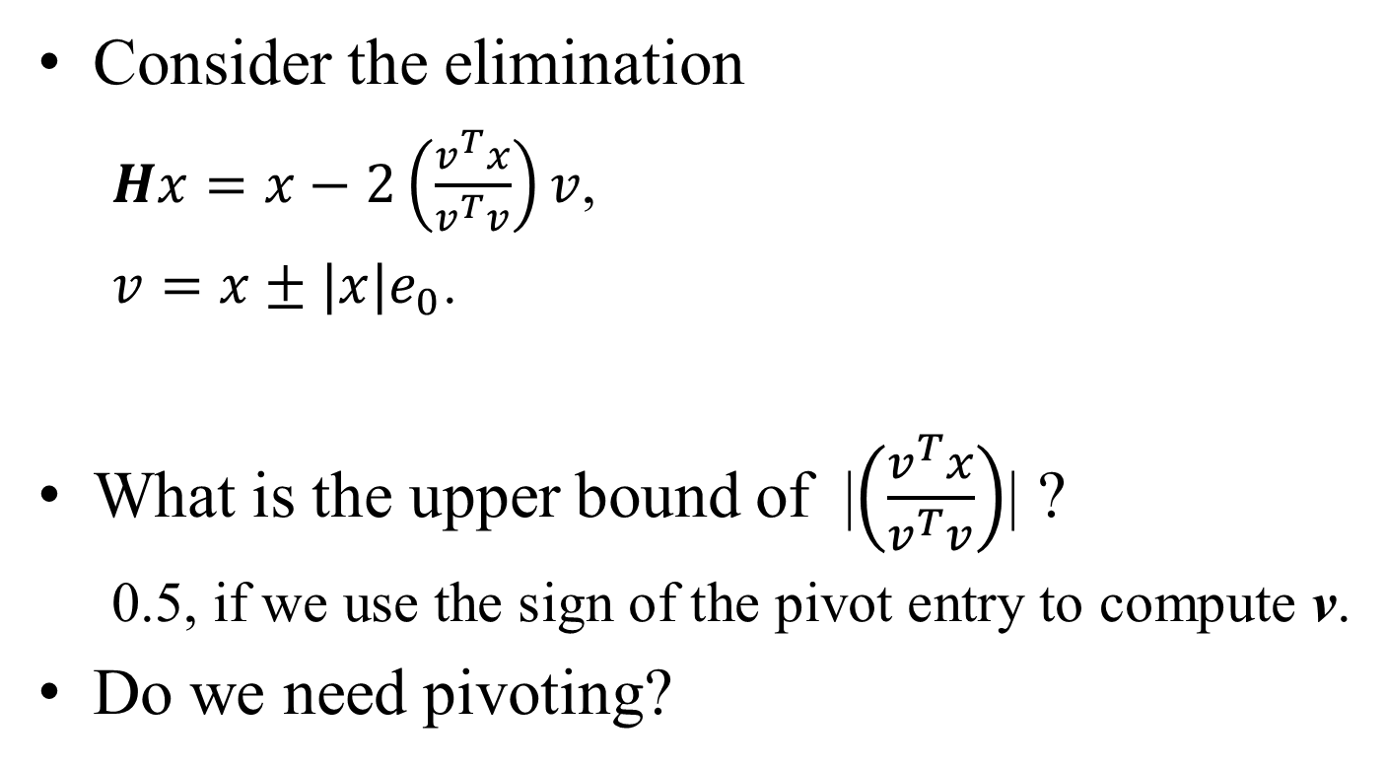
Discussion
Consider the elimination
$Hx=x−2\left(\frac{v^{T}x}{v^{T}v}\right)v$,
$v=x±|x|e_{0}$.
What is the upper bound of |$\left(\frac{v^{T}x}{v^{T}v}\right)$| ?
0.5, if we use the sign of the pivot entry to compute v.
Do we need pivoting?

Slide 24
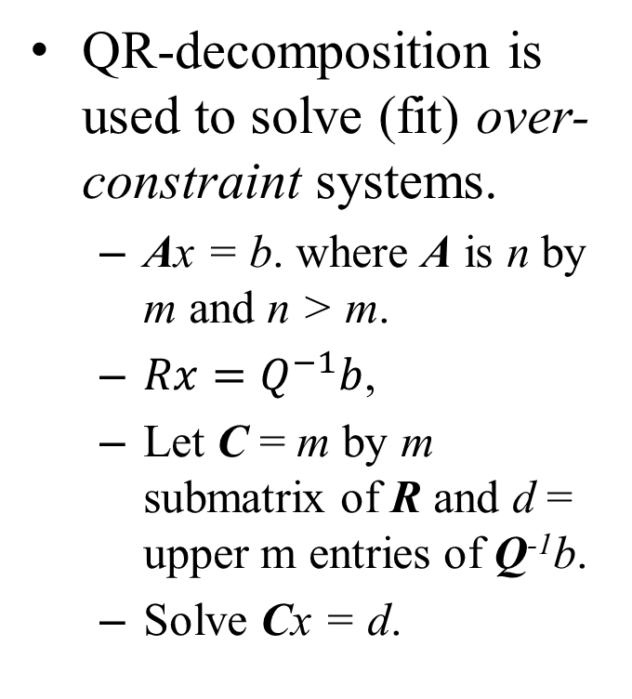
Applications
QR-decomposition is used to solve (fit) over-constraint systems.
Ax = b. where A is n by m and n > m.
$Rx=Q^{−1}b$,
Let C = m by m submatrix of R and d = upper m entries of Q⁻¹b.
Solve Cx = d.
QR-decomposition in fitting method.
m
m
C
m
n
A, over-constraint
R

Slide 25
Applications
QR-decomposition is used to convert matrix A into a tri-diagonal matrix or an upper Hessenberg matrix for computing eigenvalues.
Using similarity transformation.
We will talk about this topic later in the lectures about eigenvalues.
Tridiagonal matrix & Hessenberg matrix.
0
0
0

