Slide 1
Condition Number
Metric of the sensitivity of linear system

Slide 2
Outline
Vector norms
Matrix norms
Condition numbers
Usage of condition number
Estimation of condition number

Slide 3
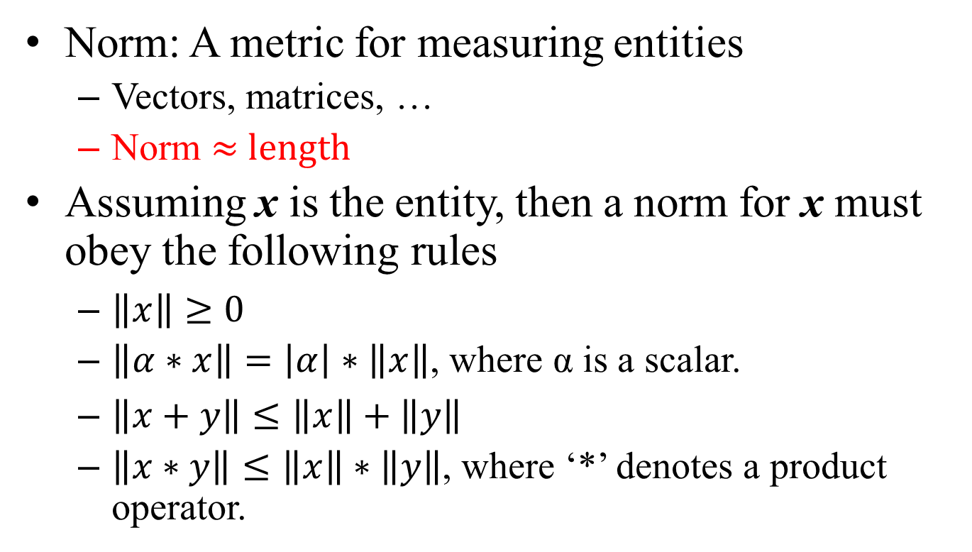
Norms
Norm: A metric for measuring entities
Vectors, matrices, …
Norm ≈ length
Assuming x is the entity, then a norm for x must obey the following rules
$\left\|x\right\|≥0$
$\left\|α∗x\right\|=\left|α\right|∗\left\|x\right\|$, where α is a scalar.
$\left\|x+y\right\|≤\left\|x\right\|+\left\|y\right\|$
$\left\|x∗y\right\|≤\left\|x\right\|∗\left\|y\right\|$, where ‘*’ denotes a product operator.

Slide 4

Vector Norms
1-norm
$\vec{x}={\left[\begin{matrix}x_{0} & … & x_{n−1}\end{matrix}\right]}^{T}$
${\left\|\vec{x}\right\|}_{1}=\sum_{i=0}^{n−1}{\left|x_{i}\right|}$
2-norm
${\left\|\vec{x}\right\|}_{2}=(\sum_{i=0}^{n−1}{{x_{i}}^{2})^{\frac{1}{2}}}$
∞-norm
${\left\|\vec{x}\right\|}_{∞}=\max_{i}\left|x_{i}\right|$

Slide 5
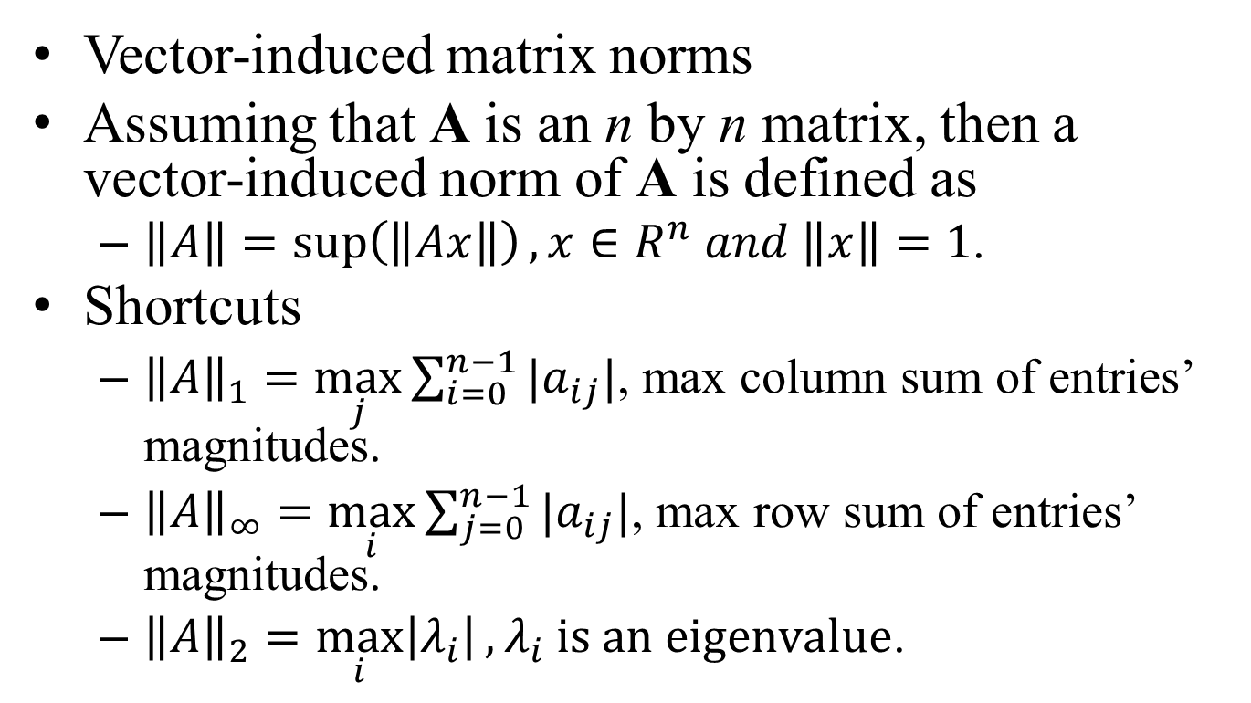
Matrix Norms
Vector-induced matrix norms
Assuming that A is an n by n matrix, then a vector-induced norm of A is defined as
$\left\|A\right\|=\sup\left(\left\|Ax\right\|\right), x∈R^{n} and \left\|x\right\|=1$.
Shortcuts
${\left\|A\right\|}_{1}=\max_{j}{\sum_{i=0}^{n−1}{|a_{ij}|}}$, max column sum of entries’ magnitudes.
${\left\|A\right\|}_{∞}=\max_{i}{\sum_{j=0}^{n−1}{|a_{ij}|}}$, max row sum of entries’ magnitudes.
${\left\|A\right\|}_{2}=\max_{i}\left|λ_{i}\right|, λ_{i} is an eigenvalue$.

Slide 6
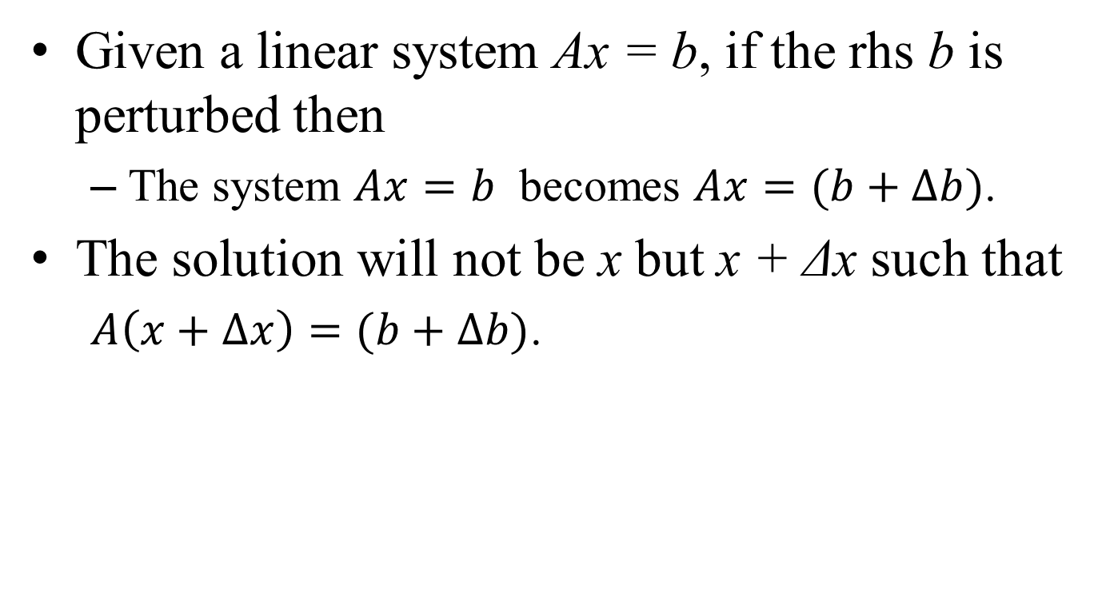
Perturbed Right Hand Side
Given a linear system Ax = b, if the rhs b is perturbed then
The system $Ax=b$ becomes $Ax=(b+∆b)$.
The solution will not be x but x + Δx such that
$A\left(x+∆x\right)=(b+∆b)$.

Slide 7
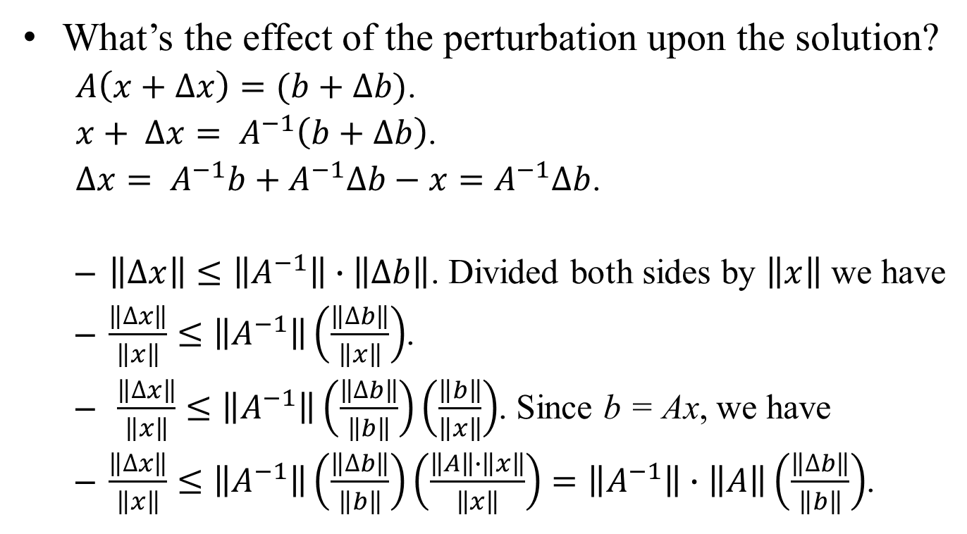
Perturbed Right Hand Side
What’s the effect of the perturbation upon the solution?
$A\left(x+∆x\right)=(b+∆b)$.
$x+ ∆x= A^{−1}\left(b+∆b\right)$.
$∆x= A^{−1}b+A^{−1}∆b−x=A^{−1}∆b$.
$\left\|∆x\right\|≤\left\|A^{−1}\right\|∙\left\|∆b\right\|$. Divided both sides by $\left\|x\right\|$ we have
$\frac{\left\|∆x\right\|}{\left\|x\right\|}≤\left\|A^{−1}\right\|\left(\frac{\left\|∆b\right\|}{\left\|x\right\|}\right)$.
$\frac{\left\|∆x\right\|}{\left\|x\right\|}≤\left\|A^{−1}\right\|\left(\frac{\left\|∆b\right\|}{\left\|b\right\|}\right)\left(\frac{\left\|b\right\|}{\left\|x\right\|}\right)$. Since b = Ax, we have
$\frac{\left\|∆x\right\|}{\left\|x\right\|}≤\left\|A^{−1}\right\|\left(\frac{\left\|∆b\right\|}{\left\|b\right\|}\right)\left(\frac{\left\|A\right\|∙\left\|x\right\|}{\left\|x\right\|}\right)=\left\|A^{−1}\right\|∙\left\|A\right\|\left(\frac{\left\|∆b\right\|}{\left\|b\right\|}\right)$.

Slide 8
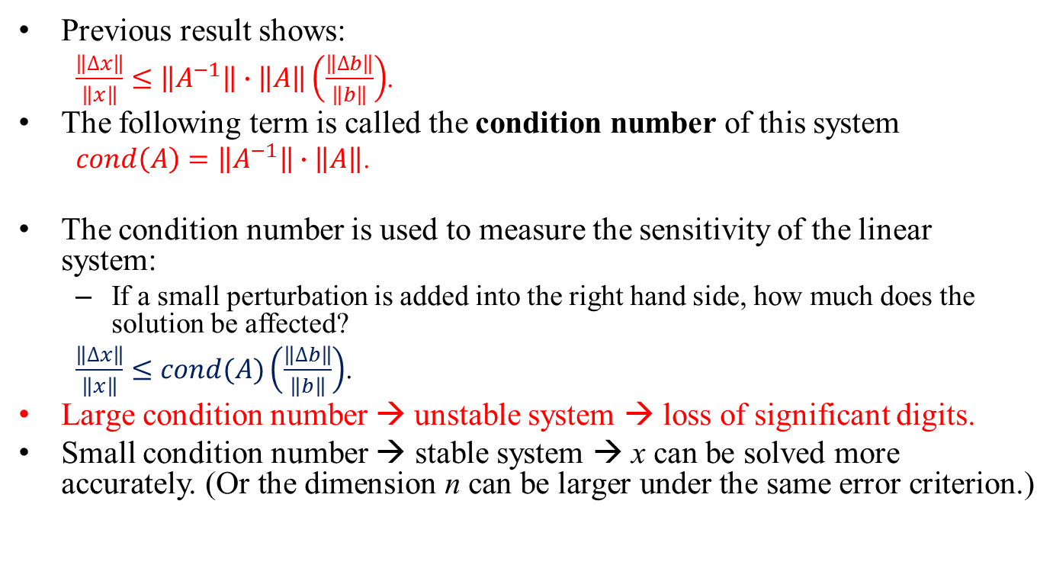
The Condition Number
Previous result shows:
$\frac{\left\|∆x\right\|}{\left\|x\right\|}≤\left\|A^{−1}\right\|∙\left\|A\right\|\left(\frac{\left\|∆b\right\|}{\left\|b\right\|}\right)$.
The following term is called the condition number of this system
$cond\left(A\right)=\left\|A^{−1}\right\|∙\left\|A\right\|$.
The condition number is used to measure the sensitivity of the linear system:
If a small perturbation is added into the right hand side, how much does the solution be affected?
$\frac{\left\|∆x\right\|}{\left\|x\right\|}≤cond(A)\left(\frac{\left\|∆b\right\|}{\left\|b\right\|}\right)$.
Large condition number → unstable system → loss of significant digits.
Small condition number → stable system → x can be solved more accurately. (Or the dimension n can be larger under the same error criterion.)

Slide 9
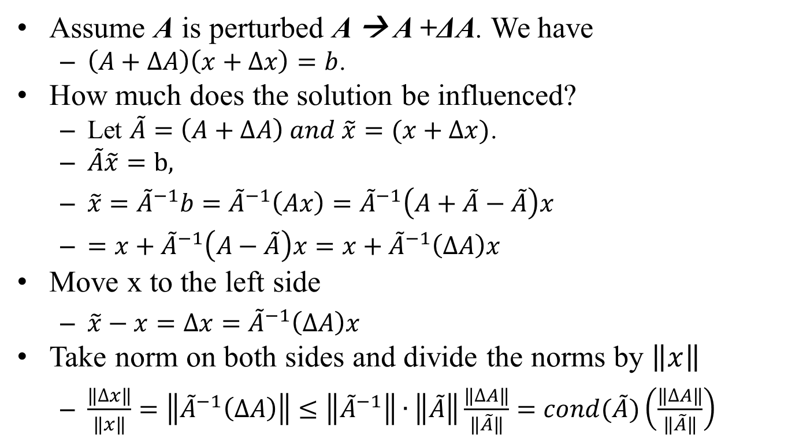
Perturbation of A
Assume A is perturbed A → A +ΔA. We have
$\left(A+∆A\right)\left(x+∆x\right)=b$.
How much does the solution be influenced?
Let $\tilde{A}=\left(A+∆A\right) and \tilde{x}=(x+∆x)$.
$\tilde{A}\tilde{x}=b,$
$\tilde{x}={\tilde{A}}^{−1}b={\tilde{A}}^{−1}\left(Ax\right)={\tilde{A}}^{−1}\left(A+\tilde{A}−\tilde{A}\right)x$
$=x+{\tilde{A}}^{−1}\left(A−\tilde{A}\right)x=x+{\tilde{A}}^{−1}\left(∆A\right)x$
Move x to the left side
$\tilde{x}−x=∆x={\tilde{A}}^{−1}\left(∆A\right)x$
Take norm on both sides and divide the norms by $\left\|x\right\|$
$\frac{\left\|∆x\right\|}{\left\|x\right\|}=\left\|{\tilde{A}}^{−1}\left(∆A\right)\right\|≤\left\|{\tilde{A}}^{−1}\right\|∙\left\|\tilde{A}\right\|\frac{\left\|∆A\right\|}{\left\|\tilde{A}\right\|}=cond(\tilde{A})\left(\frac{\left\|∆A\right\|}{\left\|\tilde{A}\right\|}\right)$

Slide 10
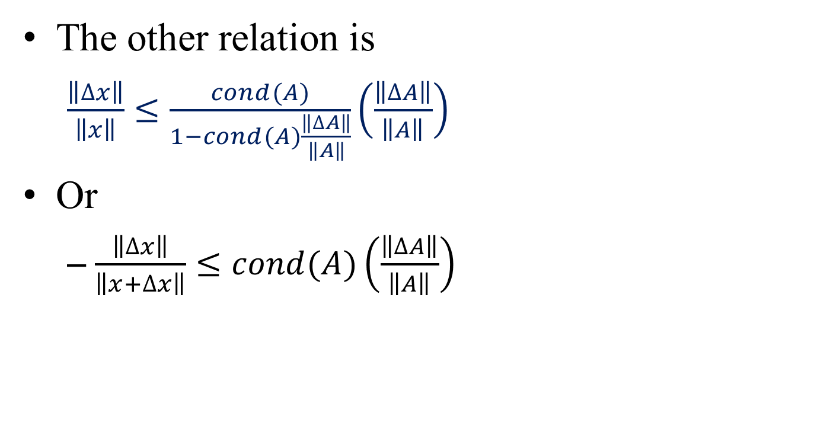
Perturbation of A
The other relation is
$\frac{\left\|∆x\right\|}{\left\|x\right\|}≤\frac{cond(A)}{1−cond(A)\frac{\left\|∆A\right\|}{\left\|A\right\|}}\left(\frac{\left\|∆A\right\|}{\left\|A\right\|}\right)$
Or
$\frac{\left\|∆x\right\|}{\left\|x+∆x\right\|}≤cond(A)\left(\frac{\left\|∆A\right\|}{\left\|A\right\|}\right)$

Slide 11
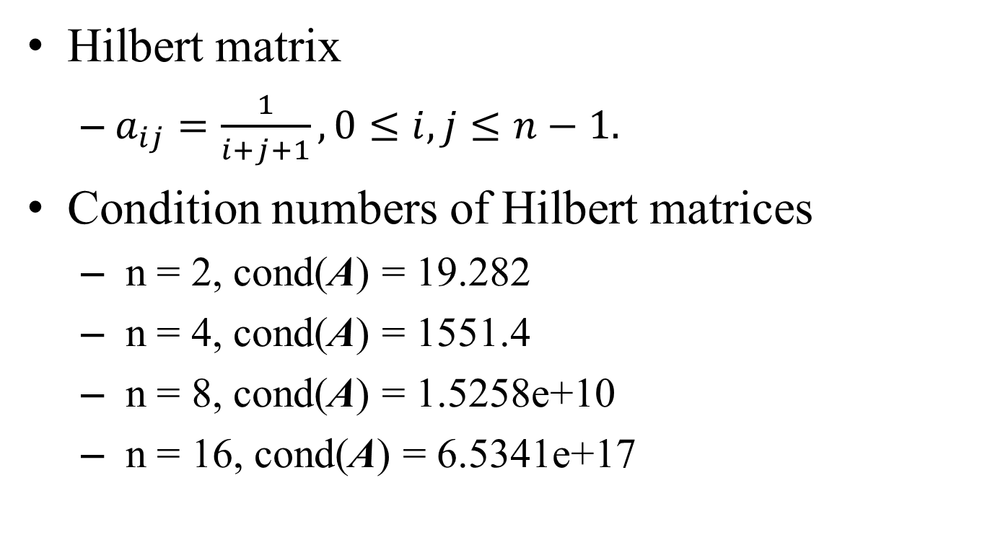
Condition Number, Hilbert Matrix
Hilbert matrix
$a_{ij}=\frac{1}{i+j+1}, 0≤i,j≤n−1.$
Condition numbers of Hilbert matrices
n = 2, cond(A) = 19.282
n = 4, cond(A) = 1551.4
n = 8, cond(A) = 1.5258e+10
n = 16, cond(A) = 6.5341e+17

Slide 12
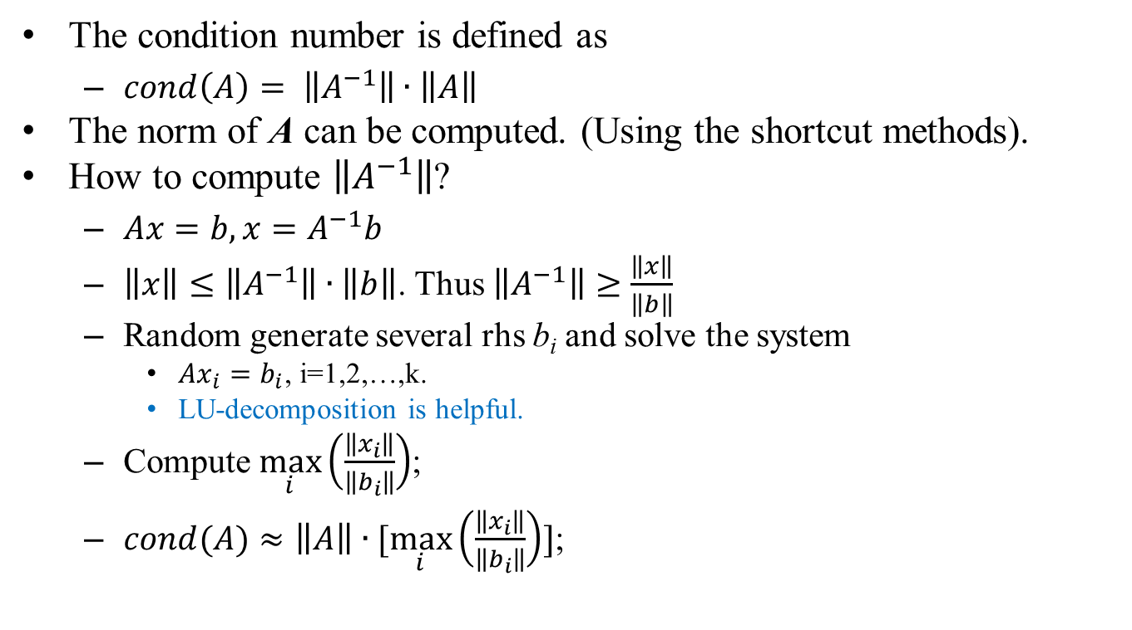
Estimation of cond(A)
The condition number is defined as
$cond\left(A\right)= \left\|A^{−1}\right\|∙\left\|A\right\|$
The norm of A can be computed. (Using the shortcut methods).
How to compute $\left\|A^{−1}\right\|$?
$Ax=b, x=A^{−1}b$
$\left\|x\right\|≤\left\|A^{−1}\right\|∙\left\|b\right\|$. Thus $\left\|A^{−1}\right\|≥\frac{\left\|x\right\|}{\left\|b\right\|}$
Random generate several rhs b_{i} and solve the system
$Ax_{i}=b_{i}$, i=1,2,…,k.
LU-decomposition is helpful.
Compute $\max_{i}\left(\frac{\left\|x_{i}\right\|}{\left\|b_{i}\right\|}\right)$;
$cond(A)≈\left\|A\right\|∙[\max_{i}\left(\frac{\left\|x_{i}\right\|}{\left\|b_{i}\right\|}\right)]\text{;}$

