Slide 1
Introduction to Iterative Methods for solving linear systems
The Jacobian Method

Slide 2
Outline
Introduction to iterative method
The general form of iterative method
Convergence analysis
Vector and matrix norms
Jacobian method
Diagonal dominant matrices

Slide 3
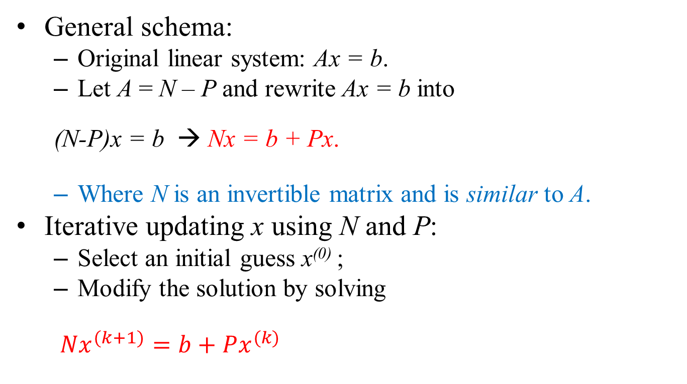
Iterative Methods
General schema:
Original linear system: Ax = b.
Let A = N – P and rewrite Ax = b into
(N-P)x = b → Nx = b + Px.
Where N is an invertible matrix and is similar to A.
Iterative updating x using N and P:
Select an initial guess x⁽⁰⁾ ;
Modify the solution by solving
$Nx^{(k+1)}=b+Px^{(k)}$

Slide 4
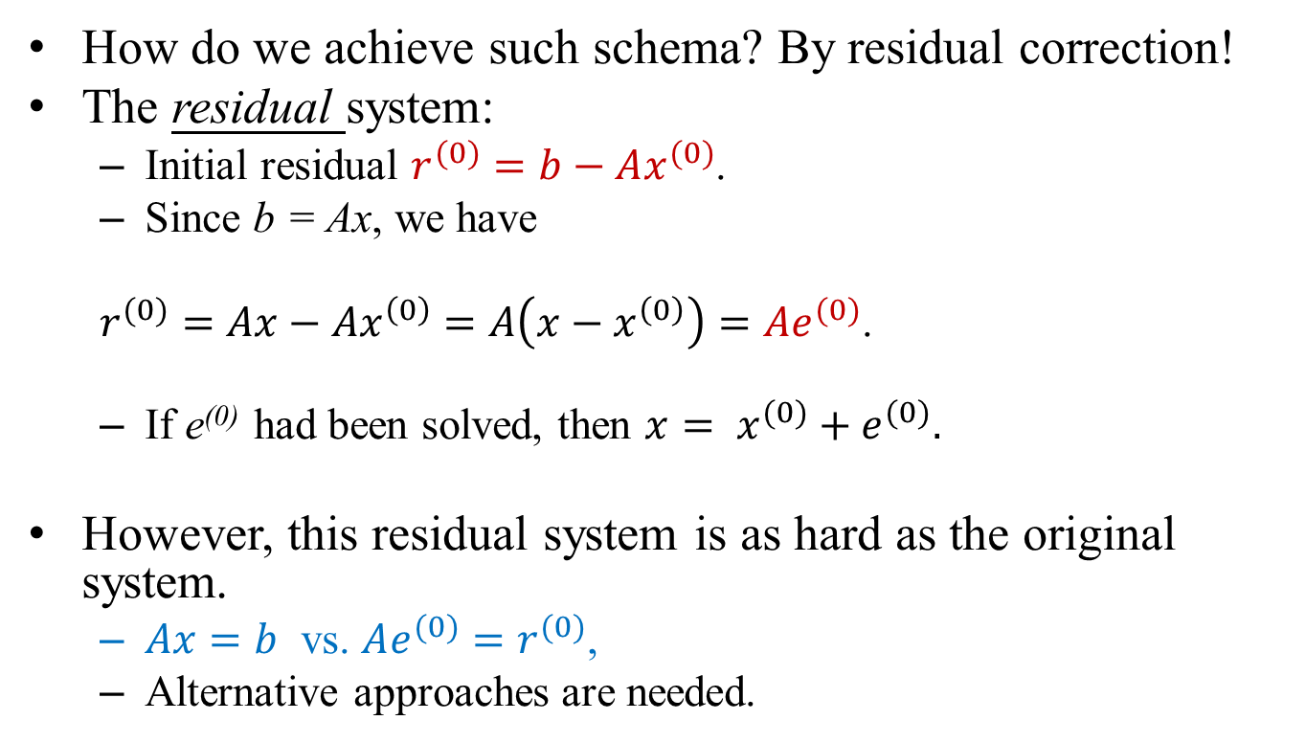
Residual Correction (1/3)
How do we achieve such schema? By residual correction!
The residual system:
Initial residual $r^{(0)}=b−Ax^{(0)}$.
Since b = Ax, we have
$r^{(0)}=Ax−{Ax}^{\left(0\right)}=A\left(x−x^{\left(0\right)}\right)=Ae^{(0)}$.
If e⁽⁰⁾ had been solved, then $x= x^{(0)}+e^{(0)}.$
However, this residual system is as hard as the original system.
$Ax=b$ vs. $Ae^{(0)}=r^{(0)}$,
Alternative approaches are needed.

Slide 5
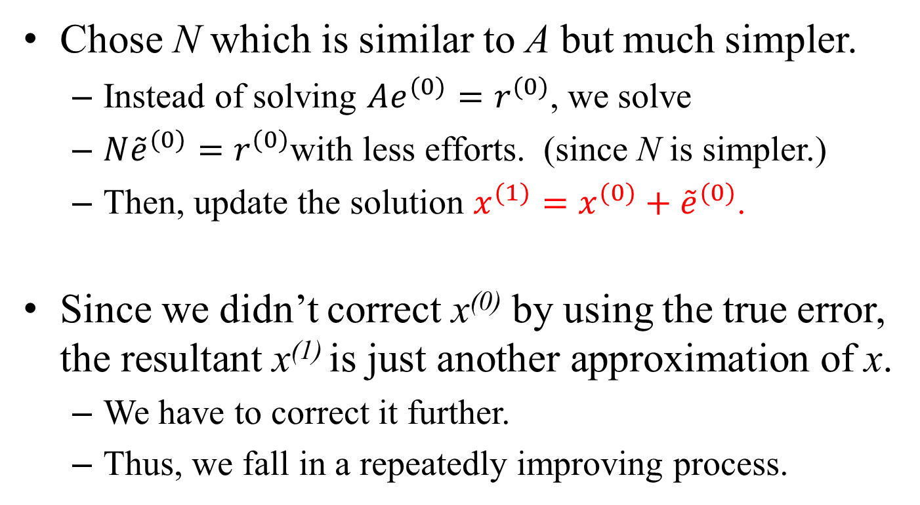
Residual Correction (2/3)
Chose N which is similar to A but much simpler.
Instead of solving $Ae^{(0)}=r^{(0)}$, we solve
$N{\tilde{e}}^{(0)}=r^{(0)}$with less efforts. (since N is simpler.)
Then, update the solution $x^{(1)}=x^{(0)}+{\tilde{e}}^{(0)}$.
Since we didn’t correct x⁽⁰⁾ by using the true error, the resultant x⁽¹⁾ is just another approximation of x.
We have to correct it further.
Thus, we fall in a repeatedly improving process.

Slide 6
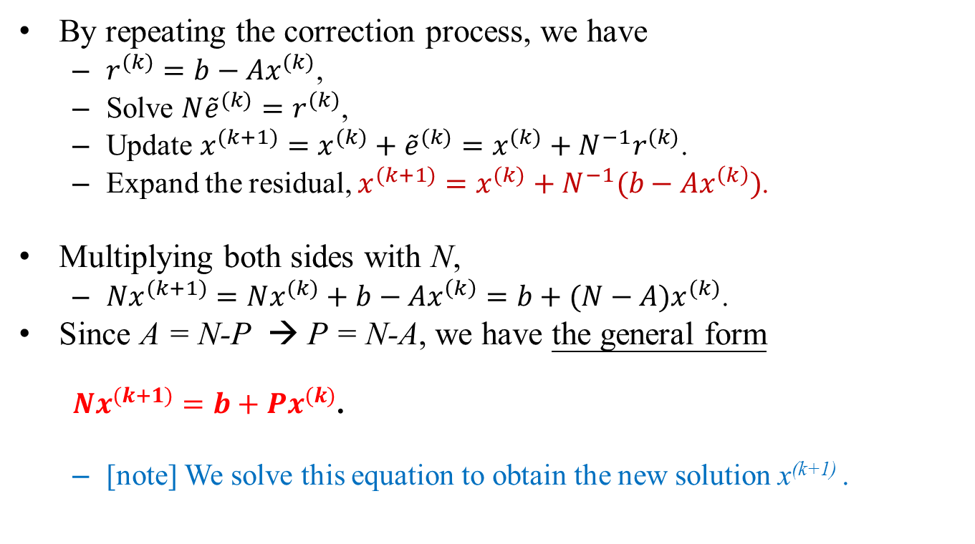
Residual Correction (3/3)
By repeating the correction process, we have
$r^{(k)}=b−Ax^{(k)}$,
Solve $N{\tilde{e}}^{(k)}=r^{(k)}$,
Update $x^{(k+1)}=x^{(k)}+{\tilde{e}}^{(k)}=x^{(k)}+N^{−1}r^{(k)}$.
Expand the residual, $x^{(k+1)}=x^{(k)}+N^{−1}(b−Ax^{\left(k\right)})$.
Multiplying both sides with N,
$Nx^{(k+1)}=Nx^{(k)}+b−Ax^{\left(k\right)}=b+(N−A)x^{(k)}$.
Since A = N-P → P = N-A, we have the general form
$Nx^{(k+1)}=b+Px^{(k)}$.
[note] We solve this equation to obtain the new solution x^{(k+1)} .

Slide 7
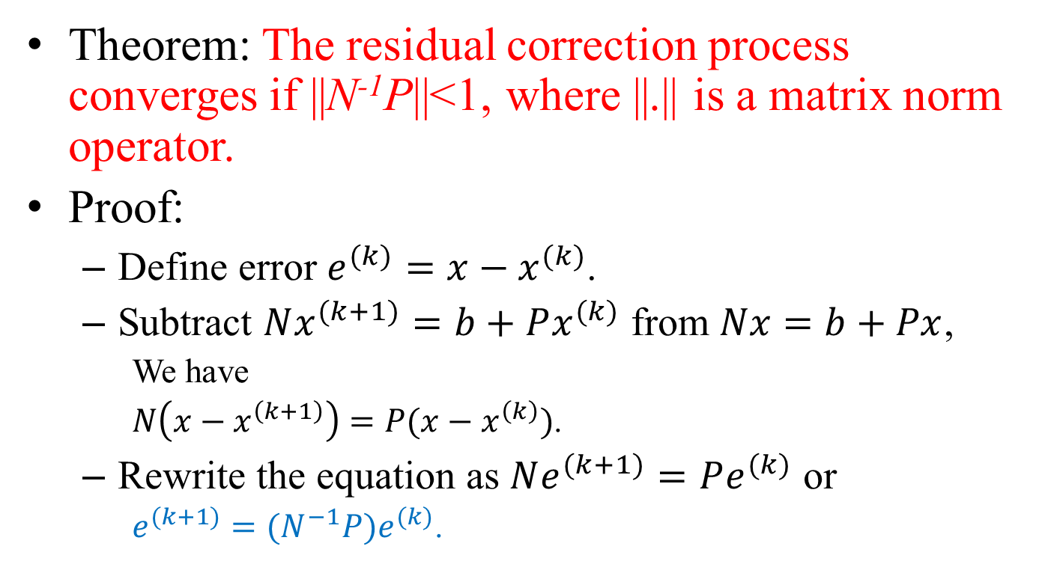
Convergence Criteria (1/2)
Theorem: The residual correction process converges if ||N⁻¹P||<1, where ||.|| is a matrix norm operator.
Proof:
Define error $e^{(k)}=x−x^{(k)}$.
Subtract $Nx^{(k+1)}=b+Px^{(k)}$ from $Nx=b+Px$,
We have
$N\left(x−x^{\left(k+1\right)}\right)=P(x−x^{\left(k\right)})$.
Rewrite the equation as $Ne^{(k+1)}=Pe^{(k)}$ or
$e^{(k+1)}={(N}^{−1}P)e^{(k)}$.

Slide 8
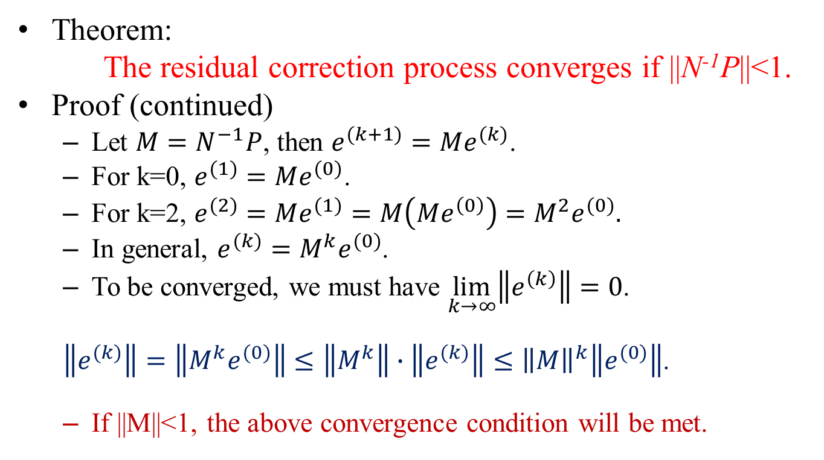
Convergence Criteria (2/2)
Theorem:
The residual correction process converges if ||N⁻¹P||<1.
Proof (continued)
Let $M=N^{−1}P$, then $e^{(k+1)}=Me^{(k)}$.
For k=0, $e^{(1)}=Me^{(0)}$.
For k=2, $e^{(2)}=Me^{(1)}=M\left(Me^{\left(0\right)}\right)=M^{2}e^{(0)}.$
In general, $e^{(k)}=M^{k}e^{(0)}$.
To be converged, we must have $\lim_{k→∞}\left\|e^{\left(k\right)}\right\|=0$.
$\left\|e^{(k)}\right\|=\left\|M^{k}e^{(0)}\right\|≤\left\|M^{k}\right\|∙\left\|e^{(k)}\right\|≤{\left\|M\right\|}^{k}\left\|e^{(0)}\right\|$.
If ||M||<1, the above convergence condition will be met.

Slide 9

Review: Vector Norms
1-norm
${\left\|x\right\|}_{1}=\sum_{i=0}^{n−1}{|x_{i}|}$
2-norm
${\left\|x\right\|}_{2}=\sqrt{\sum{{x_{i}}^{2}}}$
∞-norm
${\left\|x\right\|}_{∞}=\max_{i}{|x_{i}|}$
To measure errors, 1-norm is the most restrict norm while ∞-norm is the most loose one.

Slide 10
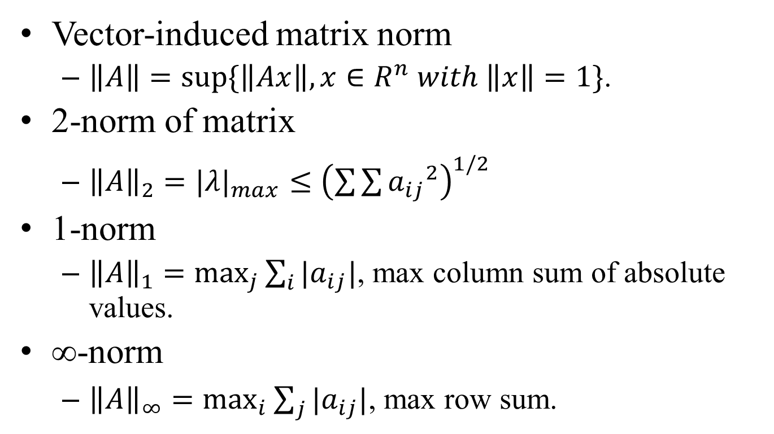
Review: Matrix Norms
Vector-induced matrix norm
$\left\|A\right\|=sup⁡\{\left\|Ax\right\|,x∈R^{n} with \left\|x\right\|=1\}$.
2-norm of matrix
${\left\|A\right\|}_{2}={|λ|}_{max}≤{\left(\sum{\sum{{a_{ij}}^{2}}}\right)}^{1/2}$
1-norm
${\left\|A\right\|}_{1}=\max_{j}{\sum_{i}{{|a}_{ij}|}}$, max column sum of absolute values.
∞-norm
${\left\|A\right\|}_{∞}=\max_{i}{\sum_{j}{|a_{ij}|}}$, max row sum.

Slide 11
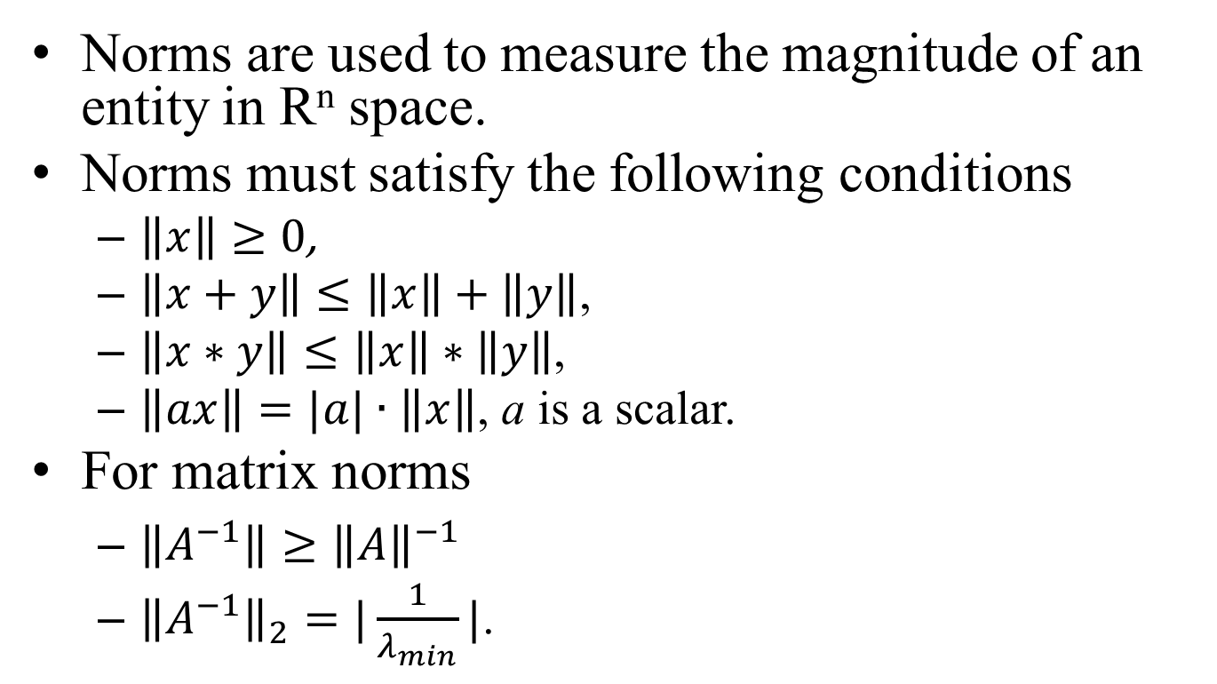
Review: Properties of Norm
Norms are used to measure the magnitude of an entity in R^{n} space.
Norms must satisfy the following conditions
$\left\|x\right\|≥0$,
$\left\|x+y\right\|≤\left\|x\right\|+\left\|y\right\|$,
$\left\|x∗y\right\|≤\left\|x\right\|∗\left\|y\right\|$,
$\left\|ax\right\|=|a|∙\left\|x\right\|$, a is a scalar.
For matrix norms
$\left\|A^{−1}\right\|≥{\left\|A\right\|}^{−1}$
${\left\|A^{−1}\right\|}_{2}=|\frac{1}{λ_{min}}|$.

Slide 12

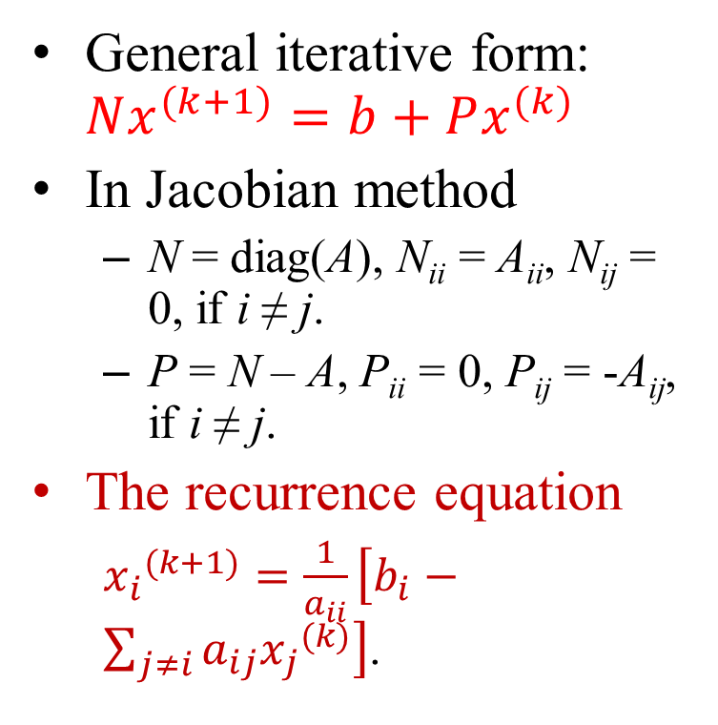
The Jacobian Method
General iterative form: $Nx^{(k+1)}=b+Px^{(k)}$
In Jacobian method
N = diag(A), N_{ii} = A_{ii}, N_{ij} = 0, if i ≠ j.
P = N – A, P_{ii} = 0, P_{ij} = -A_{ij}, if i ≠ j.
The recurrence equation
${x_{i}}^{(k+1)}=\frac{1}{a_{ii}}\left[b_{i}−\sum_{j≠i}{a_{ij}{x_{j}}^{(k)}}\right]$.
The matrices N and P in the Jacobi method::
$N=\left[\begin{matrix}a_{00} & 0 & 0 \\ 0 & a_{11} & 0 \\ 0 & 0 & a_{22}\end{matrix}\right]$,
$$P=\left[\begin{matrix}0 & −a_{01} & −a_{02} \\ −a_{10} & 0 & −a_{12} \\ −a_{20} & −a_{21} & 0\end{matrix}\right]$$

Slide 13
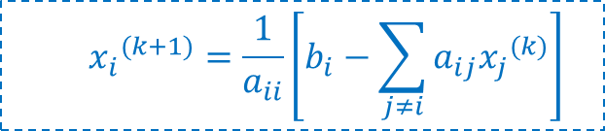
Jacobian Method
//Initialize the solution.
xold[] = {0.0};
err = ∞;
//Iterate the correction until being converged
while(err>ε){
//The correction process
for(i=0;i≤n-1;i++){
sum = b[i];
for(j=0;j≤n-1;j++)
if(j!=i) sum = sum – A[i][j]*oldx[j];
newx[i] = sum/A[i][i];
}
//Compute the delta vector
e[] = newx[] – oldx[];
//Copy the new results for the next iteration.
oldx[] = newx[];
err = norm_inf(e, n); //Compute the norm
}
return (newx);
$${x_{i}}^{(k+1)}=\frac{1}{a_{ii}}\left[b_{i}−\sum_{j≠i}{a_{ij}{x_{j}}^{(k)}}\right]$$

Slide 14
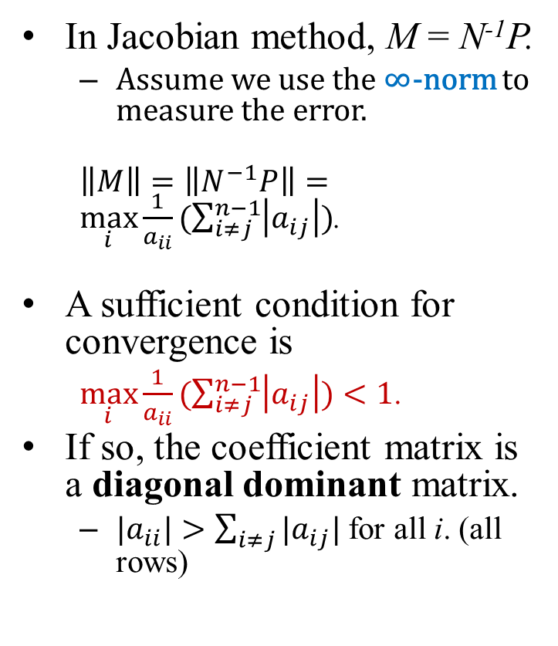
Convergence Analysis
In Jacobian method, M = N⁻¹P.
Assume we use the ∞-norm to measure the error.
$\left\|M\right\|=\left\|N^{−1}P\right\|=\max_{i}{\frac{1}{a_{ii}}(\sum_{i≠j}^{n−1}{\left|a_{ij}\right|})}$.
A sufficient condition for convergence is
$\max_{i}{\frac{1}{a_{ii}}(\sum_{i≠j}^{n−1}{\left|a_{ij}\right|})}<1$.
If so, the coefficient matrix is a diagonal dominant matrix.
${|a}_{ii}|>\sum_{i≠j}{|a_{ij}|}$ for all i. (all rows)
The matrices N and P:
$N=\left[\begin{matrix}a_{00} & 0 & 0 \\ 0 & a_{11} & 0 \\ 0 & 0 & a_{22}\end{matrix}\right]$,
$$P=\left[\begin{matrix}0 & −a_{01} & −a_{02} \\ −a_{10} & 0 & −a_{12} \\ −a_{20} & −a_{21} & 0\end{matrix}\right]$$

Slide 15
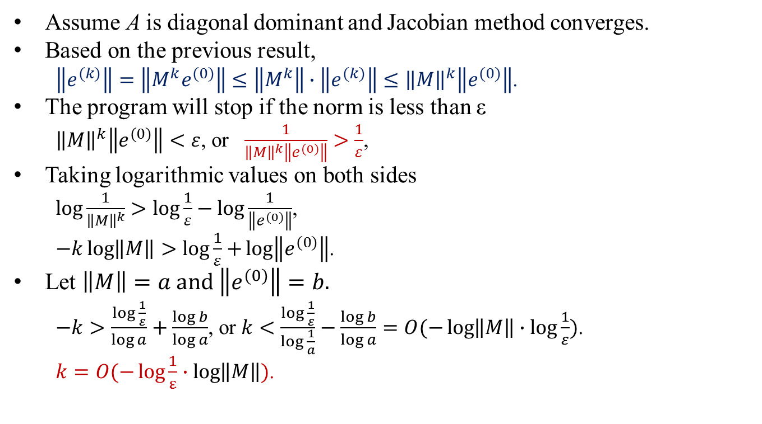
Time Complexity Analysis
Assume A is diagonal dominant and Jacobian method converges.
Based on the previous result,
$\left\|e^{(k)}\right\|=\left\|M^{k}e^{(0)}\right\|≤\left\|M^{k}\right\|∙\left\|e^{(k)}\right\|≤{\left\|M\right\|}^{k}\left\|e^{(0)}\right\|$.
The program will stop if the norm is less than ε
${\left\|M\right\|}^{k}\left\|e^{(0)}\right\|<ε$, or $\frac{1}{{\left\|M\right\|}^{k}\left\|e^{(0)}\right\|}>\frac{1}{ε}$,
Taking logarithmic values on both sides
$\log{\frac{1}{{\left\|M\right\|}^{k}}}>\log{\frac{1}{ε}−\log{\frac{1}{\left\|e^{(0)}\right\|}}}$,
$−k\log\left\|M\right\|>\log{\frac{1}{ε}+}\log\left\|e^{(0)}\right\|$.
Let $\left\|M\right\|=a and \left\|e^{(0)}\right\|=b.$
$−k>\frac{\log{\frac{1}{ε}}}{\log{a}}+\frac{\log{b}}{\log{a}}$, or $k<\frac{\log{\frac{1}{ε}}}{\log{\frac{1}{a}}}−\frac{\log{b}}{\log{a}}=O(−\log\left\|M\right\|∙\log{\frac{1}{ε}})$.
$k=O(−\log{\frac{1}{ε}}∙\log\left\|M\right\|)$.

Slide 16
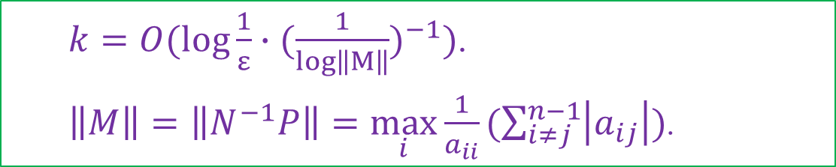
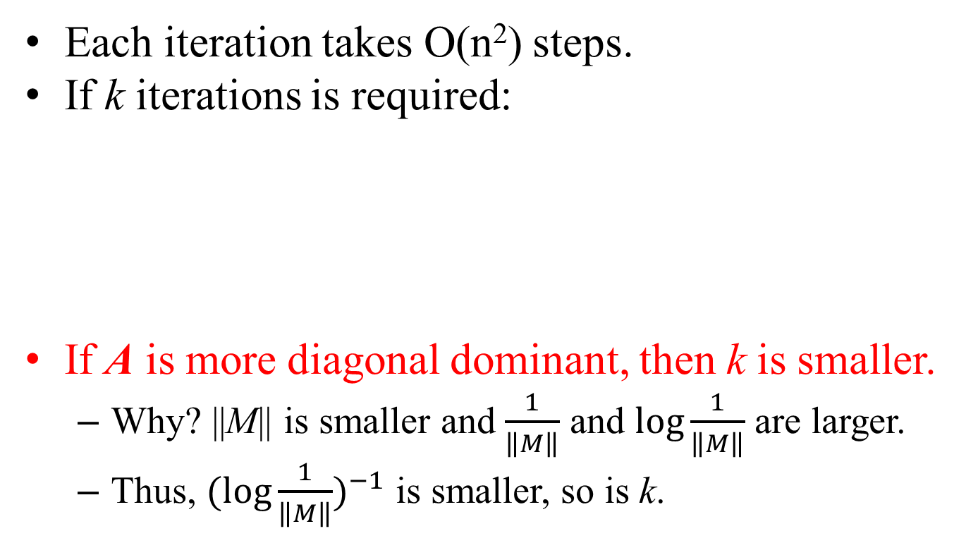
Time Complexity Analysis
Each iteration takes O(n²) steps.
If k iterations is required:
If A is more diagonal dominant, then k is smaller.
Why? ||M|| is smaller and $\frac{1}{\left\|M\right\|}$ and $\log{\frac{1}{\left\|M\right\|}}$ are larger.
Thus, ${(\log{\frac{1}{\left\|M\right\|}})}^{−1}$ is smaller, so is k.
$k=O(\log{\frac{1}{ε}}∙(\frac{1}{log\left\|M\right\|})^{−1})$.
$\left\|M\right\|=\left\|N^{−1}P\right\|=\max_{i}{\frac{1}{a_{ii}}(\sum_{i≠j}^{n−1}{\left|a_{ij}\right|})}$.

Slide 17
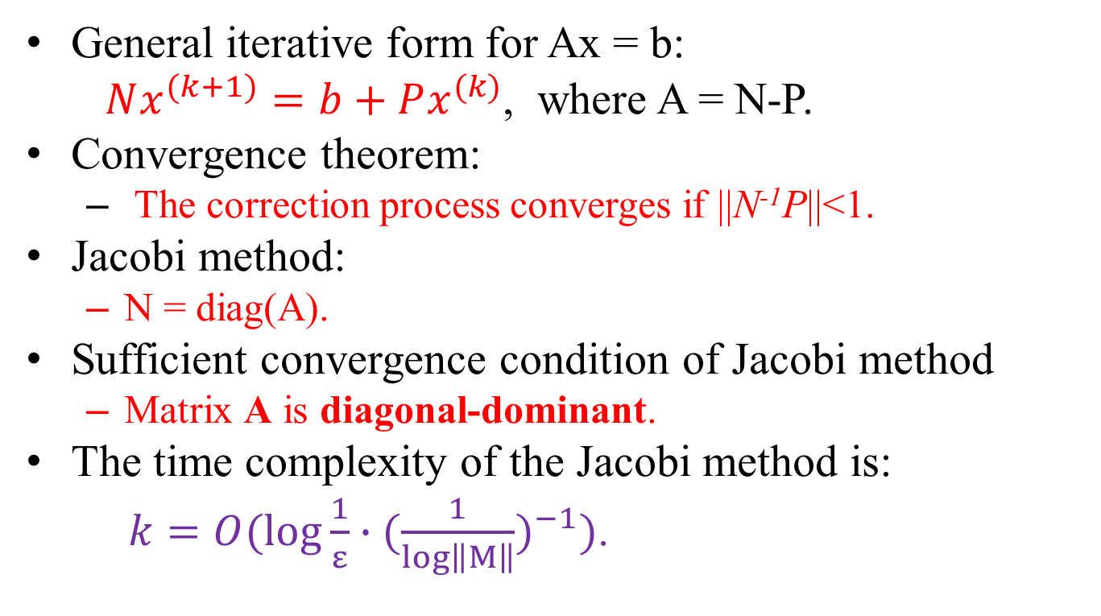
Conclusion
General iterative form for Ax = b:
$Nx^{(k+1)}=b+Px^{(k)}$, where A = N-P.
Convergence theorem:
The correction process converges if ||N⁻¹P||<1.
Jacobi method:
N = diag(A).
Sufficient convergence condition of Jacobi method
Matrix A is diagonal-dominant.
The time complexity of the Jacobi method is:
$k=O(\log{\frac{1}{ε}}∙(\frac{1}{log\left\|M\right\|})^{−1})$.

