Slide 1
Gauss-Seidel & SOR Methods
Solvers for Symmetric Positive Definite Systems

Slide 2
Outline
Review
Gaussian Seidel iteration
The algorithm
Convergence conditions
The Successive Over Relaxation (SOR) method
Optimal SOR

Slide 3
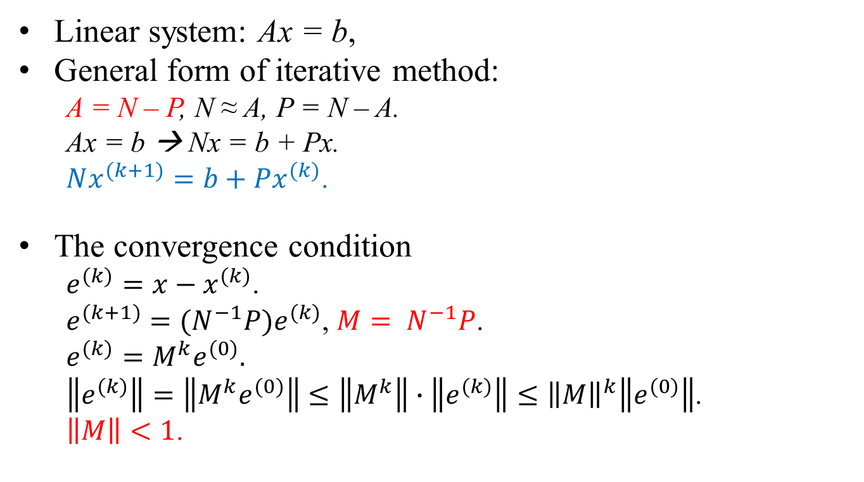
Review
Linear system: Ax = b,
General form of iterative method:
A = N – P, N ≈ A, P = N – A.
Ax = b → Nx = b + Px.
$Nx^{(k+1)}=b+Px^{(k)}$.
The convergence condition
$e^{(k)}=x−x^{(k)}$.
$e^{(k+1)}={(N}^{−1}P)e^{(k)}$, $M= N^{−1}P$.
$e^{(k)}=M^{k}e^{(0)}.$
$\left\|e^{(k)}\right\|=\left\|M^{k}e^{(0)}\right\|≤\left\|M^{k}\right\|∙\left\|e^{(k)}\right\|≤{\left\|M\right\|}^{k}\left\|e^{(0)}\right\|$.
$\left\|M\right\|<1$.

Slide 4
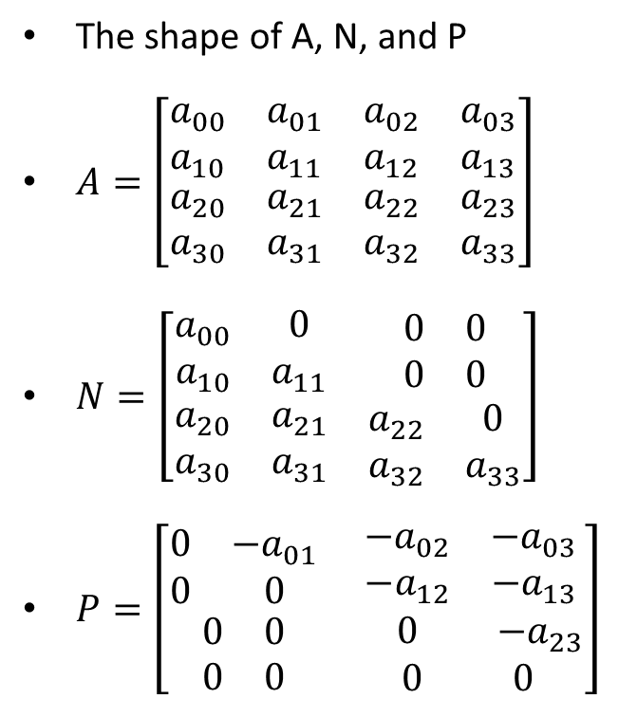
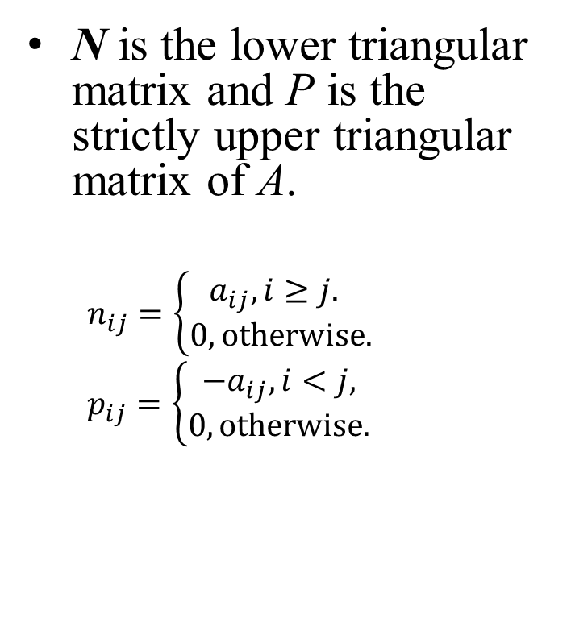
Gauss-Seidel Iteration
N is the lower triangular matrix and P is the strictly upper triangular matrix of A.
$n_{ij}=\left\{\begin{matrix}a_{ij}, i≥j. \\ 0, otherwise.\end{matrix}\right.$
$p_{ij}=\left\{\begin{matrix}−a_{ij}, i<j, \\ 0, otherwise.\end{matrix}\right.$
The shape of A, N, and P
$A=\left[\begin{matrix}\begin{matrix}a_{00} & a_{01} \\ a_{10} & a_{11}\end{matrix} & \begin{matrix}a_{02} & a_{03} \\ a_{12} & a_{13}\end{matrix} \\ \begin{matrix}a_{20} & a_{21} \\ a_{30} & a_{31}\end{matrix} & \begin{matrix}a_{22} & a_{23} \\ a_{32} & a_{33}\end{matrix}\end{matrix}\right]$
$N=\left[\begin{matrix}\begin{matrix}a_{00} & 0 \\ a_{10} & a_{11}\end{matrix} & \begin{matrix}0 & 0 \\ 0 & 0\end{matrix} \\ \begin{matrix}a_{20} & a_{21} \\ a_{30} & a_{31}\end{matrix} & \begin{matrix}a_{22} & 0 \\ a_{32} & a_{33}\end{matrix}\end{matrix}\right]$
$P=\left[\begin{matrix}\begin{matrix}0 & {−a}_{01} \\ 0 & 0\end{matrix} & \begin{matrix}{−a}_{02} & {−a}_{03} \\ {−a}_{12} & {−a}_{13}\end{matrix} \\ \begin{matrix}0 & 0 \\ 0 & 0\end{matrix} & \begin{matrix} 0 & { −a}_{23} \\ 0 & 0\end{matrix}\end{matrix}\right]$

Slide 5
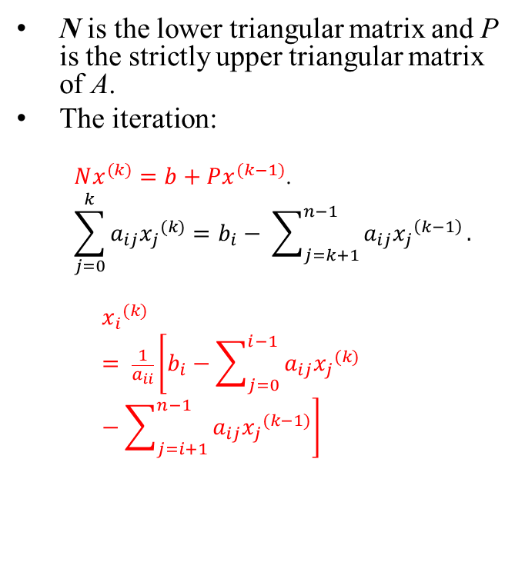
Gauss-Seidel Iteration
N is the lower triangular matrix and P is the strictly upper triangular matrix of A.
The iteration:
$Nx^{(k)}=b+Px^{(k−1)}$.
$$\sum_{j=0}^{k}{a_{ij}{x_{j}}^{(k)}}=b_{i}− \sum_{j=k+1}^{n−1}{a_{ij}{x_{j}}^{\left(k−1\right)}}.$$
$${x_{i}}^{(k)}= \frac{1}{a_{ii}}\left[b_{i}−\sum_{j=0}^{i−1}{a_{ij}{x_{j}}^{(k)}}−\sum_{j=i+1}^{n−1}{a_{ij}{x_{j}}^{(k−1)}}\right]$$
The shape of A, N, and P
$A=\left[\begin{matrix}\begin{matrix}a_{00} & a_{01} \\ a_{10} & a_{11}\end{matrix} & \begin{matrix}a_{02} & a_{03} \\ a_{12} & a_{13}\end{matrix} \\ \begin{matrix}a_{20} & a_{21} \\ a_{30} & a_{31}\end{matrix} & \begin{matrix}a_{22} & a_{23} \\ a_{32} & a_{33}\end{matrix}\end{matrix}\right]$
$N=\left[\begin{matrix}\begin{matrix}a_{00} & 0 \\ a_{10} & a_{11}\end{matrix} & \begin{matrix}0 & 0 \\ 0 & 0\end{matrix} \\ \begin{matrix}a_{20} & a_{21} \\ a_{30} & a_{31}\end{matrix} & \begin{matrix}a_{22} & 0 \\ a_{32} & a_{33}\end{matrix}\end{matrix}\right]$
$P=\left[\begin{matrix}\begin{matrix}0 & {−a}_{01} \\ 0 & 0\end{matrix} & \begin{matrix}{−a}_{02} & {−a}_{03} \\ {−a}_{12} & {−a}_{13}\end{matrix} \\ \begin{matrix}0 & 0 \\ 0 & 0\end{matrix} & \begin{matrix} 0 & { −a}_{23} \\ 0 & 0\end{matrix}\end{matrix}\right]$

Slide 6
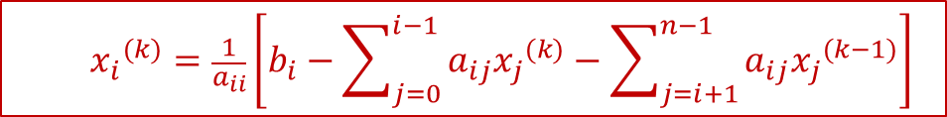
The Pseudo-Codes
//Initialize the solution.
x[] = {0.0};
err = ∞;
//Iterate until being converged
while(err>ε){
for(i=0;i≤n-1;i++){
sum = b[i];
for(j=0;j≤n-1;j++) if(j!=i) sum = sum – A[i][j]*x[j];
x[i] = sum/A[i][i];
}
//Compute the residual
r[] = b[] – A[][]*x[];
err = norm_inf(r, n); //Compute the norm
}
return (x[]);
$${x_{i}}^{(k)}=\frac{1}{a_{ii}}\left[b_{i}−\sum_{j=0}^{i−1}{a_{ij}{x_{j}}^{(k)}}−\sum_{j=i+1}^{n−1}{a_{ij}{x_{j}}^{(k−1)}}\right]$$

Slide 7
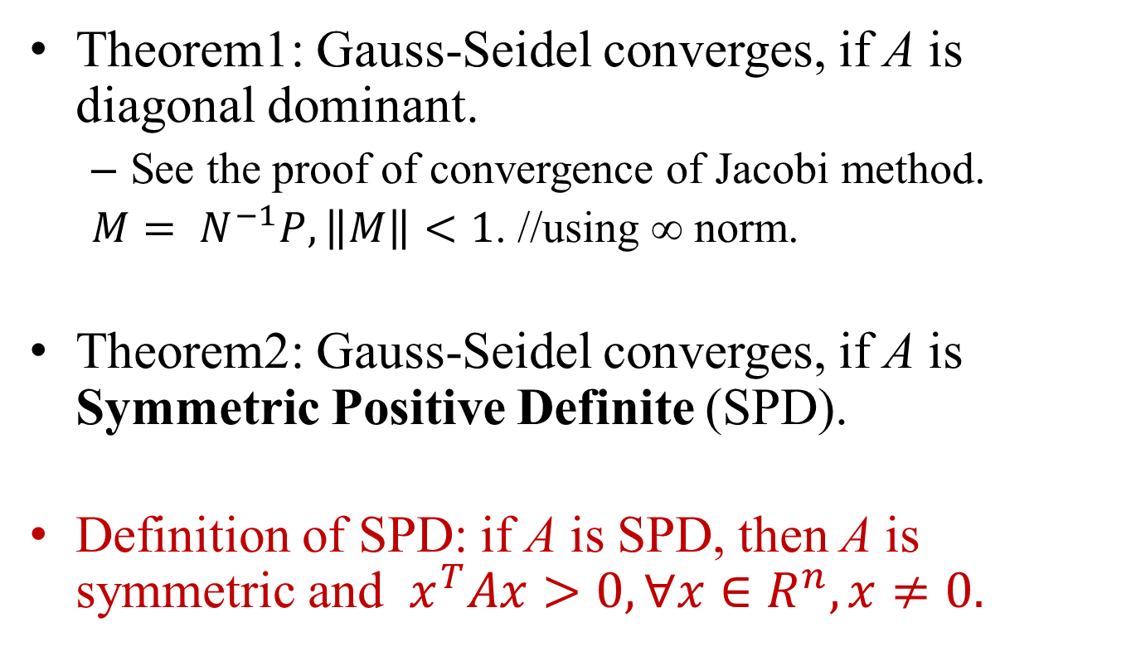
Convergence of Gauss-Seidel
Theorem1: Gauss-Seidel converges, if A is diagonal dominant.
See the proof of convergence of Jacobi method.
$M= N^{−1}P, \left\|M\right\|<1$. //using ∞ norm.
Theorem2: Gauss-Seidel converges, if A is Symmetric Positive Definite (SPD).
Definition of SPD: if A is SPD, then A is symmetric and $x^{T}Ax>0, ∀x∈R^{n},x≠0.$

Slide 8
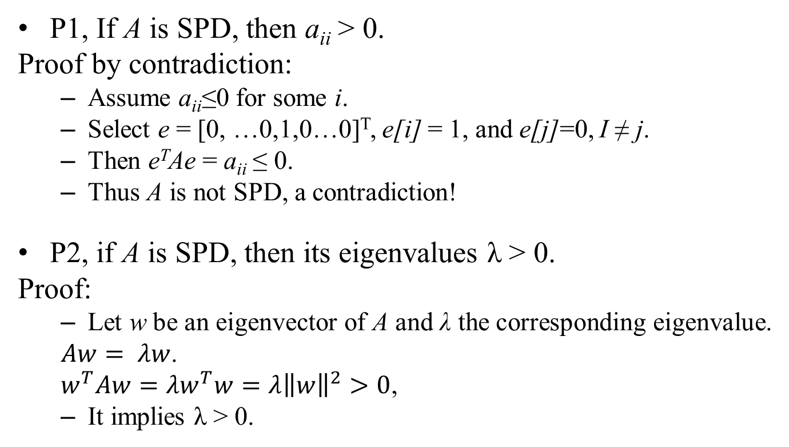
Properties
P1, If A is SPD, then a_{ii} > 0.
Proof by contradiction:
Assume a_{ii}≤0 for some i.
Select e = [0, …0,1,0…0]^{T}, e[i] = 1, and e[j]=0, I ≠ j.
Then e^{T}Ae = a_{ii} ≤ 0.
Thus A is not SPD, a contradiction!
P2, if A is SPD, then its eigenvalues λ > 0.
Proof:
Let w be an eigenvector of A and λ the corresponding eigenvalue.
$Aw= λw$.
$w^{T}Aw=λw^{T}w=λ{\left\|w\right\|}^{2}>0$,
It implies λ > 0.

Slide 9
Properties
P3, Let D = diag(A), the diagonal matrix of A, then D is SPD.
Using property P1.
P4, If A is SPD, then N = D + B^{T}, where B is the strictly upper triangle matrix of A.
See the right figure. B^{T} ~ B.
P5, D = A – B – B^{T}
P6, w^{T}Bw = w^{T}B^{T}w.
Proof by expanding the equation and using B_{ij} = B_{ji}.
A is SPD and it is divided into 3 parts in Gaussian-Seidel method.
B
B^{T}
D

Slide 10
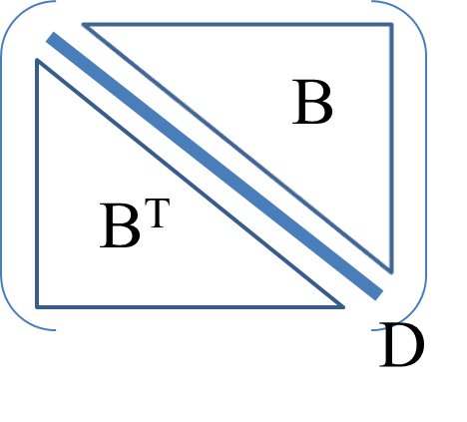
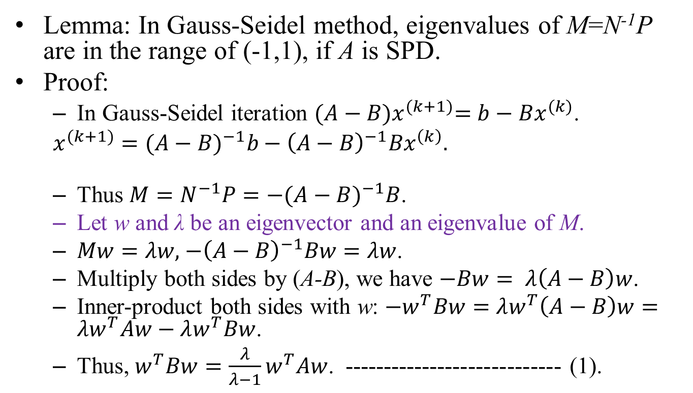
Spectral Radius of the Correction Matrix
Lemma: In Gauss-Seidel method, eigenvalues of M=N⁻¹P are in the range of (-1,1), if A is SPD.
Proof:
In Gauss-Seidel iteration ${(A−B)x}^{(k+1)}=b−Bx^{(k)}$.
$x^{(k+1)}={(A−B)}^{−1}b−{\left(A−B\right)}^{−1}{Bx}^{\left(k\right)}.$
Thus $M=N^{−1}P=−{(A−B)}^{−1}B$.
Let w and λ be an eigenvector and an eigenvalue of M.
$Mw=λw,$ $−{\left(A−B\right)}^{−1}Bw=λw$.
Multiply both sides by (A-B), we have $−Bw= λ\left(A−B\right)w$.
Inner-product both sides with w: ${−w}^{T}Bw=λw^{T}\left(A−B\right)w=λw^{T}Aw−λw^{T}Bw$.
Thus,$w^{T}Bw=\frac{λ}{λ−1}w^{T}Aw$. ---------------------------- (1).

Slide 11
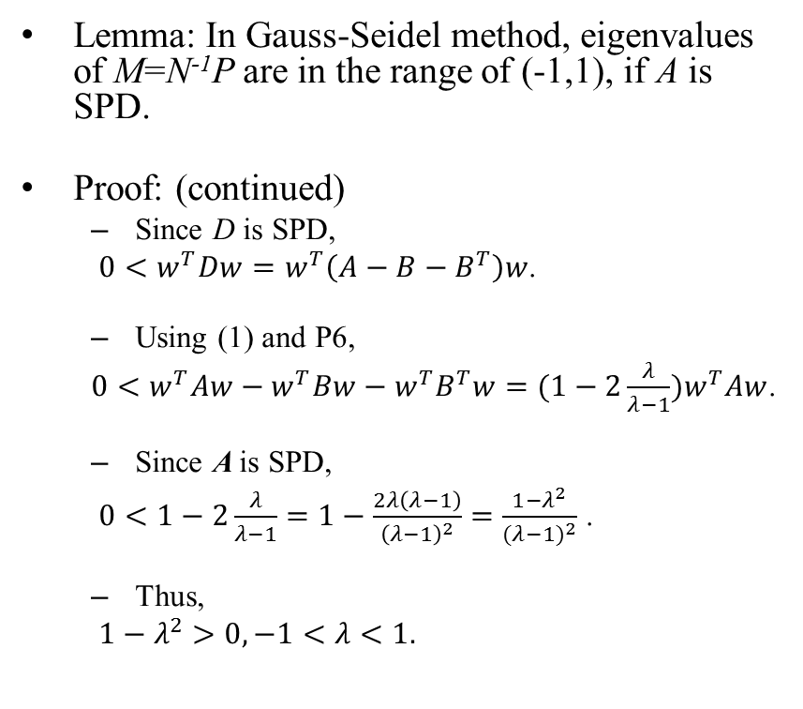
Spectral Radius of the Correction Matrix
Lemma: In Gauss-Seidel method, eigenvalues of M=N⁻¹P are in the range of (-1,1), if A is SPD.
Proof: (continued)
Since D is SPD,
${0<w}^{T}Dw=w^{T}\left(A−B−B^{T}\right)w$.
Using (1) and P6,
$0<w^{T}Aw−w^{T}Bw−w^{T}B^{T}w=(1−2\frac{λ}{λ−1})w^{T}Aw$.
Since A is SPD,
$0<1−2\frac{λ}{λ−1}=1−\frac{2λ\left(λ−1\right)}{{\left(λ−1\right)}^{2}}=\frac{1−λ^{2}}{{(λ−1)}^{2}}$ .
Thus,
$1−λ^{2}>0, −1<λ<1.$
Shape of B^{T}, D, and B.

Slide 12
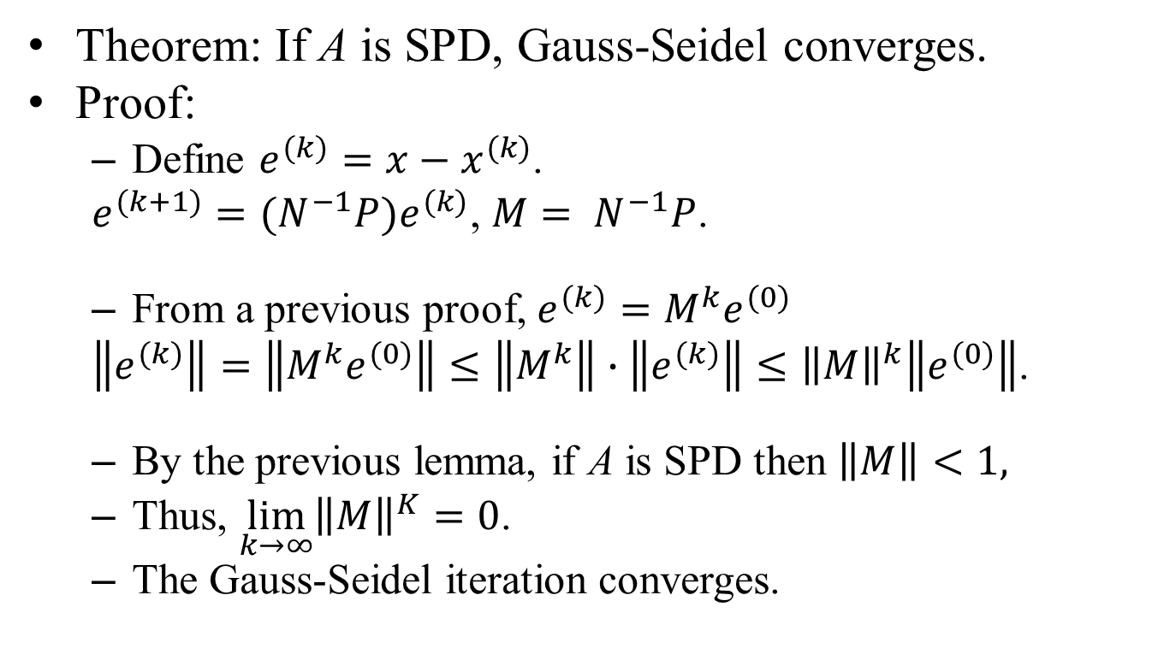
Convergence of SPD Systems
Theorem: If A is SPD, Gauss-Seidel converges.
Proof:
Define $e^{(k)}=x−x^{(k)}$.
$e^{(k+1)}={(N}^{−1}P)e^{(k)}$, $M= N^{−1}P$.
From a previous proof, $e^{(k)}=M^{k}e^{(0)}$
$\left\|e^{(k)}\right\|=\left\|M^{k}e^{(0)}\right\|≤\left\|M^{k}\right\|∙\left\|e^{(k)}\right\|≤{\left\|M\right\|}^{k}\left\|e^{(0)}\right\|$.
By the previous lemma, if A is SPD then $\left\|M\right\|<1,$
Thus, $\lim_{k→∞}{{\left\|M\right\|}^{K}}=0$.
The Gauss-Seidel iteration converges.

Slide 13
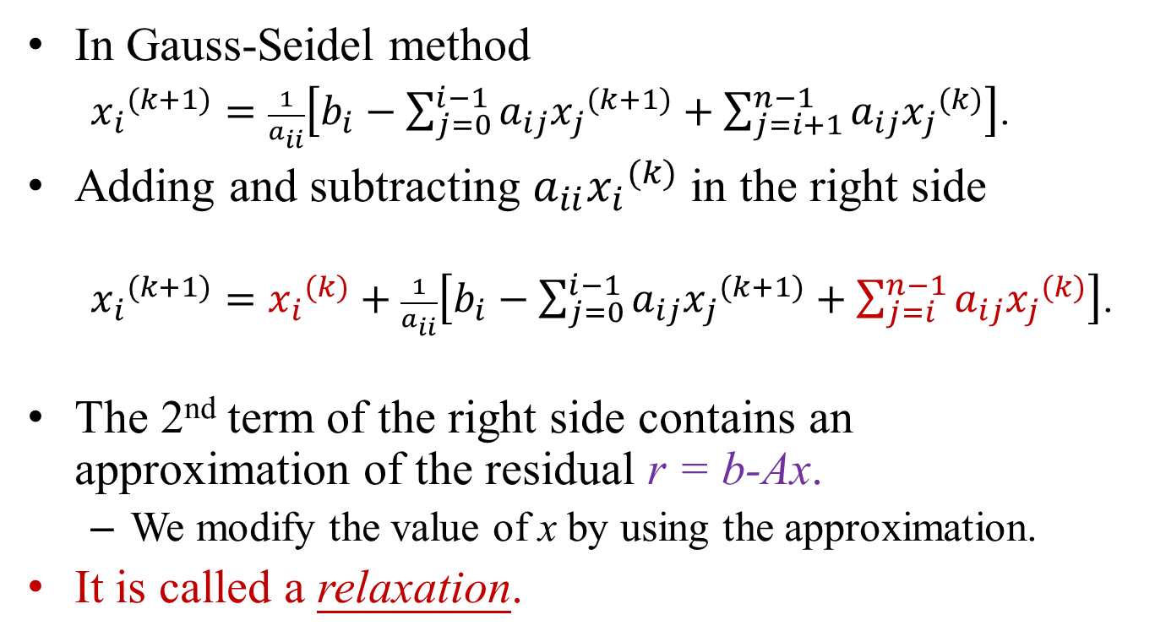
Relaxation
In Gauss-Seidel method
${x_{i}}^{(k+1)}=\frac{1}{a_{ii}}\left[b_{i}−\sum_{j=0}^{i−1}{a_{ij}{x_{j}}^{(k+1)}}+\sum_{j=i+1}^{n−1}{a_{ij}{x_{j}}^{(k)}}\right]$.
Adding and subtracting $a_{ii}{x_{i}}^{(k)}$ in the right side
${x_{i}}^{(k+1)}={x_{i}}^{(k)}+\frac{1}{a_{ii}}\left[b_{i}−\sum_{j=0}^{i−1}{a_{ij}{x_{j}}^{(k+1)}}+\sum_{j=i}^{n−1}{a_{ij}{x_{j}}^{(k)}}\right]$.
The 2nd term of the right side contains an approximation of the residual r = b-Ax.
We modify the value of x by using the approximation.
It is called a relaxation.

Slide 14
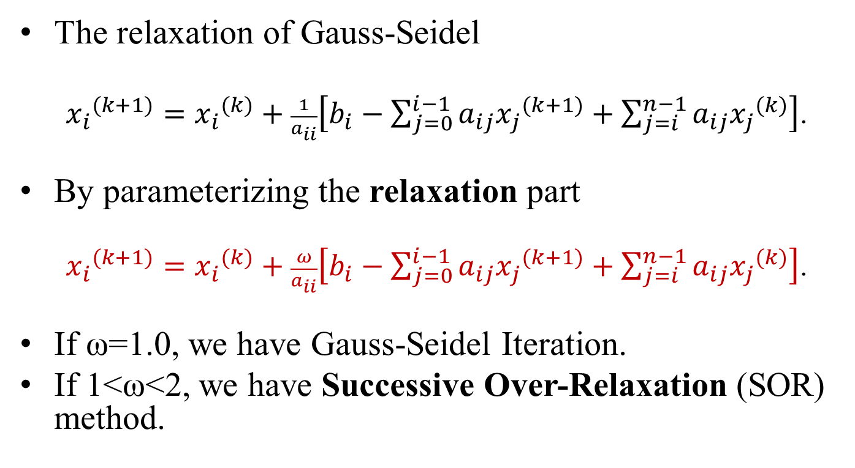
Successive Over Relaxation
The relaxation of Gauss-Seidel
${x_{i}}^{(k+1)}={x_{i}}^{(k)}+\frac{1}{a_{ii}}\left[b_{i}−\sum_{j=0}^{i−1}{a_{ij}{x_{j}}^{(k+1)}}+\sum_{j=i}^{n−1}{a_{ij}{x_{j}}^{(k)}}\right]$.
By parameterizing the relaxation part
${x_{i}}^{(k+1)}={x_{i}}^{(k)}+\frac{ω}{a_{ii}}\left[b_{i}−\sum_{j=0}^{i−1}{a_{ij}{x_{j}}^{(k+1)}}+\sum_{j=i}^{n−1}{a_{ij}{x_{j}}^{(k)}}\right]$.
If ω=1.0, we have Gauss-Seidel Iteration.
If 1<ω<2, we have Successive Over-Relaxation (SOR) method.

Slide 15
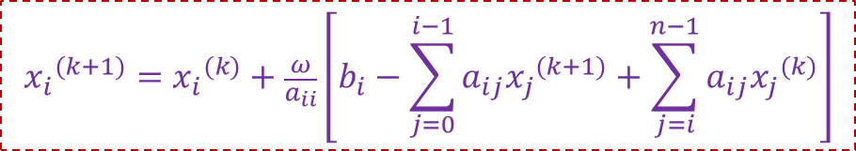
SOR Algorithm
$${x_{i}}^{(k+1)}={x_{i}}^{(k)}+\frac{ω}{a_{ii}}\left[b_{i}−\sum_{j=0}^{i−1}{a_{ij}{x_{j}}^{(k+1)}}+\sum_{j=i}^{n−1}{a_{ij}{x_{j}}^{(k)}}\right]$$
//Initialize the solution.
x[] = {0.0};
err = ∞;
//Iterate until being converged
while(err>ε){
for(i=0;i≤n-1;i++){
sum = b[i];
for(j=0;j≤n-1;j++) sum = sum – A[i][j]*x[j];
x[i] = x[i] + ω*sum/A[i][i];
}
//Compute the residual
r[] = b[] – A[][]*x[];
err = norm_inf(r, n); //Compute the norm
}
return (x[]);

Slide 16
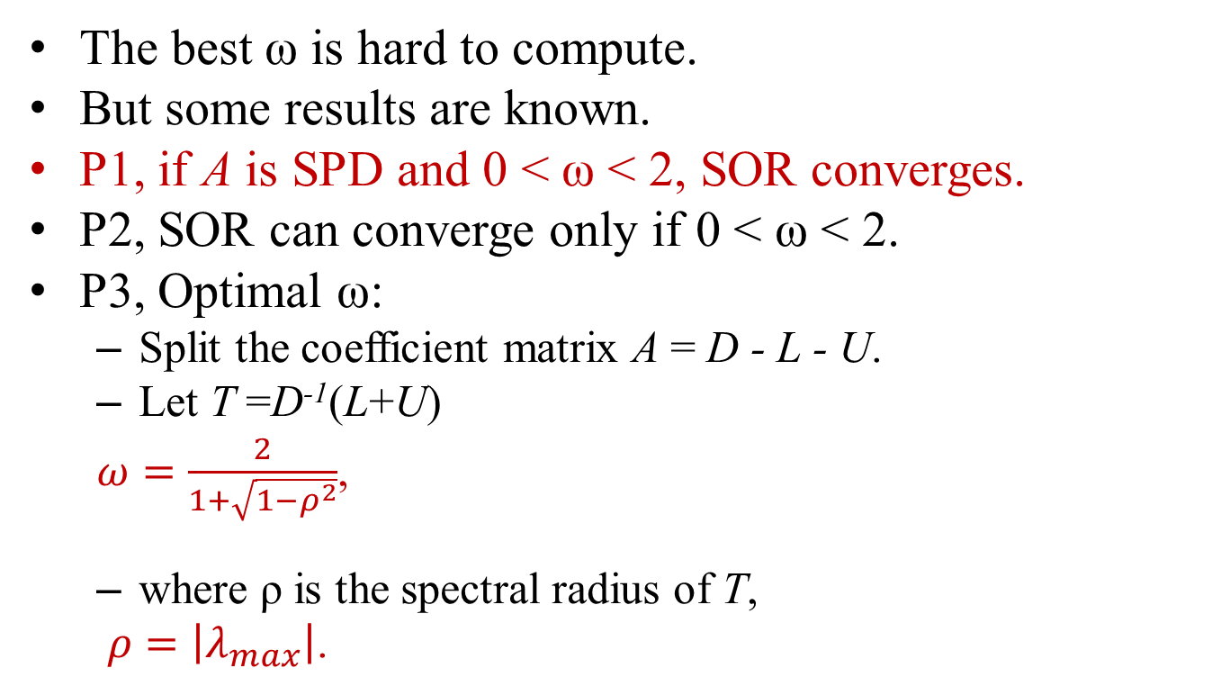
Relaxation Parameter
The best ω is hard to compute.
But some results are known.
P1, if A is SPD and 0 < ω < 2, SOR converges.
P2, SOR can converge only if 0 < ω < 2.
P3, Optimal ω:
Split the coefficient matrix A = D - L - U.
Let T =D⁻¹(L+U)
$ω=\frac{2}{1+\sqrt{1−ρ^{2}}}$,
where ρ is the spectral radius of T,
$ρ=\left|λ_{max}\right|$.
-U
-L

Slide 17
ADI Method
In Jacobi, Gauss-Seidel, and SOR methods, we update x[] from x[0] to x[n-1] in each iteration.
In Altered Direction Iteration (ADI) method,
We update x[] from x[0] to x[n-1] in most cases.
But, in some iterations, we update x[] from x[n-1] to x[0].
SSOR (Symmetric Successive Over-Relaxation) method:
Using SOR to solve the system.
Update x[] from x[0] to x[n-1] in odd-numbered iterations.
Update x[] from x[n-1] to x[0] in even-numbered iterations.
SSOR may be slower than SOR.
SSOR is used as a preconditioner for other iterative method.
What is a preconditioner?

Slide 18
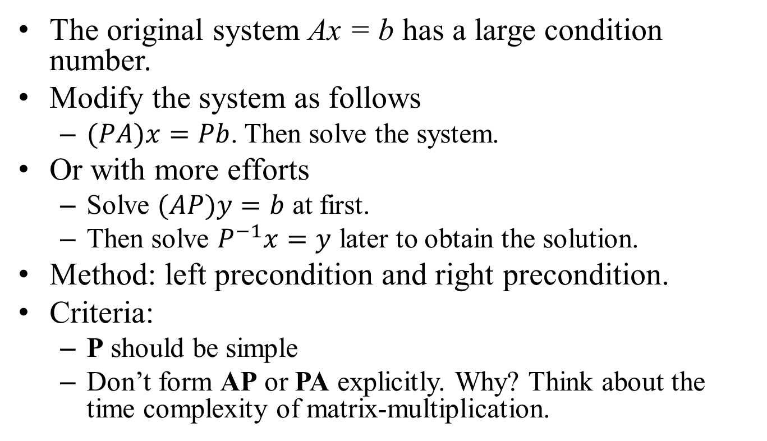
Preconditioners
The original system Ax = b has a large condition number.
Modify the system as follows
$(PA)x=Pb$. Then solve the system.
Or with more efforts
Solve $(AP)y=b$ at first.
Then solve $P^{−1}x=y$ later to obtain the solution.
Method: left precondition and right precondition.
Criteria:
P should be simple
Don’t form AP or PA explicitly. Why? Think about the time complexity of matrix-multiplication.

