Slide 1
Conjugate Gradient Method
A gradient-based method

Slide 2
Outline
Mutual conjugate vectors
Basic ideas of conjugate gradient method
The intuitive algorithm
Improvements
The final algorithm
Discussion
Time complexity
Effects of round-off errors

Slide 3
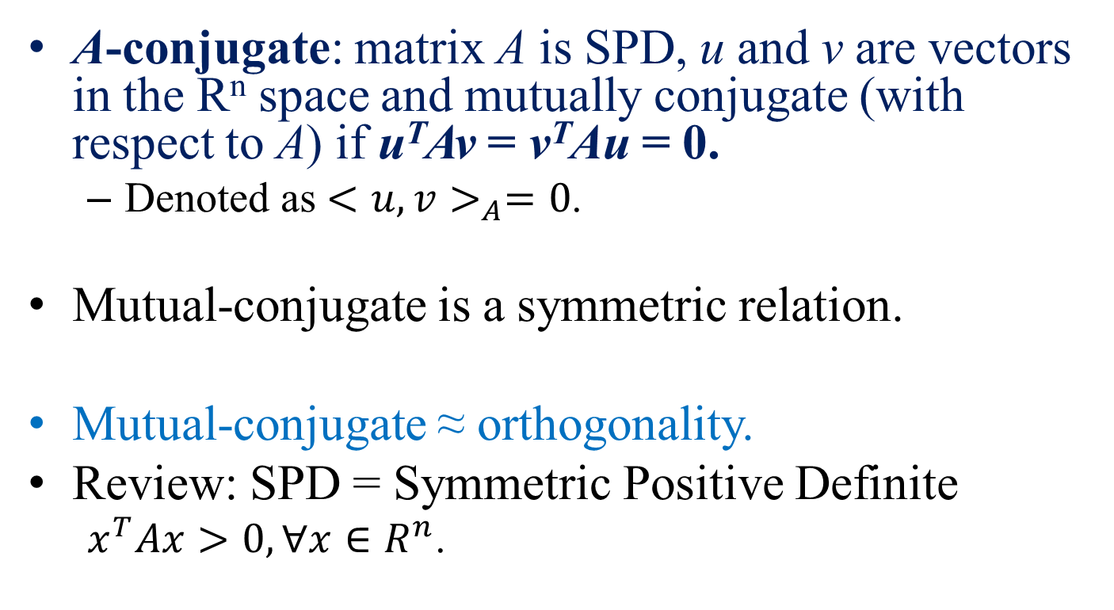
Mutual Conjugate Vectors
A-conjugate: matrix A is SPD, u and v are vectors in the R^{n} space and mutually conjugate (with respect to A) if u^{T}Av = v^{T}Au = 0.
Denoted as ${<u, v>}_{A}=0$.
Mutual-conjugate is a symmetric relation.
Mutual-conjugate ≈ orthogonality.
Review: SPD = Symmetric Positive Definite
$x^{T}Ax>0, ∀x∈R^{n}$.

Slide 4
Basic Properties (1/3)
P1, if u and v are mutual conjugate, they are linearly independent.
Proof by contradiction:
Assume they are linear dependent, then u = kv, k is a scalar.
0 = u^{T}Av = kv^{T}Av = k(v^{T}Av) ≠ 0, because A is SPD.
A contradiction.
P2, Given matrix A, we can create exactly n mutual conjugate vectors in the R^{n} space.
Proof: see the algorithm of conjugate gradient method. There are at most n linear independent vectors in R^{n} space.
P3, These n mutual conjugate vectors form a basis in R^{n} space. (Since they are linearly independent.)

Slide 5



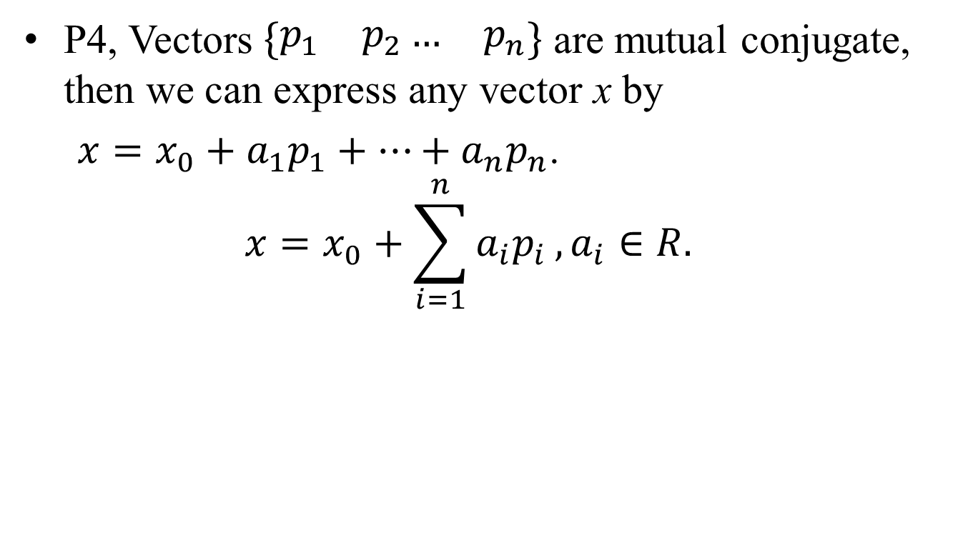



Basic Properties (2/3)
P4, Vectors $\left\{\begin{matrix}p_{1} & p_{2}… & p_{n}\end{matrix}\right\}$ are mutual conjugate, then we can express any vector x by
$x=x_{0}+a_{1}p_{1}+…+a_{n}p_{n}$.
$$x=x_{0}+\sum_{i=1}^{n}{a_{i}p_{i}}, a_{i}∈R.$$
$${\vec{p}}_{0}$$
$$a_{0}{\vec{p}}_{0}$$
$$a_{1}{\vec{p}}_{1}$$
$$\vec{x}$$
$${\vec{x}}_{0}$$
$${\vec{p}}_{1}$$
O

Slide 6

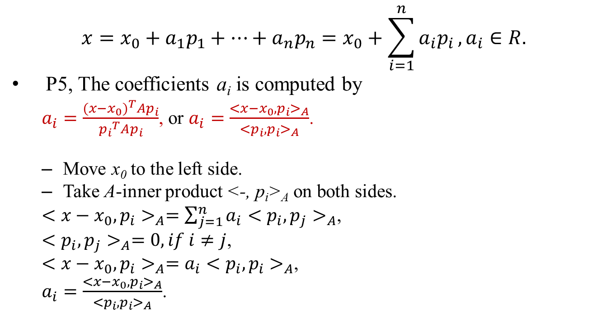
Basic Properties (3/3)
$$x=x_{0}+a_{1}p_{1}+…+a_{n}p_{n}=x_{0}+\sum_{i=1}^{n}{a_{i}p_{i}}, a_{i}∈R.$$
P5, The coefficients a_{i} is computed by
$a_{i}=\frac{{(x−x_{0})}^{T}Ap_{i}}{{p_{i}}^{T}Ap_{i}}$, or $a_{i}=\frac{{<x−x_{0},p_{i}>}_{A}}{{<p_{i},p_{i}>}_{A}}$.
Move x₀ to the left side.
Take A-inner product <-, p_{i}>_{A} on both sides.
${<x−x_{0},p_{i}>}_{A}=\sum_{j=1}^{n}{{a_{i}<p_{i},p_{j}>}_{A}}$,
${<p_{i},p_{j}>}_{A}=0, if i≠j$,
${<x−x_{0},p_{i}>}_{A}={a_{i}<p_{i},p_{i}>}_{A}$,
$a_{i}=\frac{{<x−x_{0},p_{i}>}_{A}}{{<p_{i},p_{i}>}_{A}}$.
Operator: A-inner product:
$${<a,b>}_{A}=a^{T}Ab$$

Slide 7
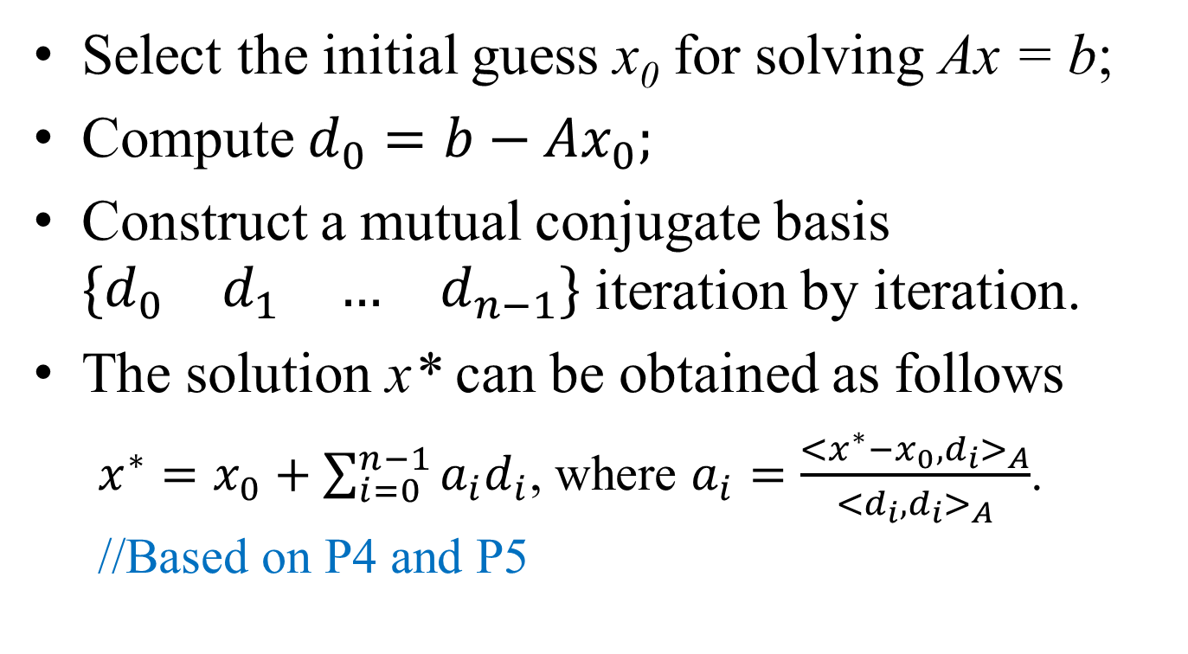
Ideas of Conjugate Gradient Method
Select the initial guess x₀ for solving Ax = b;
Compute $d_{0}=b−Ax_{0};$
Construct a mutual conjugate basis $\left\{\begin{matrix}\begin{matrix}d_{0} & d_{1}\end{matrix} & \begin{matrix}… & d_{n−1}\end{matrix}\end{matrix}\right\}$ iteration by iteration.
The solution x* can be obtained as follows
$x^{∗}=x_{0}+\sum_{i=0}^{n−1}{a_{i}d_{i}}$, where $a_{i}=\frac{{<x^{∗}−x_{0},d_{i}>}_{A}}{{<d_{i},d_{i}>}_{A}}$. //Based on P4 and P5

Slide 8
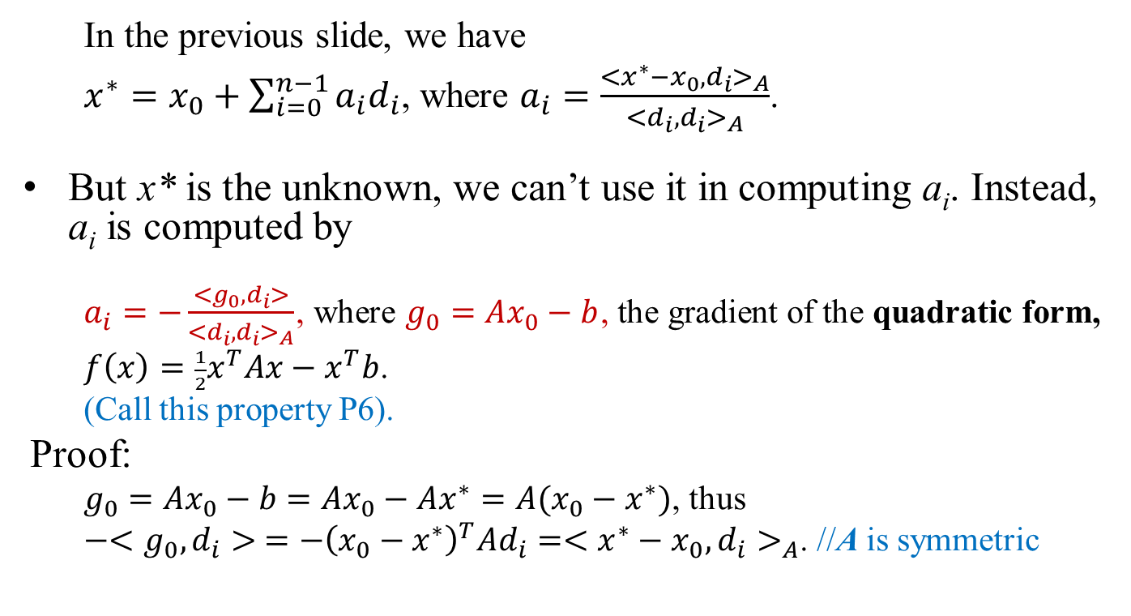
Ideas of Conjugate Gradient Method
In the previous slide, we have
$x^{∗}=x_{0}+\sum_{i=0}^{n−1}{a_{i}d_{i}}$, where $a_{i}=\frac{{<x^{∗}−x_{0},d_{i}>}_{A}}{{<d_{i},d_{i}>}_{A}}$.
But x* is the unknown, we can’t use it in computing a_{i}. Instead, a_{i} is computed by
$a_{i}=−\frac{<g_{0},d_{i}>}{{<d_{i},d_{i}>}_{A}}$, where $g_{0}=Ax_{0}−b$, the gradient of the quadratic form,
$f\left(x\right)=\frac{1}{2}x^{T}Ax−x^{T}b$.
(Call this property P6).
Proof:
$g_{0}=Ax_{0}−b=Ax_{0}−Ax^{∗}=A(x_{0}−x^{∗})$, thus
$−<g_{0},d_{i}> =−{\left(x_{0}−x^{∗}\right)}^{T}Ad_{i}={<x^{∗}−x_{0},d_{i}>}_{A}$. //A is symmetric

Slide 9
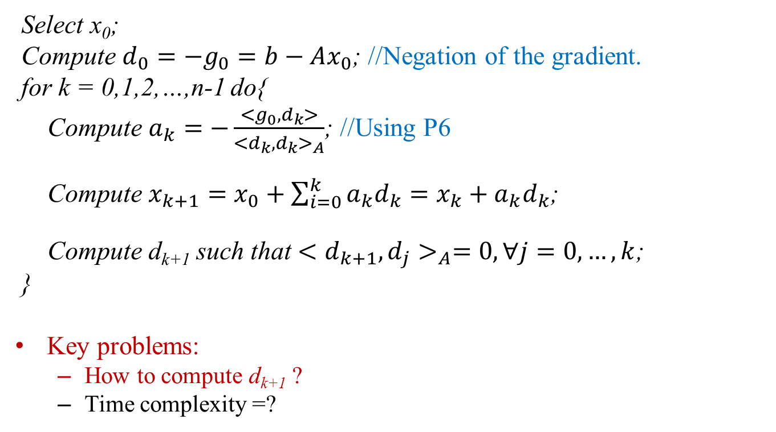
Basic Algorithm
Select x₀;
Compute $d_{0}=−g_{0}=b−Ax_{0}$; //Negation of the gradient.
for k = 0,1,2,…,n-1 do{
Compute $a_{k}=−\frac{<g_{0},d_{k}>}{{<d_{k},d_{k}>}_{A}}$; //Using P6
Compute $x_{k+1}=x_{0}+\sum_{i=0}^{k}{a_{k}d_{k}}=x_{k}+a_{k}d_{k}$;
Compute d_{k+1} such that ${<d_{k+1},d_{j}>}_{A}=0,∀j=0,…,k$;
}
Key problems:
How to compute d_{k+1} ?
Time complexity =?

Slide 10
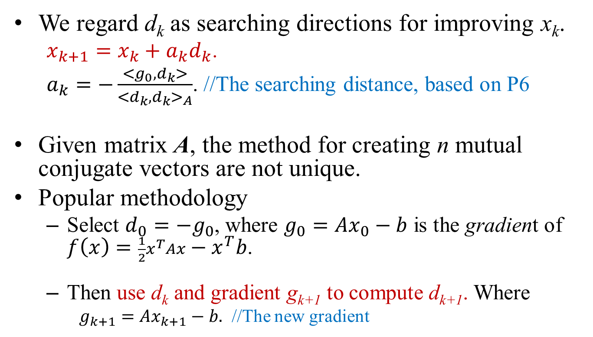
Searching Directions
We regard d_{k} as searching directions for improving x_{k}.
$x_{k+1}=x_{k}+a_{k}d_{k}$.
$a_{k}=−\frac{<g_{0},d_{k}>}{{<d_{k},d_{k}>}_{A}}$. //The searching distance, based on P6
Given matrix A, the method for creating n mutual conjugate vectors are not unique.
Popular methodology
Select $d_{0}=−g_{0}$, where $g_{0}=Ax_{0}−b$ is the gradient of $f\left(x\right)=\frac{1}{2}x^{T}Ax−x^{T}b$.
Then use d_{k} and gradient g_{k+1} to compute d_{k+1}. Where
$g_{k+1}=Ax_{k+1}−b.$ //The new gradient

Slide 11
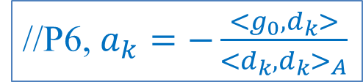
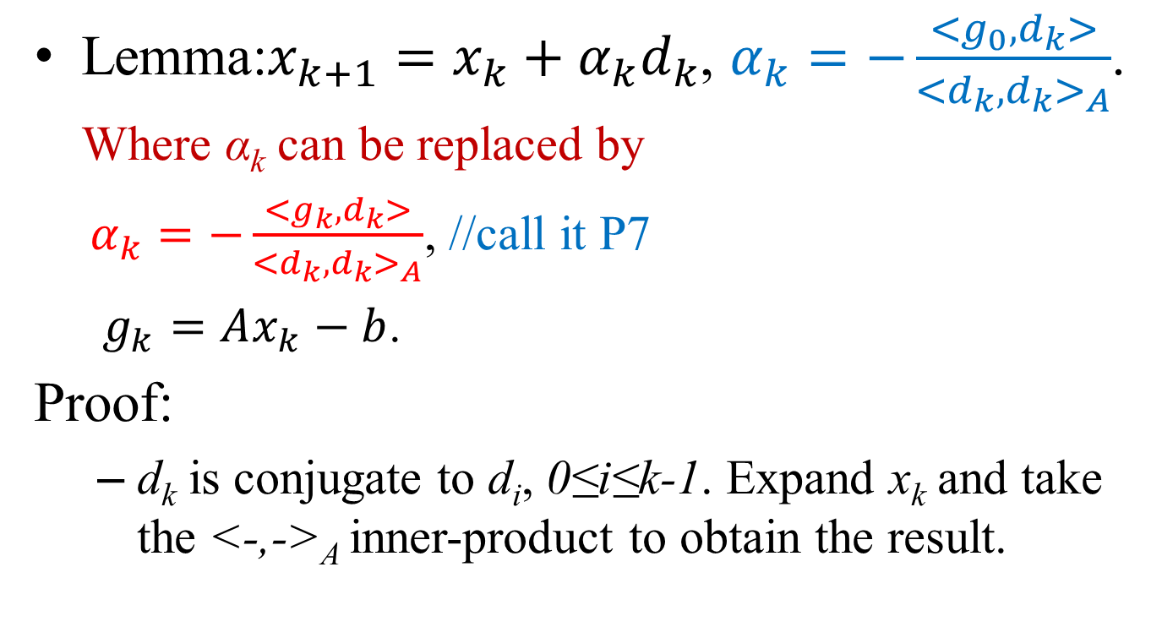
New Searching Distance
Lemma:$x_{k+1}=x_{k}+α_{k}d_{k}$, $α_{k}=−\frac{<g_{0},d_{k}>}{{<d_{k},d_{k}>}_{A}}$. Where α_{k} can be replaced by
$α_{k}=−\frac{<g_{k},d_{k}>}{{<d_{k},d_{k}>}_{A}}$, //call it P7
$g_{k}=Ax_{k}−b$.
Proof:
d_{k} is conjugate to d_{i}, 0≤i≤k-1. Expand x_{k} and take the <-,->_{A} inner-product to obtain the result.
//P6, $a_{k}=−\frac{<g_{0},d_{k}>}{{<d_{k},d_{k}>}_{A}}$

Slide 12


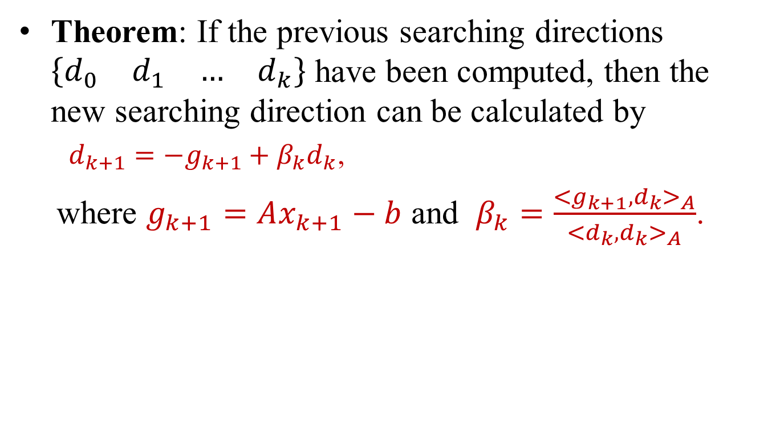



New Searching Direction
Theorem: If the previous searching directions $\left\{\begin{matrix}\begin{matrix}d_{0} & d_{1}\end{matrix} & \begin{matrix}… & d_{k}\end{matrix}\end{matrix}\right\}$ have been computed, then the new searching direction can be calculated by
$d_{k+1}=−g_{k+1}+β_{k}d_{k}$,
where $g_{k+1}=Ax_{k+1}−b$ and $β_{k}=\frac{{<g_{k+1}{,d}_{k}>}_{A}}{{<d_{k},d_{k}>}_{A}}$.
$$g_{k+1}$$
$$x_{k+1}=x_{k}+α_{k}d_{k}$$
$α_{k}=−\frac{<g_{k},d_{k}>}{{<d_{k},d_{k}>}_{A}}$,
$${−g}_{k+1}$$
$$d_{k}$$
$$d_{k+1}$$

Slide 13
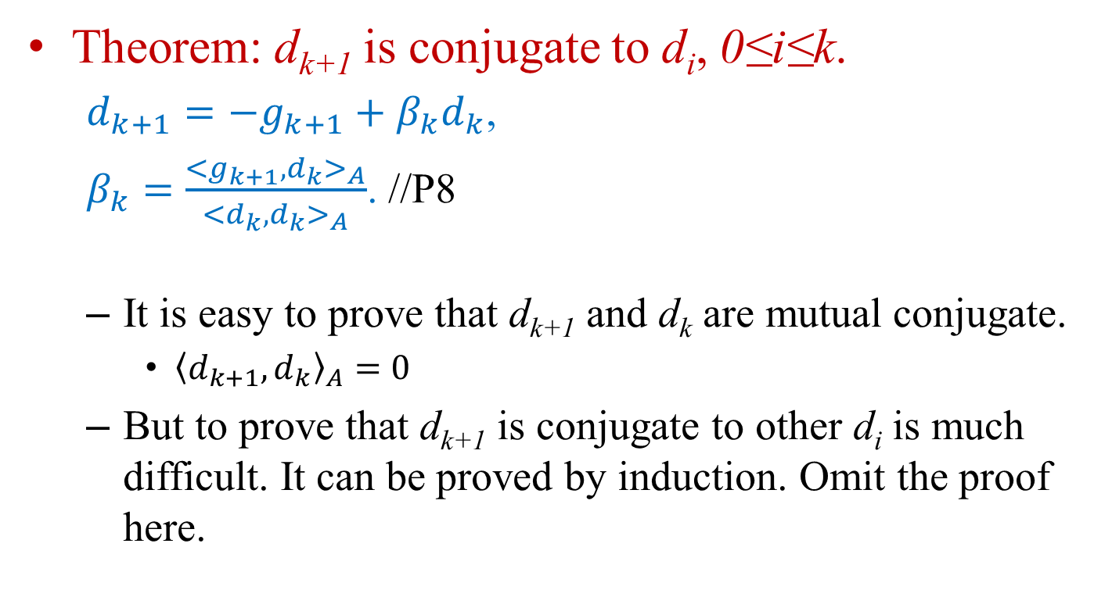
The New Direction
Theorem: d_{k+1} is conjugate to d_{i}, 0≤i≤k.
$d_{k+1}=−g_{k+1}+β_{k}d_{k}$,
$β_{k}=\frac{{<g_{k+1}{,d}_{k}>}_{A}}{{<d_{k},d_{k}>}_{A}}$. //P8
It is easy to prove that d_{k+1} and d_{k} are mutual conjugate.
${\left\langle d_{k+1},d_{k}\right\rangle }_{A}=0$
But to prove that d_{k+1} is conjugate to other d_{i} is much difficult. It can be proved by induction. Omit the proof here.

Slide 14
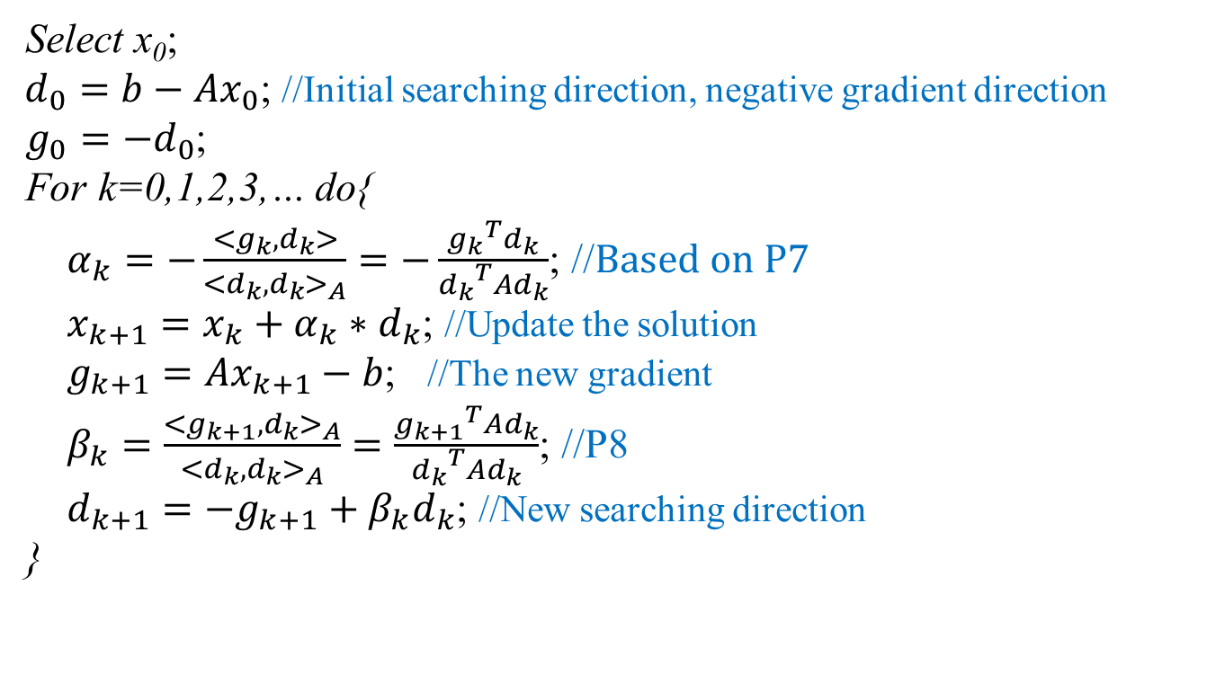
The Naïve Algorithm
Select x₀;
$d_{0}=b−Ax_{0}$; //Initial searching direction, negative gradient direction
$g_{0}=−d_{0}$;
For k=0,1,2,3,… do{
$α_{k}=−\frac{<g_{k},d_{k}>}{{<d_{k},d_{k}>}_{A}}=−\frac{{g_{k}}^{T}d_{k}}{{d_{k}}^{T}Ad_{k}}$; //$Based on P7$
$x_{k+1}=x_{k}+α_{k}∗d_{k}$; //Update the solution
$g_{k+1}=Ax_{k+1}−b$; //The new gradient
$β_{k}=\frac{{<g_{k+1},d_{k}>}_{A}}{{<d_{k},d_{k}>}_{A}}=\frac{{g_{k+1}}^{T}{Ad}_{k}}{{d_{k}}^{T}{Ad}_{k}}$; //P8
$d_{k+1}={−g}_{k+1}+β_{k}d_{k}$; //New searching direction
}

Slide 15
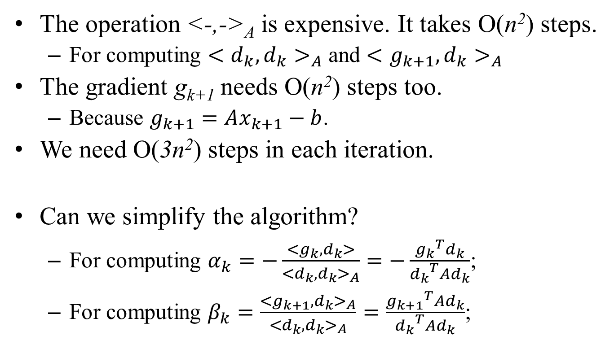
Improvements
The operation <-,->_{A} is expensive. It takes O(n²) steps.
For computing ${<d_{k},d_{k}>}_{A}$ and ${<g_{k+1},d_{k}>}_{A}$
The gradient g_{k+1} needs O(n²) steps too.
Because $g_{k+1}=Ax_{k+1}−b$.
We need O(3n²) steps in each iteration.
Can we simplify the algorithm?
For computing $α_{k}=−\frac{<g_{k},d_{k}>}{{<d_{k},d_{k}>}_{A}}=−\frac{{g_{k}}^{T}d_{k}}{{d_{k}}^{T}Ad_{k}}$;
For computing $β_{k}=\frac{{<g_{k+1},d_{k}>}_{A}}{{<d_{k},d_{k}>}_{A}}=\frac{{g_{k+1}}^{T}{Ad}_{k}}{{d_{k}}^{T}{Ad}_{k}}$;

Slide 16
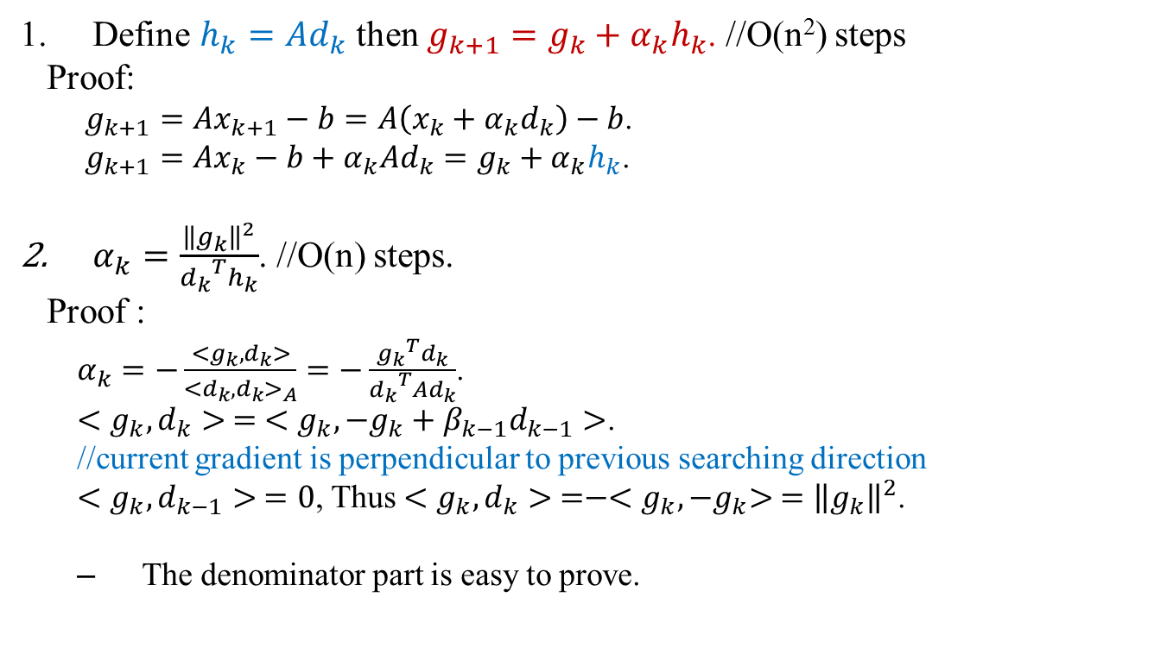
Improvements
Define $h_{k}=Ad_{k}$ then $g_{k+1}=g_{k}+α_{k}h_{k}$. //O(n²) steps
Proof:
$g_{k+1}=Ax_{k+1}−b=A\left(x_{k}+α_{k}d_{k}\right)−b$.
$$g_{k+1}=Ax_{k}−b+α_{k}Ad_{k}=g_{k}+α_{k}h_{k}\text{.}$$
$α_{k}=\frac{{\left\|g_{k}\right\|}^{2}}{{d_{k}}^{T}h_{k}}$. //O(n) steps.
Proof :
$α_{k}=−\frac{<g_{k},d_{k}>}{{<d_{k},d_{k}>}_{A}}=−\frac{{g_{k}}^{T}d_{k}}{{d_{k}}^{T}Ad_{k}}$.
$<g_{k},d_{k}> = <g_{k},{−g}_{k}+β_{k−1}d_{k−1}>$.
//current gradient is perpendicular to previous searching direction
${<g}_{k},d_{k−1}> =0$, Thus $<g_{k},d_{k}> =−<g_{k},{−g}_{k}> ={\left\|g_{k}\right\|}^{2}$.
The denominator part is easy to prove.

Slide 17
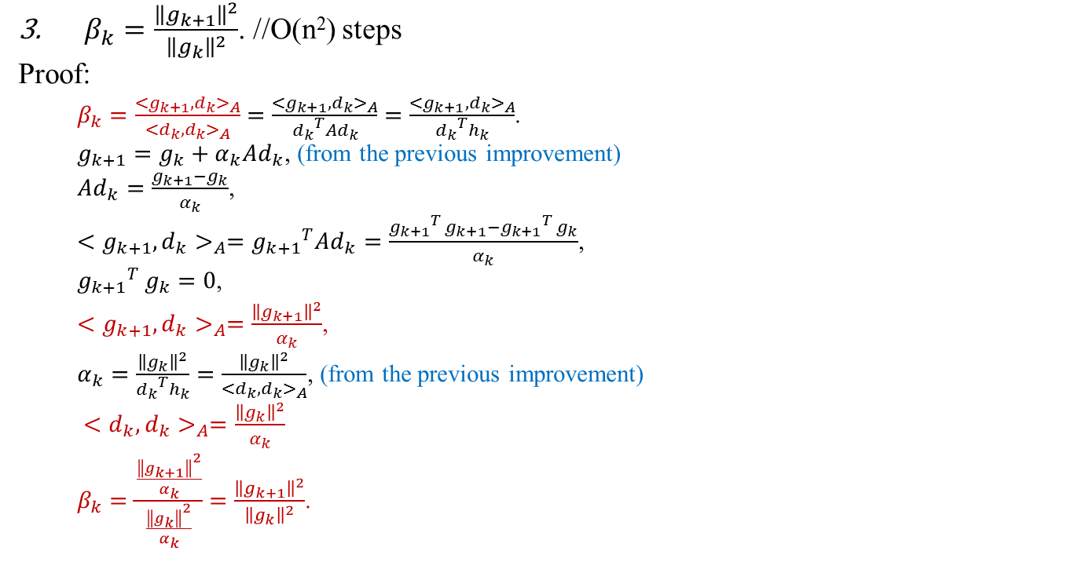
Improvements
$β_{k}=\frac{{\left\|g_{k+1}\right\|}^{2}}{{\left\|g_{k}\right\|}^{2}}$. //O(n²) steps
Proof:
$β_{k}=\frac{{<g_{k+1},d_{k}>}_{A}}{{<d_{k},d_{k}>}_{A}}=\frac{{<g_{k+1},d_{k}>}_{A}}{{d_{k}}^{T}Ad_{k}}=\frac{{<g_{k+1},d_{k}>}_{A}}{{d_{k}}^{T}h_{k}}$.
$g_{k+1}=g_{k}+α_{k}Ad_{k}$, (from the previous improvement)
$Ad_{k}=\frac{g_{k+1}−g_{k}}{α_{k}}$,
${<g_{k+1},d_{k}>}_{A}={g_{k+1}}^{T}Ad_{k}=\frac{{{g_{k+1}}_{}^{T}g}_{k+1}−{{g_{k+1}}_{}^{T}g}_{k}}{α_{k}}$,
${{g_{k+1}}_{}^{T}g}_{k}=0$,
${<g_{k+1},d_{k}>}_{A}=\frac{{\left\|g_{k+1}\right\|}^{2}}{α_{k}}$,
$α_{k}=\frac{{\left\|g_{k}\right\|}^{2}}{{d_{k}}^{T}h_{k}}=\frac{{\left\|g_{k}\right\|}^{2}}{{<d_{k},d_{k}>}_{A}}$, (from the previous improvement)
${<d_{k},d_{k}>}_{A}=\frac{{\left\|g_{k}\right\|}^{2}}{α_{k}}$
$β_{k}=\frac{\frac{{\left\|g_{k+1}\right\|}^{2}}{α_{k}}}{\frac{{\left\|g_{k}\right\|}^{2}}{α_{k}}}=\frac{{\left\|g_{k+1}\right\|}^{2}}{{\left\|g_{k}\right\|}^{2}}$.

Slide 18
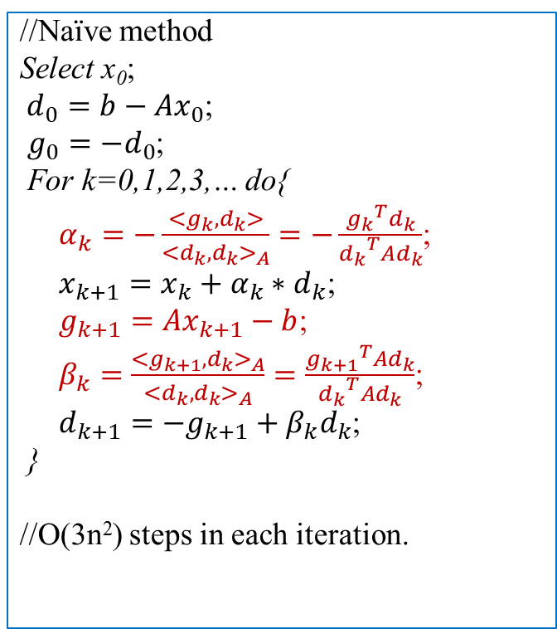
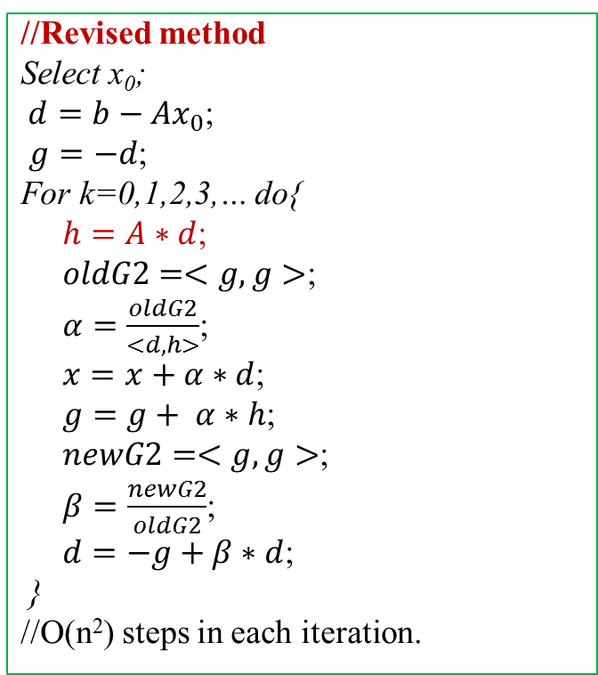
Revised Algorithm
//Revised method
Select x₀;
$d=b−Ax_{0}$;
$g=−d$;
For k=0,1,2,3,… do{
$h=A∗d$;
$oldG2=<g,g>$;
$α=\frac{oldG2}{<d,h>}$;
$x=x+α∗d$;
$g=g+ α∗h$;
$newG2=<g,g>$;
$β=\frac{newG2}{oldG2}$;
$d=−g+β∗d$;
}
//O(n²) steps in each iteration.
//Naïve method
Select x₀;
$d_{0}=b−Ax_{0}$;
$g_{0}=−d_{0}$;
For k=0,1,2,3,… do{
$α_{k}=−\frac{<g_{k},d_{k}>}{{<d_{k},d_{k}>}_{A}}=−\frac{{g_{k}}^{T}d_{k}}{{d_{k}}^{T}Ad_{k}}$;
$x_{k+1}=x_{k}+α_{k}∗d_{k}$;
$g_{k+1}=Ax_{k+1}−b$;
$β_{k}=\frac{{<g_{k+1},d_{k}>}_{A}}{{<d_{k},d_{k}>}_{A}}=\frac{{g_{k+1}}^{T}{Ad}_{k}}{{d_{k}}^{T}{Ad}_{k}}$;
$d_{k+1}={−g}_{k+1}+β_{k}d_{k}$;
}
//O(3n²) steps in each iteration.

Slide 19
Time Complexity
Theoretically, Conjugate Gradient Method will stop within n iterations.
There are exactly n mutual conjugate d_{i} in R^{n} space.
Each iteration needs O(n²) steps.
Thus the total time complexity is O(n³).
However, conjugate gradient method is numerical unstable.
The searching directions d_{i} are not mutual conjugate.

Slide 20
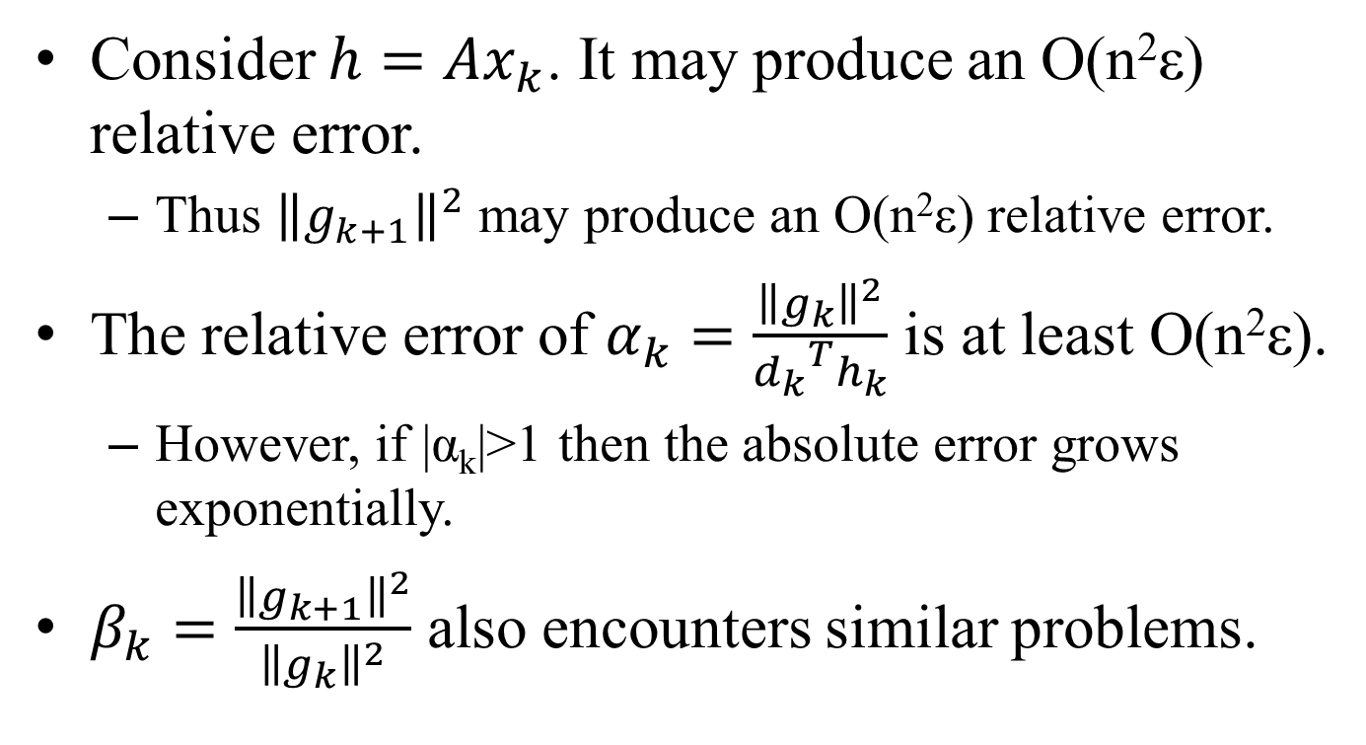
Round-Off Errors
Consider $h=Ax_{k}$. It may produce an O(n²ε) relative error.
Thus ${\left\|g_{k+1}\right\|}^{2}$ may produce an O(n²ε) relative error.
The relative error of $α_{k}=\frac{{\left\|g_{k}\right\|}^{2}}{{d_{k}}^{T}h_{k}}$ is at least O(n²ε).
However, if |α_{k}|>1 then the absolute error grows exponentially.
$β_{k}=\frac{{\left\|g_{k+1}\right\|}^{2}}{{\left\|g_{k}\right\|}^{2}}$ also encounters similar problems.

Slide 21
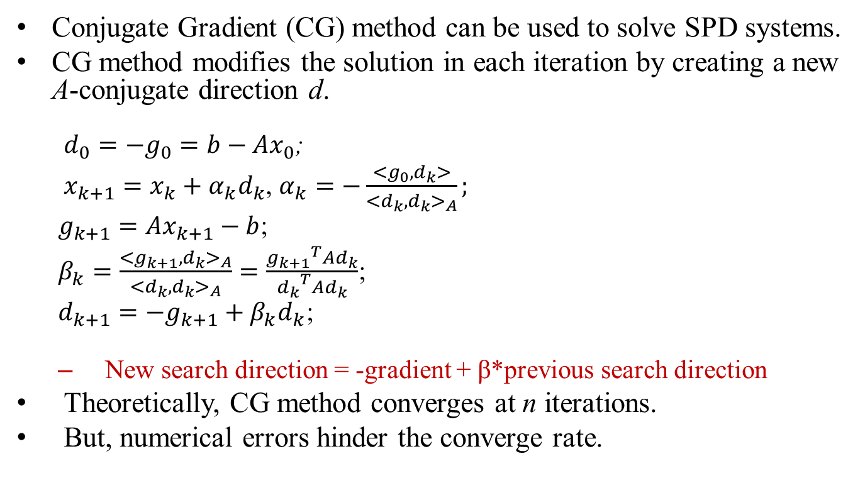
Conclusion
Conjugate Gradient (CG) method can be used to solve SPD systems.
CG method modifies the solution in each iteration by creating a new A-conjugate direction d.
$d_{0}=−g_{0}=b−Ax_{0}$;
$x_{k+1}=x_{k}+α_{k}d_{k}$, $α_{k}=−\frac{<g_{0},d_{k}>}{{<d_{k},d_{k}>}_{A}};$
$g_{k+1}=Ax_{k+1}−b$;
$β_{k}=\frac{{<g_{k+1},d_{k}>}_{A}}{{<d_{k},d_{k}>}_{A}}=\frac{{g_{k+1}}^{T}{Ad}_{k}}{{d_{k}}^{T}{Ad}_{k}}$;
$d_{k+1}={−g}_{k+1}+β_{k}d_{k}$;
New search direction = -gradient + β*previous search direction
Theoretically, CG method converges at n iterations.
But, numerical errors hinder the converge rate.

