Slide 1
Eigen Systems
An introduction to basic properties of eigenvalue and eigenvector

Slide 2
Outline
Introduction
Characteristic polynomial
Basic properties of eigen-systems
Diagonalization process
Similarity transformation
Singular values

Slide 3
Introduction
Definition: A is an n by n matrix and x is a non-zero vector in the R^{n} space. Then x is an eigenvector of A and λ is the associate eigenvalue if and only if
Ax = λx.
Applications of eigen system
Image analysis, computer vision, computer graphics and visualization
Dimension reduction and data classification
Vibration analysis
Flow field analysis
…

Slide 4
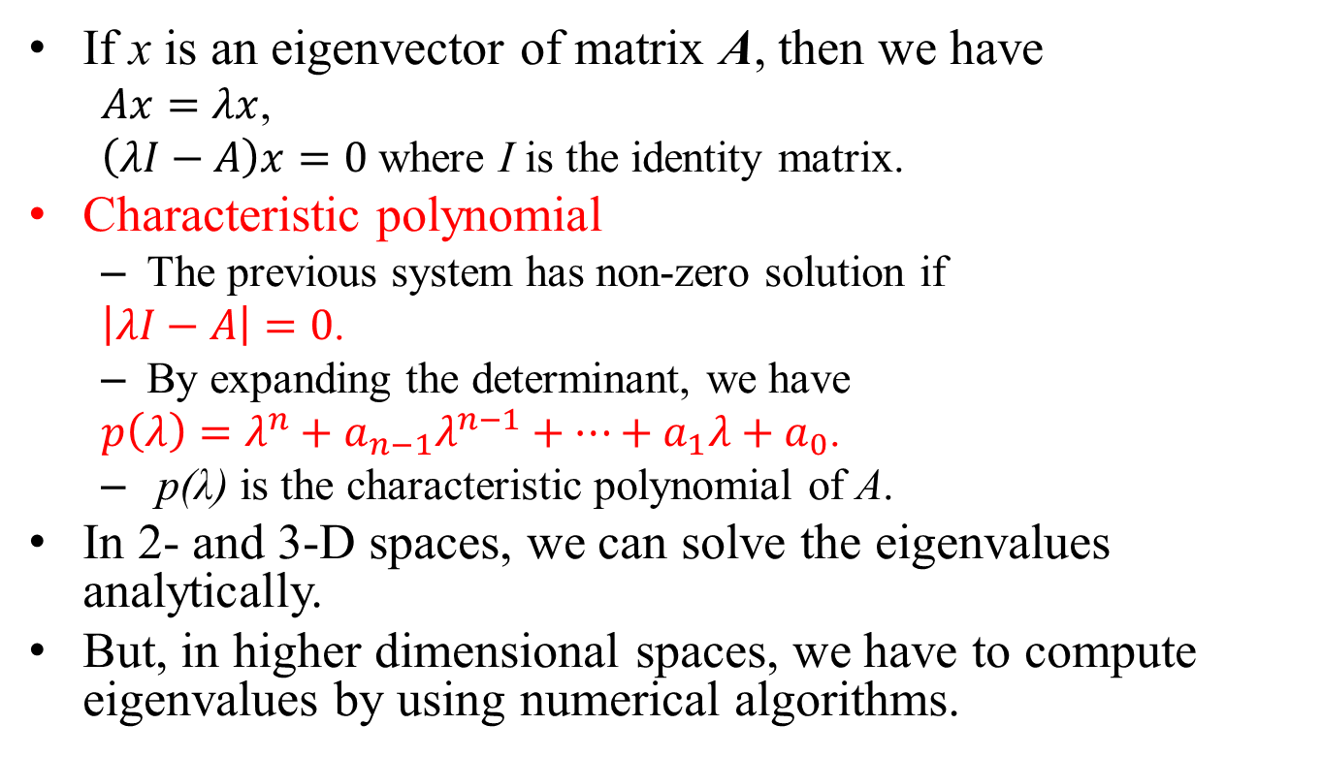
2- and 3-D Space Eigenvetors
If x is an eigenvector of matrix A, then we have
$Ax=λx$,
$\left(λI−A\right)x=0$ where I is the identity matrix.
Characteristic polynomial
The previous system has non-zero solution if
$\left|λI−A\right|=0$.
By expanding the determinant, we have
$p\left(λ\right)=λ^{n}+a_{n−1}λ^{n−1}+…+a_{1}λ+a_{0}$.
p(λ) is the characteristic polynomial of A.
In 2- and 3-D spaces, we can solve the eigenvalues analytically.
But, in higher dimensional spaces, we have to compute eigenvalues by using numerical algorithms.

Slide 5
Properties of Eigen System (1/2)
If A is symmetric, all its eigenvalues are real and the eigenvectors are mutually orthogonal.
The eigenvectors form a basis for the n-D space.
If λ is an eigenvalue of A, then λ^{k} is an eigenvalue of A^{k}.
If λ is an eigenvalue of A, then λ⁻¹ is an eigenvalue of A⁻¹.
The eigenvectors of A and A⁻¹ are the same.

Slide 6
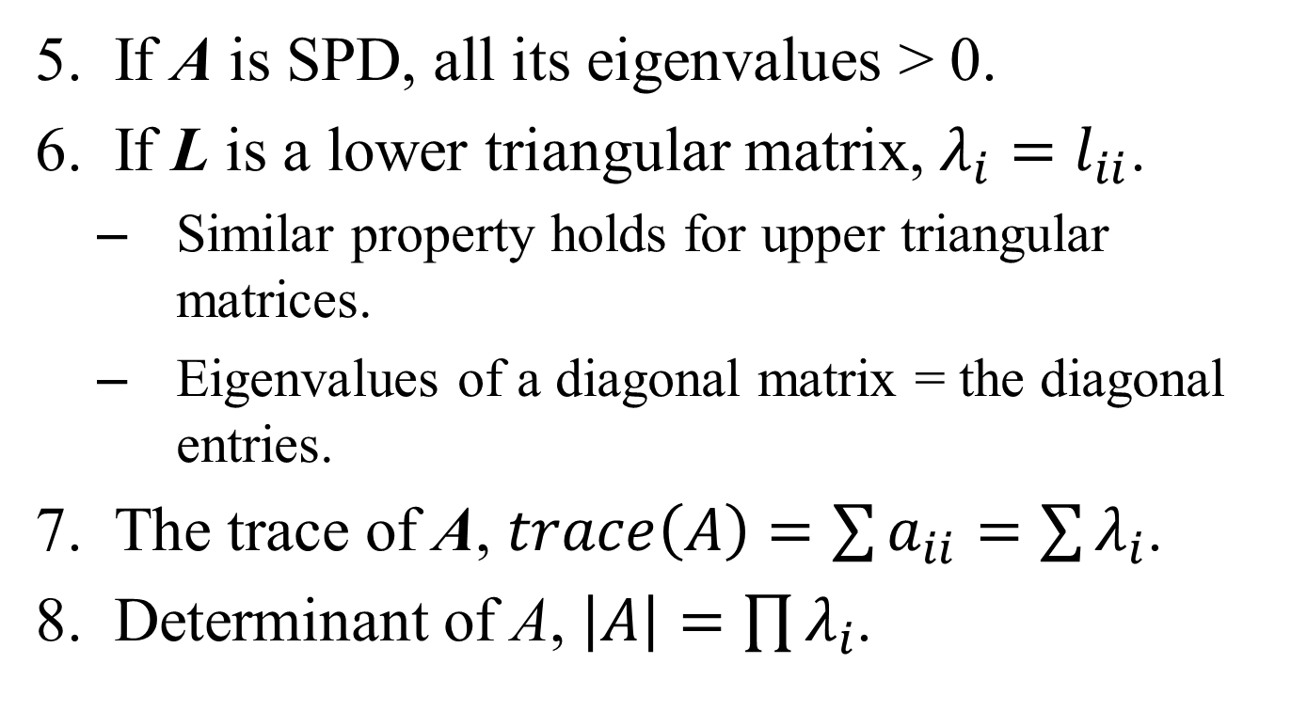
Properties of Eigen System (2/2)
If A is SPD, all its eigenvalues > 0.
If L is a lower triangular matrix, $λ_{i}=l_{ii}$.
Similar property holds for upper triangular matrices.
Eigenvalues of a diagonal matrix = the diagonal entries.
The trace of A, $trace\left(A\right)=\sum{a_{ii}=\sum{λ_{i}}}$.
Determinant of A, $\left|A\right|=\prod{λ_{i}}$.

Slide 7
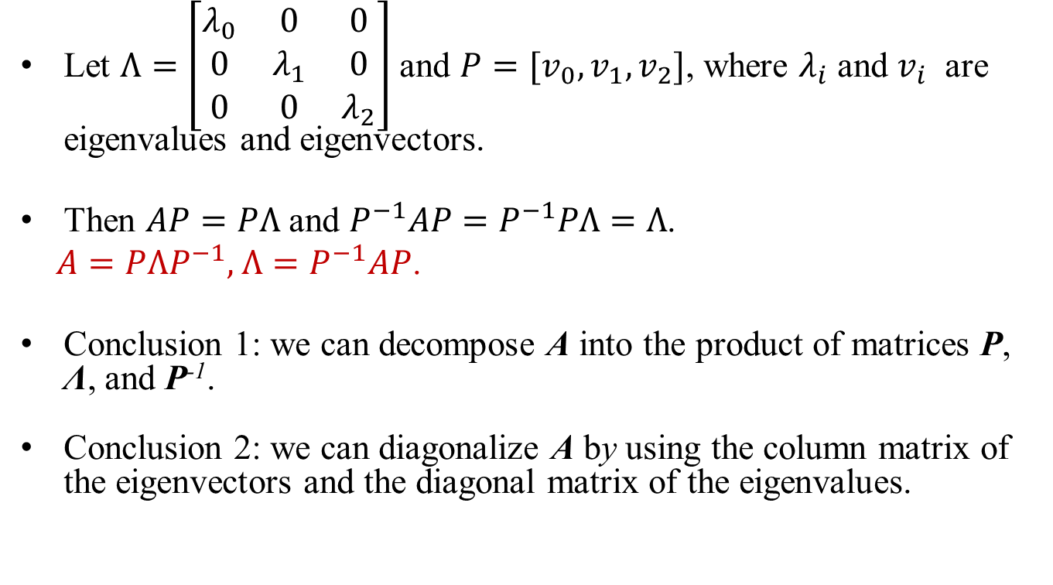
Diagonalization
Let $Λ=\left[\begin{matrix}λ_{0} & 0 & 0 \\ 0 & λ_{1} & 0 \\ 0 & 0 & λ_{2}\end{matrix}\right]$ and $P=[v_{0},v_{1},v_{2}]$, where $λ_{i}$ and $v_{i}$ are eigenvalues and eigenvectors.
Then $AP=PΛ$ and $P^{−1}AP=P^{−1}PΛ=Λ$.
$A=PΛP^{−1},$ $Λ=P^{−1}AP$.
Conclusion 1: we can decompose A into the product of matrices P, Λ, and P⁻¹.
Conclusion 2: we can diagonalize A by using the column matrix of the eigenvectors and the diagonal matrix of the eigenvalues.

Slide 8
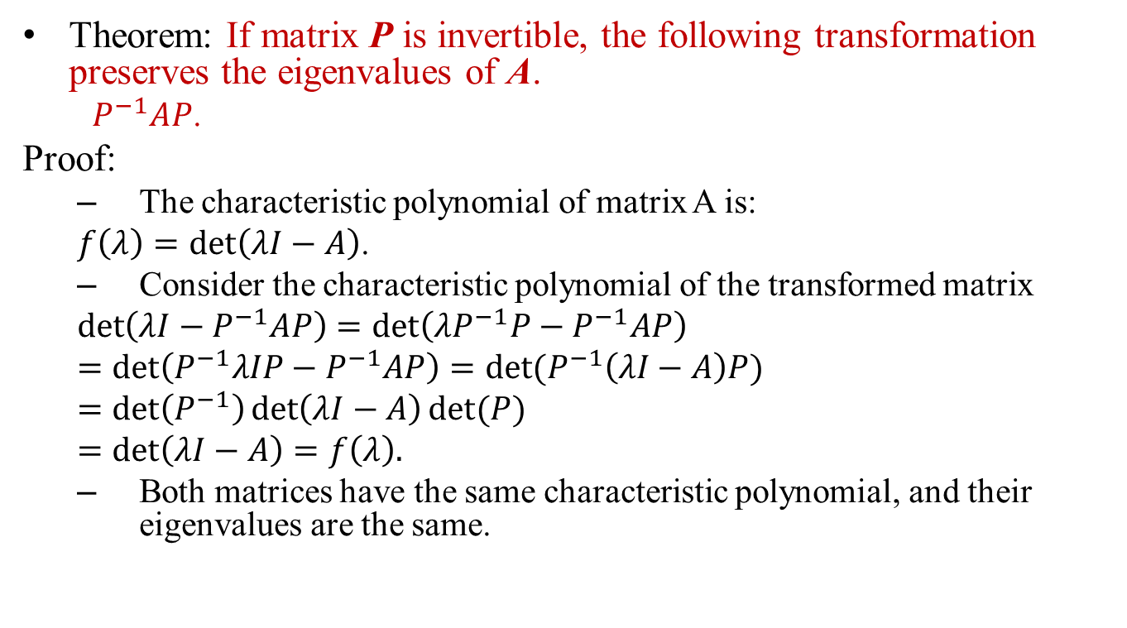
Similarity Transformation
Theorem: If matrix P is invertible, the following transformation preserves the eigenvalues of A.
${ P}^{−1}AP$.
Proof:
The characteristic polynomial of matrix A is:
$f\left(λ\right)=\det\left(λI−A\right)$.
Consider the characteristic polynomial of the transformed matrix
$\det\left(λI−P^{−1}AP\right)=\det\left(λP^{−1}P−P^{−1}AP\right)$
$=\det\left(P^{−1}λIP−P^{−1}AP\right)=det⁡(P^{−1}\left(λI−A\right)P)$
$=\det\left(P^{−1}\right)\det\left(λI−A\right)det⁡(P)$
$=\det\left(λI−A\right)=f\left(λ\right).$
Both matrices have the same characteristic polynomial, and their eigenvalues are the same.

Slide 9
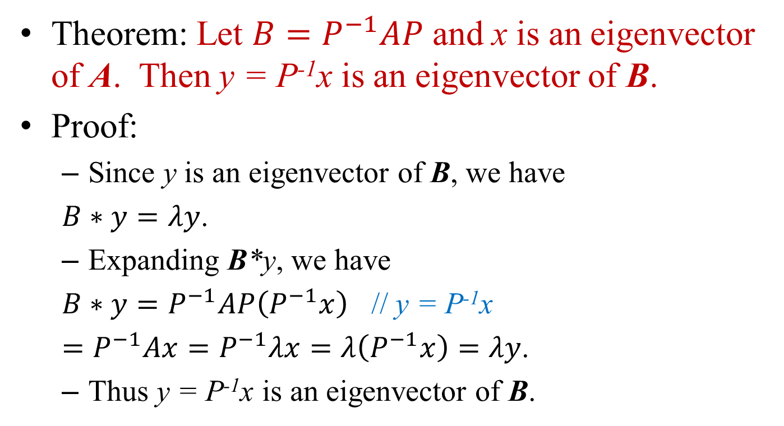
Similarity Transformation
Theorem: Let $B=P^{−1}AP$ and x is an eigenvector of A. Then y = P⁻¹x is an eigenvector of B.
Proof:
Since y is an eigenvector of B, we have
$B∗y=λy$.
Expanding B*y, we have
${B∗y=P}^{−1}AP\left(P^{−1}x\right)$ // y = P⁻¹x
$=P^{−1}Ax=P^{−1}λx=λ\left(P^{−1}x\right)=λy$.
Thus y = P⁻¹x is an eigenvector of B.

Slide 10
Singular Values
Definition: A is a M x N matrix and B = A^{T}A. The singular values of A are the square roots of the eigenvalues of B.
Question: Are singular values and eigenvalues of a square matrix the same?
Answer: No !
If A is symmetric, then yes.

