Slide 1
Power Method
And other related eigenvalue computing methods

Slide 2
Outline
Basic ideas of power method
The power method
The inverse power method
The shifted power method
Rayleigh quotient
Rayleigh quotient iteration method

Slide 3
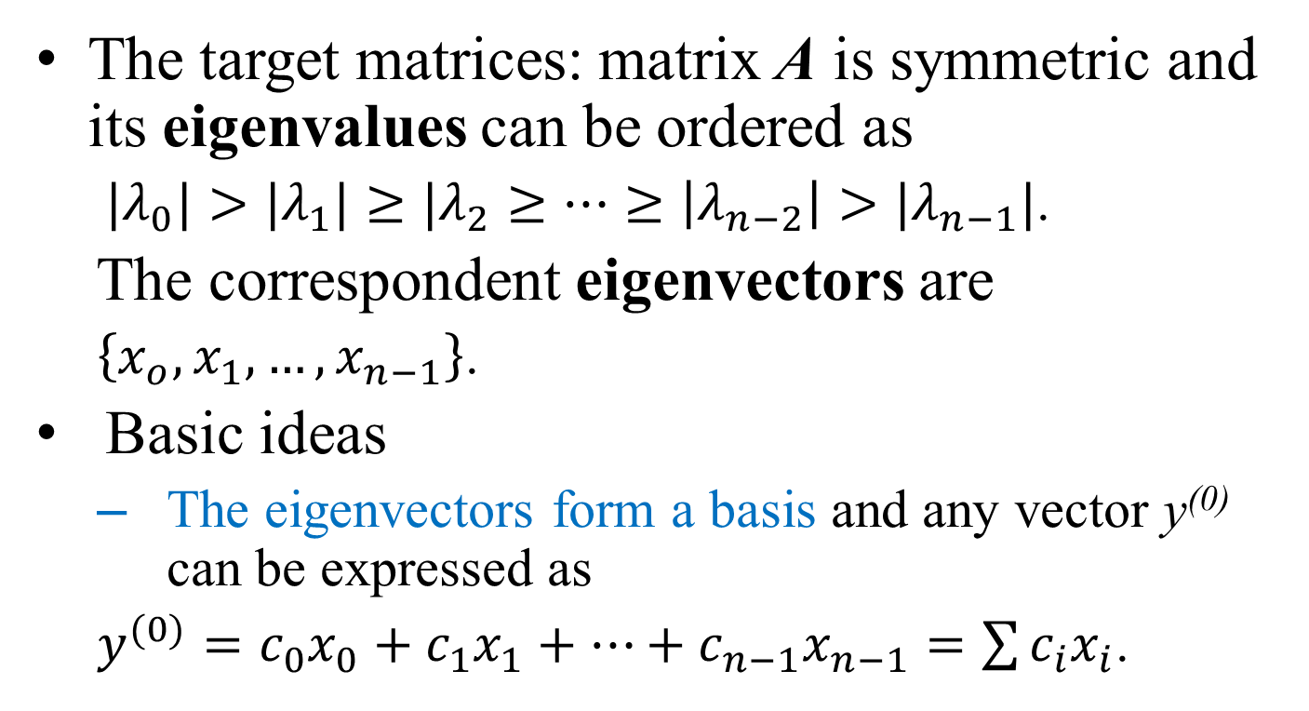
Basic Ideas
The target matrices: matrix A is symmetric and its eigenvalues can be ordered as
  ${|λ}_{0}|>|λ_{1}{|≥|λ}_{2}≥…≥\left|λ_{n−2}\right|>|λ_{n−1}|$.
The correspondent eigenvectors are
  $\left\{x_{o},x_{1},…,x_{n−1}\right\}$.
Basic ideas
  The eigenvectors form a basis and any vector y⁽⁰⁾ can be expressed as
  $y^{(0)}=c_{0}x_{0}+c_{1}x_{1}+…+c_{n−1}x_{n−1}=\sum{c_{i}x_{i}}$.

Slide 4
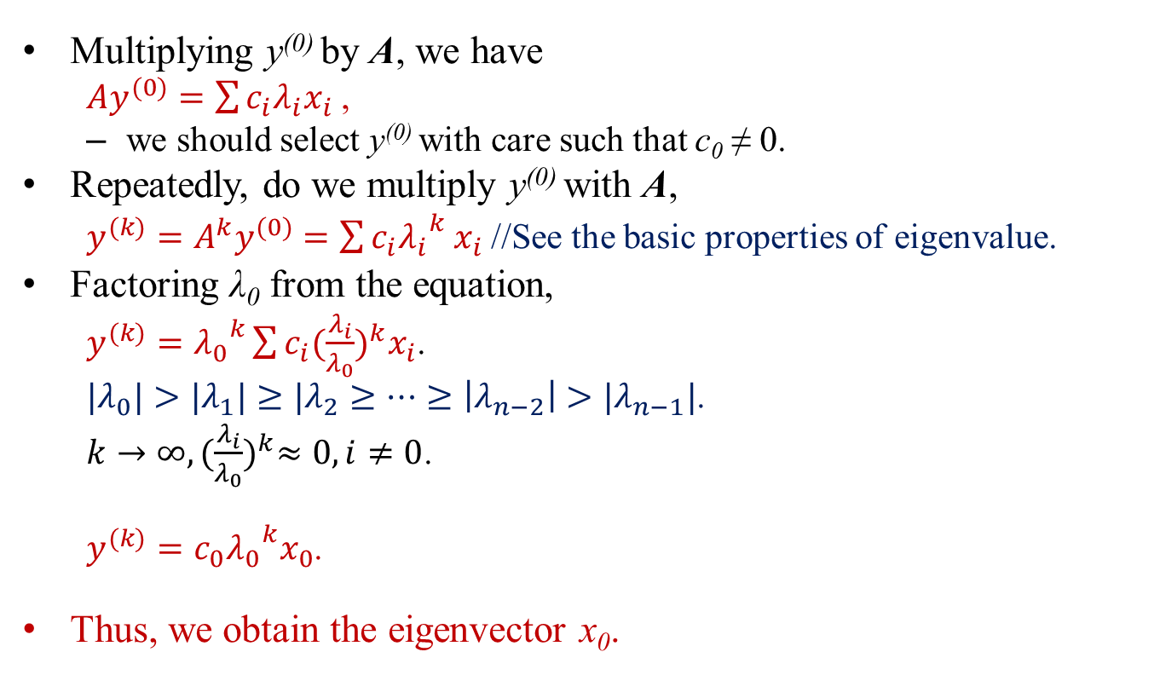
Basic Ideas
Multiplying y⁽⁰⁾ by A, we have
  $Ay^{(0)}=\sum{c_{i}λ_{i}x_{i}}$ ,
  we should select y⁽⁰⁾ with care such that c₀ ≠ 0.
Repeatedly, do we multiply y⁽⁰⁾ with A,
  $y^{(k)}=A^{k}y^{(0)}=\sum{c_{i}{λ_{i}}_{}^{k}x_{i}}$ //See the basic properties of eigenvalue.
Factoring λ₀ from the equation,
  $y^{(k)}={λ_{0}}^{k}\sum{c_{i}{(\frac{λ_{i}}{λ_{0}})}^{k}x_{i}}$.
  ${|λ}_{0}|>|λ_{1}{|≥|λ}_{2}≥…≥\left|λ_{n−2}\right|>|λ_{n−1}|$.
  $k→∞, {(\frac{λ_{i}}{λ_{0}})}^{k}≈0, i≠0$.
  $y^{(k)}={{c_{0}λ}_{0}}^{k}x_{0}$.
Thus, we obtain the eigenvector x₀.

Slide 5
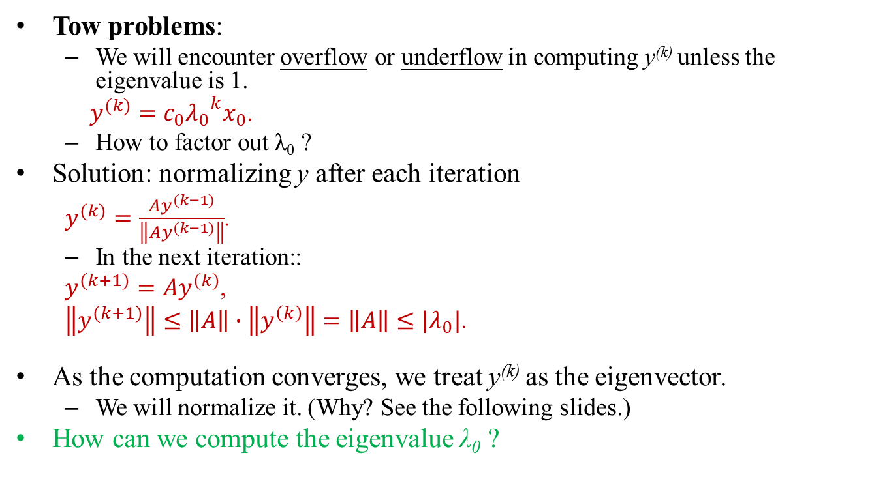
Basic Ideas
Tow problems:
  We will encounter overflow or underflow in computing y^{(k)} unless the eigenvalue is 1.
  $y^{(k)}={{c_{0}λ}_{0}}^{k}x_{0}$.
  How to factor out λ₀ ?
Solution: normalizing y after each iteration
  $y^{(k)}=\frac{Ay^{(k−1)}}{\left\|Ay^{(k−1)}\right\|}$.
  In the next iteration::
  $y^{(k+1)}=Ay^{(k)}$,
  $\left\|y^{(k+1)}\right\|≤\left\|A\right\|∙\left\|y^{\left(k\right)}\right\|=\left\|A\right\|≤|λ_{0}|$.
As the computation converges, we treat y^{(k)} as the eigenvector.
  We will normalize it. (Why? See the following slides.)
How can we compute the eigenvalue λ₀ ?

Slide 6
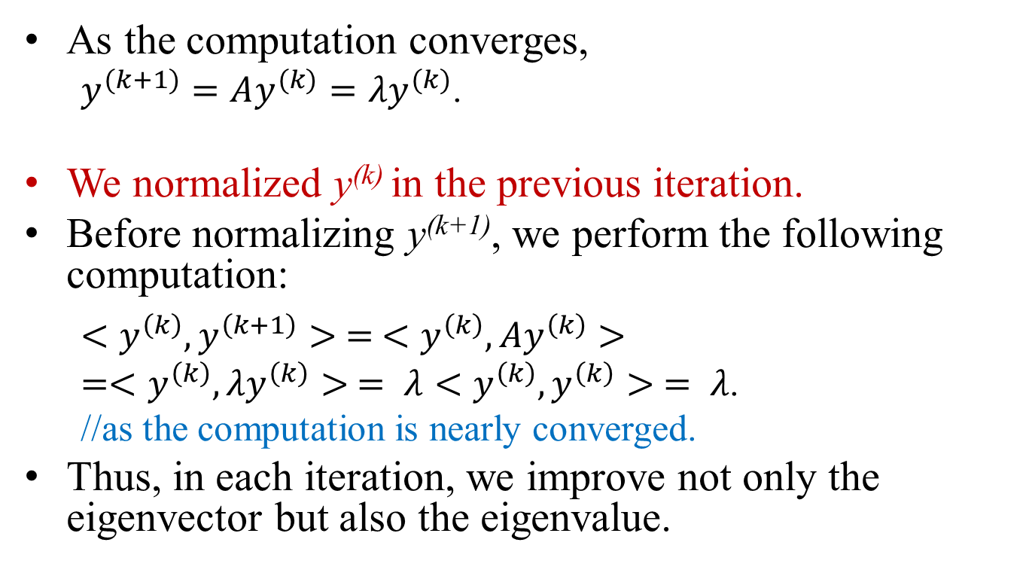
Basic Ideas
As the computation converges,
  $y^{(k+1)}=Ay^{(k)}=λy^{(k)}$.
We normalized y^{(k)} in the previous iteration.
Before normalizing y^{(k+1)}, we perform the following computation:
  $<y^{\left(k\right)},y^{\left(k+1\right)}> = <y^{\left(k\right)},{Ay}^{\left(k\right)}>$
  $=<y^{\left(k\right)},{λy}^{\left(k\right)}> = λ<y^{\left(k\right)},y^{\left(k\right)}> = λ$.
  //as the computation is nearly converged.
Thus, in each iteration, we improve not only the eigenvector but also the eigenvalue.

Slide 7
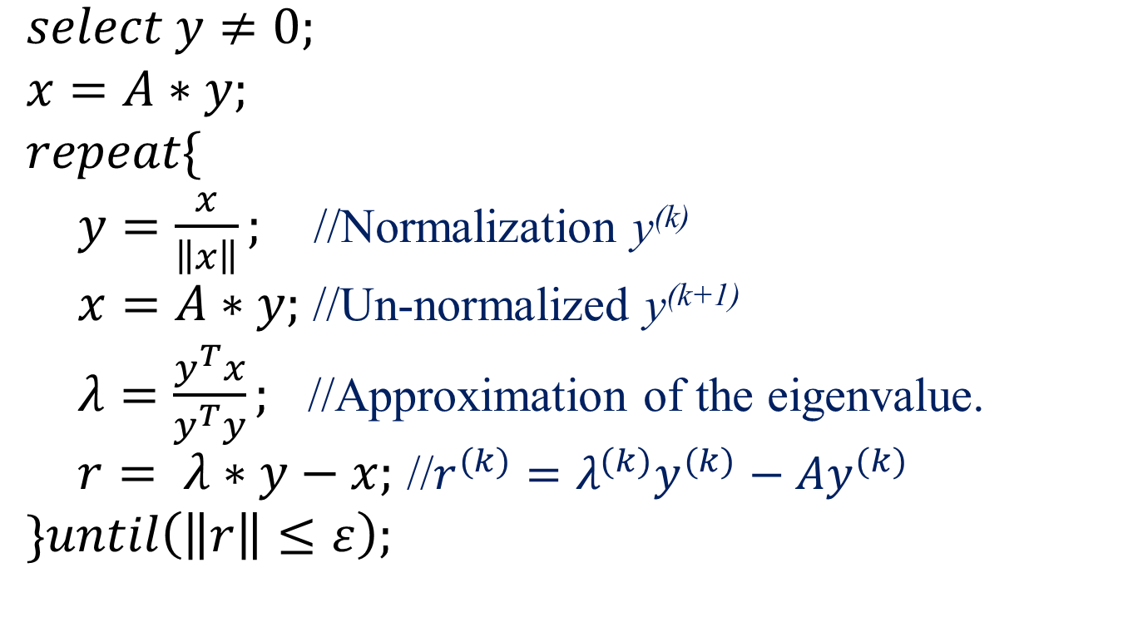
The Power Method
$select y≠0;$
$x=A∗y;$
$repeat\{$
$y=\frac{x}{\left\|x\right\|};$ //Normalization y^{(k)}
$x=A∗y;$ //Un-normalized y^{(k+1)}
$λ=\frac{y^{T}x}{y^{T}y};$ //Approximation of the eigenvalue.
$r= λ∗y−x;$ //$r^{(k)}=λ^{(k)}y^{(k)}−{Ay}^{(k)}$
$\}until\left(\left\|r\right\|≤ε\right);$

Slide 8
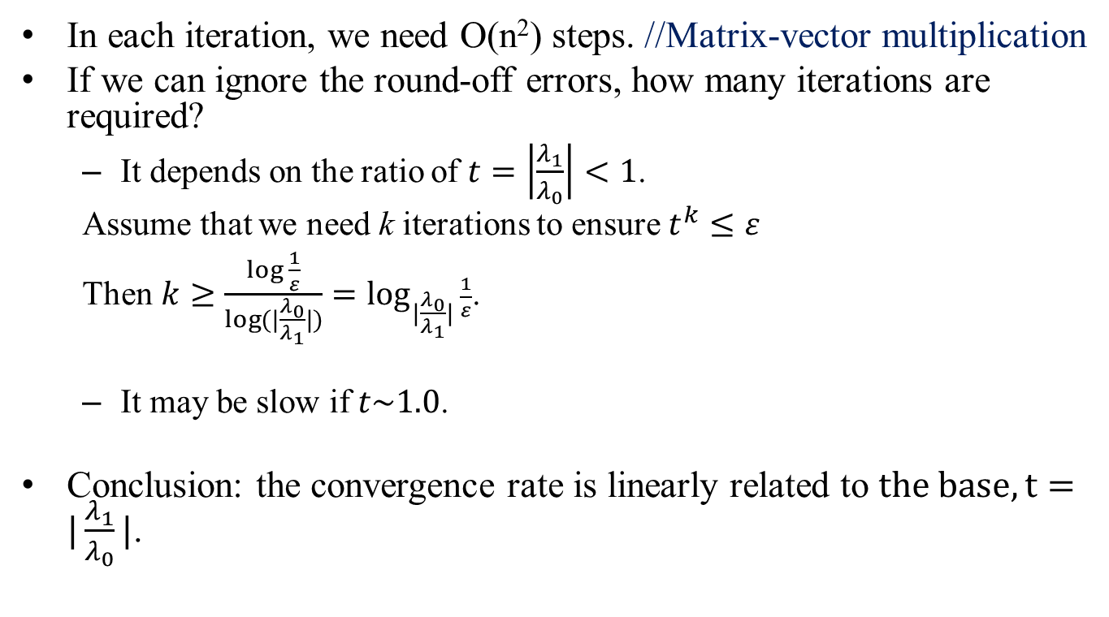
Time Complexity
In each iteration, we need O(n²) steps. //Matrix-vector multiplication
If we can ignore the round-off errors, how many iterations are required?
  It depends on the ratio of $t=\left|\frac{λ_{1}}{λ_{0}}\right|<1$.
  Assume that we need k iterations to ensure $t^{k}≤ε$
  Then$k≥\frac{\log{\frac{1}{ε}}}{\log{(|\frac{λ_{0}}{λ_{1}}|)}}=\log_{|\frac{λ_{0}}{λ_{1}}|}{\frac{1}{ε}}$.
  It may be slow if $t\sim 1.0$.
Conclusion: the convergence rate is linearly related to $the base, t=|\frac{λ_{1}}{λ_{0}}|$.

Slide 9
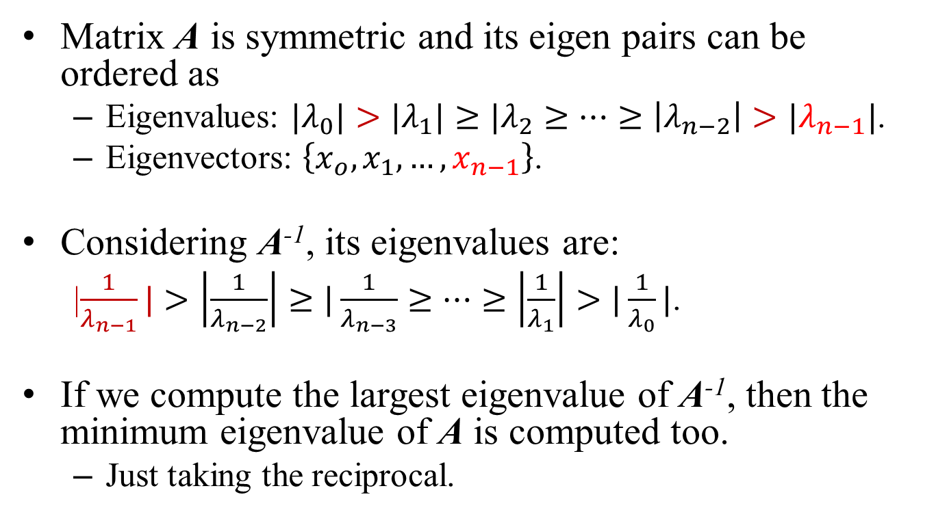
Inverse Power Method
Matrix A is symmetric and its eigen pairs can be ordered as
  Eigenvalues: ${|λ}_{0}|>|λ_{1}{|≥|λ}_{2}≥…≥\left|λ_{n−2}\right|>|λ_{n−1}|$.
  Eigenvectors: $\left\{x_{o},x_{1},…,x_{n−1}\right\}$.
Considering A⁻¹, its eigenvalues are:
  |$\frac{1}{λ_{n−1}}|>\left|\frac{1}{λ_{n−2}}\right|≥|\frac{1}{λ_{n−3}}≥…≥\left|\frac{1}{λ_{1}}\right|>|\frac{1}{λ_{0}}|$.
If we compute the largest eigenvalue of A⁻¹, then the minimum eigenvalue of A is computed too.
  Just taking the reciprocal.

Slide 10
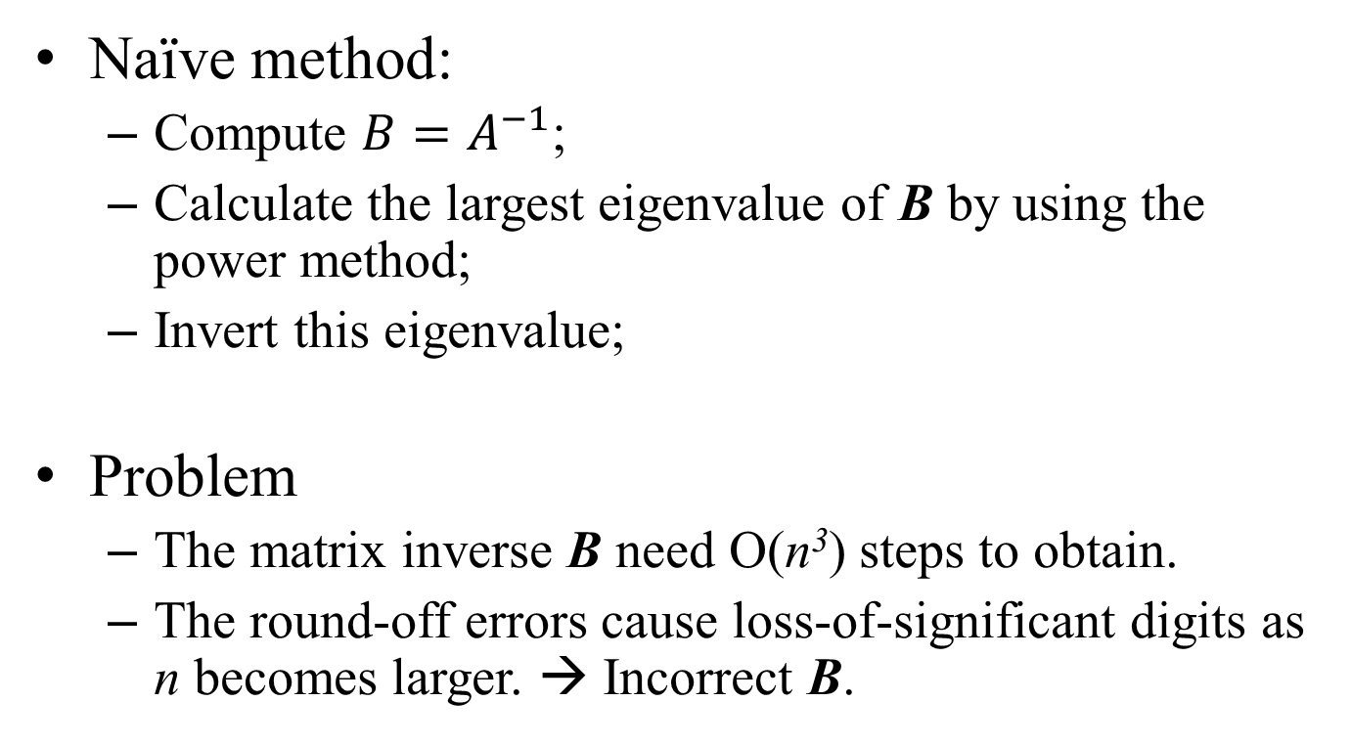
Basic Algorithm
Naïve method:
  Compute ${B=A}^{−1}$;
  Calculate the largest eigenvalue of B by using the power method;
  Invert this eigenvalue;
Problem
  The matrix inverse B need O(n³) steps to obtain.
  The round-off errors cause loss-of-significant digits as n becomes larger. → Incorrect B.

Slide 11
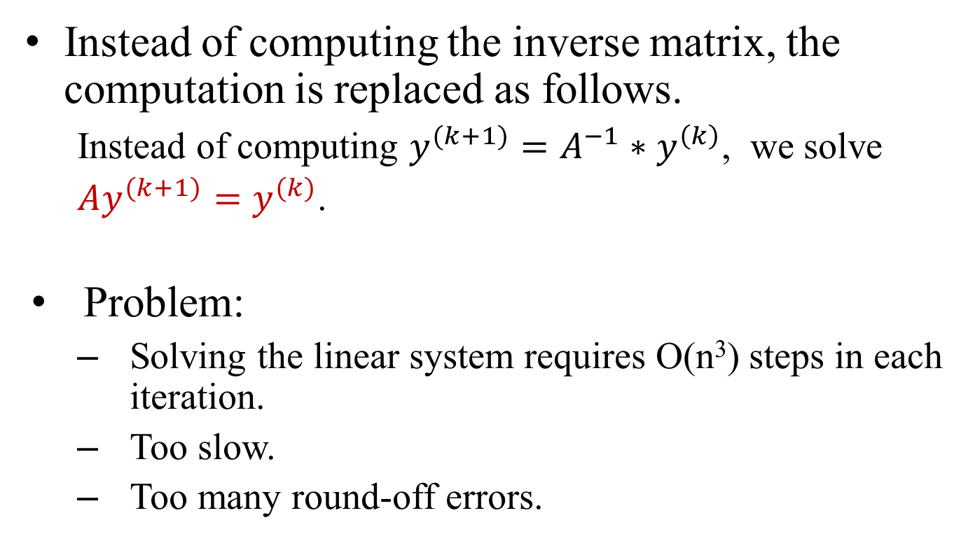
Improvement (1)
Instead of computing the inverse matrix, the computation is replaced as follows.
  Instead of computing $y^{(k+1)}=A^{−1}∗y^{\left(k\right)}$, we solve
  $Ay^{(k+1)}=y^{(k)}$.
Problem:
  Solving the linear system requires O(n³) steps in each iteration.
  Too slow.
  Too many round-off errors.

Slide 12
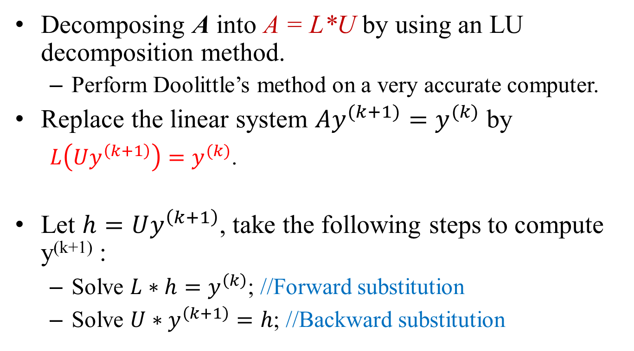
Improvement (2)
Decomposing A into A = L*U by using an LU decomposition method.
  Perform Doolittle’s method on a very accurate computer.
Replace the linear system $Ay^{(k+1)}=y^{(k)}$ by
  $L\left(Uy^{\left(k+1\right)}\right)=y^{(k)}$.
Let $h=Uy^{\left(k+1\right)}$, take the following steps to compute y^{(k+1)} :
  Solve $L∗h=y^{\left(k\right)}$; //Forward substitution
  Solve $U∗y^{\left(k+1\right)}=h$; //Backward substitution

Slide 13
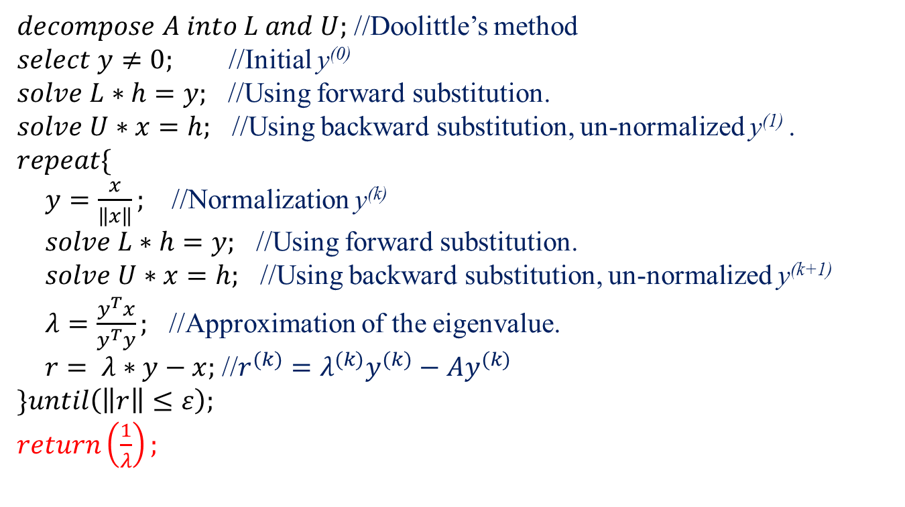
The Inverse Power Method
$decompose A into L and U;$ //Doolittle’s method
$select y≠0;$ //Initial y⁽⁰⁾
$solve L∗h=y;$ //Using forward substitution.
$solve U∗x=h;$ //Using backward substitution, un-normalized y⁽¹⁾ .
$repeat\{$
$y=\frac{x}{\left\|x\right\|};$ //Normalization y^{(k)}
$solve L∗h=y;$ //Using forward substitution.
$solve U∗x=h;$ //Using backward substitution, un-normalized y^{(k+1)}
$λ=\frac{y^{T}x}{y^{T}y};$ //Approximation of the eigenvalue.
$r= λ∗y−x;$ //$r^{(k)}=λ^{(k)}y^{(k)}−{Ay}^{(k)}$
$\}until\left(\left\|r\right\|≤ε\right);$
$return\left(\frac{1}{λ}\right);$

Slide 14
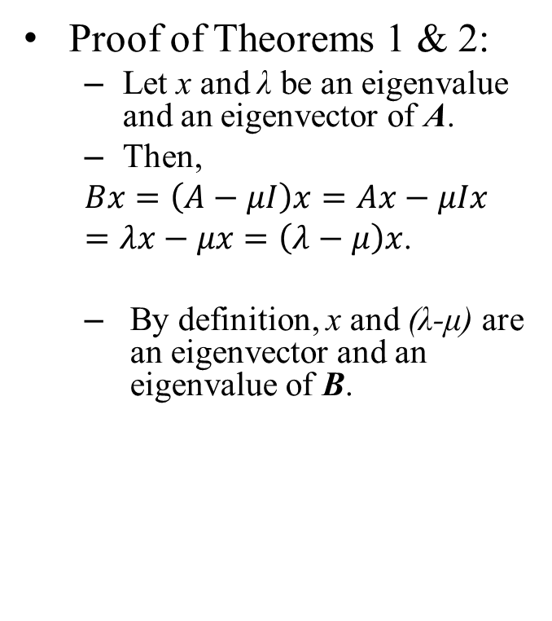
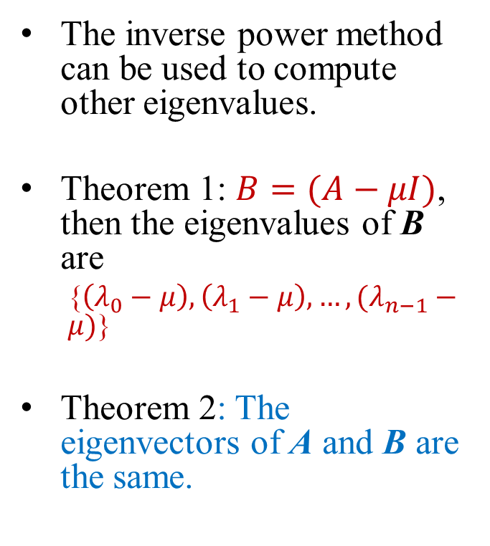
Shift Inverse Power Method
The inverse power method can be used to compute other eigenvalues.
Theorem 1: $B=(A−μI)$, then the eigenvalues of B are
  {$\left(λ_{0}−μ\right),\left(λ_{1}−μ\right),…,(λ_{n−1}−μ)$}
Theorem 2: The eigenvectors of A and B are the same.
Proof of Theorems 1 & 2:
  Let x and λ be an eigenvalue and an eigenvector of A.
  Then,
  $$Bx=\left(A−μI\right)x=Ax−μIx$$
  $=λx−μx=\left(λ−μ\right)x$.
  By definition, x and (λ-μ) are an eigenvector and an eigenvalue of B.

Slide 15
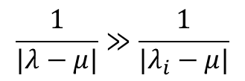
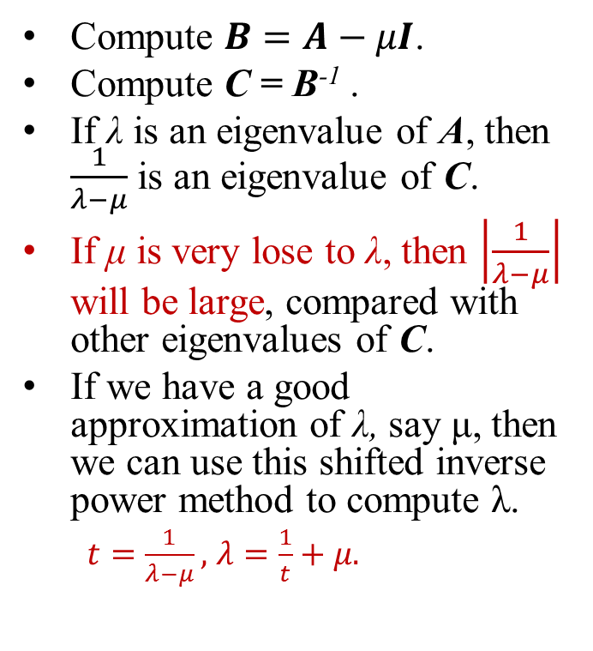
Shift Inverse Power Method
Compute $B=A−μI$.
Compute C = B⁻¹ .
If λ is an eigenvalue of A, then $\frac{1}{λ−μ}$ is an eigenvalue of C.
If μ is very lose to λ, then $\left|\frac{1}{λ−μ}\right|$ will be large, compared with other eigenvalues of C.
If we have a good approximation of λ, say μ, then we can use this shifted inverse power method to compute λ.
  $t=\frac{1}{λ−μ},$ $λ=\frac{1}{t}+μ.$
Principle of the shift inverse power method
μ
λ_{i}
λ
$$\frac{1}{|λ−μ|}≫\frac{1}{|λ_{i}−μ|}$$

Slide 16
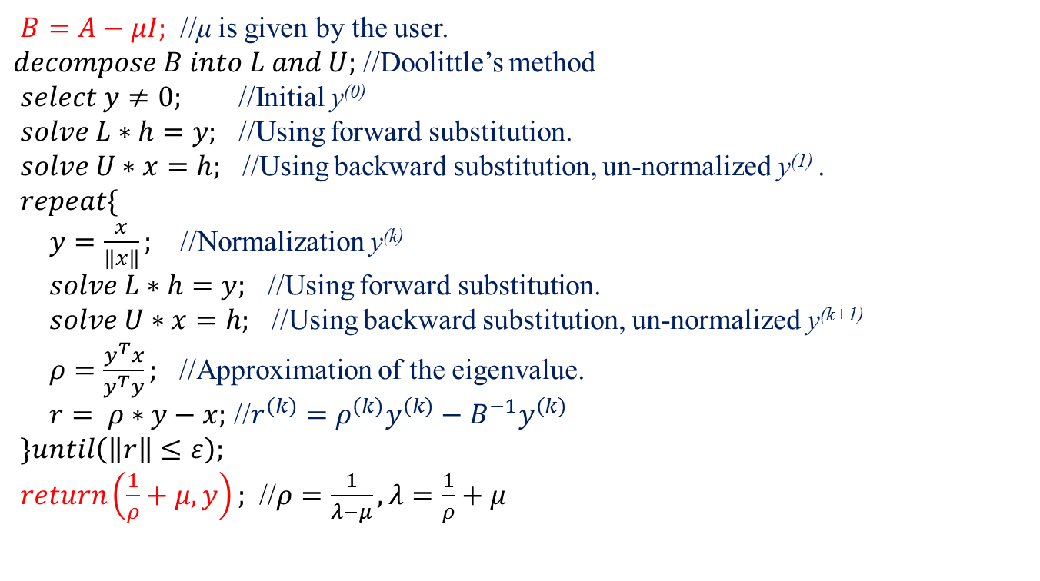
Shift Inverse Power Method
$B=A−μI;$ //μ is given by the user.
$decompose B into L and U;$ //Doolittle’s method
$select y≠0;$ //Initial y⁽⁰⁾
$solve L∗h=y;$ //Using forward substitution.
$solve U∗x=h;$ //Using backward substitution, un-normalized y⁽¹⁾ .
$repeat\{$
$y=\frac{x}{\left\|x\right\|};$ //Normalization y^{(k)}
$solve L∗h=y;$ //Using forward substitution.
$solve U∗x=h;$ //Using backward substitution, un-normalized y^{(k+1)}
$ρ=\frac{y^{T}x}{y^{T}y};$ //Approximation of the eigenvalue.
$r= ρ∗y−x;$ //$r^{(k)}=ρ^{(k)}y^{(k)}−{B^{−1}y}^{(k)}$
$\}until\left(\left\|r\right\|≤ε\right);$
$return\left(\frac{1}{ρ}+μ, y\right);$ //$ρ=\frac{1}{λ−μ}, λ=\frac{1}{ρ}+μ$

Slide 17
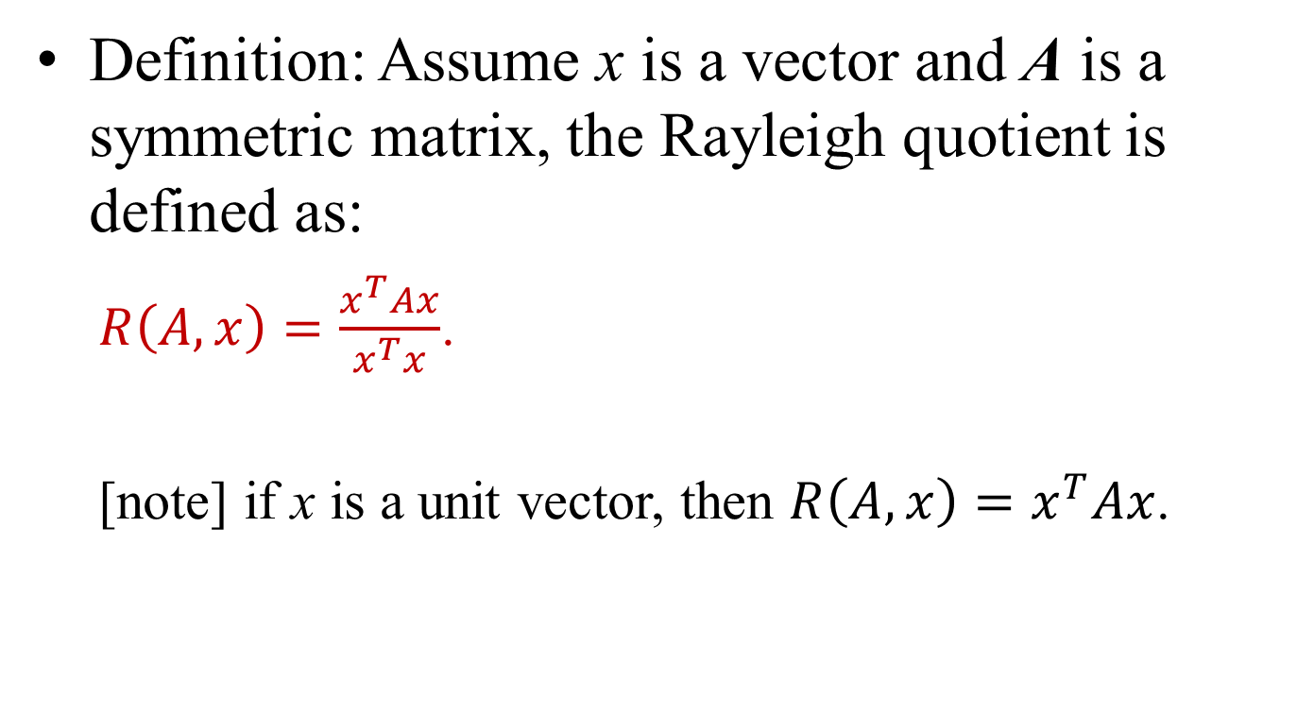
Rayleigh Quotient
Definition: Assume x is a vector and A is a symmetric matrix, the Rayleigh quotient is defined as:
  $R\left(A, x\right)=\frac{x^{T}Ax}{x^{T}x}$.
  [note] if x is a unit vector, then $R\left(A,x\right)=x^{T}Ax$.

Slide 18
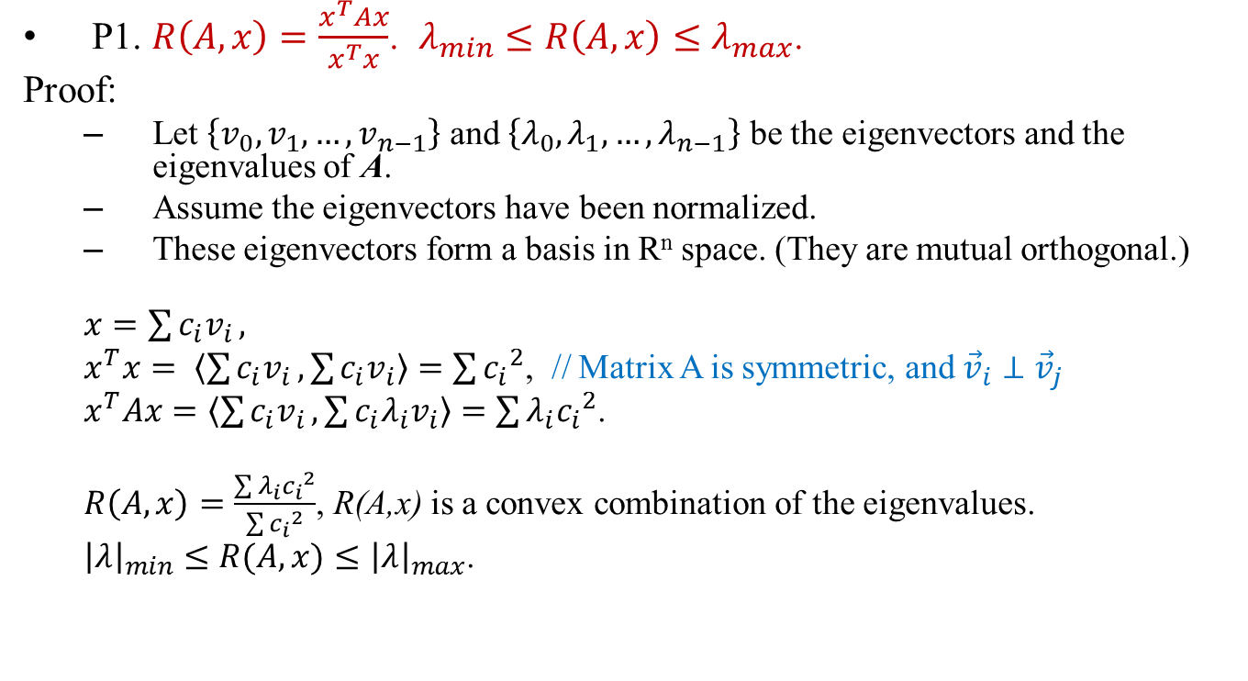
Rayleigh Quotient
P1. $R\left(A, x\right)=\frac{x^{T}Ax}{x^{T}x}$. $λ_{min}≤R\left(A,x\right)≤λ_{max}$.
Proof:
  Let $\left\{v_{0},v_{1},…,v_{n−1}\right\}$ and $\left\{λ_{0},λ_{1},…,λ_{n−1}\right\}$ be the eigenvectors and the eigenvalues of A.
  Assume the eigenvectors have been normalized.
  These eigenvectors form a basis in R^{n} space. (They are mutual orthogonal.)
  $x=\sum{c_{i}v_{i}},$
  $x^{T}x= \left\langle \sum{c_{i}v_{i}},\sum{c_{i}v_{i}}\right\rangle =\sum{{c_{i}}^{2}}$, // Matrix A is symmetric, and ${\vec{v}}_{i}⊥{\vec{v}}_{j}$
  $x^{T}Ax=\left\langle \sum{c_{i}v_{i}},\sum{c_{i}{λ_{i}v}_{i}}\right\rangle =\sum{λ_{i}{c_{i}}^{2}}$.
  $R\left(A,x\right)=\frac{\sum{λ_{i}{c_{i}}^{2}}}{\sum{{c_{i}}^{2}}}$, R(A,x) is a convex combination of the eigenvalues.
  ${\left|λ\right|}_{min}{≤R(A,x)≤\left|λ\right|}_{max}$.

Slide 19
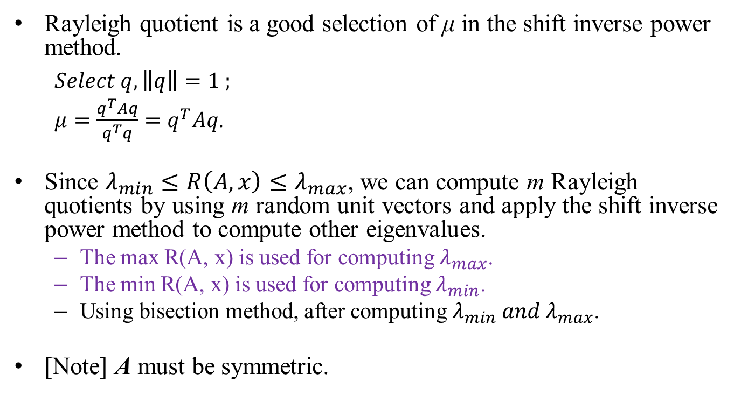
Usage of Rayleigh Quotient
Rayleigh quotient is a good selection of μ in the shift inverse power method.
  $Select q, \left\|q\right\|=1 ;$
  $μ=\frac{q^{T}Aq}{q^{T}q}=q^{T}Aq$.
Since $λ_{min}≤R\left(A,x\right)≤λ_{max}$, we can compute m Rayleigh quotients by using m random unit vectors and apply the shift inverse power method to compute other eigenvalues.
  The max R(A, x) is used for computing $λ_{max}$.
  The min R(A, x) is used for computing $λ_{min}$.
  Using bisection method, after computing $λ_{min} and λ_{max}$.
[Note] A must be symmetric.

Slide 20

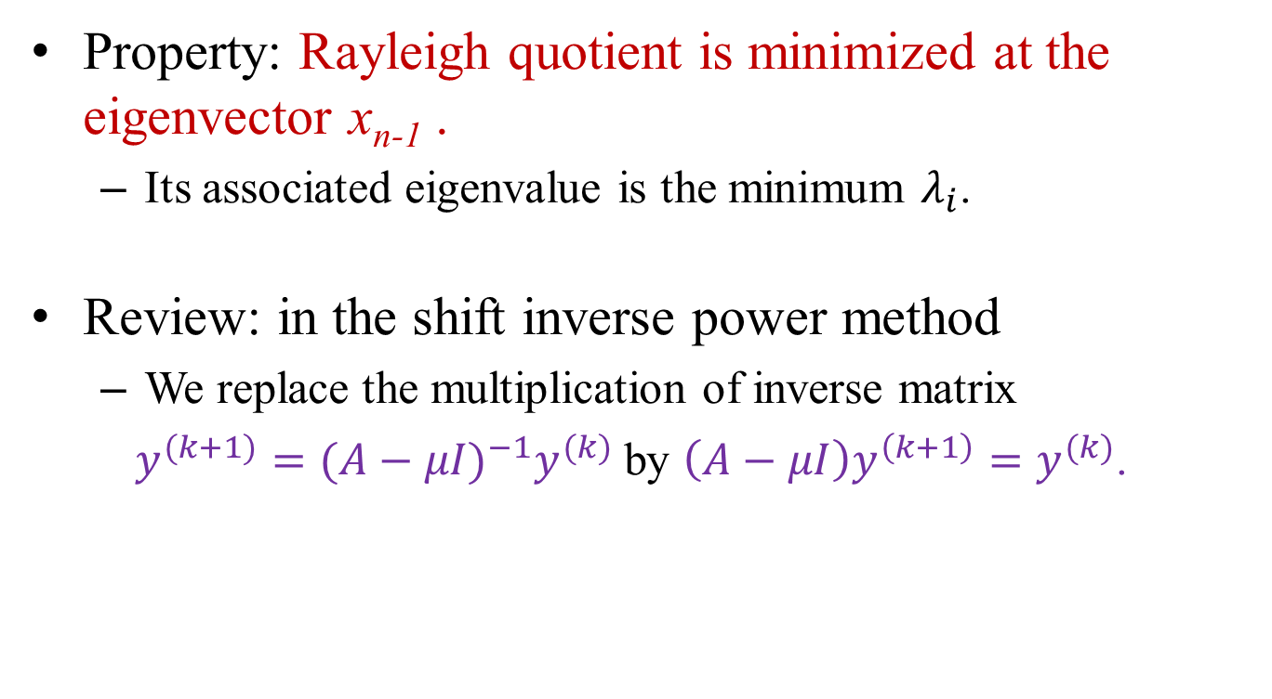
Rayleigh Quotient Iteration
Property: Rayleigh quotient is minimized at the eigenvector x_{n-1} .
  Its associated eigenvalue is the minimum $λ_{i}$.
Review: in the shift inverse power method
  We replace the multiplication of inverse matrix
  $y^{(k+1)}={(A−μI)}^{−1}y^{(k)}$by $\left(A−μI\right)y^{\left(k+1\right)}=y^{(k)}$.
  $Select q, \left\|q\right\|=1 ;$
  $μ=\frac{q^{T}Aq}{q^{T}q}=q^{T}Aq$.

Slide 21

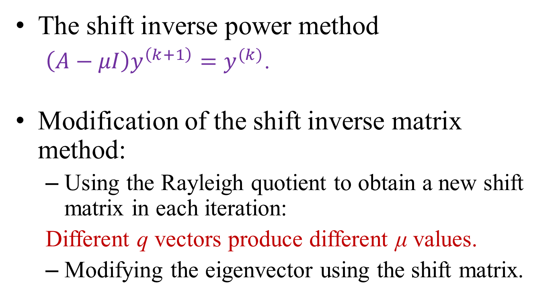
Rayleigh Quotient Iteration
The shift inverse power method
  $\left(A−μI\right)y^{\left(k+1\right)}=y^{(k)}$.
Modification of the shift inverse matrix method:
  Using the Rayleigh quotient to obtain a new shift matrix in each iteration:
  Different q vectors produce different μ values.
  Modifying the eigenvector using the shift matrix.
  $Select q, \left\|q\right\|=1 ;$
  $μ=\frac{q^{T}Aq}{q^{T}q}=q^{T}Aq$.

Slide 22
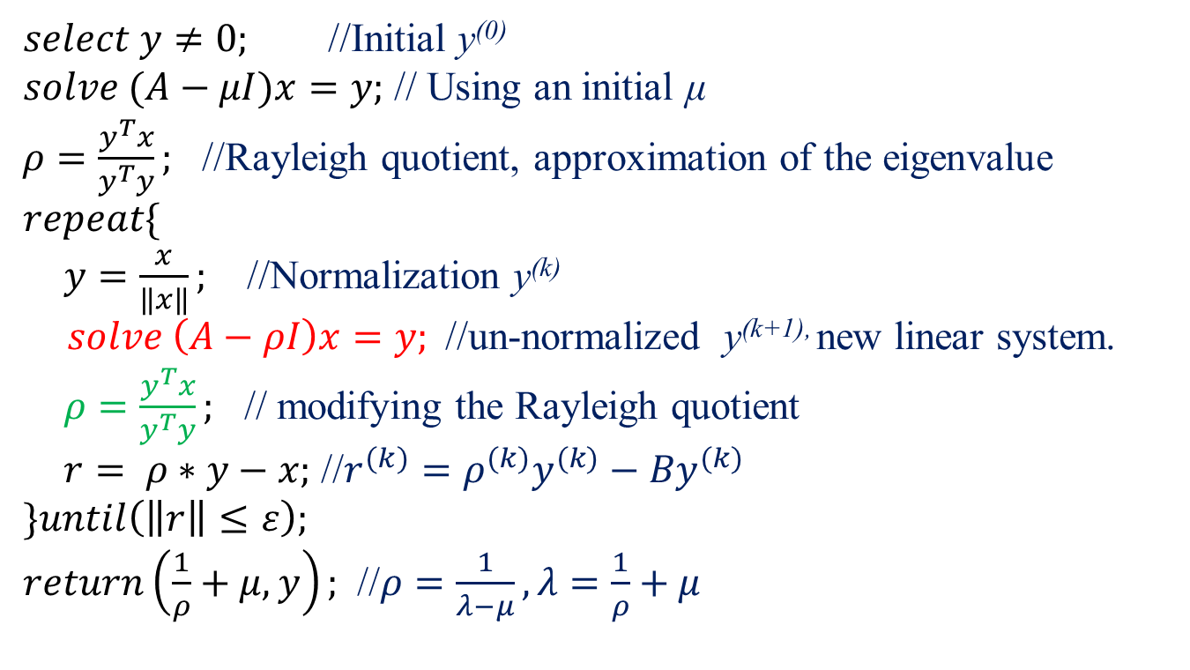
Rayleigh Quotient Iteration
$select y≠0;$ //Initial y⁽⁰⁾
$solve (A−μI)x=y;$ // Using an initial μ
$ρ=\frac{y^{T}x}{y^{T}y};$ //Rayleigh quotient, approximation of the eigenvalue
$repeat\{$
$y=\frac{x}{\left\|x\right\|};$ //Normalization y^{(k)}
$solve \left(A−ρI\right)x=y;$ //un-normalized y^{(k+1),} new linear system.
$ρ=\frac{y^{T}x}{y^{T}y};$ // modifying the Rayleigh quotient
$r= ρ∗y−x;$ //$r^{(k)}=ρ^{(k)}y^{(k)}−{By}^{(k)}$
$\}until\left(\left\|r\right\|≤ε\right);$
$return\left(\frac{1}{ρ}+μ, y\right);$ //$ρ=\frac{1}{λ−μ}, λ=\frac{1}{ρ}+μ$

Slide 23
Comparison: Shift Inverse Power Method
$B=A−μI;$ //μ is given by the user.
$decompose B into L and U;$ //Doolittle’s method
$select y≠0;$ //Initial y⁽⁰⁾
$solve L∗h=y;$ //Using forward substitution.
$solve U∗x=h;$ //Using backward substitution, un-normalized y⁽¹⁾ .
$repeat\{$
$y=\frac{x}{\left\|x\right\|};$ //Normalization y^{(k)}
$solve L∗h=y;$ //Using forward substitution.
$solve U∗x=h;$ //Using backward substitution, un-normalized y^{(k+1)}
$ρ=\frac{y^{T}x}{y^{T}y};$ //Approximation of the eigenvalue.
$r= ρ∗y−x;$ //$r^{(k)}=ρ^{(k)}y^{(k)}−{B^{−1}y}^{(k)}$
$\}until\left(\left\|r\right\|≤ε\right);$
$return\left(\frac{1}{ρ}+μ, y\right);$ //$ρ=\frac{1}{λ−μ}, λ=\frac{1}{ρ}+μ$

Slide 24
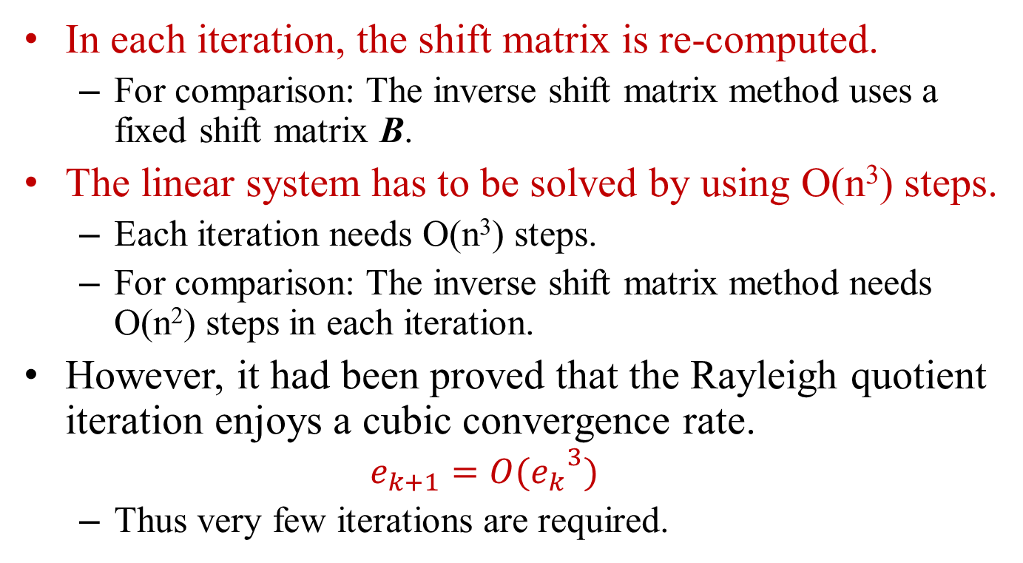
Discussion
In each iteration, the shift matrix is re-computed.
  For comparison: The inverse shift matrix method uses a fixed shift matrix B.
The linear system has to be solved by using O(n³) steps.
  Each iteration needs O(n³) steps.
  For comparison: The inverse shift matrix method needs O(n²) steps in each iteration.
However, it had been proved that the Rayleigh quotient iteration enjoys a cubic convergence rate.
  $$e_{k+1}={O(e_{k}}^{3})$$
  Thus very few iterations are required.

Slide 25
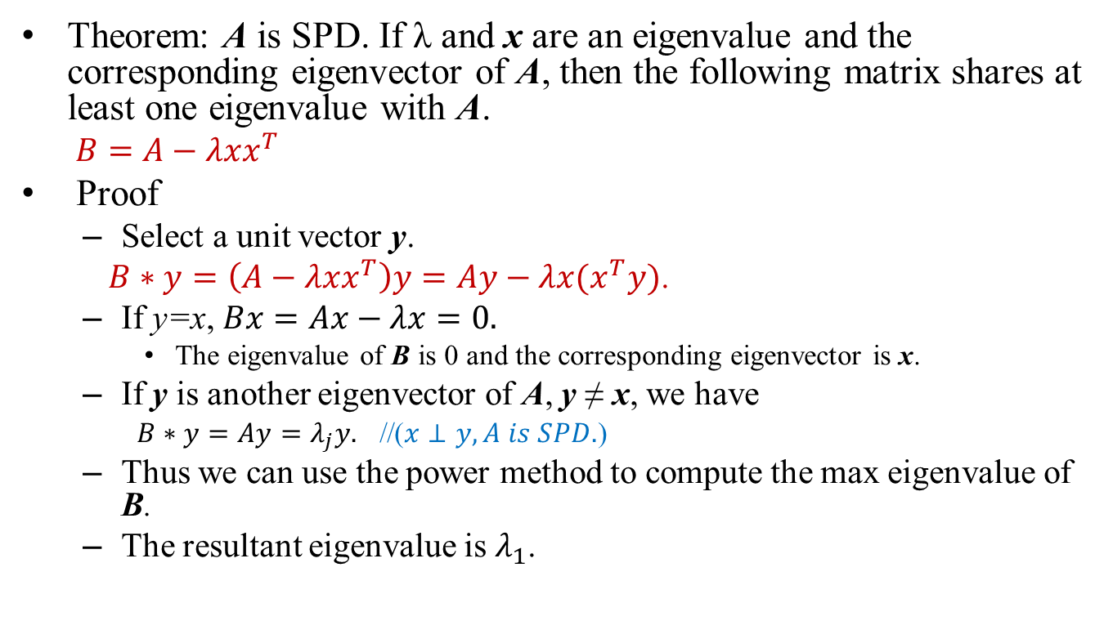
Deflection Method
Theorem: A is SPD. If λ and x are an eigenvalue and the corresponding eigenvector of A, then the following matrix shares at least one eigenvalue with A.
  $B=A−λxx^{T}$
Proof
  Select a unit vector y.
  $B∗y=\left(A−λxx^{T}\right)y=Ay−λx(x^{T}y)$.
  If y=x, $Bx=Ax−λx=0.$
    The eigenvalue of B is 0 and the corresponding eigenvector is x.
  If y is another eigenvector of A, y ≠ x, we have
    $B∗y=Ay=λ_{j}y.$ //($x⊥y, A is SPD.$)
  Thus we can use the power method to compute the max eigenvalue of B.
  The resultant eigenvalue is $λ_{1}$.

Slide 26
Conclusion
The power method computes the max eigenvalue.
The inverse power method computes the min eigenvalue.
The shift matrix method computes arbitrary eigenvalues.
The Rayleigh quotient shows the range of the eigenvalues.
The shift inverse matrix method speeds-up the shift matrix method.
The Rayleigh quotient iteration needs higher time complexity to complete an iteration.
  But, it needs less iterations.

Slide 27
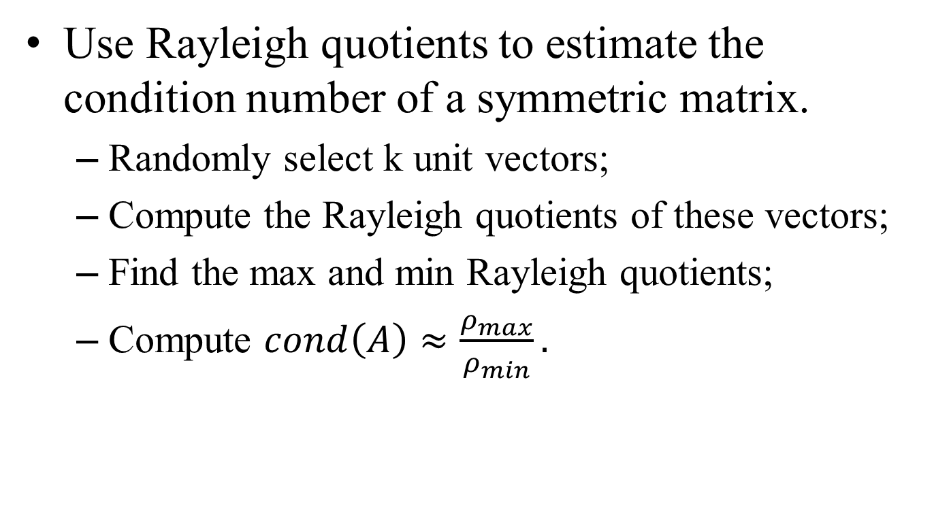
Take Home Exercise
Use Rayleigh quotients to estimate the condition number of a symmetric matrix.
  Randomly select k unit vectors;
  Compute the Rayleigh quotients of these vectors;
  Find the max and min Rayleigh quotients;
  Compute $cond\left(A\right)≈\frac{ρ_{max}}{ρ_{min}}.$

