Slide 1
Jacobi Method
Iterative Method for Computing Eigenvalues and Eigenvectors

Slide 2
Outline
Similarity transformation & diagonalization
Given’s rotation matrix
Overview of Jacobi method
Naïve algorithm
Improvement
Revised algorithm
Convergence analysis

Slide 3
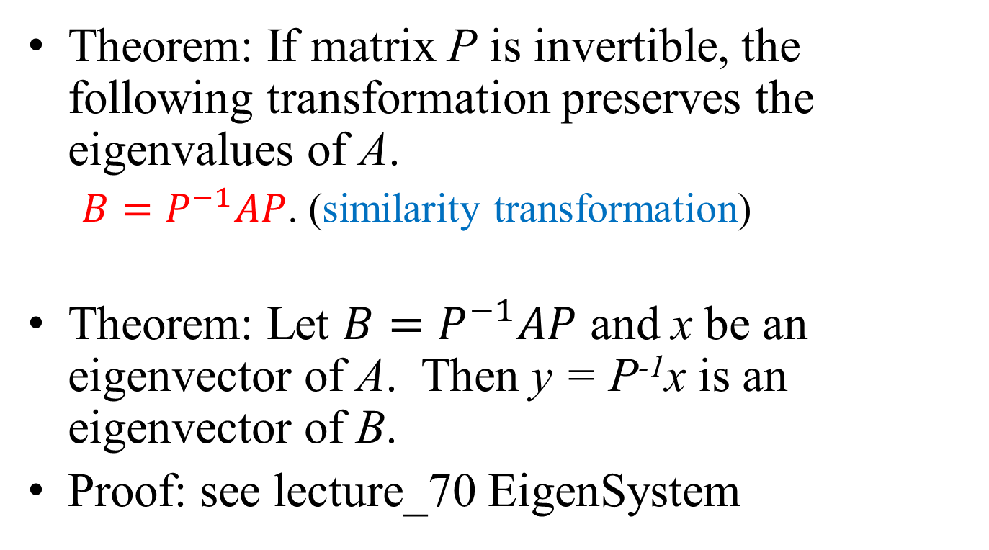
Review: Similarity Transformation
Theorem: If matrix P is invertible, the following transformation preserves the eigenvalues of A.
${B=P}^{−1}AP$. (similarity transformation)
Theorem: Let $B=P^{−1}AP$ and x be an eigenvector of A. Then y = P⁻¹x is an eigenvector of B.
Proof: see lecture_70 EigenSystem

Slide 4
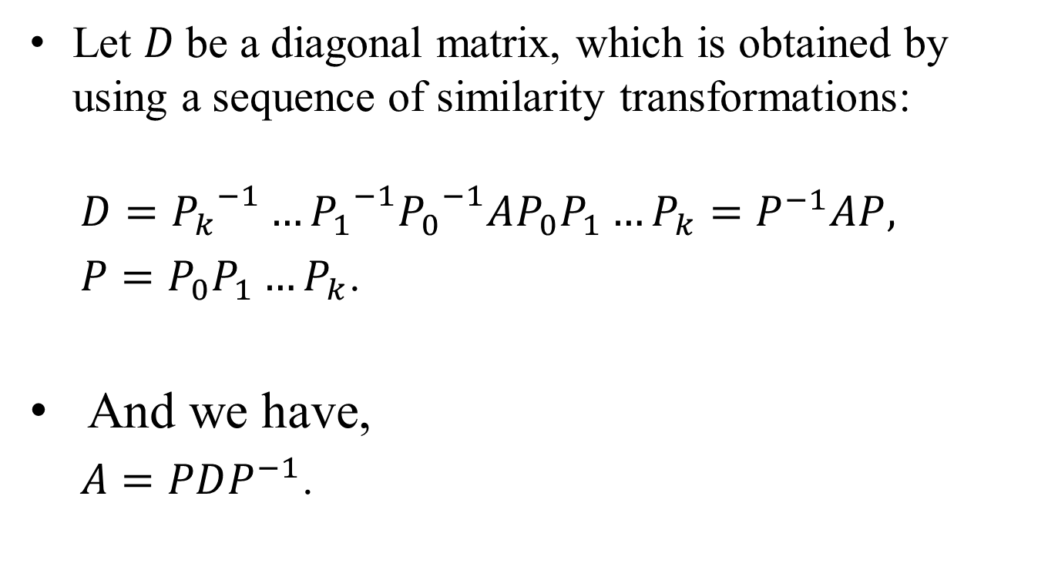
Diagonalization by Similarity Transformations
Let $D$be a diagonal matrix, which is obtained by using a sequence of similarity transformations:
$D={P_{k}}^{−1}…{P_{1}}^{−1}{P_{0}}^{−1}AP_{0}P_{1}…P_{k}=P^{−1}AP,$
$P=P_{0}P_{1}…P_{k}$.
And we have,
$A=PDP^{−1}$.

Slide 5
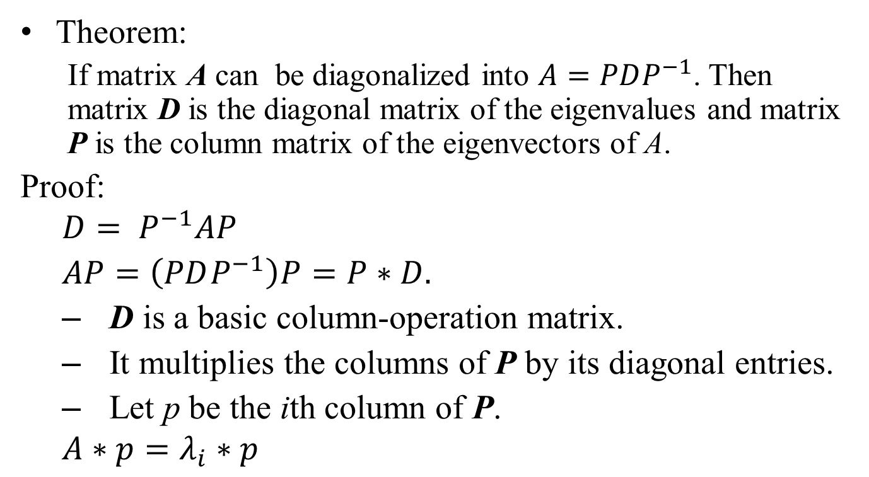
Review: Diagonalization
Theorem:
If matrix A can be diagonalized into $A=PDP^{−1}$. Then matrix D is the diagonal matrix of the eigenvalues and matrix P is the column matrix of the eigenvectors of A.
Proof:
$$D= P^{−1}AP$$
$AP=\left(PDP^{−1}\right)P=P∗D.$
D is a basic column-operation matrix.
It multiplies the columns of P by its diagonal entries.
Let p be the ith column of P.
$$A∗p=λ_{i}∗p$$

Slide 6
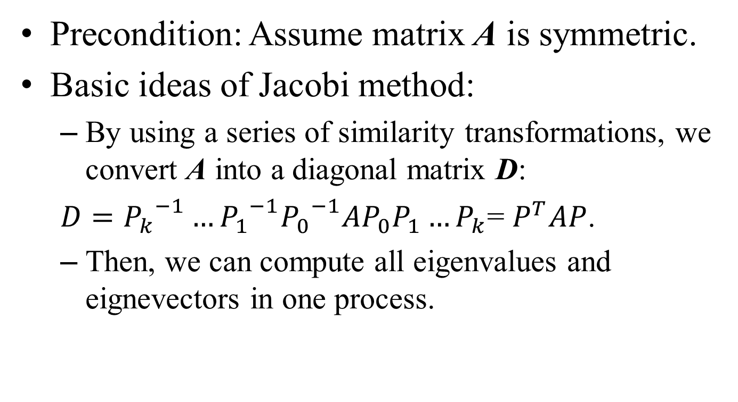
Basic Ideas of Jacobi Method
Precondition: Assume matrix A is symmetric.
Basic ideas of Jacobi method:
By using a series of similarity transformations, we convert A into a diagonal matrix D:
$D={P_{k}}^{−1}…{P_{1}}^{−1}{P_{0}}^{−1}AP_{0}P_{1}…P_{k}$= $P^{T}AP$.
Then, we can compute all eigenvalues and eignevectors in one process.

Slide 7
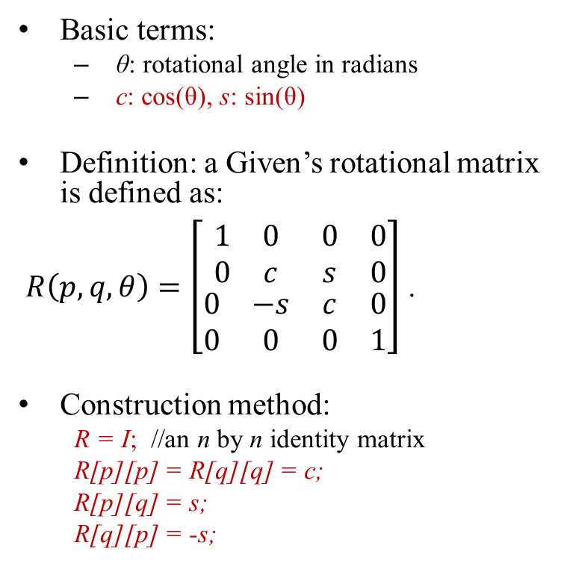
Given’s Rotational Matrix
Basic terms:
θ: rotational angle in radians
c: cos(θ), s: sin(θ)
Definition: a Given’s rotational matrix is defined as:
$R\left(p,q,θ\right)=\left[\begin{matrix}\begin{matrix}1 & 0 \\ 0 & c\end{matrix} & \begin{matrix}0 & 0 \\ s & 0\end{matrix} \\ \begin{matrix}0 & −s \\ 0 & 0\end{matrix} & \begin{matrix}c & 0 \\ 0 & 1\end{matrix}\end{matrix}\right]$ .
Construction method:
R = I; //an n by n identity matrix
R[p][p] = R[q][q] = c;
R[p][q] = s;
R[q][p] = -s;
Format of Given’s rotational matrix
cos(θ)
sin(θ)
-sin(θ)
p
q
p
q

Slide 8
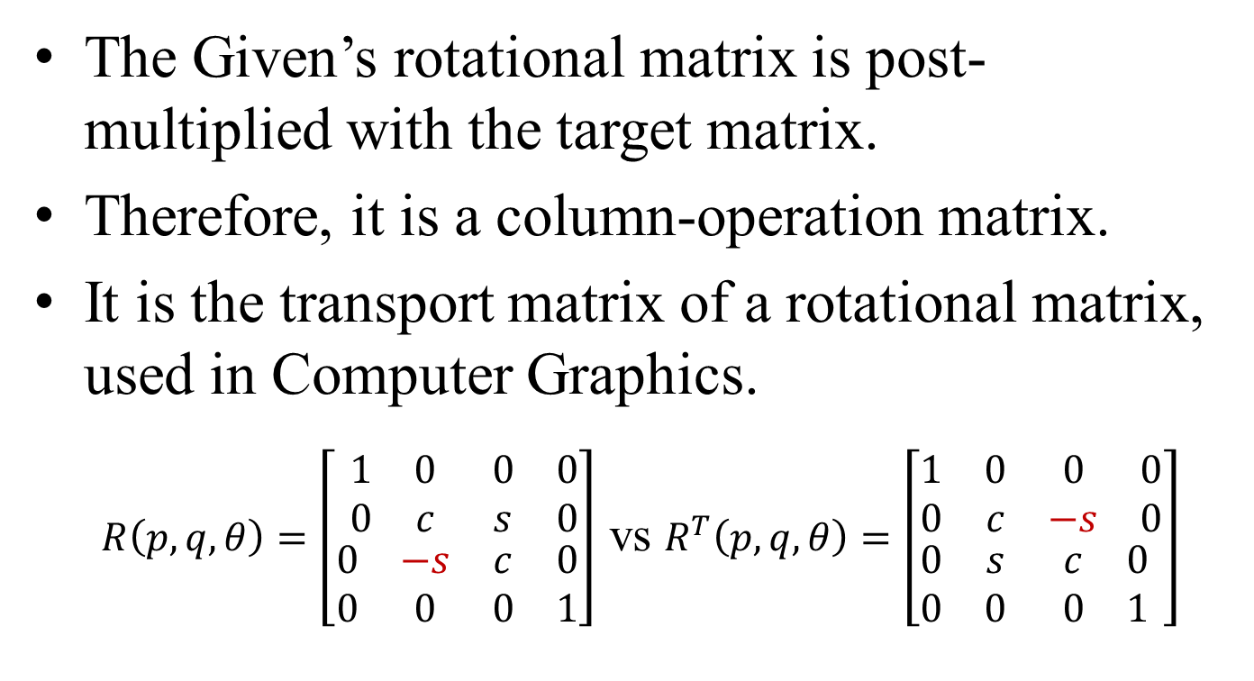
Some Notes
The Given’s rotational matrix is post-multiplied with the target matrix.
Therefore, it is a column-operation matrix.
It is the transport matrix of a rotational matrix, used in Computer Graphics.
$R\left(p,q,θ\right)=\left[\begin{matrix}\begin{matrix}1 & 0 \\ 0 & c\end{matrix} & \begin{matrix}0 & 0 \\ s & 0\end{matrix} \\ \begin{matrix}0 & −s \\ 0 & 0\end{matrix} & \begin{matrix}c & 0 \\ 0 & 1\end{matrix}\end{matrix}\right]$ vs $R^{T}\left(p,q,θ\right)=\left[\begin{matrix}\begin{matrix}1 & 0 \\ 0 & c\end{matrix} & \begin{matrix}0 & 0 \\ −s & 0\end{matrix} \\ \begin{matrix}0 & s \\ 0 & 0\end{matrix} & \begin{matrix}c & 0 \\ 0 & 1\end{matrix}\end{matrix}\right]$

Slide 9
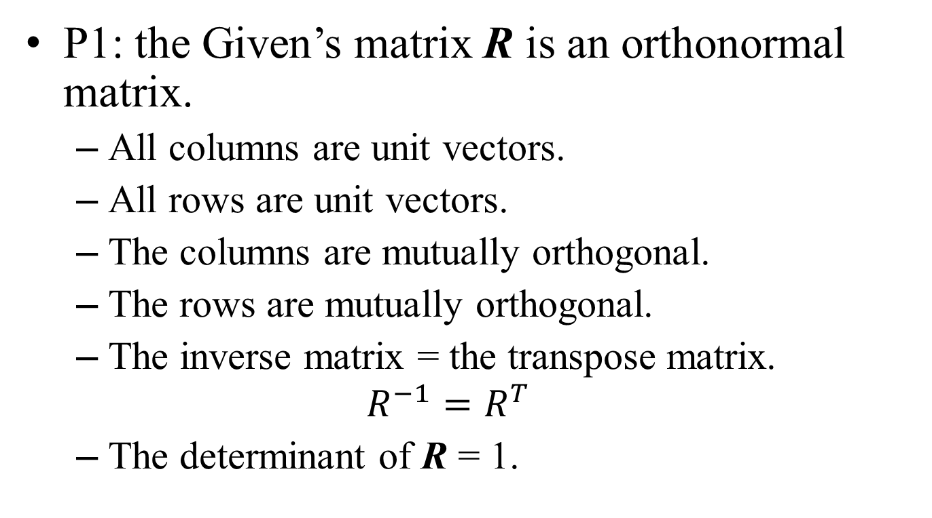
Basic Properties
P1: the Given’s matrix R is an orthonormal matrix.
All columns are unit vectors.
All rows are unit vectors.
The columns are mutually orthogonal.
The rows are mutually orthogonal.
The inverse matrix = the transpose matrix.
$$R^{−1}=R^{T}$$
The determinant of R = 1.

Slide 10
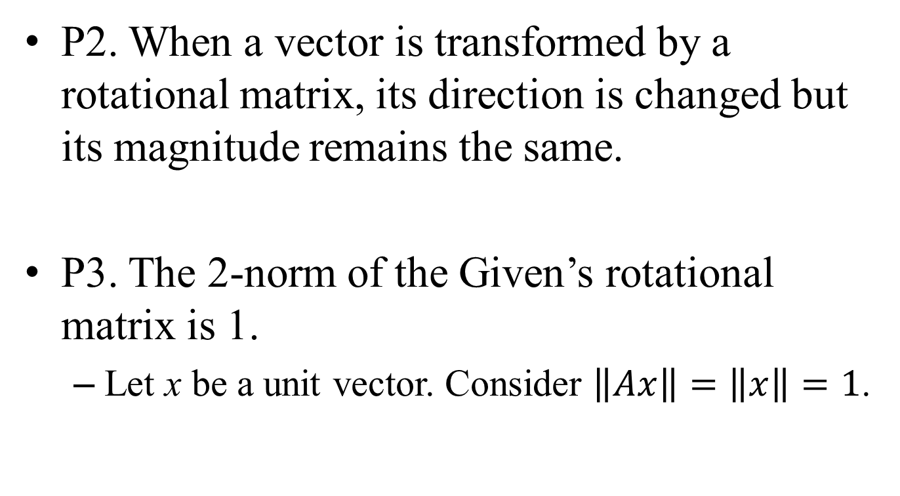
Basic Properties
P2. When a vector is transformed by a rotational matrix, its direction is changed but its magnitude remains the same.
P3. The 2-norm of the Given’s rotational matrix is 1.
Let x be a unit vector. Consider $\left\|Ax\right\|=\left\|x\right\|=1$.

Slide 11
The Transformation Matrix
The diagonalization process eliminates the off-diagonal entries gradually.
The inverse of the transformation matrix must be easy to compute.
Good candidate: Given’s rotational matrix.
A Given’s matrix
1
0
0
0
0
1
Row_p
C
S
0
1
0
Row_q
-S
C
0
0
0
0
1
Col_p
Col_q

Slide 12
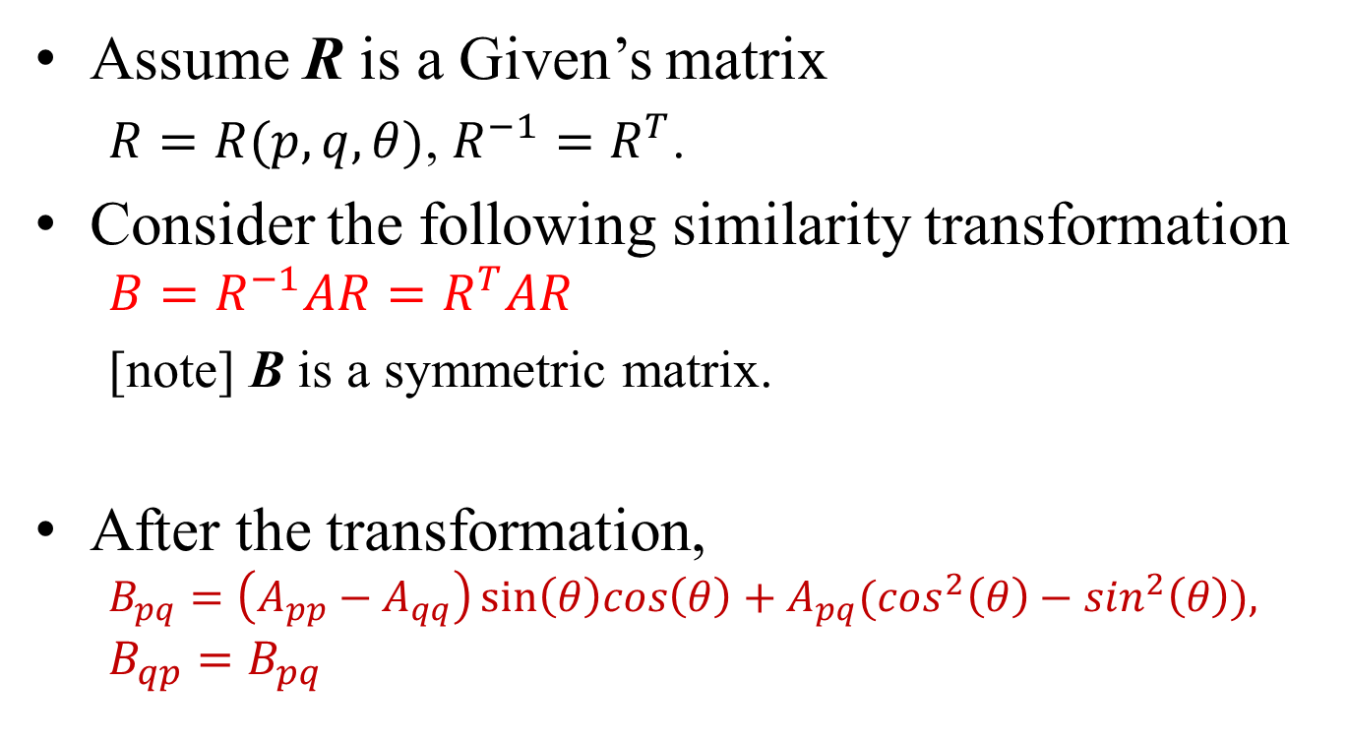
Similarity Transformation using Given’s Matrix
Assume R is a Given’s matrix
$R=R(p,q,θ)$, $R^{−1}=R^{T}$.
Consider the following similarity transformation
$${B=R}^{−1}AR=R^{T}AR$$
[note] B is a symmetric matrix.
After the transformation,
$$B_{pq}=\left(A_{pp}−A_{qq}\right)sin\left(θ\right)cos\left(θ\right)+A_{pq}(\cos^{2}\left(θ\right)−\sin^{2}\left(θ\right)){,}$$
$$B_{qp}=B_{pq}$$

Slide 13
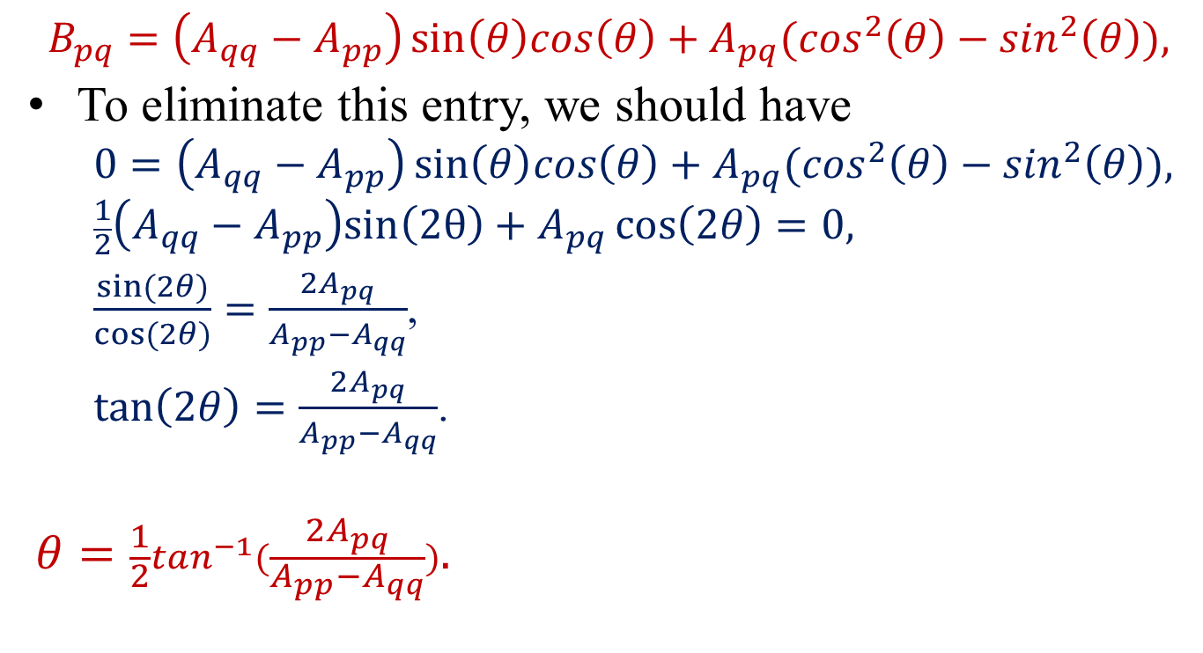
Rotational Angle of Given’s Matrix
$$B_{pq}=\left(A_{qq}−A_{pp}\right)sin\left(θ\right)cos\left(θ\right)+A_{pq}(\cos^{2}\left(θ\right)−\sin^{2}\left(θ\right)){,}$$
To eliminate this entry, we should have
$$0=\left(A_{qq}−A_{pp}\right)sin\left(θ\right)cos\left(θ\right)+A_{pq}(\cos^{2}\left(θ\right)−\sin^{2}\left(θ\right)){,}$$
$$\frac{1}{2}\left(A_{qq}−A_{pp}\right)sin\left(2θ\right)+A_{pq}\cos\left(2θ\right)=0,$$
$\frac{sin⁡(2θ)}{cos⁡(2θ)}=\frac{2A_{pq}}{A_{pp}−A_{qq}}$,
$\tan\left(2θ\right)=\frac{2A_{pq}}{A_{pp}−A_{qq}}$.
$$θ=\frac{1}{2}\tan^{−1}(\frac{2A_{pq}}{A_{pp}−A_{qq}}).$$
Why do we not consider other entries of B?
Answer: we just want to eliminate A[p][q] and A[q][p] in one transformation.

Slide 14
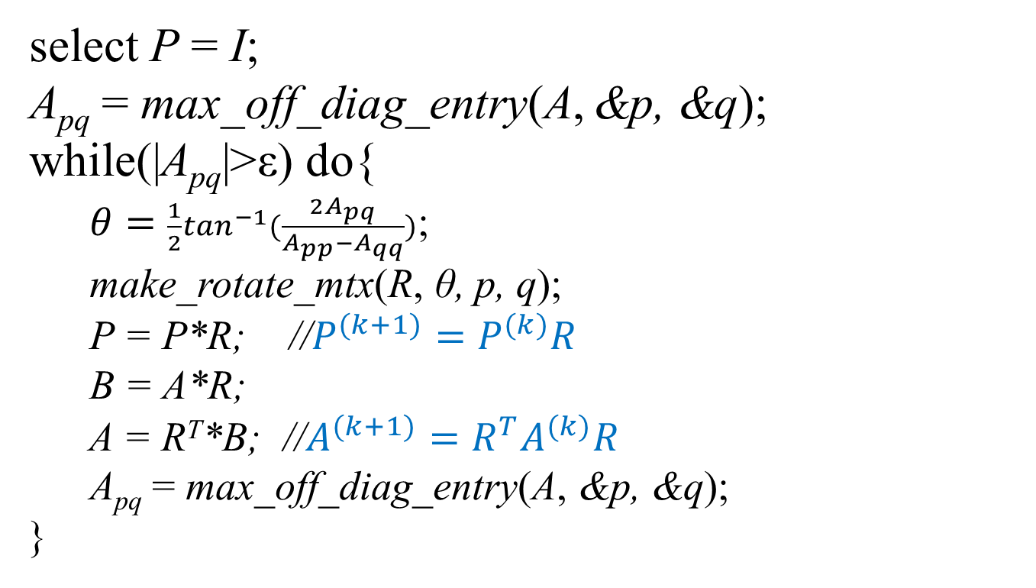
The Primitive Algorithm
select P = I;
A_{pq} = max_off_diag_entry(A, &p, &q);
while(|A_{pq}|>ε) do{
$θ=\frac{1}{2}\tan^{−1}(\frac{2A_{pq}}{A_{pp}−A_{qq}})$;
make_rotate_mtx(R, θ, p, q);
P = P*R; //$P^{(k+1)}=P^{(k)}R$
B = A*R;
A = R^{T}*B; //$A^{(k+1)}=R^{T}A^{(k)}R$
A_{pq} = max_off_diag_entry(A, &p, &q);
}

Slide 15
Improvement
In each iteration, we have to perform 3 matrix-matrix multiplication.
O(3n³) time steps.
Consider B = A*R,
R is a column-operation matrix.
new_col_p = c*old_col_p - s*old_col_q;
new_col_q = s*old_col_p + c*old_col_q;
Other columns are unhanged.
The multiplication can be achieved in O(n) steps.
Given’s matrix R =
1
1
Row_p
C
S
1
Row_q
-S
C
1
Col_p
Col_q

Slide 16
Improvement
Consider A = R^{T}*B,
R^{T} is a row-operation matrix.
new_row_p = c*old_row_p - s*old_row_q;
new_row_q = s*old_row_p + c*old_row_q;
Other rows are unhanged.
The multiplication can be achieved in O(n) steps.
R^{T} =
1
1
Row_p
C
-S
1
Row_q
S
C
1
Col_p
Col_q

Slide 17
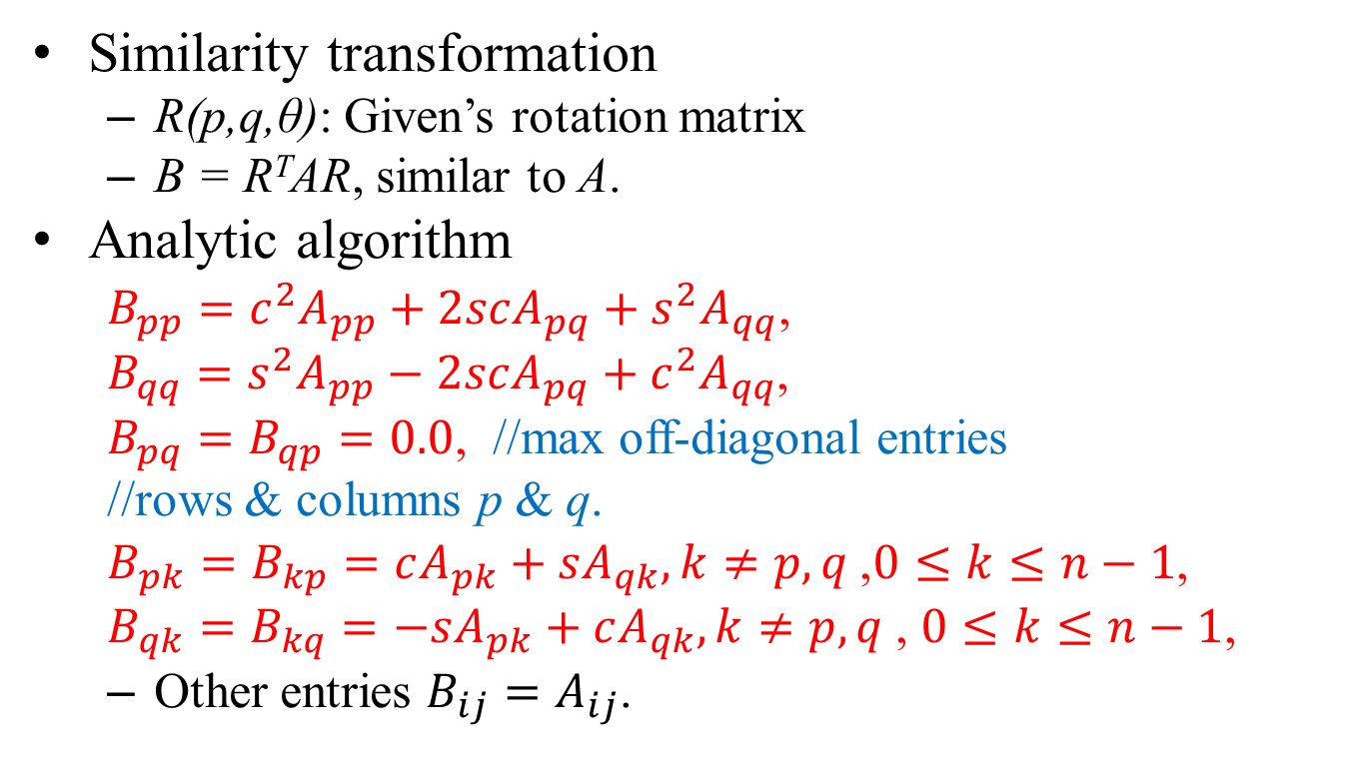
Improvement
Similarity transformation
R(p,q,θ): Given’s rotation matrix
B = R^{T}AR, similar to A.
Analytic algorithm
$B_{pp}=c^{2}A_{pp}+2scA_{pq}+s^{2}A_{qq}$,
$B_{qq}=s^{2}A_{pp}−2scA_{pq}+c^{2}A_{qq}$,
$B_{pq}=B_{qp}=0.0$, //max off-diagonal entries
//rows & columns p & q.
$B_{pk}=B_{kp}=cA_{pk}+sA_{qk},k≠p,q$,$0≤k≤n−1$,
$B_{qk}=B_{kq}=−sA_{pk}+cA_{qk},k≠p,q$, $0≤k≤n−1$,
Other entries $B_{ij}=A_{ij}$.

Slide 18
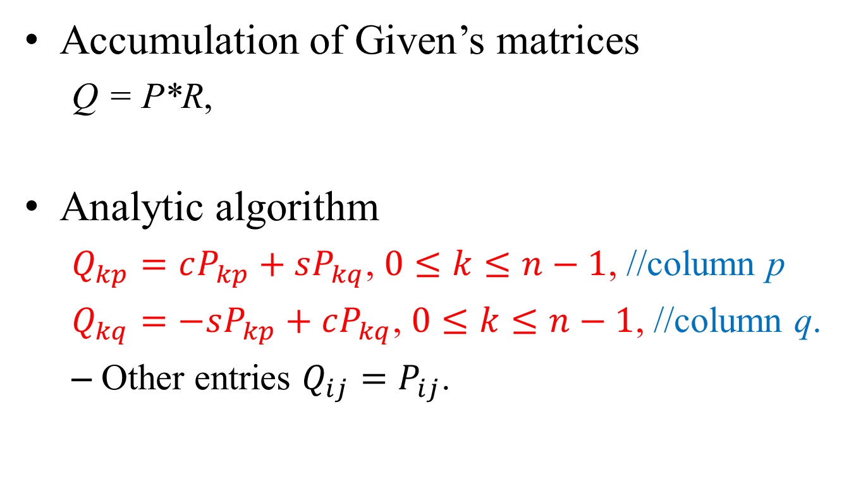
Improvement
Accumulation of Given’s matrices
Q = P*R,
Analytic algorithm
$Q_{kp}=cP_{kp}+sP_{kq}$, $0≤k≤n−1$, //column p
$Q_{kq}=−sP_{kp}+cP_{kq}$, $0≤k≤n−1$, //column q.
Other entries $Q_{ij}=P_{ij}$.

Slide 19
Improvements
The following matrix multiplications take only O(n) steps:
P = P*R;
B = A*R;
A = R^{T}*B;
The most expensive operation in each iteration is
A_{pq} = max_off_diag_entry(A, &p, &q);
It takes O(n²/2) steps.
But, it can be speed-up by using a max-heap structure.

Slide 20
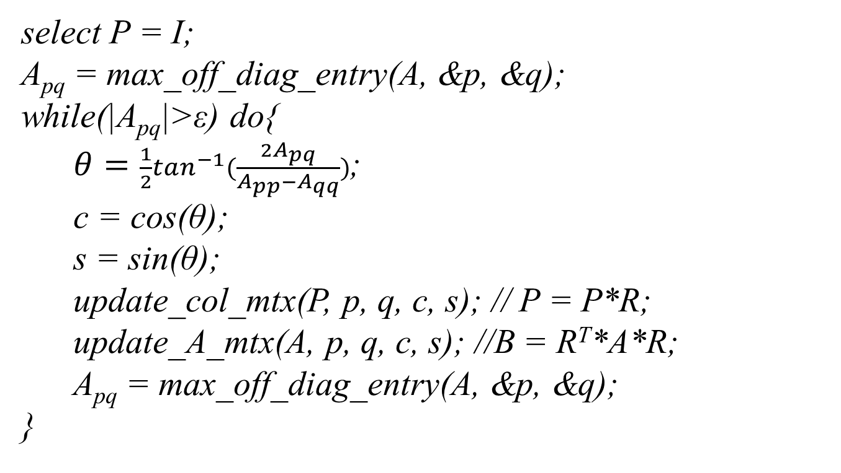
The Revised Algorithm
select P = I;
A_{pq} = max_off_diag_entry(A, &p, &q);
while(|A_{pq}|>ε) do{
$θ=\frac{1}{2}\tan^{−1}(\frac{2A_{pq}}{A_{pp}−A_{qq}})$;
c = cos(θ);
s = sin(θ);
update_col_mtx(P, p, q, c, s); // P = P*R;
update_A_mtx(A, p, q, c, s); //B = R^{T}*A*R;
A_{pq} = max_off_diag_entry(A, &p, &q);
}

Slide 21
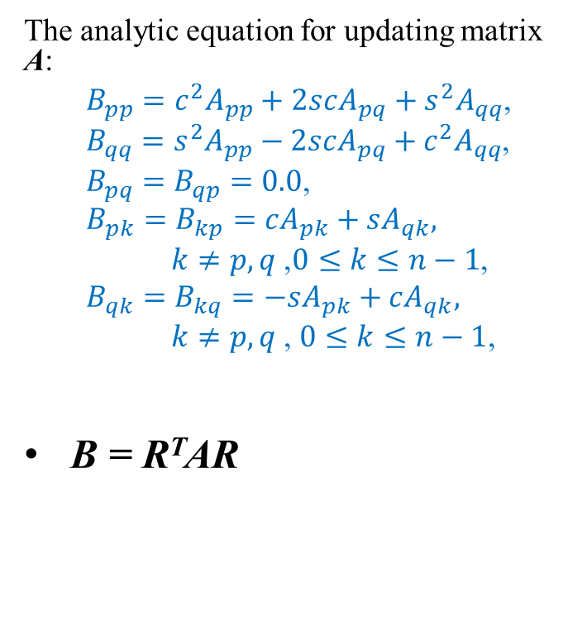
The Revised Algorithm
update_A_mtx(A, p, q, c, s) {
for(k=0;k<n;k++){
if(k≠p&&k≠q) Bp[k] = c*A[k][p] + s*A[k][q];
if(k≠p&&k≠q) Bq[k] = -s*A[k][p]+c*A[k][q];
}
Bp[p] = c*c*A[p][p] + 2.0*s*c*A[p][q] + s*s*A[q][q];
Bq[q] = s*s*A[p][p] - 2.0*s*c*A[p][q] + c*c*A[q][q];
for(k=0;k<n;k++){
A[p][k] = A[k][p] = Bp[k];
A[q][k] = A[k][q] = Bq[k];
}
A[p][q] = A[q][p] = 0.0;
}
The analytic equation for updating matrix A:
$B_{pp}=c^{2}A_{pp}+2scA_{pq}+s^{2}A_{qq}$,
$B_{qq}=s^{2}A_{pp}−2scA_{pq}+c^{2}A_{qq}$,
$B_{pq}=B_{qp}=0.0$,
$$B_{pk}=B_{kp}=cA_{pk}+sA_{qk},$$
$k≠p,q$,$0≤k≤n−1$,
$$B_{qk}=B_{kq}=−sA_{pk}+cA_{qk},$$
$k≠p,q$, $0≤k≤n−1$,
B = R^{T}AR

Slide 22
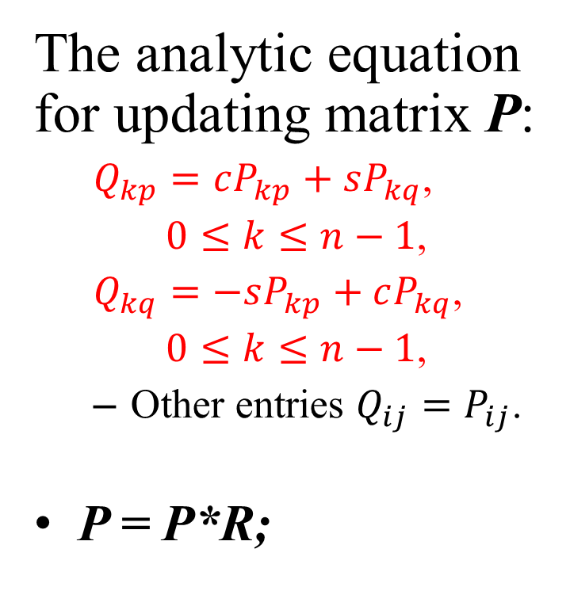
The Revised Algorithm
update_col_mtx(P, p, q, c, s){
for(k=0;k<n;k++){
Qp[k] = c*P[k][p] + s*P[k][q];
Qq[k] = -s*P[k][p] + c*P[k][q];
}
for(k=0;k<n;k++){
P[k][p] = Qp[k];
P[k][q] = Qq[k];
}
}
The analytic equation for updating matrix P:
$Q_{kp}=cP_{kp}+sP_{kq}$,
$0≤k≤n−1$,
$Q_{kq}=−sP_{kp}+cP_{kq}$,
$0≤k≤n−1$,
Other entries $Q_{ij}=P_{ij}$.
P = P*R;

Slide 23
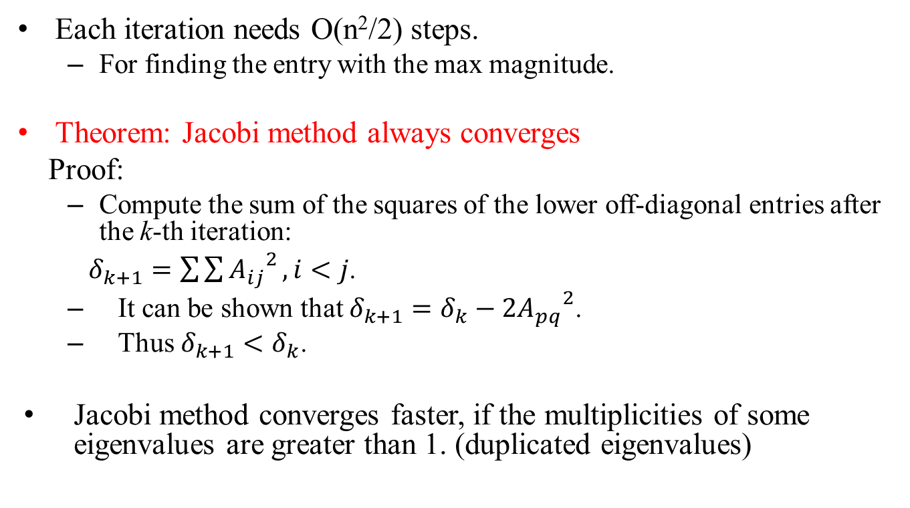
Time Complexity Analysis
Each iteration needs O(n²/2) steps.
For finding the entry with the max magnitude.
Theorem: Jacobi method always converges
Proof:
Compute the sum of the squares of the lower off-diagonal entries after the k-th iteration:
$δ_{k+1}=\sum{\sum{{A_{ij}}^{2}}},i<j$.
It can be shown that $δ_{k+1}=δ_{k}−2{A_{pq}}^{2}$.
Thus $δ_{k+1}<δ_{k}$.
Jacobi method converges faster, if the multiplicities of some eigenvalues are greater than 1. (duplicated eigenvalues)

Slide 24
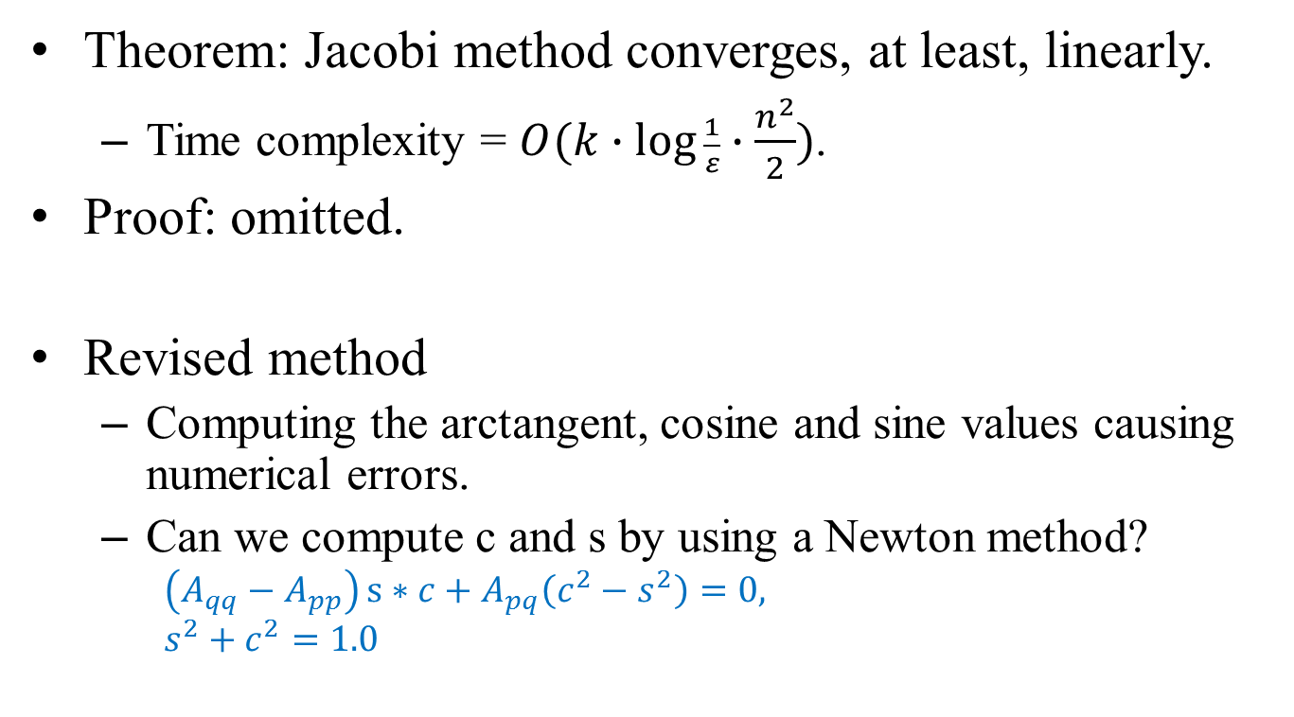
Converge Rate
Theorem: Jacobi method converges, at least, linearly.
Time complexity = $O(k∙\log{\frac{1}{ε}}∙\frac{n^{2}}{2})$.
Proof: omitted.
Revised method
Computing the arctangent, cosine and sine values causing numerical errors.
Can we compute c and s by using a Newton method?
$$\left(A_{qq}−A_{pp}\right)s∗c+A_{pq}\left(c^{2}−s^{2}\right)=0{,}$$
$$s^{2}+c^{2}=1.0$$

Slide 25
Conclusion
We use Given’s rotation to perform similarity transformation.
After a sequence of transformations, matrix A is diagonalized.
Jacobi method computes all eigenvalues and eigenvector in one process.
Jacobi method always converges for symmetric matrices.

Slide 26
Reading Assignment
Review our Algorithms & Data Structures textbooks for the following topics:
Max-heap, priority queues
Heap-sort

