Slide 1
Lanczos Algorithm
Using Householder Reflection

Slide 2
Outline
Introduction
Review: Householder’s QR decomposition
Similarity transformation using Householder matrices
Eigenvalues of tri-diagonal matrices
The algorithm
Convergence analysis
Time complexity analysis

Slide 3
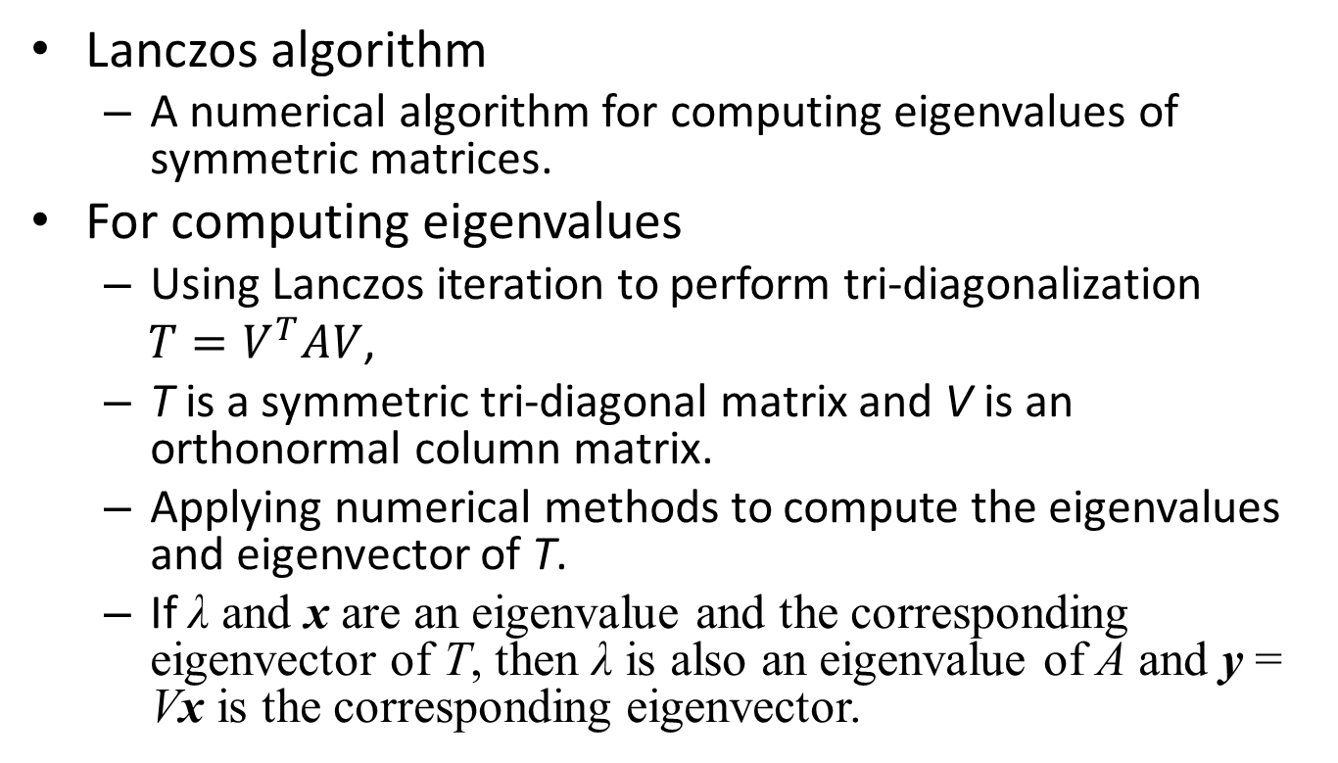
Introduction
Lanczos algorithm
A numerical algorithm for computing eigenvalues of symmetric matrices.
For computing eigenvalues
Using Lanczos iteration to perform tri-diagonalization
$T=V^{T}AV$,
T is a symmetric tri-diagonal matrix and V is an orthonormal column matrix.
Applying numerical methods to compute the eigenvalues and eigenvector of T.
If λ and x are an eigenvalue and the corresponding eigenvector of T, then λ is also an eigenvalue of A and y = Vx is the corresponding eigenvector.

Slide 4
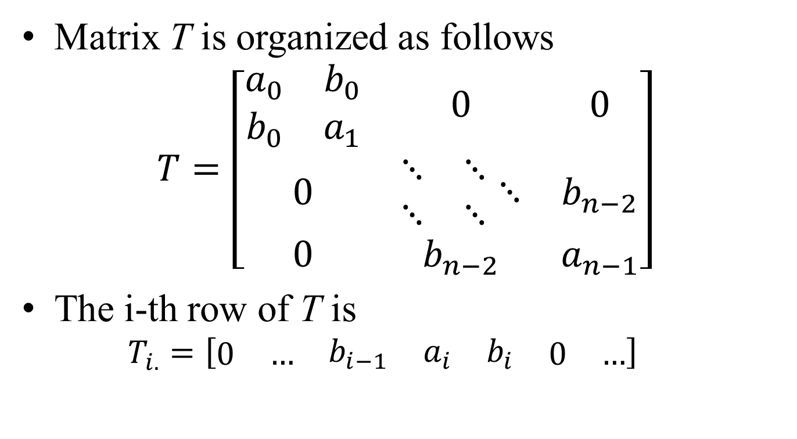
Introduction
Matrix T is organized as follows
$$T=\left[\begin{matrix}\begin{matrix}a_{0} & b_{0} \\ b_{0} & a_{1}\end{matrix} & 0 & 0 \\ 0 & \begin{matrix}⋱ & ⋱ \\ ⋱ & ⋱\end{matrix}⋱ & b_{n−2} \\ 0 & b_{n−2} & a_{n−1}\end{matrix}\right]$$
The i-th row of T is
$$T_{i.}=\left[\begin{matrix}\begin{matrix}0 & …\end{matrix} & \begin{matrix}b_{i−1} & a_{i} & b_{i}\end{matrix} & \begin{matrix}0 & …\end{matrix}\end{matrix}\right]$$

Slide 5
Introduction
The original Lanczos algorithm for the tri-diagonalization is numerical unstable.
We use Householder transformation to perform the job.
We may use any numerical methods to compute the eigenvalues of T.
In this lecture, we use
Bi-section method
Power method

Slide 6
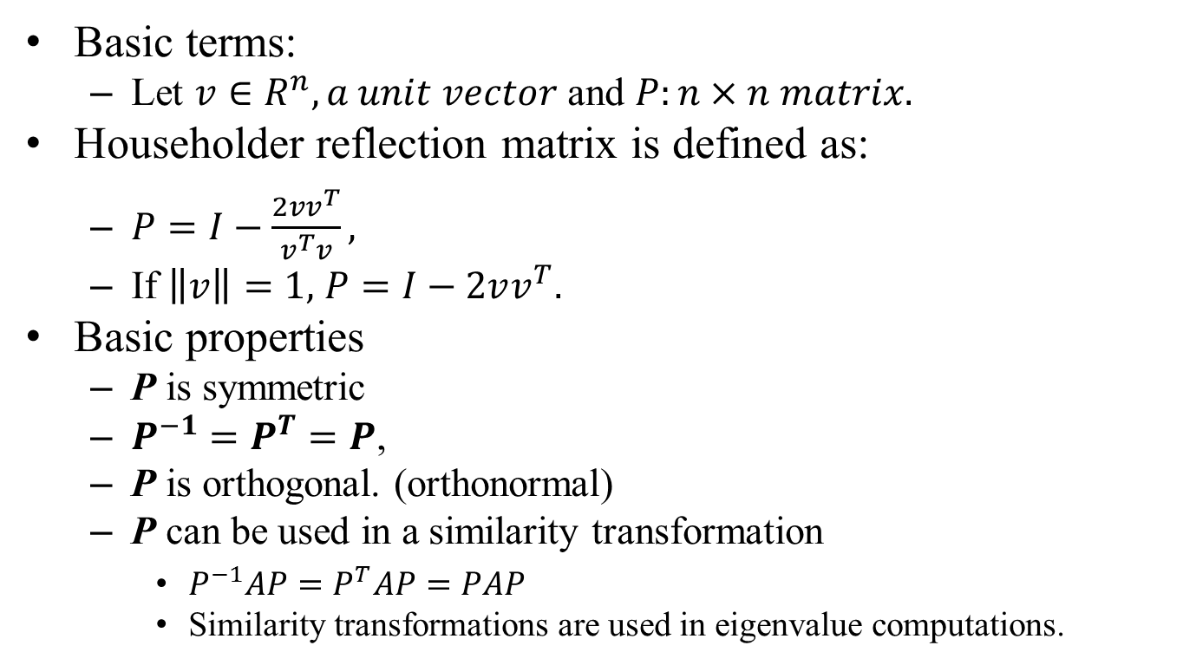
Householder Transformation
Basic terms:
Let $v∈R^{n}, a unit vector$ and $P:n×n matrix.$
Householder reflection matrix is defined as:
$P=I−\frac{2vv^{T}}{v^{T}v},$
If $\left\|v\right\|=1,$ $P=I−2vv^{T}.$
Basic properties
P is symmetric
$P^{−1}=P^{T}=P$,
P is orthogonal. (orthonormal)
P can be used in a similarity transformation
$P^{−1}AP=P^{T}AP=PAP$
Similarity transformations are used in eigenvalue computations.

Slide 7
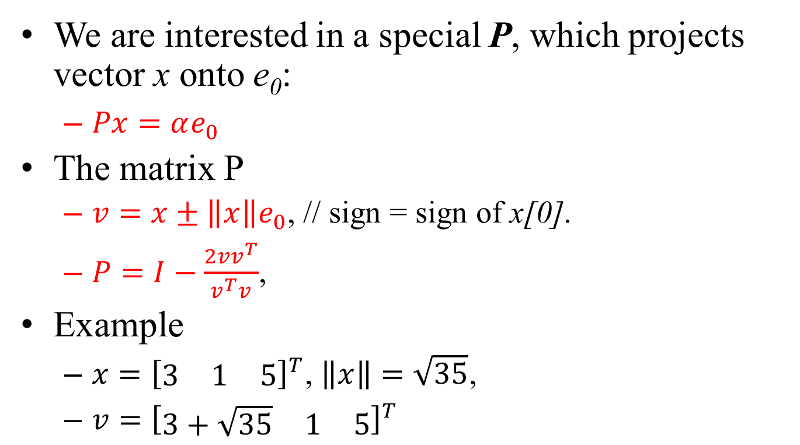
Householder Matrix
We are interested in a special P, which projects vector x onto e₀:
$Px=αe_{0}$
The matrix P
$v=x±\left\|x\right\|e_{0}$, // sign = sign of x[0].
$P=I−\frac{2vv^{T}}{v^{T}v}$,
Example
$x={\left[\begin{matrix}3 & 1 & 5\end{matrix}\right]}^{T}$, $\left\|x\right\|=\sqrt{35}$,
$v={\left[\begin{matrix}3+\sqrt{35} & 1 & 5\end{matrix}\right]}^{T}$

Slide 8
Question
Can we use Householder’s matrices to eliminate A into a diagonal matrix?
Answer:
We cannot!
Similarity transformation (PAP) ≠ QR-decomposition transformation (PA).
2-side operation vs. 1-side operation.
For example, if we eliminate the 0-th column below A₀₀ then the entries A_{0k} of the 0-th row will be modified too.
If we eliminate the 0-th row by using P, the entries after A₀₀ will not be eliminated.

Slide 9
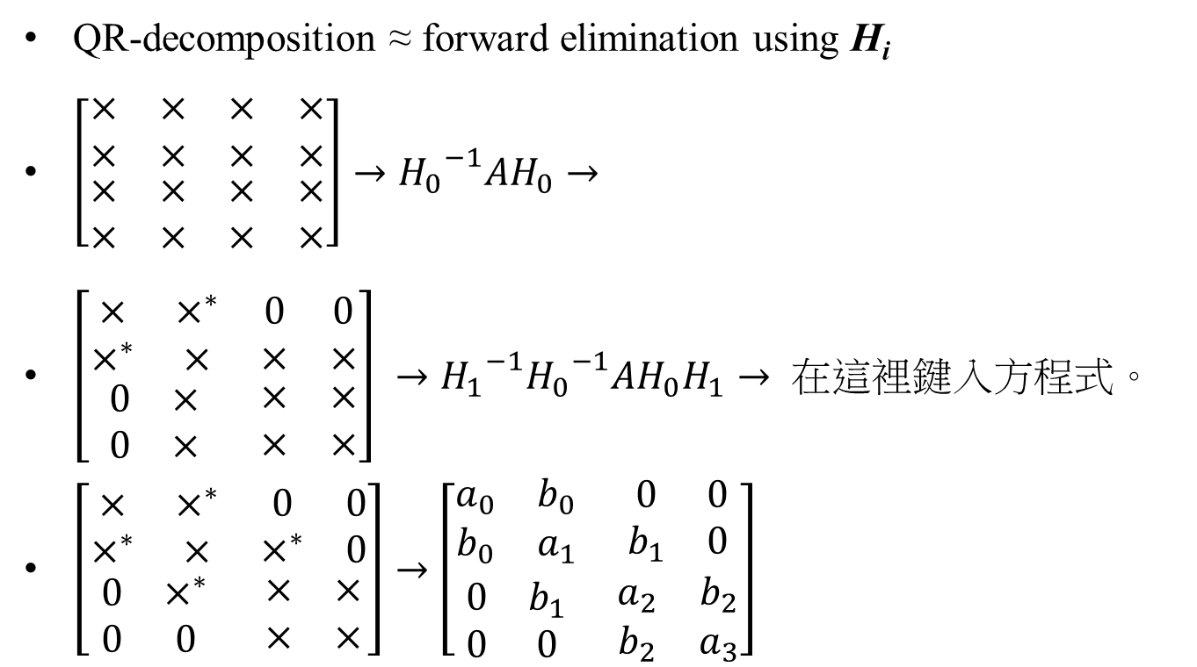
Tri-diagonalization
QR-decomposition ≈ forward elimination using H_{i}
$\left[\begin{matrix}\begin{matrix}× & × \\ × & ×\end{matrix} & \begin{matrix}× & × \\ × & ×\end{matrix} \\ \begin{matrix}× & × \\ × & ×\end{matrix} & \begin{matrix}× & × \\ × & ×\end{matrix}\end{matrix}\right]→{H_{0}}^{−1}AH_{0}→$
$\left[\begin{matrix}\begin{matrix}× & ×^{∗} \\ ×^{∗} & ×\end{matrix} & \begin{matrix}0 & 0 \\ × & ×\end{matrix} \\ \begin{matrix}0 & × \\ 0 & ×\end{matrix} & \begin{matrix}× & × \\ × & ×\end{matrix}\end{matrix}\right] →{H_{1}}^{−1}{H_{0}}^{−1}AH_{0}H_{1}→$
$\left[\begin{matrix}\begin{matrix}× & ×^{∗} \\ ×^{∗} & ×\end{matrix} & \begin{matrix}0 & 0 \\ ×^{∗} & 0\end{matrix} \\ \begin{matrix}0 & ×^{∗} \\ 0 & 0\end{matrix} & \begin{matrix}× & × \\ × & ×\end{matrix}\end{matrix}\right]→$ $\left[\begin{matrix}\begin{matrix}a_{0} & b_{0} \\ b_{0} & a_{1}\end{matrix} & \begin{matrix}0 & 0 \\ b_{1} & 0\end{matrix} \\ \begin{matrix}0 & b_{1} \\ 0 & 0\end{matrix} & \begin{matrix}a_{2} & b_{2} \\ b_{2} & a_{3}\end{matrix}\end{matrix}\right]$

Slide 10
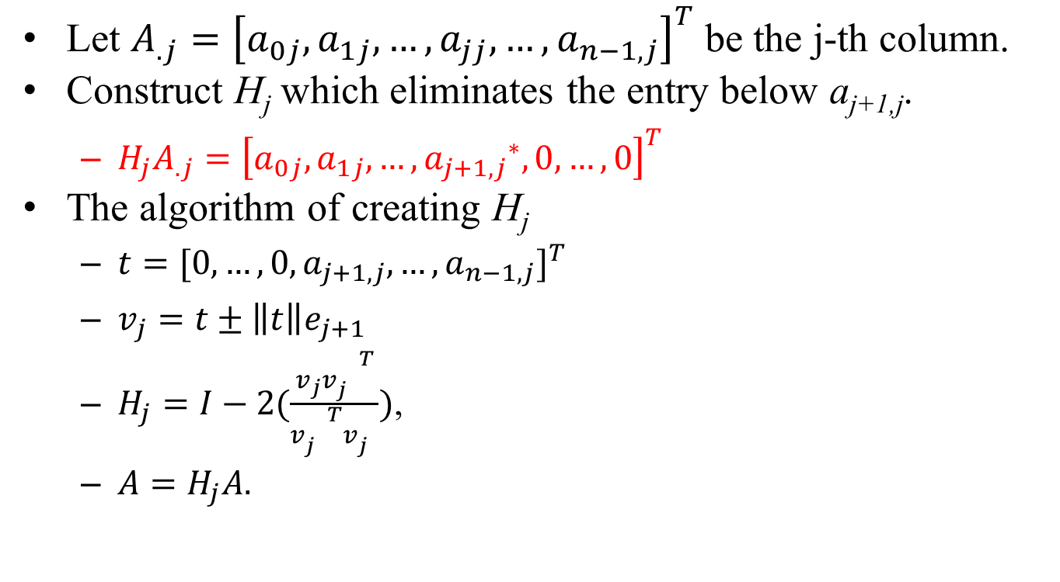
Eliminating the j-th Column
Let $A_{.j}={\left[a_{0j},a_{1j},…,a_{jj},…,a_{n−1,j}\right]}^{T}$ be the j-th column.
Construct H_{j} which eliminates the entry below a_{j+1,j}.
$H_{j}A_{.j}={\left[a_{0j},a_{1j},…,{a_{j+1,j}}^{∗},0,…,0\right]}^{T}$
The algorithm of creating H_{j}
$t={[0,…,0,a_{j+1,j},…,a_{n−1,j}]}^{T}$
$v_{j}=t±\left\|t\right\|e_{j+1}$
$H_{j}=I−2(\frac{v_{j}{v_{j}^{}}^{T}}{{v_{j}^{}}^{T}v_{j}^{}})$,
$A=H_{j}A.$
0
0

Slide 11
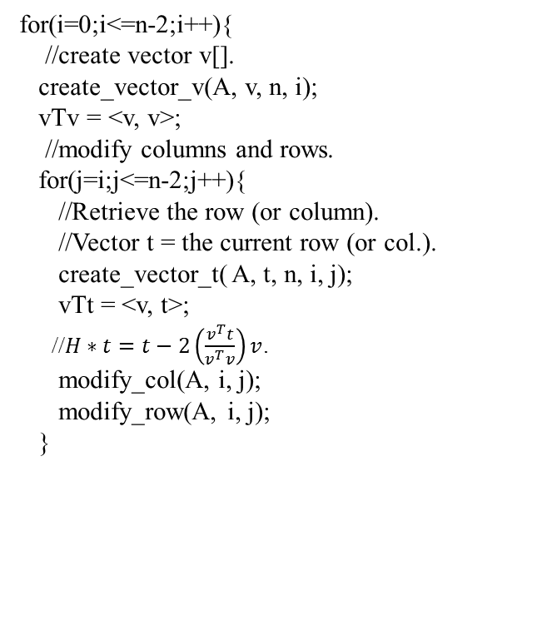
Tri-diagonalization Algorithm
for(i=0;i<=n-2;i++){
//create vector v[].
create_vector_v(A, v, n, i);
vTv = <v, v>;
//modify columns and rows.
for(j=i;j<=n-2;j++){
//Retrieve the row (or column).
//Vector t = the current row (or col.).
create_vector_t( A, t, n, i, j);
vTt = <v, t>;
//$H∗t=t−2\left(\frac{v^{T}t}{v^{T}v}\right)v$.
modify_col(A, i, j);
modify_row(A, i, j);
}
//Creation of vector v[].
void create_vector_v(A, v, n, i)
{
t[] = {0};
//retrieve the j-th column
for(j=i+1;j≤n-1;j++) t[j] = A[j][i];
//Compute the norm of the vector.
tTt = inner_product(t, t);
a = sqrt(tTt);
//t = t + sign(t[j])*e_{j};
if(t[i+1]>=0) t[i+1] = t[i+1] + a;
else t[i+1] = t[i+1] – a;
}
void create_vector_t(A, t, n, i, j)
{
t[] = {0};
//retrieve the j-th column
for(j=i+1;j≤n-1;j++) t[j] = A[j][i];
//Compute the norm of the vector.
}

Slide 12
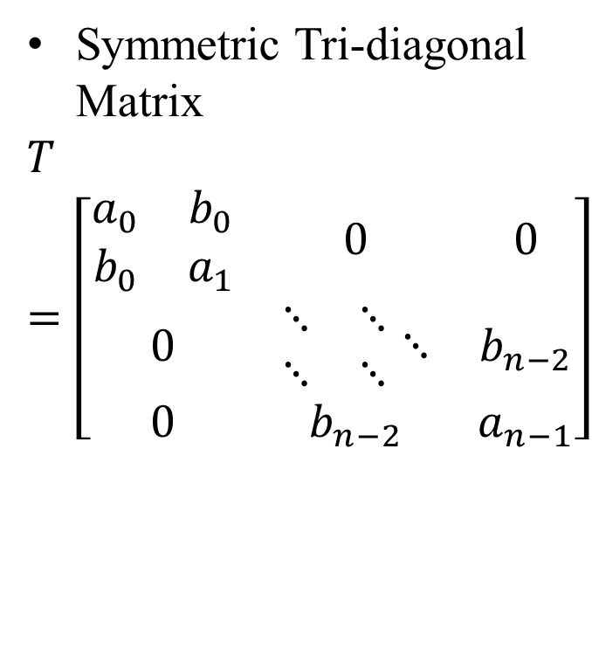
Eigenvalue Computation for Tri-diagonal Matrices
After the tri-diagonalization process, A becomes a symmetric tri-diagonal matrix T,
Having the same eigenvalues.
T is simple, computing its eigenvalues is not trivial.
But eigenvalue computing algorithms can be sped-up.
Symmetric Tri-diagonal Matrix
$$T=\left[\begin{matrix}\begin{matrix}a_{0} & b_{0} \\ b_{0} & a_{1}\end{matrix} & 0 & 0 \\ 0 & \begin{matrix}⋱ & ⋱ \\ ⋱ & ⋱\end{matrix}⋱ & b_{n−2} \\ 0 & b_{n−2} & a_{n−1}\end{matrix}\right]$$

Slide 13

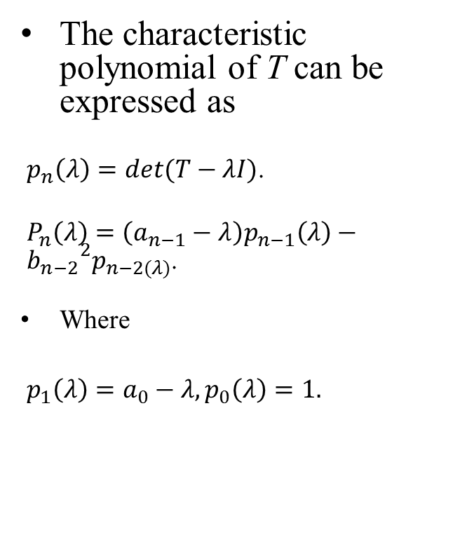
Characteristic Polynomial
The characteristic polynomial of T can be expressed as
$p_{n}\left(λ\right)=det(T−λI)$.
$P_{n}\left(λ\right)=\left(a_{n−1}−λ\right)p_{n−1}\left(λ\right)−{b_{n−2}}^{2}p_{n−2(λ)}$.
Where
$p_{1}\left(λ\right)=a_{0}−λ, p_{0}\left(λ\right)=1.$
$$\left[\begin{matrix}\begin{matrix}a_{0}−λ & b_{0} \\ b_{0} & a_{1}−λ\end{matrix} & 0 & 0 \\ 0 & \begin{matrix}⋱ & ⋱ \\ ⋱ & ⋱\end{matrix}⋱ & b_{n−2} \\ 0 & b_{n−2} & a_{n−1}−λ\end{matrix}\right]$$

Slide 14
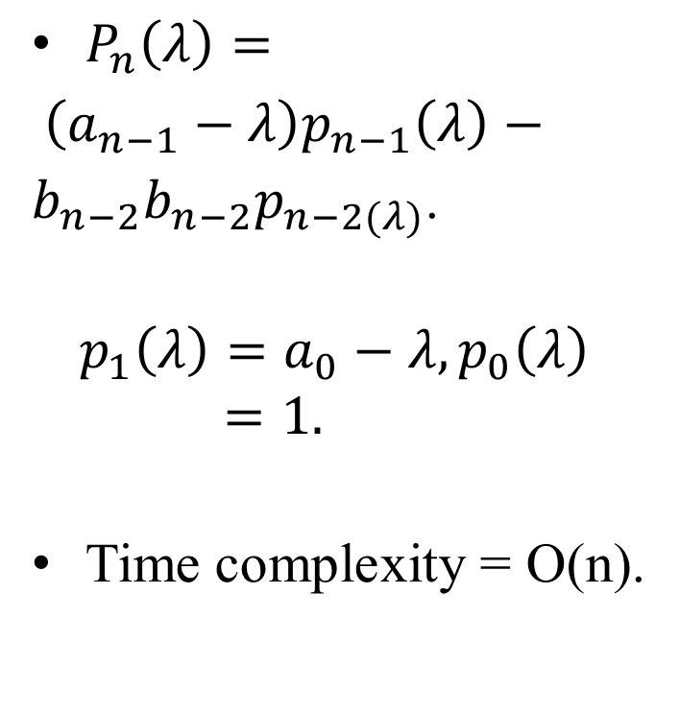
Characteristic Polynomial
double a[], b[];
double p(x, i)
{
if(i==0) return (1.0);
if(i==1) return(a[0]-x);
t1 = p(x, i-1);
t2 = p(x, i-2);
return (a[i-1]*t1 –
b[i-2]*b[i-2]*t2);
}
$P_{n}\left(λ\right)=$
$\left(a_{n−1}−λ\right)p_{n−1}\left(λ\right)−b_{n−2}b_{n−2}p_{n−2(λ)}$.
$$p_{1}\left(λ\right)=a_{0}−λ, p_{0}\left(λ\right)=1.$$
Time complexity = O(n).

Slide 15
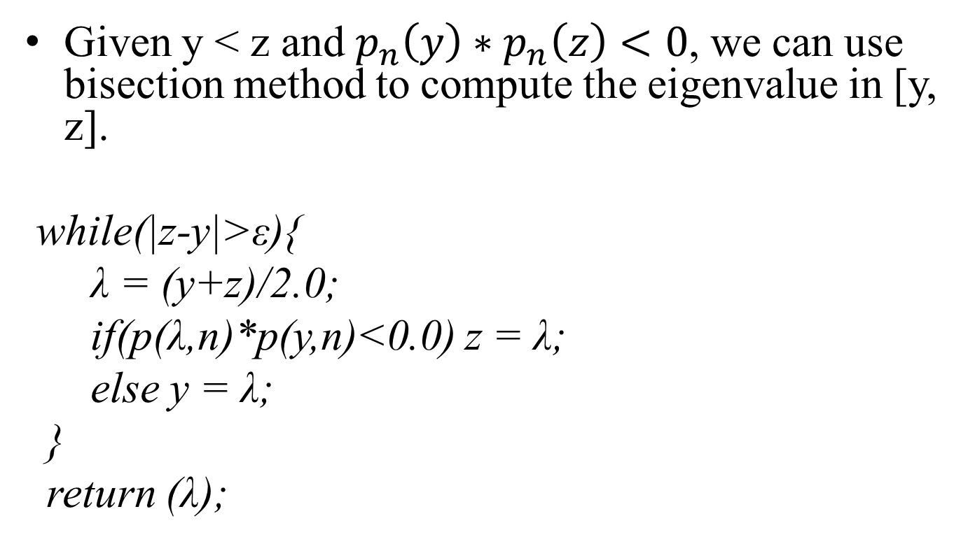
Bisection Method
Given y < z and $p_{n}\left(y\right)∗p_{n}\left(z\right)<0$, we can use bisection method to compute the eigenvalue in [y, z].
while(|z-y|>ε){
λ = (y+z)/2.0;
if(p(λ,n)*p(y,n)<0.0) z = λ;
else y = λ;
}
return (λ);

Slide 16

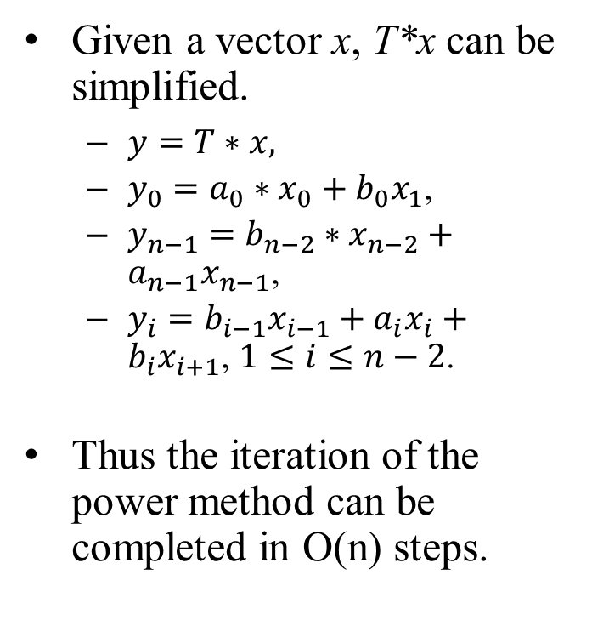
Power Method for Computing Eigenvalues
Given a vector x, T*x can be simplified.
$y=T∗x,$
$y_{0}=a_{0}∗x_{0}+b_{0}x_{1}$,
$y_{n−1}=b_{n−2}∗x_{n−2}+a_{n−1}x_{n−1}$,
$y_{i}=b_{i−1}x_{i−1}+a_{i}x_{i}+b_{i}x_{i+1}$, $1≤i≤n−2$.
Thus the iteration of the power method can be completed in O(n) steps.
The i-th row of T is
$$T_{i.}=\left[\begin{matrix}\begin{matrix}0 & …\end{matrix} & \begin{matrix}b_{i−1} & a_{i} & b_{i}\end{matrix} & \begin{matrix}0 & …\end{matrix}\end{matrix}\right]$$
$$\left[\begin{matrix}\begin{matrix}a_{0} & b_{0} \\ b_{0} & a_{1}\end{matrix} & 0 & 0 \\ 0 & \begin{matrix}⋱ & ⋱ \\ ⋱ & ⋱\end{matrix}⋱ & b_{n−2} \\ 0 & b_{n−2} & a_{n−1}\end{matrix}\right]$$

Slide 17
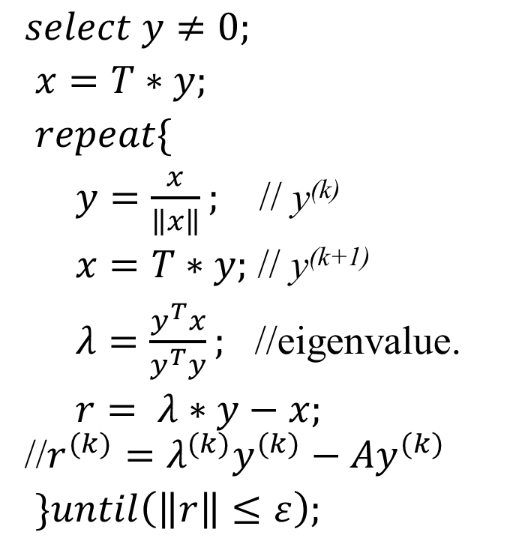
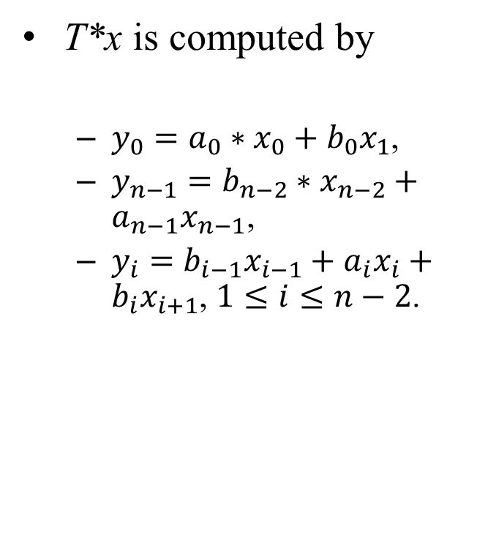
Power Method for Computing Eigenvalues
T*x is computed by
$y_{0}=a_{0}∗x_{0}+b_{0}x_{1}$,
$y_{n−1}=b_{n−2}∗x_{n−2}+a_{n−1}x_{n−1}$,
$y_{i}=b_{i−1}x_{i−1}+a_{i}x_{i}+b_{i}x_{i+1}$, $1≤i≤n−2$.
$select y≠0;$
$x=T∗y;$
$repeat\{$
$y=\frac{x}{\left\|x\right\|};$ // y^{(k)}
$x=T∗y;$ // y^{(k+1)}
$λ=\frac{y^{T}x}{y^{T}y};$ //eigenvalue.
$r= λ∗y−x;$ //$r^{(k)}=λ^{(k)}y^{(k)}−{Ay}^{(k)}$
$\}until\left(\left\|r\right\|≤ε\right);$

