Slide 1
Shape-Guided Dual-Memory Learning for 3D Anomaly Detection
Group No:19
313554050黃暐茗
312552052鄭博元
Authors: Yu-Min Chu, Chieh Liu, Ting-I Hsieh, Hwann-Tzong Chen, Tyng-Luh Liu
Institutes: National Tsing Hua University, Aeolus Robotics, Academia Sinica

Slide 2
Outline
Introduction
Related Work
Method
Experiments
Conclusion

Slide 3
Introduction
Unsupervised anomaly detection and localization are crucial in various applications, particularly in manufacturing and healthcare.
Traditional anomaly detection methods have primarily relied on color information to identify defects and abnormal regions in images. However, while effective in many cases, these methods often fall short when it comes to detecting anomalies that are better represented in 3D geometric data.

Slide 4
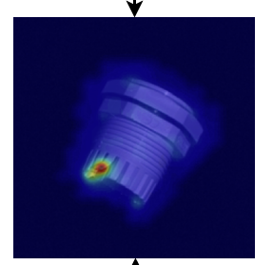
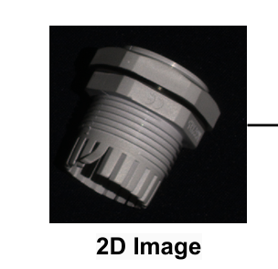
Introduction
Motivations: Recent studies, such as those by Horwitz & Hoshen (2022), have shown that integrating 3D geometric information can significantly enhance performance. The proposed method aims to address this by combining color and geometric data, using a shape-guided dual-memory approach to achieve higher accuracy in anomaly localization while also reducing computational and memory costs.

Slide 5
Related Work
Traditional Methods: 2D Anomaly Detection:
Feature Embedding-Based Methods: These methods utilize a pretrained model to extract features during the training phase. During testing, the features from the test data are compared with those from the training data using a distance metric. If the test features deviate from the normal features observed during training, they are considered anomalies. Examples include methods like those by Defard et al. (2020), Lee et al. (2022), and Roth et al. (2022).
Normalizing Flows: Techniques like CFLOW-AD and CSflow model the distribution of normal patches using normalizing flows and positional encoders. These methods aim to distinguish between in-distribution (normal) and out-of-distribution (anomalous) patches based on their probability density functions.
Student-Teacher Networks and Simulation-Based Approaches: In these methods, a teacher network is first trained on a large dataset, and then student networks are trained to replicate the teacher's output on non-defect data. The difference between the teacher’s and student’s outputs during testing indicates anomalies. This approach is exemplified by the Uninformed Students method and AST (Rudolph et al., 2023).

Slide 6
Related Work
3D Anomaly Detection:
Traditional 3D anomaly detection has been less developed due to the lack of comprehensive 3D datasets. Some earlier works focused on 3D brain scans but lacked generality for other applications. The MVTec 3D-AD dataset introduced by Bergmann et al. (2022) provides high-resolution color point clouds for more comprehensive 3D anomaly detection. Approaches like the 3D Student-Teacher framework have been proposed to learn adaptive geometric features from these 3D point clouds.
Key Papers:
Mention relevant works such as those by Horwitz & Hoshen (2022) on the importance of 3D information for anomaly detection. The paper by Horwitz & Hoshen mainly discusses how rotation-invariant 3D provides richer structural information, which helps in detecting difficult-to-recognize anomalies (the model's characteristics ensure that stable and consistent features are extracted regardless of spatial rotation). Additionally, they used the "Back to Feature" technique to complement and combine information between 3D and 2D. For example, 3D geometric features are used to analyze anomalies first, guiding RGB features to further confirm abnormal features.

Slide 7
Related Work
The definition of some terminology
AUROC:
Measures the classifier's ability to distinguish between positive and
negative classes across all thresholds.
Represented by the area under the Receiver Operating Characteristic (ROC) curve,
which plots False Positive Rate (FPR) vs. True Positive Rate (TPR).
PRO Curve:
Visualizes the overlap degree of anomalies at varying decision thresholds,
typically using FPR or threshold on the x-axis and overlap metrics like IoU on the y-axis,
indicating the model's precision in anomaly localization.
AUPRO:
Evaluates the model's accuracy in localizing anomalies at the pixel
or region level. Represented by the area under the per-region overlap (PRO) curve
, which plots FPR or threshold vs. overlap degree (e.g., IoU).

Slide 8
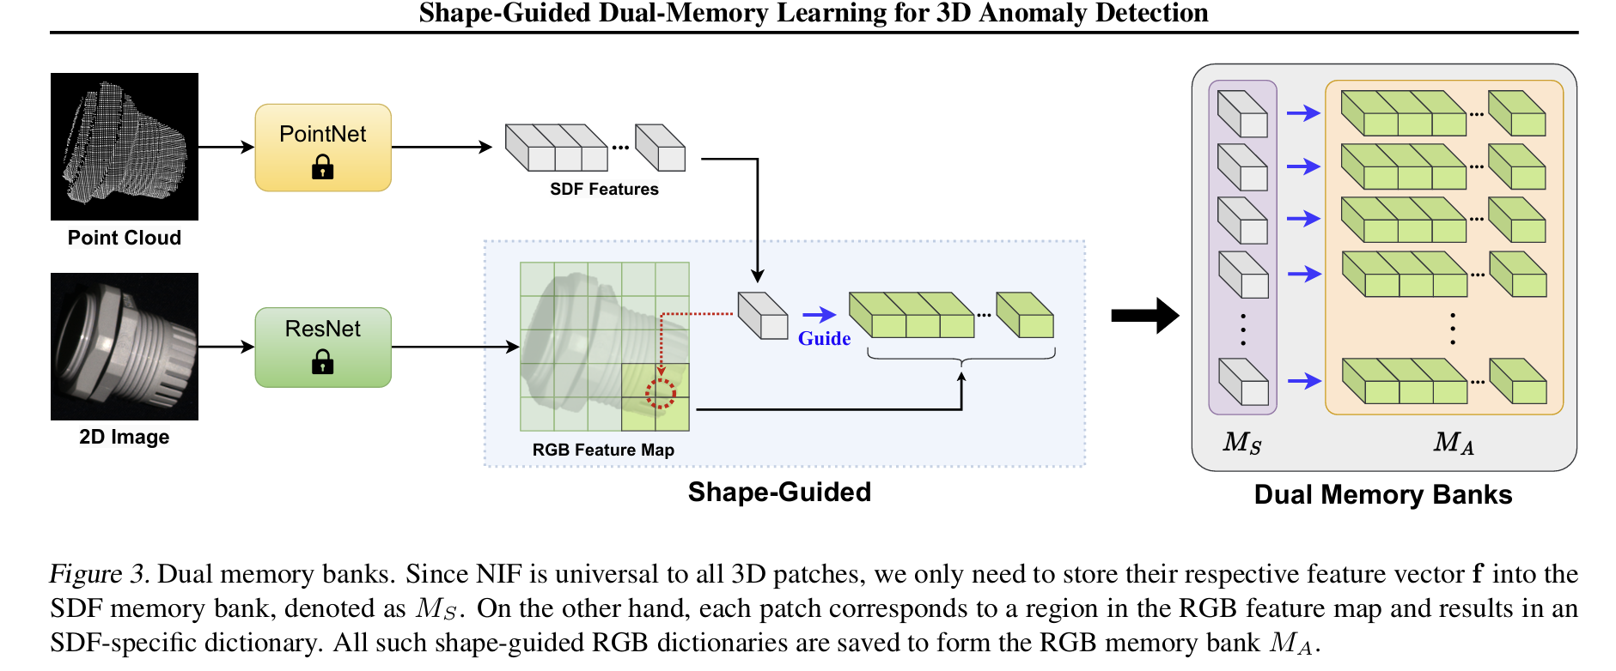
Method
Proposed Method 1: Shape-Guided Expert Learning

Slide 9
Method
Proposed Method 1: Shape-Guided Expert Learning
3D Shape Expert:
Point Cloud Processing: The 3D Shape Expert starts by dividing the object’s point cloud into local patches. Each patch represents a small area of the object’s surface, which is crucial for detecting localized anomalies.
Feature Extraction: A Neural Implicit Function (NIF) is employed to learn the local geometry of these patches. NIFs are powerful because they can represent complex shapes as continuous functions, capturing fine details that simpler models might miss.
Signed Distance Function (SDF): The NIF is trained to predict the Signed Distance Function (SDF) for each point in the patch. The SDF measures the distance from a point in space to the nearest surface, effectively encoding the shape of the object.
Memory Bank Construction: Once the model has learned what normal patches look like, the features from these patches are stored in the SDF Memory Bank. This memory bank serves as a reference for what "normal" should be during the inference phase.

Slide 10
Method
Proposed Method 1: Shape-Guided Expert Learning
2D Appearance Expert:
RGB Feature Extraction: The 2D Appearance Expert processes RGB images corresponding to the 3D patches. It uses a Convolutional Neural Network (CNN) to extract features related to color and texture.
Correspondence with 3D Shapes: The expert aligns these RGB features with the 3D patches to ensure that the appearance and geometry are considered together.
Expansion and Storage: To capture more contextual information, the RGB features are slightly expanded to include neighboring pixels. These features are then stored in the RGB Memory Bank, corresponding to the entries in the SDF Memory Bank.

Slide 11
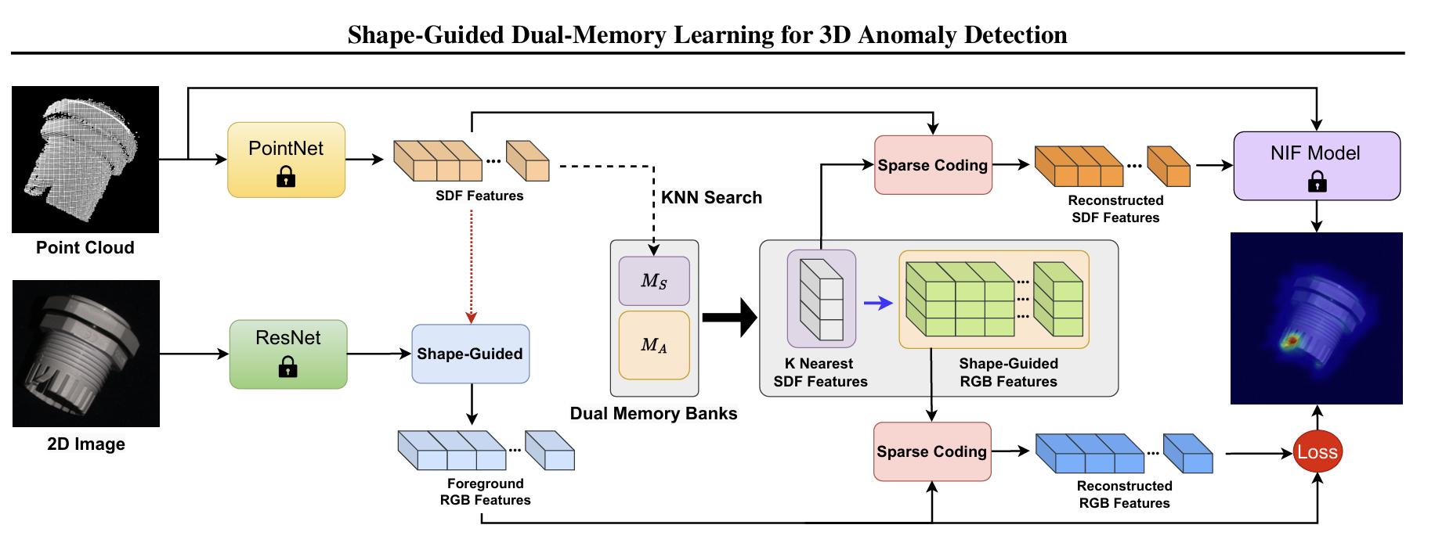
Method
Proposed Method 2 :Shape-Guided Inference:

Slide 12
Method
Proposed Method 2 :Shape-Guided Inference:
Inference Process:
Querying the Memory Banks: For each patch in the test point cloud, the system first extracts the corresponding 3D and 2D features.
Sparse Reconstruction: The extracted features are then compared to the entries in the SDF and RGB Memory Banks. The system retrieves the most similar (nearest neighbor) features from the memory banks and uses them to reconstruct what the patch would look like if it were normal.
Anomaly Detection: The difference between the reconstructed (normal) features and the actual features from the test sample indicates the presence of an anomaly. Large discrepancies suggest a defect.
Fusion of Results: Finally, the model fuses the anomaly scores from the 3D and 2D experts. This fusion ensures that anomalies that might only be visible in one modality (either shape or color) are still detected.

Slide 13
Experiments
Experiment Settings:
Dataset:
The experiments were conducted on the MVTec 3D-AD dataset
The training and validation sets consist of anomaly-free samples,
while the test set includes 249 normal samples and 948 anomalous samples,
Each sample in the dataset includes a high-resolution point cloud and a
corresponding RGB image.
Preprocessing:
Removal of the background from the point clouds using methods from the baseline BTF.
Point clouds were cropped into patches, and these were stored in npz files.

Slide 14
Experiments
Experiment Settings:
Local Patches:
The method divides the entire point cloud into local patches to model local structures.
Farthest Point Sampling (FPS) was used to sample points from the original point cloud, followed by the identification of K-nearest neighbors within the receptive field to form local patches.
The patches may overlap, with adjustments made to ensure comprehensive coverage of the original point cloud.
Parameter Settings:
Each point cloud was divided into overlapping 3D local patches, with each patch containing 500 points.
An overlapping ratio of 10 was used, resulting in approximately 150 local patches for a typical point cloud of 7,500 points.
For training PointNet and the NIF model, 20 query points were sampled around each real point.
The learning rate was set to 0.0001, and the batch size was set to 32, achieving efficient convergence
Main Experiments:

Slide 15
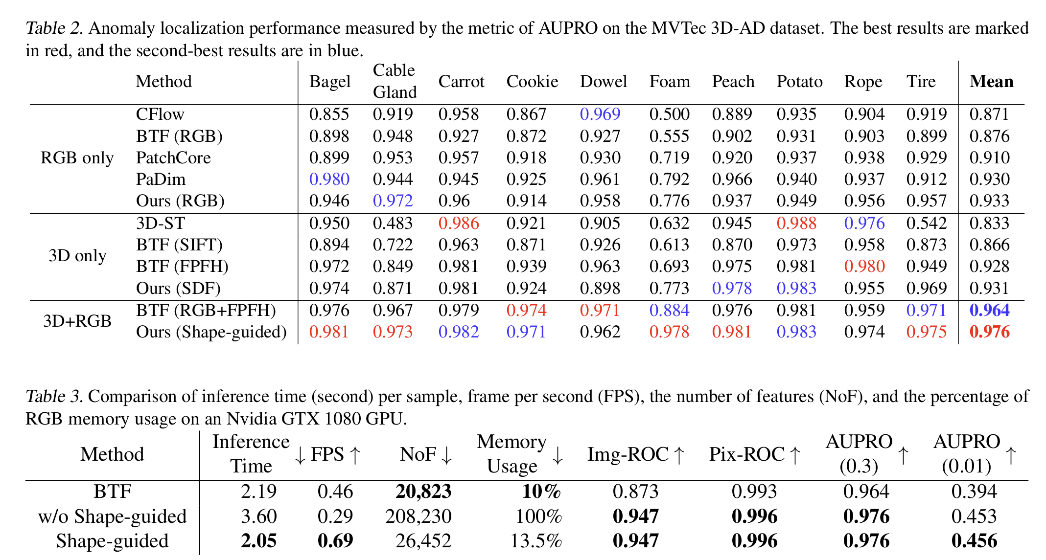
Experiments
Experiment Results:

Slide 16
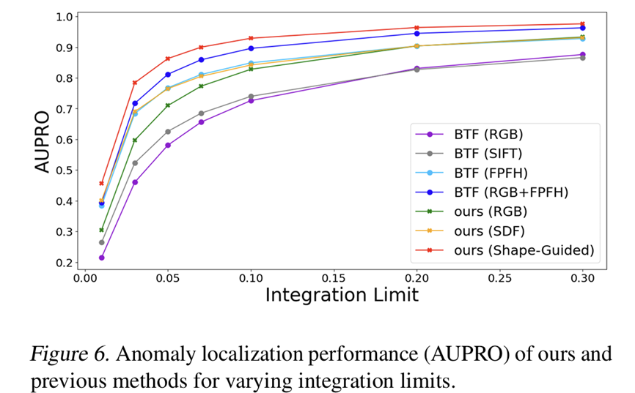
Experiments:
Experiment Results:

Slide 17
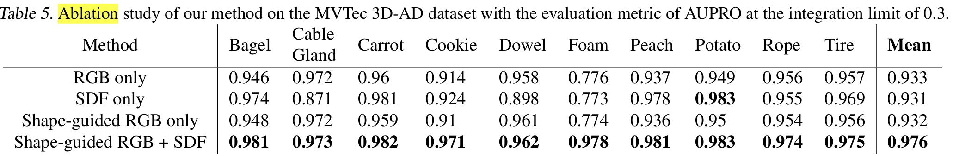
Ablation Study (Optional):

Slide 18
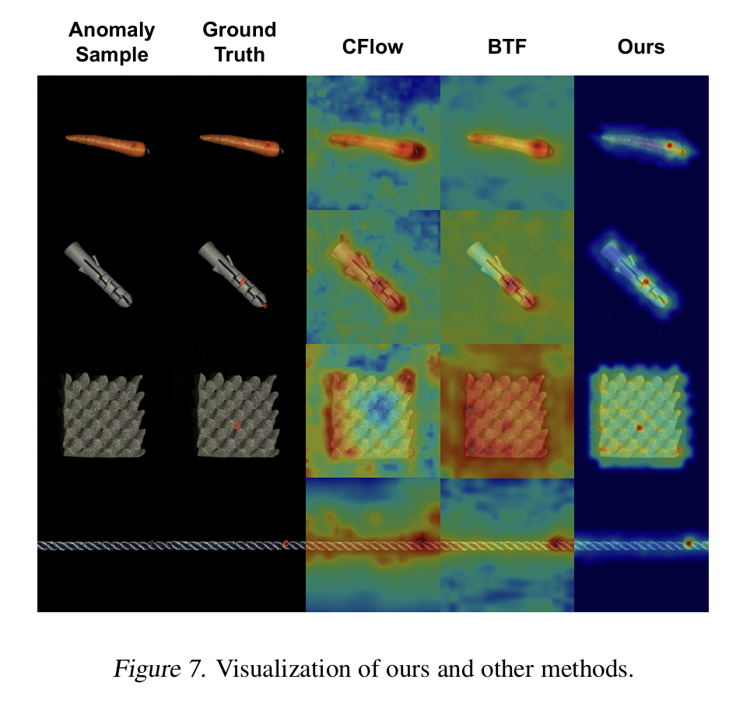
Visualization

Slide 19
Conclusion
Problem: Automating the detection of 3D anomalies using unsupervised methods on complex datasets.
Importance: Enhances accuracy and efficiency in identifying defects, critical for quality control in various industries.
Difficulty: High complexity due to the need for precise localization and the integration of 2D and 3D data.
Results: Achieves state-of-the-art performance with better recall rates, lower false-positive rates, and efficient computation, significantly improving over previous methods.

Slide 20
Thank You for Your Attention

Slide 21
Experiments

