Slide 1
Lab 1: Sequential Multiplier
Lan-Da Van and Chun-Jen Tsai
Department of Computer Science
National Yang Ming Chiao Tung University
Taiwan, R.O.C.
Fall, 2024

Slide 2
Lab 1 Goal: Simulate an 8-bit Multiplier
In this lab, you must simulate the operations of a sequential binary multiplier using the Vivado Simulator.
You should review your textbook on Digital Circuit Design by Mano. Some design guideline of the sequential binary multiplier is in Section 8.10 of Mano’s book.
The multiplier is designed using only adder, shifter, multiplexor, and gate-level operators. You cannot use the multiplication operator of Verilog.
The lab file submission deadline is on 09/16 by 6:00pm.

Slide 3
Write Simulation for a Multiplier
The input/output ports of the 8-bit multiplier is as follows: ‘clk’ is the system clock, ‘enable’ activates the multiplication operation, ‘A’ is the 8-bit unsigned multiplicand input, ‘B’ is the 8-bit unsigned multiplier input, and ‘C’ is the 16-bit unsigned product output.
module SeqMultiplier(
input wire clk,
input wire enable,
input wire [7:0] A,
input wire [7:0] B,
output wire [15:0] C
);

Slide 4
Sequential Binary Multiplier Behavior
Sequential binary multiplication of 10111 and 10011:
23x19 = (437)₁₀
00010111 → multiplicand
× 00010011 → multiplier 00000000 00000000 00000000
00010111 00000000
00000000 00010111
+ 00010111
000110110101 → product

Slide 5
C Model of the Multiplier
The C code that performs the sequential multiplication:
typedef unsigned char Byte;
typedef unsigned short Word;
SeqMultiplier(Byte A, Byte B, Word *C)
{
int idx;
*C = 0;
for (idx = 8; idx != 0; idx--)
{
*C = *C << 1;
if ((B & 0x80) == 0x80)
{
*C += A;
}
B = B << 1;
}
}

Slide 6
Verilog Module of the Multiplier
module SeqMultiplier(input wire clk, input wire enable,
input wire [7:0] A, input wire [7:0] B,
output wire [15:0] C);
reg [15:0] prod;
reg [7:0] mult;
reg [3:0] counter;
wire shift;
assign C = prod;
assign shift = |(counter^7);
always @(posedge clk) begin
if (!enable) begin
mult <= B;
prod <= 0;
counter <= 0;
end
else begin
mult <= mult << 1;
prod <= (prod + (A & {8{mult[7]}})) << shift;
counter <= counter + shift;
end
end
endmodule

Slide 7
Verilog Module of the Multiplier with Comment (1/2)
module SeqMultiplier(
input wire clk,
input wire enable,
input wire [7:0] A,
input wire [7:0] B,
output wire [15:0] C
);
reg [15:0] prod;
reg [7:0] mult;
reg [3:0] counter;
wire shift;
assign C = prod;
assign shift = |(counter^7); //1 if counter<7; 0 if counter==7
/*
Every bit of counter exclusive or 7(4'b0111), and or together
ex: When counter = 4'd2 = 4'b0010, then counter^7 = 4'b0101, shift = 0|1|0|1 = 1
That is, only when counter^7 == 4'b0000 --> counter == 7 will shift be 0.
*/

Slide 8
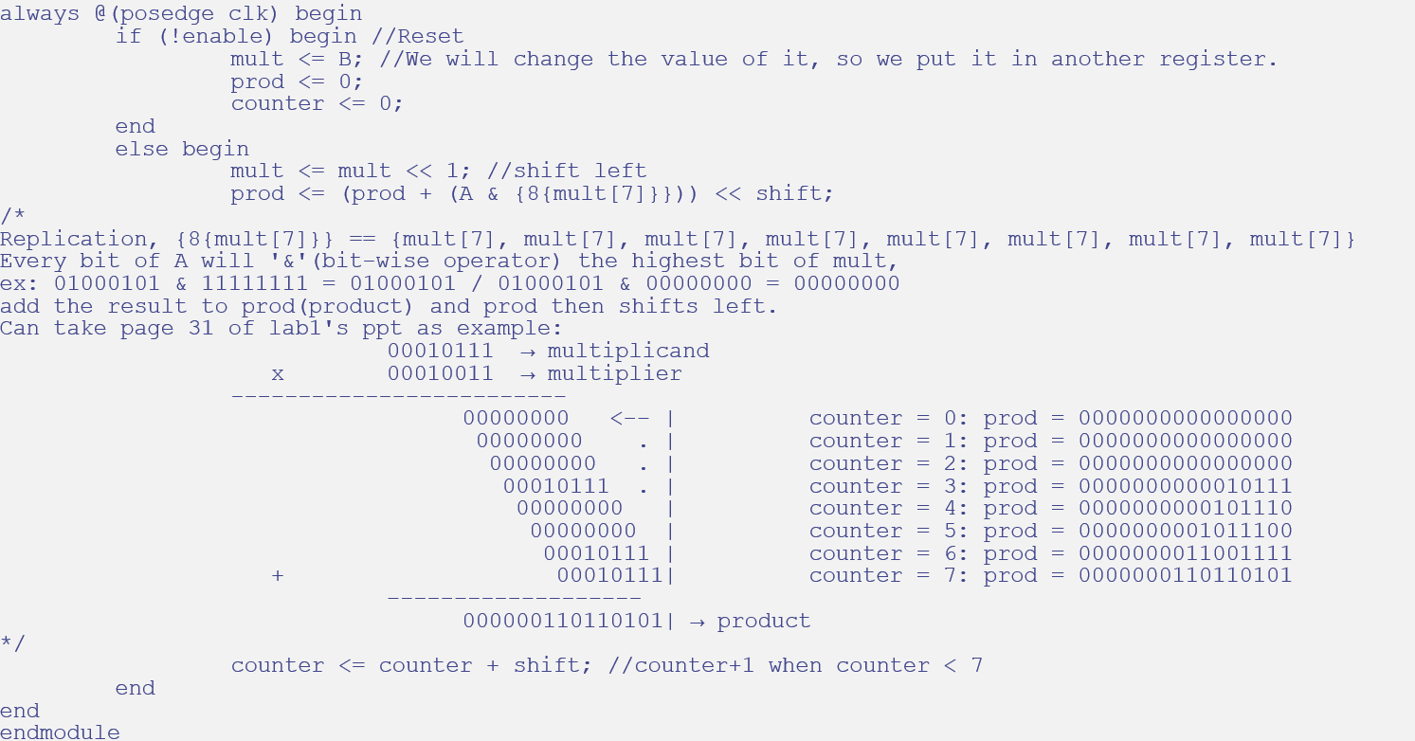
Verilog Module of the Multiplier with Comment (2/2)

Slide 9
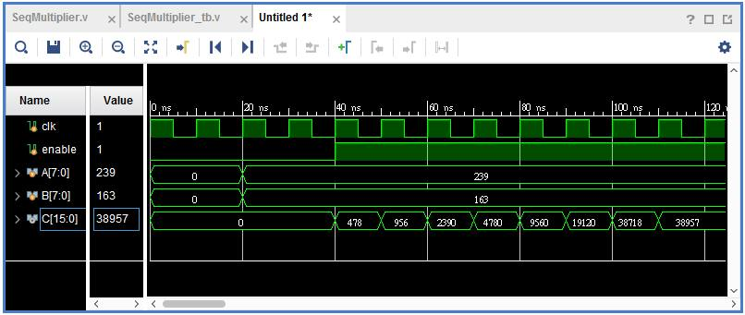
Example of Simulated Waveforms
An example of the timing diagram of 239×163 = 38957

Slide 10
Lab 1 Demo Guide
You can design one 8X8 sequential multiplier in Verilog. You have to finish the design by one-bit by one-bit in shift and add way.
You should complete the simulation and show some multiplication result waveforms.
You should upload your Lab 1 solution to E3 before the deadline.
During the demo time, TA will ask you to modify the testbench to show different results.
You can download your code from E3 during demo.

