Slide 1
Lab 2: Matrix Multiplication Simulation
Chun-Jen Tsai and Lan-Da Van
Department of Computer Science
National Yang Ming Chiao Tung University
Taiwan, R.O.C.
Fall, 2024

Slide 2
Lab 2: Matrix Multiplication Simulation
In this lab, you will design a circuit to do 3×3 matrix multiplications on Vivado Simulator.
Two register arrays of 3×3 matrices will be given to you in the sample Verilog simulation testbench.
You must design a Verilog module to compute their multiplication, and print the result from the testbench.
You must use no more than 9 multipliers to implement your circuit.
The lab file submission deadline is on 09/23 by 6:00pm.

Slide 3
Input Matrix Format
Each input matrix has 9 unsigned 8-bit elements of values between 0 ~ 255. Matrices A and B are declared in Verilog as follows:
Each matrix is stored in a 72-bit register, and each number in the matrix has 8 bits.
The matrix is stored in row-major format.
The output matrix has 9 unsigned 18-bit elements.
reg [0:9*8-1] A = 72'h_4F_7E_57_0F_14_7B_21_4C_54;
reg [0:9*8-1] B = 72'h_17_28_3A_40_2F_33_6C_22_77;

Slide 4
Specification of the Multiplier
The matrix multiplier module is defined as follows:
You must follow this declaration to design your matrix multiplication module in order to use the sample simulation testbench.
module mmult(
input clk, // Clock signal.
input reset_n, // Reset signal (negative logic).
input enable, // Activation signal for matrix // multiplication (tells the circuit // that A and B are ready for use).
input [0:9*8-1] A_mat, // A matrix.
input [0:9*8-1] B_mat, // B matrix.
output valid, // Signals that the output is valid
// to read.
output reg [0:9*18-1] C_mat // The result of A x B.
);

Slide 5
Computation of A_{3×3} × B_{3×3}
A 3×3 matrix multiplication is composed of 9 inner products:
You can compute the outputs in each column of the C matrix in parallel in one clock cycle.
At each clock cycle, you use nine multipliers.
Three columns of the C matrix takes three cycles to compute!

Slide 6
Testbench of the mmult() Module
We provide a testbench for you to test the mmult() module.
The testbench is composed of three parts:
Simulation of the clock and reset signals
Instantiation of the mmult() module and generation of its input signals
Print the output matrix to the console window

Slide 7
Simulation of Cock and Reset Signals
Digital systems usually requires clock and reset signals.
reg clk = 1; // Clock signal
reg reset_n = 1; // Reset signal
// 100MHz clock generator
always
#5 clk = !clk;
// Declare the event
event reset_trigger;
initial begin
forever begin
// Check whether the event //“reset_trigger” is triggered or not
@ (reset_trigger);
@ (negedge clk);
reset_n = 0;
@ (negedge clk);
reset_n = 1;
end
end
// To issue a reset, you must
// trigger a reset event by the
// following code:
initial begin
// Wait for 10 ns and then trigger
// the event “reset_trigger”.
#10 -> reset_trigger;
end

Slide 8
Instantiation & Invocation of mmult()
reg [0:9*8-1] A, B; // 3x3 matrices
wire [0:9*18-1] C;
reg enable;
wire valid;
// Instiantiates a 3x3 matrix multiplier
mmult uut(
.clk(clk), .reset_n(reset_n), .enable(enable), .A_mat(A), .B_mat(B), .valid(valid), .C_mat(C)
);
initial begin
// Add stimulus here
A = 72'h4F_7E_57_0F_14_7B_21_4C_54;
B = 72'h17_28_3A_40_2F_33_6C_22_77;
// Wait for 10 ns and then trigger the event “reset_trigger”.
#10 -> reset_trigger;
// Wait for 100 ns for global reset to finish
#100 enable = 1;
end

Slide 9
Print the Output Matrix
In the simulator, you can print the output to console:
always @(*) begin // @(*) means all the inputs are included.
@(posedge valid);
// Wait one clock cycle so that the output is saved in result[].
#10 $display("\nThe result of C = A x B is:\n");
for (idx = 0; idx < 9; idx = idx+1) // E.g.
begin // for idx = 0
$write(" %d ", result[idx*18 +: 18]);// result[0+:18] = result[0:17]
if (idx%3 == 2) $write("\n"); // for idx = 1
end // result[18+:18] = result[18:35]
$write("\n"); // for idx = 2
End // result[35+:18] = result[36:53]
always @(posedge clk) begin
if (~reset_n) result <= 0; // Reset the register “result”
else if (valid) result <= C; // Write the output “C” into the register
// “result”
else result <= result; // Keep the value in the register “result”
end

Slide 10
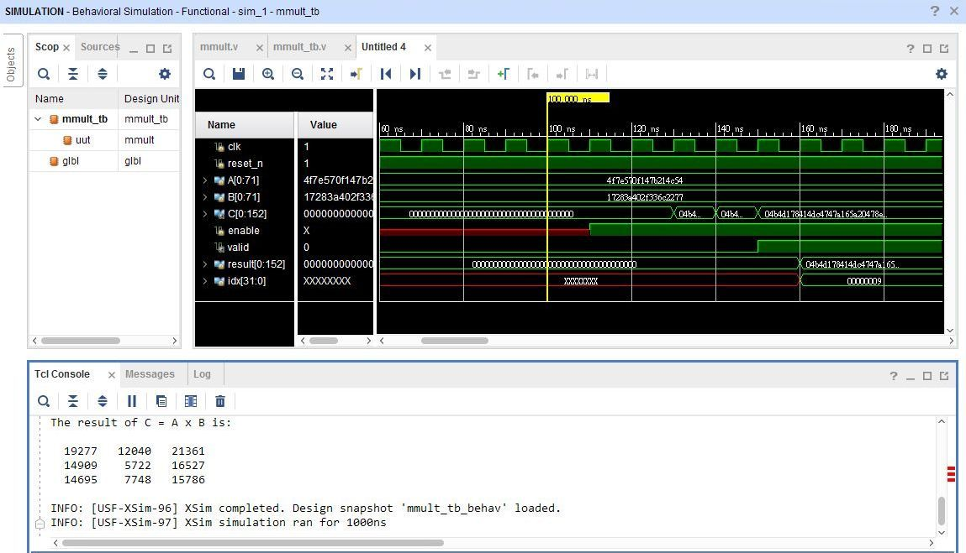
The Simulation Output
The $display() function sends output to “Tcl Console”.

Slide 11
Lab 2 Demo Guide
You can download the sample testbench file mmult_tb.v from E3, and create a Vivado project for it.
You should upload your lab2 solution to E3 before the deadline.
During the demo time, TA will ask you to modify the testbench to show different results.
You can download your code from E3 during demo.

