Slide 1

Swift Programming Basics - 2
2022/3/23

Slide 2
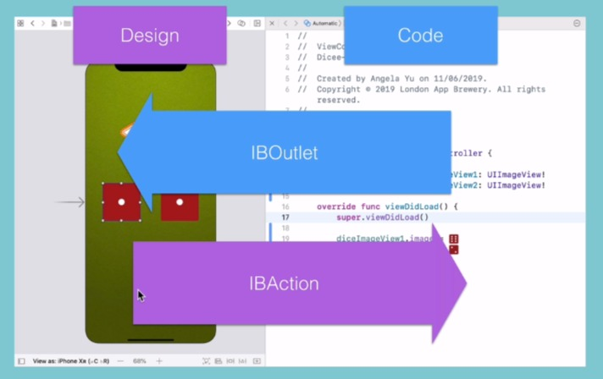
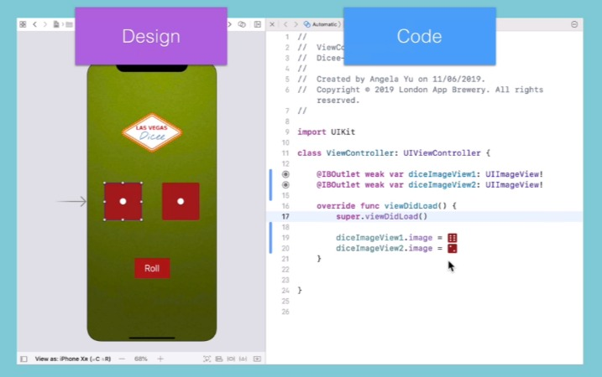
Interface Builder (IB) and Storyboard

Slide 3

Swift Code Style

Slide 4
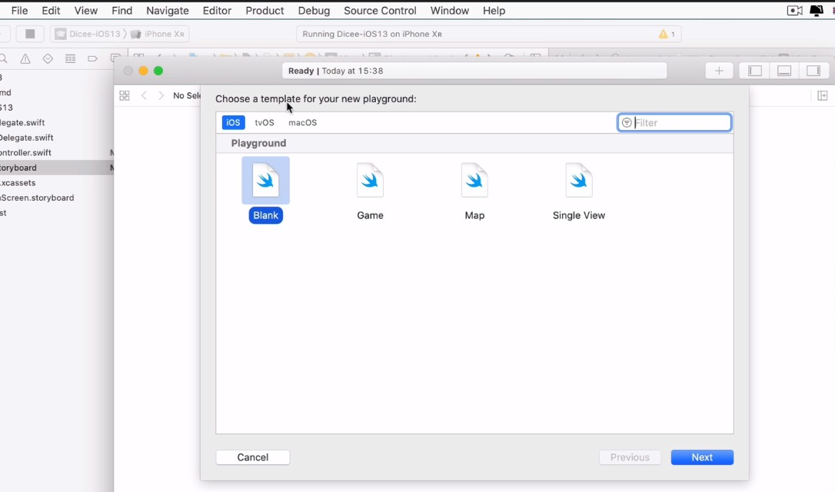
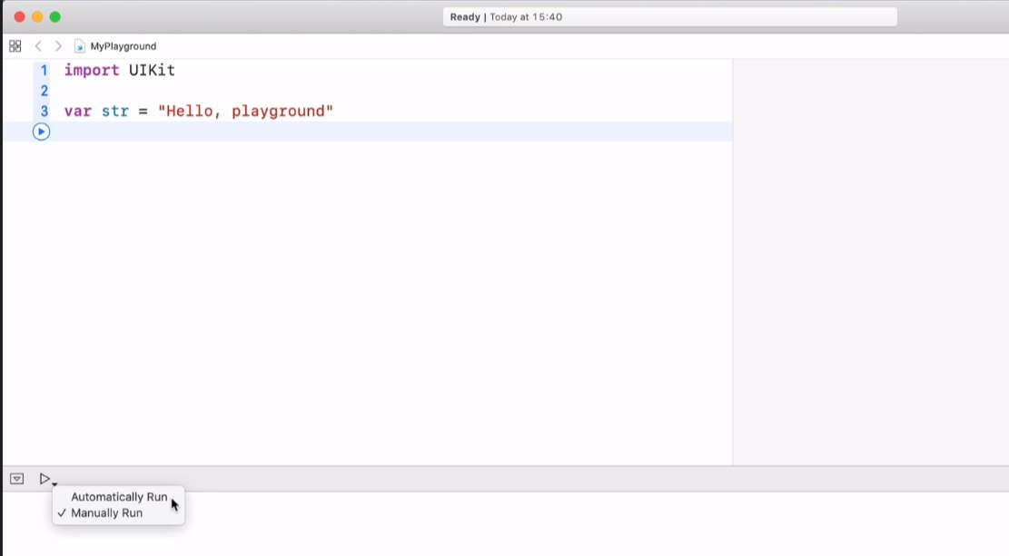
Test Your Code
Head ever to File, New and select Playground, then it should create a new playground, use a blank playground to test your Swift code.

Slide 5
Commenting

Slide 6

Print Statement

Slide 7
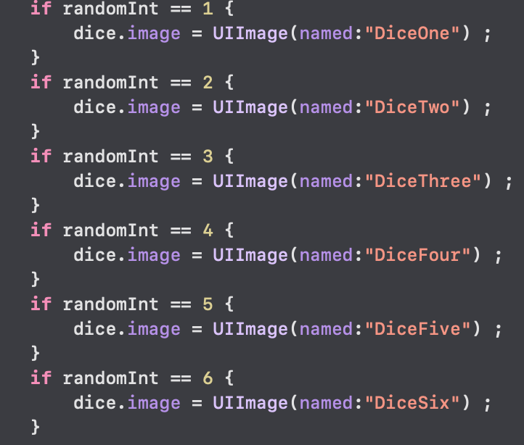
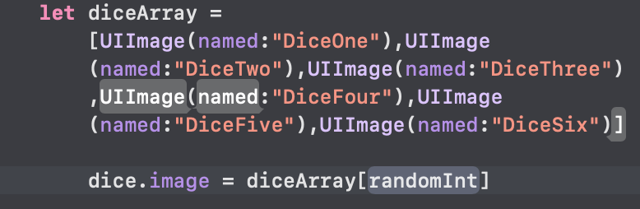
Back to Our Storyboard
It’s hard to use the individually variable.
Instead, we can create an Array as an ordered sequence of items.

Slide 8
Variable
Label
Data
yellowDuck
54088

Slide 9
Creating a Variable
Label
Data
var
=
yellowDuck
54088

Slide 10
Creating a Variable
Label
Data
var
=
yellowDuck
54088
Keyword
Equals

Slide 11
Variable as a Reference to Data
Label
Data
yellowDuck
54088
“不必”
3.14159

Slide 12
Variable as a Reference to Data
Reference
Data
yellowDuck
54088
var yellowDuck = 54088
“不必”
3.14159

Slide 13
Variable as a Reference to Data
Reference
Data
54088
var yellowDuck = 54088
yellowDuck
“不必”
yellowDuck = “不必”
3.14159

Slide 14
Variable as a Reference to Data
Reference
Data
54088
var yellowDuck = 54088
“不必”
yellowDuck = “不必”
yellowDuck
3.14159
yellowDuck = 3.14159

Slide 15
Variable as a Reference to Data
Reference
Data
54088
var yellowDuck = 54088
“不必”
yellowDuck = “不必”
3.14159
yellowDuck = 3.14159
yellowDuck
Object

Slide 16
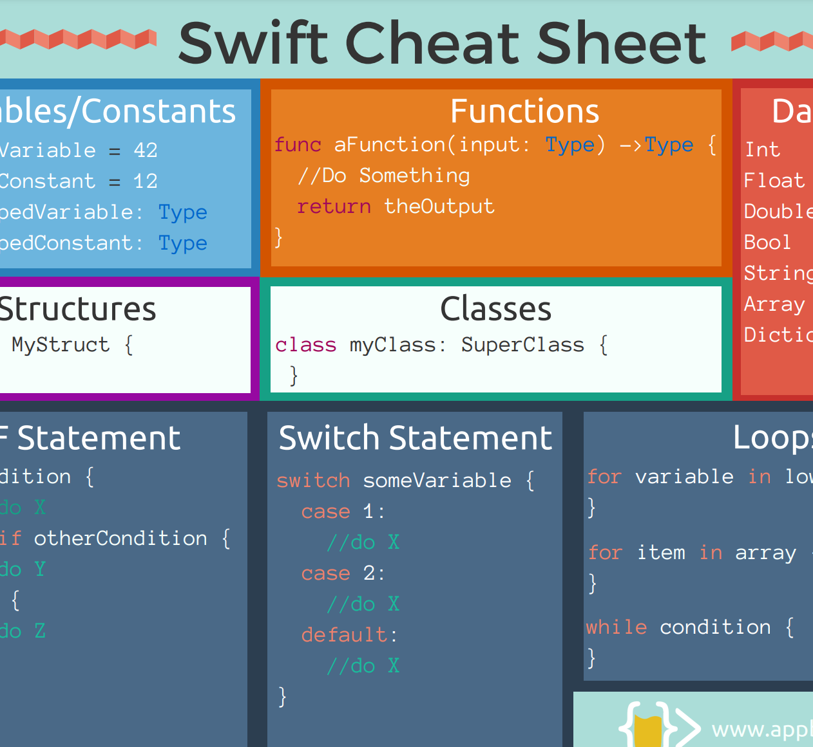
Swift Cheat Sheet
You can download the cheat sheet from E-learning- Swift_Cheat_Sheet.pdf (copyright: www.appbrewery.co)

Slide 17
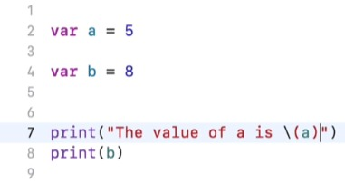
Variable and Print

Slide 18
Challenge(搶答題-3名，加分題10%)
Try to declare two variable and exchange their value, then print their value.
宣告兩個變數，在程式裡交換其資料後印出

Slide 19
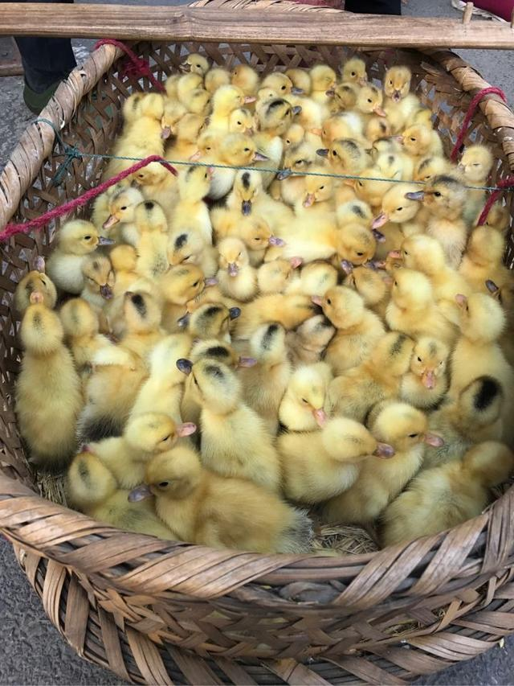
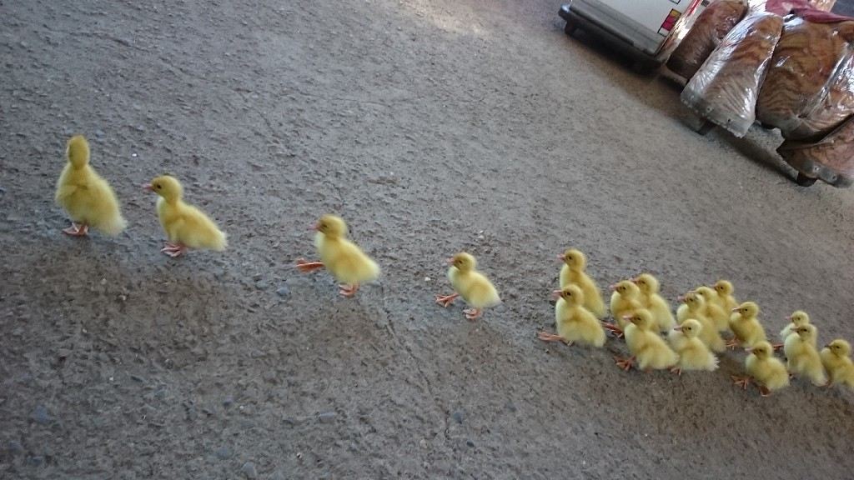
Arrays

Slide 20
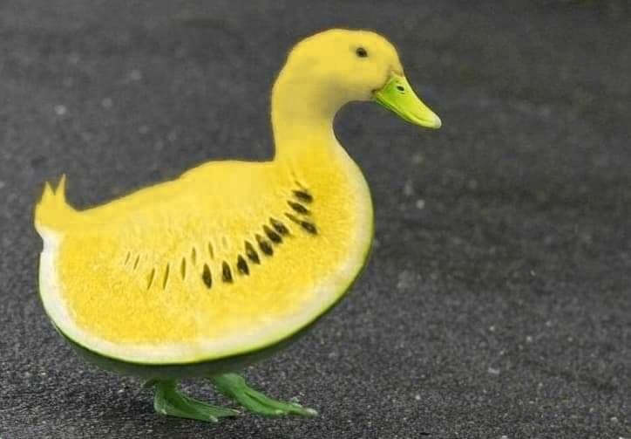
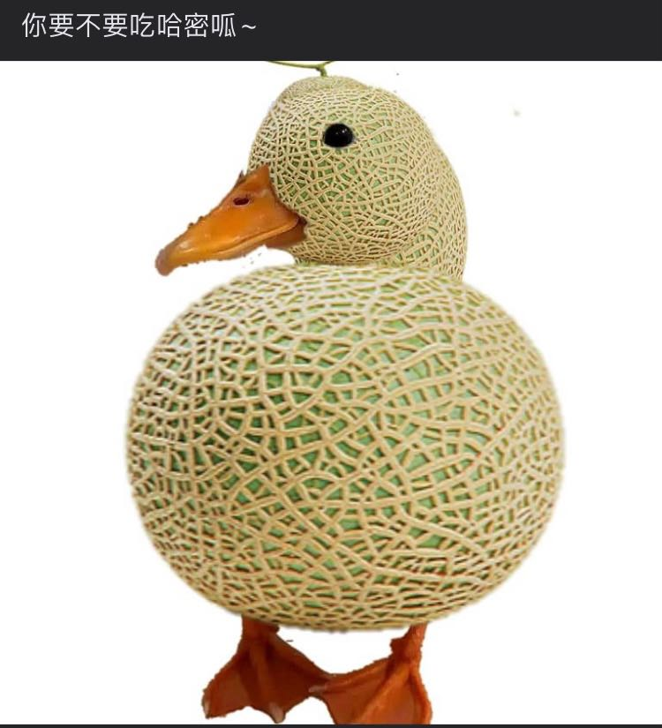
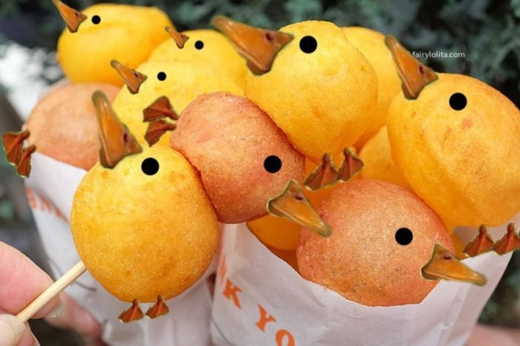
Creating an Array
[
,
,
]
西呱
哈密呱
地呱球

Slide 21
Accessing Items from an Array
[
,
,
]
[
x
]
西呱
哈密呱
地呱球

Slide 22
Accessing Items from an Array
[
0
]
[
1
]
[
2
]
[
,
,
]
[
x
]
西呱
哈密呱
地呱球

Slide 23
Storing Array in a Variable
var
=
[
,
,
]
ducks
西呱
哈密呱
地呱球

Slide 24
Back to Our Storyboard “Again”
It’s hard to use the individually variable.
Instead, we can create an Array as an ordered sequence of items.

Slide 25
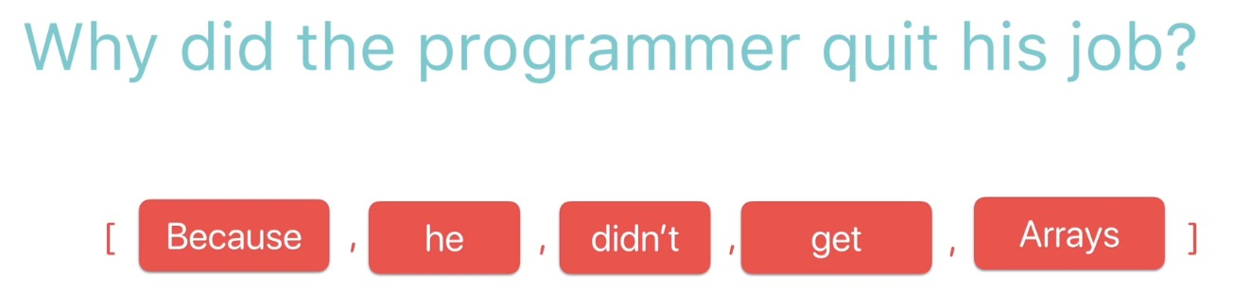

Slide 26

Last Step…

Slide 27

Randomization
We can use the Int.random() function to generate a random integer, the usage is as below:
https://developer.apple.com/documentation/swift/int/2995648-random
to generate a random integer in the range 1~100

Slide 28
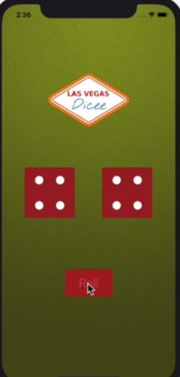
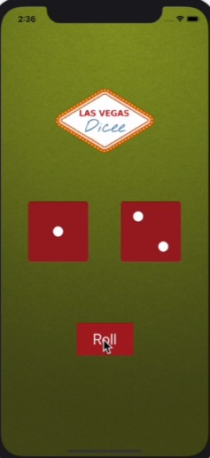
Finish Your Dice program
Let your “Roll” button can randomize the dices.

Slide 29
Exercise 1
Deadline: 2022/4/15 23:59
Please design an iOS app to play a dice game which have the following buttons and functions:
Roll : User can click the button and randomize the dice in the app – 70%
Exchange : User can click it to exchange the faces of two dices – 20%
Order : User can click the button to order the faces by sequence of all dices – 10%
Please upload a word document to E-learning – Homework/Report contained of following things:
Cover : Exercise number / your name / your student ID
Content : Your project’s navigator(專案架構)/ Storyboard / ViewController, please describe it as detail as you can by the snapshot and source code
Result : please illustrate the buttons and functions you have done in your project from snapshots
Free Style is Allowed

Slide 30
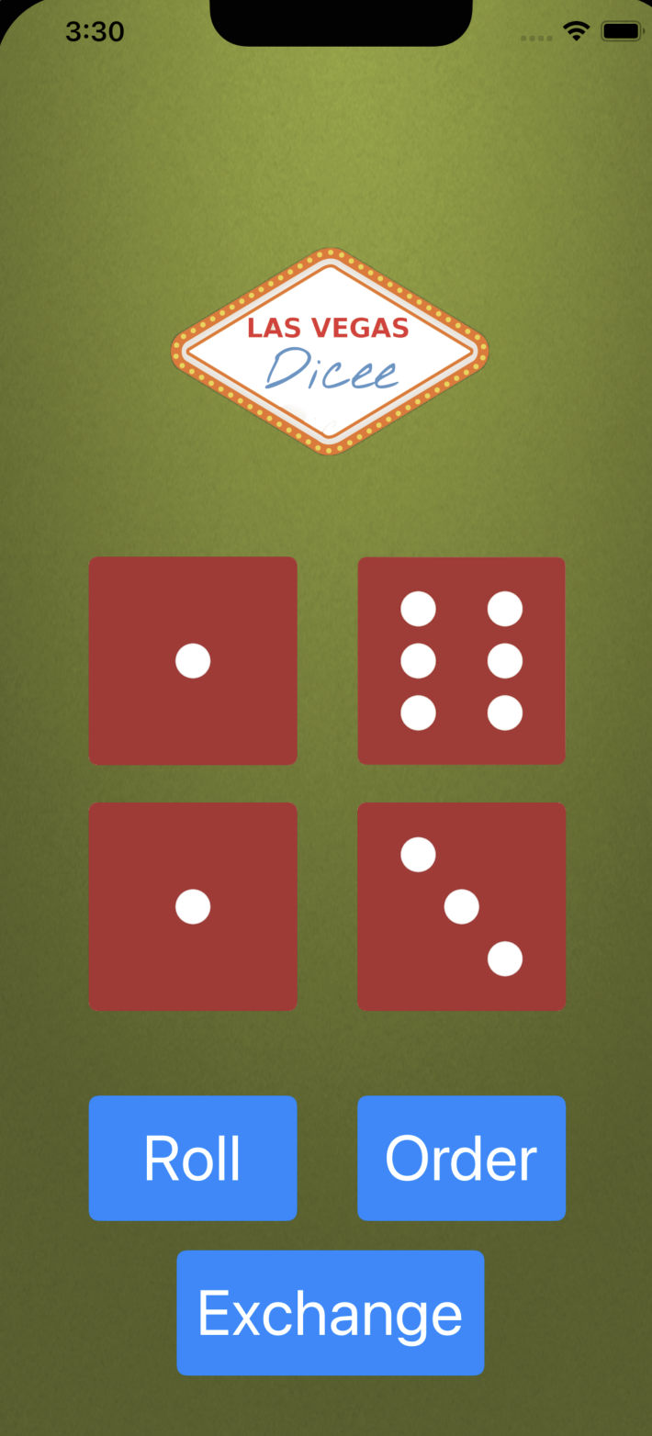
Exercise 1 - Sample

