Slide 1

Swift Programming Basics
Week 4
2022/3/16

Slide 2
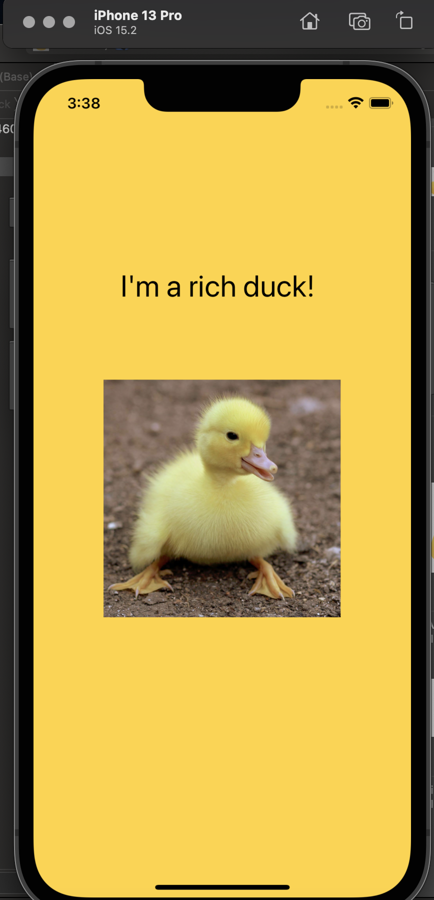
How do we go from a display-only app to something that has user interaction

Slide 3


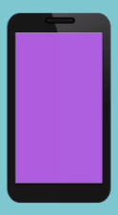
User Interaction

Slide 4
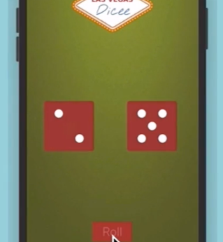
What Will We Make Today…

Slide 5
Outline
1. Designing user interface
2. Changing UI Elements Programmatically
3.Detect user integration and respond to it
4.Learn to use Swift Variables and Array to store data
5.Learn about randomization in swift

Slide 6
Download the initial Project duckdice.zip from E-learning
https://elearning.pu.edu.tw/learn/path/download.php?path=e1FE5NPfGWGOBkHoEY8EMROlxbpybBZA-qwG70Zzjj_0WfYIJ6--Aa67o5r-Lzxz
This project only contains the image set we will use in the lesson, so you can make it your own.

Slide 7
Set The Background Image
The first thing is to grab an Image view to cover the entire area of the app and give our app a background image.
place an image View on the top right corner and we're going to drag the toggles so that it fills the entire screen.
Choose image called green background by Attribute Inspector
Next page you can see the example.

Slide 8
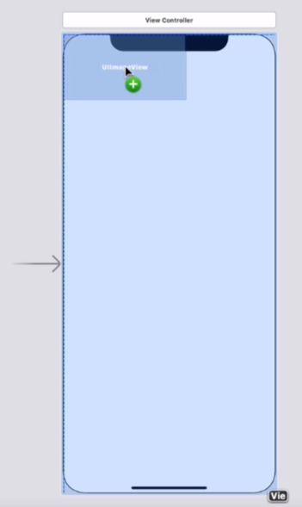
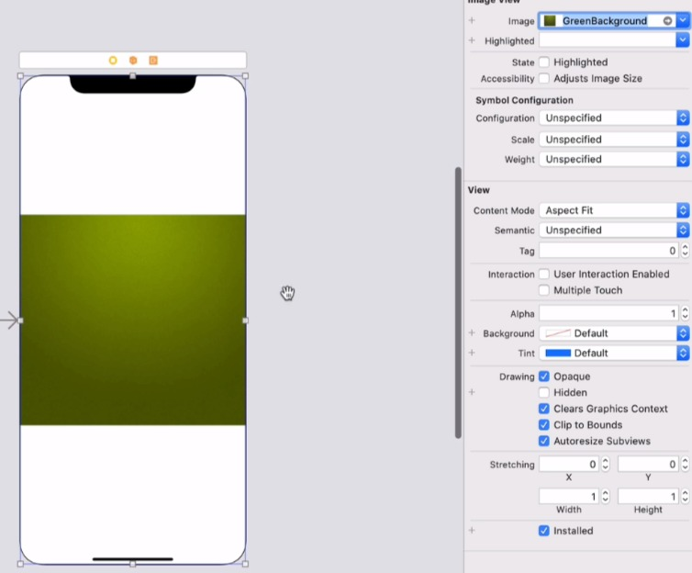
1
2
3

Slide 9
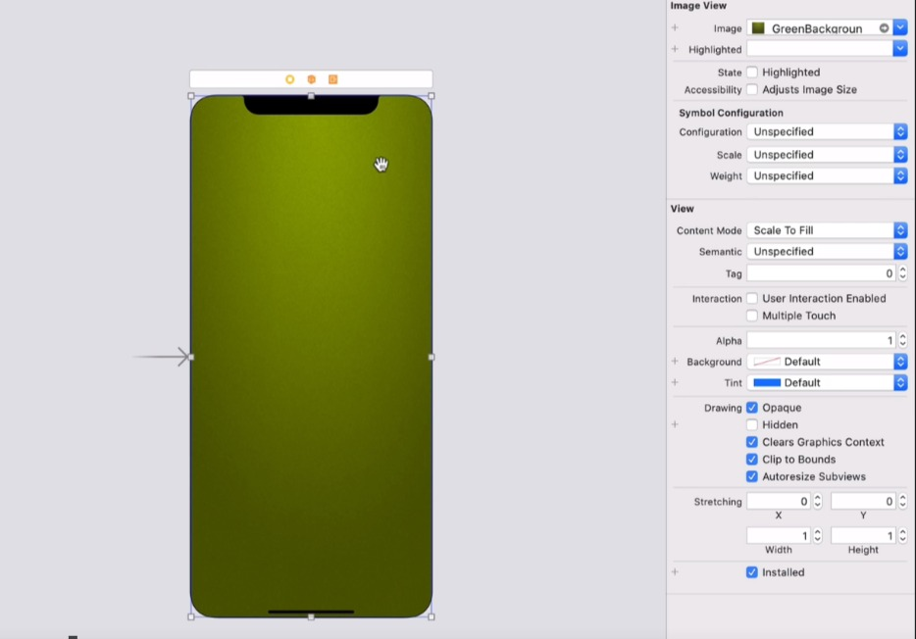
Change The Content Model of Image View
Change to Scale to Fill

Slide 10
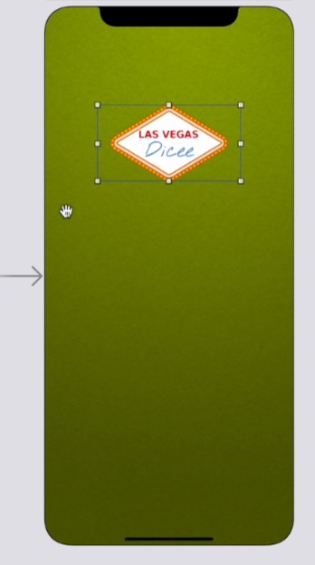
Add The logo
All the image we need is contained in the Assets, please finish this step your own…

Slide 11
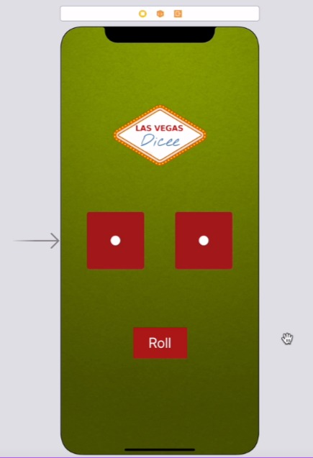
Add Two Dice Images and One Button
All the image we need is contained in the Assets, please finish this step your own…

Slide 12
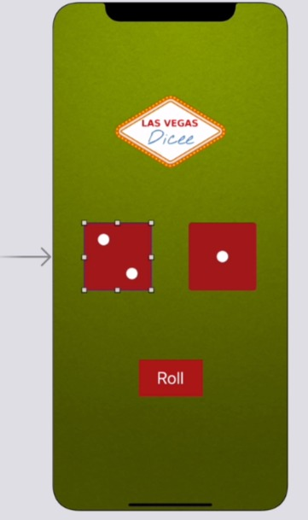
How to Resort The Code?

Slide 13

View Controller

Slide 14
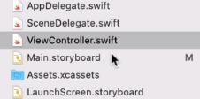
What is View Controller?
When you create any Xcode project, the ViewController.swift always comes with the template.
Notice these are two separate files: the ViewController.swift is our code file and the Main.storyboard is our design file.

Slide 15
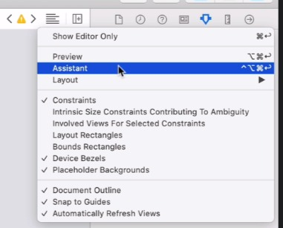
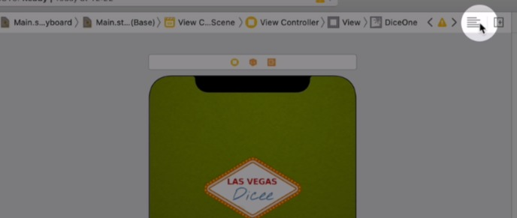
Assistant Editor
Given that we can only write our code in this ViewController file, how can we access the components in the Main.storyboard file?
Assistant editor can help.

Slide 16
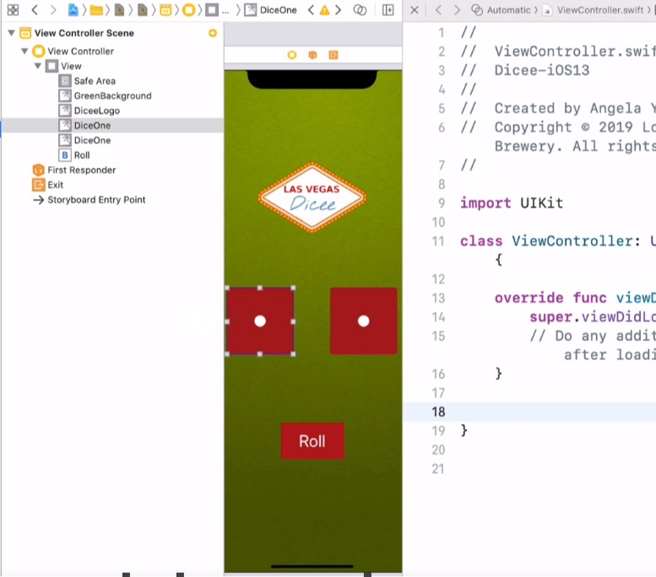
Editor Interface

Slide 17
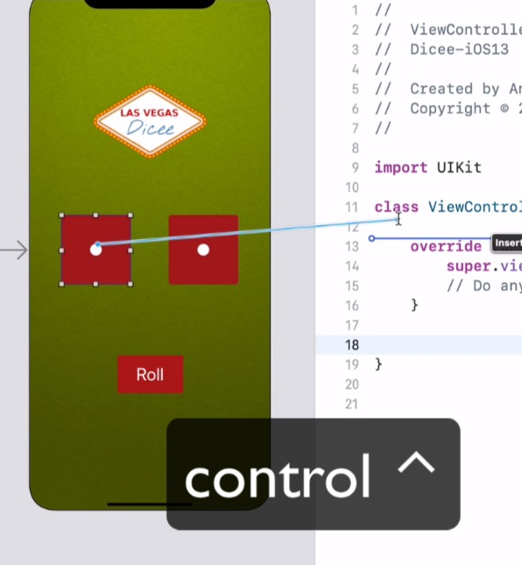
How to Use Assistant Editor
Hold down the control button on our keyboard, not the command button, and click on the Image View DiceOne, and then drag it over to our code file.

Slide 18
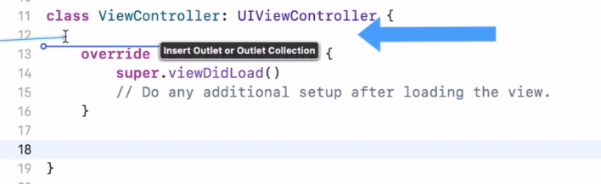
Our First Program
the place where we want to put it is just below this class ViewController on line 10 and before the override function: viewDidLoad, so anywhere between 10 and 12.

Slide 19
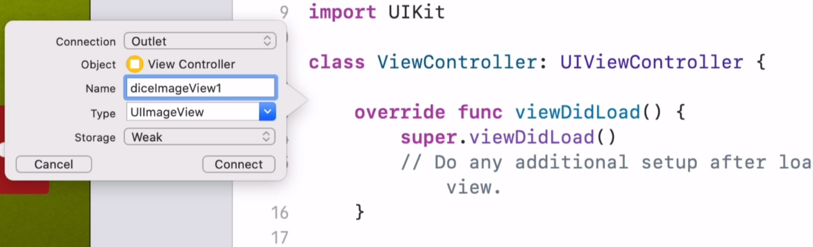
The Connection Between View and Control
First, set the name that we'll use in our code file to refer to this specific Image View.
You can set the name you own, I set “diceImageView” here.
Click connect, then you'll see that we've created an Interface Builder Outlets.

Slide 20
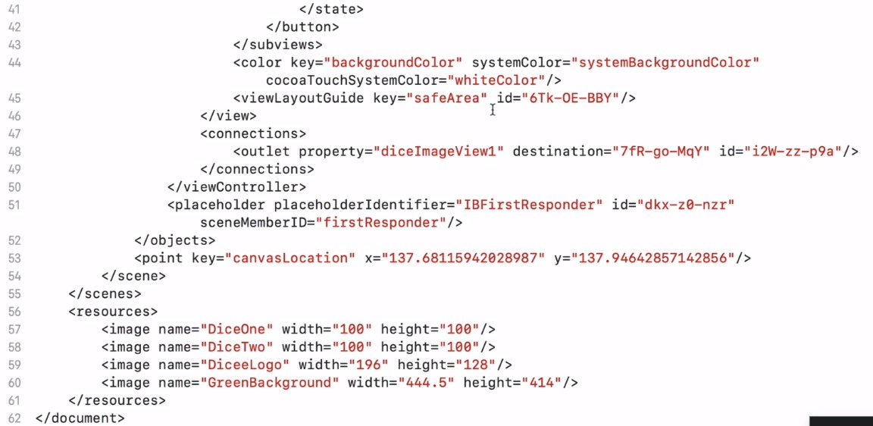
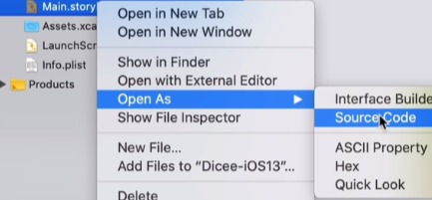
How Can We Know the Name of Objects?
Behind the scenes when we create each of these outlets, there's code that's being written in the Main.storyboard, and you can view it by right-clicking and opening as Source Code.

Slide 21
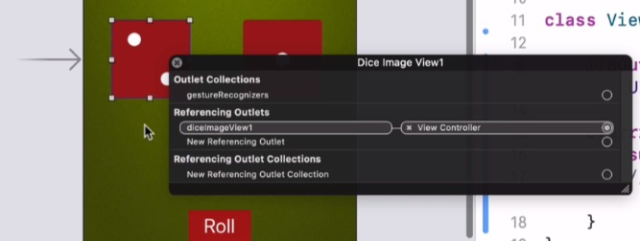
Delete The Connection
When you have connection errors, what you need to do is to simply right click and just delete this connection.

Slide 22
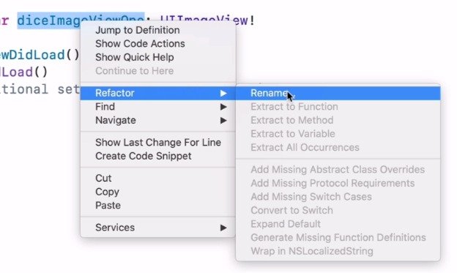
Quickly Rename
The best way for renaming is to right-click on the name you want to change, then go to Refactor, Rename.

Slide 23
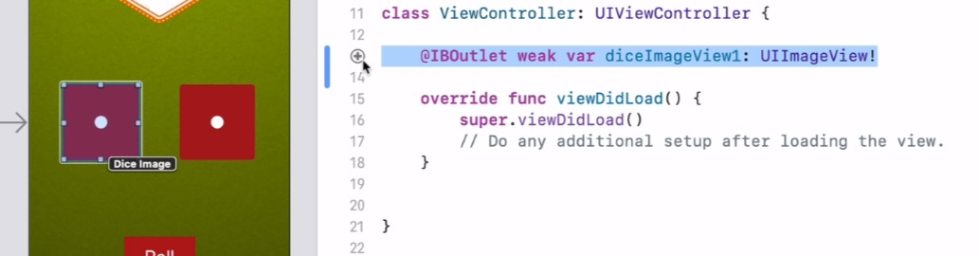
Observe The Connection
When you hover over this little circle, you can see that it's now highlighting the element that's linked to this name.
So, we can now use this name and change the properties of this Image View.

Slide 24
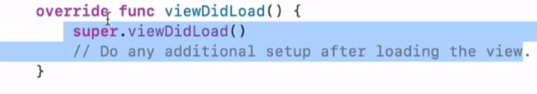
viewDidLoad
There is only two lines of code inside the viewDidLoad and they're all going to be activated depending on when the view loads up.

Slide 25

Dot Notation
We can use the dot notation. The way that we would write our code is
"Who needs to be changed?" (Dot. ) "What property about this thing needs to change?"

Slide 26
Change The Image When Loads Up
Use the imageView’s name: diceImageView1 and the image property as “Who.What”.
Set the Image you want to replace as value.
Who.What = UIImage(named: “DiceSix")

Slide 27
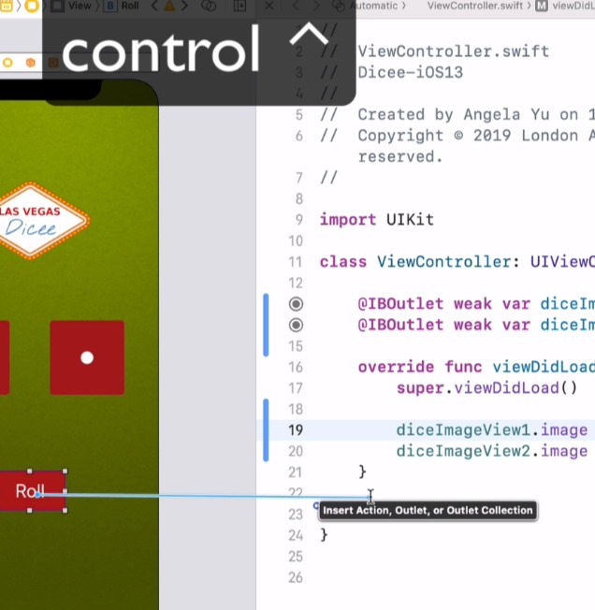
Use The IB Action
Hold down the control button, click and drag, drop it right here just above that final curly brace, notice that the Connection type is usually automatically selected as an Action.

Slide 28
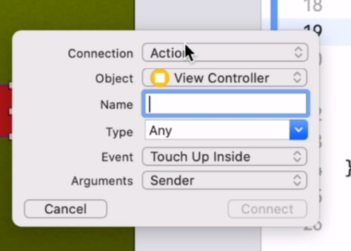
IB Action
Because the Roll button is a button, so the natural way of interacting with it or the natural connection you would want to create is an Action.

Slide 29
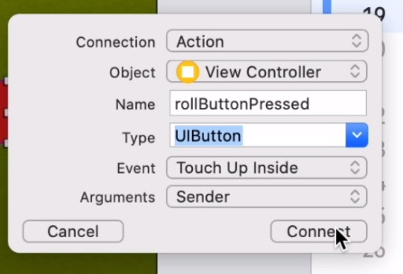
Action Properties
Here I set the action’s name as “rollButtonPressed” to describe the fact that it was tapped, or it was pressed.
Change the type of thing that triggered the action.
If you click on the dropdown list, you can see that we can select that it was a button that triggered the Action

Slide 30

Test The Button
Write a print command in the rollButtonPressed function and see the result.

Slide 31
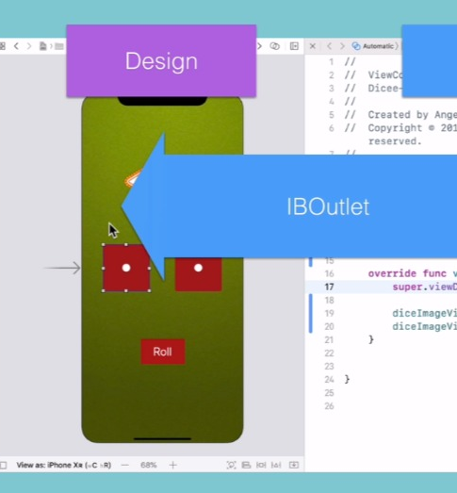
Today’s Work
Combined the two part we learned today and let button’s action to be the modification the two dices.

