Slide 1
Summary of logics
Team Legacy
04.October.2020

Slide 2
Summary of logic flow
Nutrition
Schedule
Exercise
PSQI + sensor
User feedback on subjective and objective sleeping score
PSQI(Pittsburgh Sleep Quality Index)
Exercise type, duration and load based on ESA (European space agency) suggestion and user feedback on previous workout
Schedule to update sleeping and exercise timetable based previous two information
Nutrition guidelines provided based scheduled activities and user attributes

Slide 3
Sleep
Aim: Make sure astronauts have enough rest and slept well both objectively and subjectively.
To do:
Objective sleep scoring system
Subjective sleep scoring system – based on Pittsburgh Sleep Quality Index

Slide 4
Sleep – Objective sleep scoring
Considering the type of data NASA has:
Total sleep time, start and end times, date of data period, sleep onset, sleep latency, sleep efficiency, wake after sleep onset, light (white, blue, red and green) illumination, FMS plans to also include sleep phases: light, deep, rapid eye movement, and wake.

Slide 5
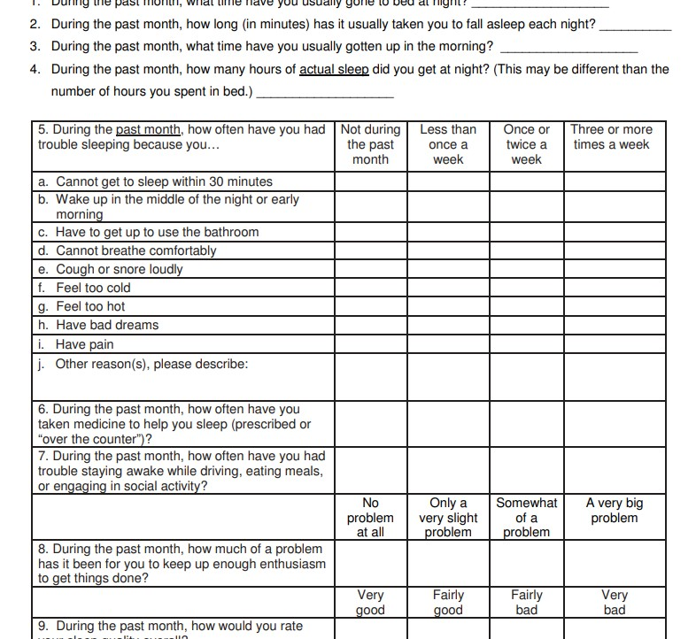
Sleep – Subjective sleep scoring
Subjective sleep scoring system is developed based on gold standard Pittsburgh Sleep Quality Index (PSQI) questionnaire.
Buysse et al. 1988

Slide 6
Sleep – Combination
Based on the objective and subjective scores the schedule planner app would then suggest actions to be taken.
For instance, if the objective score is good (e.g. 80 out of 100), but subjectively astronaut feels tiresome (subjective score), the planar would suggest actions such as mediation (proven to be effective in improving PSQI score; Black et al., 2015).
Another example would be advice to take melatonin if sleep latency was too high (may be effective, shown DIJK et al., 2001)

Slide 7
Nutrition
Aim: replenish astronaut with suitable calories according to gold standard guidance published by WHO and FAO.
To do:
Calculate amount of calories astronaut needs per day
Convert amount of calories to amount (gram) of nutrition to intake per day

Slide 8
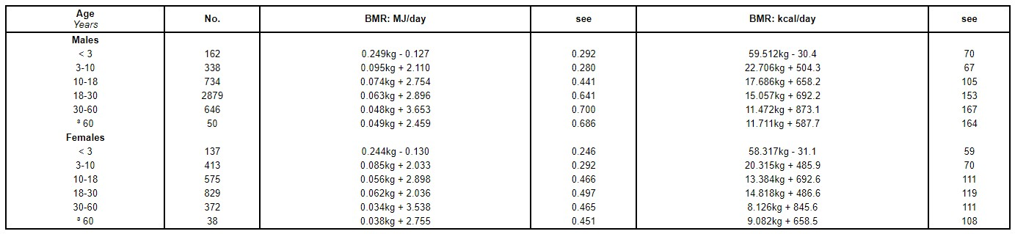
Nutrition – Calories Needed
Baseline suitable energy intake per day is suggested by FAO (Food and Agriculture Organization of the United Nations) given in the following equations
Human energy requirements Report of a Joint FAO/WHO/UNU Expert Consultation, 2001
Note: baseline assume lowest possible energy consumption, i.e. sleeping

Slide 9
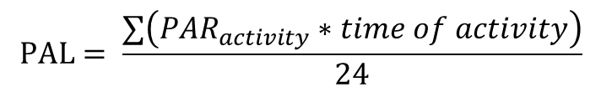
Nutrition – Calories Needed
PAL (physical activity level) adjustment to calories needed, where mean PAL can be calculated from sum of energy cost or basal metabolic rate (PAR) of activity multiplied by time of activity
$$PAL= \frac{∑\left(PAR_{activity}∗time of activity\right)}{24}$$
Human energy requirements Report of a Joint FAO/WHO/UNU Expert Consultation, 2001
PAR was published on annex 5, Human energy requirements Report of a Joint FAO/WHO/UNU Expert Consultation, 2001

Slide 10
Nutrition – what to eat
Protein
Minimum protein intake per day is 0.83 g/kghuman weight
Suggested protein intake 1.2-2.0 g/kghuman weight
“Protein and Amino Acid Requirements in Human Nutrition” WHO, 2002
American College of Sports Medicine
We therefore propose astronaut to have 1.2g/kg of protein if no exercises on the day
and 1.6g/kg of protein if exercised on the day

Slide 11
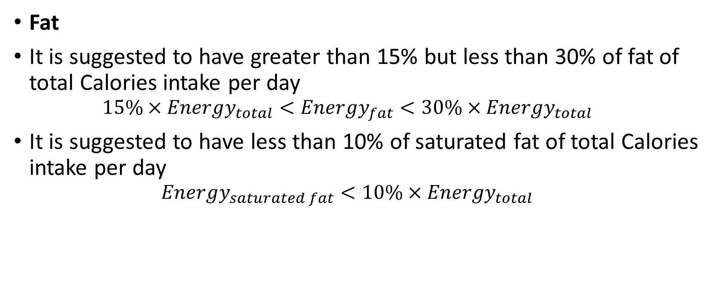
Nutrition – what to eat
Fat
It is suggested to have greater than 15% but less than 30% of fat of total Calories intake per day
$$15\%×Energy_{total}<Energy_{fat}<30\%×Energy_{total}$$
It is suggested to have less than 10% of saturated fat of total Calories intake per day
$$Energy_{saturated fat}<10\%×Energy_{total}$$
“Healthy diet” WHO, 2018

Slide 12
Nutrition – what to eat
Carbohydrates
It is suggested to have between 50-75% of carbonhydrates of total Calories intake per day
Sugar
It is suggested to eat less than 5% of sugar of total Calories intake per day
FAO/WHO Scientific Update on carbohydrates in human nutrition: conclusions. 2007
“Healthy diet” WHO, 2018

Slide 13
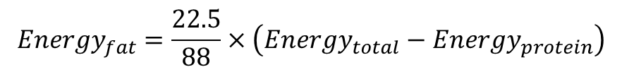
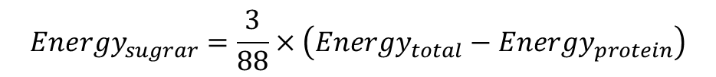
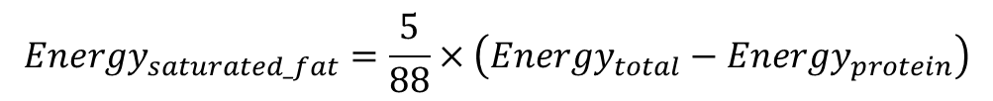
Nutrition – what to eat
The suggested guidance priorities protein intake, making sure
astronaut keeps muscle strength
We therefore propose astronaut to have (22.5/88) of remaining energy
of fat.
In which are saturated:
Carbohydrates:
Sugar:
$$Energy_{fat}=\frac{22.5}{88}×\left(Energy_{total}−Energy_{protein}\right)$$
$$Energy_{saturated_fat}=\frac{5}{88}×\left(Energy_{total}−Energy_{protein}\right)$$
$$Energy_{carbohydrates}=\frac{62.5}{88}×\left(Energy_{total}−Energy_{protein}\right)$$
$$Energy_{sugrar}=\frac{3}{88}×\left(Energy_{total}−Energy_{protein}\right)$$

Slide 14
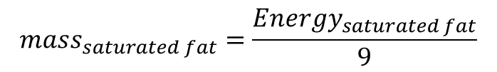
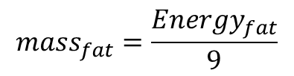
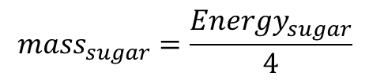
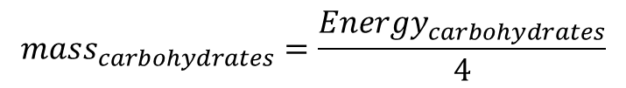
Nutrition – what to eat
This can be converted to mass of nutrition with known nutrition energy per gram:
Fat contains 9 kcal (37 kJ) per gram
Protein contains 4 kcal (17 kJ) per gram
Carbohydrate contains 4 kcal (17 kJ) per gram
British nutrition foundation
$$mass_{fat}=\frac{Energy_{fat}}{9}$$
$$mass_{saturated fat}=\frac{Energy_{saturated fat}}{9}$$
$$mass_{carbohydrates}=\frac{Energy_{carbohydrates}}{4}$$
$$mass_{sugar}=\frac{Energy_{sugar}}{4}$$

Slide 15
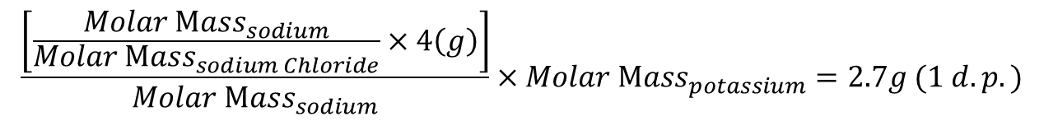
Nutrition – what to eat
Sodium
It is suggested to have less than 2g of sodium or 5g to table salt (sodium chloride) intake
Potassium
It is suggested to have 1:1 molar ratio of potassium to sodium intake
“Guideline: Sodium intake for adults and children” WHO, 2012
“Guideline: Potassium intake for adults and children” WHO, 2012
We therefore propose astronaut to have 4g of table salt intake per day
Potassium intake can be calculated by
$$\frac{\left[\frac{Molar Mass_{sodium}}{Molar Mass_{sodium Chloride}}×4\left(g\right)\right]}{Molar Mass_{sodium}}×Molar Mass_{potassium}=2.7g (1 d.p.)$$

Slide 16
Exercise
3 phases
1. adaptation phase first 1-20 days of mission
2. main phase 130-150 days
3. preparation for reentry, final15-30 days of mission

Slide 17
Exercise
Phase 1
Start from 2nd day / 3rd day
Cycle ergometer <= 1hr
1hr → 2.5hr
Cycle ergometer (30), treadmill (30) and resistive exercise devices (60) balance use, 4-5 sessions per device each week in a periodic order.
Intensity is relatively low (50-60% of pre-flight capacity)
Note: setup takes ~ 1 hour

Slide 18
Exercise
Phase 2
3-5% increment per week, goal 80% or higher of individual maximal capacity
6-7 resistance + 4-7 cardio sessions per week.
Focus on lower limbs

Slide 19
Exercise – code logic
Aim: schedule suitable workout for astronaut
Identify intensity of training based on
Target
Previous user feedback on training difficulties.
Identify workout to do, time length, and load

Slide 20
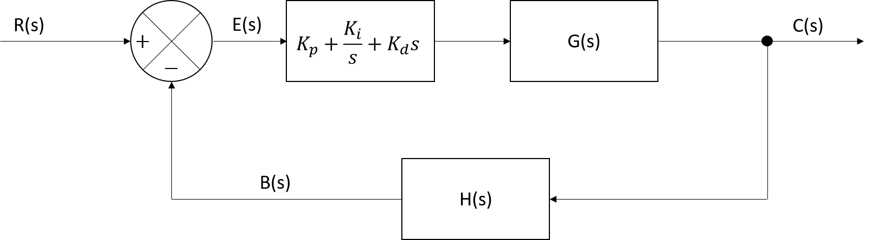
Exercise – Identify intensity of training
Adopt PID controller
Where R(s) is target work load, B(s) is user feedback work load

Slide 21
Exercise - Identify workout to do, time length, and load – phase 1
Workout can be separated into phase 1, adaptation phase, and phase 2, main phase.
Phase 1 criteria:
Last for 21 days
No workout on day 1
Target load starts from 50-60% of max pre-flight workout load capacity
Phase 1 parameter used:
Last for 21 days
No workout on day 1
Total exercise time = setup time + actual workout time, where actual workout time is assumed to be 0.6*Total exercise time
Workout (total exercise) time: 1st week – 1 hr; 2nd week – 2 hrs; 3rd week – 2.5 hrs
Workout load (of max capacity): 1st week – 50% normally but 60% if astronaut found easy; 2nd week onwards decided by PID controller.
Exercise in space: the European Space Agency approach to in-flight exercise countermeasures for long-duration missions on ISS, 2016

Slide 22
Exercise - Identify workout to do, time length, and load – phase 2
Phase 2 criteria:
Days after 21st day
Target load starts from 80% of max pre-flight workout load capacity
Phase 2 parameter used:
Days after 21st day
Total exercise time = setup time + actual workout time, where actual workout time is assumed to be 0.6*Total exercise time
Workout (total exercise) time: 2.5 hrs
Workout load (of max capacity): decided by PID controller.
Exercise in space: the European Space Agency approach to in-flight exercise countermeasures for long-duration missions on ISS, 2016

