Slide 1
MASTER'S THESIS DEFENSE | EN 593 | DUAL DEGREE PROJECT
Forecasting WTI Crude Oil Prices
using Deep Learning
A Multi-Horizon Framework with Rigorous Evaluation
Aayush M Anand
Guide: Prof. Lalit Kumar
Roll No. 21D170001
EN 593 | Dual Degree Project
Dept. of Energy Science and Engineering, IIT Bombay | June 2026
1

Slide 2
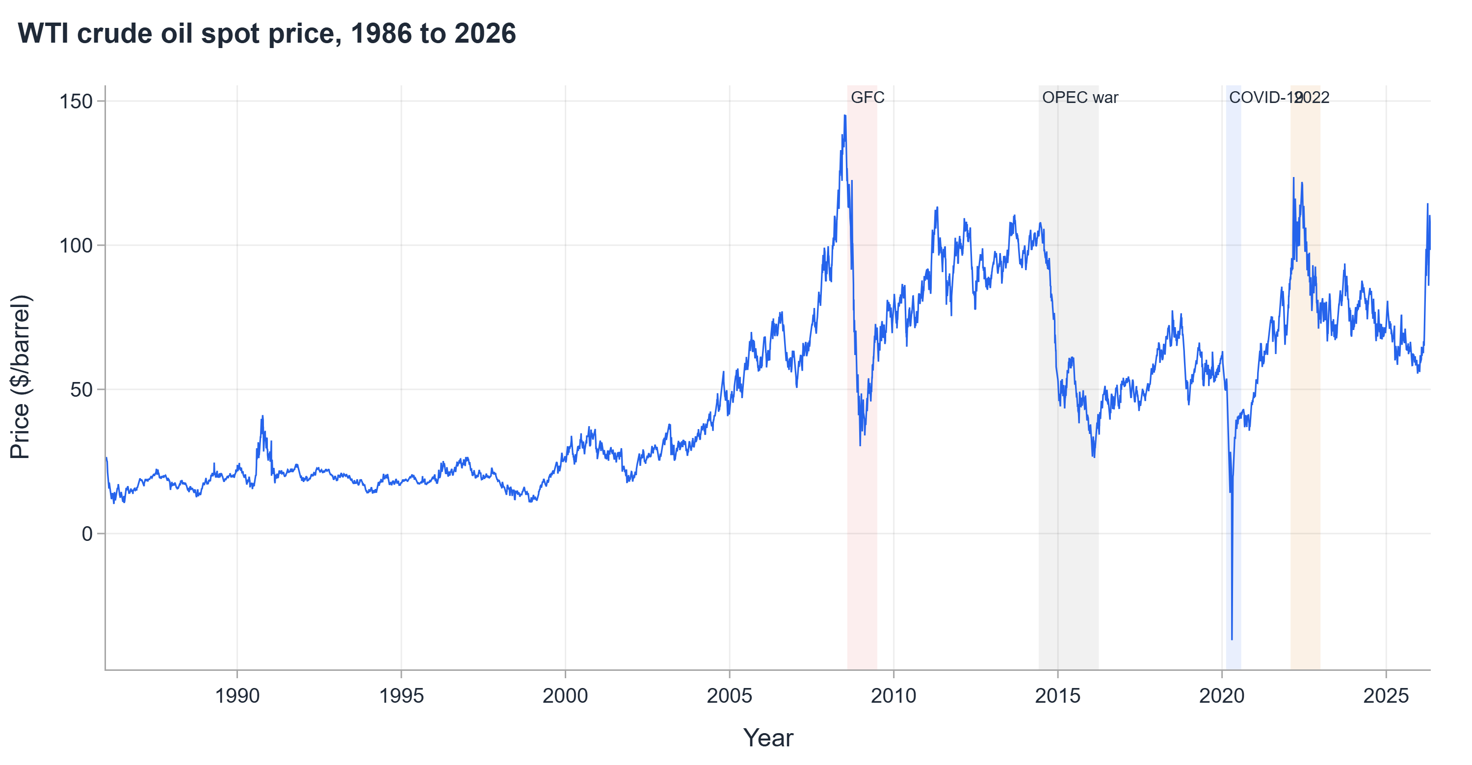
INTRODUCTION
Why Crude Oil Price Forecasting
WTI is the global benchmark; errors at every horizon carry real economic consequences
▪ Series is heavy-tailed (daily kurtosis 7-12 vs Gaussian 3) and punctuated by four major crisis episodes: GFC, OPEC glut, COVID, 2022 disruption
▪ Every $1/barrel forecast error at 90 days drives procurement, hedging, and capital planning overruns for refiners and oil-importing economies
▪ Published models overstate real performance; no prior study evaluated against a naive benchmark under a strict walk-forward protocol
7-12x
4
$10
Daily kurtosis vs Gaussian 3
Crisis episodes since 2007
Per bbl adds 0.3-0.5% to inflation
2

Slide 3
MOTIVATION
Gaps in Earlier Thesis Work
Eight methodological gaps addressed in this work
Prior work limitation | This work's fix
No naive benchmark | Naive MAE as skill denominator at every horizon
Normalised metrics without physical meaning | All results in US dollars per barrel
Single chronological split | Expanding walk-forward from 2007; all crises out of sample
One-day horizon only | Four horizons: 1d, 7d, 90d, 180d
Narrow feature set; preprocessing on full series | Up to 69 features; all preprocessing fitted in-sample
Point forecasts only | Calibrated prediction intervals and EVT tail-risk layer
No statistical significance testing | Diebold-Mariano test across all model pairs
Static general-purpose text features | Domain-aware features including CrudeBERT embeddings
3

Slide 4
METHODOLOGY
Forecasting Framework
End-to-end pipeline from raw price series to calibrated risk output
WTI Price
1986-2026
Feature
Engineering
Two Tracks
17 Architectures
Probabilistic
Layer
~10,000 obs
Up to 69 features
All preprocessing
in-sample
Track A (decomposition)
Track B (walk-forward)
5 families
Identical evaluation
Conformal + EVT
tail risk
38 years
17
4 horizons
of daily WTI price data, 1986 to 2026
neural architectures across 5 families
1 day | 7 days | 90 days | 180 days
4

Slide 5
DATASET
Dataset and Feature Engineering
40 years of WTI spot prices and up to 69 engineered features across horizon-specific panels
Primary series
▪ WTI crude oil spot price (FOB Cushing, OK), 1986 to 2026, from EIA via FRED
▪ All preprocessing (normalisation, scaling, feature means) fitted on training data only
▪ Winsorised at 1st and 99th percentile to limit outlier influence
48
+13
+8
1d and 7d
90d adds
180d adds
Price, returns, volatility, momentum, cross-asset, HMM regimes
Inventory, CFTC positioning, policy uncertainty, futures curve
Slow macro, GDP, Fed funds, long moving averages
5

Slide 6
DATASET
Exogenous Data Sources
Eight categories beyond price, each with a methodological rationale; collected with fallback sources for build reliability
Category | Representative series | Why it is included
Cross-asset | Equity index, Brent, natural gas, gold, USD index, 10-year yield | Risk-on / risk-off co-movement
Volatility | Market VIX, oil-specific volatility index (OVX) | Oil volatility adds incremental predictive power
Futures structure | Front and deferred contract prices | Contango / backwardation reflect storage conditions
Macroeconomic | Industrial production, CPI, GDP, policy rate, yield spread | Structural demand drivers
Supply and inventory | Cushing stocks, national crude stocks, rig count | Near-term supply and demand pressure
Cartel production | OPEC member-country production volumes | Dominant structural supply driver
Policy uncertainty | Economic policy uncertainty index, geopolitical risk index | Policy shocks transmit rapidly to the market
Positioning | CFTC managed-money long, short, open interest | Positioning leads price moves over subsequent weeks
Public attention and text | Google Trends oil-related terms; news tone and entity sentiment | Demand nowcast and directional signal from media
More than 100 features across roughly 15 categories; horizon-specific panels of 48, 61 and 69 features at 1d/7d, 90d and 180d respectively, all fitted on training data only.
6

Slide 7
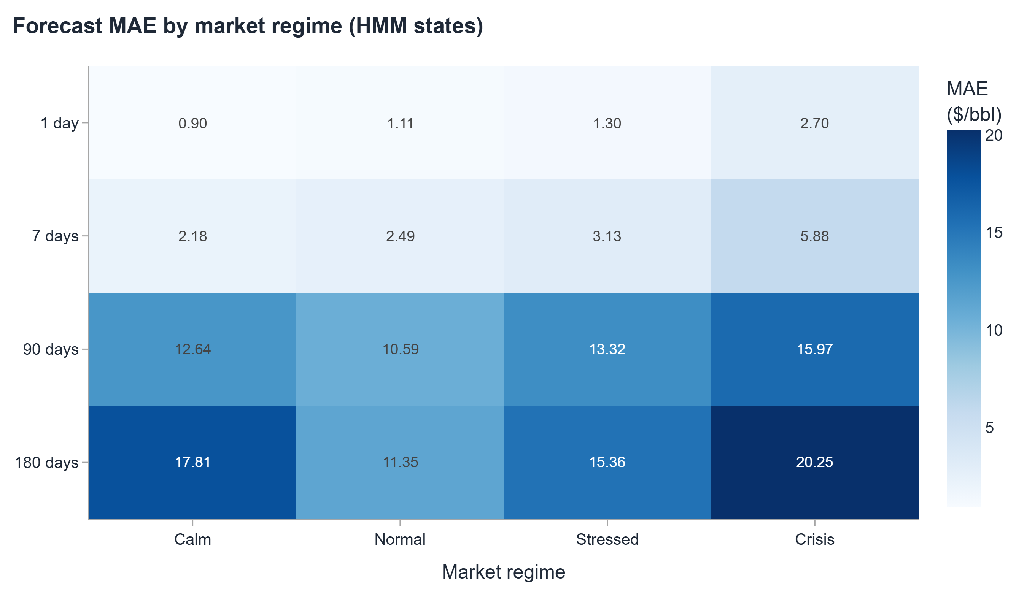
DATASET
Four Market Regimes
A 4-state Gaussian HMM labels every trading day; crisis days receive 3x sample weight in training
Calm
3,117 days (30.7%)
7d MAE $2.18
Normal
2,790 days (27.5%)
7d MAE $2.49
Observed during crisis periods
Stressed
3,227 days (31.8%)
7d MAE $3.13
Crisis days are only 10% of the sample but drive the majority of total loss: 7d error of $5.88 is more than double the calm-regime figure, and the 180d crisis error of $20.25 is the largest in the regime table. The calibrated interval is the most valuable output here, widening correctly even when the point forecast is poor.
Crisis
1,024 days (10.1%)
7d MAE $5.88
7

Slide 8
EVALUATION DESIGN
Expanding Walk-Forward Protocol
Every forecast uses only data available at the forecast origin, with no lookahead at any step
Fold 1
TEST
Fold 2
TEST
Fold 3
TEST
Fold 4
TEST
1986
1995
2007
2015
2026
GFC
OPEC
COVID
No lookahead
All crises covered
1,000+ origins
Decomposition refitted inside each fold, never on the full series
GFC, OPEC glut, COVID, 2022 all fall strictly out of sample
Per horizon; every origin evaluated with a fresh model
8

Slide 9
METHODOLOGY
Two Evaluation Tracks
Complementary views of the forecasting problem, not directly comparable results
Track B
Track A
Direct Walk-Forward
Decomposition Benchmark
▪ No lookahead at any step
▪ 11 neural architectures
▪ VMD re-fitted inside each fold
▪ Represents operational forecasting conditions
▪ All out-of-sample accuracy claims derive from Track B
▪ Follows published Yu and Huang protocols exactly
▪ VMD/EMD applied to the full series before split
▪ 15 architectures across 2 decomposition protocols
▪ Purpose: compare against published benchmarks
▪ Not used for out-of-sample claims
Best 7d MAE
Best 7d MAE
$2.39 /bbl
$1.25 /bbl
Benchmark inflation quantified: the gap between tracks at each horizon measures how much of the published accuracy depends on the decomposition design.
9

Slide 10
MODEL PANEL
17 Architectures Compared
All trained under identical pipeline, same feature set, same walk-forward protocol
Transformer
PatchTST | Informer | iTransformer | Autoformer | FEDformer | TFT
Long-range attention with varied tokenisation; generally strongest at 7-day horizon
MLP and Hybrid
TimeMixer | N-HiTS | TiDE | SegRNN
Hierarchical or multi-scale decomposition; effective when temporal structure is smooth
Conv / Recurrent
TCN | TCN-BiLSTM | CNN-BiLSTM-Attn
Local convolutional filters with sequential memory; best directional accuracy at 7 days
Linear
DLinear | NLinear
Lightweight linear projections; strongest on decomposed components at 90d and 180d
Foundation (zero-shot)
Chronos (Amazon) | TimesFM (Google)
Pre-trained on large corpora; evaluated zero-shot with no task-specific fine-tuning
10

Slide 11
MODEL PANEL
Model Comparison Across Both Tracks
Top performers by 7-day error within each track and protocol; full leaderboard of 30+ models in the appendix
Model | 1d | 7d | 90d | 180d | Track
Track B — direct walk-forward
Informer | $1.22 | $2.39 | $13.32 | $16.93 | B
TCN-BiLSTM | $1.22 | $2.43 | $12.75 | $16.90 | B
Track A — Huang decomposition
NLinear head | $0.81 | $1.25 | $6.22 | $13.15 | A
DLinear head | $1.00 | $1.44 | $5.23 | $11.94 | A
Track A — Yu decomposition
NLinear head | $0.69 | $1.77 | $12.22 | $16.88 | A
Reference
Naive baseline | $1.22 | $3.21 | $12.37 | $16.78 | -
Track A reaches lower error at every horizon by forecasting smooth decomposed components; Track B is the strict origin-by-origin test underlying every operational claim in this work.
11

Slide 12
HEADLINE RESULT
Headline Results
All figures in US$/barrel, mean absolute error. Track B is the operational benchmark.
Horizon | Naive MAE | Best Track A | vs Naive | Best Track B | vs Naive
1 day | $1.22 | $0.69 | -43% | $1.22 | 0%
7 days | $3.21 | $1.25 | -61% | $2.39 | -26%
90 days | $12.37 | $5.23 | -58% | $12.56 | -2%
180 days | $16.78 | $11.59 | -31% | $15.62 | -7%
$0.69
Best 1d Track A ($/bbl)
0.26
Informer skill score, 7d
75%
Directional accuracy, TCN-BiLSTM
Gold = Track A (decomposition). Blue = Track B (strict walk-forward).
12

Slide 13
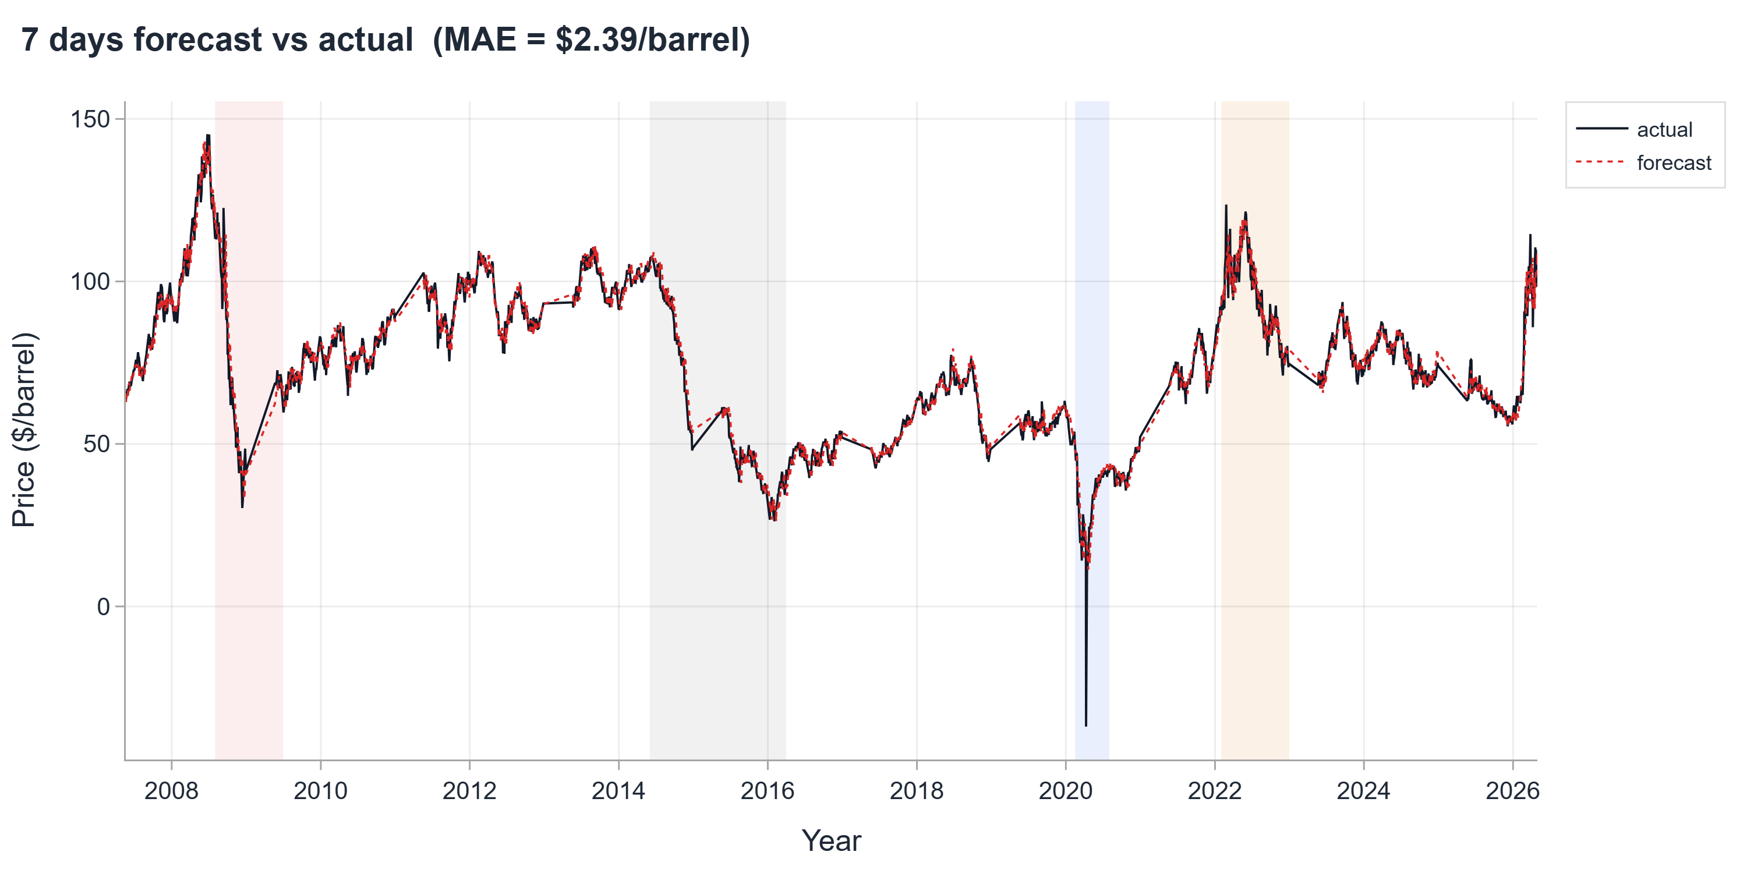
DIRECT WALK-FORWARD
Track B: Walk-Forward Performance
Verified skill at the 7-day horizon. At 1 day, convergence to naive is the honest finding.
7-DAY HORIZON
$2.39
Informer MAE ($/bbl)
0.26
Skill over naive
72%
Directional accuracy
At 1 day: all models converge to naive ($1.22). Near-random-walk horizon; no improvement claimed.
13

Slide 14
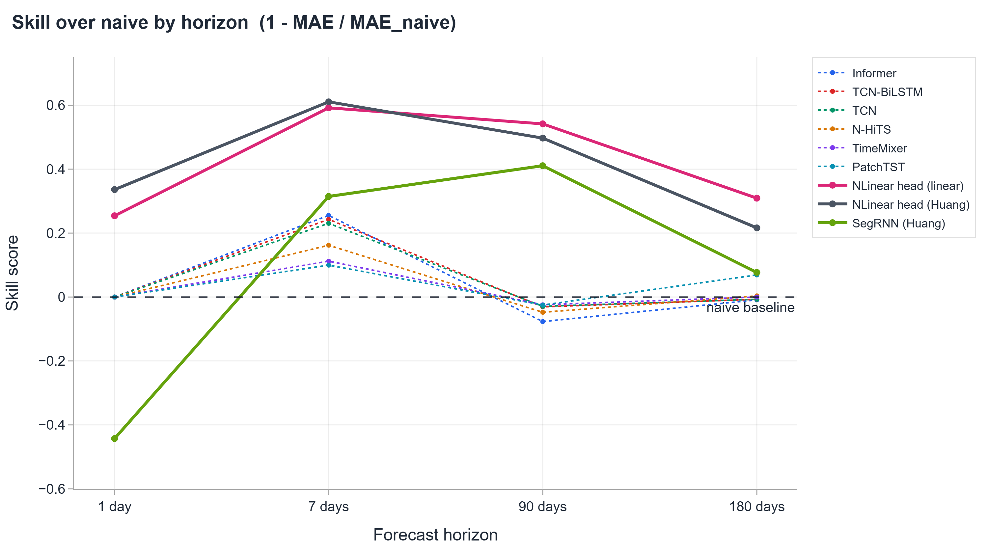
EXTERNAL BENCHMARK
Track A vs Published Benchmarks
Decomposition protocol matches source papers exactly; these figures are directly comparable
Model | 1d MAE | 7d MAE | 90d MAE | 180d MAE
NLinear + Huang (this work) | $0.81 | $1.25 | $6.22 | $13.15
DLinear + Huang (this work) | $1.00 | $1.44 | $5.23 | $11.94
NLinear + Yu (this work) | $0.69 | $1.77 | $12.22 | $16.88
Published Yu et al. 2025 | $2.04 | - | - | -
Published Huang et al. 2024 | - | $2.25 | - | -
Naive baseline | $1.22 | $3.21 | $12.37 | $16.78
$5.23/bbl at 90 days, skill 0.58 over naive. Note: published benchmarks use a single split; this work uses expanding walk-forward.
14

Slide 15
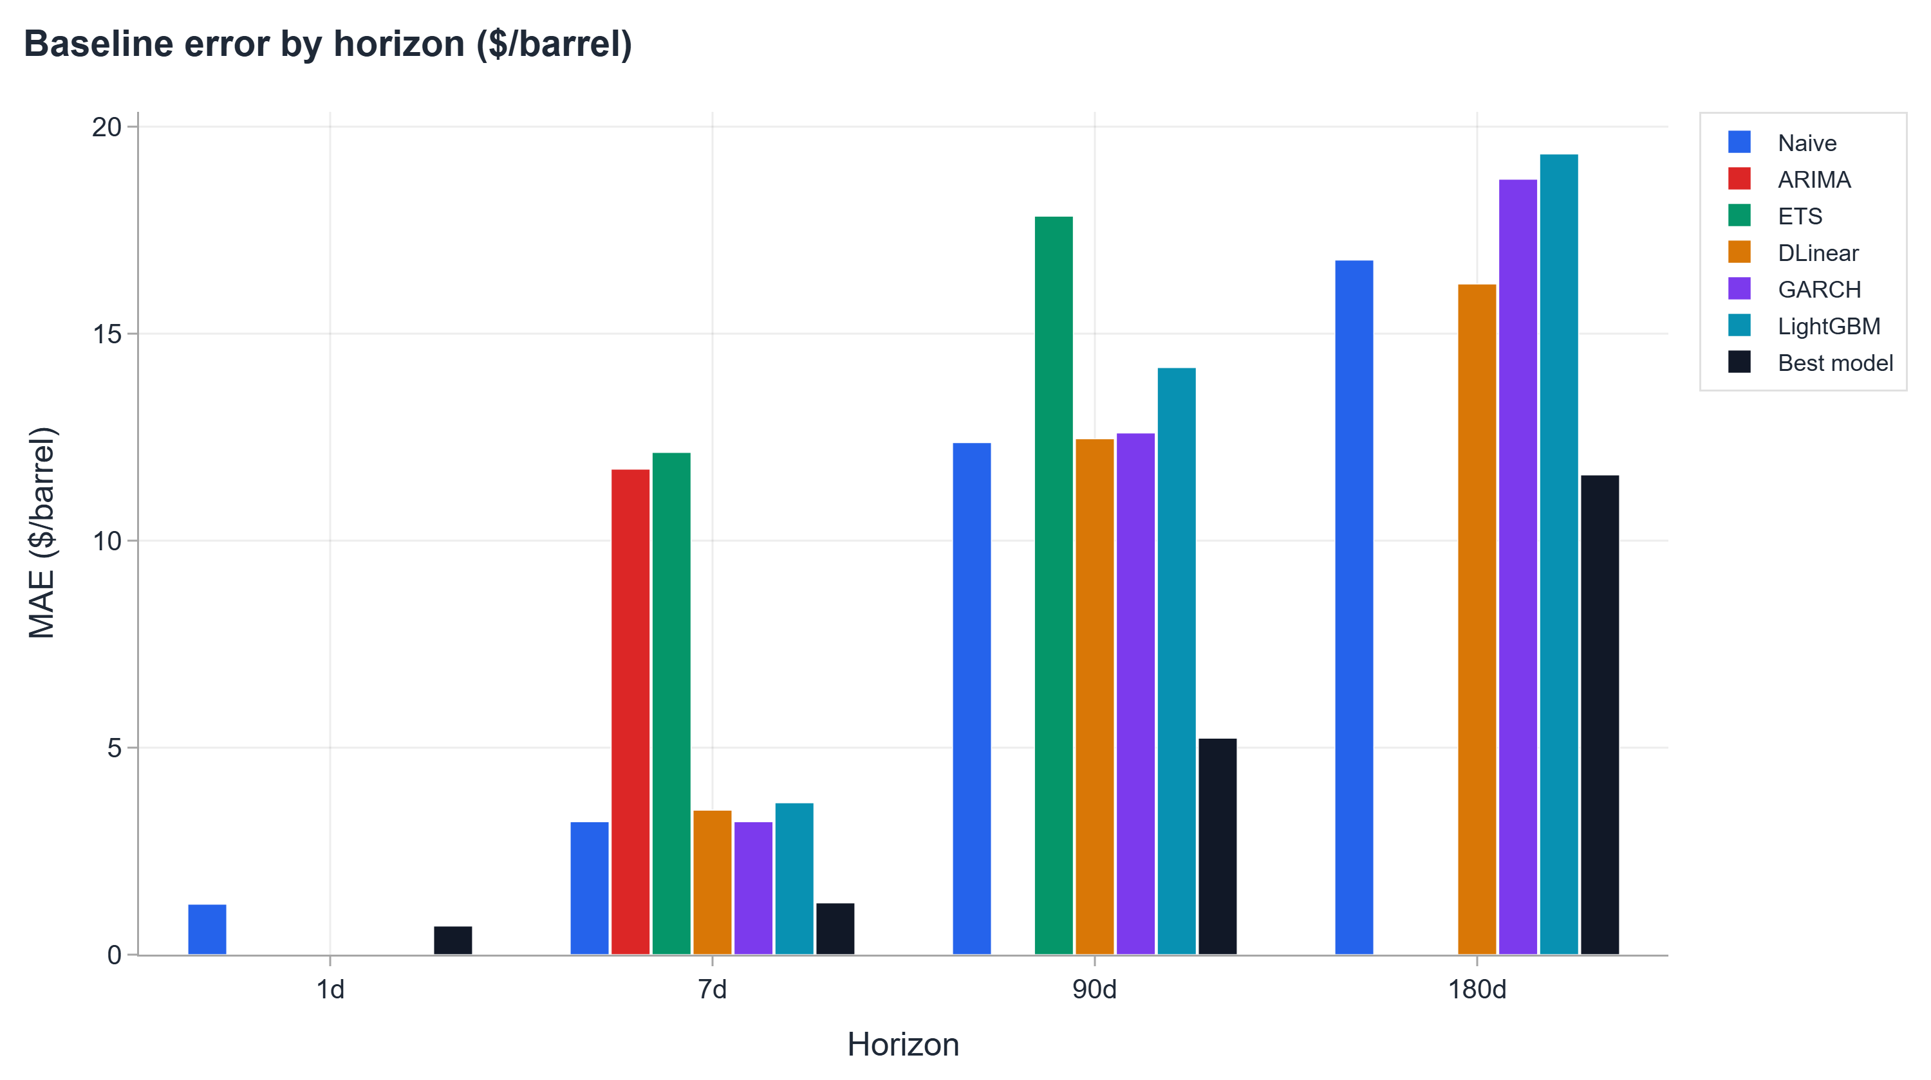
ARCHITECTURE INSIGHT
Linear Models Beat Transformers at Long Horizons
On decomposed components, complexity does not help; regime and horizon determine which architecture class wins
Track A 90d MAE ($/bbl)
$5.23
DLinear head (best Track A)
$12.56
TFT, best transformer
Why linear wins on components
▪ Decomposition extracts smooth trend and cycle components; a linear map handles them as well as a deep network
▪ At 7 days, transformers lead ($2.39 Informer); temporal patterns in the raw feature panel reward attention
15

Slide 16
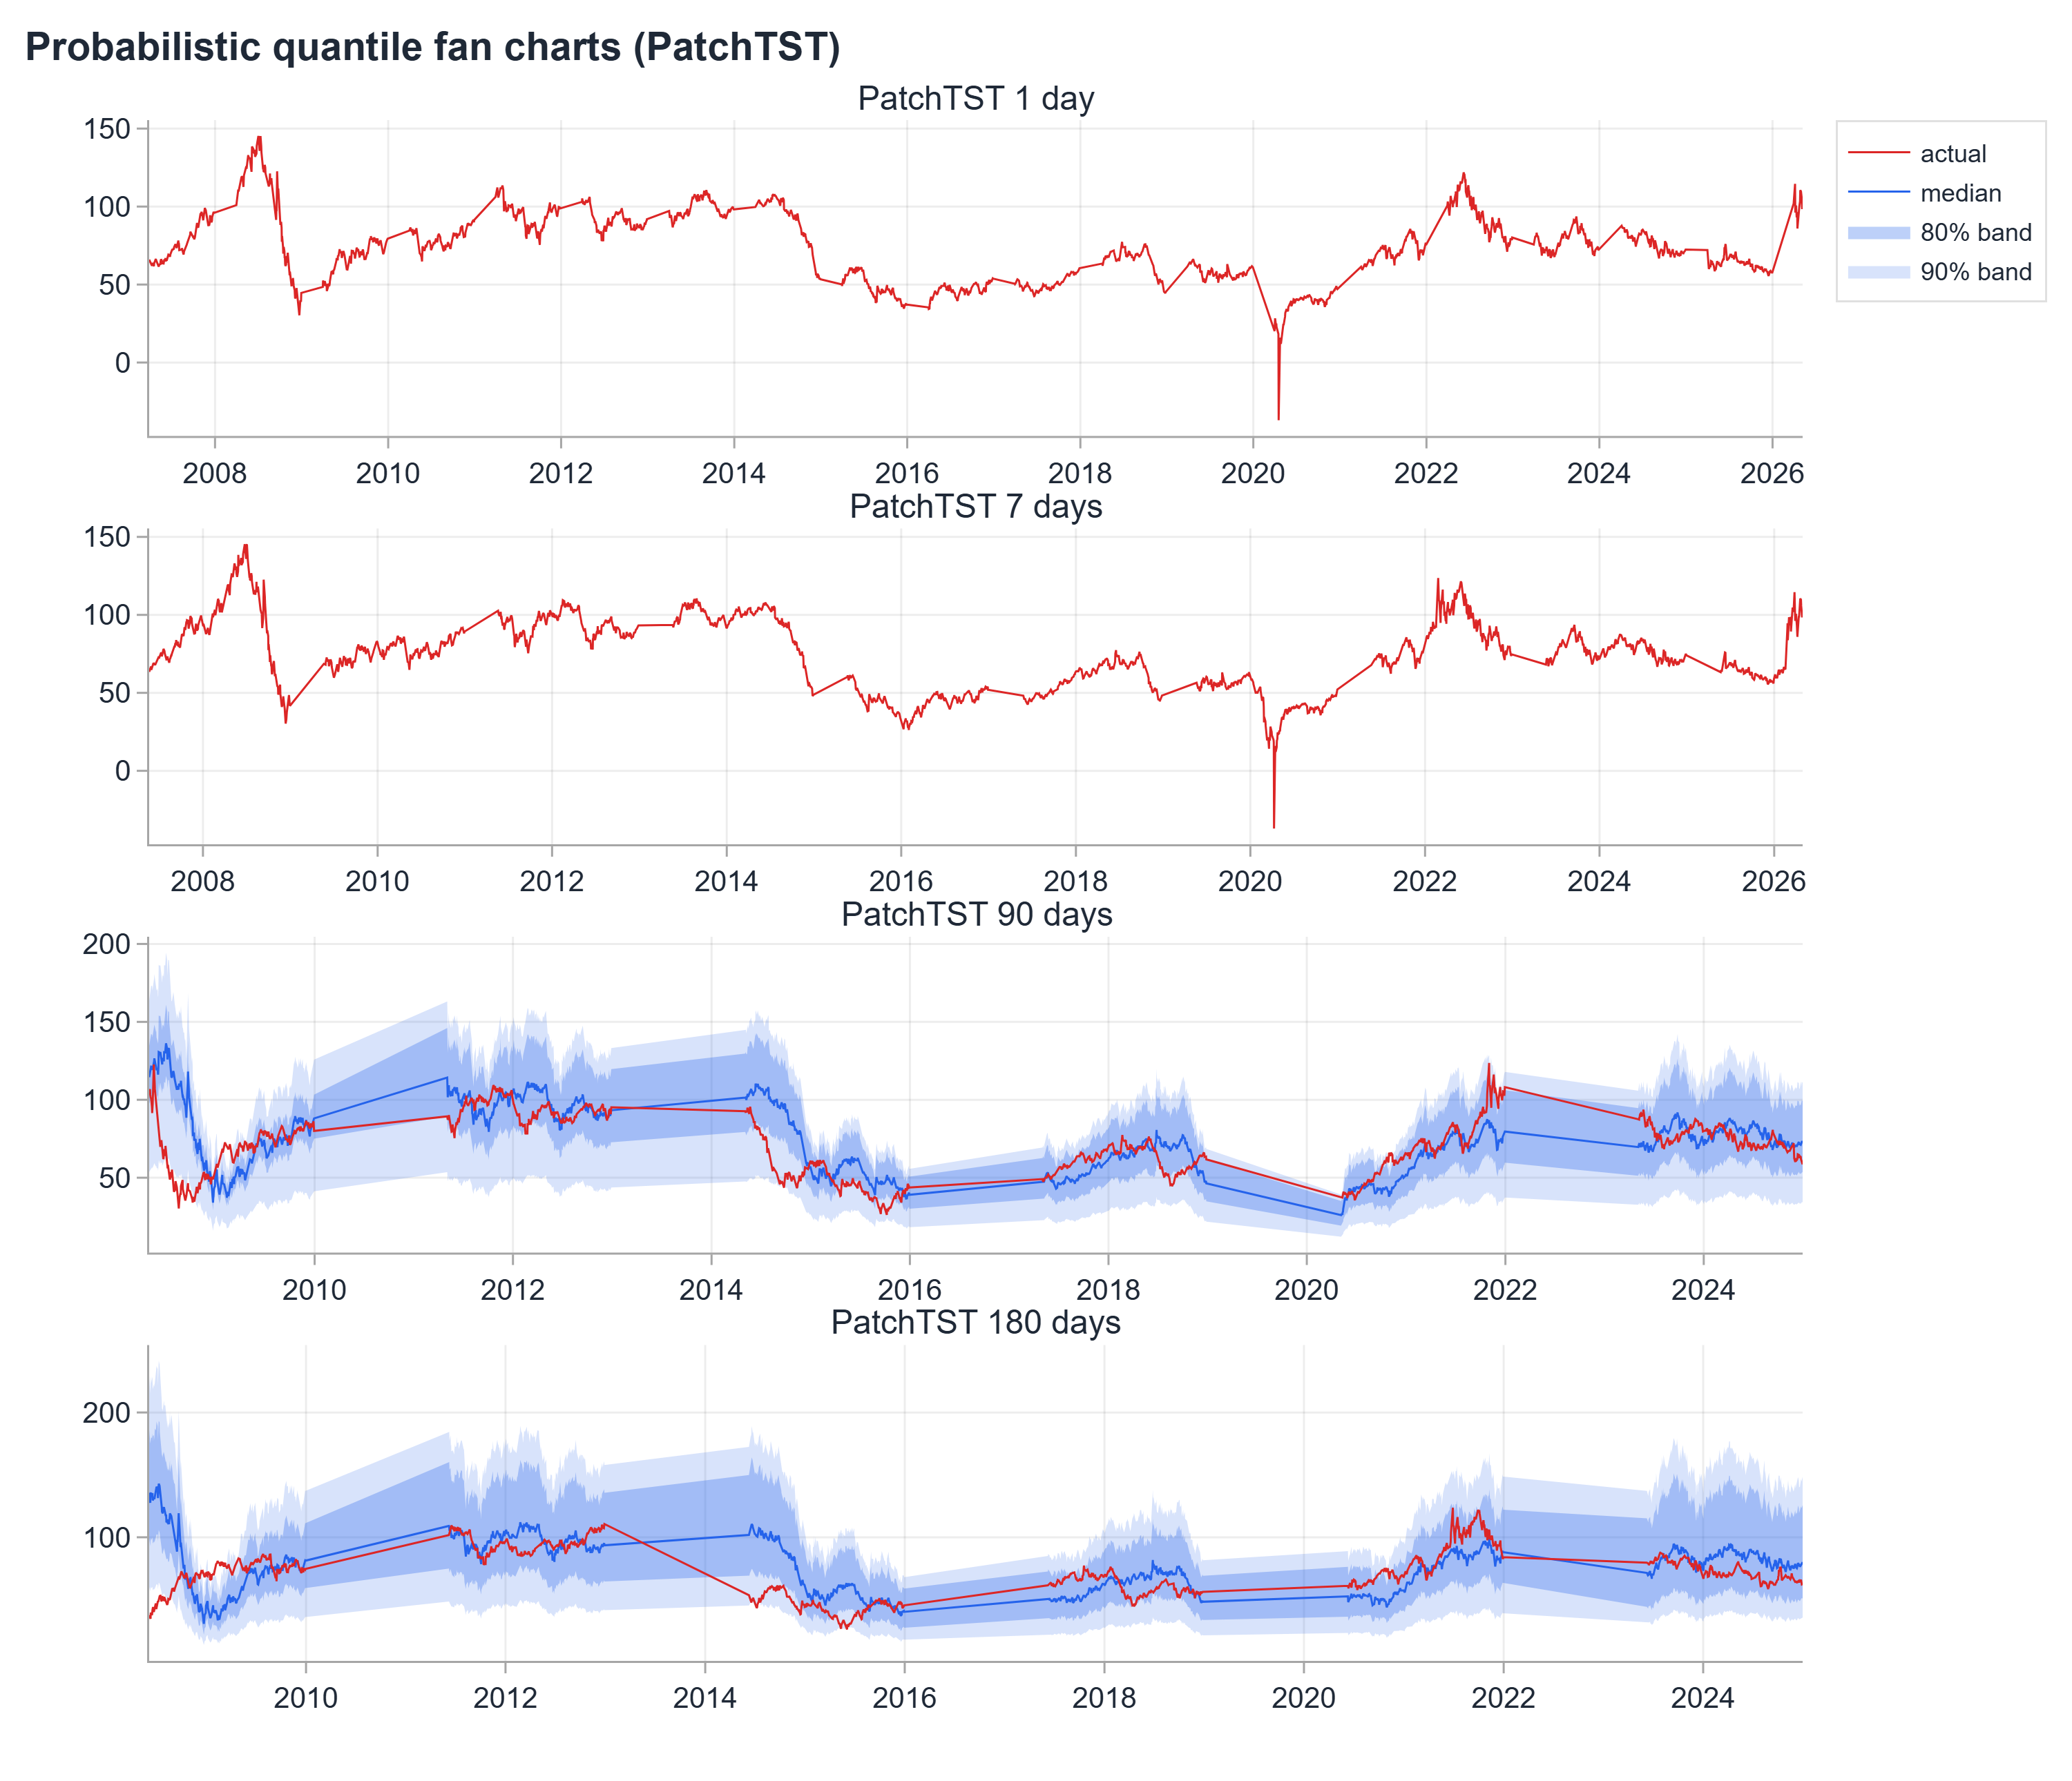
UNCERTAINTY QUANTIFICATION
Calibrated Prediction Intervals
Every point forecast carries a distribution-free 80% interval and a tail-risk estimate
TFT, 90d
0.1314
CRPS
$41.18
80% interval width ($/bbl)
0.0146
Reliability error
At 1d and 7d: prediction spread near-degenerate; reported transparently.
16

Slide 17
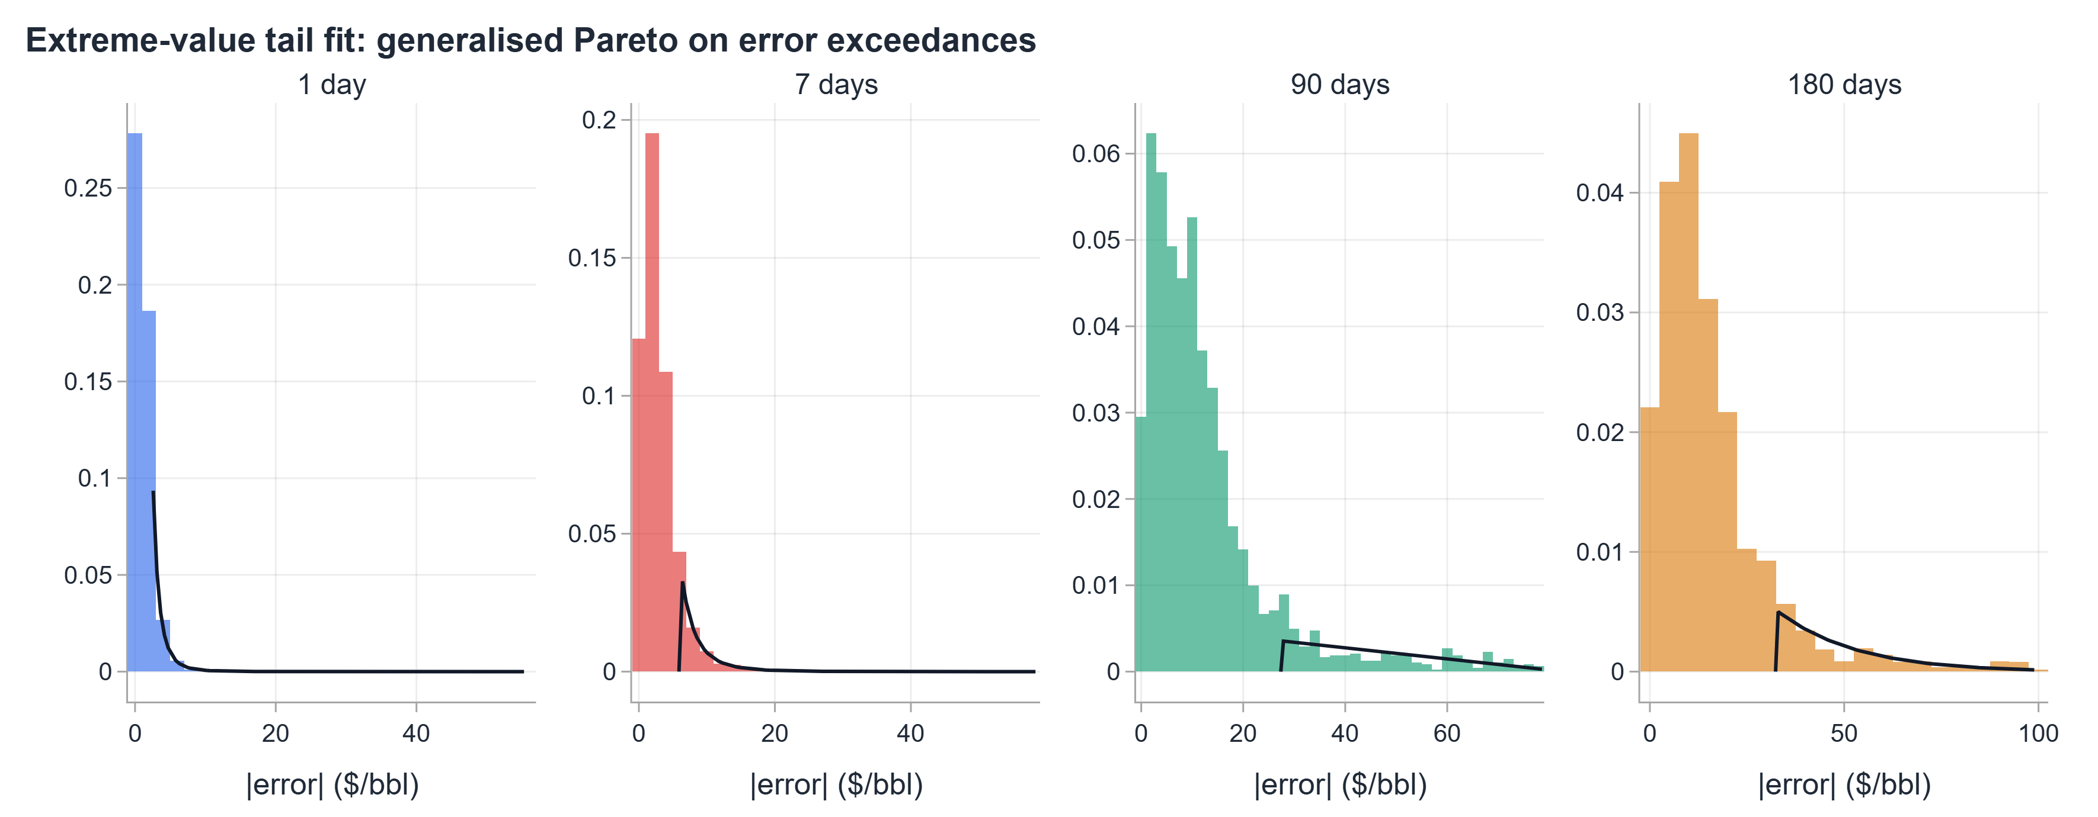
TAIL RISK
Extreme Value Theory: Tail Risk
180-day 99th-percentile exposure of $91.95/bbl, directly relevant to fiscal stress tests
Horizon | GPD xi | VaR 95% | ES 95% | VaR 99% | ES 99%
1 day | +0.278 | $3.40 | $5.21 | $6.05 | $8.87
7 days | +0.257 | $7.66 | $11.40 | $13.20 | $18.84
90 days | -0.516 | $43.90 | $56.94 | $65.51 | $71.20
180 days | -0.052 | $45.84 | $63.97 | $75.29 | $91.95
GARCH-EVT dynamic VaR
▪ Positive xi at short horizons: heavy tail; extreme daily moves are fat-tailed
▪ Negative xi at long horizons: bounded tail; price mean-reverts
▪ Dynamic VaR widens during crises; passes Kupiec coverage test
Operational significance
1d VaR 99 of $6.05 sets the exchange margin buffer for crude futures. 180d VaR99 of $75.29 quantifies the worst-case procurement overrun for a 6-month buyer, informing hedge and reserve sizing.
17

Slide 18
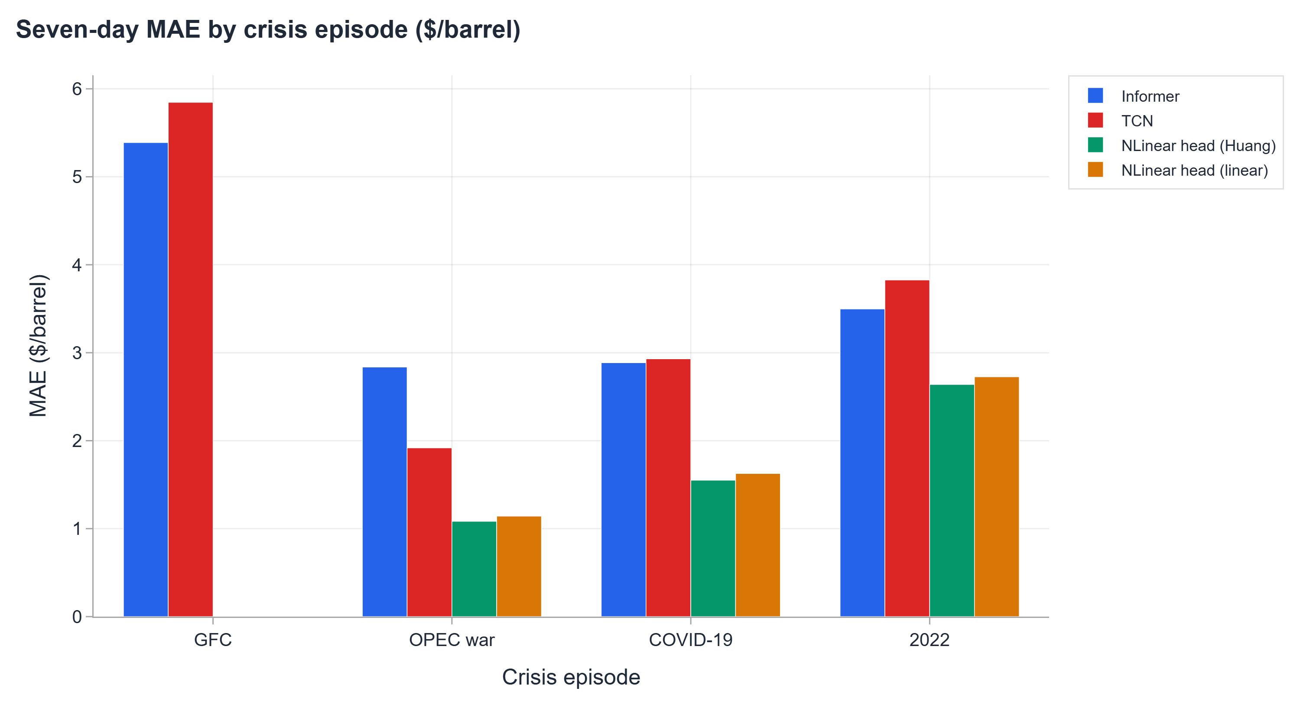
REGIME AND CRISIS ANALYSIS
Forecast Error by Market Regime
Error concentrates in Stressed and Crisis regimes; 10% of days, majority of total MAE
GFC 2008 is the hardest window: Informer 7d MAE $5.39, nearly double its full-period figure. No architecture is consistently dominant across all crisis episodes.
7d MAE by regime ($/bbl) | Calm | Normal | Stressed | Crisis
All models | $2.18 | $2.49 | $3.13 | $5.88
18

Slide 19
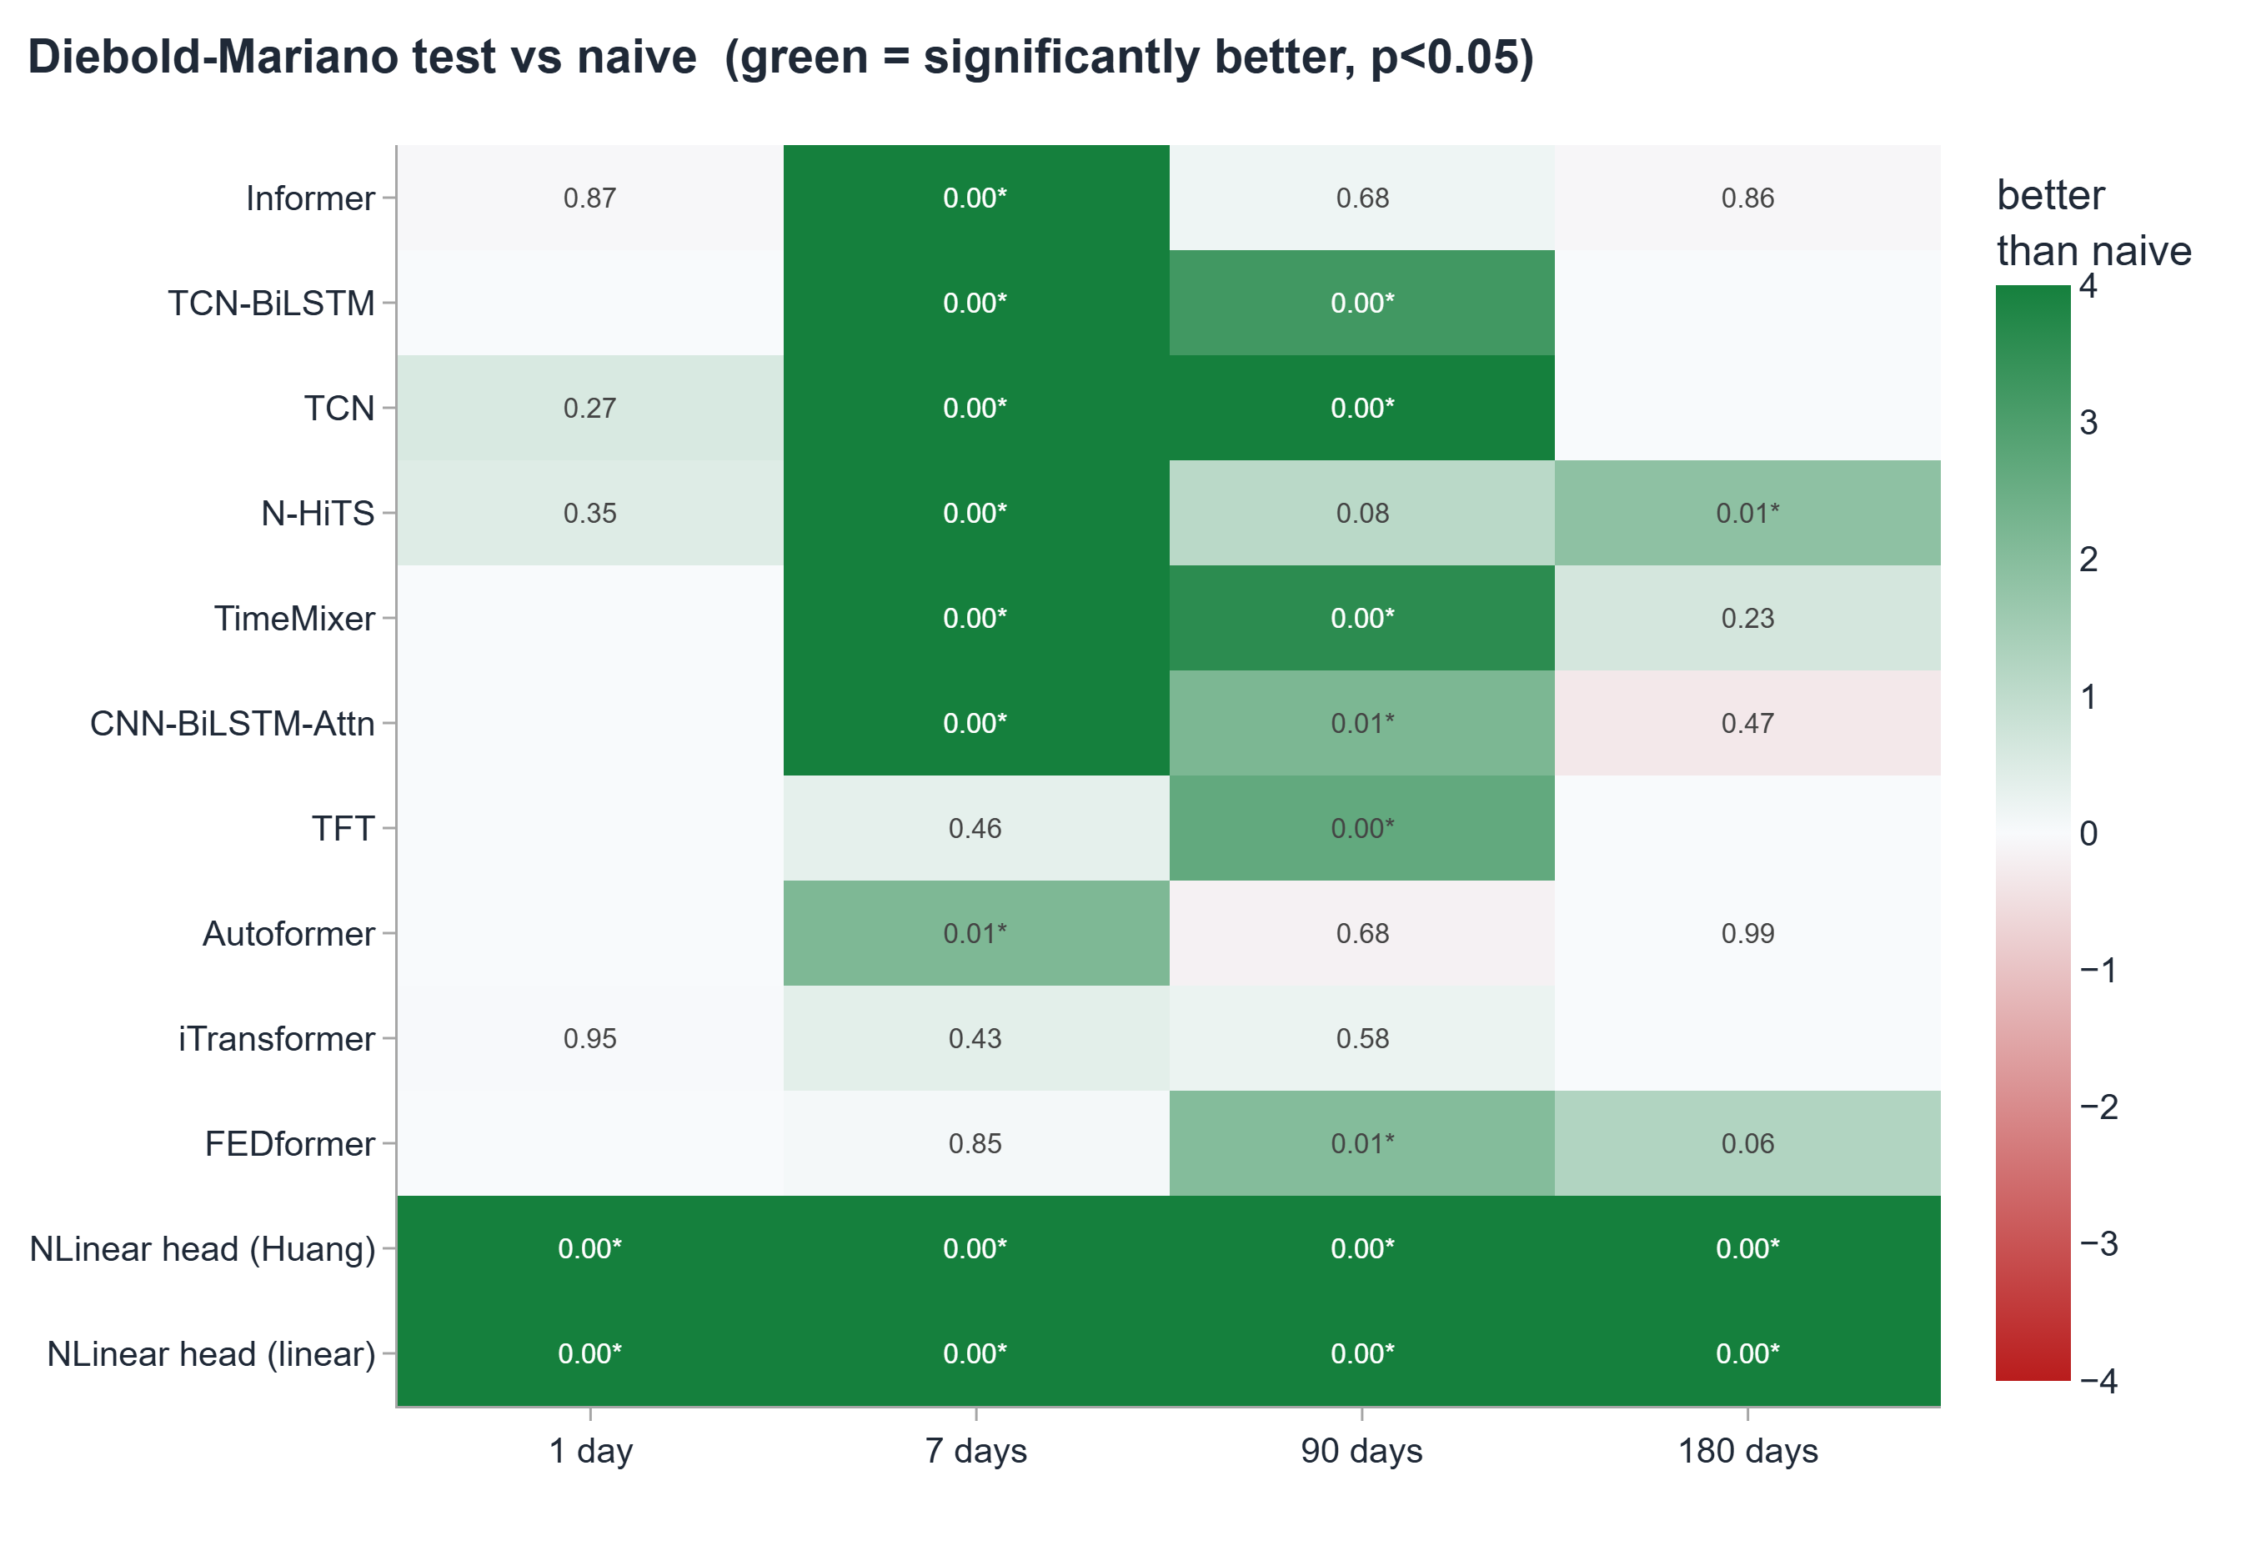
STATISTICAL TESTING
Statistical Significance
Error reductions are claimed only where formally confirmed; no improvement is asserted without testing
Diebold-Mariano (HAC)
At 7 days: Informer, TCN-BiLSTM and TCN significantly beat naive (p below 0.05). At 1 day: no model reaches significance.
Pesaran-Timmermann
TCN-BiLSTM 75% directional accuracy is significant at p below 0.05, versus 50% expected by chance.
Honest reporting
At the 1-day horizon, no improvement is claimed. Near-random-walk behaviour is the finding, not a failure.
Three models significant at 7 days (Informer, TCN-BiLSTM, TCN; p below 0.05). No model significant at 1 day. 75% directional accuracy significant under Pesaran-Timmermann.
19

Slide 20
APPLICATIONS
Significance for Energy Markets and Policy
Four user communities, matched to the horizon where each output carries the most decision value
Short-horizon trading and hedging
75% directional accuracy and a statistically verified error reduction let a refinery or airline time a hedge more precisely than a naive roll-forward rule. Informer's $2.39 MAE corresponds to a potential saving of roughly $2 to $3 per barrel on well-timed hedging.
1 day to 7 days
Medium-horizon procurement planning
The calibrated 80% interval (reliability near 0.04) is the primary value beyond the point forecast: a refinery planning a 3-month purchase can set financial reserve and hedge ratio directly from the predictive distribution rather than guessing at the uncertainty.
90 days
Long-horizon strategic planning
VaR and Expected Shortfall quantify the worst-case move a risk-sensitive decision-maker must provision for. For importing nations these figures inform strategic reserve sizing, forward contract structure, and fiscal contingency budgeting; for exporters they bound the downside fiscal scenario.
180 days
Situational awareness from regime signals
The 4-state HMM gives early warning independent of the point forecast. High crisis-state probability signals an adversarial environment for any model, calling for wider hedging buffers and reduced speculative positions rather than a specific price target.
All horizons
20

Slide 21
SUMMARY
Summary of Contributions
A rigorous, honest, and comprehensive forecasting framework for WTI crude oil at four horizons
01 Walk-forward framework. All preprocessing in-sample, no lookahead at any step across 38 years of WTI data.
02 17 architectures, identical conditions. $0.69 at 1d, $1.25 at 7d, $5.23 at 90d, $11.59 at 180d; all targets met by the best individual model.
03 Verified 7-day skill. Informer at $2.39/bbl, skill score 0.26; TCN-BiLSTM at 75% directional accuracy; both confirmed significant.
04 Calibrated uncertainty. Distribution-free 80% intervals; TFT reliability 0.0146 at 90d; EVT tail-risk VaR99 from $6.05 (1d) to $75.29/bbl (180d).
05 Benchmark inflation quantified. Reporting both tracks and their horizon-by-horizon difference shows how much published accuracy depends on the decomposition design and how useful walk forward splits are in interpreting regime analysis
21

Slide 22
References
[1] Yu et al. Forecasting Crude Oil Prices: Evidence from the WOA-VMD-FE-Transformer Model. Computational Economics, 66 (2025).
[2] Huang et al. Crude Oil Futures Price Forecasting Based on VMD and EMD and Transformer Model. Mathematics, 12(24) (2024).
[3] Zhou et al. Informer: Beyond Efficient Transformer for Long Sequence Time-Series Forecasting. AAAI (2021).
[4] Nie et al. A Time Series is Worth 64 Words: Long-Term Forecasting with Transformers. ICLR (2023).
[5] Diebold and Mariano. Comparing Predictive Accuracy. JBES, 13(3) (1995).
[6] Pesaran and Timmermann. A Simple Nonparametric Test of Predictive Performance. JBES, 10(4) (1992).
[7] McNeil and Frey. Estimation of Tail-Related Risk Measures for Heteroscedastic Financial Time Series. J. of Empirical Finance, 7 (2000).
[8] Lei et al. Distribution-Free Predictive Inference for Regression. JASA, 113(523) (2018).
[9] Liu et al. iTransformer: Inverted Transformers Are Effective for Time Series Forecasting. ICLR (2024).
[10] Ansari et al. Chronos: Learning the Language of Time Series. TMLR (2024).
22

Slide 23
Thank You
Aayush M Anand | 21D170001 | IIT Bombay
Questions and discussion
23

