Slide 1

JUnit
Dwight Deugo (dwight@espirity.com)
Nesa Matic (nesa@espirity.com)
Notes:
Portions of the notes for this lecture include excerpts from the Eclipse 3.0 and 3.1 Help facility. These excerpts are made available under EPL for ease of use by instructors, (c) Copyright (c) 2000, 2005 IBM Corporation and others. For more complete information instructors are encouraged to read the full notes from the Eclipse Help facility.

Slide 2
Additional Contributors
None as of September, 2005

Slide 3
Module Road Map
JUnit
Notes:
In this module, you will learn about JUnit and Eclipse’s support of JUnit

Slide 4
Module Road Map
JUnit
  What is JUnit?
  Where Does it Come From?
  Working with TestCases
  Working with TestSuites
  JUnit Window
Notes:
In particular we will talk about JUnit testing framework, its components and how to use it within the Eclipse environment.

Slide 5
What is JUnit?
Regression testing framework
Written by Erich Gamma and Kent Beck
Used for unit testing in Java
Open Source
Released under IBM's CPL
Notes:
JUnit is a testing framework used for unit testing.
Testing is an important activity in the development, and there are different levels of testing. There are unit testing, integration testing, regression testing, load balancing testing, etc.
JUnit framework is designed to help you with the lowest level of testing, unit testing.
CPL is Common Public License

Slide 6
Where Does JUnit Come From?
JUnit’s web site: http://junit.org/index.htm
Eclipse includes JUnit
  Eclipse provides new GUI to run JUnit test cases and suites
You can run your unit tests outside of Eclipse
  If you wish using TestRunner
  Using JUnit’s Window
Notes:
TestRunner is the JUnit user interface for running test cases and suites

Slide 7
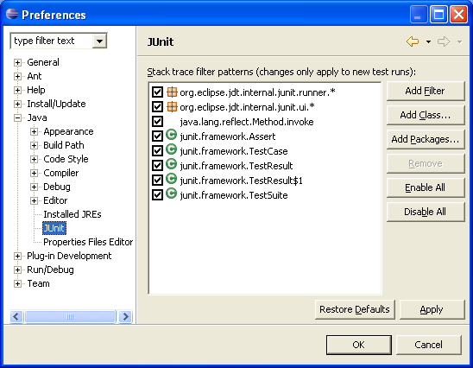
Eclipse JUnit Setup
Eclipse preferences can be set in the JUnit Preferences window
For the most part you can leave these alone
Filters needed to identify packages, classes, or patterns that should not be shown in the stack trace of a test failure

Slide 8
JUnit Test Cases
Test case
  Runs multiple tests
Implemented a subclass of TestCase
Define instance variables that store the state of the tests in the class
Initialize TestCase by overriding setUp
method
Clean-up after test case is done by overriding tearDown method
Notes:
When you use JUnit for unit testing you write test cases. These test cases are implemented as subclasses of TestCase, which is part of the JUnit framework. The test cases correspond to Java classes, and contain code used for testing of classes’ methods.
It is possible to initialize test case (for example initialize objects) and also clean it up after testing is performed.

Slide 9
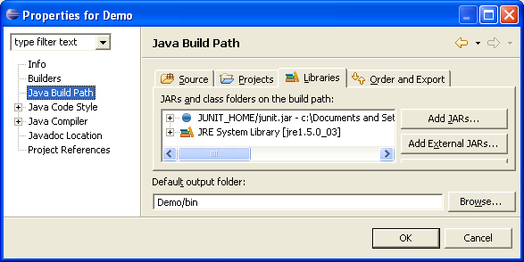
Creating TestCases in Eclipse…
Create a new package to contain your test case classes
Add the JUnit JAR file to the project’s buildpath
Or, will be done for you the first time you build a test case
Notes:
It is good design to keep test classes separate from the domain classes, so they should be in a separate package.
It is important that JUnit jar file is added to the project’s buidpath, as otherwise JUnit classes won’t be found in your project.

Slide 10
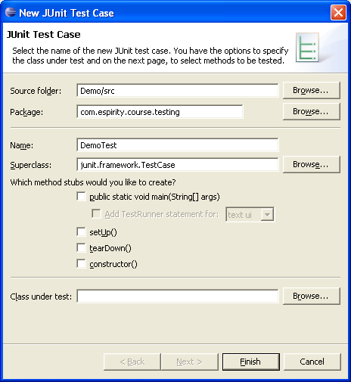
…Creating TestCases in Eclipse
Select your testing package
From the context menu select New → JUnit Test Case
In the next Window fill in the name of your test case
This will create the corresponding class in your testing package
Notes:
As for many other things Eclipse provides wizards for creating test cases that get you through the process of creating them.
Selecting methods in the wizard will allow creation of templates for these methods that later on you can change.

Slide 11
TestCase Template
package com.espirity.course.testing;
import junit.framework.TestCase;
public class FirstTestCase extends TestCase {
public FirstTestCase(String arg0) {
super(arg0);
}
public static void main(String[] args) {
}
protected void setUp() throws Exception {
super.setUp();
}
protected void tearDown() throws Exception {
super.tearDown();
}
}
Notes:
If creation of setup() and tearDown() methods was selected in the wizard, Eclipse will create these methods when creating the test case. Than you can put a code in these methods to initialize resources before test runs, and clean up resources before test finishes.

Slide 12
Adding Tests to TestCases
Any method in a TestCase class is considered a test if it begins with the word test
  You can write many tests (have many test methods)
Each test method should use a variety of assert methods to test things about the state of their classes under tests
  Assert methods are inherited
Notes:
Assert methods are used for actual testing. These methods are inherited from the test cases superclass.

Slide 13
Assert Methods
Assert methods include:
  assertEqual(x,y)
  assertFalse(boolean)
  assertTrue(boolean)
  assertNull(object)
  assertNotNull(object)
  assetSame(firstObject, secondObject)
  assertNotSame(firstObject, secondObject)

Slide 14
Adding Two Tests to TestCase
package testing;
import junit.framework.TestCase;
public class FirstTestCase extends TestCase {
public FirstTestCase(String arg0) {
super(arg0);
}
public static void main(String[] args) {}
protected void setUp() throws Exception {
super.setUp();
}
protected void tearDown() throws Exception {
super.tearDown();
}
public void testCompareSucceed() {
assertEquals(0, 0); //this assertion will succeed
}
public void testCompareFail() {
assertEquals(0, 1); //this assertion will fail
}
}

Slide 15
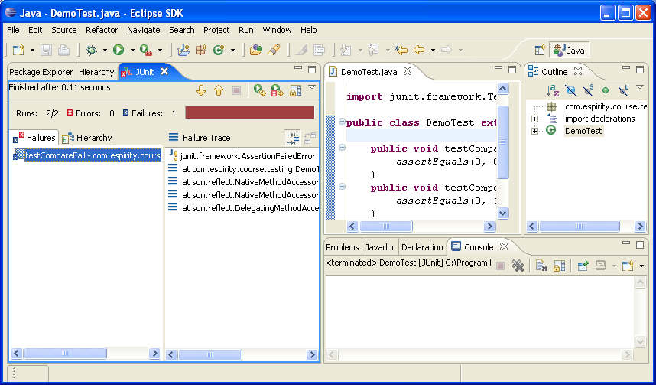
Running TestCase
Select TestCase class
From the Run menu select Run → Run As → JUnit Test
This will run the tests in your TestCase class along with the setup and teardown methods
You will then get a report in the JUnit Window

Slide 16
JUnit Window…
Red indicates a test has failed
If you wish to see the tests in TestCase click on the Hierarchy tab
You can see which test failed
You can see the call trace leading to the failure
Notes:
JUnit window gives you a report on running the tests. It indicates which tests fail and also gives you the call trace for each failure. All the details on running the tests are displayed in the window. These details include how many errors occurred, how many tests run.

Slide 17
…JUnit Window
You can see how many tests ran
Errors occur when exceptions are thrown
How many failures occurred
You can see the details of the failure

Slide 18
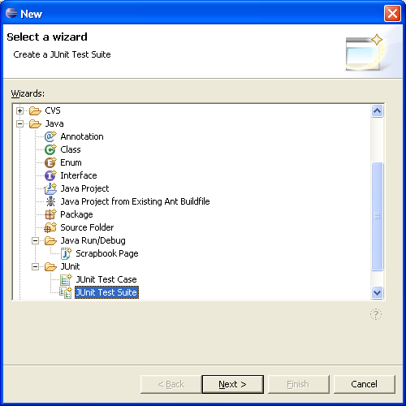
Creating JUnit TestSuite…
Test Suite
  Runs multiple test cases or suites
Implemented as subclass of TestSuite
To create a TestSuite
  Select your testing package
  From the context menu select New → Other… → Java → JUnit
  Then from the Wizard select JUnit Test Suite
Notes:
TestSuite is a class from JUnit framework that allows you to group and run individual tests together. Creation of a test suite in Eclipse is similar to creation of test case, as wizards get you through the process of creating it.

Slide 19
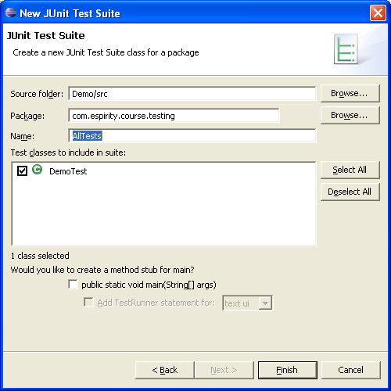
…Creating JUnit TestSuite
Fill in the name of your TestSuite Class
Select the TestCases to include in your TestSuite

Slide 20
TestSuite Template
package com.espirity.course.testing;
import junit.framework.Test;
public class AllInclusiveTestSuite {
public static Test suite() {
TestSuite suite =
new TestSuite("Test for com.espirity.course.testing");
//$JUnit-BEGIN$
suite.addTestSuite(FirstTestCase.class));
suite.addTestSuite(SecondTestCase.class));
//$JUnit-END$
return suite;
}
}

Slide 21
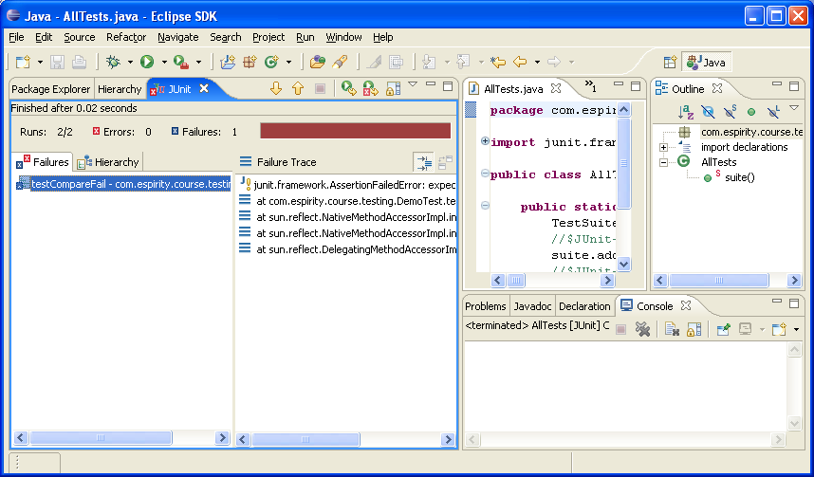
Running TestSuite
Select TestSuite class
From the Run menu select Run → Run As → JUnit Test
This will run the test cases in your TestSuite class
You will then get a report in the JUnit Window
Notes:
Running test suites is similar to running test cases. The difference is that with running the test case you run an individual test case class, and with running the test suite you run multiple test cases, i.e. multiple classes.

Slide 22
Interesting Point
The JUnit classes TestCase and TestSuite both implement the JUnit Test interface
Therefore, you can add JUnit TestSuites to other TestSuites
public static Test suite() {
TestSuite suite = new TestSuite("Test for testing");
//$JUnit-BEGIN$
suite.addTestSuite(FirstTestCase.class);
suite.addTestSuite(SecondTestCase.class);
suite.addTest(AllTests.suite());
//$JUnit-END$
return suite;
}
}
Notes:
This allows you to nest test suites, and test many suites at the same time. It is an important feature when you have many test cases and many test suites as you can group them and run them together.
AllTests is another class that implements a TestSuite.

Slide 23
Summary
You have learned:
  What is JUnit
  How it is integrated into Eclipse
  How to write Test Cases
  How to write Test Suites
  How do use JUnit in Eclipse

Slide 24

Labs!
Lab: Using JUnit
Notes:
Now it’s time for the lab.

