Slide 1

Debugging
Dwight Deugo (dwight@espirity.com)
Nesa Matic (nesa@espirity.com)
Notes:
Portions of the notes for this lecture include excerpts from the Eclipse 3.0 and 3.1 Help facility. These excerpts are made available under EPL for ease of use by instructors, (c) Copyright (c) 2000, 2005 IBM Corporation and others. For more complete information instructors are encouraged to read the full notes from the Eclipse Help facility.

Slide 2
Additional Contributors
None as of September, 2005

Slide 3
Module Road Map
Eclipse Debugging
Notes:
In this module, you will learn about Eclipse’s debugging facility

Slide 4
Module Road Map
Eclipse Debugging
  Debug Perspective
  Debug Session
  Breakpoint
  Debug Views
  Breakpoint Types
  Evaluating and displaying expressions
Notes:
In particular we will look at the Debug Perspective and its components, breakpoints, and facilities commonly used when debugging.

Slide 5
Debugging in Eclipse
The Java Debugger
  Part of Eclipse Java Development Tools (JDT)
  More than System.out.printn(̎̎̎̎error̎̎̎̎)
  Detects errors as code executes
  Correct errors as code executes
  Actions you can perform debugging include:
    Control Execution
    Set simple breakpoints
    Set conditional breakpoints
    Review and change variable values
    Hot code replace

Slide 6
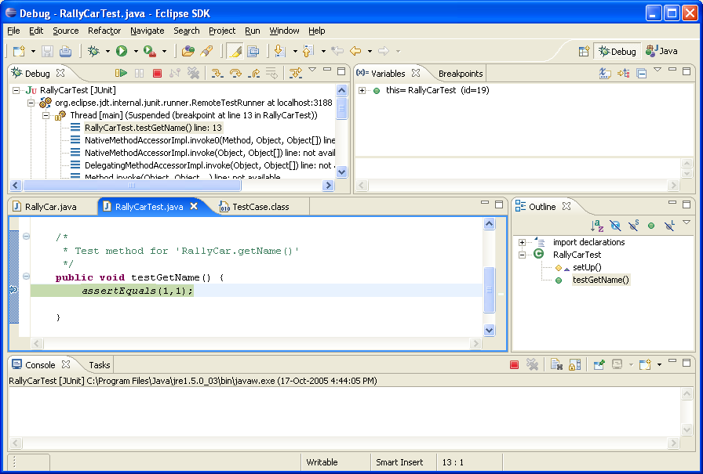
Debug Perspective
Threads and Monitor View
Variable View
Editor View
Console View
Tasks View
Outline View
Notes:
Debug perspective is design to help debugging the code. It contains views that are specific for debugging. Perspective opens automatically when a breakpoint is hit during the execution of the Java application. However you need to run Java application in a debug mode, otherwise the execution will not stop at the breakpoint, and the breakpoint will be ignored.

Slide 7
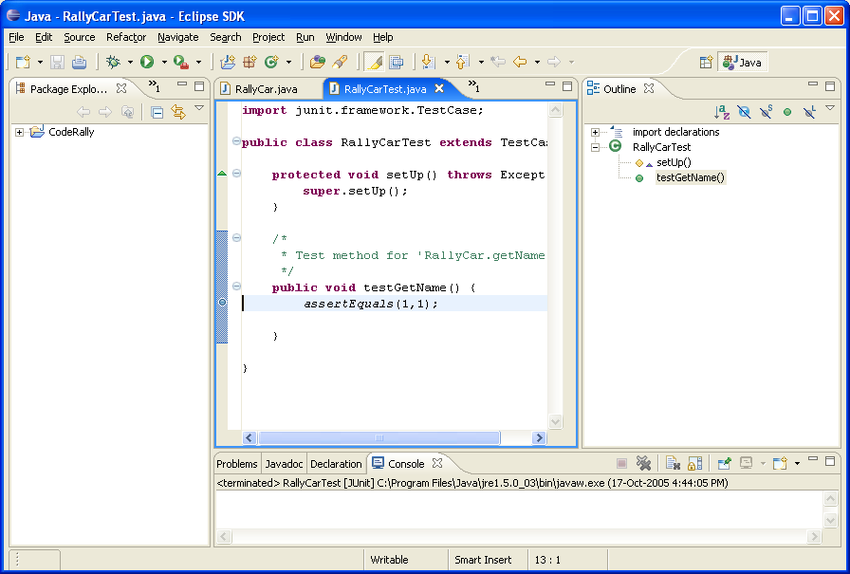
Simple Breakpoint
Breakpoint
  Stops the execution of a program at the point
  Thread suspends at the location where the breakpoint is set
Setting a breakpoint
  CTRL+Shift+B at current point in editor line
  Double click in editors marker bar a current line
Notes:
Breakpoint can be set by:
Double-click on the left bar beside the line in the editor where you want to add the breakpoint
Choosing Add Breakpoint from the context menu on the bar in the editor

Slide 8
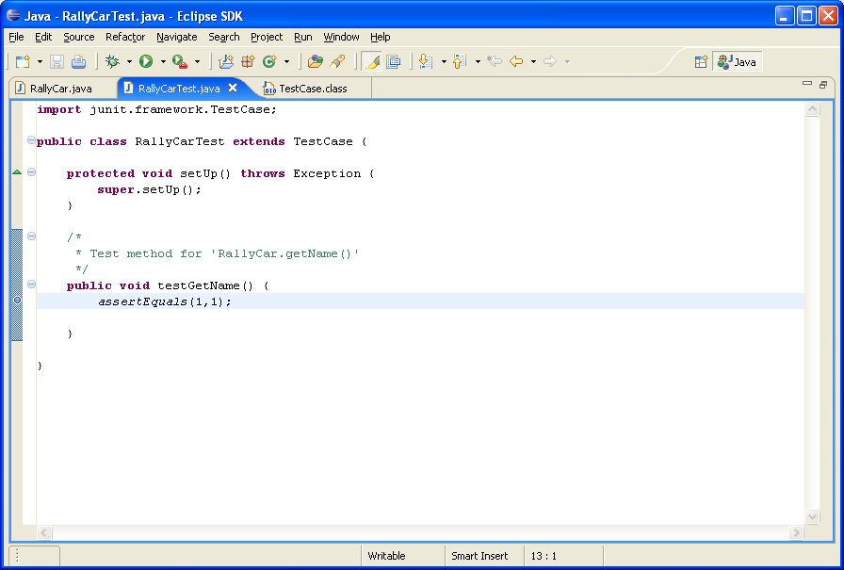
Deleting Breakpoints
Double click on the breakpoint in the editor
CTRL+Shift+B at current point in editor line
Notes:
Another way to remove the breakpoint is by choosing Remove Breakpoint from the context menu on the breakpoint.

Slide 9
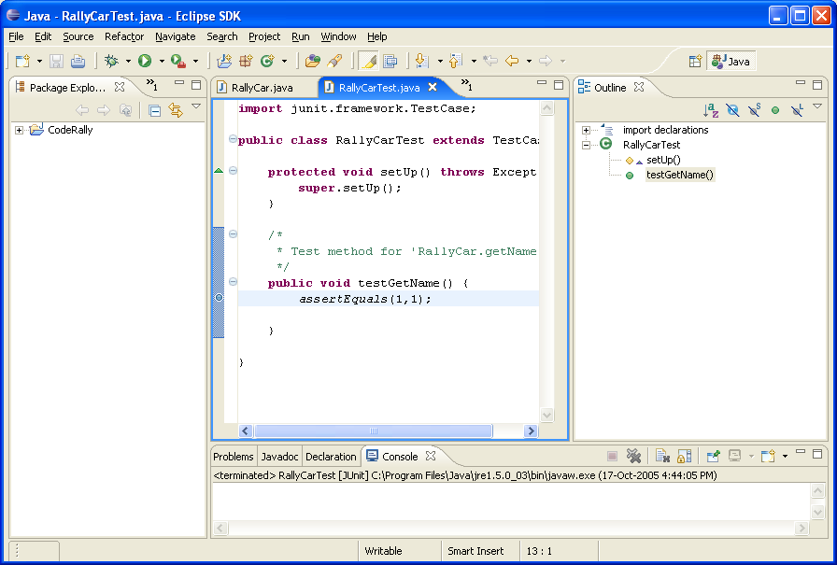
Starting a Debugging Session
Select Java class containing the following:
  main() method
  Resulting execution will pass breakpoint
Select Run → Debug As… → Java Application
Or Select Debug As… → Java Application from the debug menu
Notes:
Debugging session usually starts on a Java application, i.e. class containing the main() method. The debugging session can also start if you execute Java code from the Scrapbook and a breakpoint is encountered during the execution.

Slide 10
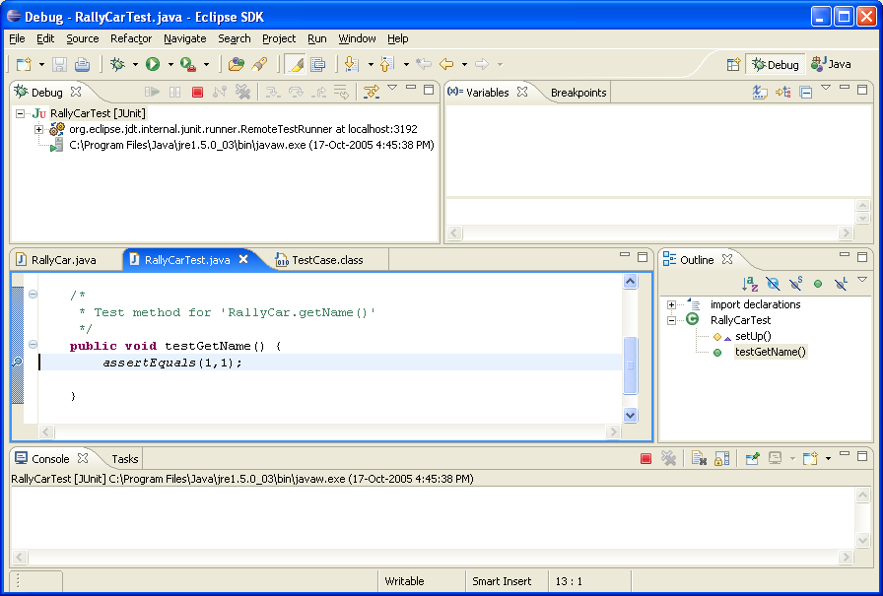
Debug Session
Execution suspends prior to the line with a breakpoint
You can set
multiple
breakpoints

Slide 11
Control Execution From Breakpoint…
Step Into or F5:
  For methods, execute method and suspend on first statement in the method
  For assignments, similar to Step Over
  For conditionals, similar to Step Over
Step Over or F6
  Execute next statement
Step Return or F7
  Resume execution to the end of the method on the next line after it was invoked
Notes:
Control Execution toolbar buttons are used for controlling the debugging session.

Slide 12
…Control Execution From Breakpoint
Resume or F8
  Continue execution until program ends or another breakpoint is reached
Terminate
  Stops the current execution thread

Slide 13
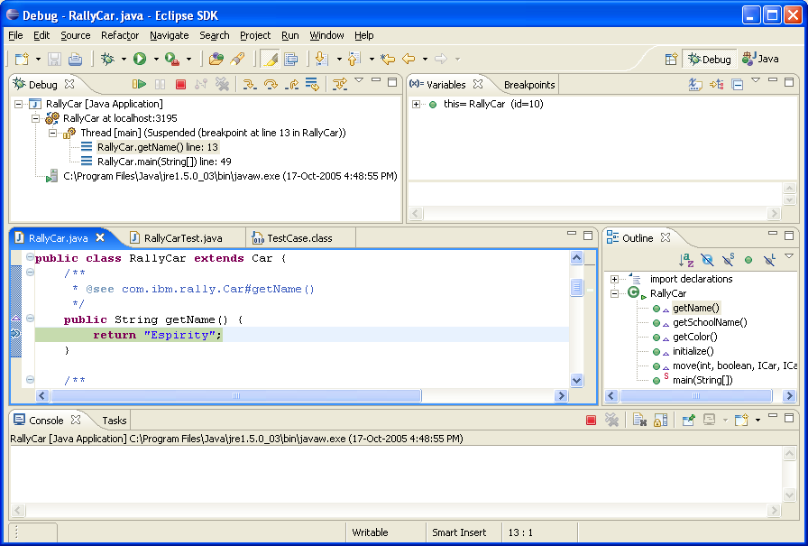
Variables and Fields
To see the values bound to fields:
  Use Variables View
  Select variable in editor and select Inspect
  Select variable in editor and select Display

Slide 14
Code Debugging in this Module
public class Debug {
private int something = 0;
private Vector list = new Vector();
public void firstMethod(){
thirdMethod(something);
something = something + 1;
}
public void secondMethod(){
thirdMethod(something);
something = something + 2;
}
public void thirdMethod(int value){
something = something + value;
}
public static void main(String[] args) {
Debug debug = new Debug();
debug.firstMethod();
debug.secondMethod();}
}

Slide 15
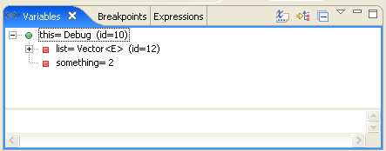
Variables View
Shows all fields of instance where breakpoint occurred
  Select this to see all fields
  Select any field to see value
  If field is bound to an object, you can select Inspect from the menu to view its fields and values

Slide 16
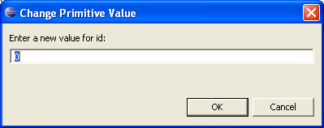
Changing Field Values
To change field value:
  Select field in Variables view
  Select Change Value… from the context menu
  Enter new value into Set Variable Value window
  Click OK

Slide 17
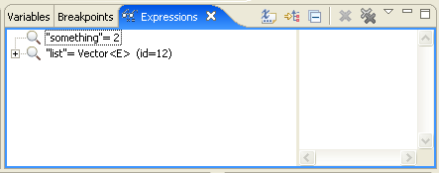
Expressions View
Remembers all objects you have inspected
Displays the fields of the object
  You can see the values of the fields
  You can Inspect the fields
Opens when:
  You Inspect an object
  You click on the Watch from the context menu
Notes:
Expression view is used with the Inspector. You can also invoke the view from a Scrapbook by selecting the Java code and choosing Inspect from the context menu.
Another way to open Expressions View is to select variable in the Variables View, and choose Watch from the context menu. This option allows you to watch over selected variable during the execution of the application.

Slide 18
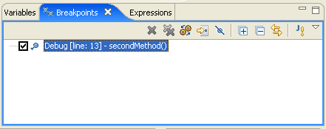
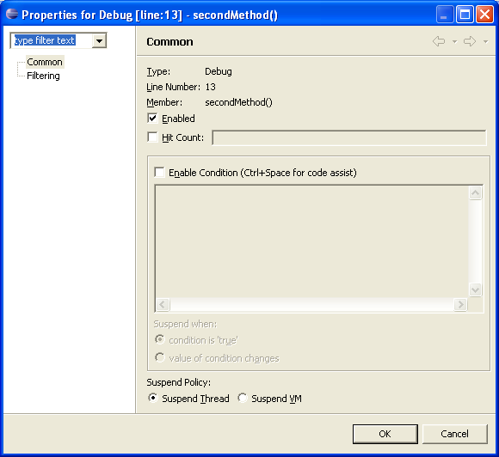
Breakpoint View
Lists all available breakpoints
Can be used for manipulating breakpoints (through the views menu):
  Enabling
  Disabling
  Removing
Also displays breakpoints properties
Accessed like other debugging views
Notes:
Breakpoint View can be open by click on the Breakpoints tab in the Debugging Perspective.
Breakpoints can be manipulated in the Breakpoint View, meaning that you can remove, enable, or disable breakpoints. Double-click on the breakpoint in the view opens up an editor on the code where the breakpoint is set, and selects the line with the breakpoint.
Breakpoints properties are viewed by choosing Properties from the context menu on a breakpoint.
It is possible to set conditional breakpoints from the properties view. These breakpoints stop the execution only if the condition evaluates to true. To specify condition select the Enable Condition in the properties window and specify the condition.

Slide 19
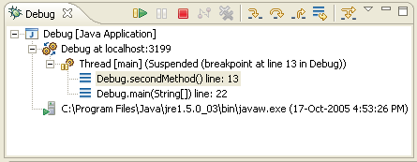
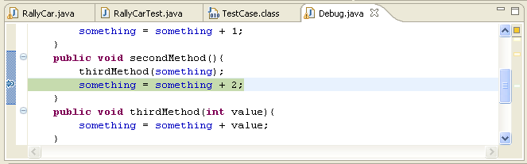
Debug View
Shows:
  Active threads
  Current stack frame when execution has stopped
  Previous stack frames
Method and variables are shown in the editor for the selected frame
  Update in the editor updates the source
Notes:
When you debug, an editor on code that you debug is available in the perspective. When the execution stops at the break point editor shows (highlights) the line where the breakpoint is. Using debugging controls results in editor showing different methods, variables, etc. You can change the code in the editor directly, save the change, and continue with the debugging.

Slide 20
Breakpoint Types
Breakpoints can be set for the following Java entities:
  Line (simple breakpoint)
  Method
  Field (Watchpoint)
  Java Exception
Each breakpoint is set a different way and has different properties

Slide 21
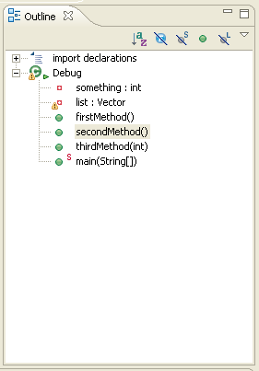
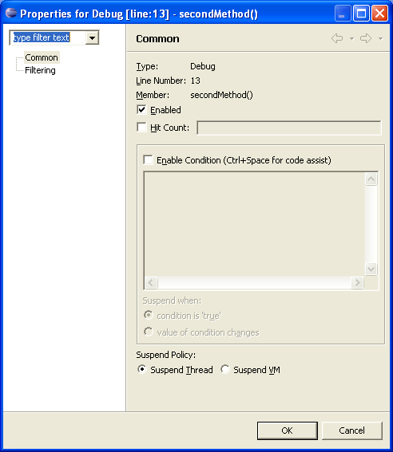
Method Breakpoints
To set method breakpoint:
  Select method in the Outline View
  From context menu select Toggle Method Breakpoint
To set breakpoint’s properties:
  Select breakpoint in editor
  Select Breakpoint Properties.. from context menu
  Set properties as desired
    Entry, exit, enable hit count
Execution suspends on entry/exit into method
Notes:
You cannot specify condition for method breakpoints, i.e. methods breakpoints cannot be conditional.

Slide 22
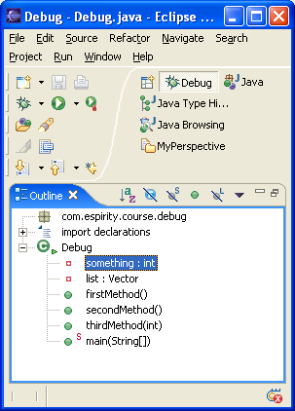
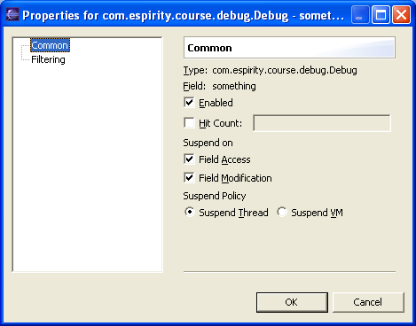
Field Breakpoints
Also known as watchpoint
To set the watchpoint:
  Select field in the Outline View
  From context menu select Toggle Watchpoint
To set watchpoint’s properties:
  Select breakpoint in editor
  Select Breakpoint Properties.. from context menu
  Set properties as desired
    Access/modification, enable
Execution suspended on access/modification of field
Notes:
You cannot specify condition for field breakpoints, i.e. field breakpoints cannot be conditional.

Slide 23
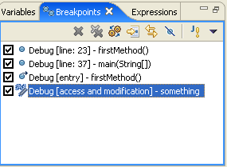
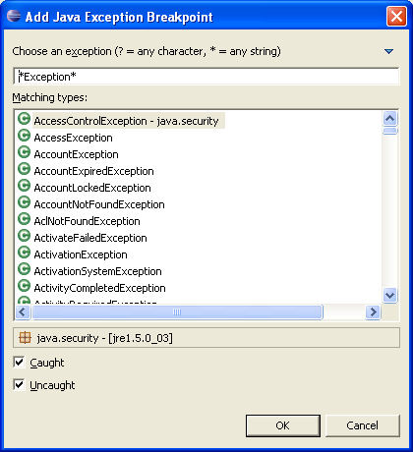
Java Exception Breakpoint
To Add Java Exception Point:
  Select Add Java Exception Point from menu
  Enter exception type
  Specify what triggers a breakpoint:
    Caught exception
    Uncaught exception
    Both

Slide 24
How To Debug
Here are simple steps for debugging in Eclipse:
  Set your breakpoints
  Hit a breakpoint during execution
  Walk/step through code to other breakpoints
  Follow along in editor
  Inspect/Watch interesting fields
  Watch the Console for things to happen
Notes:
Debugging is an important facility of any development environment. Eclipse debugger contains facilities that help you in debugging the code. You will find that inspecting objects is probably most commonly used activity during the debugging. Watch what happens during the debugging, i.e. watch for field, variables values.

Slide 25
Summary
You have learned:
  The views in the Debug Perspective
  Typical debug session
  How to use the Inspector
  About the different types of breakpoints
  How to set breakpoints
  How step around your code doing debugging

Slide 26

Labs!
Lab: Debugging in Eclipse
Notes:
Now it’s time for the lab.

