Slide 1

www.espirity.com
Views
Dwight Deugo (dwight@espirity.com)
Nesa Matic (nesa@espirity.com)
Notes:
Portions of the notes for this lecture include excerpts from the Eclipse 3.0 and 3.1 Help facility. These excerpts are made available under EPL for ease of use by instructors, (c) Copyright (c) 2000, 2005 IBM Corporation and others. For more complete information instructors are encouraged to read the full notes from the Eclipse Help facility.

Slide 2
Additional Contributors
None as of September, 2005

Slide 3
Module Road Map
Adding Views
Notes:
In this module, we discuss Eclipse’s Plug-in Development Environment.

Slide 4
Module Road Map
Adding Views
  Plug-in development environment (PDE)
  Developing plug-in with new views
  Using PDE for plug-in development
  Plug-in editor
  Installing and running plug-in
Notes:
In this module, we discuss Eclipse’s Plug-in Development Environment. We will use it to develop a new view to extend the Workbench.

Slide 5
Plug-in Development Environment (PDE)
A tool that designed to help developing platform plug-ins inside the platform workbench
  It ensures that the rules for creating new plug-ins are followed so that they are correctly incorporated by the platform.
Provides set of platform extension contributions
  Collectively these contributions streamline process of plug-in development
PDE is platform based
  Relies on the JDT
Notes:
The Plug-in Development Environment (PDE) is a tool that is designed to help you develop platform plug-ins while working inside the platform workbench.
PDE provides a set of platform extension contributions (views, editors, perspectives, etc.) that collectively streamline the process of developing plug-ins inside the workbench.
In line with the general platform philosophy, PDE is not a separately launched tool. When you install PDE, your workbench will look the same, but you will see that new perspectives, wizards, editors, and views are available. PDE blends with the platform and offers its capabilities through a new perspective.
PDE is based on the platform and the Java development tooling (JDT). You need to understand the concepts presented in the Platform ISV Guide and the JDT User Guide in order to use PDE and understand the remaining concepts in this guide.

Slide 6
PDE and Projects
Plug-ins are managed by PDE inside projects
  Each project represents one plug-in
Each project holds:
  Holders and files that define the plug-in
  The ways plug-in will interact with the platform
Plug-ins are in the workspace
  They show up in the resource navigator and other views that show workspace resources
Notes:
PDE takes advantage of the project structure in the platform. When you use PDE, you organize your work into projects, folders, and files. PDE looks into the projects in your workspace and pays special attention to those that have plug-in or fragment manifest files as their immediate children. If a project has a plug-in manifest, PDE considers it a plug-in project. In addition, PDE will associate a special PDE nature with these projects to be able to attach special PDE builders.
We know that the platform is based on the concept of plug-ins that have a clearly defined structure and specification. The goal of PDE is to ensure that you follow the rules when creating new plug-ins so that they are correctly incorporated by the platform.
PDE manages plug-ins inside projects. Each project represents one plug-in and holds folders and files that define the plug-in and the ways it will interact with the platform. These plug-ins will be in your workspace and will show up in the resource navigator and other views that show workspace resources (such as Java Package Explorer).

Slide 7
PDE Projects
Special kind of projects that contain:
  Plug-in code
  Other plug-in details such as manifest file
  Set of features for developing plug-ins
Some of the features include:
  Computing and managing Java class path for plug-ins and fragments under development
  Manifest syntax check
It is possible to convert non-plug-in projects into plug-in projects
Notes:
Developing plug-in without using wizards from PDE requires knowledge of what should be be in project’s classpath. For example JAR files such as swt.jar, jFace.jar and workbench.jar must be added to the project’s classpath by hands. When using PDE, the appropriate plug-in type is selected and the environment takes care of managing the classpath.

Slide 8
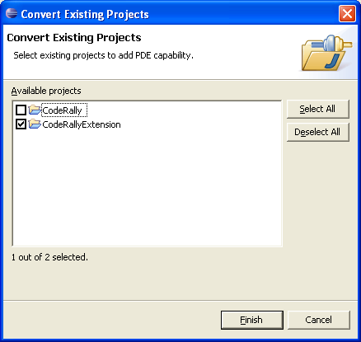
Converting Java Projects
To activate wizard, use the right mouse button context menu in the Package Explorer View
  PDE Tools -> Convert Projects to Plugi-n Project…
Select the project for converting and click Finish
Notes:
Java projects do not need to have manifest files. If they are missing, PDE will create generic ones that can be used as a starting point. Files that already exist will be left intact. As an option, you can re-compute the build path in the process. If your project has a classpath you want preserved, deselect this checkbox.

Slide 9
Workbench Host vs. Runtime
There are two different instances of Workbench that can run:
  Host, the instance used for developing plug-ins
  Run-time, the instance used for running, i.e. testing developed plug-ins
Runtime Workbench instance is launched from the host instance
  It will contain all plug-ins of the host instance as well as the ones just developed in the host instance
  It is launched by choosing:
    Window → New Window
Notes:
One of the most important concepts in PDE to understand is the concept of host and run-time workbench instances. When you start up the workbench, you will use it to work on your projects that define the plug-ins you are building. The workbench instance that you are running as you develop your plug-in using the PDE and other tools is the host instance. The features available in this instance will come exclusively from the plug-ins that are installed with your application.
Once you are happy with your plug-in and want to test it, you can launch another workbench instance, the run-time instance. This instance will contain the same plug-ins as the host instance, but will also have the plug-ins you were working on in the host instance. PDE launcher will take care of merging your plug-ins with the host plug-ins and creating the run-time instance.
When starting the run-time Workbench instance the Plug-in Development Environment launcher will take care of merging your plug-ins with the host plug-ins and creating the run-time instance.

Slide 10
External vs. Workspace Plug-ins
External plug-ins arrived with the basic platform installation
  Simply referenced from their original location without modification
  Considered read-only
Workspace plug-ins are plug-ins under development in the host workbench
  Can be added, deleted and modified in any way
Notes:
External and workspace plug-ins are treated differently by PDE because of their location. For example, opening the plug-in manifest of a workspace plug-in will launch an editor on that manifest file in the workspace. The same operation for an external plug-in will launch an editor on an external URL that references the plug-in's manifest file in the host install location.
These differences are fairly transparent to PDE users, but should be understood.

Slide 11
Configuring PDE
PDE is installed as part of the default platform installation
Once installed runtime Workbench instance path must be defined
  The path of the Workbench installation that will be used to run and debug plug-ins
  The default path is the host Workbench instance
  There may be need to differentiate these paths
Different workspaces should be used for host and runtime Workbench instances
Notes:
It is possible to use different workbench instances for development and run-time. For example, you might have a stable platform configuration that you use as a development tool, but wish to deploy your plug-ins in a different version. The run-time instance may be based on a new (and possibly less stable) technology, or may incorporate a different set of plug-ins than your host configuration.

Slide 12
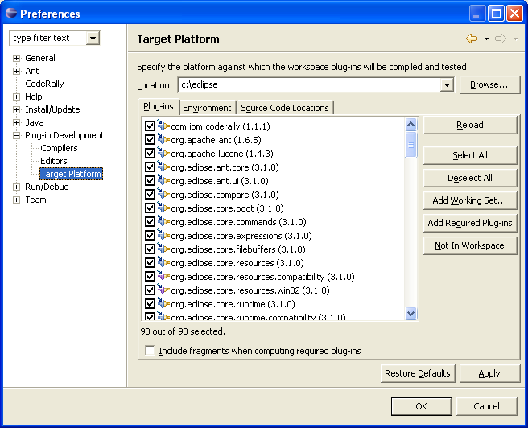
Runtime Workspace Location
Set up by selecting:
  Window → Preferences → Plug-in Development → Target Platform
Notes:
When you set the application location (c:\runtime\eclipse) and press the Reload button, the list of plug-ins and fragments on the page will fill up with the discovered external plug-ins. By default, all these plug-ins will be invisible to PDE. You can make them visible by enabling them individually or pressing Select All button.
Workspace plug-ins and enabled external plug-ins will be used by PDE to resolve Java classes and plug-in dependencies. In the case where a workspace plug-in has the same id as an external plug-in, the workspace plug-in masks its external counterpart.

Slide 13
Views and Editors as Plug-ins
Platform allows creation of new views and editors
  They can be created as plug-ins and added to the Workbench
This allows further customization of the Workbench
  Allows for adding views and editors with special functionality
  Added plug-ins can be visible only for certain perspectives

Slide 14
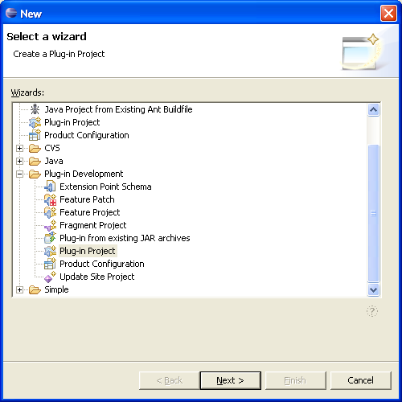
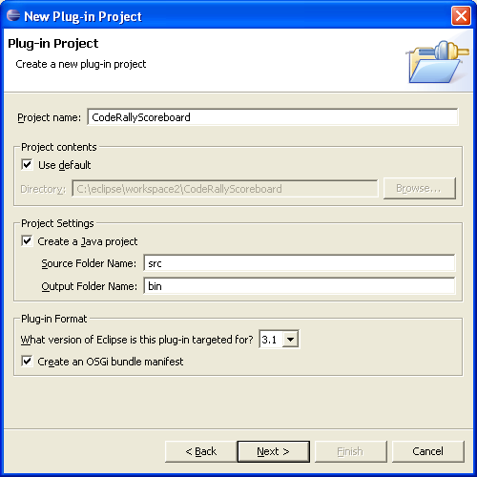
Creating Plug-in Project
To create new plug-in project select:
  File → New → Plug-in Development → Plug-in Project
Click Next, specify project’s name and click Next again
Notes:
You may also choose to change other options on this window, such as Java build output, plug-in runtime library and the source folder. The default values are displayed in the wizard.

Slide 15
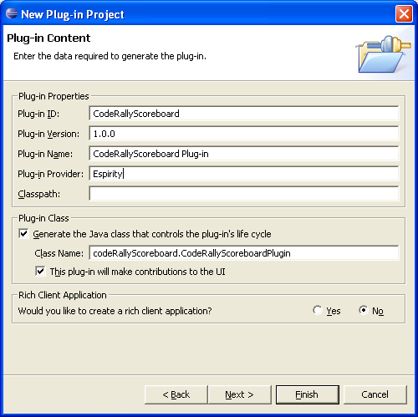
Plug-in Content
Specify:
  Plug-in id (will be stored in the plug-in manifest)
  Plug-in name
  Version
  Provider name
  Class name
    Optional
Click Next
Notes:
The plug-in class represents the tool plug-in and manages the life cycle of the plug-in. You don't have to specify a plug-in class, The platform will provide one for you.

Slide 16
Plug-in Templates
PDE predefines plug-in templates that can be used during plug-in development
  If templates are used wizards will be used for creating on the plug-in
    Tool will populate the manifest file based on options chosen through the wizards
  Otherwise details must be specified in the the manifest file
    Extension points, required plug-ins, etc.
Notes:
You will need to choose what the content of your new plug-in is going to look like. If you choose a blank plug-in, only the plug-in project will be created. If you use the template wizards, the PDE will also create files such as the plug-in class, build properties, and plug-in manifest. Some of the templates provided by PDE also generate useful content such as views, editors, property pages etc. This content is generated by templates that can be combined into a wizard. All the available templates are individually selectable in the "Custom plug-in wizard".

Slide 17
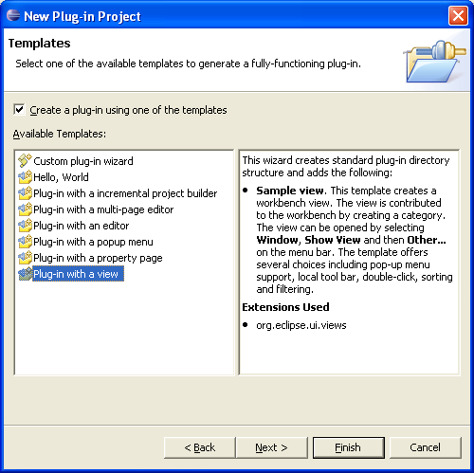
Plug-in with a View
Extension point will be automatically added by the tool to the manifest file
Click Next
Notes:
In this example, we use the “Plug-in with a view" template wizard. You can read about the wizard in the area to the right of the wizard list.

Slide 18
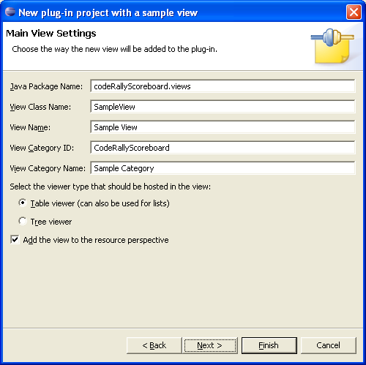
View Settings
Specifying View details:
  Package name
  Class name
  Category id
  Category name
  Viewer type
Click Next
Notes:
Categories can be used to group related views together in the workbench Show View dialog. We define our own category, "Sample Category" so that it will display in its own group. Category is identified by its id and has a name associated with it.
Viewers allow you to create widgets while still using your model objects. If you use an SWT widget directly, you have to convert your objects into the strings and images expected by SWT. Viewers act as adapters on SWT widgets, handling the common code for handling widget events that you would otherwise have to implement yourself.
If you want the view to show by default in the resource perspective, the option should be turned on.

Slide 19
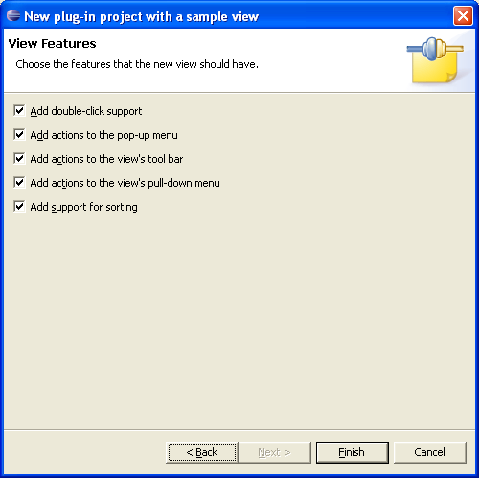
View Features
Select list of features to be added to the view
  By default all of them are selected
Click Finish

Slide 20
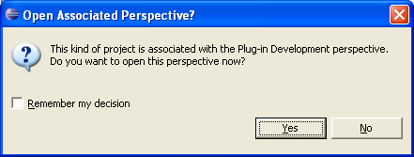
Plug-in Development Perspective
Defines views and editors that are mostly used when developing plug-ins
When using PDE wizards, after creating plug-in you will be prompt if wanted to switch to this perspective
  Also, all required plug-ins will be installed at this time if they are not already there

Slide 21
Generated View Class
public class SampleView extends ViewPart {
private TableViewer viewer;
…
class ViewContentProvider implements IStructuredContentProvider { … }
class ViewLabelProvider extends LabelProvider implements ITableLabelProvider { … }
public SampleView() {}
public void createPartControl(Composite parent) {
viewer = new TableViewer(parent, SWT.MULTI | SWT.H_SCROLL | SWT.V_SCROLL);
viewer.setContentProvider(new ViewContentProvider());
viewer.setLabelProvider(new ViewLabelProvider());
viewer.setInput(getViewSite());
…
}
private void showMessage(String message) {
MessageDialog.openInformation(
viewer.getControl().getShell(),
"Sample View",
message);
}
public void setFocus() {
viewer.getControl().setFocus();
}}
Notes:
All plug-ins with view classes extend ViewPart class.
The viewer attribute type was defined through wizards.
The content provider class is responsible for providing objects to the view. It can wrap existing objects in adapters or simply return objects as-is. These objects may be sensitive to the current input of the view, or ignore it and always show the same content (like Task List, for example).
A label provider defines how model objects should be presented in the view. Each view can present the same model objects using different labels and icons, if needed. Alternatively, a single label provider can be shared between views in order to ensure that objects of the same type are presented in the same way everywhere.
createPartControl() method represents a callback that will allow us to create the viewer and initialize it.

Slide 22
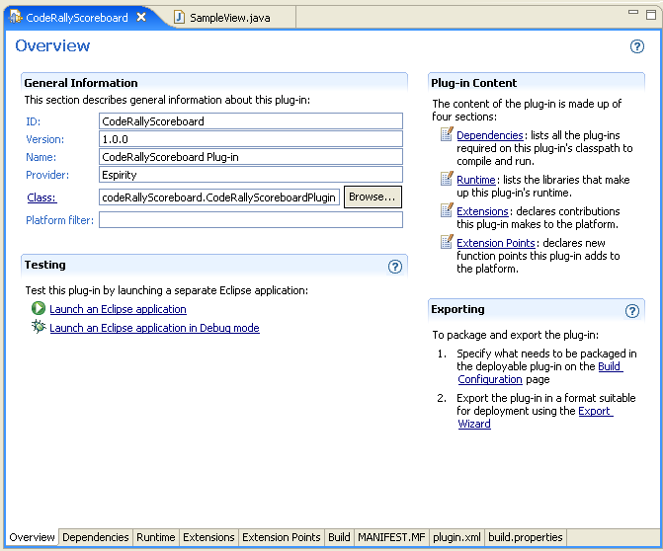
Plug-in Editor
Double-click on the plug-in.xml opens the editor
Plug-in details can be changed in the editor
Overview page displays basic plug-in information
Notes:
After you've created a PDE plug-in using the New Project wizard, you will see the plug-in manifest editor for your new plug-in.
The PDE has a number of multi-page editors, including the plug-in manifest editor, that share the same basic behavior. The editor has one source page that shows the raw file content and one or more form pages that present the same information in a more structured format.
The plug-in manifest editor partitions the form information into several pages for less clutter. The best way to learn about the plug-in manifest editor is to visit each page.

Slide 23
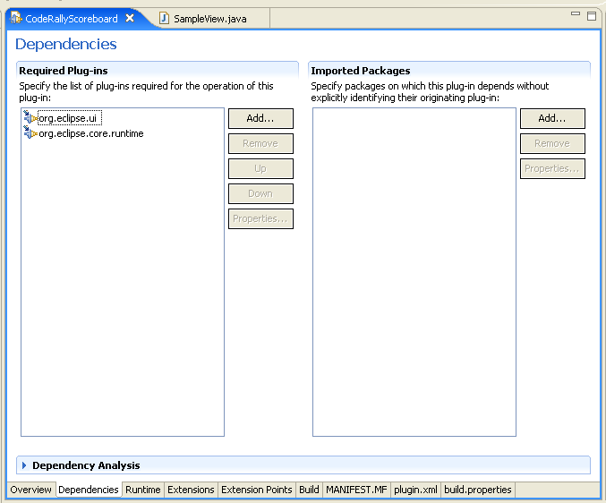
Dependencies Page
Displays dependant plug-ins
  Created by tools when the plug-in type is chosen
  New dependences can be added
Notes:
The Dependencies page shows the dependencies that your plug-in has on other plug-ins. The plug-ins your plug-in currently depends on are shown in the list. You can modify the list by adding more plug-ins (button Add...) or removing them from the list. Changes in this list will prompt PDE to update the plug-in manifest and also configure the build path of the project so that the classes of the imported plug-in are visible to the plug-in under development.
Since the PDE distinguishes between workspace and external plug-ins, the eligible plug-ins will be shown in two separate lists of checkboxes.
Once you add the plug-in reference to the list, you can browse it by selecting Open from the pop-up menu or double-clicking on the entry.

Slide 24
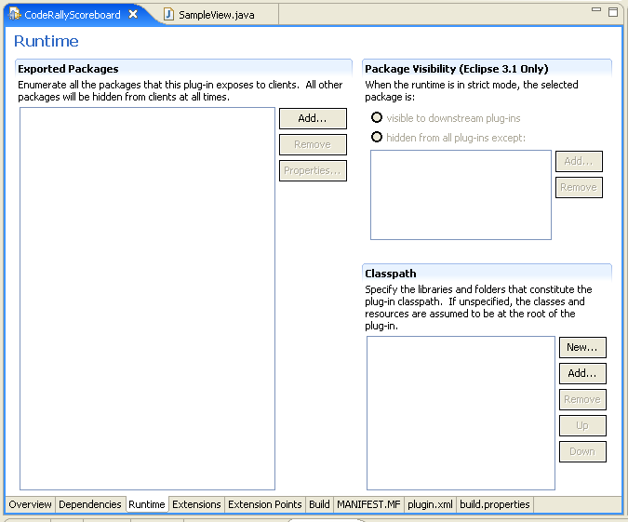
Runtime Page
Displays runtime information such as plug-in classpath
Populated by the tools based on inputs from wizards
Additional libraries can be added to the classpath
Notes:
The Runtime page shows information about run-time libraries. When packaged, platform plug-ins deliver all of their Java classes in JAR libraries. This page defines how the classes that are in source folders during the design time are packaged into the libraries. One source folder and one library have already been set during the project creation by the wizard. You can define more on this page.

Slide 25
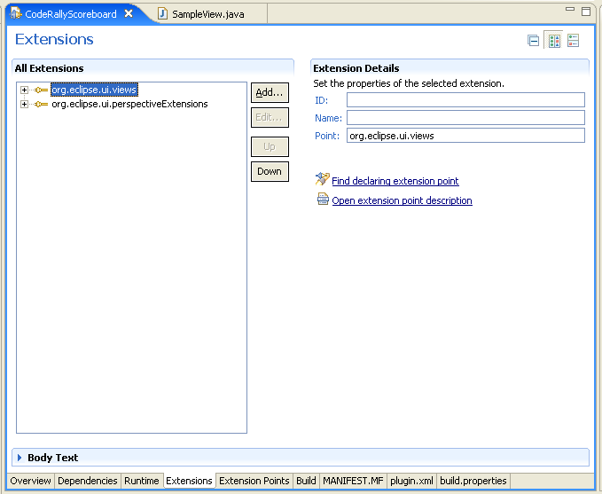
Extensions Page
Displays plug-in extensions
  Created by the tool based on the plug-in type
  Extensions can be added
Notes:
The Extensions page is used to browse and edit plug-in extensions. Extensions are the central mechanism for contributing behavior to the platform. Unless your plug-in is a simple Java API library made available to other plug-ins, new behavior is contributed as an extension.

Slide 26
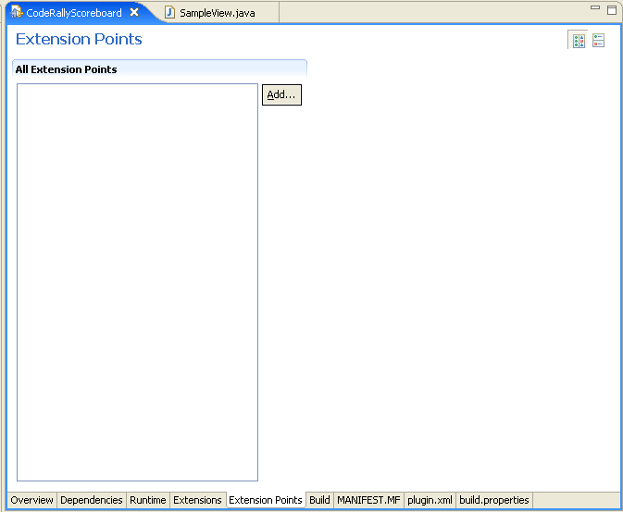
Extension Points Page
Displays plug-in extension points
  There are none in our example
Notes:
The Extension points page is used to browse and edit extension points defined by the plug-in. Our plug-in's extension points can be used by the plug-in itself or another plug-in.

Slide 27
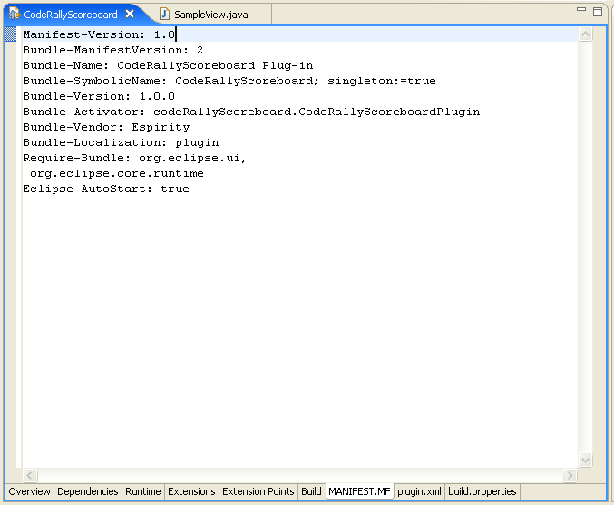
MANIFEST.MF Page
OSGI bundle information for the plug-in
  Version
  Symbolic name (ID)
  Name
  Required bundles

Slide 28
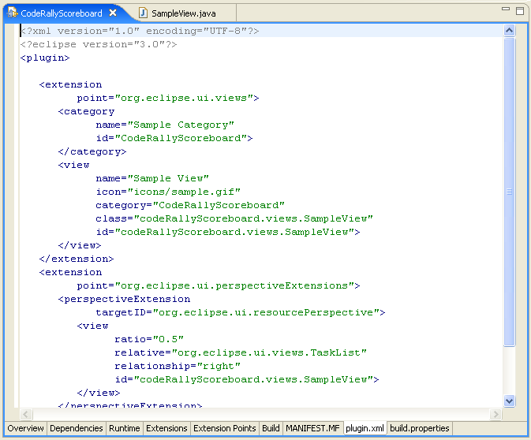
plugin.xml Page
Editor uses round-trip for changing the plug-in details:
  Changes to other pages in editor will change source
  Changes in source will change content of other editor pages
Notes:
The Source page shows the raw XML source for the plug-in manifest file. You can do all of your editing in this page, but you will not be able to validate the page as you go. The form editors can provide much more assistance in editing the file correctly.

Slide 29
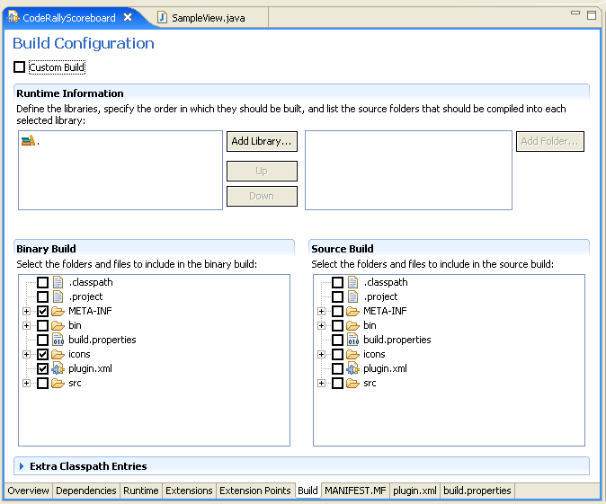
Build and build.properties Pages
Interface to the build.properties file:
  source.. = src/
  output.. = bin/
  bin.includes = plugin.xml,\
  META-INF/,\
  .,\
  icons/

Slide 30
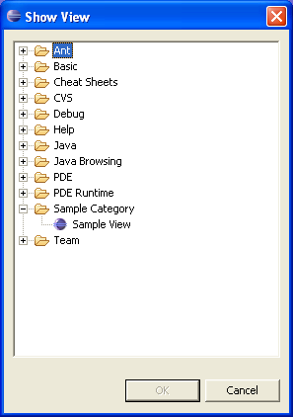
Running the Plug-in From Workbench
From the Workbench
  Run → Run As → Eclipse Application
  This will open a new Workbench
To make view plug-in visible select:
  Window → Show View → Other…
Select the view plug-in and click OK
Notes:
You can run your new plug-in from the current Workbench by selecting the Run Icon (the little man), selecting Run as -> Run-time Workbench. The create a new instantiation of your Workbench including the new plug-in you have developed.
Your new plug-in’s meta data is stored in C:\...eclipse\runtime-workspace\.metadata. If you have problems running your plug-in make sure to delete this directory to clean things up for the next invocation.

Slide 31
… Running the Plug-in From Scratch
Restart the Workbench
  This causes newly defined plug-in to be picked up by the system and stored in the plug-in registry
    Exit the platform
    Start it again
To make view plug-in visible select:
  Window → Show View → Other…
Select the view plug-in and click OK
Notes:
If you are currently running the workbench, you will need to shut it down and restart it. When the platform starts, it assembles a list of all of the plug-ins installed in the system, called the plug-in registry. This registry keeps track of plug-ins and the extension points that they contribute. Restarting the workbench will cause it to find your new plug-in.

Slide 32
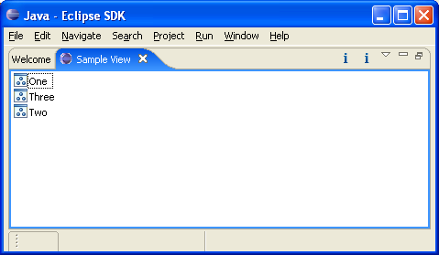
Showing the View
The view shows up in the Workbench with its sample content
  The sample content was generated by the PDE
  The content should be changed to implement specific functionality that view should provide
Sample Content

Slide 33
Getting Ready to Export Plug-in
Check the build.properties file in your project for the following content:
source.. = src/
output.. = bin/
bin.includes = plugin.xml,\
META-INF/,\
.,\
icons/

Slide 34
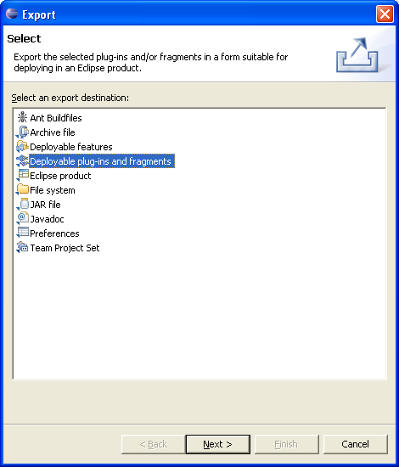
Export Deployable Plug-ins and Fragments…

Slide 35
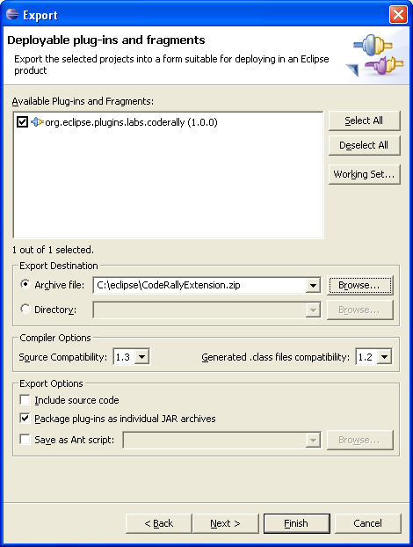
…Export Deployable Plug-ins and Fragments
Export the code as a Archive file
The plug-in will have a zip extension
Your plug-in is in the zip file and has the jar extension
Notes:
Every plug-in has its unique identifier. Our plug-in will be installed in the directory com.espirity.course.plugins.workbench located under plugins directory of the Eclipse. This directory must be unique and that’s the reason why it follows Java packaging naming convention.

Slide 36
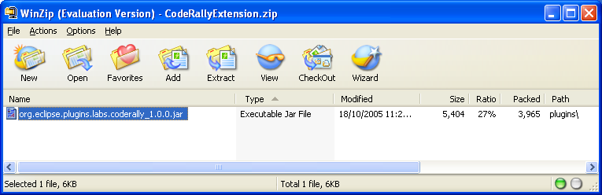
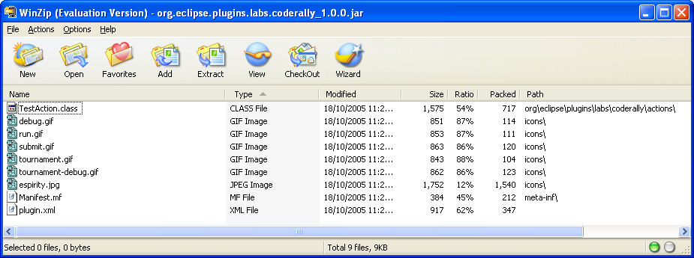
Plug-in ZIP and JAR files
The Plug-in ZIP file has:
  Your Plug-in’s JAR file
Unzip contents into plugins directory

Slide 37
Installing Plug-in
Make sure the new plug-in.jar file is in Eclipse’s plugin directory.
Restart Eclipse
Warning
  Try your new plug-in in a fresh/non-development Eclipse install
  You don’t want to have problems in your development install

Slide 38
Summary
You have learned:
  How to use PDE to develop plug-ins
  How to use the plug-in editor
  How to develop a plug-in with a view
  How to install and run a plug-in

Slide 39

Labs!
Lab: Adding Views to the Workbench
Notes:
Now it’s time for the lab.

