Slide 1

www.espirity.com
Perspectives
Dwight Deugo (dwight@espirity.com)
Nesa Matic (nesa@espirity.com)
Notes:
Portions of the notes for this lecture include excerpts from the Eclipse 3.0 and 3.1 Help facility. These excerpts are made available under EPL for ease of use by instructors, (c) Copyright (c) 2000, 2005 IBM Corporation and others. For more complete information instructors are encouraged to read the full notes from the Eclipse Help facility.

Slide 2
Additional Contributors
None as of September, 2005

Slide 3
Module Overview
Adding Perspectives
Notes:
In this module, we discuss how to create and add a new Perspective to Eclipse.

Slide 4
Module Road Map
Adding Perspectives
  Perspectives
  Extending perspectives
  Adding new perspectives
  Perspective plug-in
  Installing and running perspective plug-in
  Customizing perspectives
Notes:
In this module, we discuss how to create and add a new Perspective to Eclipse.

Slide 5
What is a Perspective?
Perspective is a collection of views on underlying resources
  Resources are part of user’s workspace
  Perspective defines different views on the resources
Perspectives are task oriented
  Different tasks are represented through perspective
  Designed to help developers with accomplishing these specific tasks
Notes:
Each Workbench window contains one or more perspectives. A perspective defines the initial set and layout of views in the Workbench window. Within the window, each perspective shares the same set of editors. Each perspective provides a set of capabilities aimed at accomplishing a specific type of task or working with specific types of resources. For example, the Java perspective combines views that you would commonly use while editing Java source files, while the Debug perspective contains the views that you would use while debugging Java programs. As you work in the Workbench, you will probably switch perspectives frequently.
Perspectives control what appears in certain menus and toolbars. They define visible action sets, which you can change to customize a perspective. You can save a perspective that you build in this manner, making your own custom perspective that you can open again later.

Slide 6
Perspective Details
Each perspective in the Workbench has:
  Type, used to define which actions and views are visible in the user interface
  Input, used to define which resources are visible in the workspace
Resource perspective
  Input = Workspace
  Type = Resource
Java perspective
  Input = Project
  Type = Java
Notes:
The visible resources in the Java perspective are a subset of the visible resources in the Resource perspective. Each perspective contains a set of views and editors which exist wholly within the perspective and are not shared with the other. These parts define the presentation for a shared, underlying model.

Slide 7
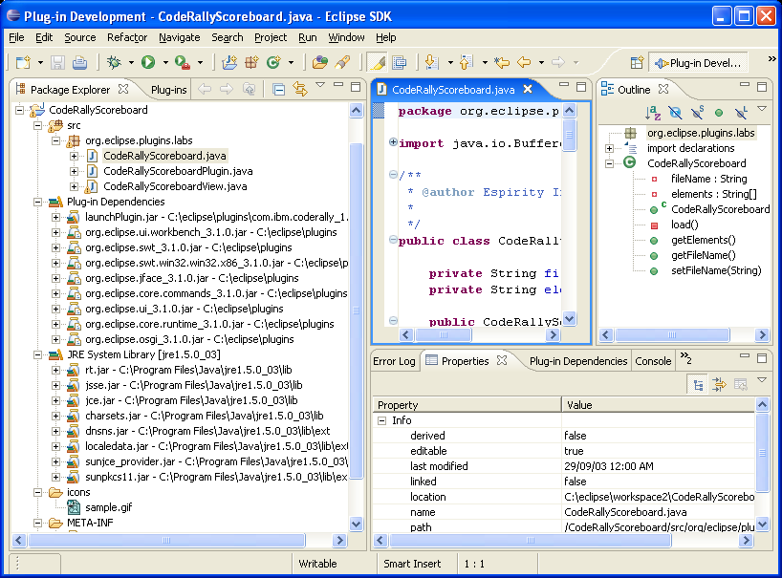
Information Filtering
Each perspective opens on relevant set of resources
  This subset is an input for the perspective
  Based on the file hierarchies
  Irrelevant resources are hidden
Notes:
The above picture shows Package Explorer view of the Java perspective. Java perspective is used for managing Java resources, such as Java classes. Because of that the details for Java classes (such as fields, methods, etc.) are shown in the Package Explorer. These details wouldn’t be shown in some other perspective that is not meant for managing Java resources.

Slide 8
Perspective Implementation
Perspective is a page within a Workbench window
  Implemented as a IWorkbenchPage type
Multiple perspectives make up a Workbench window
  Implemented as a IWorkbenchWindow type
Multiple windows make up a Workbench
  Implemented as a IWorkbench type
  Obtained by invoking PlatformUI.getWorkbench()
All types are defined in the org.eclipse.ui package
  Package contains interfaces that define Eclipse user interface
Notes:
Perspectives are an additional organizational layer of inside a workbench window. A perspective defines a collection of views, a layout for the views, and the visible action sets that should be used when the user first opens the perspective.
Perspectives are implemented using IPerspectiveFactory, which implementors are expected to configure an IPageLayout with information that describes the perspective and its perspective page layout – there will be more talk about layout later in this module.

Slide 9
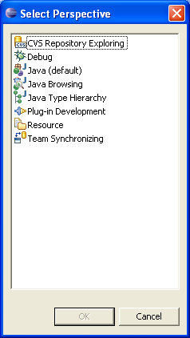
Opening Perspectives
There are two different ways to open a perspective:
  Using menus
    Window → Open Perspective → …
  Programmatically
    The openPage method creates and returns an object of type IWorkbenchPage
// window is an instance of IWorkbenchWindow
window.openPage(
"org.eclipse.ui.resourcePerspective", //type
ResourcesPlugin.getWorkspace()); //input
Notes:
In the above example the two parameters to openPage identify the perspective type and input. The perspective type is identified by a string, and represents its unique id. In this case "org.eclipse.ui.resourcePerspective" identifies the Resource perspective. The perspective input may be any object of type IAdaptable. In this case the input is the entire workspace.
When a page is returned from invoking openPage method, you can query the page by sending getInput and getPerspective messages. Method getPerspective returns an object of IPerspectiveDescriptor type, that contains information about perspective id label, and icon.

Slide 10
Adding Perspectives
There are generally two different approaches for adding new perspectives:
  Creating new perspectives
    Defining new perspective with its own set of views/editors
  Modifying existing perspectives
    Changing layout of existing perspectives and saving it as a new perspective
Should perspective be modified or created from scratch?
  Depends on the requirements
Notes:
In some cases modification of existing perspectives makes more sense than creation of new one.
If you are adding a view for doing some specific task that is already targeted in another perspective, it may be better to modify that existing perspective with the new view, rather than creating new perspective.
On the other hand, if tasks are completely new, than it makes more sense to crate new perspective and add the view to it.

Slide 11
When to Create a Perspective
A perspective should be created when targeting specific tasks for user
  Tasks should be performed through views and other UI elements that are part of perspective
For example, web application development
  Contain specific tasks for creation and manipulation of web elements
    html, jsp, servlets
  Tasks can be grouped into a Web perspective
Notes:
Another example can be Enterprise Java Bean development. An EJB perspective can contain EJB related tasks, such as creating, deploying and testing EJBs. Or there may be Testing perspective on its own, containing views that help with testing the application (Java app, EJB app, etc.)

Slide 12
Creating New Perspectives
It is also, in general, a three-step process:
  Define a plug-in
  Define the perspective extension within the plug-in manifest file
  Define a perspective class
Once these steps are completed, the plug-in can be installed and run

Slide 13
Perspective Plug-in
Accomplished by adding perspective extension point to the plug-in
Single extension point
  org.eclipse.ui.perspectives
<extension point="org.eclipse.ui.perspectives">
<perspective
name="MyFirstPerspective"
class="org.eclipse.demo.plugins.perspectives.MyFirstPerspective"
id="org.eclipse.demo.plugins.perspectives.MyPerspective"
icon="icons/eclipse.gif">
</perspective>
</extension>
Notes:
The attributes that define a perspective are:
id - a unique name that will be used to identify this perspective
name - a translatable name that will be used in the workbench window menu bar to represent this perspective
class – a fully qualified name of the class that implements org.eclipse.ui.IPerspectiveFactory interface
icon - a relative name of the icon that will be associated with the perspective (not used in the example above)

Slide 14
Opening Perspective
When perspective opens:
  An object of type IWorkbenchPage is created
    Object’s id is same as perspective id:
      org.eclipse.demo.plugins.perspectives.MyPerspective
  Perspective description is obtained based on the id
    Description is of type IPerspectiveDescriptor
  Perspective class is obtained from the description
  A new instance of perspective class is created
  A createInitialLayout() method is called on the created instance

Slide 15
Perspective Class
Specifies initial layout of the perspective
  Must implement IPerspectiveFactory interface
The interface has createInitialLayout method defined
  Called when perspective opens
  Initially specifies an editor area and no views
Additional views and folders can be added to the layout
  Folders are stack of views
Place holders can be viewed
  They specify position for views within a page
Notes:
import org.eclipse.ui.*;
import org.eclipse.jface.resource.ImageDescriptor;
import org.eclipse.core.internal.plugins.DefaultPlugin;
import org.eclipse.core.runtime.Platform;
import java.net.URL;
import java.net.MalformedURLException;
public class MyNewPerspective implements IPerspectiveFactory {
private static String ICON_FOLDER_NAME = "icons/";\
public void createInitialLayout(IPageLayout layout) {
defineActions(layout);
defineLayout(layout);
}
public void defineActions(IPageLayout layout) {
……
}
public void defineLayout(IPageLayout layout) {
String editorArea = layout.getEditorArea();
…
}
public static ImageDescriptor getImage(String imageName) {
try {
DefaultPlugin plugin = (DefaultPlugin)
Platform.getPlugin(CarletonSchemePlugin.PLUGIN_ID);
URL installURL = plugin.getDescriptor().getInstallURL();
URL url = new URL(installURL, ICON_FOLDER_NAME + imageName);
return ImageDescriptor.createFromURL(url);
} catch (MalformedURLException e) {
// Should not happen
return null;
}
}
}

Slide 16
New Perspective
Initial Layout
Customized Layout
Perspective window
Perspective window
Editor area
View
Editor area
Notes:
When a perspective is defined only the editor area is obtained. Additional views are added relative to the editor. The above picture shows only one additional view, but there can be as many views as wanted. All views are stacked within the same folder, so the folder must be created first and than views added to it.

Slide 17
Creating Layout
public void createInitialLayout(IPageLayout layout){
//adding new wizard for creating files
layout.addNewWizardShortcut("org.eclipse.ui.wizards.new.file");
//adding views for the show view menu option
layout.addShowViewShortcut(IPageLayout.ID_RES_NAV);
//adding views
//Get the editor area first
String editorArea = layout.getEditorArea();
//Create folder layout (left to editor) to hold views
IFolderLayout folderLayout = layout.createFolder("topFolder", IPageLayout.TOP, (float) 0.40, editorArea); folderLayout.addView(IPageLayout.ID_RES_NAV);
}
Notes:
The createFolder method of the perspective class adds a new folder to the page layout. The position and relative size of the folder are expressed as a fraction of an existing editor area. In the example created folder is positioned to the top of the editor area and occupies 40% of the original space of the editor area. The positioning constants are defined on IPageLayout, and include TOP, BOTTOM, LEFT and RIGHT.

Slide 18
Manifest File
Specifies plug-in details
  Plug-in name, version, id, …
Manifest-Version: 1.0
Bundle-ManifestVersion: 2
Bundle-Name: Code Rally Perspective
Bundle-SymbolicName: org.eclipse.demo.plugins.labs.coderally.perspective; singleton:=true
Bundle-Version: 1.0.0
Bundle-Localization: plugin
Require-Bundle: org.eclipse.ui,
org.eclipse.core.runtime
Eclipse-AutoStart: true
Bundle-Vendor: Espirity
Bundle-Activator: org.eclipse.plugins.labs.coderally.perspective.CodeRallyPerspectivePlugin

Slide 19
Plugin.xml File
Specifies extensions
<?xml version="1.0" encoding="UTF-8"?>
<?eclipse version="3.0"?>
<plugin>
<extension point="org.eclipse.ui.perspectives">
<perspective
name="Code Rally Perspective"
class="coderally.perspective.CodeRallyPerspective"
id="coderally.perspective.CodeRallyPerspective"
icon="icons/perspective.gif">
</perspective>
</extension>
</plugin>

Slide 20
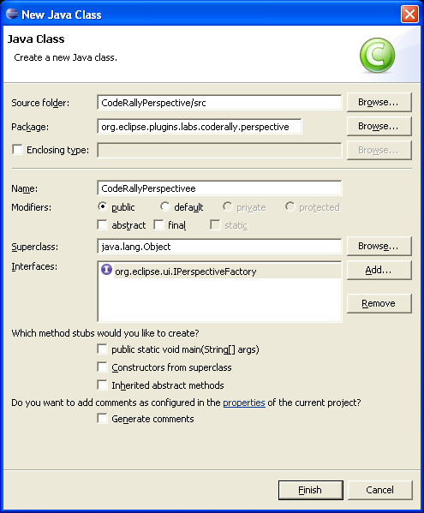
Step 1: Define the Class
Create a perspective class
  Will be specified in the manifest when defining extension
  Implements IPerspectiveFactory interface
  Defines createInitialLayout method

Slide 21
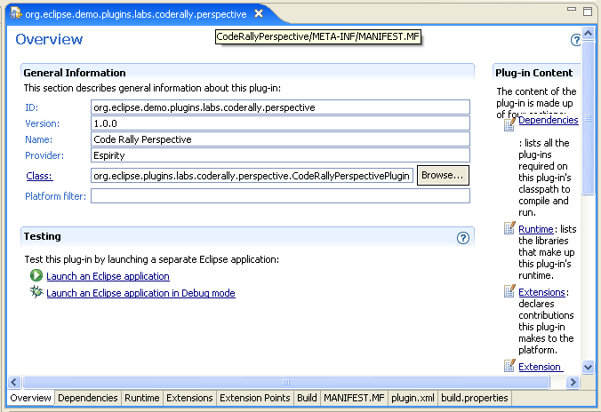
Step 2: MANIFEST.MF and plugin.xml
Add the plug-in details to the manifest file

Slide 22
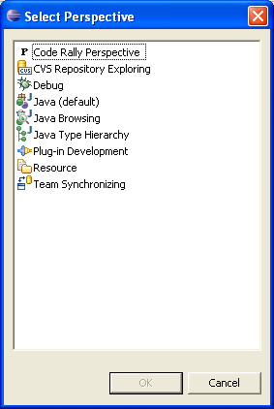
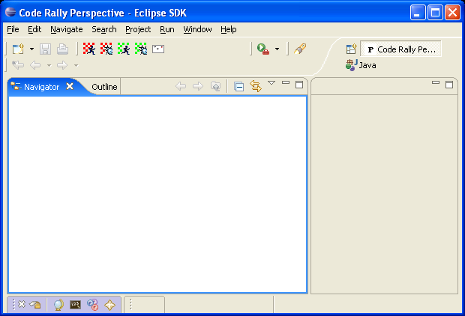
Step 3: Run the Plug-in
Exit and restart Eclipse
Or Run Icon → Run As → Eclipse Application
Select Window → Open Perspective → Other…

Slide 23
Perspective id
Perspectives id may be required by other plug-ins
  Referencing perspectives from different plug-ins
  Perspective id is required for referencing
Perspective id is stored in the manifest file
  Requires plug-in code to read manifest file and get the id
    Not the best way as implementation is not trivial (but not hard, though) and file processing is time consuming
It is more convenient to have perspective id stored locally, in the code
  The public interface IPerspectivePlugin holds the id by convention

Slide 24
Perspective Plug-in Interface
Implemented by perspective plug-in class
Used for convenience of storing the perspective id
public interface IPerspectivePlugin {
// Plug-in id
public final static String PLUGIN_ID = "MyPerspectivePlugin";
// Perspective id
public final static String MY_PERSPECTIVE_ID =
PLUGIN_ID + ".MyPerspective";
}

Slide 25
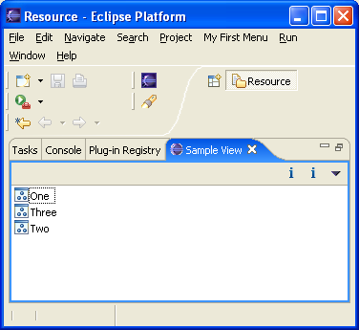
More Perspective Customization
It is possible to disable editor area at the perspective opening
It is also possible to display views that are part of another custom plug-in
View from another plug-in
Notes:
When editor area is disabled initially it is possible to enable it again through menus by choosing Window -> Hide (Show) Editors. That also applies for showing/hiding views.
In the example above a custom view defined in another plug-in is added to the perspective and editor area is hidden.

Slide 26
MANIFEST.MF Changes
Manifest-Version: 1.0
Bundle-ManifestVersion: 2
Bundle-Name: Code Rally Perspective
Bundle-SymbolicName: org.eclipse.demo.plugins.labs.coderally.perspective; singleton:=true
Bundle-Version: 1.0.0
Bundle-Localization: plugin
Require-Bundle: org.eclipse.ui,
org.eclipse.core.runtime,
org.eclipse.plugins.labs
Eclipse-AutoStart: true
Bundle-Vendor: Espirity
Bundle-Activator: org.eclipse.plugins.labs.coderally.perspective.CodeRallyPerspectivePlugin
Notes:
The added required plug-in is the one that contains view you want to add to the perspective.

Slide 27
Perspective Class Changes
public void createInitialLayout(IPageLayout layout){
//adding new wizard for creating files
layout.addNewWizardShortcut("org.eclipse.ui.wizards.new.file");
//adding views for the show view menu option
layout.addShowViewShortcut(IPageLayout.ID_RES_NAV);
//adding views
//Get the editor area first
String editorArea = layout.getEditorArea();
//Create folder layout (left to editor) to hold views
IFolderLayout folderLayout = layout.createFolder("topFolder", IPageLayout.TOP, (float) 0.40, editorArea); //folderLayout.addView(IPageLayout.ID_RES_NAV);
folderLayout.addView(
"com.espirity.course.plugins.views.SampleView");
layout.setEditorAreaVisible(false);
}
Notes:
When adding a view to the folder that contains views the id of the view used is the one that’s defined in view’s plug-in manifest file. To disable editor area a message setEditorAreaVisible could be sent to the IPageLayout object.

Slide 28
Extending Existing Perspectives
Suitable for introducing new action sets, wizards and views to existing perspectives
It is, in general, extending an existing perspective is a three-step process:
  Define a plug-in
  Define an action set or view extension within the plug-in manifest file
  Add a perspectiveExtension extension to the plug-in registry
Once these steps are completed, the plug-in can be installed and run

Slide 29
Perspective Extension
…
<extension point="org.eclipse.ui.perspectiveExtensions"> <perspectiveExtension
targetID="MyPerspectivePlugin">
<actionSet id="org.eclipse.jdt.ui.JavaActionSet"/>
<viewShortcut id="org.eclipse.jdt.ui.PackageExplorer"/>
<newWizardShortcut
id="org.eclipse.jdt.ui.wizards.NewProjectCreationWizard"/>
<perspectiveShortcut id="org.eclipse.jdt.ui.JavaPerspective"/>
<view id="org.eclipse.jdt.ui.PackageExplorer"
relative="org.eclipse.ui.views.ResourceNavigator" relationship="stack"/>
</perspectiveExtension>
</extension>
…
Notes:
In the above example the perspective MyPerspectivePlugin is extended. Instead of defining new perspective a perspective extension is defined.
An action set is added. Then menu items for Show View, File > New, and Open Perspective are added. And then the Packages view is stacked on top of the Navigator.

Slide 30
Summary
You have learned:
  What are perspectives
  Different ways of extending perspectives
  How to create new perspective
  How to install and run perspective plug-in
  How to do perspective customization

Slide 31

Labs!
Lab: Adding Perspectives to the Workbench
Notes:
Now it’s time for the lab.

