Slide 1

www.espirity.com
Javadoc
Dwight Deugo (dwight@espirity.com)
Nesa Matic (nesa@espirity.com)
Notes:
Portions of the notes for this lecture include excerpts from the Eclipse 3.0 Help facility. These excerpts are made available under CPL for ease of use by instructors, (c) Copyright (c) 2000, 2004 IBM Corporation and others. For more complete information instructors are encouraged to read the full notes from the Eclipse Help facility.

Slide 2
Additional Contributors
None as of September, 2004

Slide 3
Module Overview
Javadoc
Exporting Javadoc in Eclipse

Slide 4
Module Road Map
Javadoc
  Doclets
  Comments
    Placement
    Sections
    Tags
  Running Javadoc
Exporting Javadoc in Eclipse
Notes:
In this module we discuss Javadoc. We begin by describing what it is and what it does and how doclets can help it do more. Next we look at creating Comments for Javadoc. In particular, we examine the different placement and section of Javadoc as well as the different tags. We end with a description on how to run Javadoc and where the complete documentation on the tool can be found.

Slide 5
Javadoc
Tool
  Parses the declarations and documentation comments in java source files and produces a set of HTML (plus other format) pages describing the classes
.java
.html
.java
.pdf
Javadoc
.java
.rtf

Slide 6
Javadoc Doclets
Use Javadoc doclets to customize Javadoc output
  A doclet is a program written with the doclet API that specifies the content and format of the output to be generated by the javadoc
  You can write a doclet to generate any kind of text-file output
  Sun provides:
    A "standard" doclet for generating HTML-format
    An experimental MIF doclet for generating MIF, PDF, PS, RTF, FrameMaker, and other formats
  Doclets can also be used to perform special tasks not related to producing API documentation
Notes:
You could use a Doclet as a diagnostic doclet that can check that all class members of the classes on which Javadoc operates have documentation comments.

Slide 7
Processing Source Files
Tool parses by default the following:
  The public and protected classes
  Nested classes (but not anonymous inner classes)
  Interfaces
  Constructors
  Methods
  Fields
Use the tool to generate the API documentation or the implementation documentation for a set of source files
  Run the tool on packages and/or source files
  Use Javadoc comments to customize documentation

Slide 8
Running Javadoc
Tool normally processes files that end in .java
  Can run the tool by explicitly passing in individual source filenames
  Normally tool is run by passing package names
The tool can be run three ways without explicitly specifying the source filenames:
  Passing in package names
  Using –subpackages option
  Using wildcards with source filenames (*.java)
The tool processes a .java file only if it fulfills all of the following requirements:
  The file, after removing the .java suffix, is a legal class name
  The directory path relative to the root of the source tree is a legal package name
  The package statement contains the legal package name

Slide 9
Javadoc Comments
Consists of the characters between the characters /** that begin the comment and the characters */ that end it
The text in a comment can continue onto multiple lines
/**
* This is the typical format of a simple
* documentation comment
* that spans three lines. */

Slide 10
Placement of Comments
Documentation comments are recognized only when placed immediately before:
  Class
  Interface
  Constructor
  Method
  Field declarations
Documentation comments placed in the body of a method are ignored
Only one documentation comment per declaration statement is permitted

Slide 11
Class Comment Example
/**
* This is the class comment for the class MyClass
*/
public class MyClass{
…
}

Slide 12
Comment Sections
The first sentence of a Javadoc comment is the main description
  Provides a short description of the item
  Begins after the starting delimiter /** and continues until the tag section
The tag section starts with the first block tag
  Defined by the first @ character that begins a line (ignoring leading asterisks, white space, and leading separator /**)
  It is possible to have a comment with only a tag section and no main description
The argument to a tag can span multiple lines
There can be any number of tags
Notes:
The main description cannot continue after the tag section begins.
Some types of tags can be repeated while others cannot.

Slide 13
Comment Sections Example
/**
* This is the class comment for the class MyClass
* and ends here
* @see eclipse.org.ecesis
*/
public class MyClass{
…
}

Slide 14
Tags
A tag is a special keyword
There are two kinds of tags:
  Block tags, which appear as @tag
    Also known as "standalone" tags
    Must appear at the beginning of a line, ignoring leading asterisks, white space, and separator (/**)
  In-line tags, which appear within curly braces, as {@tag}
    An in-line tag is allowed and interpreted anywhere that text is allowed
Notes:
You can use the @ character elsewhere in the text and it will not be interpreted as the start of a tag.
Each block tag has associated text that includes any text following the tag up to, but not including, either the next tag, or the end of the doc comment. Text can span multiple lines.
If you want to start a line with the @ character and not have it be interpreted, use the HTML entity &#064;

Slide 15
Tags Example
/**
* This is the class comment for the class MyClass
* and ends here
* @deprecated
* replaced by {@link eclipse.org.ecesis.YourClass}
*/
public class MyClass{
…
}
Notes:
Current Tags:
@author 1.0 @author name-text
{@docRoot} 1.3 Represents the relative path to the generated document's (destination) root directory from any generated page. /** * See the <a href="{@docRoot}/source.html">Copyright</a>. */
@deprecated 1.0 @deprecated deprecated-text
@exception 1.0 @exception class-name description
{@inheritDoc} 1.4 Inherits (copies) documentation from the "nearest" inheritable class or implementable interface into the current doc comment at this tag's location.
{@link} 1.2 {@link package.class#member label}
{@linkplain} 1.4 {@linkplain package.class#member label}
@param 1.0 @param parameter-name description
@return 1.0 @return description
@see1.0 Loads of options to see @see reference
@serial 1.2 Used in the doc comment for a default serializable field. @serial field-description | include | exclude
@serialData 1.2 The data-description documents the types and order of data in the serialized form. @serialData data-description
@serialField 1.2 Documents an ObjectStreamField component of a Serializable class's serialPersistentFields member @serialField field-name field-type field-description
@since 1.1 @since since-text
@throws 1.2 @throws class-name description
{@value} 1.4 When used in the doc comment of a static field, displays the value of the constant. {@value}
@version 1.0 @version version-text

Slide 16
HTML Comments
Comments can contain standard HTML
Should use HTML entities and can use HTML tags
Use whichever version of HTML your browser supports
/**
* This is the <b>typical</b> format of a simple
* documentation comment
* that spans three lines.
*/

Slide 17
Where Tags Can Be Used: Overview Tags
Overview Tags
  Appear in the documentation comment for the overview page
  These tags must appear after the main description
  Resides in the source file typically named overview.html
  Include:
    @see
    @since
    @author
    @version
    {@link}
    {@linkplain}
    {@docRoot}

Slide 18
Where Tags Can Be Used: Package Tags
Package Tags
  Appear in the documentation comment for a package
  Resides in the source file named package.html
  Include:
    @see
    @since
    @deprecated
    @serial
    @author
    @version
    {@link}
    {@linkplain}
    {@docRoot}

Slide 19
Where Tags Can Be Used: Class/Interface Tags
Class/Interface Tags
  Appear in the documentation comment for a class or interface
  Include:
    @see
    @since
    @deprecated
    @serial
    @author
    @version
    {@link}
    {@linkplain}
    {@docRoot}
/**
* A class representing a window on the
* screen.
* For example:
* <pre>
* Car car = new Car();
* car.go();
* </pre>
*
* @author Dwight Deugo
* @version 1.0
* @see eclipse.org.ecesis.car
*/
class Car extends Vehicle {
...
}

Slide 20
Where Tags Can Be Used: Field Tags
Field Tags
  Appear in the documentation comment for a field
  Include:
    @see
    @since
    @deprecated
    @serial
    @serialField
    {@link}
    {@linkplain}
    {@docRoot}
    {@value}
/**
* The location of the car.
*
* @see #getLocation()
*/
int location = new Point(1,2);

Slide 21
Where Tags Can Be Used: Method/Constructor Tags
Method/Constructor Tags
  Appear in the documentation comment for a constructor or method
  Include:
    @see
    @since
    @deprecated
    @param
    @return
    @throws
    @exception
    @serialData
    {@link}
    {@linkplain}
    {@inheritDoc}
    {@docRoot}
/**
* Returns the car at the
* specified location
* @param index the location of car.
* @return the desired car.
* @exception IndexOutOfRangeException
* @see getLocation()
*/
public Car getCarAtLocation(Point location){
...
}

Slide 22
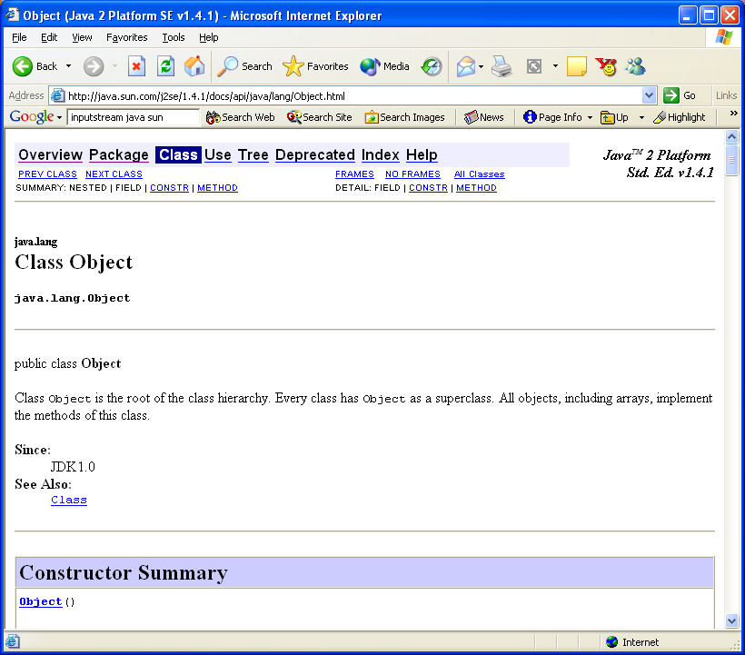
Sample Output

Slide 23
Running Javadoc Program
At the Command Prompt execute:
  javadoc [options] <package> | <class>.java
Most commonly used options include:
  -subpackages <package1>:<package2>
      Documentation generation from source files in the specified packages and their subpackages.
  -exclude <packagename1>:<packagename2>
    Excludes specified packages and their subpackages.
  -sourcepath <suurcepathlist>
    Represents the search path for finding .java files. Multiple paths can be specified by separating them with a semicolon.
  -classpath <classpathlist>
    Represents the search path for finding .class files. Multiple paths can be specified by separating them with a semicolon.
Notes:
Using javadoc you can document separate java classes, or entire java packages (all classes from packages), or both packages and classes.
Option –subpackages is useful when adding new subpackages to the source code, as these subpackages will be automatically included in the documentation when added.

Slide 24
Full Documentation
The complete API is at
  http://java.sun.com/j2se/1.4.2/docs/tooldocs/windows/javadoc.html

Slide 25
Module Road Map
Javadoc
Exporting Javadoc in Eclipse
  Javadoc support in Eclipse
  Using Eclipse to Export Javadoc

Slide 26
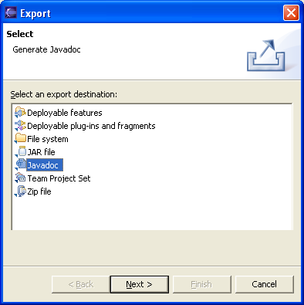
Exporting Javadoc
Select the package and then select Export … from the Package Explorer context menu
Select Javadoc as the export destination

Slide 27
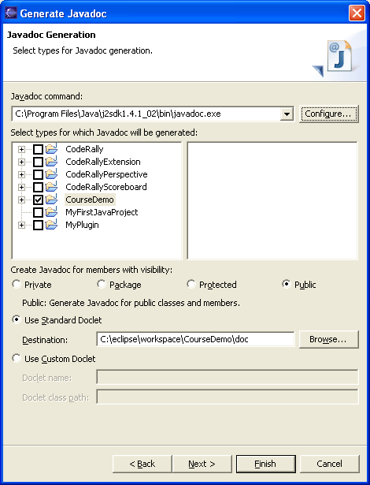
Select Javadoc Options
Specify Javadoc command to be used
Select your options
  Types
  Member visibility
  Destination
Select Next

Slide 28
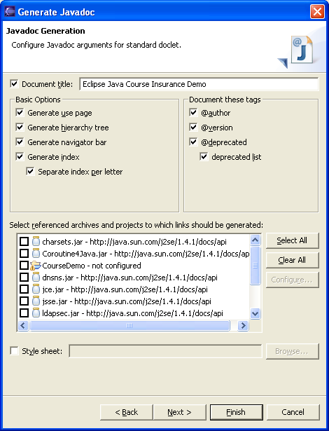
Configure Javadoc Arguments…
Configure Javadoc arguments for standard doclet

Slide 29
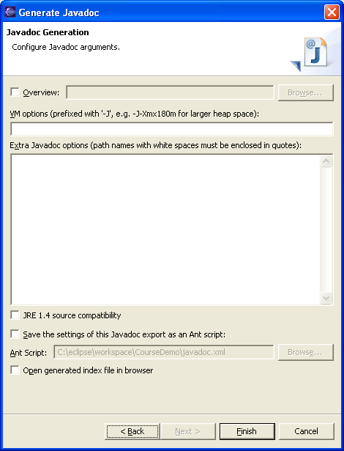
…Configure Javadoc Arguments
Configure extra Javadoc arguments
Click Finish

Slide 30
Module Summary
In this module we have discussed:
  How to generate Java Document
  Javadoc Tool
    Comments and tags
    Running the program
  Javadoc support in Eclipse

Slide 31

Labs Slide!
Lab: Javadoc

