Slide 1
ECE 4755
Final Project
10-point DFT and IDFT of the Lab 7 speech signal
and impulse response
Wayne Blaylock October 5, 2026

Slide 2
What the project covers
Q1–Q4
10-point DFT and IDFT of speech.wav in MATLAB and in C, then plot the C results.
Q5
Same DFT, IDFT, and plots for impulse.wav.
Q6–Q8
DFT of both excerpts on the DSPLab, then the product and its IDFT on the scope.
Q9–Q10
Plot the board product in MATLAB, then repeat the product on the full files and compare.
ECE 4755 Final Project | Wayne Blaylock
2

Slide 3
Method
Blocks of 10 samples. Last block is zero-padded. No fft or ifft.
X[k] = Σ x[n] exp(−j 2π k n / 10)
x[n] = (1/10) Σ X[k] exp(+j 2π k n / 10)
Y[k] = X[k] H[k], then IDFT for the circular convolution
speech.wav
182,932 samples, 44.1 kHz, 4.148 s, 8 pad samples
impulse.wav
130,036 samples, 44.1 kHz, 2.949 s, 4 pad samples
Board excerpts
Speech at sample 43968, impulse at sample 55680, 256 samples each
DSPLab
C5509A, dsplab55.gel, D/A 10 kHz, FIFO 256, signed
ECE 4755 Final Project | Wayne Blaylock
3

Slide 4
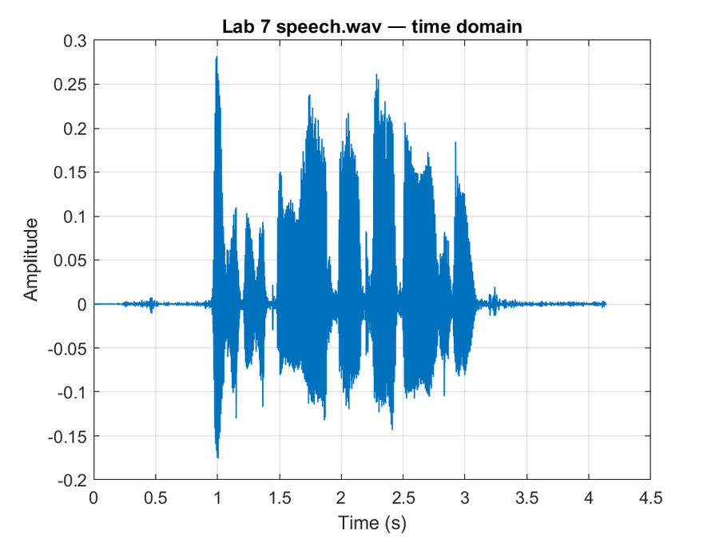
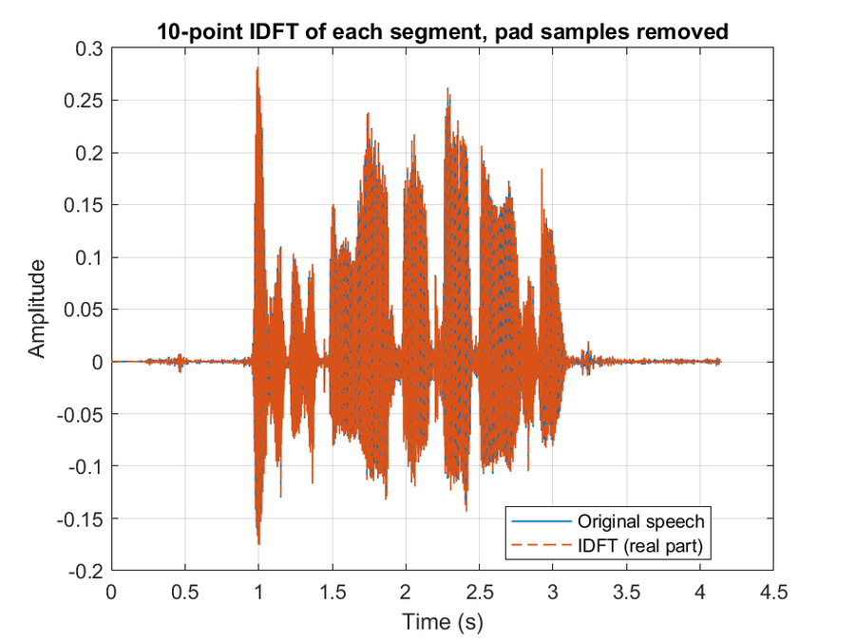
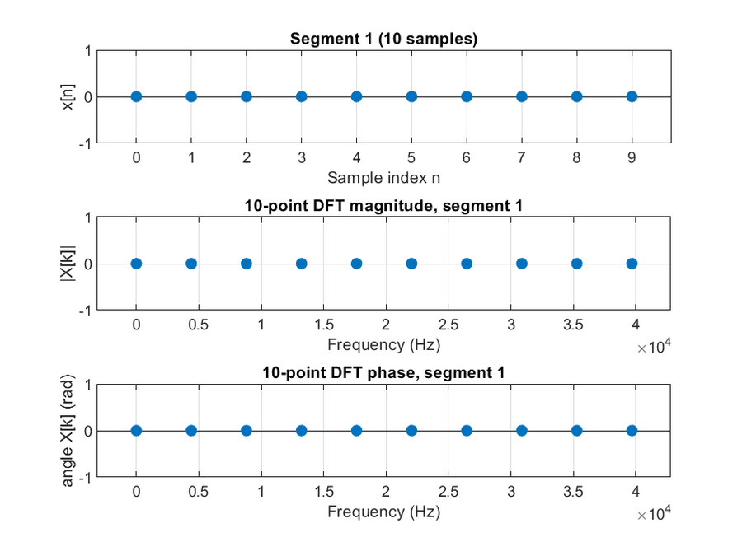
Q1 MATLAB speech DFT and IDFT
IDFT error after dropping the pad is 2.78e-16. Bin spacing is 4,410 Hz, so one block only shows a coarse spectrum.
ECE 4755 Final Project | Wayne Blaylock
4

Slide 5
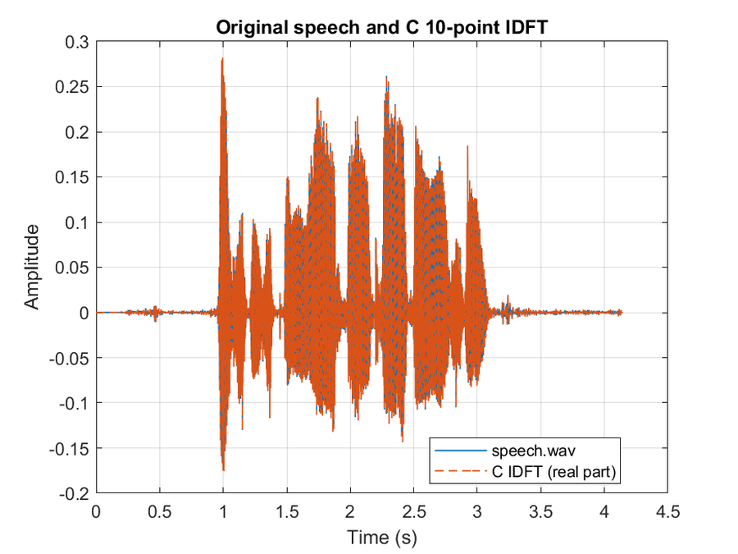
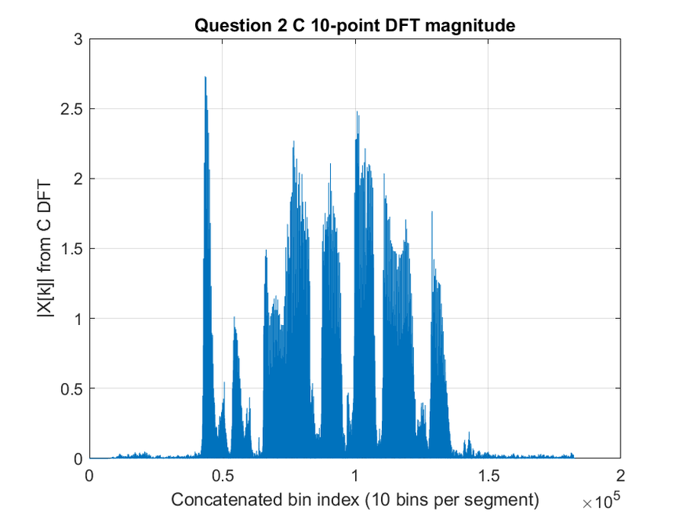
Q2–Q4 Floating-point C on speech.wav
Left: C IDFT on the original. Right: concatenated C DFT magnitude. Segment 4500 matches a MATLAB DFT of the same block.
ECE 4755 Final Project | Wayne Blaylock
5

Slide 6
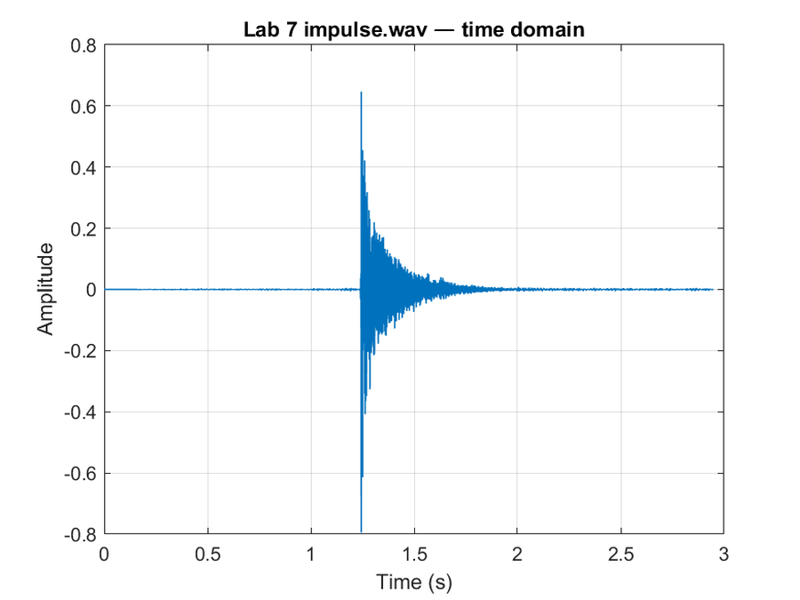
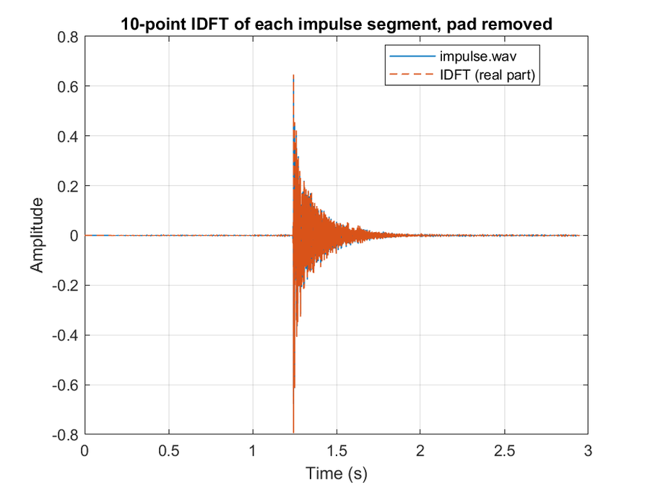
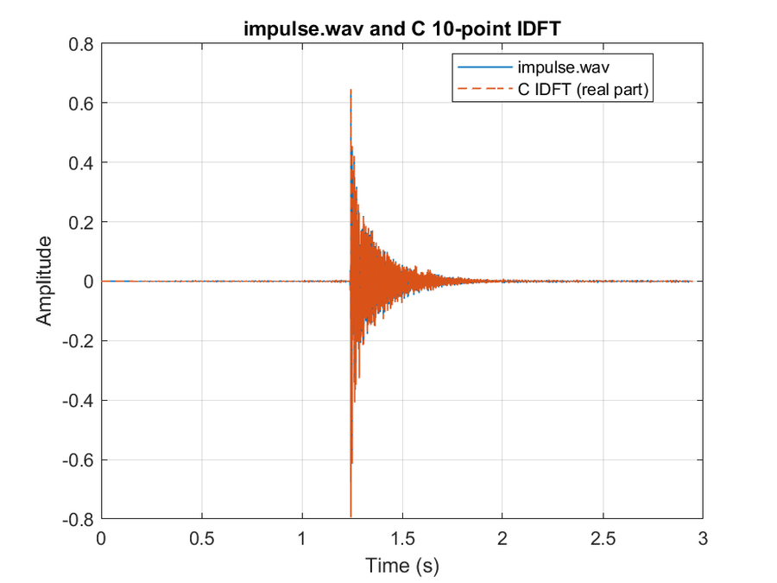
Q5 Same procedure on impulse.wav
MATLAB IDFT and C IDFT both match impulse.wav. The impulse spectrum is broader than the speech spectrum.
ECE 4755 Final Project | Wayne Blaylock
6

Slide 7
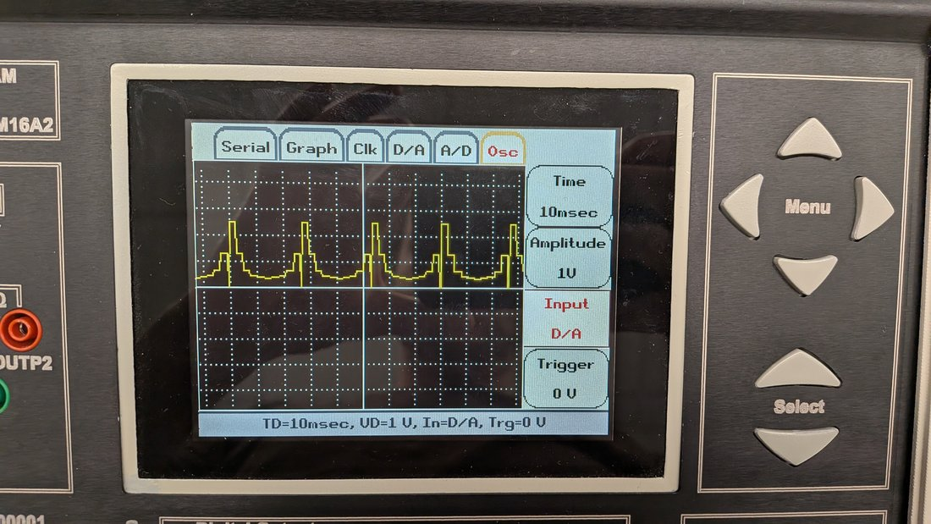
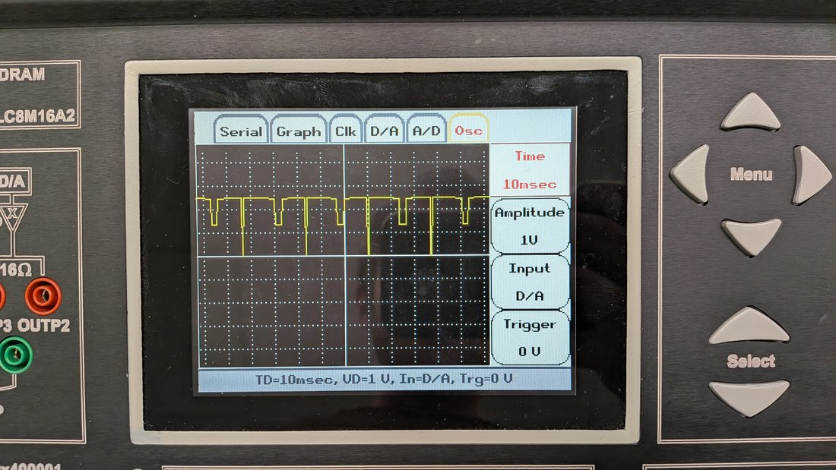
Q6 10-point DFT on the DSPLab scope
D0 released: speech excerpt. D0 pressed: impulse excerpt. Each bin is held for 25 samples. Scope scale is relative.
Speech energy is in the low bins. The impulse excerpt is more spread across the 10 bins.
ECE 4755 Final Project | Wayne Blaylock
7

Slide 8
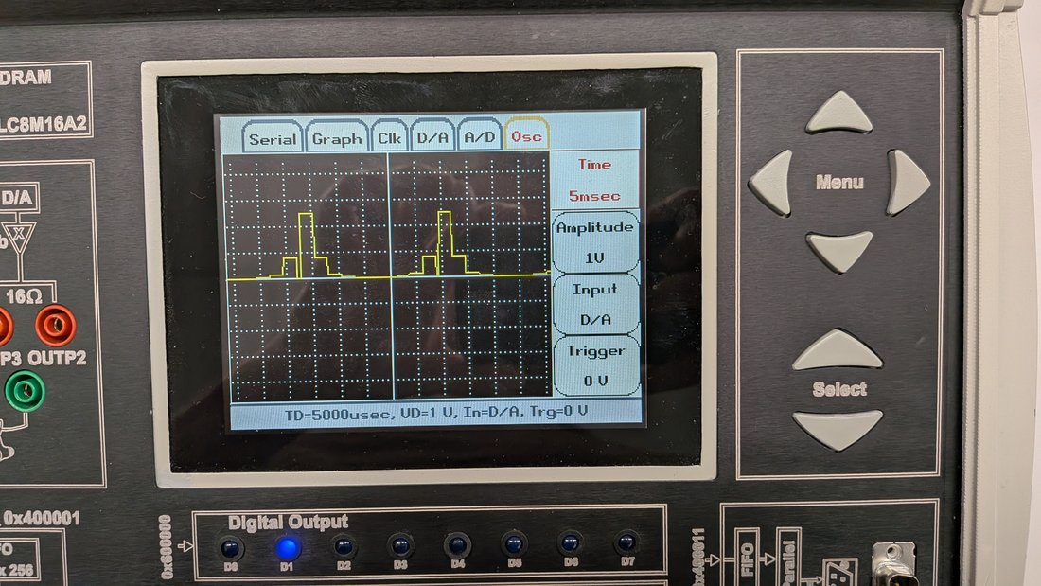
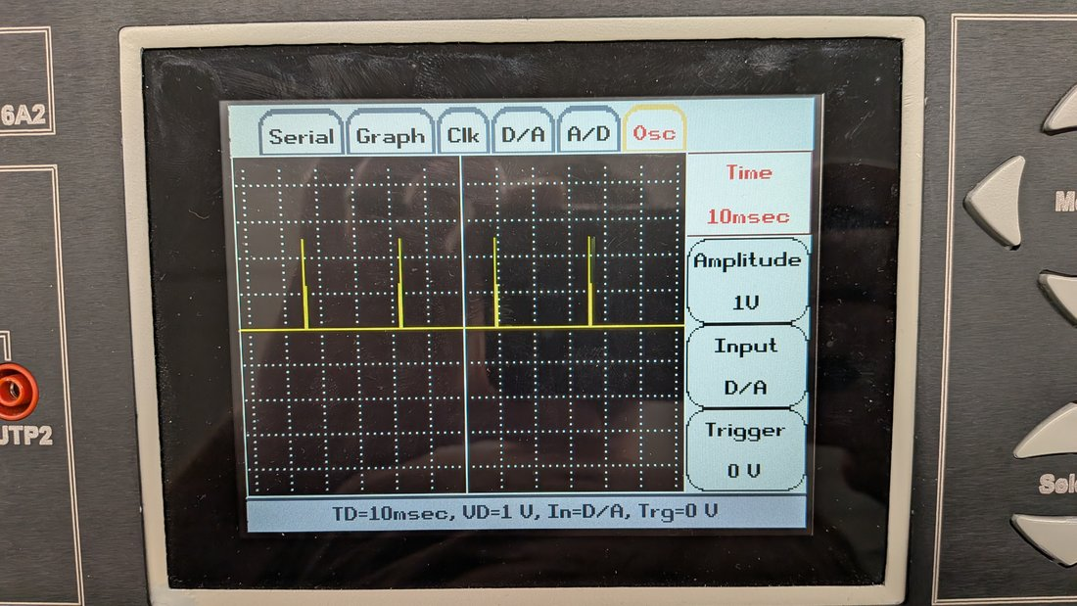
Q7–Q8 Product and IDFT on the DSPLab
Left: average |X[k] H[k]|. Right: IDFT of that product, a 10-point circular convolution. Spikes are the large blocks after DAC scaling.
ECE 4755 Final Project | Wayne Blaylock
8

Slide 9
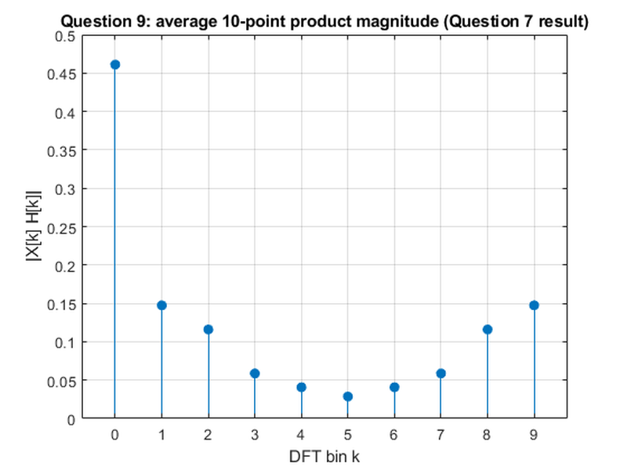
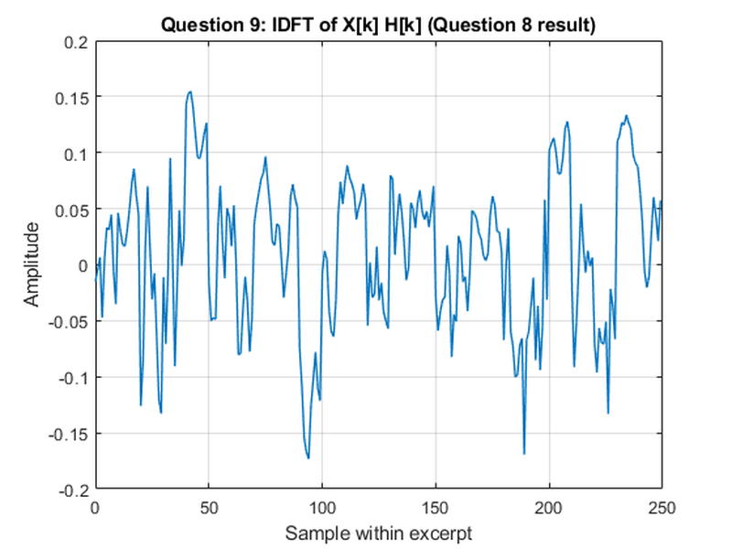
Q9 MATLAB plots of the Q7 and Q8 results
Same excerpts as the board. Shapes match the scope photos. Counts do not, because the DAC auto-scales.
ECE 4755 Final Project | Wayne Blaylock
9

Slide 10
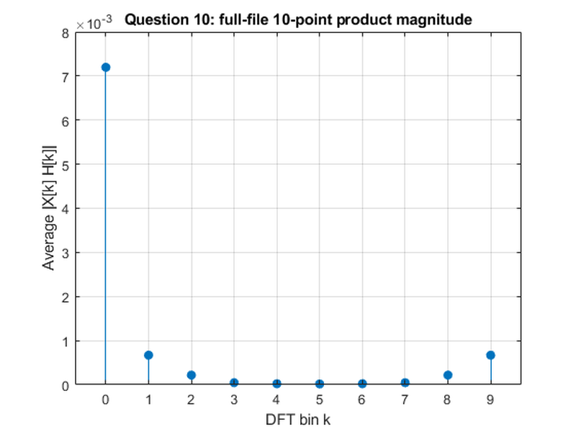
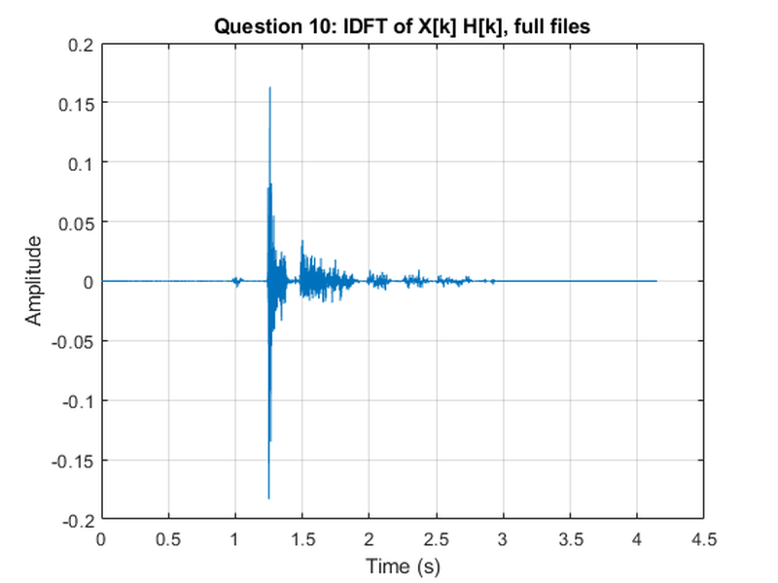
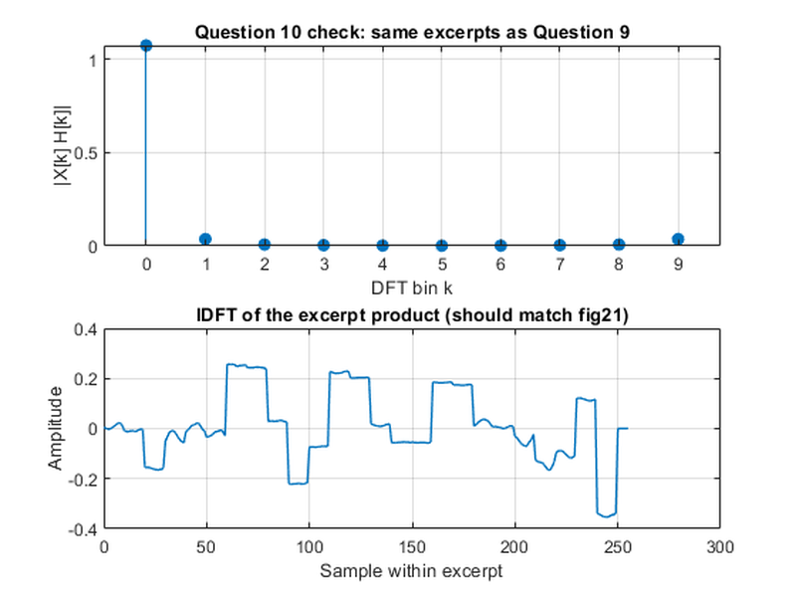
Q10 Full-file product, then compare
Left and center are the full files, time-aligned. Right is the board excerpts and matches Q9. The full-file result is the same method, not the same waveform, because the excerpts do not start at the same sample.
IDFT of each product is a circular convolution of that 10-sample pair, not one linear convolution of the whole files.
ECE 4755 Final Project | Wayne Blaylock
10

Slide 11
Conclusions
1
10-point DFT and IDFT, from the sum, reconstruct speech.wav and impulse.wav.
2
C text files match the MATLAB transforms for both signals.
3
The board can only hold excerpts. D0 switches speech and impulse on the scope.
4
X[k] H[k] followed by the IDFT is a circular convolution per block.
5
The excerpt check matches the board plots. The full-file product does not, and should not.
ECE 4755 Final Project | Wayne Blaylock
11

