Slide 1
計算機實習 03
110.03.19

Slide 2
Outline
Class
deconstructor
const object and const member function
friend function

Slide 3
Class

Slide 4
deconstructor
Deconstructor will be called when an object leaves the scope where it is declared.
Cannot be called independently like constructor.
Deconstructor is defined by adding ~ in front of the class name (e.g. have a class called fruit then the deconstructor of it will be ~fruit)

Slide 5
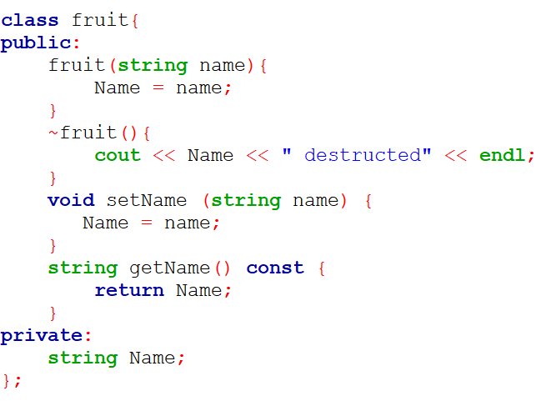
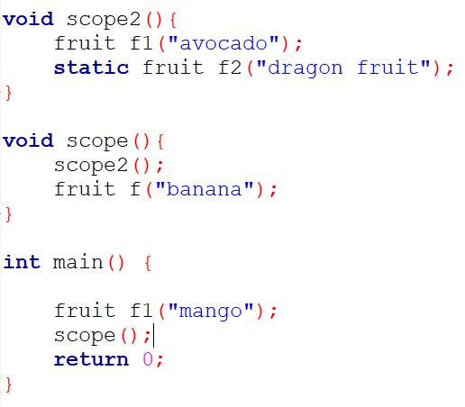

deconstructor example

Slide 6
const with Class
To prevent any modification to any variables inside class.
Can improve performance when used appropriately.
There are two types of const with class
const object
const member function
Cannot use const on constructor and deconstructor

Slide 7
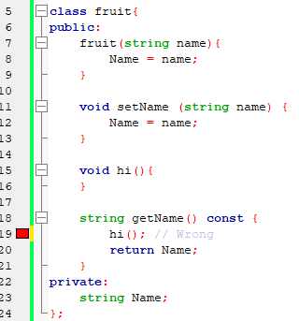
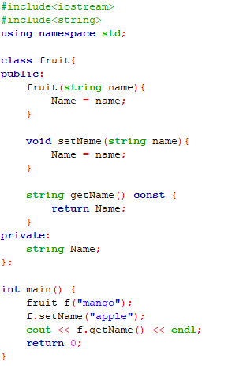
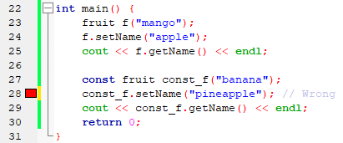
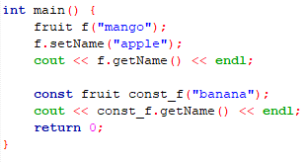
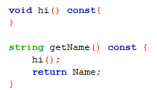

const example
const object can only call const member function
Similarly, const member function can only call const member function

Slide 8
friend function
Class private member can only be access by class member function in normal.
We can define a friend function to a class to access the private member outside the class.

Slide 9
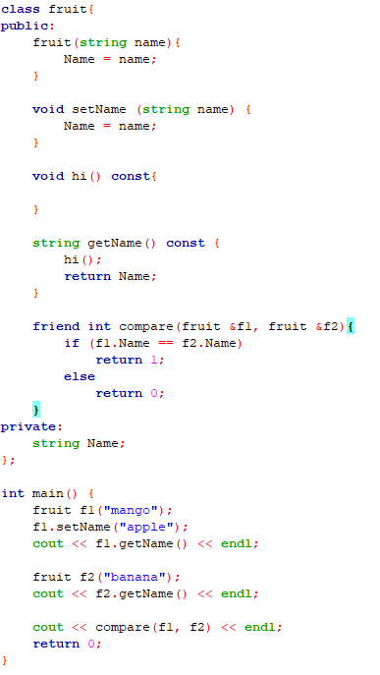

friend function example
friend function declared inside class
Output:
call friend function

Slide 10
課堂練習03
繳交截止日期：2021/03/19 23:55

Slide 11
練習02
水果比重，質量交換
說明：請實作一個有class的小程式。
首先讓使用者輸入兩筆水果的資料，接著輸出哪個水果比較重，將較重的水果質量改成比另一個水果還輕，然後比多一次，再輸出比較重的水果名稱。
提示：
這class會記錄水果的名稱 (Name) 與其質量 (Mass)。
這class中有一個friend function做質量的對比。
*如果此練習沒用class實作，則0分計算。

Slide 12
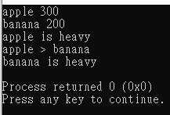
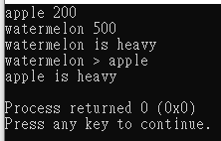
練習02
執行結果的範例如下：
1
2
*截圖只需實作任一範例

Slide 13
繳交規範

Slide 14

繳交內容
上傳內容須為 .zip 壓縮檔
內容包含:
程式碼 (C++為.cpp)
執行結果截圖 (只接受 .png 或 .jpg 形式)
檔名皆須為 AX-10XXXXXXX 或 PX-10XXXXXXX
Assignment: A
Practice: P
壓縮的內容
需上傳的壓縮檔

Slide 15
繳交方式
1. 作業上傳以 新eeclass系統 為主 https://ncueeclass.ncu.edu.tw/
2. 有修計實者， 作業繳交至 “計算機實習”
3. 無修計實者， 但只有修計概者， 作業繳交至 “計算機概論”
4. 不接受補交

