Slide 1
計算機實習 04
110.03.26

Slide 2
Outline
Class
class pointer
this pointer
Operator overloading

Slide 3
Class

Slide 4
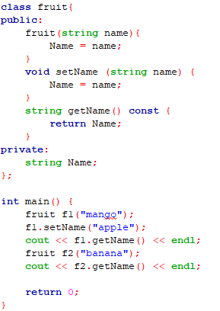
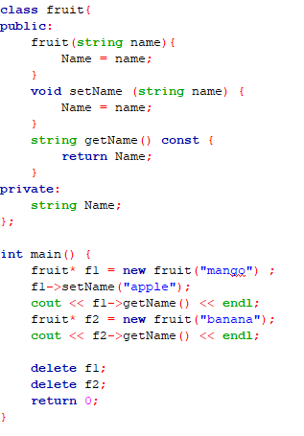
class pointer
Non-pointer version
Pointer version
new will request memory space in main memory for storing specified type and return the starting memory address of it
Use -> instead of . to call member function or access member variable
Use delete to release the memory space that claimed early

Slide 5
Why pointer?
For dynamic memory managment
stack
queue
linked list
tree
graph
etc

Slide 6
this pointer
A pointer that point to the object itself.
More flexibility when member variables have same name with other variable inside member function.
Allow cascade member function call.

Slide 7
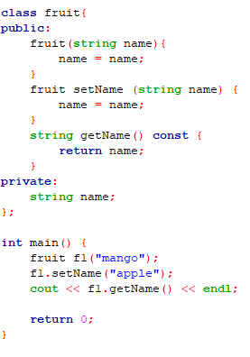
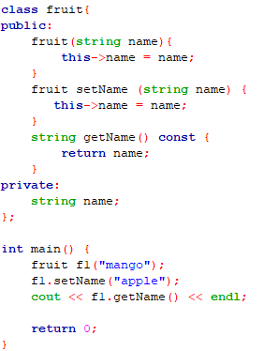
this pointer example
Modified private string name now
same name with the class private variable
Did not modify this private variable at all
Output a blank string
Output apple

Slide 8
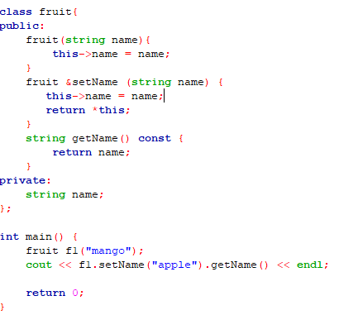
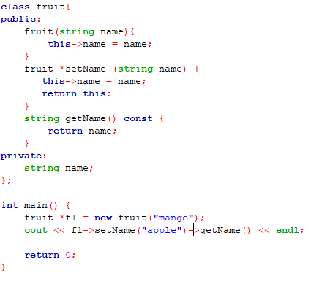
this pointer example(Cont.)
Pointer version
Return object itself by adding * before this
Return this pointer (object address)
Cascade member function call
Both output apple

Slide 9
Operator overloading

Slide 10
Operator overloading
Similar to function overloading but operator version.
Can only be used with object.
Provide more convenient way to implement some operation.

Slide 11
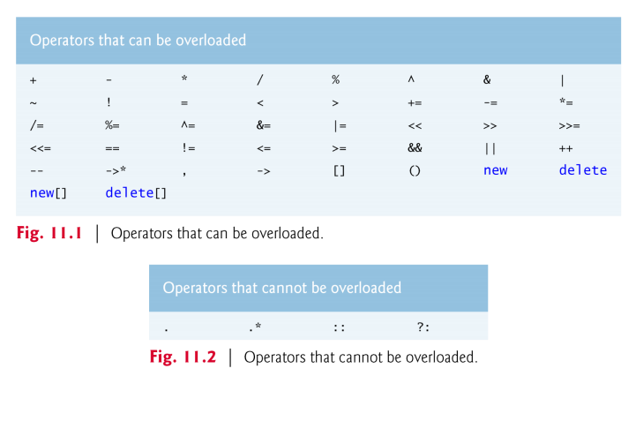
Operator overloading(Cont.)

Slide 12
Operator overloading(Cont.)
Expression | As member function (a as object & b as any type) | As non-member function (c & d as any type) | Example
a+b | a.operator+ (b) | operator+ (c, d) | a+b calls a.operator+ (b) (as member function of a)
a=b | a.operator= (b) | cannot use as non-member function | string s; s = “happy”; calls s.operator= ("happy") (as member function of s)
a+=b | a.operator+= (b) | operator+= (c, d) | string s; s += “sad”; calls s.operator+= (“sad”) (as member function of s)
a<<b | a.operator<< (b) | operator<< (c, d) | cout << x; calls operator<< (cout, x) (as non-member function)

Slide 13
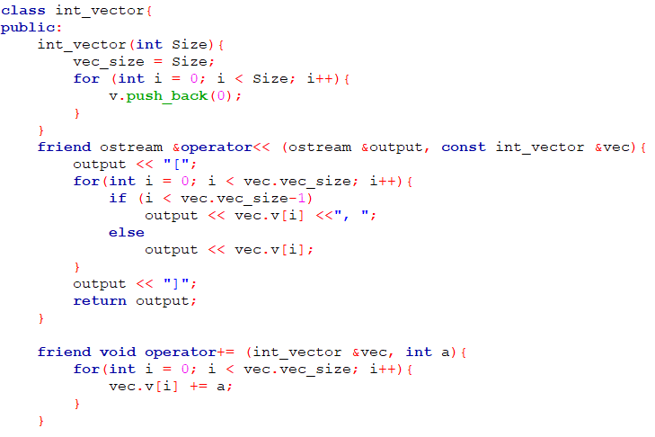
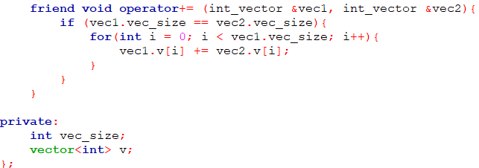
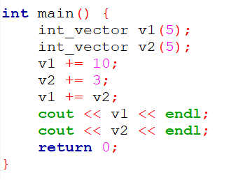

Operator overloading example
non-member function version of overloading +=
initialize vector with an input size
Overloading += operator to implement addition between vectors
Overloading << operator to implement vector output stream
Overloading += operator to implement addition between vector and integer

Slide 14
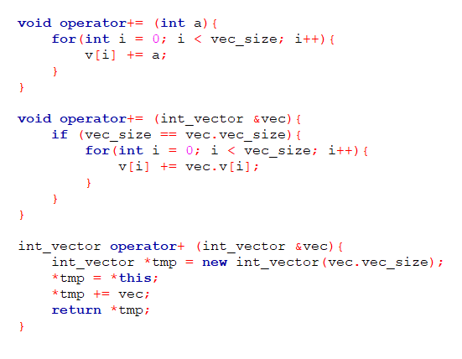
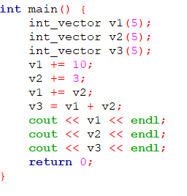

More example
member function version of overloading += and +
need a new temporary memory space to store the addition result to prevent modifying the original object

Slide 15
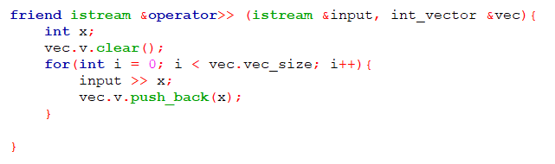
istream example
clear vector everytime when operator >> is used
Amount to read is decided by the size of the right element of the >> operator

Slide 16
課堂練習04
繳交截止日期：2021/03/26 23:55

Slide 17
練習04 - 串接向量和排序
利用class和operator overloading來實作向量的輸入、輸出和串接兩個向量後排序。
overload >> , << , + 分別實現向量輸入、輸出和串接兩個向量後排序(由小到大)。
Input
第一行正整數 N(1~20)代表第一個向量(v1)的大小，第二行正整數 M(1~20)代表第二個向量(v2)的大小，接下來會有 N 與 M 個數字的輸入，分別代表v1和v2的內容。
Output
以特定格式輸出原本兩個輸出的向量和串接兩個向量後排序後的結果。
沒有用class和operator overloading會扣分

Slide 18
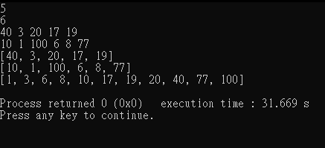
練習04 - 向量輸出格式
前後要有中括號[]包住
數值之間以逗號加空白, 分開
輸出完要記得換行

Slide 19
練習04 - 輸入輸出範例
Sample input | Sample output
5 6 40 3 20 17 19 10 1 100 6 8 77 | [40, 3, 20, 17, 19] [10, 1, 100, 6, 8, 77] [1, 3, 6, 8, 10, 17, 19, 20, 40, 77, 100]
1 1 10 2 | [10] [2] [2, 10]

Slide 20
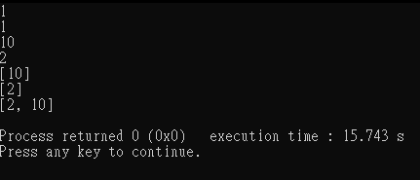
練習04 - 輸入輸出範例
*截圖只需實作任一範例

Slide 21
繳交規範

Slide 22

繳交內容
上傳內容須為 .zip 壓縮檔
內容包含:
程式碼 (C++為.cpp)
執行結果截圖 (只接受 .png 或 .jpg 形式)
檔名皆須為 AX-10XXXXXXX 或 PX-10XXXXXXX
Assignment: A
Practice: P
壓縮的內容
需上傳的壓縮檔

Slide 23
繳交方式
1. 作業上傳以 新eeclass系統 為主 https://ncueeclass.ncu.edu.tw/
2. 有修計實者， 作業繳交至 “計算機實習”
3. 無修計實者， 但只有修計概者， 作業繳交至 “計算機概論”
4. 不接受補交

