Slide 1

ICU Patient Mortality Predictor & Physiological Analyzer (ICU-MPLA)
Course: Advanced Python Programming | Wayne Lee
ICU Mortality Prediction & Physiological Time-Series Analysis

Slide 2
1. Introduction & Background
Research motivation, dataset overview, and project objectives
Notes:
Let's begin with the first section: how to apply for access and log into the system for the first time.

Slide 3
Clinical Background & Challenges
ICU mortality risk prediction is vital for clinical decision support, resource allocation, and patient stratification in clinical trials
Traditional acuity scoring systems (e.g., APACHE II, SAPS-II) are static, rule-based, and fail to capture complex temporal dynamics
Irregularly sampled physiological time-series data presents unique challenges:
High dimensionality and varying sampling frequencies (vital signs vs. lab values)
Significant proportion of missing values as lab tests are ordered only when clinically indicated
Severe outcome class imbalance (mortality rate ~14%)
Notes:
When setting up your password, it must be at least 8 characters long and include a mix of alphabets <ㄟ否北> and letters. For security purposes, your password will expire and must be updated every 90 days

Slide 4
2. Software Architecture & Concurrency
OOP design, multi-processing pipeline, and code structure

Slide 5
Object-Oriented Software Design
The codebase is refactored from flat procedural scripts to an Object-Oriented design:
PatientRecord Class: Encapsulates clinical demographics and physiological time-series variables; handles file parsing and warnings cleanly
FeatureExtractor Class: Computes statistical aggregates and handles parallel dataset building
ICUPredictor Class: Manages classifier models, cross-validation, threshold optimization, and serialized joblib exports
Decorators & Logging: A custom @timer decorator profiles execution runtimes; the python logging library handles diagnostic outputs

Slide 6
Multiprocessing Performance Benchmark
Parsing thousands of independent patient records sequentially creates significant CPU and I/O bottlenecks in Python
Multiprocessing implemented via concurrent.futures.ProcessPoolExecutor to run calculations in parallel on multiple cores
Runtime Benchmarks (8,000 patient records):
Sequential Feature Extraction (1 Worker): 168.83 seconds
Parallel Feature Extraction (4 Workers): 21.16 seconds
Performance Gain: 7.98× Speedup (near-linear multi-core efficiency)
Features an argparse CLI in train.py with a --workers argument for thread scaling

Slide 7
3. Dataset & Feature Engineering
PhysioNet 2012 dataset, feature extraction, and preprocessing

Slide 8
PhysioNet Challenge 2012 Cohort
Study Cohort: 8,000 adult ICU records split equally into Set A (development) and Set B (independent test)
Baseline Descriptors: Age, Gender, Height, Weight, and ICU unit type (CCU, CSRU, MICU, SICU) collected at admission
Physiological Time-Series: 37 variables monitored over the first 48 hours of ICU stay (e.g., HR, Temp, GCS, Urine, BUN, Creatinine, pH)
Primary Outcome: In-hospital death (Set A: 13.85% mortality rate; Set B: 14.20% mortality rate)

Slide 9
Longitudinal Feature Engineering
Irregular sequences are converted to fixed-size representations by extracting 5 statistical aggregates per time-series parameter:
Mean: Captures the overall physiological baseline level over 48 hours
Minimum (Min): Highlights critical dips (e.g., severe hypotension or hypothermia)
Maximum (Max): Highlights critical spikes (e.g., high fever or severe hypertension)
Last Value: Represents the patient's state at the end of the 48-hour window
Count: Captures observation frequency, acting as a clinical proxy for patient instability
Combined with baseline descriptors, this yields a structured matrix of 190 features per patient

Slide 10
4. Model Development & Evaluation
Classifier comparison, cross-validation, and threshold optimization

Slide 11
Model Comparison (5-Fold Stratified CV)
Model | AUROC (Mean ± SD) | PhysioNet Score | Key Technique | Status
Logistic Regression | 0.8282 ± 0.0270 | 0.3413 | Median imputation + class weights | Baseline
Random Forest | 0.8358 ± 0.0157 | 0.0487 | 200 trees, unoptimized threshold | Baseline
XGBoost | 0.8475 ± 0.0137 | 0.4666 | Native NaN handling, threshold grid search (0.66) | ✓ Selected
Note: XGBoost was selected as the final classifier due to its highest AUROC, best PhysioNet utility score, and native handling of missing ICU time-series values. The optimal decision threshold (0.66) was tuned via cross-validation to maximize clinical recall of high-risk patients.

Slide 12
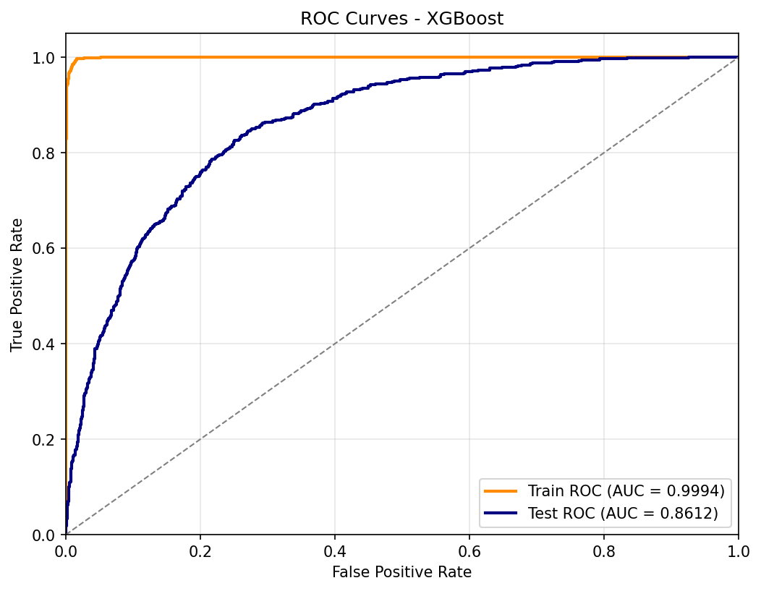
Independent Test Set B Evaluation
Evaluated on the independent validation cohort Set B (4,000 patient records) to assess generalizability
Test Accuracy: 87.30% | Test AUROC: 0.8612 (indicating robust discrimination)
PhysioNet Challenge Score: 0.4137 (Sensitivity: 41.37%, Precision: 57.32%)
Confusion Matrix: TN = 3,257 | FP = 175 | FN = 333 | TP = 235

Slide 13
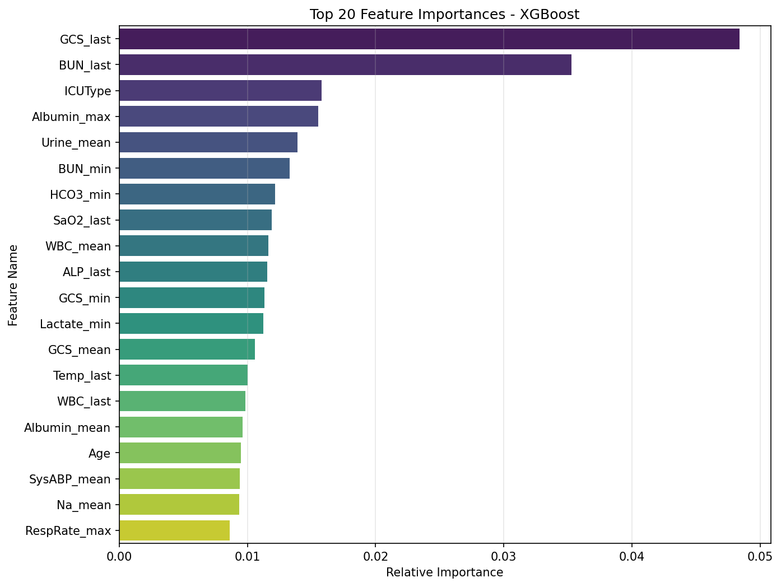
Key Physiological Predictors
Glasgow Coma Score (GCS): GCS_min and GCS_last are the most critical predictors, reflecting neurological function
Age: Older patients have lower physiological reserve, correlating with high risk
Blood Urea Nitrogen (BUN): Mean BUN_mean reflects renal function and fluid balance
Urine Output: Mean urine output (Urine_mean) is a crucial marker for tissue perfusion
White Blood Cell (WBC): High WBC_mean counts indicate systemic inflammation or sepsis

Slide 14
5. Interactive Clinical Dashboard
Streamlit app design, visualization modules, and UX improvements

Slide 15
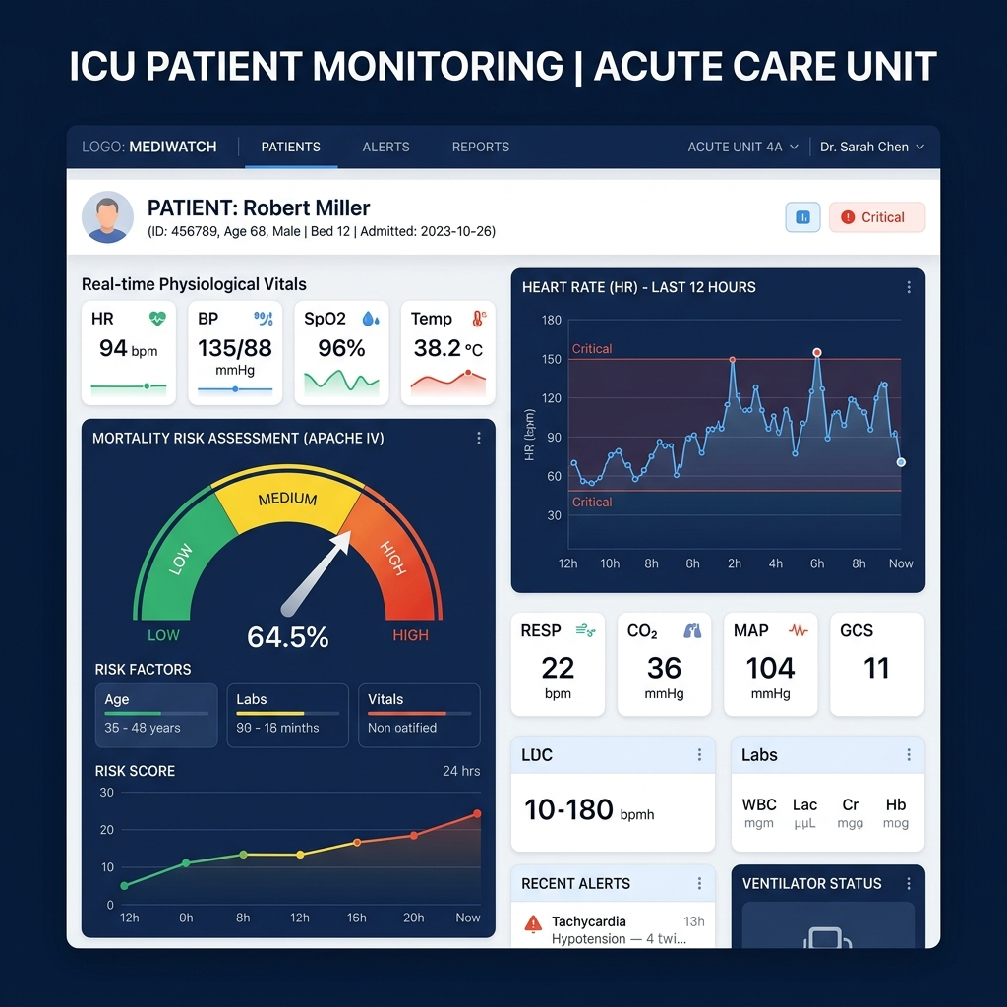
Streamlit Clinical Dashboard Platform
Sidebar Controls & Citations: Patient selectors and profile banners moved to the sidebar along with clear data source attributions
Longitudinal Explorer: High-contrast vitals cards with auto-height layout, Plotly Gauge risk scores with suffix and font constraint, and scrollable alert panels
Risk Simulator: Grouped 5×2 physiological sliders with side-by-side gauge predictions and clinical recommendations, updating in real-time on a single page

Slide 16
6. Conclusion & Future Work
Key findings, limitations, and directions for future development

Slide 17
Key Takeaways & Next Steps
Conclusion:
Developed an end-to-end Python pipeline from raw data ingestion to interactive web UI
XGBoost model outperformed linear and traditional ensemble approaches, achieving AUROC of 0.8612
The clinical risk simulator bridges the gap between predictive ML models and clinical utility
Future Work:
Explore deep learning recurrent architectures (LSTMs, GRUs, Transformers) to process raw time-series directly
Validate model generalizability using external databases (e.g., MIMIC-IV) and multi-center cohorts

