Slide 1

ICU Patient Mortality Predictor & Physiological Analyzer (ICU-MPLA)
Course: Advanced Python Programming | Wayne Lee
ICU Mortality Prediction & Time-Series Analysis | GitHub: waynelee9511cloud/advanced-icu-mpla
Notes:
"Good afternoon, everyone. Thank you for joining today's EDC system training session. My name is Shelly and today I will be walking you through the electronic data capture system for our study: 'A First-in-Human Study to Assess the Safety and Tolerability of SNS851.' This study is sponsored by Oneness Biotech."

Slide 2
1. Introduction & Background
Notes:
Let's begin with the first section: how to apply for access and log into the system for the first time.

Slide 3
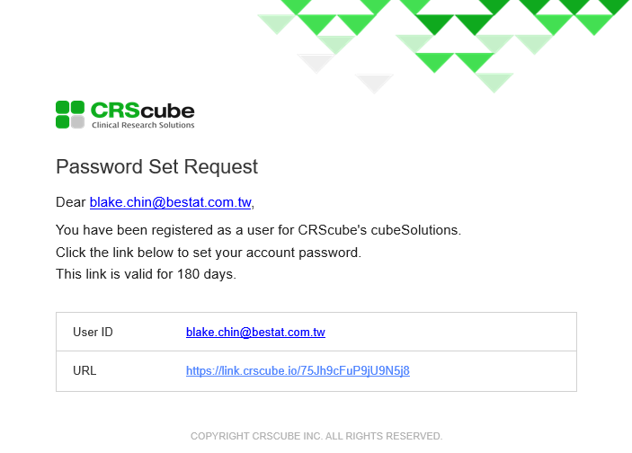
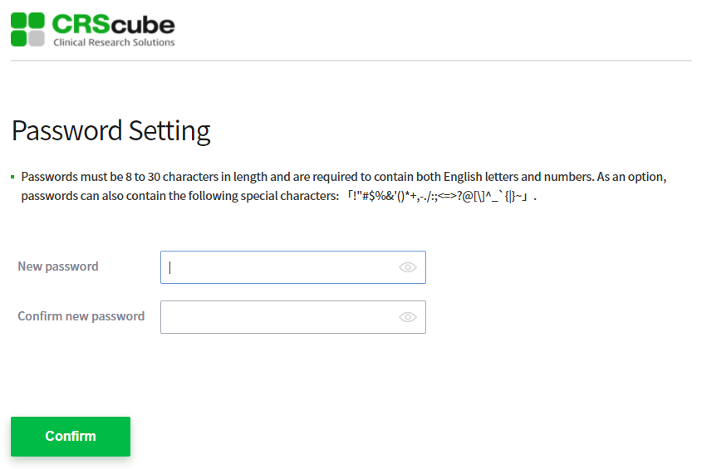
Clinical Background & Challenges
ICU mortality risk prediction is vital for clinical decision support, resource allocation, and patient stratification in clinical trials
Traditional acuity scoring systems (e.g., APACHE II, SAPS-II) are static, rule-based, and fail to capture complex temporal dynamics
Irregularly sampled physiological time-series data presents unique challenges:
High dimensionality and varying sampling frequencies (vital signs vs. lab values)
Significant proportion of missing values as lab tests are ordered only when clinically indicated
Severe outcome class imbalance (mortality rate ~14%)
Notes:
When setting up your password, it must be at least 8 characters long and include a mix of alphabets <ㄟ否北> and letters. For security purposes, your password will expire and must be updated every 90 days

Slide 4
2. Software Architecture & Concurrency

Slide 5
Object-Oriented Software Design
The codebase is refactored from flat procedural scripts to an Object-Oriented design:
**`PatientRecord` Class**: Encapsulates clinical demographics and physiological時序 variables; handles file parsing and warnings cleanly
**`FeatureExtractor` Class**: Computes statistical aggregates and handles parallel dataset building
**`ICUPredictor` Class**: Manages classifier models, cross-validation, threshold optimization, and serialized joblib exports
**Decorators & Logging**: A custom `@timer` decorator profiles execution runtimes; the python `logging` library handles diagnostic outputs

Slide 6
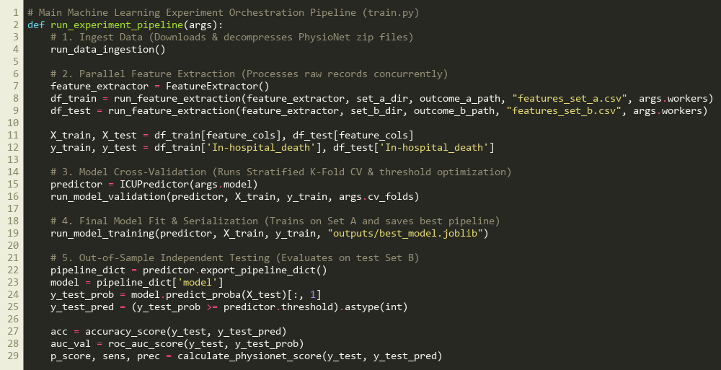
Core Experimental Ingestion & Orchestration
Replaces scattered scripts with a single automated training/testing orchestrator (train.py)
Coordinates raw data downloading, feature extraction, cross-validation, and final testing
Executes independent out-of-sample evaluations automatically on Test Set B

Slide 7
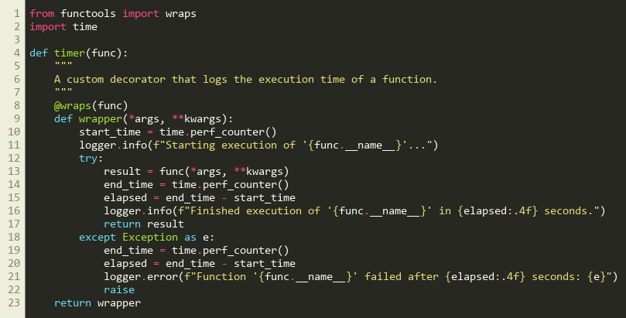
System Profiling via Custom Decorators
Implements a reusable, non-intrusive @timer decorator closure to wrap pipeline functions
Uses time.perf_counter() to automatically track execution time of core methods
Standardizes logging levels (INFO, ERROR) to replace scattered print statements
Preserves original function names and docstrings using functools.wraps

Slide 8
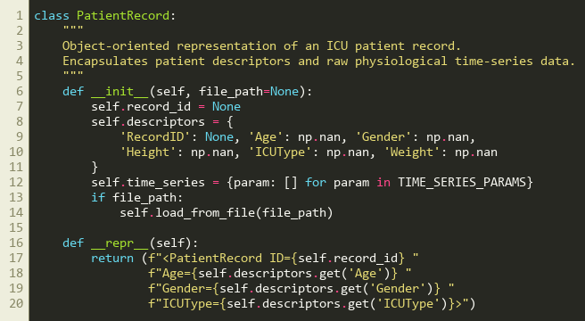
Strong Encapsulation: PatientRecord Class
Bundles irregular, sparsely sampled physiological measurements and descriptors into a class
Constructor validates demographic indicators and handles missing values safely on load
Defines a custom string representation (__repr__) for clean terminal debugging
Decouples raw reading and format parsing from subsequent feature engineering steps

Slide 9
Multiprocessing Performance Benchmark
Parsing thousands of independent patient records sequentially creates significant CPU and I/O bottlenecks in Python
Multiprocessing is implemented using `concurrent.futures.ProcessPoolExecutor` to run calculations in parallel on multiple cores
**Runtime Benchmarks (8,000 patient records)**:
Sequential Feature Extraction (1 Worker): **168.83 seconds**
Parallel Feature Extraction (4 Workers): **21.16 seconds**
Performance Gain: **7.98x Speedup** (near-linear multi-core efficiency)
Features an `argparse` CLI in `train.py` with a `--workers` argument for thread scaling

Slide 10
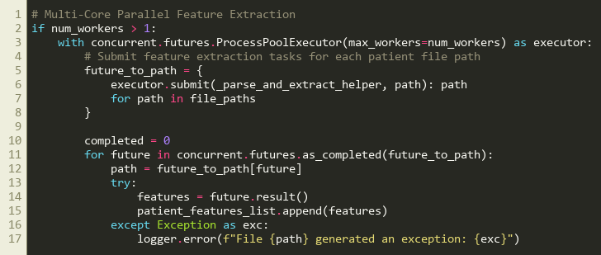
Concurrency: Parallel Feature Extraction
Parallelizes feature aggregation across independent records using a ProcessPoolExecutor
Implements a top-level parsing helper function to satisfy Windows pickling limits
Achieved a 7.98x speedup (processing 8,000 files in 21.16s vs 168.83s sequentially)

Slide 11
3. Dataset & Feature Engineering

Slide 12
PhysioNet Challenge 2012 Cohort
**Study Cohort**: 8,000 adult ICU records split equally into Set A (development) and Set B (independent test)
**Baseline Descriptors**: Age, Gender, Height, Weight, and ICU unit type (CCU, CSRU, MICU, SICU) collected at admission
**Physiological Time-Series**: 37 variables monitored over the first 48 hours of ICU stay (e.g., HR, Temp, GCS, Urine, BUN, Creatinine, pH)
**Primary Outcome**: In-hospital death (Set A: 13.85% mortality rate; Set B: 14.20% mortality rate)

Slide 13
Longitudinal Feature Engineering
Irregular sequences are converted to fixed-size representations by extracting 5 statistical aggregates per time-series parameter:
**Mean**: Captures the overall physiological baseline level over 48 hours
**Minimum (Min)**: Highlights critical dips (e.g., severe hypotension or hypothermia)
**Maximum (Max)**: Highlights critical spikes (e.g., high fever or severe hypertension)
**Last Value**: Represents the patient's state at the end of the 48-hour window
**Count**: Captures observation frequency, acting as a clinical proxy for patient instability
Combined with baseline descriptors, this yields a structured matrix of **190 features** per patient

Slide 14
4. Model Development & Evaluation

Slide 15
Model Comparison (5-Fold Stratified CV)
**Logistic Regression (Linear Baseline)**:
Built with median imputation and standardization
Class weights balanced to handle outcome skewness
Mean AUROC: 0.8282 (±0.0270)
Mean PhysioNet Score: 0.3413
**Random Forest (Ensemble Baseline)**:
Built with median imputation and 200 decision trees
High class-imbalance sensitivity leads to poor default recall
Mean AUROC: 0.8358 (±0.0157)
Mean PhysioNet Score: 0.0487 (unoptimized threshold)
**XGBoost (Selected Classifier)**:
Natively handles NaNs during tree splitting without manual imputation bias
Balanced minority class scale weights (`scale_pos_weight`)
Optimized decision threshold via validation fold grid search
Mean AUROC: **0.8475 (±0.0137)**
Mean PhysioNet Score: **0.4666**
Optimal decision threshold: **0.6600**

Slide 16
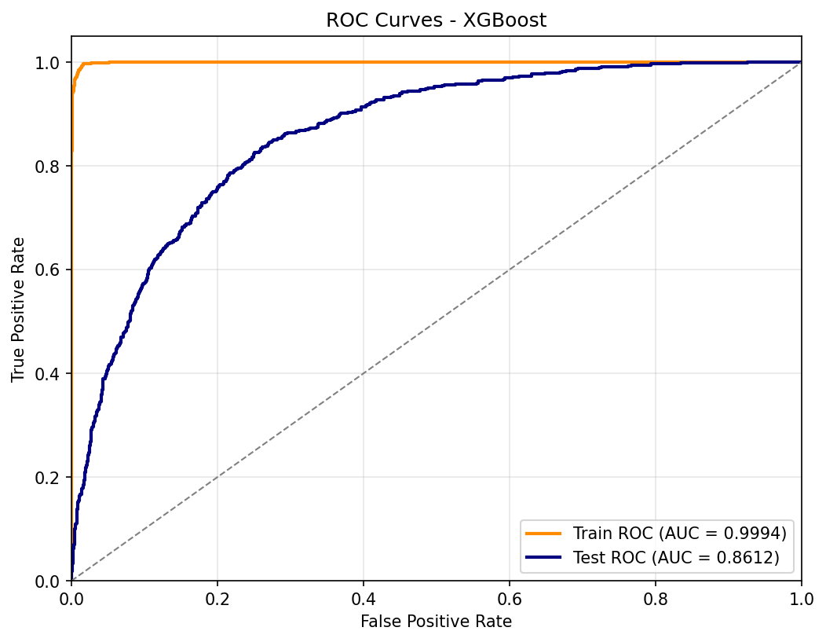
Independent Test Set B Evaluation
Evaluated on the independent validation cohort Set B (4,000 patient records) to assess generalizability
Test Accuracy: **87.30%** | Test AUROC: **0.8612** (indicating robust discrimination)
PhysioNet Challenge Score: **0.4137** (Sensitivity: 41.37%, Precision: 57.32%)
Confusion Matrix: TN = 3,257, FP = 175, FN = 333, TP = 235

Slide 17
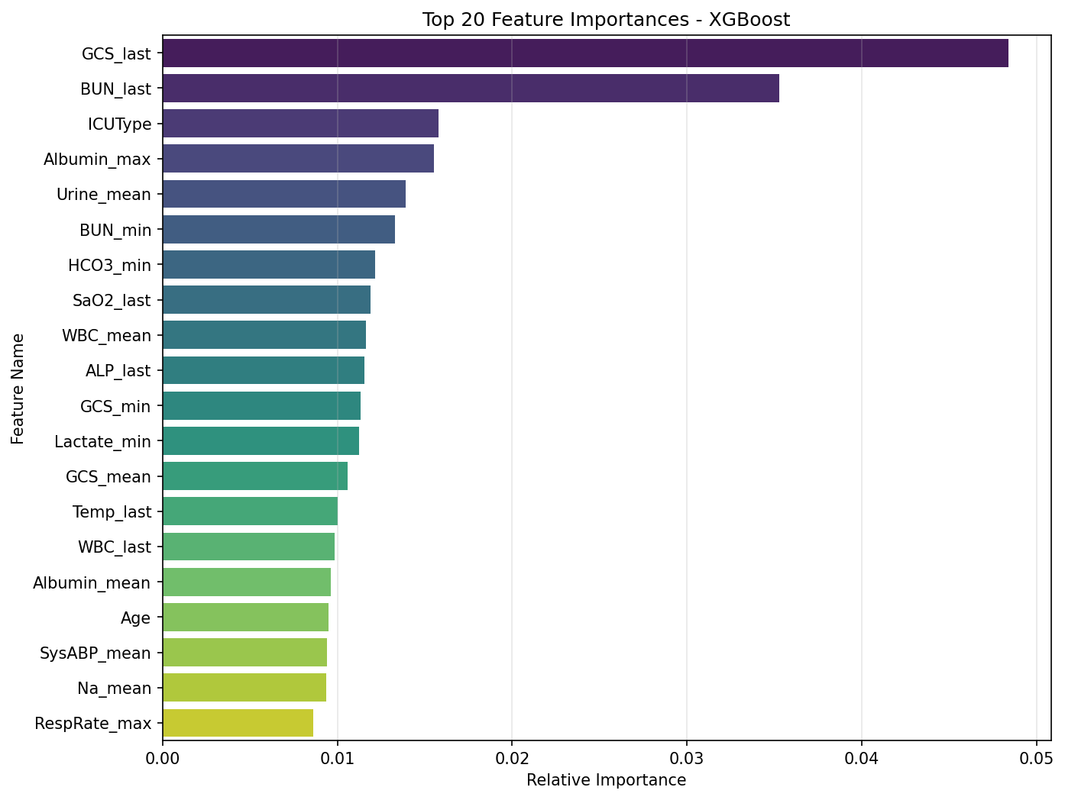
Key Physiological Predictors
**Glasgow Coma Score (GCS)**: Minimum (`GCS_min`) and last (`GCS_last`) values are the most critical predictors, reflecting neurological function
**Age**: Older patients have lower physiological reserve, correlating with high risk
**Blood Urea Nitrogen (BUN)**: Mean levels (`BUN_mean`) reflect renal function and fluid balance
**Urine Output**: Mean urine output (`Urine_mean`) is a crucial marker for tissue perfusion
**White Blood Cell (WBC)**: High counts (`WBC_mean`) indicate systemic inflammation or sepsis

Slide 18
5. Interactive Clinical Dashboard

Slide 19
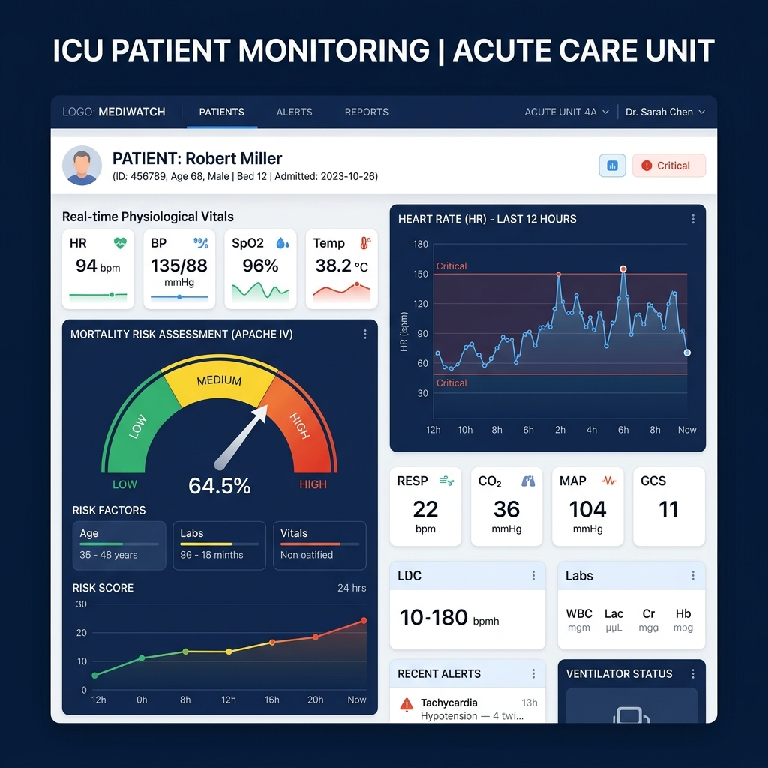
Streamlit Clinical Dashboard Platform
**Sidebar Controls & Citations**: Patient selectors and profile banners moved to the sidebar along with clear data source attributions
**Longitudinal Explorer**: High-contrast vitals cards with auto-height layout, Plotly Gauge risk scores with suffix and font constraint, and scrollable alert panels
**Risk Simulator**: Grouped 5x2 physiological sliders with side-by-side gauge predictions and clinical recommendations, updating in real-time on a single page
**Live URL**: [advanced-icu-mpla.streamlit.app](https://advanced-icu-mpla.streamlit.app) (Free Streamlit Cloud Hosting)

Slide 20
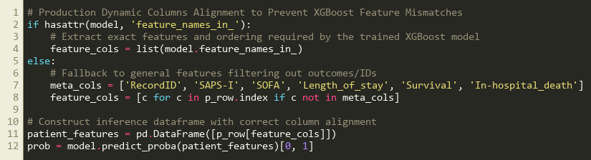
Production Safeguards: Dynamic Feature Alignment
XGBoost models restrict the ordering and dimensions of features during live predictions
The simulator checks the trained model's feature_names_in_ dynamically at runtime
Aligns and formats input vectors to ensure robust predictions without column mismatch errors
Safeguards live clinical deployment against feature shifts or missing values

Slide 21
6. Conclusion & Future Work

Slide 22
Key Takeaways & Next Steps
**Conclusion**:
Developed an end-to-end Python pipeline from raw data ingestion to interactive web UI
XGBoost model outperformed linear and traditional ensemble approaches, achieving AUROC of 0.8612
The clinical risk simulator bridges the gap between predictive ML models and clinical utility
**Future Work**:
Explore deep learning recurrent architectures (e.g., LSTMs, GRUs, Transformers) to process raw time-series directly
Validate model generalizability using external databases (e.g., MIMIC-IV) and multi-center cohorts
**Project Resources**:
**GitHub Codebase**: [github.com/waynelee9511cloud/advanced-icu-mpla](https://github.com/waynelee9511cloud/advanced-icu-mpla)
**Live Dashboard Application**: [advanced-icu-mpla.streamlit.app](https://advanced-icu-mpla.streamlit.app)

