Slide 1
A Framework for Quantitative Evaluation of Stain Color Augmentation / Normalization Methods
Dorsa Ziaei
Summer Internship 07/19
FDA (OSEL – CDRH)

Slide 2
Outline
Normalization Progress
Still Training:
  Deep Convolutional Gaussian Mixture Model
  Generative Adversarial Networks
Results
  Macenko
  Reinhard
  Vahadane

Slide 3
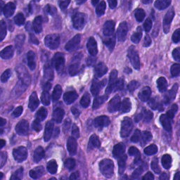
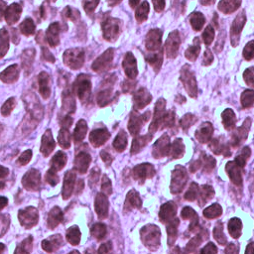
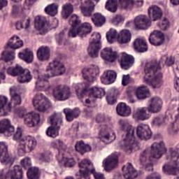
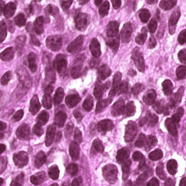
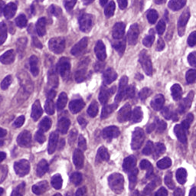
Normalization Results
Dataset:
Train: 949 images Hamamatsu
Template: 1 image
3D-Histech
 | Original | Normalized | Template | Delta_e
Reinhard |  |  |  | Max:62 Avg: 50.67
Macenko |  |  |  | Max:85 Avg: 41.43
Vahadane |  |  |  | Max:67 Avg:37.95

Slide 4
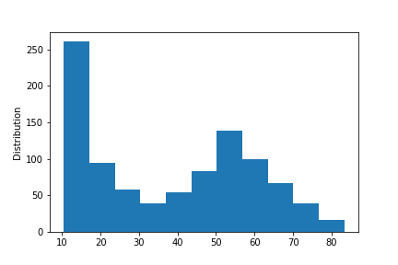
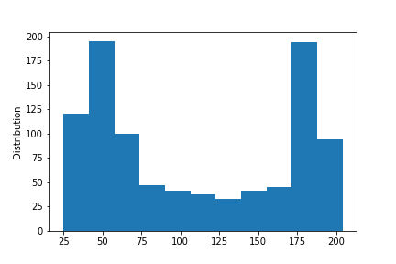
Macenko-Reinhard
Average Max

Slide 5
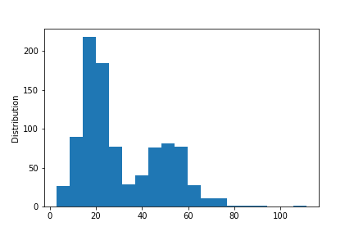
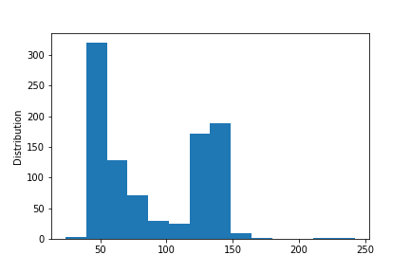
Macenko-Vahadane
Average Max

Slide 6
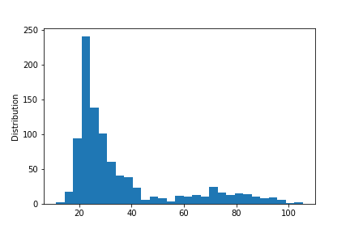
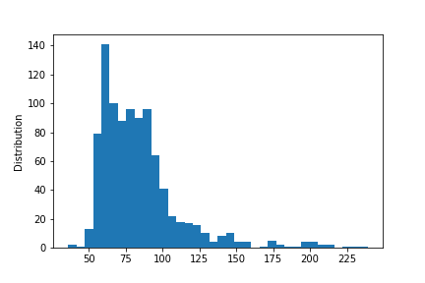
Vahadane-Reinhard
Average Max

