Slide 1

Website Development Roadmap
Planning
Design confirmed
Website development
20YY
Testing and Git
Initial concept of my website
Happy with overall structure of structure
Implement design
Test, works, commit!
Start: 17 Sep 2019
Start: 19 Sep 2019
18 Sep 2019
18 Sep 2019
1 day
22 Sep 2019
22 Sep 2019
Feature 02
Feature 01
Feature 03
1 day
Wireframing
html structure
Features
Launch
Create mobile version of website
Set up html according to wireframe
Make sure core features are implemented error free
22 Sep 2019
Start: 18 Sep 2019
Start: 19 Sep 2019
20 Sep 2019

Slide 2
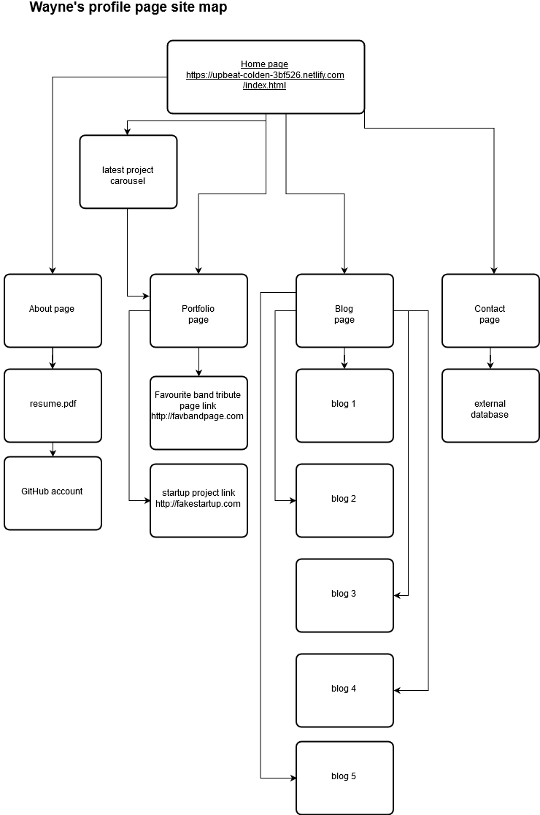
Site map

Slide 3
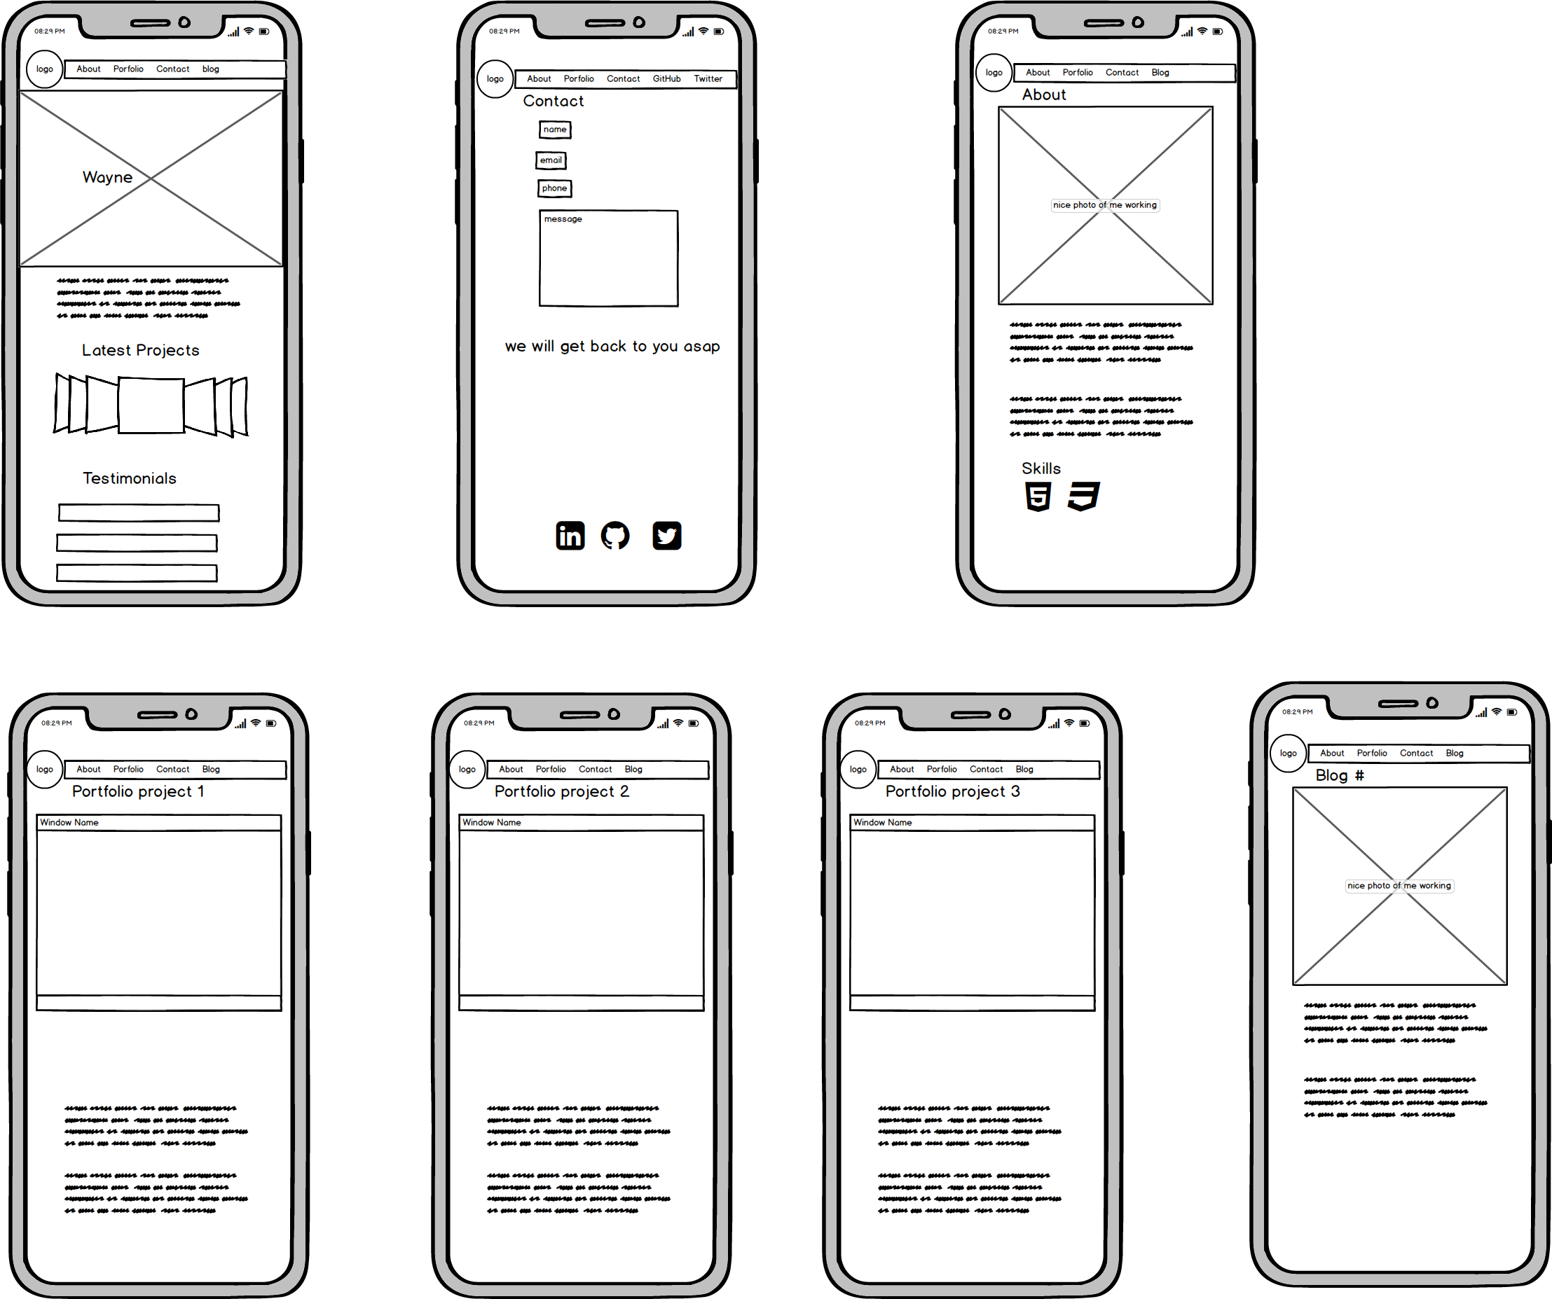
Wire frame - mobile

Slide 4
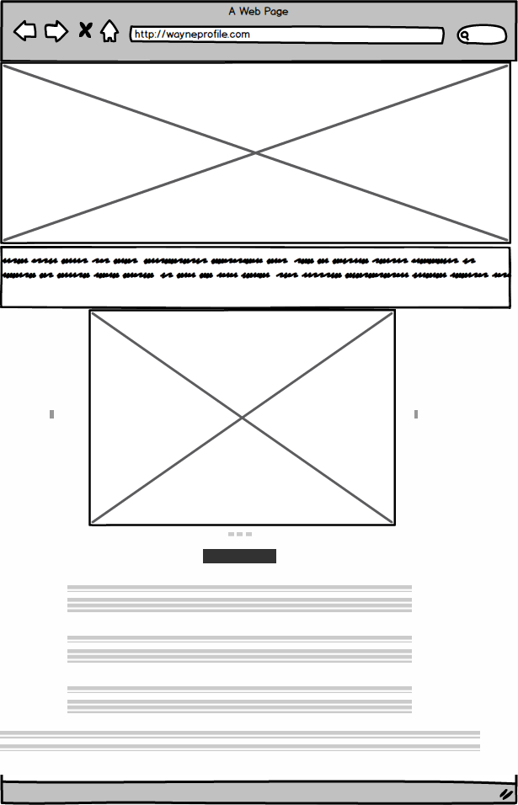
Wire frame - desktop

Slide 5
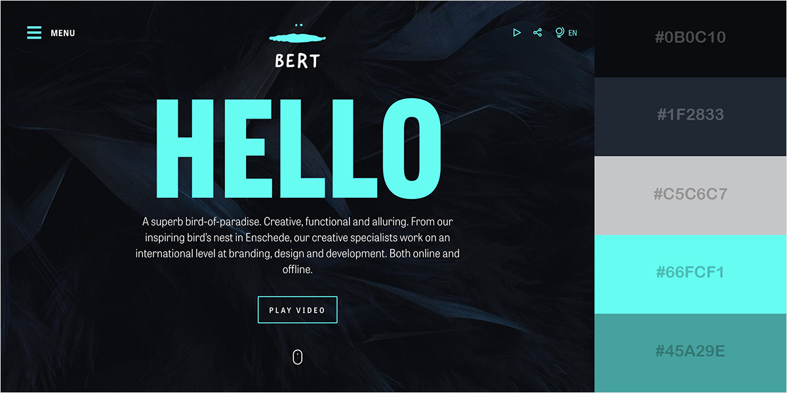
UX/UI

Slide 6


Slide 7
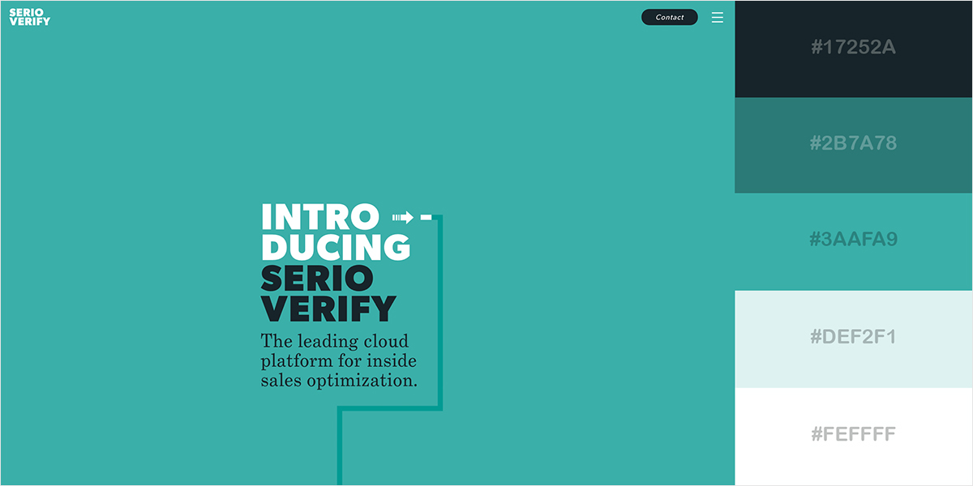

Slide 8
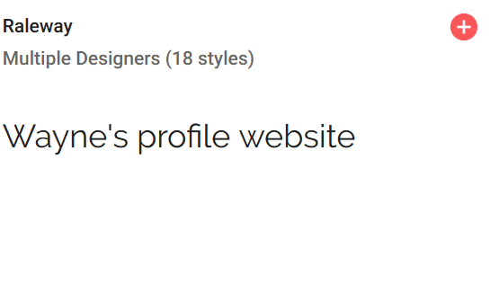
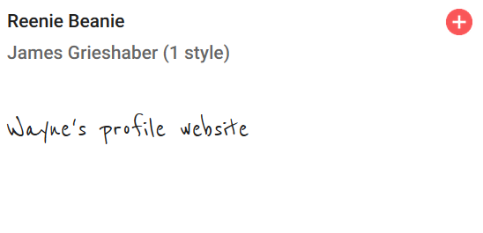
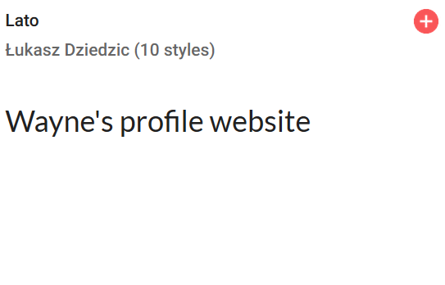
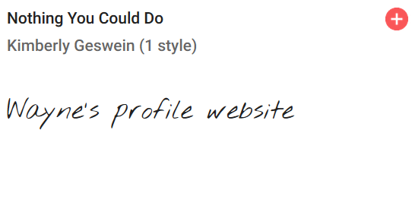
Fonts

Slide 9


Image editing

Slide 10
Challenges
Incorporating codes from other website
Forgetting to git add/commit and unable to revert back to a more recent workable version
Decision on what design to use
Getting text and images to work together – use image editing tools
Time management

Slide 11
Aha moments
Spending 2 hours fixing a simple error such as missing a ; or }
Finally getting the code to do exactly as planned – the carousel

Slide 12
Wayne’s profile website
https://upbeat-colden-3bf526.netlify.com/

