Slide 1



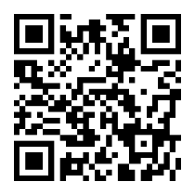







secret santa
secret santa
check in
deliveries
696-7464 Dapibu…
Ap #791-947 Feli…
7805 A Avenue
P.O. Box 666, 782…
5263 Sed St.
9551 Lorem Ave
2km
2.3km
4km
6km
10km
13km
Registering device…
check in
n n n n n
Home | Re | Help

Slide 2
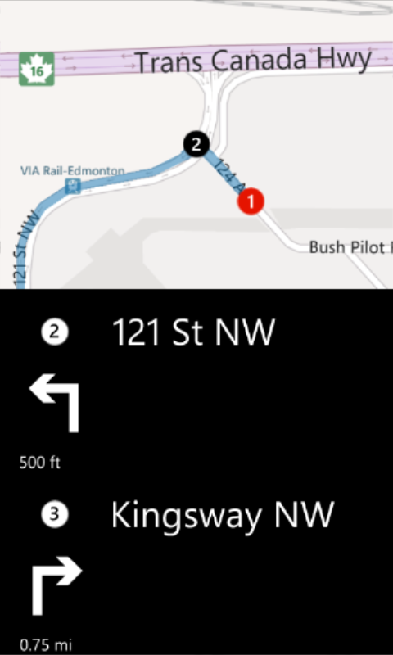




secret santa
secret santa
delivery
delivery
13168 123 Ave NW, Edmonton, AB, T5L
13168 123 Ave NW, Edmonton, AB, T5L
Status
Undelivered
Delivered
Status
Reason
Not Home
Note
No place to leave Form
deliver
Save | Add Comment | Help

